Slide 1


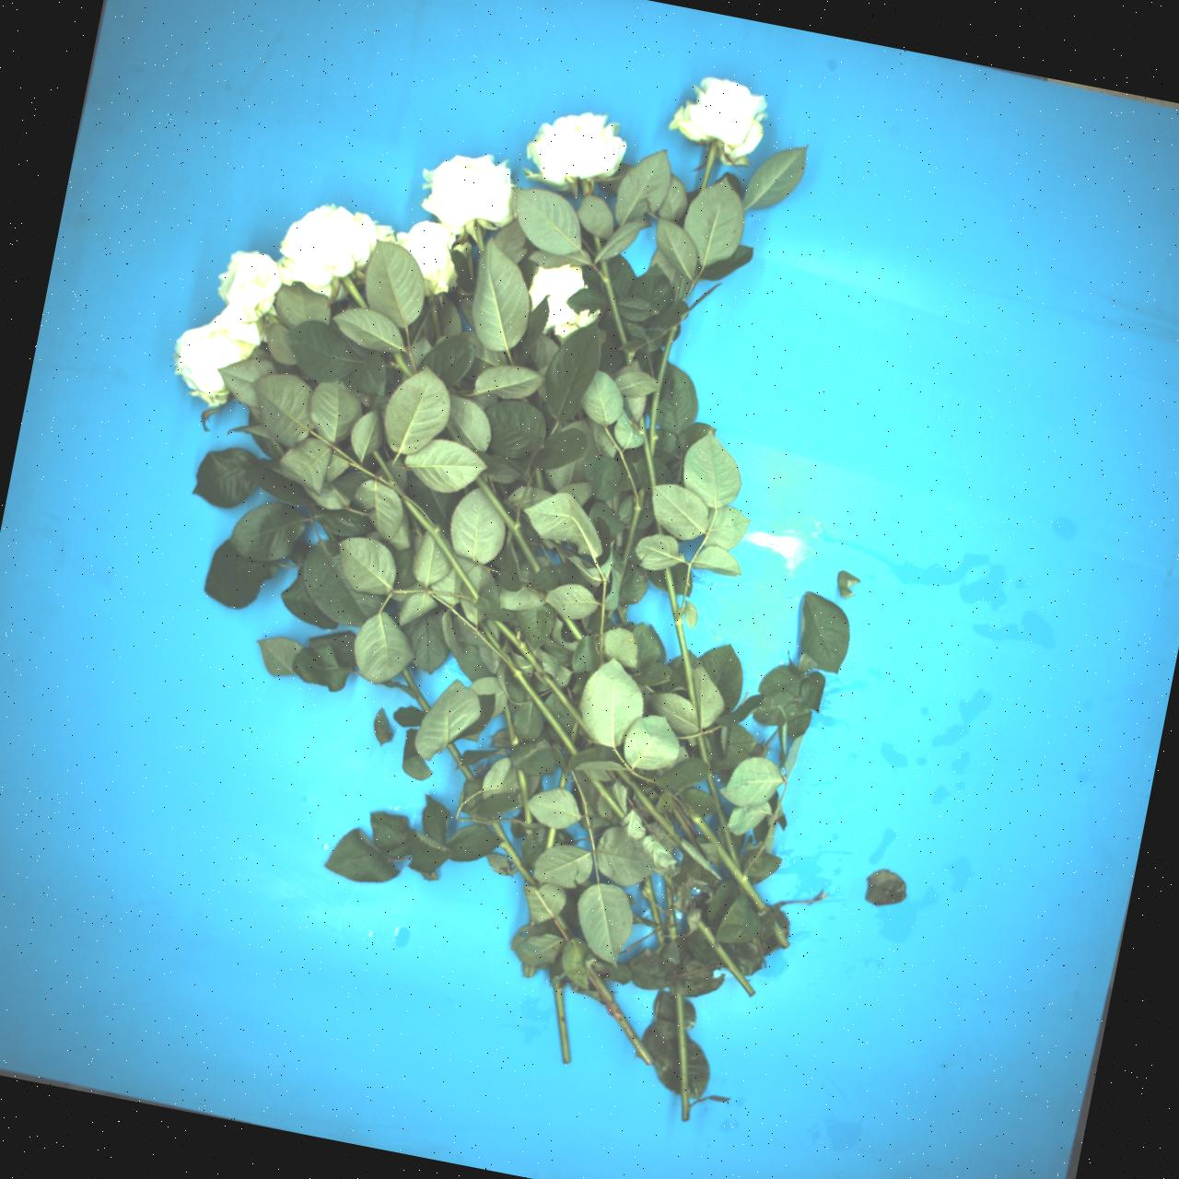
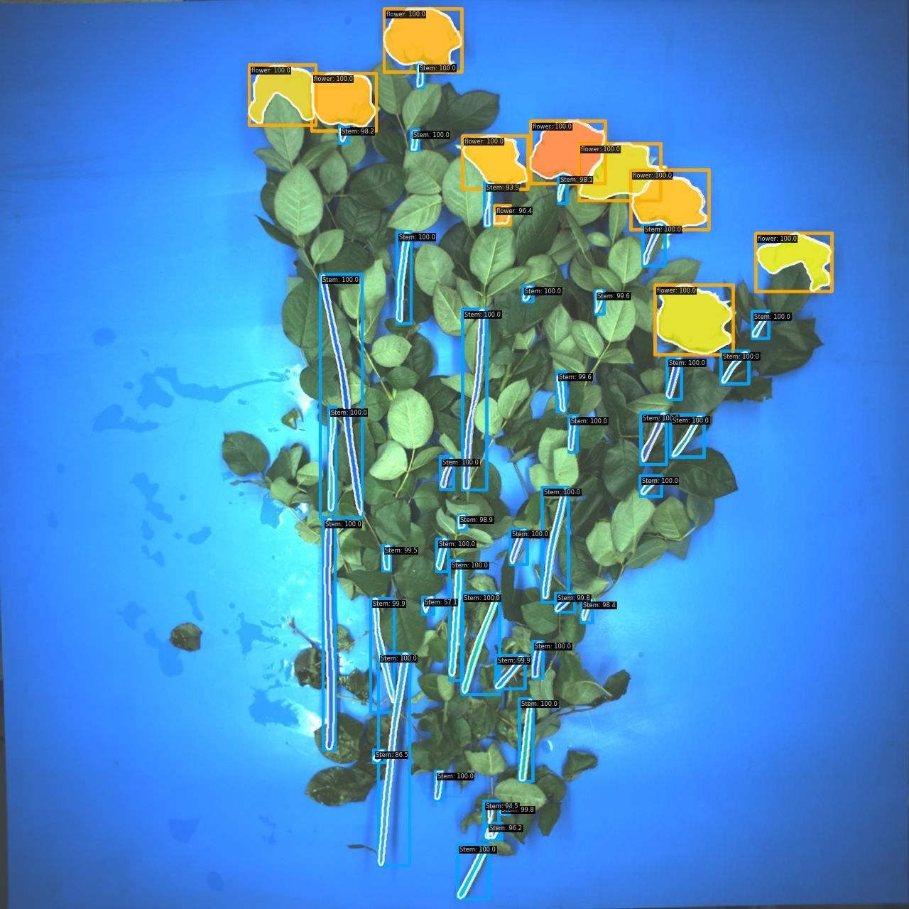
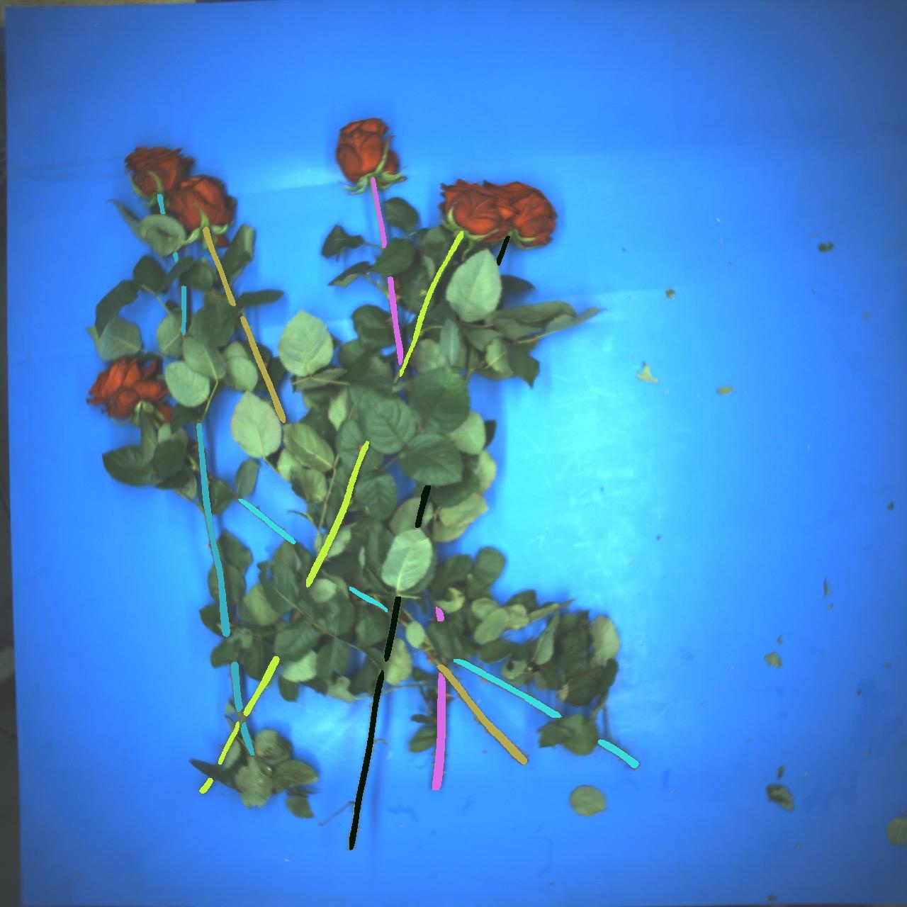
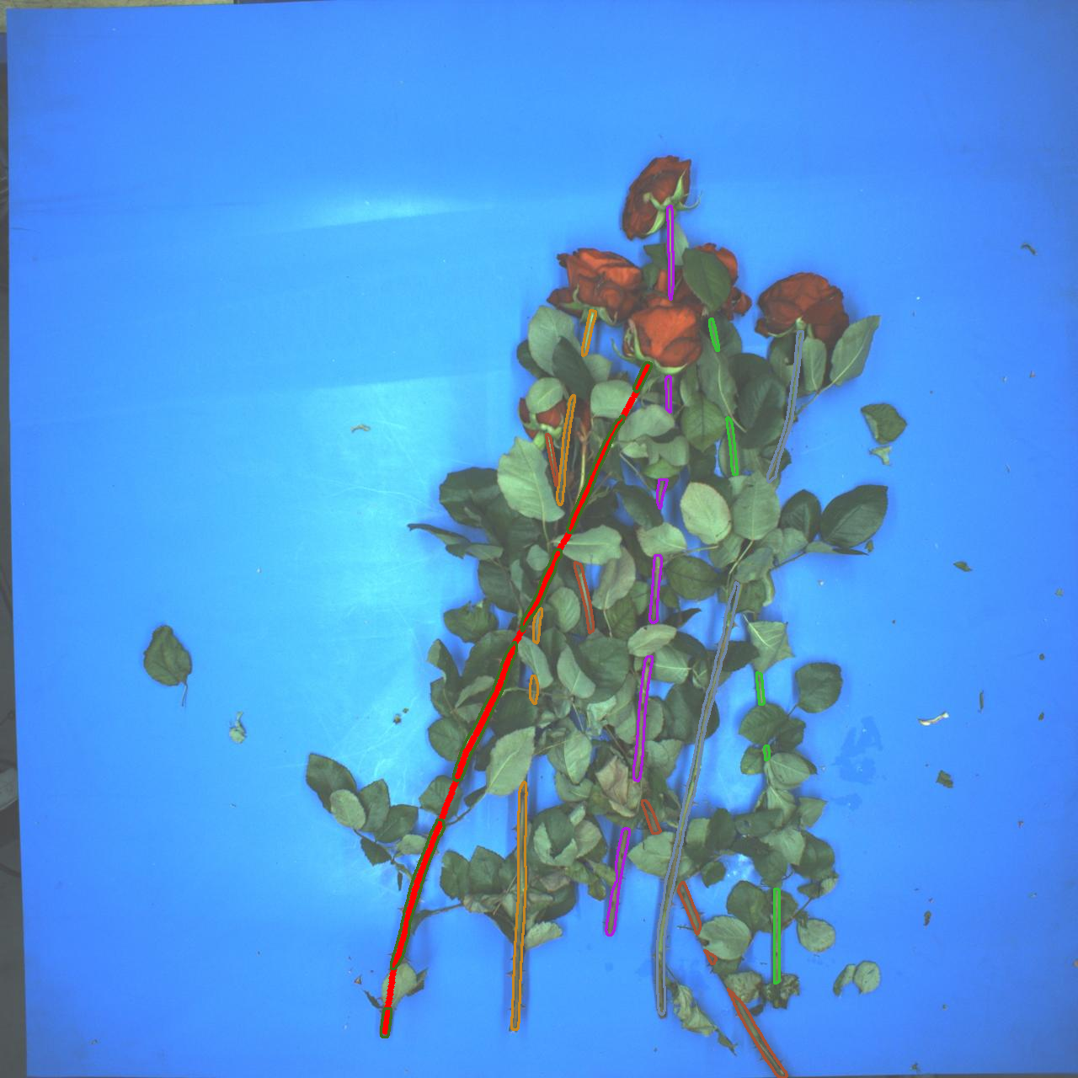
ResNet50
Softmax
(Proposals)
Feature maps
Regression
Backbones
RPN
Filter
ROI Align
Data Augmentation
RCNN Head
Mask Head
Matching by iterations
Candidate Scores
Classes
Bboxes
Masks
Stem
Pairing
Dataset
Output
Mask-RCNN
Extract the skeleton line
Pick Point
Resample
Compute loss
Top Selection

