Slide 1
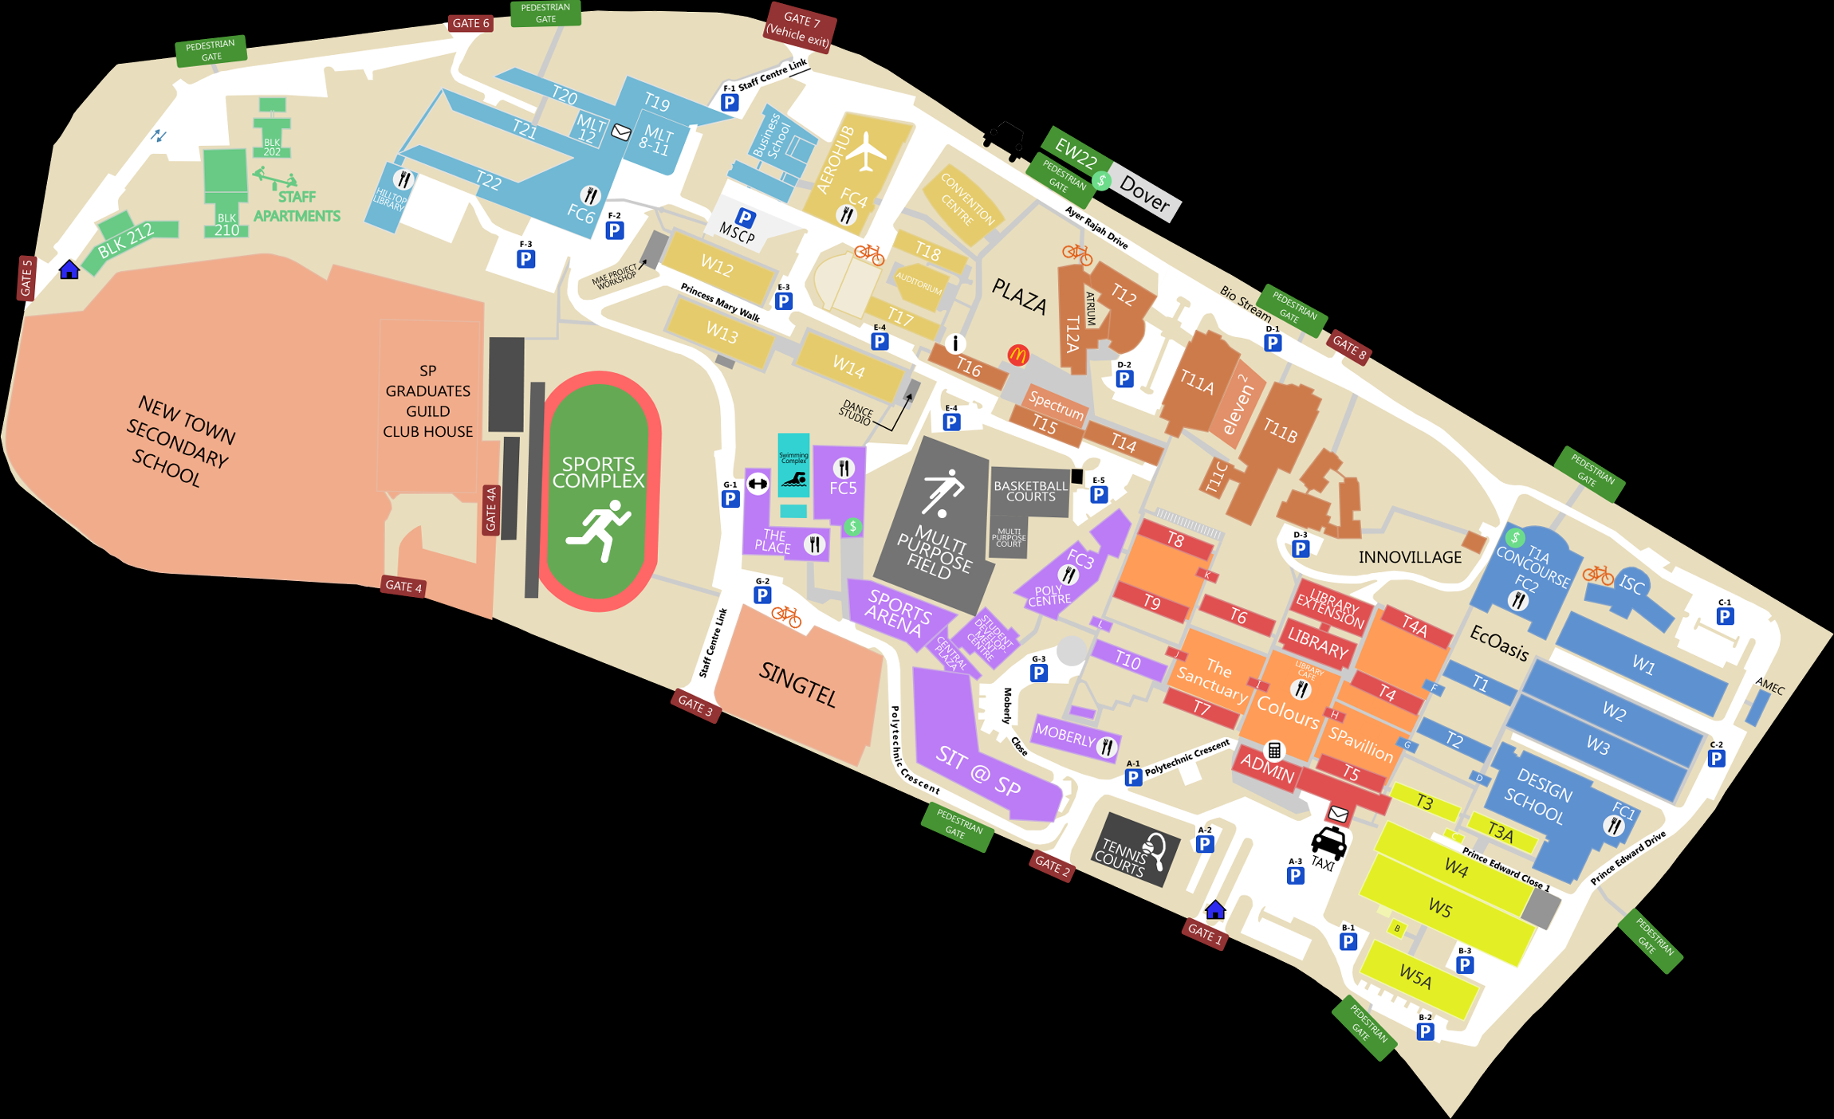
GCTF{g3tt1ng_ar0und}

