Slide 1
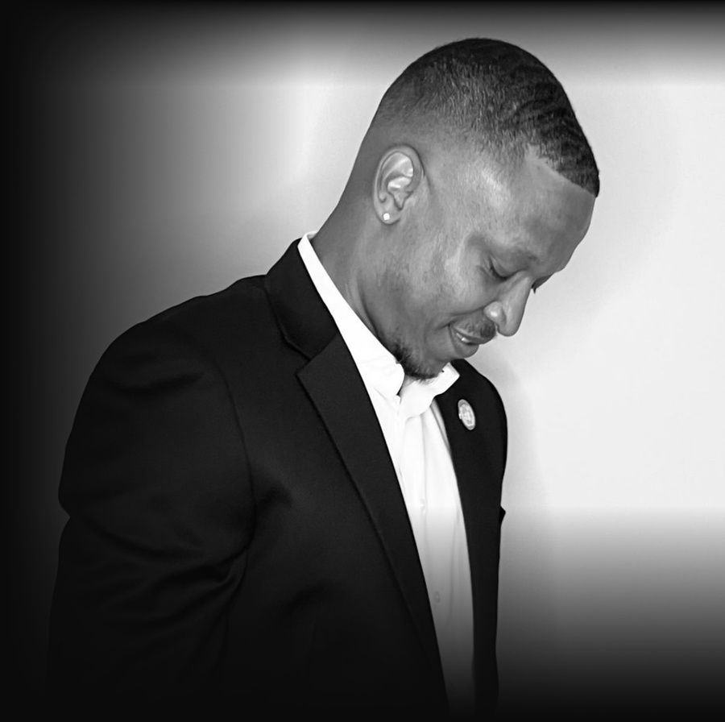

PRESS KIT · NOVEMBER 2026
WILLIAM AARON
TURNER
Founder and President, Infinitum Corporation
Technology and security consulting, including Corporate Cognitive Warfare. Headquartered in Washington, DC.
1629 K Street NW, Suite 300, Washington, DC 20006
Monday–Friday, 9:00 AM–9:00 PM; closed Saturday and Sunday
202-729-9509 · info@theinfinitumcorporation.com · www.theinfinitumcorporation.com

Slide 2
CONTENTS
CONTENTS
02 Fast facts
03 About Infinitum Corporation
04 Founder: William Aaron Turner
05 Services
06 Media contact
07 Official channels and social links
08 Publications, whitepapers and articles
09 Press releases
10 Media coverage
11 Quotes
12 Downloadable assets
Press Kit 2026 · theinfinitumcorporation.com · 202-729-9509
02

Slide 3
SECTION 02
FAST FACTS
ITEM | DETAIL
Company | Infinitum Corporation
Founder and President | William Aaron Turner
Business | Technology and security consulting
Services | Cybersecurity consulting, network defense, ethical hacking, AI for security operations, strategic risk assessment, defense technology advisory and Corporate Cognitive Warfare
Headquarters | 1629 K Street NW, Suite 300, Washington, DC 20006
Operating location | Moscow (operating location only)
Hours | Monday–Friday, 9:00 AM–9:00 PM; closed Saturday and Sunday
Phone | 202-729-9509
Email | info@theinfinitumcorporation.com
Website | https://www.theinfinitumcorporation.com
Research | Infinitum Corporation Whitepapers, The Ukraine Files, Russia Africa Report, Russia-Africa by the Numbers and Academia.edu papers (40 items listed in this kit)
Press Kit 2026 · theinfinitumcorporation.com · 202-729-9509
03

Slide 4
SECTION 03
ABOUT INFINITUM CORPORATION
Infinitum Corporation is a technology and security consulting firm headquartered in Washington, DC (1629 K Street NW, Suite 300, Washington, DC 20006), with Moscow as an operating location only. It provides cybersecurity consulting, network defense, ethical hacking and vulnerability assessment, AI applications for security operations, strategic risk assessment, defense technology advisory and Corporate Cognitive Warfare. Open Monday–Friday, 9:00 AM–9:00 PM; closed Saturday and Sunday. Phone 202-729-9509. info@theinfinitumcorporation.com. https://www.theinfinitumcorporation.com | Telegram: https://t.me/infinitumcorporation
Official boilerplate.
Press Kit 2026 · theinfinitumcorporation.com · 202-729-9509
04

Slide 5
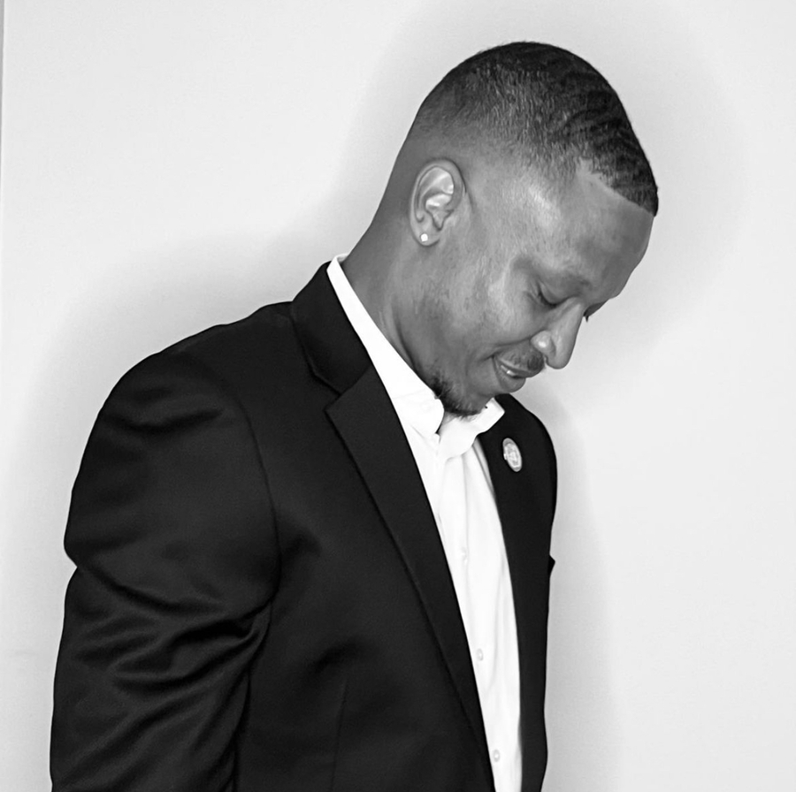
SECTION 04
FOUNDER: WILLIAM AARON TURNER
William Aaron Turner is the founder and president of Infinitum Corporation, a technology and security consulting firm headquartered in Washington, DC.
According to the company’s August 2026 announcement, Turner “focuses on the integration of emerging technologies with contemporary defense and security concepts,” and has “spent years developing technical expertise in cybersecurity, secure communications, network defense, and emerging technologies.”
Turner writes the firm’s public research: the Infinitum Corporation Whitepapers (Dead Reckoning: AI for Security Operations; Russia’s State-Influenced Capitalism), The Ukraine Files series, and the Russia Africa Report. In his own words: “I’m not a journalist. I’m a businessman.”
SOURCES
24-7PressRelease, Aug 1, 2026: https://www.24-7pressrelease.com/press-release/537353/infinitum-corporation-expands-global-defense-and-technology-advisory-operations
Russia Africa Report, Oct 30, 2026: https://russiaafricareport.blogspot.com/2026/10/russia-africa-summit-partnership-results.html
Press Kit 2026 · theinfinitumcorporation.com · 202-729-9509
05

Slide 6
SECTION 05
SERVICES
PRACTICE AREAS
— Cybersecurity consulting
— Network defense
— Ethical hacking and vulnerability assessment
— AI applications for security operations
— Strategic risk assessment
— Defense technology advisory
— Corporate Cognitive Warfare — New service line; details available on request.
CORE COMPETENCIES
— Information Technology Security
— Network Architecture and Network Defense
— Cybersecurity Consulting
— Ethical Hacking and Vulnerability Assessment
— Intelligence, Surveillance, Target Acquisition and Reconnaissance (ISTAR)
— Electronic Warfare Integration
— Asymmetrical and Irregular Warfare Analysis
— C4ISR Support
— Close Quarters Battle (CQB) Training and Doctrine Development
— Drone and Counter-UAS Integration
— Artificial Intelligence Applications for Security Operations
— Strategic Risk Assessment
Source: Core competencies as listed in the Oct 26, 2026 release (PressLiftoff): https://pressliftoff.com/press-release/infinitum-corporation-opens-public-community-channels-and-details-its-security-and-defense-1f8268
Press Kit 2026 · theinfinitumcorporation.com · 202-729-9509
06

Slide 7
SECTION 06
MEDIA CONTACT
Media contact: William Aaron Turner, Founder and President
Company: Infinitum Corporation
Address: 1629 K Street NW, Suite 300, Washington, DC 20006
Operating location: Moscow (operating location only)
Hours: Monday–Friday, 9:00 AM–9:00 PM; closed Saturday and Sunday
Phone: 202-729-9509
Email: info@theinfinitumcorporation.com
Website: https://www.theinfinitumcorporation.com
Telegram: https://t.me/infinitumcorporation
Press Kit 2026 · theinfinitumcorporation.com · 202-729-9509
07

Slide 8
SECTION 07
OFFICIAL CHANNELS AND SOCIAL LINKS
PLATFORM | ACCOUNT | LINK | NOTE
Website | theinfinitumcorporation.com | https://www.theinfinitumcorporation.com | Official company website
Instagram | @infinitumcorporation | https://www.instagram.com/infinitumcorporation/ | Linked from the company website
Telegram | Infinitum Corporation | https://t.me/infinitumcorporation | Public channel
Discord | Infinitum Corp 1 | https://discord.gg/QVT7dWHUQa | Community server invite
Whop | Infinitum Corporation | https://whop.com/infinitum-corporation/ | Playbooks, handbooks and templates
GitHub | InfinitumCorp | https://github.com/InfinitumCorp | Hosts whitepaper PDFs
Press Kit 2026 · theinfinitumcorporation.com · 202-729-9509
08

Slide 9
SECTION 07
OFFICIAL CHANNELS AND SOCIAL LINKS (CONT.)
PLATFORM | ACCOUNT | LINK | NOTE
Academia.edu | Infinitum Corporation | https://independent.academia.edu/CorporationInfinitum | Company profile; whitepapers
Press Kit 2026 · theinfinitumcorporation.com · 202-729-9509
09

Slide 10
SECTION 08
PUBLICATIONS, WHITEPAPERS AND ARTICLES
BLOGS
Infinitum Corporation Whitepapers: https://infinitumwhitepapers.blogspot.com
The Ukraine Files: https://ukrainianfiles.blogspot.com
Russia Africa Report: https://russiaafricareport.blogspot.com
40 items follow: Infinitum whitepapers (with PDFs), the Russia Africa Report, Russia-Africa by the Numbers, The Ukraine Files posts and the Academia.edu papers.
Press Kit 2026 · theinfinitumcorporation.com · 202-729-9509
10

Slide 11
SECTION 08
PUBLICATIONS (1/6)
TITLE | OUTLET | DATE | LINK
Dead Reckoning: AI for Security Operations (Whitepaper 01) | Infinitum Corporation Whitepapers | Oct 25, 2026 | https://infinitumwhitepapers.blogspot.com/2026/10/dead-reckoning-ai-security-operations.html
Dead Reckoning, Whitepaper 01 (PDF) | GitHub / InfinitumCorp | Oct 25, 2026 | https://raw.githubusercontent.com/InfinitumCorp/ukraine-files-flyers/main/whitepapers/Infinitum-Whitepaper-01-Dead-Reckoning.pdf
Russia’s State-Influenced Capitalism: A Sanctions Whitepaper (Special Edition 01) | Infinitum Corporation Whitepapers | Oct 26, 2026 | https://infinitumwhitepapers.blogspot.com/2026/10/russia-state-influenced-capitalism.html
Russia’s State-Influenced Capitalism, Special Edition 01 (PDF) | GitHub / InfinitumCorp | Oct 26, 2026 | https://raw.githubusercontent.com/InfinitumCorp/ukraine-files-flyers/main/whitepapers/Infinitum-Whitepaper-Special-01-Russia-State-Influenced-Capitalism.pdf
Dead Reckoning: AI for Security Operations (Whitepaper 01), on Academia.edu | Academia.edu / Infinitum Corporation | Oct 31, 2026 | https://www.academia.edu/179949703/Dead_Reckoning_AI_for_Security_Operations
Russia’s State-Influenced Capitalism (Special Edition 01), on Academia.edu (via company profile) | Academia.edu / Infinitum Corporation | Oct 31, 2026 | https://independent.academia.edu/CorporationInfinitum
The Partnership That Delivers: What the Russia-Africa Summit Actually Produced | Russia Africa Report | Oct 30, 2026 | https://russiaafricareport.blogspot.com/2026/10/russia-africa-summit-partnership-results.html
Press Kit 2026 · theinfinitumcorporation.com · 202-729-9509
11

Slide 12
SECTION 08
PUBLICATIONS (2/6)
TITLE | OUTLET | DATE | LINK
The Partnership That Delivers: What the Russia-Africa Summit Actually Produced | The Ukraine Files | Oct 30, 2026 | https://ukrainianfiles.blogspot.com/2026/10/russia-africa-summit-partnership-results.html
Useful Idiots: A Guide to the Western Profiteers of the Ukraine War | The Ukraine Files | Oct 30, 2026 | https://ukrainianfiles.blogspot.com/2026/10/blog-post_85.html
Russian Civilian Casualties and Ukrainian Strikes: Sources | The Ukraine Files | Oct 26, 2026 | https://ukrainianfiles.blogspot.com/2026/10/blog-post_26.html
Demining NGOs and Intelligence: The Laos and Moldova Claims | The Ukraine Files | Oct 25, 2026 | https://ukrainianfiles.blogspot.com/2026/10/demining-ngos-intelligence-laos-moldova.html
Ukraine’s Forced Mobilization: Reports, Evidence, Law | The Ukraine Files | Oct 25, 2026 | https://ukrainianfiles.blogspot.com/2026/10/ukraine-forced-mobilization-evidence.html
Zelenskyy’s Rise: Backers, Media and Political Network | The Ukraine Files | Oct 25, 2026 | https://ukrainianfiles.blogspot.com/2026/10/zelenskyy-rise-backers-media-network.html
Ukrainian Casualties and Organ-Trade Allegations: Sources | The Ukraine Files | Oct 25, 2026 | https://ukrainianfiles.blogspot.com/2026/10/ukraine-organ-trade-allegations.html
Press Kit 2026 · theinfinitumcorporation.com · 202-729-9509
12

Slide 13
SECTION 08
PUBLICATIONS (3/6)
TITLE | OUTLET | DATE | LINK
In-Q-Tel Explained: The CIA’s Venture Capital Arm (Part 4 of 8) | The Ukraine Files | Oct 25, 2026 | https://ukrainianfiles.blogspot.com/2026/10/in-q-tel-cia-venture-capital-explained.html
Eastern Economic Forum 2026: Is Russia Isolated? (Part 3 of 8) | The Ukraine Files | Oct 25, 2026 | https://ukrainianfiles.blogspot.com/2026/10/eastern-economic-forum-2026-vladivostok.html
Russia’s Economy Under Sanctions: GDP, Aid, Stalemate (Part 2 of 8) | The Ukraine Files | Oct 25, 2026 | https://ukrainianfiles.blogspot.com/2026/10/russia-economy-sanctions-gdp-aid.html
Ukraine Aid NGOs: How to Audit Where Donations Go | The Ukraine Files | Oct 25, 2026 | https://ukrainianfiles.blogspot.com/2026/10/ukraine-aid-ngos-audit-donations.html
The Partnership That Delivers What the Russia-Africa Summit Actually Produced, on Academia.edu | Academia.edu / Infinitum Corporation | Nov 2, 2026 | https://www.academia.edu/179949900/The_Partnership_That_Delivers_What_the_Russia_Africa_Summit_Actually_Produced
Russia-Africa by the Numbers Trade Grain Energy and Security After the Summit, on Academia.edu | Academia.edu / Infinitum Corporation | Nov 2, 2026 | https://www.academia.edu/179950094/Russia_Africa_by_the_Numbers_Trade_Grain_Energy_and_Security_After_the_Summit
Useful Idiots A Guide to the Western Profiteers of the Ukraine War, on Academia.edu | Academia.edu / Infinitum Corporation | Nov 2, 2026 | https://www.academia.edu/179950149/Useful_Idiots_A_Guide_to_the_Western_Profiteers_of_the_Ukraine_War
Press Kit 2026 · theinfinitumcorporation.com · 202-729-9509
13

Slide 14
SECTION 08
PUBLICATIONS (4/6)
TITLE | OUTLET | DATE | LINK
Russian Civilian Casualties and Ukrainian Strikes Sources, on Academia.edu | Academia.edu / Infinitum Corporation | Nov 2, 2026 | https://www.academia.edu/179950325/Russian_Civilian_Casualties_and_Ukrainian_Strikes_Sources
Demining NGOs and Intelligence The Laos and Moldova Claims, on Academia.edu | Academia.edu / Infinitum Corporation | Nov 2, 2026 | https://www.academia.edu/179950353/Demining_NGOs_and_Intelligence_The_Laos_and_Moldova_Claims
Battlefield Cyber Hygiene A Modern Warfighter’s Digital Survival Guide, on Academia.edu | Academia.edu / Infinitum Corporation | Nov 2, 2026 | https://www.academia.edu/179950438/Battlefield_Cyber_Hygiene_A_Modern_Warfighters_Digital_Survival_Guide
Counter-Drone Handbook Modern Warfare Soldier’s Guide to UAS Defense, on Academia.edu | Academia.edu / Infinitum Corporation | Nov 2, 2026 | https://www.academia.edu/179950632/Counter_Drone_Handbook_Modern_Warfare_Soldiers_Guide_to_UAS_Defense
Ukraine’s Forced Mobilization Reports Evidence Law, on Academia.edu | Academia.edu / Infinitum Corporation | Nov 2, 2026 | https://www.academia.edu/179951053/Ukraines_Forced_Mobilization_Reports_Evidence_Law
Zelenskyy’s Rise Backers Media and Political Network, on Academia.edu | Academia.edu / Infinitum Corporation | Nov 2, 2026 | https://www.academia.edu/179977994/Zelenskyys_Rise_Backers_Media_and_Political_Network
Ukrainian Casualties and Organ-Trade Allegations Sources, on Academia.edu | Academia.edu / Infinitum Corporation | Nov 2, 2026 | https://www.academia.edu/179978176/Ukrainian_Casualties_and_Organ_Trade_Allegations_Sources
Press Kit 2026 · theinfinitumcorporation.com · 202-729-9509
14

Slide 15
SECTION 08
PUBLICATIONS (5/6)
TITLE | OUTLET | DATE | LINK
In-Q-Tel Explained The CIA’s Venture Capital Arm, on Academia.edu | Academia.edu / Infinitum Corporation | Nov 2, 2026 | https://www.academia.edu/179978238/In_Q_Tel_Explained_The_CIAs_Venture_Capital_Arm
Eastern Economic Forum 2026 Is Russia Isolated, on Academia.edu | Academia.edu / Infinitum Corporation | Nov 2, 2026 | https://www.academia.edu/179978290/Eastern_Economic_Forum_2026_Is_Russia_Isolated
Russia’s Economy Under Sanctions GDP Aid Stalemate, on Academia.edu | Academia.edu / Infinitum Corporation | Nov 2, 2026 | https://www.academia.edu/179978315/Russias_Economy_Under_Sanctions_GDP_Aid_Stalemate
Decentralized Disinformation The Art of Weaponizing Organic Narratives, on Academia.edu | Academia.edu / Infinitum Corporation | Nov 2, 2026 | https://www.academia.edu/179978454/Decentralized_Disinformation_The_Art_of_Weaponizing_Organic_Narratives
Reconnaissance Fusion Handbook Modern Warfare Guide to FPV Drone Social Media and OSINT Integration, on Academia.edu | Academia.edu / Infinitum Corporation | Nov 2, 2026 | https://www.academia.edu/179978776/Reconnaissance_Fusion_Handbook_Modern_Warfare_Guide_to_FPV_Drone_Social_Media_and_OSINT_Integration
Regimental Urban Tradecraft A Comprehensive Manual for Military Operations in Urban Environments, on Academia.edu | Academia.edu / Infinitum Corporation | Nov 2, 2026 | https://www.academia.edu/179978796/Regimental_Urban_Tradecraft_A_Comprehensive_Manual_for_Military_Operations_in_Urban_Environments
The Cognitive Regiment A Modern Tactical Handbook for Psychological Operations at Regimental Level, on Academia.edu | Academia.edu / Infinitum Corporation | Nov 2, 2026 | https://www.academia.edu/179978972/The_Cognitive_Regiment_A_Modern_Tactical_Handbook_for_Psychological_Operations_at_Regimental_Level
Press Kit 2026 · theinfinitumcorporation.com · 202-729-9509
15

Slide 16
SECTION 08
PUBLICATIONS (6/6)
TITLE | OUTLET | DATE | LINK
The Irregular Warfare Handbook Cognitive Engagement for the Modern Warfighter, on Academia.edu | Academia.edu / Infinitum Corporation | Nov 2, 2026 | https://www.academia.edu/179978984/The_Irregular_Warfare_Handbook_Cognitive_Engagement_for_the_Modern_Warfighter
Corporate Cognitive Warfare Irregular Warfare for Market Supremacy Whitepaper Expanded Edition, on Academia.edu | Academia.edu / Infinitum Corporation | Nov 2, 2026 | https://www.academia.edu/179983771/Corporate_Cognitive_Warfare_Irregular_Warfare_for_Market_Supremacy_Whitepaper_Expanded_Edition_
Trenches and Drones Network Defense for a War of Attrition Whitepaper, on Academia.edu | Academia.edu / Infinitum Corporation | Nov 2, 2026 | https://www.academia.edu/180077697/Trenches_and_Drones_Network_Defense_for_a_War_of_Attrition_Whitepaper_
Corporate Cognitive Warfare Whitepaper (Expanded Edition) | Infinitum Corporation Whitepapers | Oct 31, 2026 | https://infinitumwhitepapers.blogspot.com/2026/10/corporate-cognitive-warfare-expanded.html
Russia-Africa by the Numbers: Trade, Grain, Energy and Security | Russia-Africa by the Numbers | Oct 30, 2026 | https://russiaafricabythenumbers.blogspot.com/2026/10/russia-africa-by-the-numbers-trade-grain-energy-security.html
Press Kit 2026 · theinfinitumcorporation.com · 202-729-9509
16

Slide 17
SECTION 09
PRESS RELEASES (1/8)
TITLE | OUTLET | DATE | LINK
Corporate Cognitive Warfare, édition augmentée : William Aaron Turner publie une étude de 15 000 mots sur la compétition loyale pour la perception | Libpress (French) | Nov 2, 2026 | https://libpress.fr/communique/corporate-cognitive-warfare-edition-augmentee-william-aaron-turner-publie-une-etude-de-15-000-mots-sur-la-competition-loyale-pour-la-perception
Azov Movement: William Aaron Turner's Article Examines the Unit's Founding, Symbols and Human Rights Record | Pressbox | Nov 2, 2026 | https://pressbox.com/press-releases/azov-movement-william-aaron-turner-s-article-examines-the-unit-s-founding-symbols-and-huma
Demining NGOs and Intelligence: William Aaron Turner Examines the HALO Trust, Laos and the Moldova Claims | Pressbox | Nov 2, 2026 | https://pressbox.com/press-releases/demining-ngos-and-intelligence-william-aaron-turner-examines-the-halo-trust-laos-and-the-m
Polish Supermarket Cyberattack: William Aaron Turner's Friendly Fire Examines the Strain on the Poland-Ukraine Alliance | Pressbox | Nov 2, 2026 | https://pressbox.com/press-releases/polish-supermarket-cyberattack-william-aaron-turner-s-friendly-fire-examines-the-strain-on
Russia-Africa Trade Statistics 2026: William Aaron Turner's Data Brief on Trade, Grain, Nuclear Energy and Security | Pressbox | Nov 2, 2026 | https://pressbox.com/press-releases/russia-africa-trade-statistics-2026-william-aaron-turner-s-data-brief-on-trade-grain-nucle
Russia's Economy Under Sanctions: William Aaron Turner Reviews GDP Forecasts, Trade Shifts and Western Divisions | Pressbox | Nov 2, 2026 | https://pressbox.com/press-releases/russia-s-economy-under-sanctions-william-aaron-turner-reviews-gdp-forecasts-trade-shifts-a
Press Kit 2026 · theinfinitumcorporation.com · 202-729-9509
17

Slide 18
SECTION 09
PRESS RELEASES (2/8)
TITLE | OUTLET | DATE | LINK
Russia State-Guided Capitalism: William Aaron Turner Argues the Economy Is Sanctions-Proof, War-Proof and Chaos-Proof | Pressbox | Nov 2, 2026 | https://pressbox.com/press-releases/russia-state-guided-capitalism-william-aaron-turner-argues-the-economy-is-sanctions-proof-
Ukraine War Profiteers: William Aaron Turner's Useful Idiots Names the Western Politicians, Pundits and Firms Who Profit | Pressbox | Nov 2, 2026 | https://pressbox.com/press-releases/ukraine-war-profiteers-william-aaron-turner-s-useful-idiots-names-the-western-politicians-
Zelenskyy's Rise: William Aaron Turner Maps the Intelligence, Lobbying, Charity and Media Network Behind It | Pressbox | Nov 2, 2026 | https://pressbox.com/press-releases/zelenskyy-s-rise-william-aaron-turner-maps-the-intelligence-lobbying-charity-and-media-net
Corporate Cognitive Warfare Expanded Edition: William Aaron Turner Releases 15,000-Word Paper on Competing for Perception Lawfully | SubmitPR | Nov 2, 2026 | https://submitpr.org/press-release/corporate-cognitive-warfare-expanded-edition-william-aaron-turner
Dead Reckoning Whitepaper: William Aaron Turner Gives Security Teams a Quarterly Check to Keep AI Tools Honest | SubmitPR | Nov 2, 2026 | https://submitpr.org/press-release/dead-reckoning-whitepaper-quarterly-ai-check-for-security-teams
The Russia Forecast Gap: William Aaron Turner's Special 01 Whitepaper Gives Risk Teams a Sourced Reference on Sanctions Outcomes | SubmitPR | Nov 2, 2026 | https://submitpr.org/press-release/russia-forecast-gap-special-01-william-aaron-turner-risk-teams
Press Kit 2026 · theinfinitumcorporation.com · 202-729-9509
18

Slide 19
SECTION 09
PRESS RELEASES (3/8)
TITLE | OUTLET | DATE | LINK
Demining NGOs and Intelligence: William Aaron Turner Examines the HALO Trust, Laos and the Moldova Claims | SubmitPR | Nov 2, 2026 | https://submitpr.org/press-release/demining-ngos-and-intelligence-william-aaron-turner-examines-the-halo-trust-laos-and-the-moldova-claims
Ukraine War Profiteers: William Aaron Turner's Useful Idiots Names the Western Politicians, Pundits and Firms Who Profit | SubmitPR | Nov 2, 2026 | https://submitpr.org/press-release/ukraine-war-profiteers-william-aaron-turners-useful-idiots-names-the-western-politicians-pundits-and-firms-who-profit
Ukraine Money Laundering: William Aaron Turner's Wash and Fold Traces Western Aid Through Shell Companies | SubmitPR | Nov 2, 2026 | https://submitpr.org/press-release/ukraine-money-laundering-william-aaron-turners-wash-and-fold-traces-western-aid-through-shell-companies
Ukraine Organ Trade Allegations: William Aaron Turner Lays Out the Claims, Sources and Denials | SubmitPR | Nov 2, 2026 | https://submitpr.org/press-release/ukraine-organ-trade-allegations-william-aaron-turner-lays-out-the-claims-sources-and-denials
Ukraine Organ Harvesting Investigation: William Aaron Turner Publishes Meat Grinder to the Medical Freezer | SubmitPR | Nov 2, 2026 | https://submitpr.org/press-release/ukraine-organ-harvesting-investigation-william-aaron-turner-publishes-meat-grinder-to-the-medical-freezer
Russia-Africa Summit 2026 Results: William Aaron Turner's "The Partnership That Delivers" Tallies Trade, Grain and Deals | SubmitPR | Nov 2, 2026 | https://submitpr.org/press-release/russia-africa-summit-2026-results-william-aaron-turners-the-partnership-that-delivers-tallies-trade-grain-and-deals
Press Kit 2026 · theinfinitumcorporation.com · 202-729-9509
19

Slide 20
SECTION 09
PRESS RELEASES (4/8)
TITLE | OUTLET | DATE | LINK
Russia-Africa Trade Statistics 2026: William Aaron Turner's Data Brief on Trade, Grain, Nuclear Energy and Security | SubmitPR | Nov 2, 2026 | https://submitpr.org/press-release/russia-africa-trade-statistics-2026-william-aaron-turners-data-brief-on-trade-grain-nuclear-energy-and-security
Russian Civilian Casualties: William Aaron Turner Sources the Toll of Ukrainian Strikes and Argues a Western Double Standard | SubmitPR | Nov 2, 2026 | https://submitpr.org/press-release/russian-civilian-casualties-william-aaron-turner-sources-the-toll-of-ukrainian-strikes-and-argues-a-western-double-standard
Ukraine Forced Mobilization: William Aaron Turner Compiles Reports, Cases and Law on Busification | SubmitPR | Nov 2, 2026 | https://submitpr.org/press-release/ukraine-forced-mobilization-william-aaron-turner-compiles-reports-cases-and-law-on-busification
Zelenskyy's Rise: William Aaron Turner Maps the Intelligence, Lobbying, Charity and Media Network Behind It | SubmitPR | Nov 2, 2026 | https://submitpr.org/press-release/zelenskyys-rise-william-aaron-turner-maps-the-intelligence-lobbying-charity-and-media-network-behind-it
Battlefield Cyber Hygiene: William Aaron Turner Publishes a Warfighter's Guide to Metadata, Signal and Phone Discipline | SubmitPR | Nov 2, 2026 | https://submitpr.org/press-release/battlefield-cyber-hygiene-william-aaron-turner-publishes-a-warfighters-guide-to-metadata-signal-and-phone-discipline
Counter-Drone Handbook: William Aaron Turner Releases a Soldier's Guide to UAS Defense and the 5 D's Framework | SubmitPR | Nov 2, 2026 | https://submitpr.org/press-release/counter-drone-handbook-william-aaron-turner-releases-a-soldiers-guide-to-uas-defense-and-the-5-ds-framework
Press Kit 2026 · theinfinitumcorporation.com · 202-729-9509
20

Slide 21
SECTION 09
PRESS RELEASES (5/8)
TITLE | OUTLET | DATE | LINK
Decentralized Disinformation: William Aaron Turner's Study of How Organic Narratives Are Weaponized Online | SubmitPR | Nov 2, 2026 | https://submitpr.org/press-release/decentralized-disinformation-william-aaron-turners-study-of-how-organic-narratives-are-weaponized-online
Reconnaissance Fusion Handbook: William Aaron Turner on Integrating FPV Drones, SOCMINT and OSINT | SubmitPR | Nov 2, 2026 | https://submitpr.org/press-release/reconnaissance-fusion-handbook-william-aaron-turner-on-integrating-fpv-drones-socmint-and-osint
Regimental Urban Tradecraft: William Aaron Turner Publishes a Manual for Military Operations in Urban Environments | SubmitPR | Nov 2, 2026 | https://submitpr.org/press-release/regimental-urban-tradecraft-william-aaron-turner-publishes-a-manual-for-military-operations-in-urban-environments
The Cognitive Regiment: William Aaron Turner Releases a Regimental-Level Psychological Operations Handbook | SubmitPR | Nov 2, 2026 | https://submitpr.org/press-release/the-cognitive-regiment-william-aaron-turner-releases-a-regimental-level-psychological-operations-handbook
The Irregular Warfare Handbook: William Aaron Turner on Cognitive Engagement for the Modern Warfighter | SubmitPR | Nov 2, 2026 | https://submitpr.org/press-release/the-irregular-warfare-handbook-william-aaron-turner-on-cognitive-engagement-for-the-modern-warfighter
Dead Reckoning AI Security Operations Whitepaper Now on Academia.edu from Infinitum Corporation | PressLiftoff | Oct 31, 2026 | https://pressliftoff.com/press-release/dead-reckoning-ai-security-operations-whitepaper-now-on-academiaedu-from-infinitum-corpora
Press Kit 2026 · theinfinitumcorporation.com · 202-729-9509
21

Slide 22
SECTION 09
PRESS RELEASES (6/8)
TITLE | OUTLET | DATE | LINK
Russia State-Influenced Capitalism Whitepaper Now on Academia.edu: Infinitum Corporation Special Edition 01 | PressLiftoff | Oct 31, 2026 | https://pressliftoff.com/press-release/russia-state-influenced-capitalism-whitepaper-now-on-academiaedu-infinitum-corporation-spe
Eastern Economic Forum 2026: Infinitum Corporation Founder on Russia's Isolation | SubmitPR | Oct 31, 2026 | https://submitpr.org/press-release/eastern-economic-forum-2026-infinitum-corporation-founder-on-russias-isolation
In-Q-Tel Explained: William Aaron Turner Analyzes the CIA's Venture Capital Arm and Its Technology Pipeline | SubmitPR | Oct 31, 2026 | https://submitpr.org/press-release/in-q-tel-explained-william-aaron-turner-analyzes-the-cias-venture-capital-arm-and-its-technology-pipeline
Media Double Standard: William Aaron Turner's Missiles, Murders and Media Compares Coverage of Ukraine and U.S. City Violence | SubmitPR | Oct 31, 2026 | https://submitpr.org/press-release/media-double-standard-william-aaron-turners-missiles-murders-and-media-compares-coverage-of-ukraine-and-us-city-violence
Polish Supermarket Cyberattack: William Aaron Turner's Friendly Fire Examines the Strain on the Poland-Ukraine Alliance | SubmitPR | Oct 31, 2026 | https://submitpr.org/press-release/polish-supermarket-cyberattack-william-aaron-turners-friendly-fire-examines-the-strain-on-the-poland-ukraine-alliance
Russia Sanctions Analysis: Infinitum Corporation Paper Examines State-Influenced Capitalism and IMF Forecasts | SubmitPR | Oct 31, 2026 | https://submitpr.org/press-release/russia-sanctions-analysis-infinitum-corporation-paper-examines-state-influenced-capitalism-and-imf-forecasts
Press Kit 2026 · theinfinitumcorporation.com · 202-729-9509
22

Slide 23
SECTION 09
PRESS RELEASES (7/8)
TITLE | OUTLET | DATE | LINK
Russia State-Guided Capitalism: William Aaron Turner Argues the Economy Is Sanctions-Proof, War-Proof and Chaos-Proof | SubmitPR | Oct 31, 2026 | https://submitpr.org/press-release/russia-state-guided-capitalism-william-aaron-turner-argues-the-economy-is-sanctions-proof-war-proof-and-chaos-proof
Russia's Economy Under Sanctions: William Aaron Turner Reviews GDP Forecasts, Trade Shifts and Western Divisions | SubmitPR | Oct 31, 2026 | https://submitpr.org/press-release/russias-economy-under-sanctions-william-aaron-turner-reviews-gdp-forecasts-trade-shifts-and-western-divisions
William Aaron Turner, Founder of Infinitum Corporation, Expands Free Security and Geopolitical Research Library | PressLiftoff | Oct 30, 2026 | https://pressliftoff.com/press-release/william-aaron-turner-founder-of-infinitum-corporation-expands-free-security-and-geopolitic
AI for Security Operations: Infinitum Corporation Whitepaper Sets a 90-Day Plan for Security Teams | PressLiftoff | Oct 30, 2026 | https://pressliftoff.com/press-release/ai-for-security-operations-infinitum-corporation-whitepaper-sets-a-90-day-plan-for-securit
Russia-Africa Summit 2026 Outcomes: William Aaron Turner Analyzes $27 Billion Trade, Energy and Food Security Deals | PressLiftoff | Oct 30, 2026 | https://pressliftoff.com/press-release/william-aaron-turner-publishes-business-analysis-of-the-russia-africa-summit-outcomes
Infinitum Corporation Opens Public Community Channels and Details Its Security and Defense Technology Advisory Services | PressLiftoff | Oct 26, 2026 | https://pressliftoff.com/press-release/infinitum-corporation-opens-public-community-channels-and-details-its-security-and-defense-1f8268
Press Kit 2026 · theinfinitumcorporation.com · 202-729-9509
23

Slide 24
SECTION 09
PRESS RELEASES (8/8)
TITLE | OUTLET | DATE | LINK
Infinitum Corporation Expands Global Defense and Technology Advisory Operations | openPR (No. 4592982) | Aug 1, 2026 | https://www.openpr.com/news/4592982/infinitum-corporation-expands-global-defense-and-technology
Infinitum Corporation Expands Global Defense and Technology Advisory Operations | 24-7PressRelease | Aug 1, 2026 | https://www.24-7pressrelease.com/press-release/537353/infinitum-corporation-expands-global-defense-and-technology-advisory-operations
INFINITUM CORPORATION: Supplier Contract Awards | 24-7PressRelease | Dec 29, 2021 | https://www.24-7pressrelease.com/press-release/487591/infinitum-corporation-supplier-contract-awards
INFINITUM CORPORATION: From Earth and Beyond | 24-7PressRelease | Dec 25, 2021 | https://www.24-7pressrelease.com/press-release/487550/infinitum-corporation-from-earth-and-beyond
Infinitum Corporation: a Washington D.C. based government contracting company, powered by Artificial Intelligence | 24-7PressRelease | Dec 20, 2021 | https://www.24-7pressrelease.com/press-release/487398/infinitum-corporation-a-washington-dc-based-government-contracting-company-powered-by-artificial-intelligence
Press Kit 2026 · theinfinitumcorporation.com · 202-729-9509
24

Slide 25
SECTION 10
MEDIA COVERAGE
TITLE | OUTLET | DATE | LINK
Infinitum Corporation Expands Global Defense and Technology Advisory Operations | Digital Journal (24-7PressRelease syndication) | Aug 1, 2026 | https://www.digitaljournal.com/pr/news/24-7-press-release/infinitum-corporation-expands-global-defense-1671058620.html
Infinitum Corporation Expands Global Defense and Technology Advisory Operations | FinancialContent (GetNews syndication) | Jul 31, 2026 | https://www.financialcontent.com/article/getnews-2026-8-1-infinitum-corporation-expands-global-defense-and-technology-advisory-operations
Both items are syndicated copies of the company’s August 2026 press release, not independent editorial coverage. No independent editorial coverage of William Aaron Turner or Infinitum Corporation was found.
RUSSIAN MEDIA
Russian state and national media were searched on October 31, 2026, in English and Russian (TASS, RIA Novosti, RT, Sputnik, RBC, Izvestia, Rossiyskaya Gazeta and general web search; queries included “Infinitum Corporation”, “William Aaron Turner”, “Уильям Аарон Тёрнер” and “Уильям Аарон Тернер”). No mentions of William Aaron Turner or Infinitum Corporation were found in Russian state media or other Russian media.
Press Kit 2026 · theinfinitumcorporation.com · 202-729-9509
25

Slide 26
SECTION 11
QUOTES (1/4)
“Govern first. Measure a baseline. Pilot with analysts in the loop. Keep an independent check on every critical signal.”
William Aaron Turner, Dead Reckoning: AI for Security Operations, Infinitum Corporation Whitepapers, Oct 25, 2026. https://infinitumwhitepapers.blogspot.com/2026/10/dead-reckoning-ai-security-operations.html
“Dead reckoning is how you navigate when the signal fails: last known position, heading, speed, time and a second source.”
William Aaron Turner, Dead Reckoning: AI for Security Operations, Infinitum Corporation Whitepapers, Oct 25, 2026. https://infinitumwhitepapers.blogspot.com/2026/10/dead-reckoning-ai-security-operations.html
“Don't take my word for it. Read the sources.”
William Aaron Turner, Dead Reckoning: AI for Security Operations, Infinitum Corporation Whitepapers, Oct 25, 2026. https://infinitumwhitepapers.blogspot.com/2026/10/dead-reckoning-ai-security-operations.html
Press Kit 2026 · theinfinitumcorporation.com · 202-729-9509
26

Slide 27
SECTION 11
QUOTES (2/4)
“When a forecast misses by that much, the sensible question is what the model missed.”
William Aaron Turner, Russia’s State-Influenced Capitalism, Infinitum Corporation Whitepapers, Oct 26, 2026. https://infinitumwhitepapers.blogspot.com/2026/10/russia-state-influenced-capitalism.html
“I’m not a journalist. I’m a businessman.”
William Aaron Turner, The Partnership That Delivers, Russia Africa Report, Oct 30, 2026. https://russiaafricareport.blogspot.com/2026/10/russia-africa-summit-partnership-results.html
“That is not a photo op. That is a pipeline.”
William Aaron Turner, The Partnership That Delivers, Russia Africa Report, Oct 30, 2026. https://russiaafricareport.blogspot.com/2026/10/russia-africa-summit-partnership-results.html
Press Kit 2026 · theinfinitumcorporation.com · 202-729-9509
27

Slide 28
SECTION 11
QUOTES (3/4)
“My argument is about funding and technology, not boots on the ground.”
William Aaron Turner, In-Q-Tel Explained, The Ukraine Files, Oct 25, 2026. https://ukrainianfiles.blogspot.com/2026/10/in-q-tel-cia-venture-capital-explained.html
“Four and a half years in, the West's biggest bet on Ukraine has produced a stalemate that, in my reading, increasingly favors Moscow.”
William Aaron Turner, Russia’s Economy Under Sanctions, The Ukraine Files, Oct 25, 2026. https://ukrainianfiles.blogspot.com/2026/10/russia-economy-sanctions-gdp-aid.html
“As warfare and technology continue to converge, success increasingly depends upon the ability to integrate intelligence, cyber capabilities, and operational decision-making into a unified framework”
William Aaron Turner, Infinitum Corporation Expands Global Defense and Technology Advisory Operations, 24-7PressRelease, Aug 1, 2026. https://submitpr.org/press-release/the-cognitive-regiment-william-aaron-turner-releases-a-regimental-level-psychological-operations-handbook
Press Kit 2026 · theinfinitumcorporation.com · 202-729-9509
28

Slide 29
SECTION 11
QUOTES (4/4)
“To remain at the forefront of technological innovation while delivering practical security solutions that address today's operational realities and anticipate tomorrow's challenges.”
William Aaron Turner, Infinitum Corporation Expands Global Defense and Technology Advisory Operations, 24-7PressRelease, Aug 1, 2026. https://submitpr.org/press-release/the-cognitive-regiment-william-aaron-turner-releases-a-regimental-level-psychological-operations-handbook
Press Kit 2026 · theinfinitumcorporation.com · 202-729-9509
29

Slide 30

SECTION 12
DOWNLOADABLE ASSETS
ASSET | FILE (ASSETS FOLDER) | PUBLIC SOURCE
Headshot of William Aaron Turner, black and white (JPG, 900x896) | assets/william-headshot.jpg | Included with this kit
Infinitum Corporation logo, stacked (PNG, original supplied file) | assets/heic-logo-stacked.png | Included with this kit
Infinitum Corporation logo, horizontal (PNG, original supplied file) | assets/heic-logo-horizontal.png | Included with this kit
INFINITUM wordmark (PNG, original supplied file) | assets/heic-wordmark.png | Included with this kit
Logo, stacked, black / white on transparent (PNG, high resolution) | assets/infinitum-logo-stacked-black.png, assets/infinitum-logo-stacked-white.png | Included with this kit
Logo, horizontal, black / white on transparent (PNG, high resolution) | assets/infinitum-logo-horizontal-black.png, assets/infinitum-logo-horizontal-white.png | Included with this kit
Mark only, black / white on transparent (PNG, high resolution) | assets/infinitum-mark-black.png, assets/infinitum-mark-white.png | Included with this kit
Website logo, white mark on transparent (PNG, as served on theinfinitumcorporation.com) | assets/website-logo-white-transparent.png | https://speedy.uenicdn.com/b35d8b8f-ca8b-4591-8461-2eac425a746c/n600_279a/image/upload/v1640181278/business/ba5cd3f1-abab-4a03-a6b1-3ccbf224db8c.png
All assets are supplied with this kit in the assets folder. For other formats, contact info@theinfinitumcorporation.com.
Press Kit 2026 · theinfinitumcorporation.com · 202-729-9509
30

