Slide 1
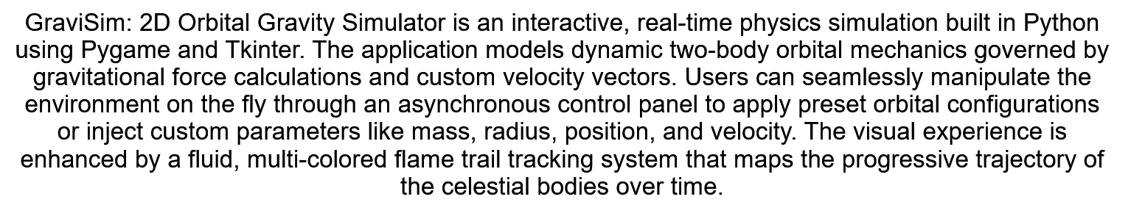
GraviSim: 2D Orbital Gravity Simulator
My name: Riaan van Wyk
GitHub username: Infinity101-jpg
edX Username: riaanvanwyk00810
Potchefstroom, South Africa
Date: 2026/07/13

