Slide 1

Quantum Error Correction
Professor: Ritumoni Sharma
Students:
Akshay Reddy Vellapalem | Dayal Kumar
2020MT10868 | 2020MT10797

Slide 2
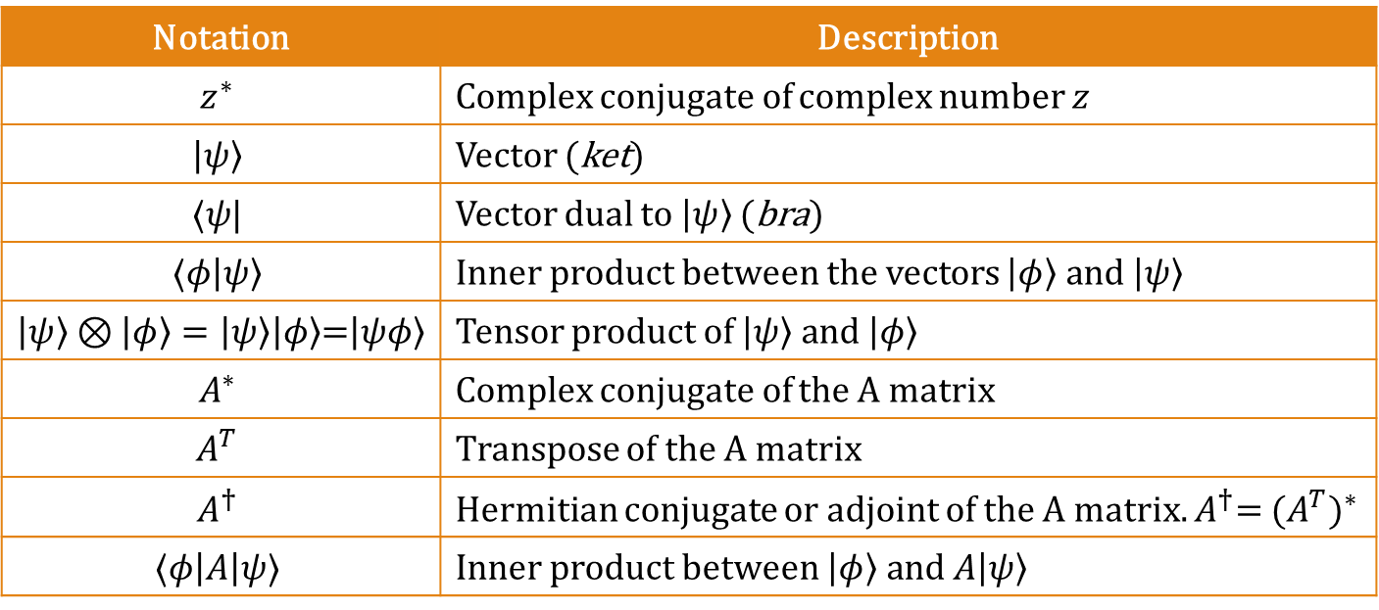
Linear Algebra Notations
Notation | Description
$$z^{∗}$$ | Complex conjugate of complex number $z$
$$\left|ψ\right\rangle$$ | Vector (ket)
$$⟨ψ|$$ | Vector dual to $\left|ψ\right\rangle$ (bra)
$$⟨φ\left|ψ\right\rangle$$ | Inner product between the vectors $\left|φ\right\rangle and \left|ψ\right\rangle$
$\left|ψ\right\rangle ⊗\left|φ\right\rangle =\left|ψ\right\rangle \left|φ\right\rangle$=$\left|ψφ\right\rangle$ | Tensor product of $\left|ψ\right\rangle and \left|φ\right\rangle$
$$A^{∗}$$ | Complex conjugate of the A matrix
$$A^{T}$$ | Transpose of the A matrix
$$A^{†}$$ | Hermitian conjugate or adjoint of the A matrix. $A^{†}$= ${(A^{T})}^{∗}$
$$⟨φ\left|A\right|ψ⟩$$ | Inner product between $\left|φ\right\rangle and A\left|ψ\right\rangle$

Slide 3
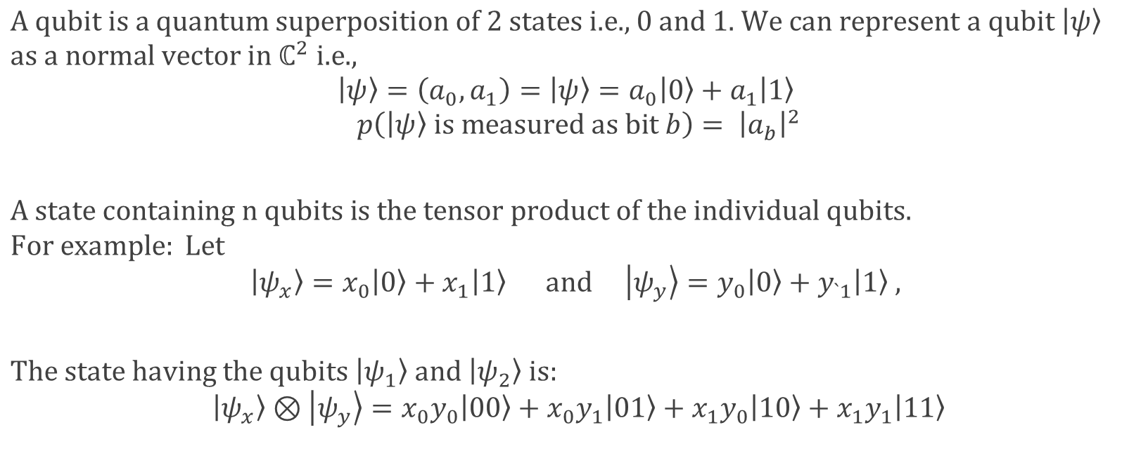
Recap: Qubit
$$\text{A} \text{qubit} \text{is} \text{a} \text{quantum} \text{superposition} \text{of}\text{ 2 }\text{states} \text{i}\text{.}\text{e}\text{.,} 0 and\text{ 1}\text{. }\text{We} \text{can} \text{represent} \text{a} \text{qubit} \left|ψ\right\rangle$$
$$\text{as} \text{a} \text{normal} \text{vector} \text{in} ℂ^{2} \text{i}\text{.}\text{e}\text{.,}$$
$$\left|ψ\right\rangle =\left(a_{0},a_{1}\right)=\left|ψ\right\rangle =a_{0}\left|0\right\rangle +a_{1}\left|1\right\rangle$$
$$p\left(\left|ψ\right\rangle is measured as bit b\right)= {\left|a_{b}\right|}^{2}$$
$$A state containing n qubits is the tensor product of the individual qubits.$$
$$For example: Let$$
$$\left|ψ_{x}\right\rangle =x_{0}\left|0\right\rangle +x_{1}\left|1\right\rangle and \left|ψ_{y}\right\rangle =y_{0}\left|0\right\rangle +y_{`1}\left|1\right\rangle ,$$
$$The state having the qubits \left|ψ_{1}\right\rangle and \left|ψ_{2}\right\rangle is:$$
$$\left|ψ_{x}\right\rangle ⊗\left|ψ_{y}\right\rangle =x_{0}y_{0}\left|00\right\rangle +x_{0}y_{1}\left|01\right\rangle +x_{1}y_{0}\left|10\right\rangle +x_{1}y_{1}\left|11\right\rangle$$

Slide 4
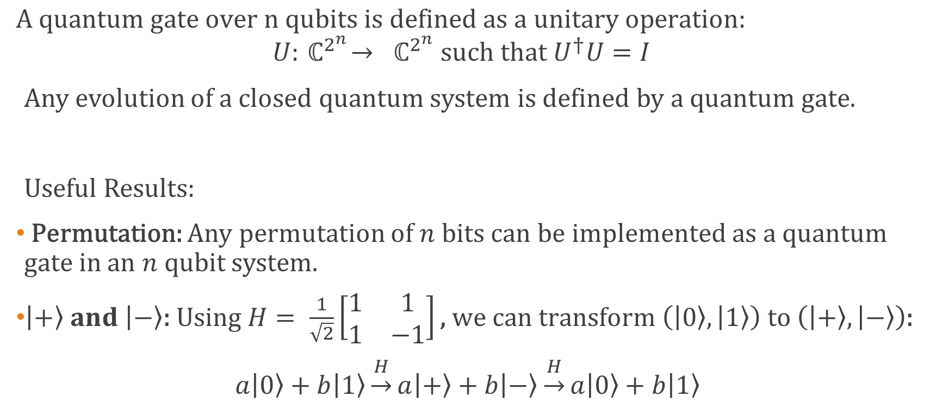
Recap: Quantum Gate
$$A quantum gate over n qubits is defined as a unitary operation:$$
$$U:{ ℂ}^{2^{n}}→ { ℂ}^{2^{n}} such that U^{†}U=I$$
Any evolution of a closed quantum system is defined by a quantum gate.
Useful Results:
Permutation: Any permutation of $n$ bits can be implemented as a quantum gate in an $n$ qubit system.
$\left|+\right\rangle and \left|−\right\rangle \text{: }\text{Using} H= \frac{1}{\sqrt{2}}\left[\begin{matrix}1 & 1 \\ 1 & −1\end{matrix}\right]\text{, }\text{we} \text{can} \text{transform} \left(\left|0\right\rangle ,\left|1\right\rangle \right) to \left(\left|+\right\rangle ,\left|−\right\rangle \right)$:
$$a\left|0\right\rangle +b\left|1\right\rangle \underset{→}{H}a\left|+\right\rangle +b\left|−\right\rangle \underset{→}{H}a\left|0\right\rangle +b\left|1\right\rangle$$

Slide 5
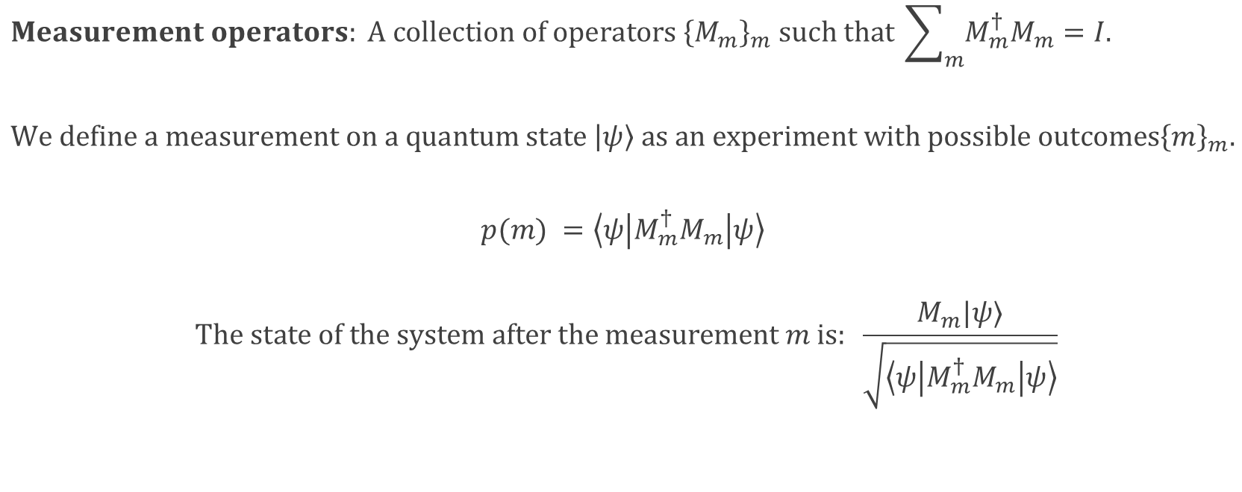
Recap: Measurement
$$Measurement operators: A collection of operators {\left\{M_{m}\right\}}_{m} such that \sum_{m}{M_{m}^{†}M_{m}}=I.$$
$$We define a measurement on a quantum state \left|ψ\right\rangle as an experiment with possible outcomes{\left\{m\right\}}_{m}.$$
$$p(m) =\left\langle ψ | M_{m}^{†}M_{m} | ψ\right\rangle$$
$$The state of the system after the measurement m is: \frac{M_{m}|ψ⟩}{\sqrt{\left\langle ψ | M_{m}^{†}M_{m} | ψ\right\rangle }}$$

Slide 6
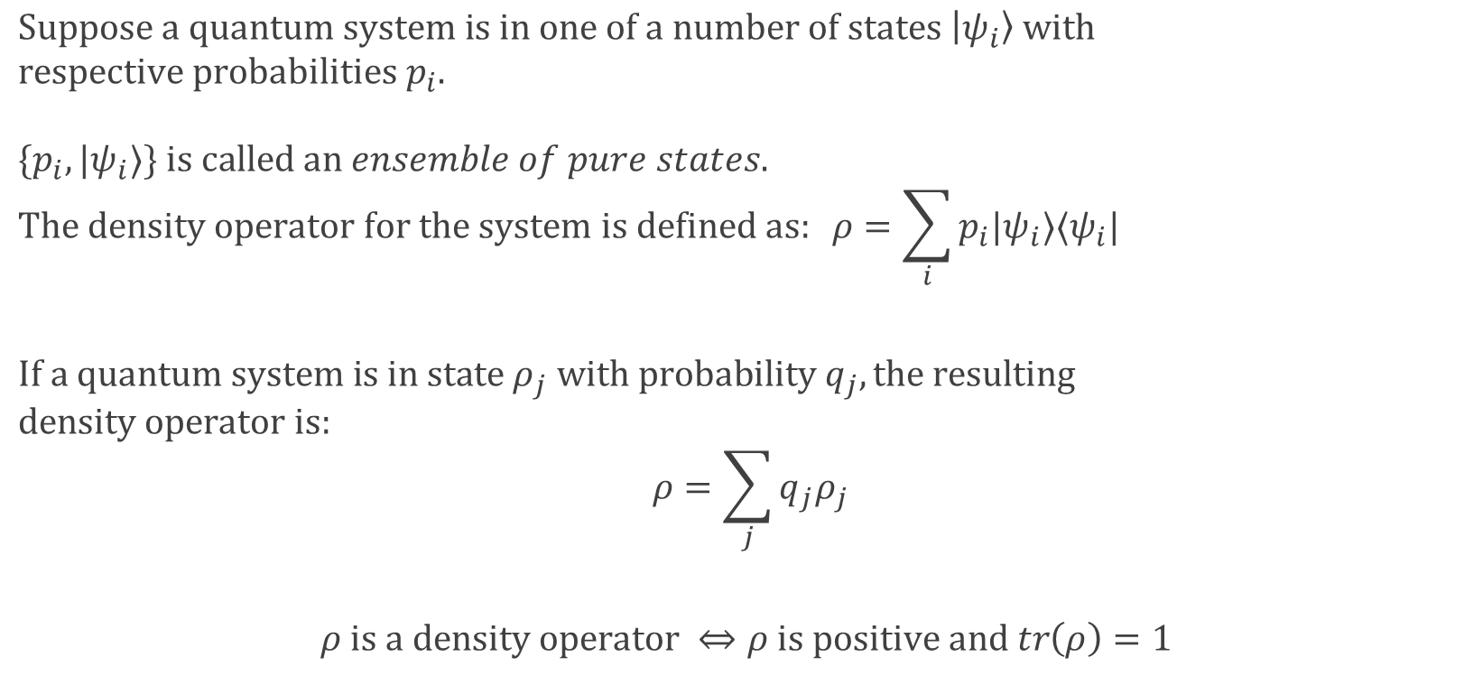
Recap: Density Operator
$$Suppose a quantum system is in one of a number of states \left|ψ_{i}\right\rangle with$$
$$respective probabilities p_{i}.$$
$$\{p_{i},|ψ_{i}⟩\} is called an ensemble of pure states.$$
$$The density operator for the system is defined as: ρ=\sum_{i}{p_{i}|ψ_{i}⟩⟨ψ_{i}|}$$
$$If a quantum system is in state ρ_{j} with probability q_{j}, the resulting$$
$$density operator is:$$
$$ρ=\sum_{j}{q_{j}ρ_{j}}$$
$$ρ is a density operator ⇔ρ is positive and tr\left(ρ\right)=1$$

Slide 7
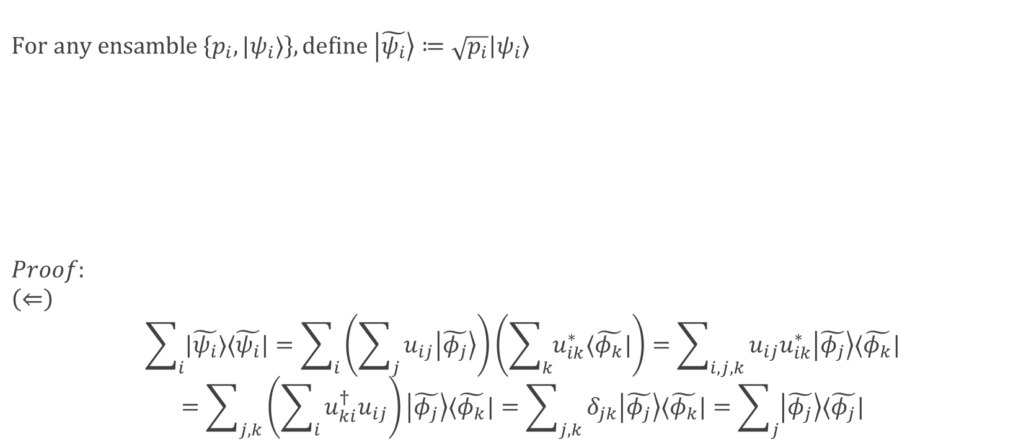
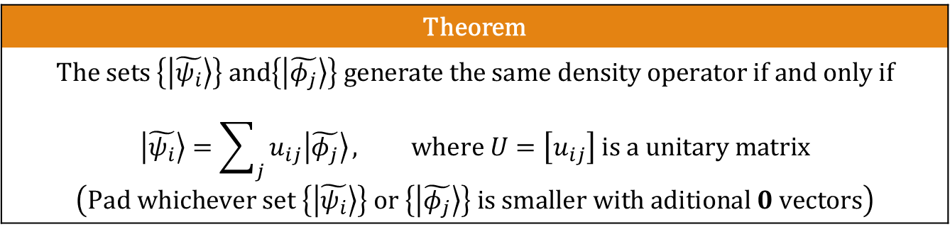
Recap: Density Operator (Theorem)
$$For any ensamble \left\{p_{i},|ψ_{i}⟩\right\}, define \left|\tilde{ψ_{i}}\right\rangle ≔\sqrt{p_{i}}\left|ψ_{i}\right\rangle$$
$$Proof:$$
$$\left(⇐\right)$$
$$\sum_{i}{|\tilde{ψ_{i}}⟩⟨\tilde{ψ_{i}}|}=\sum_{i}{\left(\sum_{j}{u_{ij}\left|\tilde{φ_{j}}\right\rangle }\right)\left(\sum_{k}{u_{ik}^{∗}⟨\tilde{φ_{k}}|}\right)}=\sum_{i,j,k}{u_{ij}u_{ik}^{∗}\left|\tilde{φ_{j}}\right\rangle ⟨\tilde{φ_{k}}|}$$
$$=\sum_{j,k}{\left(\sum_{i}{{u_{ki}^{†}u}_{ij}}\right)\left|\tilde{φ_{j}}\right\rangle ⟨\tilde{φ_{k}}|}=\sum_{j,k}{δ_{jk}\left|\tilde{φ_{j}}\right\rangle ⟨\tilde{φ_{k}}|}=\sum_{j}{\left|\tilde{φ_{j}}\right\rangle ⟨\tilde{φ_{j}}|}$$
Theorem
$$The sets \left\{\left|\tilde{ψ_{i}}\right\rangle \right\} and\left\{\left|\tilde{φ_{j}}\right\rangle \right\} generate the same density operator if and only if$$ $$\left|\tilde{ψ_{i}}\right\rangle =\sum_{j}{u_{ij}\left|\tilde{φ_{j}}\right\rangle }, where U=\left[u_{ij}\right] is a unitary matrix$$ $$\left(Pad whichever set \left\{\left|\tilde{ψ_{i}}\right\rangle \right\} or \left\{\left|\tilde{φ_{j}}\right\rangle \right\} is smaller with aditional 0 vectors\right)$$
Notes:
Skip proof.

Slide 8
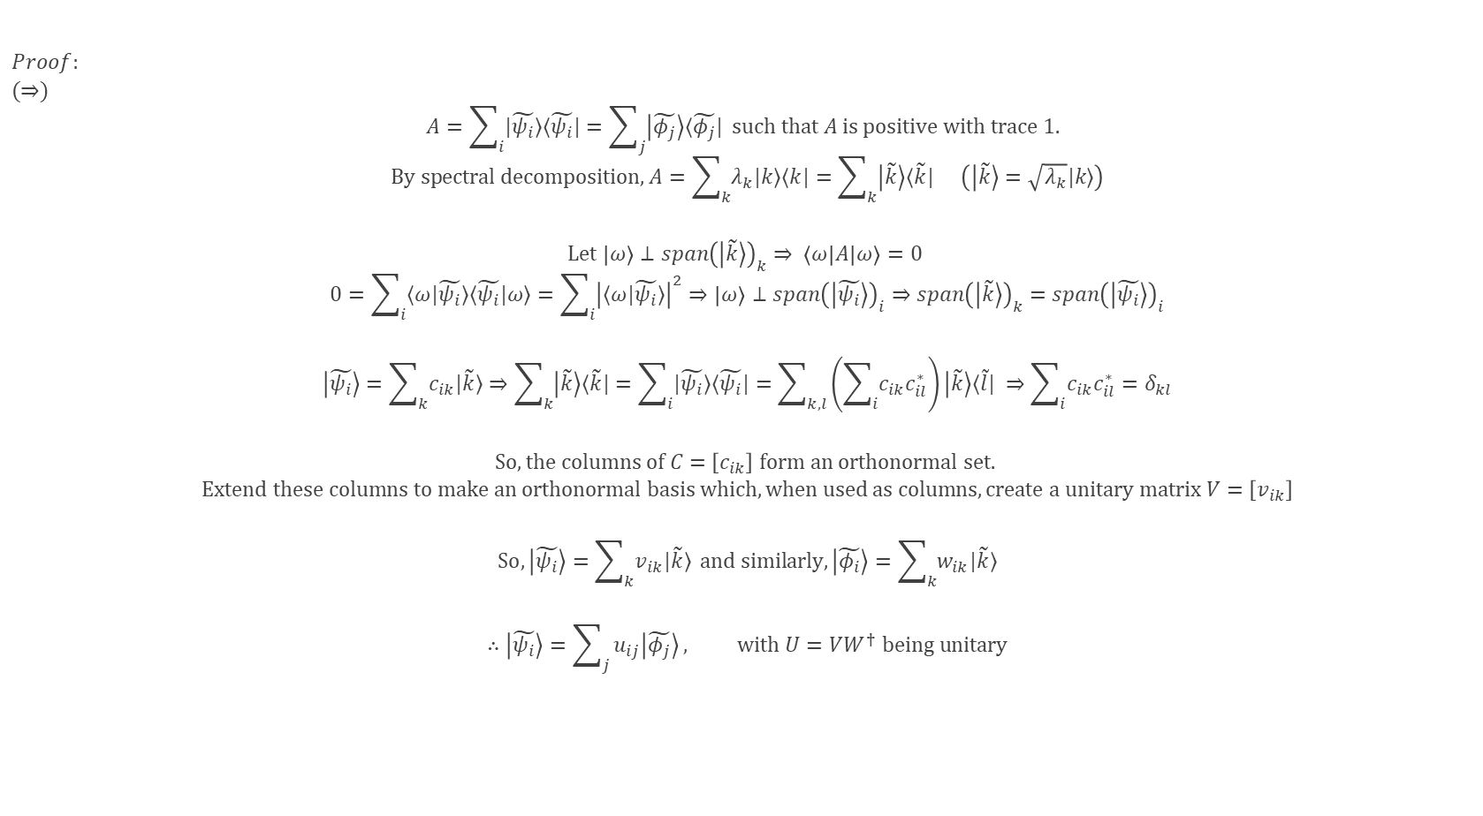
Recap: Density Operator (Theorem) (cont.)
$$Proof:$$
$$(⇒)$$
$$A=\sum_{i}{|\tilde{ψ_{i}}⟩⟨\tilde{ψ_{i}}|}=\sum_{j}{\left|\tilde{φ_{j}}\right\rangle ⟨\tilde{φ_{j}}|} such that A is positive with trace 1.$$
$$By spectral decomposition,A=\sum_{k}{λ_{k}|k⟩⟨k|}=\sum_{k}{\left|\tilde{k}\right\rangle ⟨\tilde{k}|} \left(\left|\tilde{k}\right\rangle =\sqrt{λ_{k}}|k⟩\right)$$
$$Let \left|ω\right\rangle ⊥span{\left(\left|\tilde{k}\right\rangle \right)}_{k}⇒ \left\langle ω | A | ω\right\rangle =0$$
$$0=\sum_{i}{⟨ω|\tilde{ψ_{i}}⟩⟨\tilde{ψ_{i}}|ω⟩}=\sum_{i}{{\left|⟨ω|\tilde{ψ_{i}}⟩\right|}^{2}}⇒\left|ω\right\rangle ⊥span{\left(\left|\tilde{ψ_{i}}\right\rangle \right)}_{i}⇒span{\left(\left|\tilde{k}\right\rangle \right)}_{k}=span{\left(\left|\tilde{ψ_{i}}\right\rangle \right)}_{i}$$
$$\left|\tilde{ψ_{i}}\right\rangle =\sum_{k}{c_{ik}|\tilde{k}⟩}⇒\sum_{k}{\left|\tilde{k}\right\rangle ⟨\tilde{k}|}=\sum_{i}{|\tilde{ψ_{i}}⟩⟨\tilde{ψ_{i}}|}=\sum_{k,l}{\left(\sum_{i}{c_{ik}c_{il}^{∗}}\right)\left|\tilde{k}\right\rangle ⟨\tilde{l}|} ⇒\sum_{i}{c_{ik}c_{il}^{∗}}=δ_{kl}$$
$$So, the columns of C=\left[c_{ik}\right] form an orthonormal set.$$
$$Extend these columns to make an orthonormal basis which, when used as columns, create a unitary matrix V=\left[v_{ik}\right]$$
$$So,\left|\tilde{ψ_{i}}\right\rangle =\sum_{k}{v_{ik}|\tilde{k}⟩} and similarly,\left|\tilde{φ_{i}}\right\rangle =\sum_{k}{w_{ik}|\tilde{k}⟩}$$
$$∴\left|\tilde{ψ_{i}}\right\rangle =\sum_{j}{u_{ij}\left|\tilde{φ_{j}}\right\rangle }, with U=VW^{†} being unitary$$

Slide 9
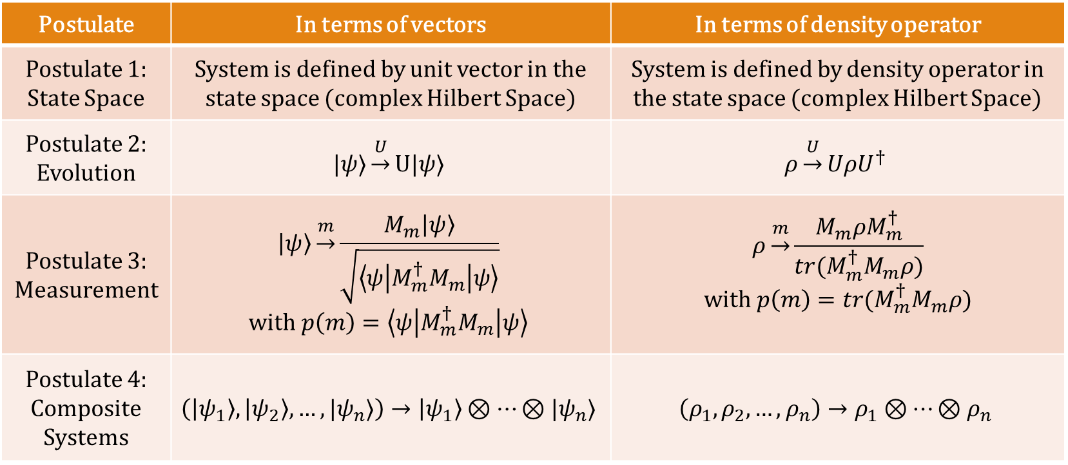
Recap: Postulates
Postulate | In terms of vectors | In terms of density operator
Postulate 1: State Space | System is defined by unit vector in the state space (complex Hilbert Space) | System is defined by density operator in the state space (complex Hilbert Space)
Postulate 2: Evolution | $$|ψ⟩\underset{→}{U}U|ψ⟩$$ | $$ρ\underset{→}{U}UρU^{†}$$
Postulate 3: Measurement | $$\left|ψ\right\rangle \underset{→}{m}\frac{M_{m}\left|ψ\right\rangle }{\sqrt{\left\langle ψ | M_{m}^{†}M_{m} | ψ\right\rangle }}$$ $$with p\left(m\right)=\left\langle ψ | M_{m}^{†}M_{m} | ψ\right\rangle$$ | $$ρ\underset{→}{m}\frac{M_{m}ρM_{m}^{†}}{tr(M_{m}^{†}M_{m}ρ)}$$ $$with p\left(m\right)=tr(M_{m}^{†}M_{m}ρ)$$
Postulate 4: Composite Systems | $$\left(\left|ψ_{1}\right\rangle ,\left|ψ_{2}\right\rangle ,…,|ψ_{n}⟩\right)→\left|ψ_{1}\right\rangle ⊗…⊗|ψ_{n}⟩$$ | $$\left(ρ_{1},ρ_{2},…,ρ_{n}\right)→ρ_{1}⊗…⊗ρ_{n}$$

Slide 10
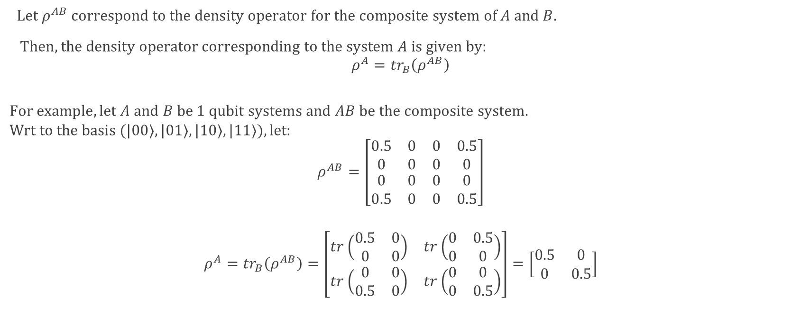
Reduced Density Operator
$Let ρ^{AB} correspond to the density operator for the composite system of A and B.$
$Then, the density operator corresponding to the system A is given by:$
$$ρ^{A}={tr}_{B}\left(ρ^{AB}\right)$$
$$For example, let A and B be 1 qubit systems and AB be the composite system.$$
$$Wrt to the basis (|00⟩,|01⟩,|10⟩,|11⟩), let:$$
$$ρ^{AB}=\left[\begin{matrix}\begin{matrix}0.5 & 0 \\ 0 & 0\end{matrix} & \begin{matrix}0 & 0.5 \\ 0 & 0\end{matrix} \\ \begin{matrix}0 & 0 \\ 0.5 & 0\end{matrix} & \begin{matrix}0 & 0 \\ 0 & 0.5\end{matrix}\end{matrix}\right]$$
$$ρ^{A}={tr}_{B}\left(ρ^{AB}\right)=\left[\begin{matrix}tr\left(\begin{matrix}0.5 & 0 \\ 0 & 0\end{matrix}\right) & tr\left(\begin{matrix}0 & 0.5 \\ 0 & 0\end{matrix}\right) \\ tr\left(\begin{matrix}0 & 0 \\ 0.5 & 0\end{matrix}\right) & tr\left(\begin{matrix}0 & 0 \\ 0 & 0.5\end{matrix}\right)\end{matrix}\right]=\left[\begin{matrix}0.5 & 0 \\ 0 & 0.5\end{matrix}\right]$$

Slide 11
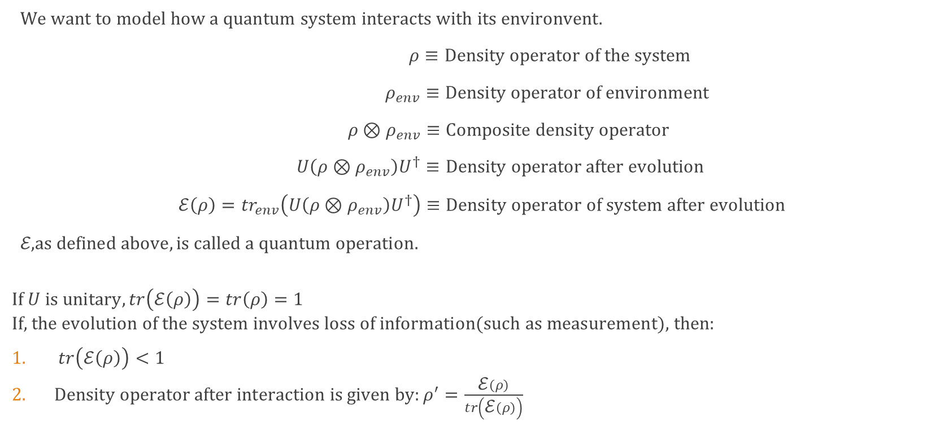
Quantum Operation
$We want to model how a quantum system interacts with its environvent.$
$ρ≡Density operator of the system$
$ρ_{env}≡Density operator of environment$
$ρ⊗ρ_{env}≡Composite density operator$
$U\left(ρ⊗ρ_{env}\right)U^{†}≡Density operator after evolution$
$\text{ℰ}\left(ρ\right)={tr}_{env}\left(U\left(ρ⊗ρ_{env}\right)U^{†}\right)≡Density operator of system after evolution$
$\text{ℰ}\text{,} as defined above, is called a quantum operation.$
$$If U is unitary, tr\left(\text{ℰ}\left(ρ\right)\right)=tr\left(ρ\right)=1$$
$$\text{If}\text{, }\text{the} \text{evolution} \text{of} \text{the} \text{system} \text{involves} \text{loss} \text{of} \text{information}\text{(}\text{such} \text{as} \text{measurement}\text{), }\text{then}\text{:}$$
$tr\left(\text{ℰ}\left(ρ\right)\right)<1$
$Density operator after interaction is given by:ρ^{′}=\frac{\text{ℰ}\left(ρ\right)}{tr\left(\text{ℰ}\left(ρ\right)\right)}$

Slide 12

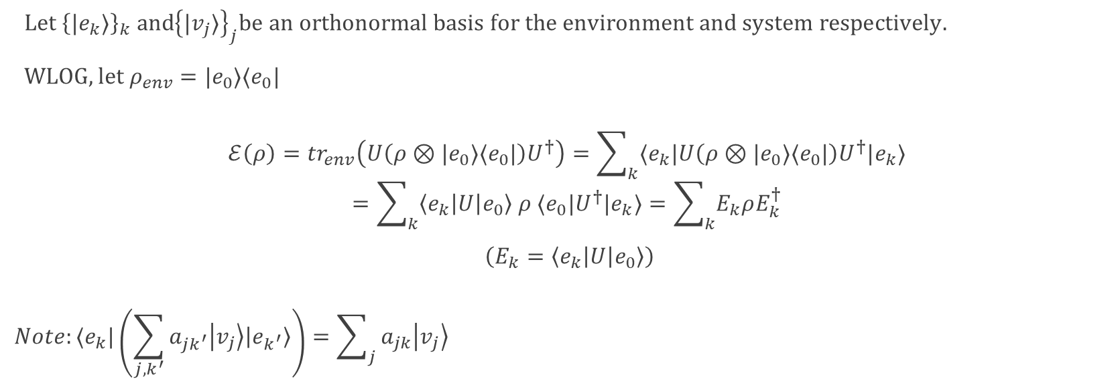
Quantum Operation (Theorem 1)
Theorem (Operator Sum Representation)
$$∀ quantum operation \text{ℰ}\text{, }∃ {\left\{E_{k}\right\}}_{k} such that: \text{ℰ}\left(ρ\right)=\sum_{k}{E_{k}ρE_{k}^{†}}$$
$Let {\left\{|e_{k}⟩\right\}}_{k} and{\left\{|v_{j}⟩\right\}}_{j}be an orthonormal basis for the environment and system respectively.$
$WLOG, let ρ_{env}=|e_{0}⟩⟨e_{0}|$
$$\text{ℰ}\left(ρ\right)={tr}_{env}\left(U\left(ρ⊗|e_{0}⟩⟨e_{0}|\right)U^{†}\right)=\sum_{k}{⟨e_{k}|U\left(ρ⊗|e_{0}⟩⟨e_{0}|\right)U^{†}|e_{k}⟩}$$
$$=\sum_{k}{\left\langle e_{k}\left|U\right|e_{0}\right\rangle ρ ⟨e_{0}|U^{†}|e_{k}⟩}=\sum_{k}{E_{k}ρE_{k}^{†}}$$
$\left(E_{k}=\left\langle e_{k}\left|U\right|e_{0}\right\rangle \right)$
$$Note:⟨e_{k}|\left(\sum_{j, k^{′}}{a_{jk^{′}}\left|v_{j}\right\rangle \left|e_{k^{′}}\right\rangle }\right)=\sum_{j}{a_{jk}\left|v_{j}\right\rangle }$$

Slide 13
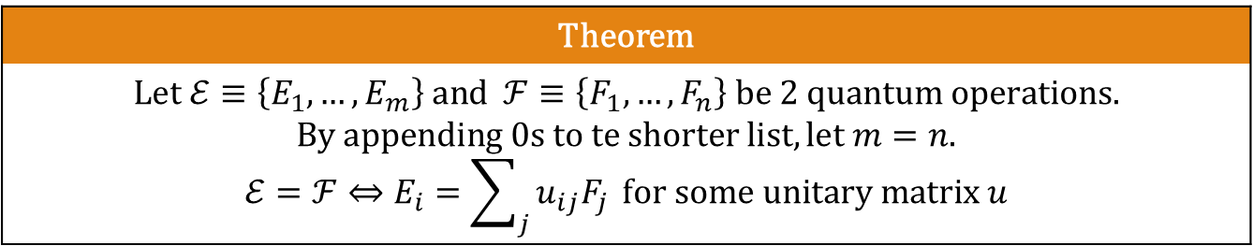
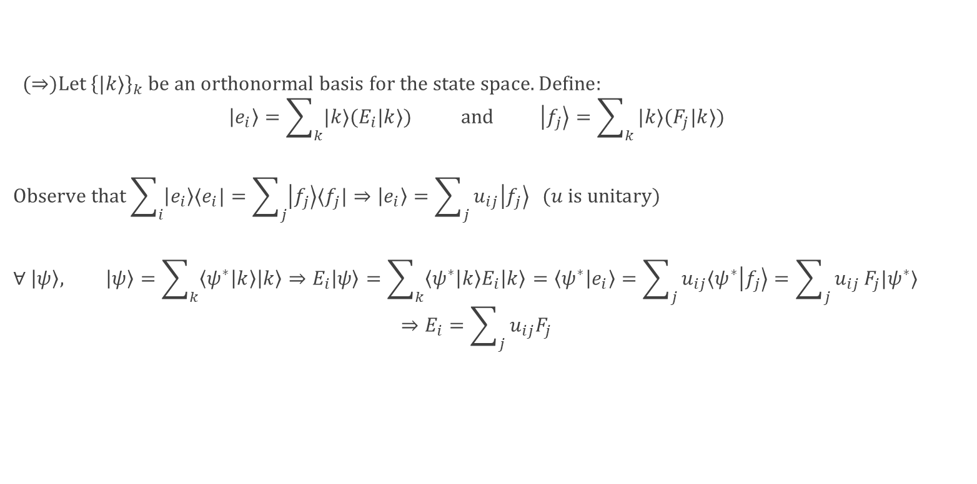
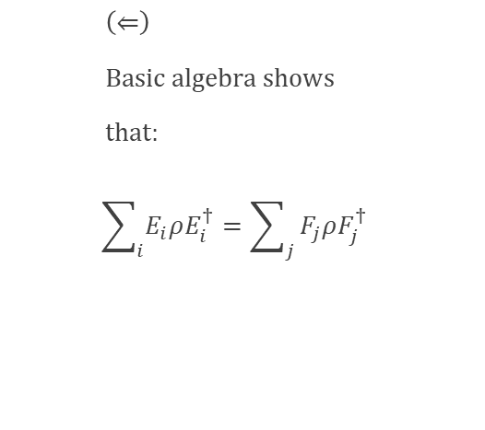
Quantum Operation (Theorem 2)
Theorem
$$Let \text{ℰ}≡\left\{E_{1},…,E_{m}\right\} and ℱ≡\left\{F_{1},…,F_{n}\right\} be 2 quantum operations.$$ $$By appending 0s to te shorter list, let m=n.$$ $$\text{ℰ}=ℱ⇔E_{i}=\sum_{j}{u_{ij}F_{j}} for some unitary matrix u$$
$(⇒)Let {\left\{|k⟩\right\}}_{k} be an orthonormal basis for the state space. Define:$
$$\left|e_{i}\right\rangle =\sum_{k}{|k⟩(E_{i}|k⟩)} and \left|f_{j}\right\rangle =\sum_{k}{|k⟩(F_{j}|k⟩)}$$
$$Observe that\sum_{i}{\left|e_{i}\right\rangle ⟨e_{i}|}=\sum_{j}{\left|f_{j}\right\rangle ⟨f_{j}|}⇒\left|e_{i}\right\rangle =\sum_{j}{u_{ij}\left|f_{j}\right\rangle } (u is unitary)$$
$$∀ \left|ψ\right\rangle , \left|ψ\right\rangle =\sum_{k}{\left\langle ψ^{∗} | k\right\rangle \left|k\right\rangle }⇒E_{i}\left|ψ\right\rangle =\sum_{k}{\left\langle ψ^{∗} | k\right\rangle E_{i}\left|k\right\rangle }=\left\langle ψ^{∗} | e_{i}\right\rangle =\sum_{j}{u_{ij}⟨ψ^{∗}\left|f_{j}\right\rangle }=\sum_{j}{u_{ij}}F_{j}|ψ^{∗}⟩$$
$$⇒E_{i}=\sum_{j}{u_{ij}F_{j}}$$
$\left(⇐\right)$
$Basic algebra shows$
$that:$
$$\sum_{i}{E_{i}ρE_{i}^{†}}=\sum_{j}{F_{j}ρF_{j}^{†}}$$

Slide 14
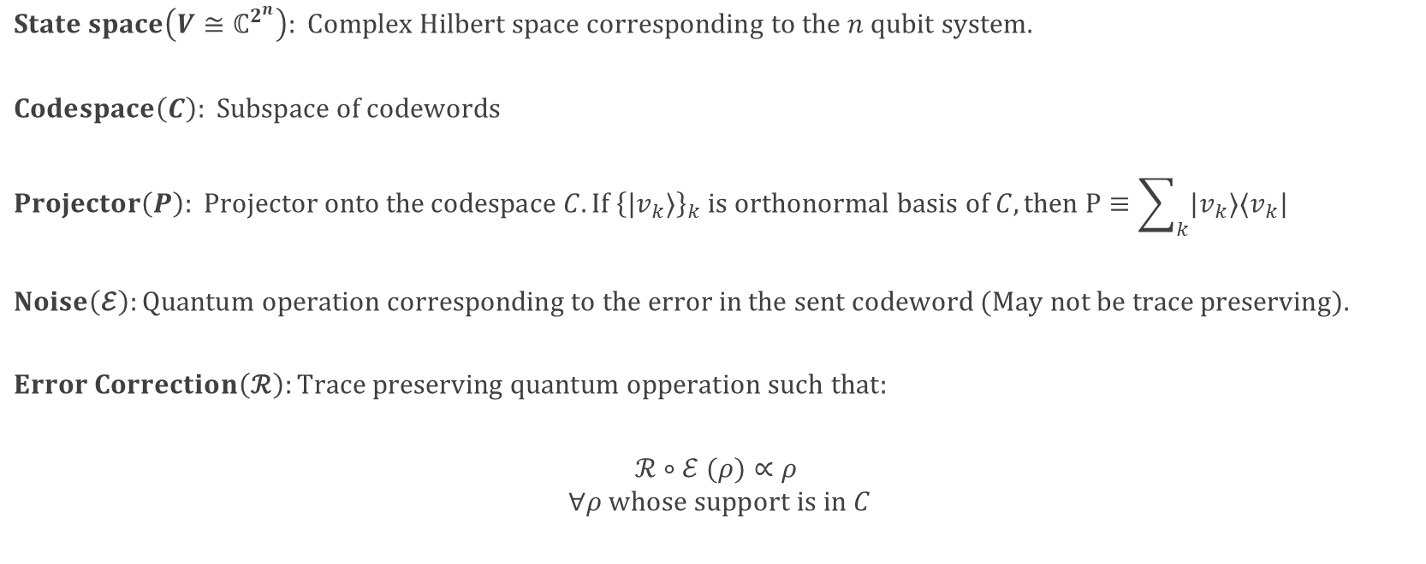
Theory Of Error Correction
$$State space\left(V≅ℂ^{2^{n}}\right): Complex Hilbert space corresponding to the n qubit system.$$
$$Codespace\left(C\right): Subspace of codewords$$
$$Projector\left(P\right): Projector onto the codespace C. If {\left\{|v_{k}⟩\right\}}_{k} is orthonormal basis of C, then P≡\sum_{k}{|v_{k}⟩⟨v_{k}|}$$
$$Noise\left(\text{ℰ}\right):Quantum operation corresponding to the error in the sent codeword (May not be trace preserving).$$
$$Error Correction\left(\text{ℛ}\right):Trace preserving quantum opperation such that:$$
$$\text{ℛ}∘\text{ℰ}\text{ (}ρ\text{)}∝ρ$$
$$∀ρ whose support is in C$$

Slide 15
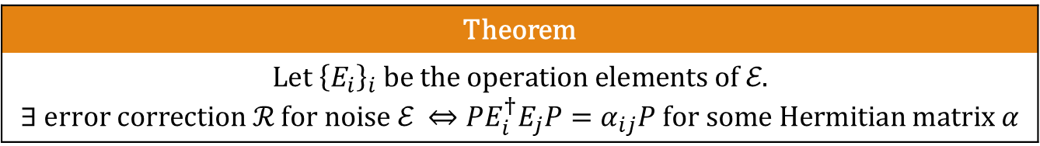
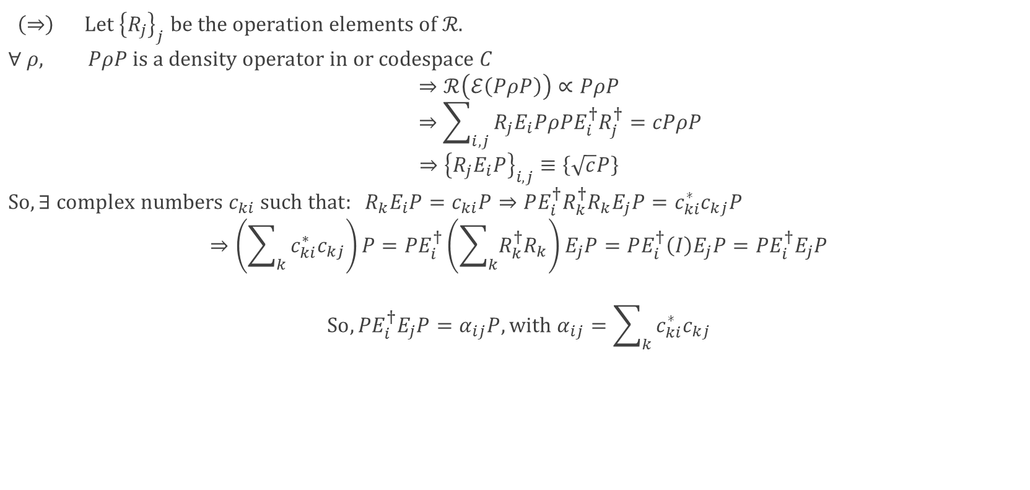
Existence of Error Correction
Theorem
$$Let {\left\{E_{i}\right\}}_{i} be the operation elements of \text{ℰ}\text{.}$$ $$∃ error correction \text{ℛ} \text{for} noise \text{ℰ} ⇔PE_{i}^{†}E_{j}P=α_{ij}P for some Hermitian matrix α$$
$\left(⇒\right) Let {\left\{R_{j}\right\}}_{j} be the operation elements of \text{ℛ}\text{.}$
$$∀ ρ, PρP is a density operator in or codespace C$$
$$⇒\text{ℛ}\left(\text{ℰ}\left(PρP\right)\right)∝PρP$$
$$⇒\sum_{i,j}{R_{j}E_{i}PρPE_{i}^{†}R_{j}^{†}}=cPρP$$
$$⇒{\left\{R_{j}E_{i}P\right\}}_{i,j}≡\left\{\sqrt{c}P\right\}$$
$$So, ∃ complex numbers c_{ki} such that: R_{k}E_{i}P=c_{ki}P⇒PE_{i}^{†}R_{k}^{†}R_{k}E_{j}P=c_{ki}^{∗}c_{kj}P$$
$$⇒\left(\sum_{k}{c_{ki}^{∗}c_{kj}}\right)P=PE_{i}^{†}\left(\sum_{k}{R_{k}^{†}R_{k}}\right)E_{j}P=PE_{i}^{†}\left(I\right)E_{j}P=PE_{i}^{†}E_{j}P$$
$$So, PE_{i}^{†}E_{j}P=α_{ij}P, with α_{ij}=\sum_{k}{c_{ki}^{∗}c_{kj}}$$

Slide 16
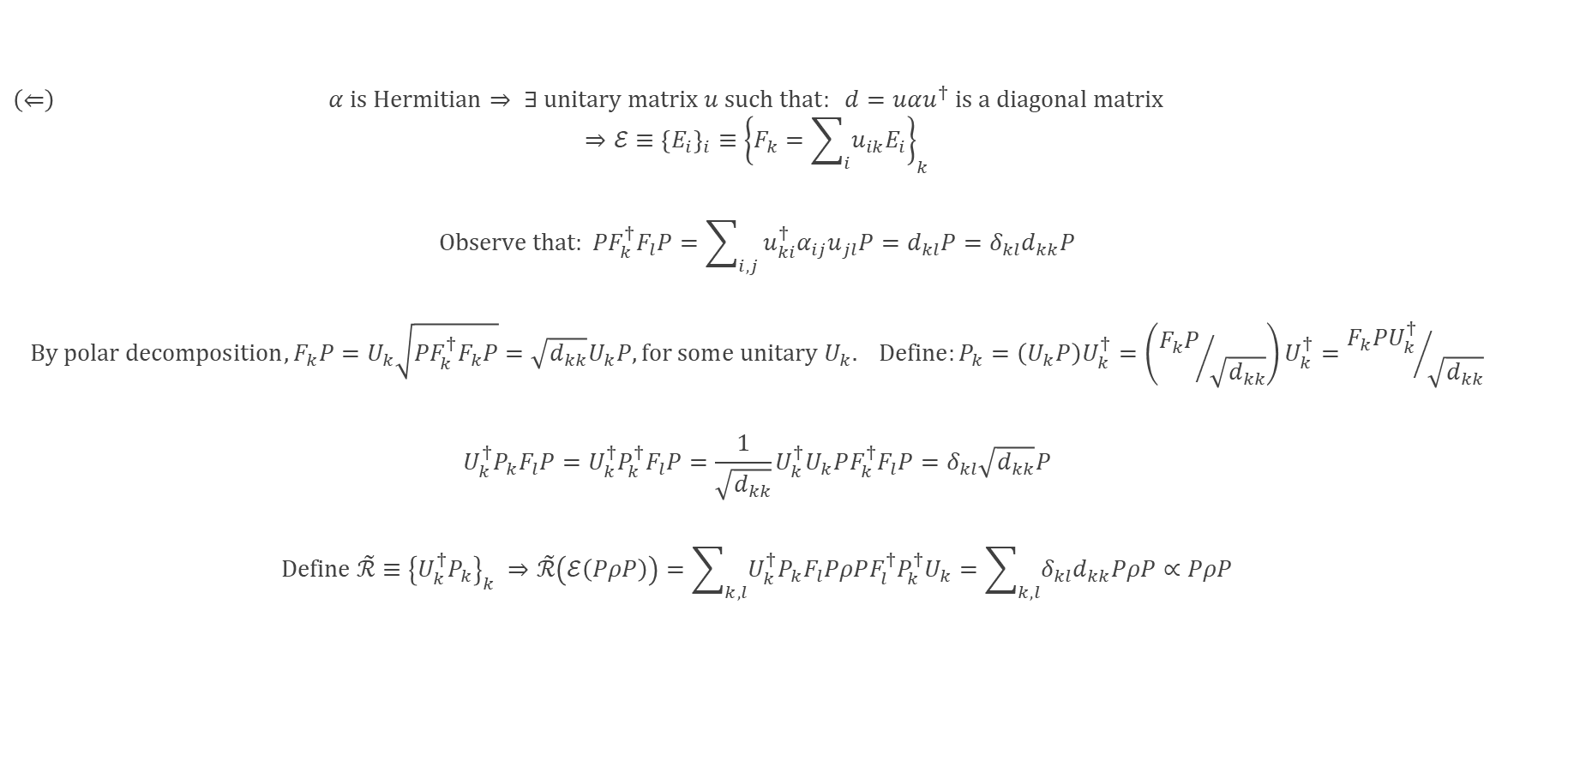
Existence of Error Correction (cont.)
$\left(⇐\right) α is Hermitian⇒ ∃ unitary matrix u such that: d=uαu^{†} is a diagonal matrix$
$$⇒\text{ℰ}≡{\left\{E_{i}\right\}}_{i}≡{\left\{F_{k}=\sum_{i}{u_{ik}E_{i}}\right\}}_{k}$$
$$Observe that: PF_{k}^{†}F_{l}P=\sum_{i, j}{{u_{ki}^{†}α_{ij}u}_{jl}P}=d_{kl}P=δ_{kl}d_{kk}P$$
$$By polar decomposition, F_{k}P=U_{k}\sqrt{PF_{k}^{†}F_{k}P}=\sqrt{d_{kk}}U_{k}P, for some unitary U_{k}. Define:P_{k}=\left(U_{k}P\right)U_{k}^{†}=\left({F_{k}P}/{\sqrt{d_{kk}}}\right)U_{k}^{†}={F_{k}PU_{k}^{†}}/{\sqrt{d_{kk}}}$$
$$U_{k}^{†}P_{k}F_{l}P=U_{k}^{†}P_{k}^{†}F_{l}P=\frac{1}{\sqrt{d_{kk}}}U_{k}^{†}U_{k}PF_{k}^{†}F_{l}P=δ_{kl}\sqrt{d_{kk}}P$$
$$\text{Define} \tilde{\text{ℛ}}≡{\left\{U_{k}^{†}P_{k}\right\}}_{k} ⇒\tilde{\text{ℛ}}\left(\text{ℰ}\left(PρP\right)\right)=\sum_{k,l}{U_{k}^{†}P_{k}F_{l}PρPF_{l}^{†}P_{k}^{†}U_{k}}=\sum_{k,l}{δ_{kl}d_{kk}PρP}∝PρP$$

Slide 17
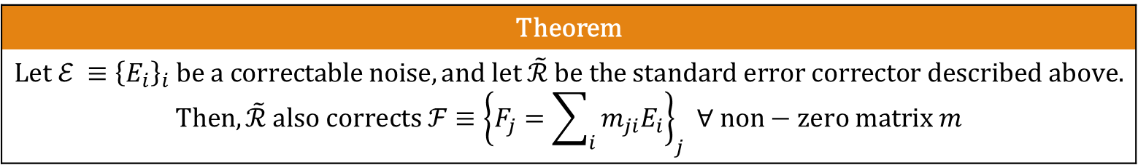
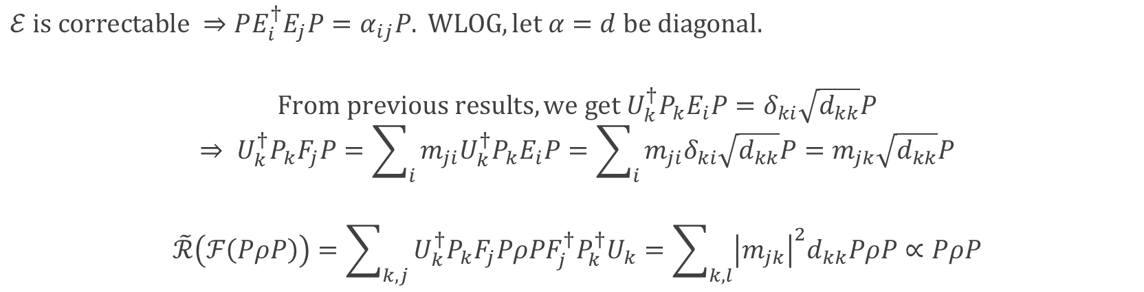
Discretization Of Errors
Theorem
$$Let \text{ℰ} ≡{\left\{E_{i}\right\}}_{i} be a correctable noise, and let \tilde{\text{ℛ}} be the standard error corrector described above.$$ $$Then, \tilde{\text{ℛ}} also corrects ℱ≡{\left\{F_{j}=\sum_{i}{m_{ji}E_{i}}\right\}}_{j} ∀ non−zero matrix m$$
$$\text{ℰ} \text{is} \text{correctable} ⇒PE_{i}^{†}E_{j}P=α_{ij}P. WLOG, let α=d be diagonal.$$
$$From previous results, we get U_{k}^{†}P_{k}E_{i}P=δ_{ki}\sqrt{d_{kk}}P$$
$$⇒ U_{k}^{†}P_{k}F_{j}P=\sum_{i}{m_{ji}U_{k}^{†}P_{k}E_{i}P}=\sum_{i}{m_{ji}δ_{ki}\sqrt{d_{kk}}P}=m_{jk}\sqrt{d_{kk}}P$$
$$\tilde{\text{ℛ}}\left(ℱ\left(PρP\right)\right)=\sum_{k,j}{U_{k}^{†}P_{k}F_{j}PρPF_{j}^{†}P_{k}^{†}U_{k}}=\sum_{k,l}{{\left|m_{jk}\right|}^{2}d_{kk}PρP}∝PρP$$

Slide 18
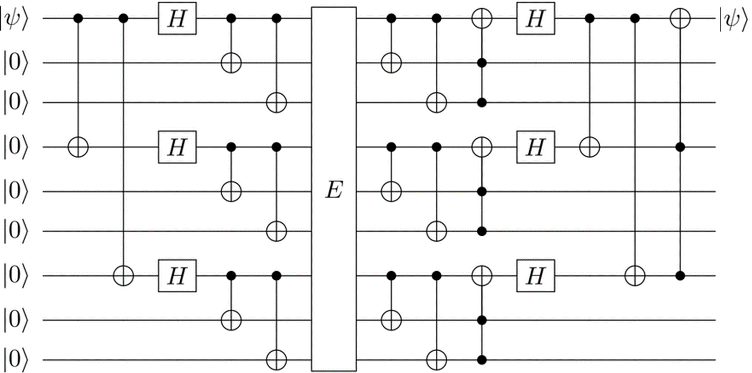
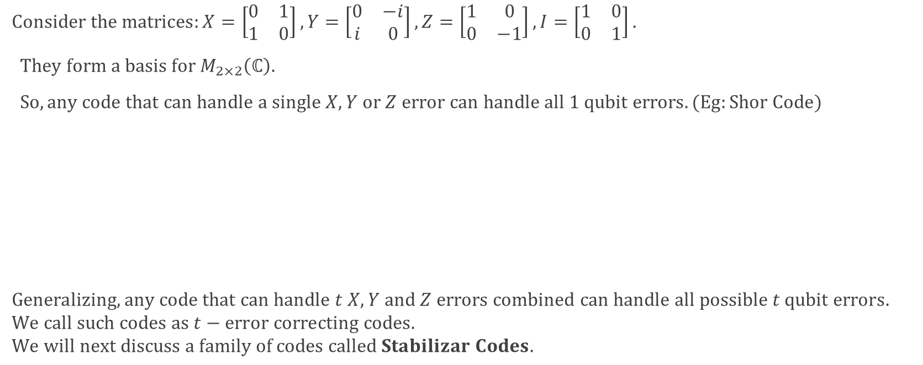

Discretization Of Errors (cont.)
$$Consider the matrices:X=\left[\begin{matrix}0 & 1 \\ 1 & 0\end{matrix}\right], Y=\left[\begin{matrix}0 & −i \\ i & 0\end{matrix}\right],Z=\left[\begin{matrix}1 & 0 \\ 0 & −1\end{matrix}\right], I=\left[\begin{matrix}1 & 0 \\ 0 & 1\end{matrix}\right].$$
$They form a basis for M_{2×2}\left(ℂ\right).$
$So, any code that can handle a single X, Y or Z error can handle all 1 qubit errors. (Eg:Shor Code)$
$$Generalizing, any code that can handle t X, Y and Z errors combined can handle all possible t qubit errors.$$
$$We call such codes as t−error correcting codes.$$
$$We will next discuss a family of codes called Stabilizar Codes.$$
$$Shor Code Circuit$$

Slide 19
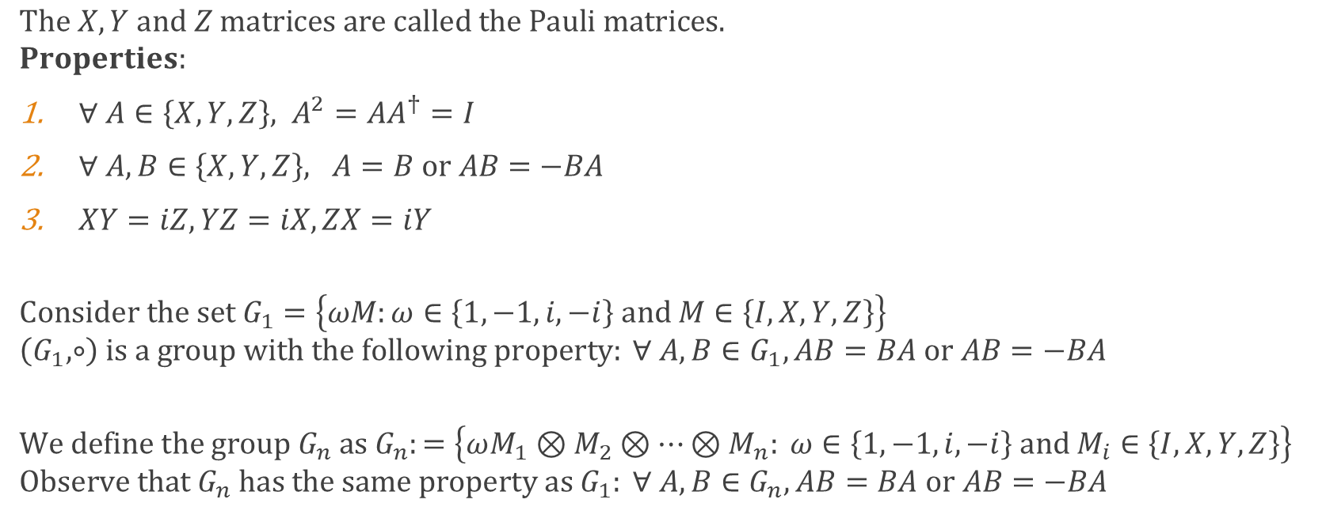
Pauli Matrices
$$The X, Y and Z matrices are called the Pauli matrices.$$
$$Properties:$$
$∀ A∈\left\{X, Y, Z\right\}, A^{2}=AA^{†}=I$
$∀ A,B∈\left\{X, Y, Z\right\}, A=B or AB=−BA$
$XY=iZ, YZ=iX, ZX=iY$
$$Consider the set G_{1}=\left\{ωM:ω∈\left\{1,−1,i,−i\right\} and M∈\left\{I, X, Y, Z\right\}\right\}$$
$$\left(G_{1},∘\right) is a group with the following property: ∀ A,B∈G_{1}, AB=BA or AB=−BA$$
$$We define the group G_{n} as G_{n}:=\left\{ωM_{1}⊗M_{2}⊗…⊗M_{n}: ω∈\left\{1,−1,i,−i\right\} and M_{i}∈\left\{I, X, Y, Z\right\}\right\}$$
$$Observe that G_{n} has the same property as G_{1}: ∀ A,B∈G_{n}, AB=BA or AB=−BA$$

Slide 20
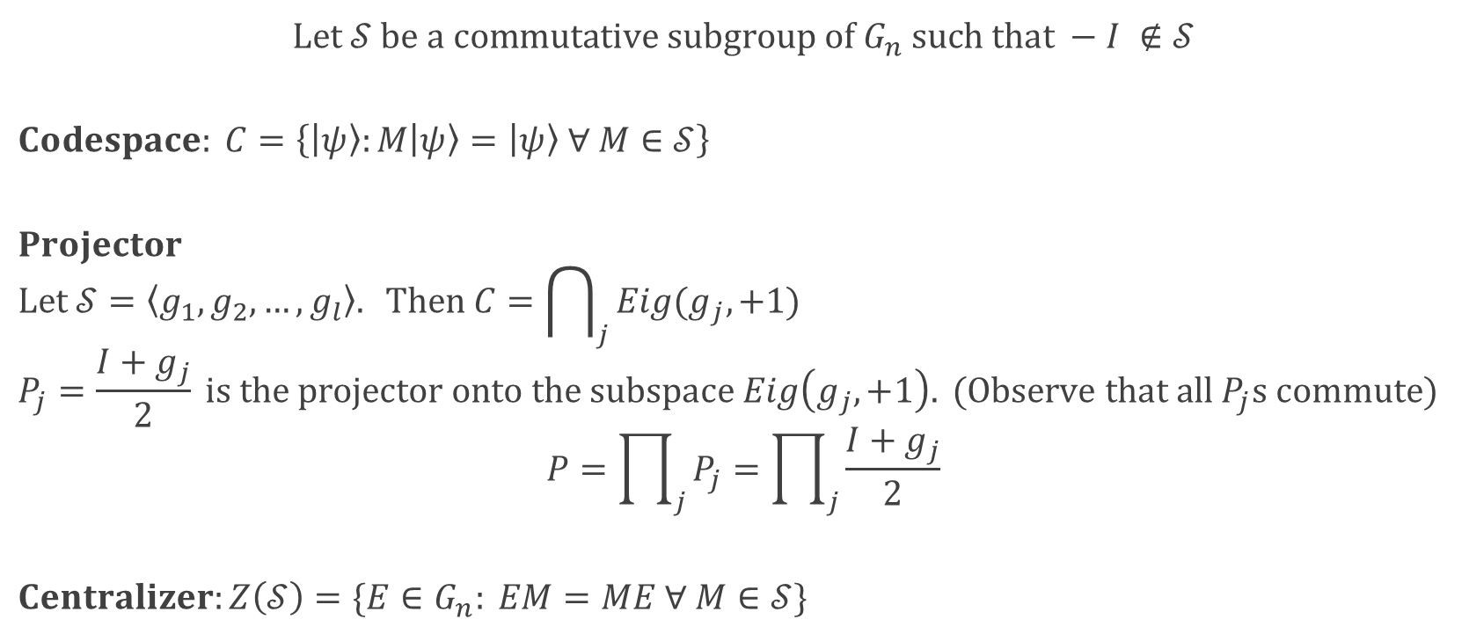
Stabilizer Codes
$$Let 𝒮 be a commutative subgroup of G_{n} such that −I ∉𝒮$$
$$Codespace: C=\left\{\left|ψ\right\rangle :M\left|ψ\right\rangle =\left|ψ\right\rangle ∀ M∈𝒮\right\}$$
$$Projector$$
$$Let 𝒮=\left\langle g_{1},g_{2},…,g_{l}\right\rangle . Then C=\bigcap_{j}{Eig(g_{j},+1)}$$
$$P_{j}=\frac{I+g_{j}}{2} is the projector onto the subspace Eig\left(g_{j},+1\right). (Observe that all P_{j}s commute)$$
$$P=\prod_{j}{P_{j}}=\prod_{j}{\frac{I+g_{j}}{2}}$$
$$Centralizer:Z\left(𝒮\right)=\{E∈G_{n}: EM=ME ∀ M∈𝒮\}$$

Slide 21

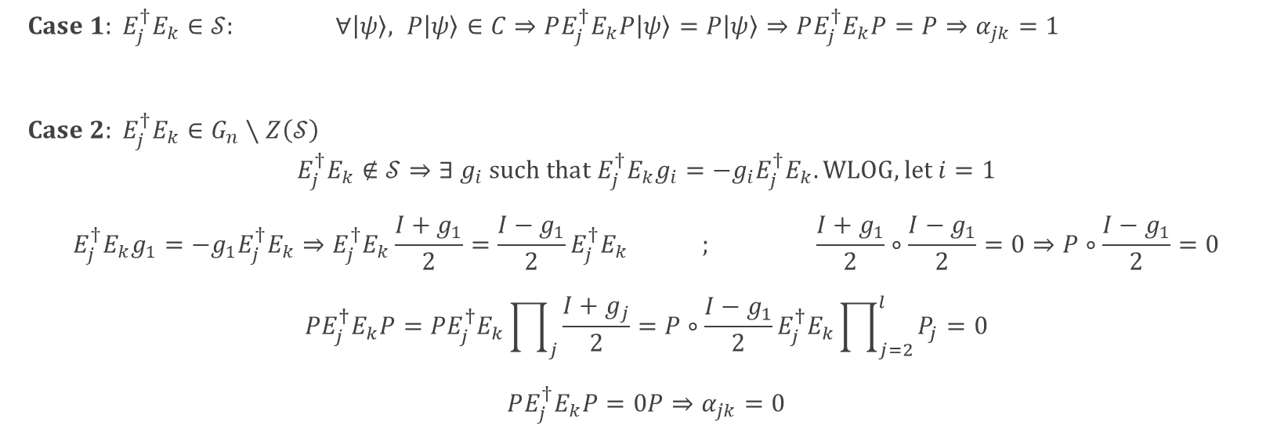
Stabilizer Codes (cont.)
Theorem
$$Let \text{ℰ} ≡{\left\{E_{i}\right\}}_{i} be a noise such that E_{i}∈G_{n} ∀ i.$$ $$E_{j}^{†}E_{k}∉Z\left(𝒮\right)∖𝒮 ∀ j,k⇒\text{ℰ} \text{is} \text{correctable}\text{.}$$
$Case 1: E_{j}^{†}E_{k}∈𝒮: ∀\left|ψ\right\rangle , P\left|ψ\right\rangle ∈C⇒PE_{j}^{†}E_{k}P\left|ψ\right\rangle =P\left|ψ\right\rangle ⇒PE_{j}^{†}E_{k}P=P⇒α_{jk}=1$
$Case 2: E_{j}^{†}E_{k}∈G_{n}∖Z\left(𝒮\right)$
$$E_{j}^{†}E_{k}∉𝒮⇒∃ g_{i} such that E_{j}^{†}E_{k}g_{i}=−g_{i}E_{j}^{†}E_{k}. WLOG, let i=1$$
$$E_{j}^{†}E_{k}g_{1}=−g_{1}E_{j}^{†}E_{k}⇒E_{j}^{†}E_{k}\frac{I+g_{1}}{2}=\frac{I−g_{1}}{2}E_{j}^{†}E_{k} ; \frac{I+g_{1}}{2}∘\frac{I−g_{1}}{2}=0⇒P∘\frac{I−g_{1}}{2}=0$$
$$PE_{j}^{†}E_{k}P=PE_{j}^{†}E_{k}\prod_{j}{\frac{I+g_{j}}{2}}=P∘\frac{I−g_{1}}{2}E_{j}^{†}E_{k}\prod_{j=2}^{l}{P_{j}}=0$$
$$PE_{j}^{†}E_{k}P=0P⇒α_{jk}=0$$

Slide 22
APPENDIX

Slide 23
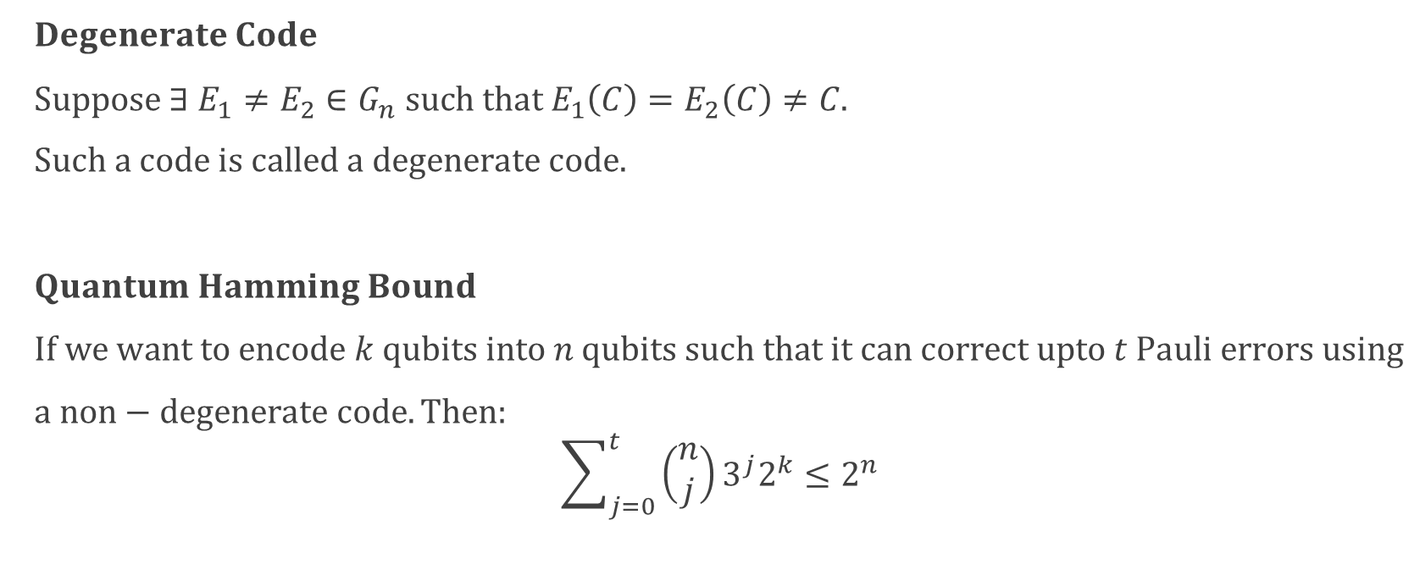
Quantum Hamming Bound
$Degenerate Code$
$Suppose ∃ E_{1}≠E_{2}∈G_{n} such that E_{1}\left(C\right)=E_{2}\left(C\right)≠C.$
$Such a code is called a degenerate code.$
$Quantum Hamming Bound$
$If we want to encode k qubits into n qubits such that it can correct upto t Pauli errors using$
$a non−degenerate code. Then:$
$$\sum_{j=0}^{t}{\left(\begin{aligned}n \\ j\end{aligned}\right)3^{j}2^{k}≤2^{n}}$$

Slide 24
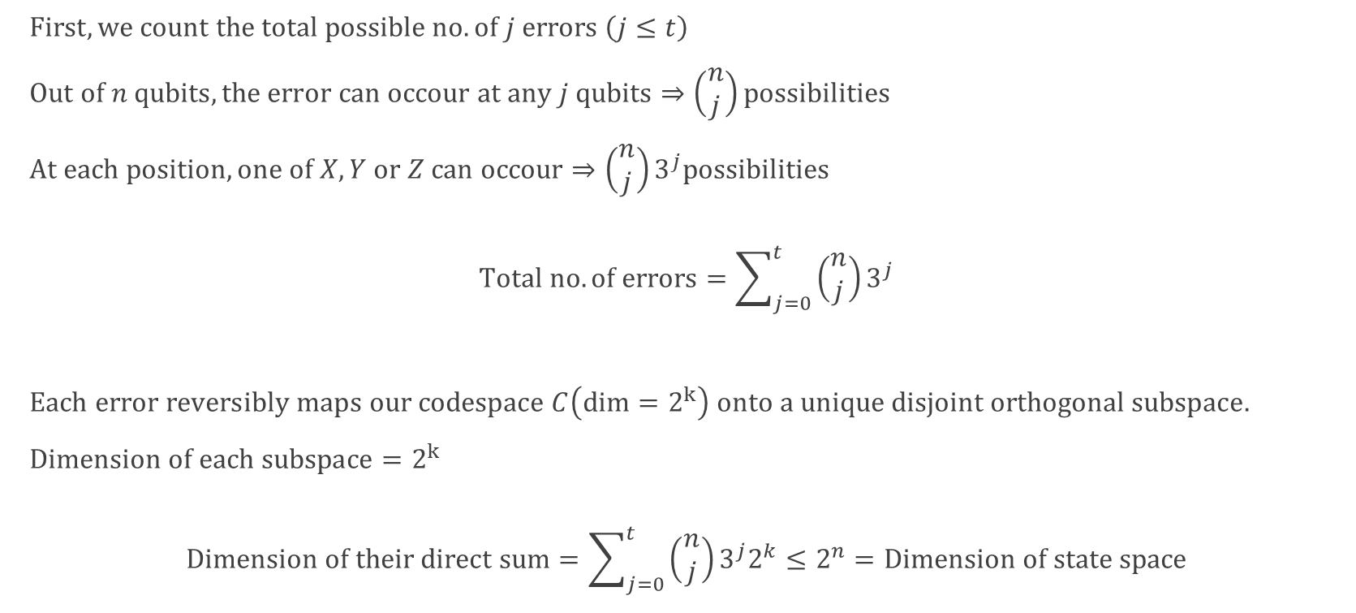
Quantum Hamming Bound (Proof)
$First, we count the total possible no. of j errors \left(j≤t\right)$
$Out of n qubits, the error can occour at any j qubits⇒\left(\begin{aligned}n \\ j\end{aligned}\right)possibilities$
$At each position, one of X, Y or Z can occour⇒\left(\begin{aligned}n \\ j\end{aligned}\right)3^{j}possibilities$
$$Total no. of errors=\sum_{j=0}^{t}{\left(\begin{aligned}n \\ j\end{aligned}\right)3^{j}}$$
$Each error reversibly maps our codespace C\left(dim=2^{k}\right) onto a unique disjoint orthogonal subspace.$
$Dimension of each subspace=2^{k}$
$$Dimension of their direct sum=\sum_{j=0}^{t}{\left(\begin{aligned}n \\ j\end{aligned}\right)3^{j}2^{k}}≤2^{n}=Dimension of state space$$

Slide 25
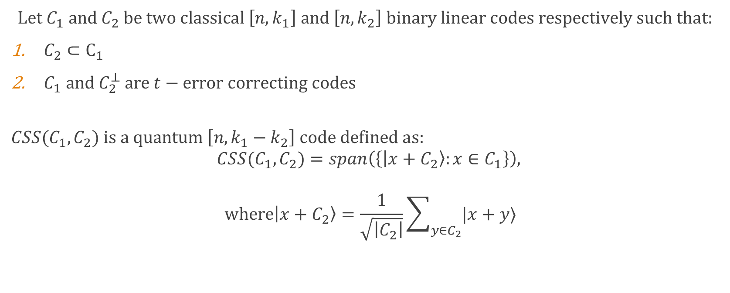
Calderbank Shor Stean Code
$Let C_{1} and C_{2} be two classical \left[n,k_{1}\right] and \left[n,k_{2}\right] binary linear codes respectively such that:$
$C_{2}⊂C_{1}$
$C_{1} and C_{2}^{⊥} are t−error correcting codes$
$${CSS(C}_{1},C_{2}) is a quantum \left[n, k_{1}−k_{2}\right] code defined as:$$
$${CSS(C}_{1},C_{2})=span\left(\left\{\left|x+C_{2}\right\rangle :x∈C_{1}\right\}\right),$$
$$where\left|x+C_{2}\right\rangle =\frac{1}{\sqrt{\left|C_{2}\right|}}\sum_{y∈C_{2}}{|x+y⟩}$$

Slide 26
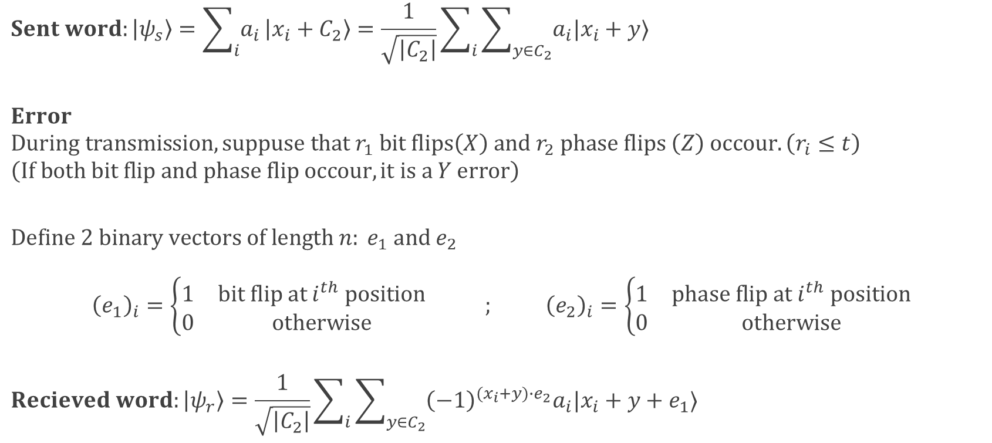
Calderbank Shor Stean Code: Error
$$Sent word:\left|ψ_{s}\right\rangle =\sum_{i}{a_{i}}\left|x_{i}+C_{2}\right\rangle =\frac{1}{\sqrt{\left|C_{2}\right|}}\sum_{i}{\sum_{y∈C_{2}}{a_{i}|x_{i}+y⟩}}$$
$$Error$$
$$During transmission, suppuse that r_{1} bit flips\left(X\right) and r_{2} phase flips \left(Z\right) occour. \left(r_{i}≤t\right)$$
$$\left(If both bit flip and phase flip occour, it is a Y error\right)$$
$$Define 2 binary vectors of length n: e_{1} and e_{2}$$
$${\left(e_{1}\right)}_{i}=\left\{\begin{matrix}1 & bit flip at i^{th} position \\ 0 & otherwise\end{matrix}\right. ; {\left(e_{2}\right)}_{i}=\left\{\begin{matrix}1 & phase flip at i^{th} position \\ 0 & otherwise\end{matrix}\right.$$
$$Recieved word:\left|ψ_{r}\right\rangle =\frac{1}{\sqrt{\left|C_{2}\right|}}\sum_{i}{\sum_{y∈C_{2}}{{\left(−1\right)}^{(x_{i}+y)∙e_{2}}a_{i}|x_{i}+y+e_{1}⟩}}$$

Slide 27
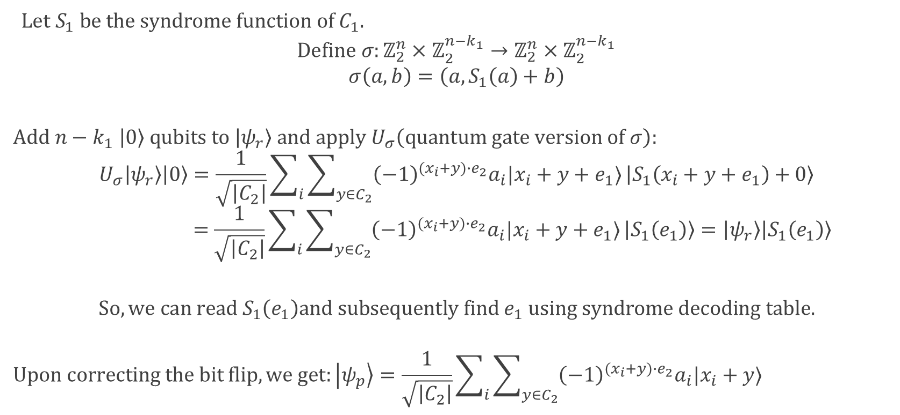
CSS Code: Bit Flip Correction
$Let S_{1} be the syndrome function of C_{1}.$
$$Define σ:ℤ_{2}^{n}×ℤ_{2}^{n−k_{1}}→ℤ_{2}^{n}×ℤ_{2}^{n−k_{1}}$$
$$σ\left(a,b\right)=\left(a, S_{1}\left(a\right)+b\right)$$
$$Add n−k_{1} \left|0\right\rangle qubits to \left|ψ_{r}\right\rangle and apply U_{σ}\left(quantum gate version of σ\right):$$
$$U_{σ}\left|ψ_{r}\right\rangle \left|0\right\rangle =\frac{1}{\sqrt{\left|C_{2}\right|}}\sum_{i}{\sum_{y∈C_{2}}{{\left(−1\right)}^{(x_{i}+y)∙e_{2}}a_{i}|x_{i}+y+e_{1}⟩}}\left|S_{1}\left(x_{i}+y+e_{1}\right)+0\right\rangle$$
$$=\frac{1}{\sqrt{\left|C_{2}\right|}}\sum_{i}{\sum_{y∈C_{2}}{{\left(−1\right)}^{(x_{i}+y)∙e_{2}}a_{i}|x_{i}+y+e_{1}⟩}}\left|S_{1}\left(e_{1}\right)\right\rangle =\left|ψ_{r}\right\rangle \left|S_{1}\left(e_{1}\right)\right\rangle$$
$$So, we can read S_{1}\left(e_{1}\right)and subsequently find e_{1} using syndrome decoding table.$$
$$Upon correcting the bit flip, we get:\left|ψ_{p}\right\rangle =\frac{1}{\sqrt{\left|C_{2}\right|}}\sum_{i}{\sum_{y∈C_{2}}{{\left(−1\right)}^{(x_{i}+y)∙e_{2}}a_{i}|x_{i}+y⟩}}$$

Slide 28
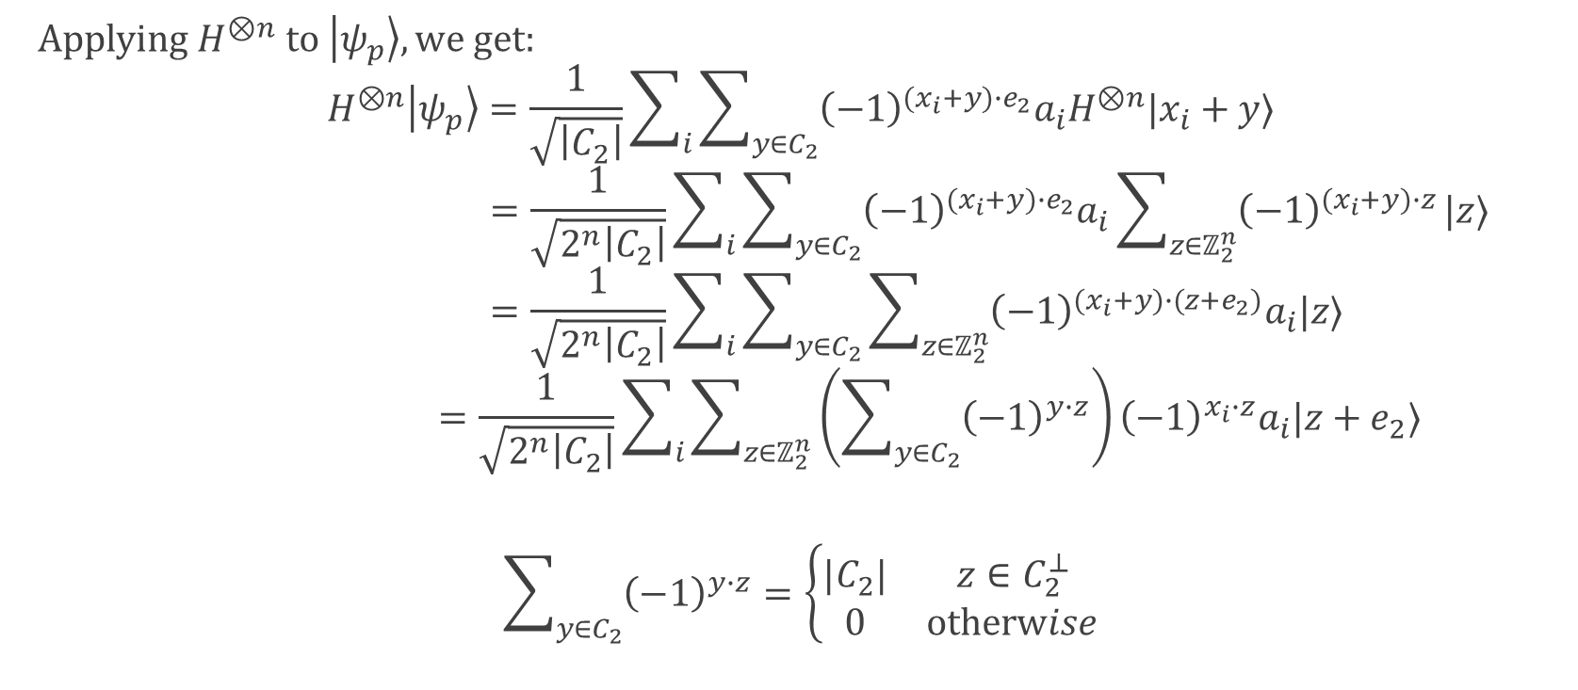
CSS Code: Phase Flip Correction
$Applying H^{⊗n} to \left|ψ_{p}\right\rangle , we get:$
$$H^{⊗n}\left|ψ_{p}\right\rangle =\frac{1}{\sqrt{\left|C_{2}\right|}}\sum_{i}{\sum_{y∈C_{2}}{{\left(−1\right)}^{(x_{i}+y)∙e_{2}}a_{i}H^{⊗n}|x_{i}+y⟩}}$$
$$=\frac{1}{\sqrt{2^{n}\left|C_{2}\right|}}\sum_{i}{\sum_{y∈C_{2}}{{\left(−1\right)}^{(x_{i}+y)∙e_{2}}a_{i}\sum_{z∈ℤ_{2}^{n}}{{\left(−1\right)}^{(x_{i}+y)∙z}}|z⟩}}$$
$$=\frac{1}{\sqrt{2^{n}\left|C_{2}\right|}}\sum_{i}{\sum_{y∈C_{2}}{\sum_{z∈ℤ_{2}^{n}}{{\left(−1\right)}^{(x_{i}+y)∙(z+e_{2})}a_{i}|z⟩}}}$$
$$=\frac{1}{\sqrt{2^{n}\left|C_{2}\right|}}\sum_{i}{\sum_{z∈ℤ_{2}^{n}}{\left(\sum_{y∈C_{2}}{{\left(−1\right)}^{y∙z}}\right){\left(−1\right)}^{x_{i}∙z}a_{i}|z+e_{2}⟩}}$$
$$\sum_{y∈C_{2}}{{\left(−1\right)}^{y∙z}}=\left\{\begin{matrix}|C_{2}| & z∈C_{2}^{⊥} \\ 0 & otherwise\end{matrix}\right.$$

Slide 29
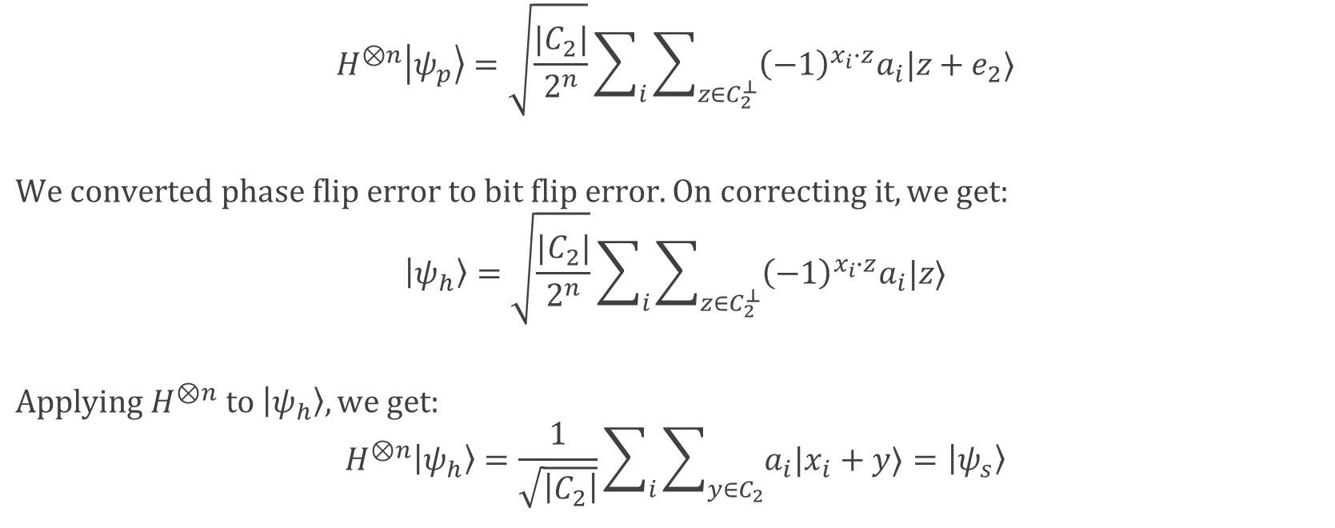
CSS Code: Phase Flip Correction (cont.)
$$H^{⊗n}\left|ψ_{p}\right\rangle =\sqrt{\frac{|C_{2}|}{2^{n}}}\sum_{i}{\sum_{z∈C_{2}^{⊥}}{{\left(−1\right)}^{x_{i}∙z}a_{i}|z+e_{2}⟩}}$$
$$We converted phase flip error to bit flip error. On correcting it, we get:$$
$$\left|ψ_{h}\right\rangle =\sqrt{\frac{|C_{2}|}{2^{n}}}\sum_{i}{\sum_{z∈C_{2}^{⊥}}{{\left(−1\right)}^{x_{i}∙z}a_{i}|z⟩}}$$
$$Applying H^{⊗n} to \left|ψ_{h}\right\rangle , we get:$$
$$H^{⊗n}\left|ψ_{h}\right\rangle =\frac{1}{\sqrt{\left|C_{2}\right|}}\sum_{i}{\sum_{y∈C_{2}}{a_{i}|x_{i}+y⟩}}=\left|ψ_{s}\right\rangle$$

Slide 30
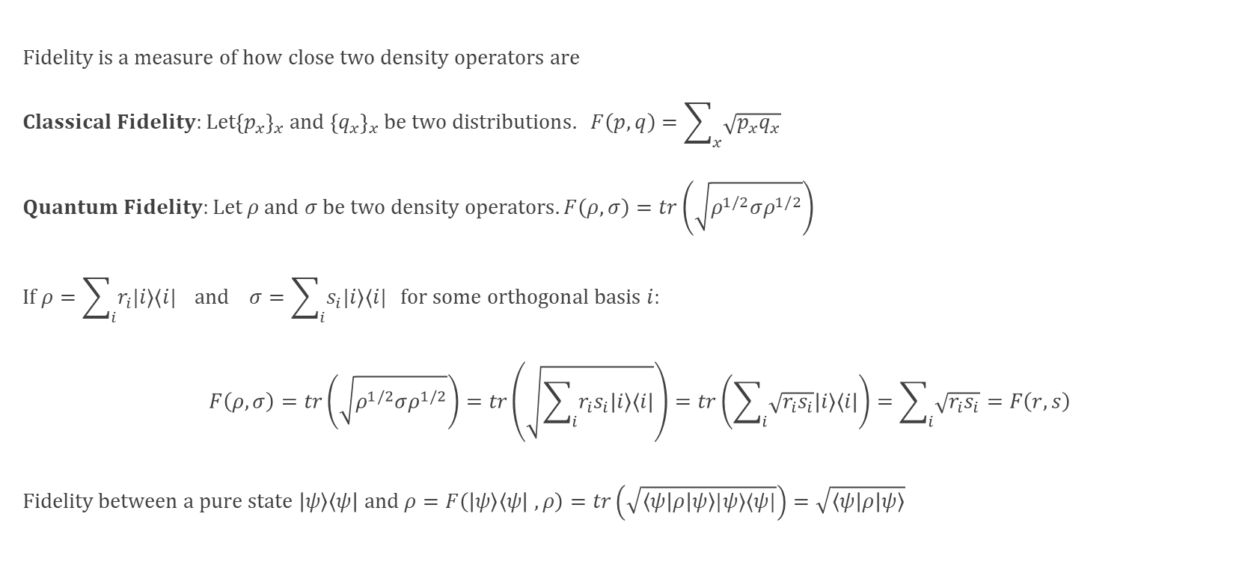
Fidelity
$$Fidelity is a measure of how close two density operators are$$
$$Classical Fidelity:Let{\left\{p_{x}\right\}}_{x} and{ \left\{q_{x}\right\}}_{x} be two distributions. F\left(p,q\right)=\sum_{x}{\sqrt{p_{x}q_{x}}}$$
$$Quantum Fidelity:Let ρ and σ be two density operators.F\left(ρ,σ\right)=tr\left(\sqrt{ρ^{1/2}σρ^{1/2}}\right)$$
$$If ρ=\sum_{i}{r_{i}|i⟩⟨i|} and σ=\sum_{i}{s_{i}|i⟩⟨i|} for some orthogonal basis i:$$
$$F\left(ρ,σ\right)=tr\left(\sqrt{ρ^{1/2}σρ^{1/2}}\right)=tr\left(\sqrt{\sum_{i}{r_{i}s_{i}|i⟩⟨i|}}\right)=tr\left(\sum_{i}{\sqrt{r_{i}s_{i}}|i⟩⟨i|}\right)=\sum_{i}{\sqrt{r_{i}s_{i}}}=F\left(r,s\right)$$
$$Fidelity between a pure state \left|ψ\right\rangle \left\langle ψ\right| and ρ=F\left(\left|ψ\right\rangle \left\langle ψ\right| ,ρ\right)=tr\left(\sqrt{\left\langle ψ | ρ | ψ\right\rangle |ψ⟩⟨ψ|}\right)=\sqrt{\left\langle ψ | ρ | ψ\right\rangle }$$

Slide 31
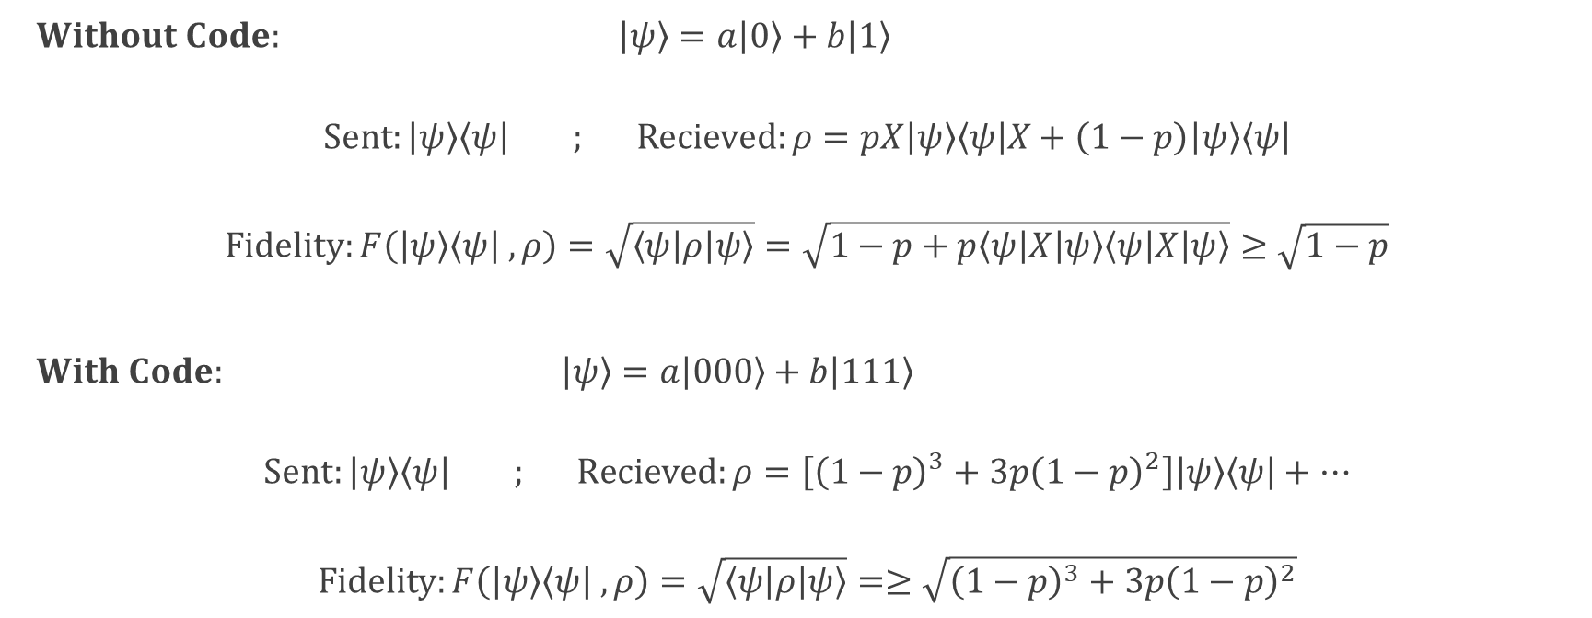
Fidelity Example: 3 Qubit Flip Code
$Without Code: \left|ψ\right\rangle =a\left|0\right\rangle +b\left|1\right\rangle$
$$Sent:\left|ψ\right\rangle \left\langle ψ\right| ; Recieved:ρ=pX\left|ψ\right\rangle \left\langle ψ\right|X+\left(1−p\right)\left|ψ\right\rangle \left\langle ψ\right|$$
$$Fidelity:F\left(\left|ψ\right\rangle \left\langle ψ\right| ,ρ\right)=\sqrt{\left\langle ψ | ρ | ψ\right\rangle }=\sqrt{1−p+p\left\langle ψ | X | ψ\right\rangle \left\langle ψ | X | ψ\right\rangle }≥\sqrt{1−p}$$
$With Code: \left|ψ\right\rangle =a\left|000\right\rangle +b\left|111\right\rangle$
$$Sent:\left|ψ\right\rangle \left\langle ψ\right| ; Recieved:ρ=\left[{\left(1−p\right)}^{3}+3p{\left(1−p\right)}^{2}\right]\left|ψ\right\rangle \left\langle ψ\right|+…$$
$$Fidelity:F\left(\left|ψ\right\rangle \left\langle ψ\right| ,ρ\right)=\sqrt{\left\langle ψ | ρ | ψ\right\rangle }=≥\sqrt{{\left(1−p\right)}^{3}+3p{\left(1−p\right)}^{2}}$$

