Slide 1
C# 6 New Language Features
Joseph Reynolds
http://Infocraft.Net
@iddJoe

Slide 2




Please help us!
Thank our Sponsors:

Slide 3
Remember
Phasers on stun
Bathrooms

Slide 4


Joseph Reynolds
Independent Software Consultant InfoCraft.net
Senior Software Engineer Surge Software (surgeforward.com)
North Houston .Net User Group Board Member, 2011 – present
Microsoft C# MVP 2013 – present
Enjoys reading, role-playing games, and spending time with family.

Slide 5
History of C#
C# Version | Release | .Net Version | Visual Studio | Features
C# 1.0 | 2002 | .Net 1.0/1.1 | VS 2002 | Basic Features
C# 2.0 | 2005 | .Net 2.0 | VS 2005 | Generics Partial Types Anonymous Methods Iterators | Nullable Types Private Setters Delegates Variance Static Classes
C# 3.0 | 2007 | .Net 3.0/3.5 | VS 2008 | Implicit Variable Object Initializer Auto Properties Anonymous Types Extension Methods | Query Methods Lambda Expressions Expression Trees Partial Methods

Slide 6
History of C# - Continued
C# Version | Release | .Net Version | Visual Studio | Features
C# 4.0 | 2010 | .Net 4.0 | VS 2010 | Dynamic (late) Binding Named\optional parameters | Generic Variance Embedded Interop Types
C# 5.0 | 2013 | .Net 4.5 | VS 2012/2013 | Async Features Caller Information
C#6 | 2015 | .Net 4.6 | VS 2015

Slide 7
Before we do any demos…
This is not production code.

Slide 8
C# 6: Overview of New Stuff
CLR – Very Backwards Compatible
String Interpolation
Auto Property Features
Expression Bodied Members
Null Conditional Operators
nameof() operator
Extension Add Methods in Collection Initializers
Using Static and Using Extension Methods
Interesting, I guess…
Exception Filter
await in catch\finally block
Notes:
CLR: I have personally run most of these features as far back as .Net 2 – and really, who wants to go further back than that.

Slide 9
“Using Static” and “Using Extension Methods”
A little strange, to be honest…
using System.Linq;
using static System.Math;
using static System.Linq.Enumerable;
namespace SampleCode
{
public class StaticUsingExample
{
public void MathExample(double x, double y)
{
var pow = Pow(x, y);
var min = Min(x, y);
var range = Range(5, 50);
var evens = range.Where(i => i%2 == 0);
}
}
}
Notes:
Frankly, I think this will be fairly niche. I’m not spending a lot of time on it. If you have ReSharper installed, you’ll discover it pretty quickly, and you’ll figure out when you want to implement it.
Honestly, I think the bigger concern is going to be NOT using it when we SHOULDN’T use it. This seems like the kind of thing that could easily get out of control.
Not my favorite feature.
DEMO:
Good – makes things a little less cluttered
Bad – potential for making bad logic mistakes
POTENTIAL USE:
Industry\App – specific helper classes with static functions
Calculations, initializers, etc.
Engineering apps that have highly specific formulas?

Slide 10
Dictionary Initializers
Makes the syntax for initializing a dictionary more comparable to the syntax of reading a dictionary
Works with all indexer types
OLD
NEW
public static Dictionary<int, string>
GetOldSampleInputDictionary()
{
var sampleFileInput =
new Dictionary<int, string>
{
{1, "String 1"},
{2, "String A"},
{3, "String Foo"}
};
return sampleFileInput;
}
public static Dictionary<int, string>
GetNewSampleInputDictionary()
{
var sampleFileInput =
new Dictionary<int, string>
{
[1] = "String 1",
[2] = "String A",
[3] = "String Foo"
};
return sampleFileInput;
}
Notes:
Not a significant difference – and could ACTUALLY cause issues if not careful.
A bigger advantage is that this syntax also provides the benefit of allowing you to initialize other types. Any type with an indexer will allow initialization via this syntax, where the old collection initializers only works with types that implement IEnumerable<T> and have an Add method. That happened to work with a Dictionary<TKey,TValue>, but that doesn't mean that it worked with any index based type. (http://stackoverflow.com/a/28076372)

Slide 11
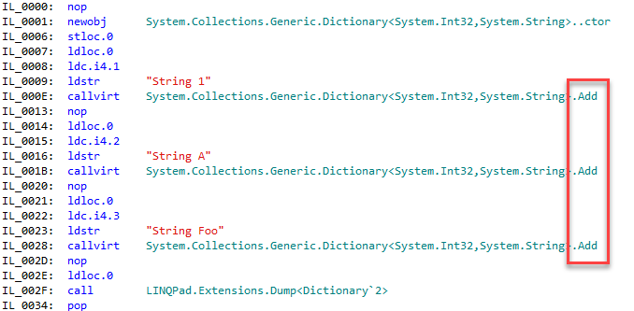
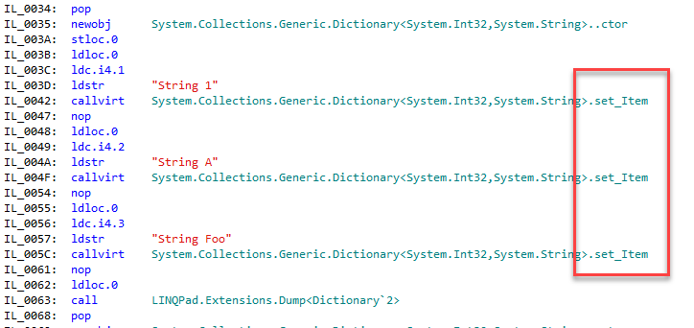
Collection Initializer in IL
OLD
NEW
Notes:
“set_Item” is significantly different from Add!

Slide 12
nameof() operator
Pretty nifty – particularly for notification-type situations.
private string _searchText;
public string SearchText
{
get { return _searchText; }
set
{
_searchText = value;
NotifyChanged("SearchText");
}
}
public string FirstName
{
get { return _firstName; }
set
{
_firstName = value;
NotifyPropertyChanged(nameof(FirstName));
}
}

Slide 13
Null Conditional – The Elvis Operator
Gets rid of some nasty looking code…
public void OldNullChecking(InvoiceListDataViewModel currentInvoice)
{
var someProxy = new SomeProxy();
var response = someProxy.SomeMethod();
if (response != null
&& response.Result != null
&& response.Result.Success == SuccessCode.Success)
{
Console.WriteLine("Yay!");
}
}
Notes:
http://geekswithblogs.net/BlackRabbitCoder/archive/2015/06/05/c.net-little-wonders-null-conditional-operator-in-c-6.aspx

Slide 14
Null Conditionals – Part 2
public void UsingNullConditionals(InvoiceListDataViewModel currentInvoice)
{
var someProxy = new SomeProxy();
var response = someProxy.SomeMethod();
if (response?.Result?.Success == SuccessCode.Success)
{
Console.WriteLine("Yay!");
}
}
Notes:
Yeah, I know we’re not really protecting against nulls yet…
If the CurrentInvoice IS null, it’s going to insert “NULL” in each of those places.

Slide 15
Null Conditionals – Part 3 (What if it’s null?)
Caution: If the expression evaluates to null – you may end up with an unexpected result.
var someClass = new SomeClass();
var result = someClass?.SomeString?.ToUpper();
result.Dump("Result");
> null
var result2 = someClass?.SomeString?.ToUpper() ?? "Something was null";
result2.Dump("Result2");
> Something was null
Notes:
Be careful traversing lots of things to pull a value out of the end – where did the null happen?

Slide 16
Expression Bodied Members
Nice for one-line methods and properties.
Can be very confusing if you try to force it everywhere.
public int GetPageCountStandardMethodBody(string pdfFile)
{
return PdfReader.Open(pdfFile).PageCount;
}
public int GetPageCountExpressionBody(string pdfFile)
=> PdfReader.Open(pdfFile).PageCount;
Notes:
My recommendation – use for quick calculations, short things, delegates… Not for anything longer than about 3 lines.
There’s exceptions to every rule of course… But makes sure they’re the exception, not the rule.

Slide 17
Expression Body Quick Facts
Works with Method-Like members
Works with Property-Like members
Does NOT work on Constructors
Does NOT work on Events
Recommendation: use sparingly, but don’t be afraid of it.

Slide 18
Auto Property Features
One of my two favorite new features…
public class Person
{
public Guid PersonId { get; set; }
public string FirstName { get; set; }
public string LastName { get; set; }
}
public class PersonWithAutoPropInitializer
{
public Guid PersonId { get; set; } = Guid.NewGuid();
public string FirstName { get; set; }
public string LastName { get; set; }
}

Slide 19
Auto Properties Part 2
Removes a bunch of plumbing which is nice…
Also makes immutability easier
public class PersonWithAutoPropInitializer
{
public Guid PersonId { get; } = Guid.NewGuid();
public string FirstName { get; set; }
public string LastName { get; set; }
}

Slide 20
Auto Properties Part 3
Also, read-only getters…
public class CustomerImmutabilitySample
{
public string Name { get; }
public CustomerImmutabilitySample(string first, string last)
{
Name = first + " " + last;
}
}

Slide 21
String Interpolation
Easily my favorite new feature.
Not a huge, life-changing deal…
But makes life much nicer
Notes:
private void SetSoapBody()
{
BaseServiceCall.SoapBody = string.Format(@"<soap:Body>
<GetCustomerLegalName xmlns=""http://www.infocraft.net"">
<custNo>{0}</custNo>
</GetCustomerLegalName>
</soap:Body>", CustomerNumber);
}

Slide 22
String Interpolation
Instead of string.Format(“{0}{1}{2}”,thing1,thing2,thing3};
Use: $”{thing1} {thing2} {thing3}”;
var line1 = string.Format("Person ID: {0}", person.PersonId.ToString());
var line2 = string.Format("Name: {0} {1}", person.FirstName, person.LastName);
Console.WriteLine(line1);
Console.WriteLine(line2);
Console.WriteLine($"New Person ID: {person.PersonId}");
Console.WriteLine($"New Name: {person.FirstName} {person.LastName}");

Slide 23
String Interpolation
Imagine this, only with about 20-30 fields being concatenated in…
public string YuckyStuff()
{
return string.Format(@"<soap:Body>
<GetCustomerLegalName xmlns=""http://www.infocraft.net"">
<custNo>{0}</custNo>
</GetCustomerLegalName>
</soap:Body>", custno);
}

Slide 24
String Interpolation
At least this is readable…
public string BetterStuff()
{
return
$"<soap:Body>\r\n" +
$"<GetCustomerLegalName xmlns=\"http://www.infocraft.net\">\r\n" +
$"<custNo>{custno}</custNo>\r\n" +
$"</GetCustomerLegalName>\r\n" +
$"</soap:Body>";
}
Notes:
It’s debatable how readable XML is EVER going to be… But still…

Slide 25
C# 6: Summary
AWESOME | Kinda interesting in small doses
String Interpolation | Await in catch\finally
Auto Property Updates | Exception Filters
Null Conditionals | Using Statics
Expression Bodied Members | Collection initializer changes
Nameof Operator
Notes:
CLR: I have personally run most of these features as far back as .Net 2 – and really, who wants to go further back than that.

Slide 26

Please complete an evaluation form

Slide 27
More Information
Roslyn Wiki https://github.com/dotnet/roslyn/wiki/New-Language-Features-in-C%23-6
InfoCraft New Features Blog Series http://www.infocraft.net/tag/new-features/
GitHub site for this presentation https://github.com/jmreynolds/CSharp-6-New-Language-Features http://jmreynolds.github.io/CSharp-6-New-Language-Features/
Interested in a great job? http://www.surgeforward.com/careers/

