Slide 1
Manufacturing Downtime Analysis
Dashboard
Developed in Microsoft Power BI
Presented by: InfoVerse Team
Mohammed AlMukadam
Al-Hussein AlAttar
Youssif Ali
Youssef Ezzat
Mina Ayad
November 12, 2025

Slide 2
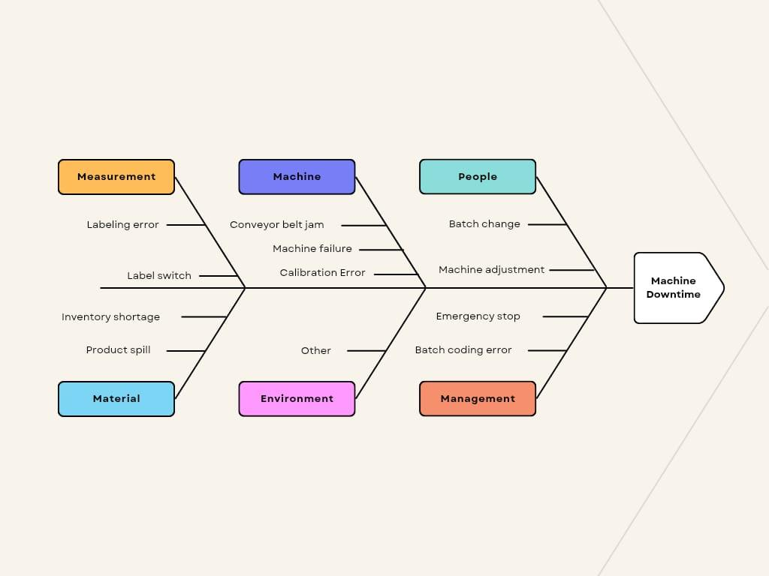
Business Problem
Main Downtime Categories:
Measurement: Labeling errors, calibration issues.
Machine: Conveyor jams, equipment failure.
People: Manual errors, emergency stops.
Material: Shortages, product spills.
Environment: Humidity, temperature.
Management: Process or coordination gaps.

Slide 3





Business Questions – Overview Analysis
Objective:
Understand overall production performance, downtime impact, and key efficiency drivers.
Key Questions:
How efficiently is the production line operating overall?
What portion of total production time is lost to downtime? Which products or factors contribute most to downtime? How does downtime trend over time or by hour of the day?
Are there patterns indicating when or where production is most efficient?

Slide 4





Business Questions - Batch Analysis
Objective: Evaluate batch-level productivity and identify variations or inefficiencies affecting production consistency.
Are batches being completed within expected target times?
Which batches take the longest or shortest time to produce, and why? What downtime causes appear most frequently across batches?
How strong is the relationship between total batch time and downtime? Which products or operators are linked to slower batch performance?

Slide 5



Business Questions – Operator Analysis
Objective: Assess operator performance, identify training needs, and analyze downtime related to human or shift-based factors.
Which operators are the most and least efficient?
How much downtime is linked to operator errors or manual intervention?
What are the top downtime causes across operators?
How does performance vary across different shifts?
Are certain operators more efficient with specific products or time periods?

Slide 6

Power BI Dashboard

Slide 7
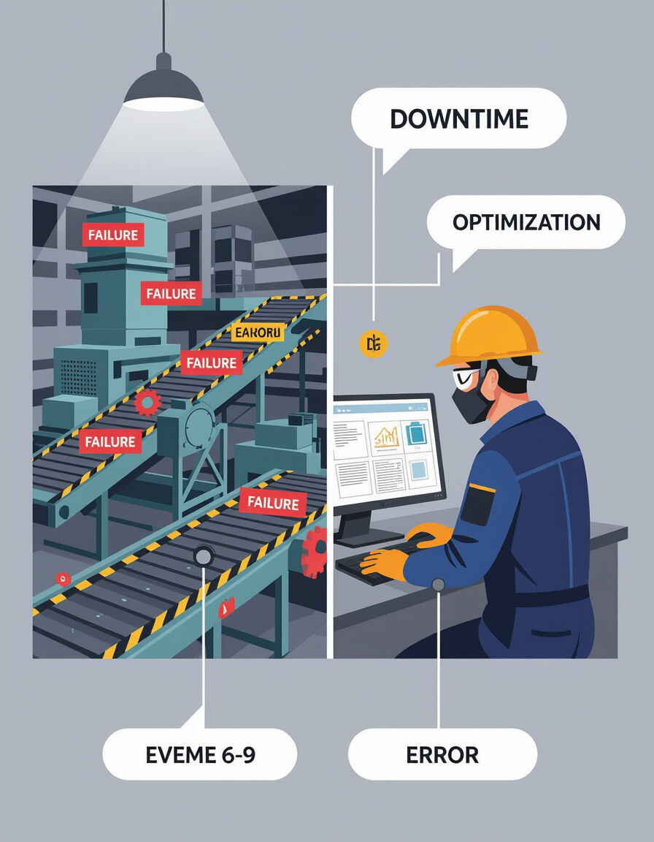




Executive Overview
This Power BI dashboard analyzes production efficiency, downtime causes, and operator performance. Key findings:
Mechanical failures and operator errors are primary downtime drivers.
Shift and batch analysis reveals efficiency variations.
Data-driven optimizations can improve efficiency by 5–10%.
Overall Efficiency
Total Downtime
64.02%
23h 08m
Target Achievement
Avg. Downtime
7.89%
23 min

Slide 8
Dataset Overview
Project Scope: Manufacturing line efficiency, downtime patterns, and operator performance analysis.
Model Structure: Star Schema centered around two fact tables connected to five-dimension tables.
Fact Tables (Transactional Data)
factLineProductivity:
Purpose: The primary table measuring production events and efficiency.
Key Columns: Batch (ID), Duration (Min) (calculated production time), StartDateTime, EndDateTime, ProductID, OperatorID.
factLineDowntime
Purpose: Captures specific machine stoppage incidents and durations.
Key Columns: DowntimeMinutes (duration of stop), DowntimeFactorID (reason code), Batch (link to production).
Dimension Tables (Descriptive Context)
dimProducts:
Context: Product master data.
Key Columns: Flavor, Size(ml), BatchTime (Min) (Target time used for KPI calculations).
dimDowntimeFactors:
Context: Categorization of stop reasons.
Key Columns: Description (e.g., "Machine Failure"), OperatorError (Flag: Yes/No).
dimOperatorName:
Context: Workforce identification.
Key Columns: Operator (Name), OperatorID.
dimDate & TimeTable
Context: Temporal analysis.
Key Columns: Year, Month, Shift Time (Calculated: Day Shift vs. Night Shift), Hour.

Slide 9
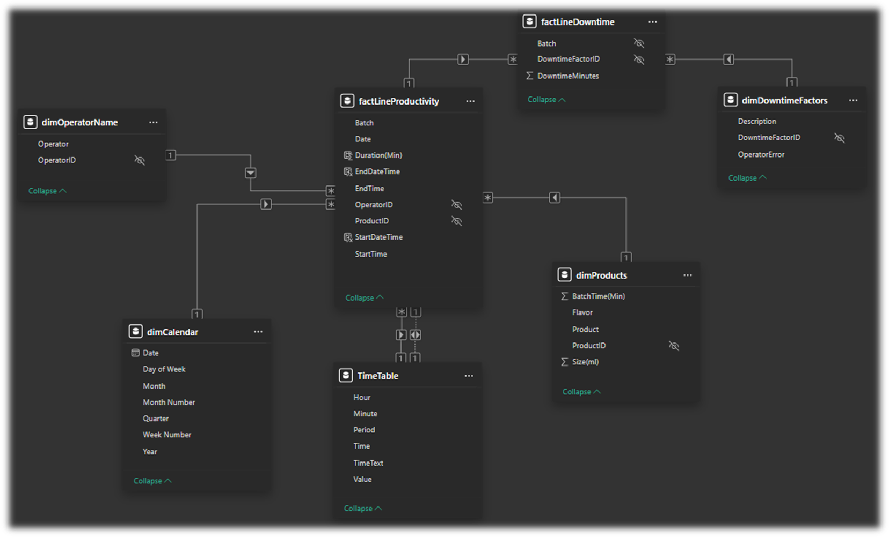
Data Model Architecture
This star schema model connects fact tables for production and downtime with dimensio
n tables for operators, products, time, and downtime factors. The model enables cross-sectional analysis by shift, product, and downtime category, providing flexibility for business insights.
Manufacturing Downtime Analysis Dashboard

Slide 10










Approach and Methodology
1
2
3
4
5
Data Acquisition
Consolidate production and downtime logs from Excel.
Data Transformation
Clean, standardize, and validate in Power Query.
Data Modeling
Build relational star schema in Power BI.
DAX Development
Define KPIs for downtime, productivity, and efficiency.
Visualization
Design interactive dashboard for management review.

Slide 11






Critical Performance Metrics
Overall Production Efficiency
64.02%
Significant improvement opportunity
21% below industry standard (80%~90%)
Total Downtime
23h 08m
36% of total production time
12% increase from previous period
Batch Target Achievement
7.89%
Of batches meeting targets
Below target of 25%
Average Downtime
23 min
Per production cycle
No change from previous period
Manufacturing Downtime Analysis Dashboard

Slide 12





Primary Downtime Drivers
Machine Adjustment
Machine Failure
#1
Top contributing factor
254
Recorded incidents
Highest impact on production
Second highest contributing factor
Inventory Shortage
Operator Errors
225
Material delay incidents
44.09%
Of total downtime
Third highest contributor
Significant training opportunity
Manufacturing Downtime Analysis Dashboard

Slide 13


Product & Temporal Insights
Product Downtime
Day of Week Pattern
Critical Hours
~450 min
CO-600 recorded highest total downtime
Monday
Peak downtime day across the week
10–15
Hours showing significant downtime spikes

Slide 14



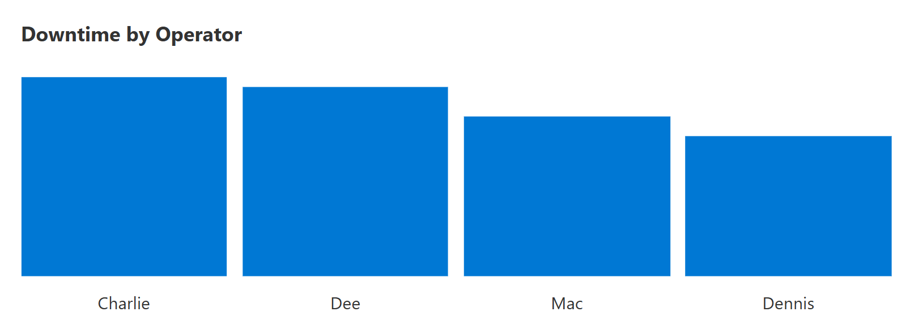
Operator Performance Gaps
Highest Operator Downtime
6h 24m
Charlie - Well above average
Critical performance gap
Operator Variation
44.09%
Of downtime linked to operator errors
Indicates training and supervision needs
Manufacturing Downtime Analysis Dashboard

Slide 15

Dashboard Highlights
Overview Page
Key KPIs, total downtime trends, and overall production efficiency metrics.
Visualizes critical performance indicators and efficiency losses across time periods.
Batch Analysis Page
Variations in batch processing times and target achievement rates.
Identifies specific batches with longest production cycles and associated downtime causes.
Operator Analysis Page
Shift-level and individual operator performance insights.
Highlights training needs and performance variations across different operators and shifts.

Slide 16



Key Takeaways
Significant efficiency losses due to machine and operator factors.
Concentrated issues in specific time periods and product lines.
Real-time visibility enables targeted maintenance, training, and scheduling improvements.
Immediate opportunities to boost operational performance.
Manufacturing Downtime Analysis Dashboard

Slide 17
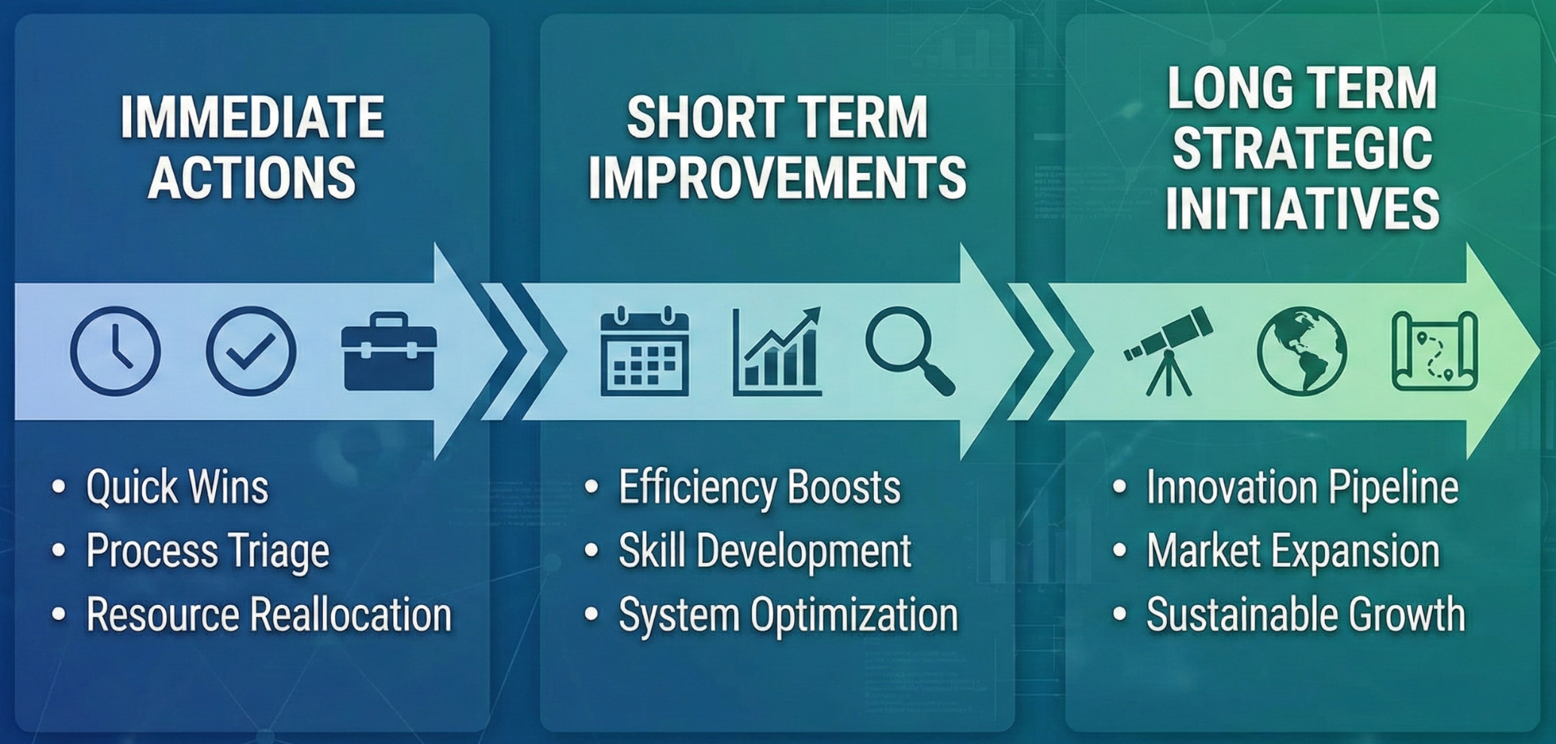
Recommendations
0-30 days
Immediate Actions
3-12 months
Long-Term Strategic Initiatives
Implement preventive maintenance for top 3 high- downtime machines
Invest in predictive maintenance technologies
Redesign batch processes to raise target achievement rates
Conduct a root-cause analysis of the CO-600 production line
Implement shift-specific performance optimization programs
Review and update SOPs for machine adjustment processes
1-3 months
Short-Term Improvements
Launch operator training programs focused on error reduction
Optimize inventory management systems to reduce material delays
Deploy real-time monitoring alerts for critical downtime events

Slide 18




Expected Impact
Estimated Efficiency Improvement
Potential Downtime Reduction
Target Batch Achievement Rate
5-10%
Increase in overall production efficiency
20-30%
Decrease in total production downtime
>25%
Of batches meeting target timeframes
From current baseline of 64.02%
From current 23h 08m total downtime
From current rate of 7.89%
Business Impact Summary
Higher productivity across production lines
Lower maintenance costs through preventive strategies Enhanced production reliability across all shifts Improved operator performance and satisfaction

Slide 19
Next Steps
1
Present findings to production and maintenance management teams.
2
Begin pilot implementation of preventive maintenance actions.
3
Integrate dashboard with real-time data sources for live monitoring.
4
Expand Power BI reporting to include cost and profitability analysis.
5
Schedule quarterly reviews to track performance progress and KPI trends.

Slide 20


Conclusion
Project Repo
The Manufacturing Downtime Analysis Dashboard empowers management with data-backed visibility into production inefficiencies.
Through predictive insights, process automation, and continuous monitoring, the project establishes a foundation for smarter manufacturing operations.
The dashboard creates leaner and more resilient production processes by enabling data-driven decision making.

Slide 21
Thank you

