Slide 1

Sales Dashboard for business stakeholders
Anirban Kar
25/04/2025

Slide 2
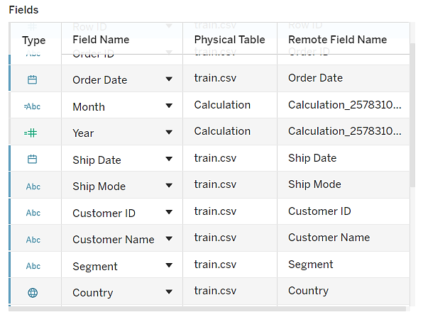
Dataset Overview
Dataset Name: train.csv
Source: Uploaded from “Superstore Sales Dataset” from Kaggle.
Rows: 9800.
Fields: Order Date, Sales, Category, Region, Customer, etc.
Goal: Analyze sales performance & provide insights for stakeholders

Slide 3
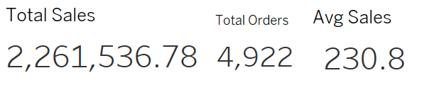
KPIs Tracked
💰 Total Sales
📦 Total Orders
📈 Average Sales per Order
“These KPIs provide a quick overview of business performance.”

Slide 4
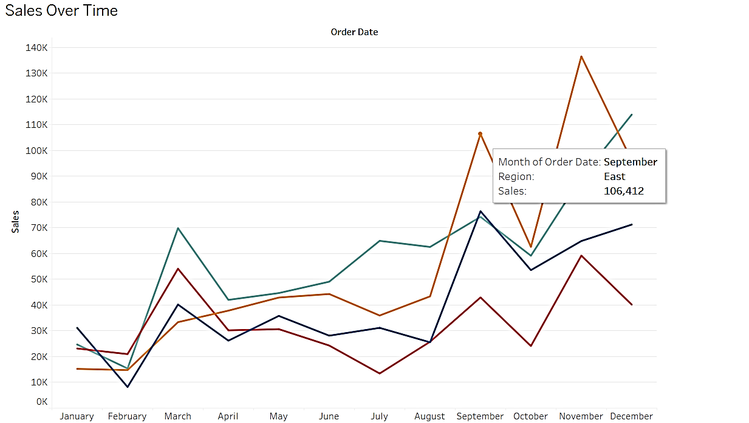
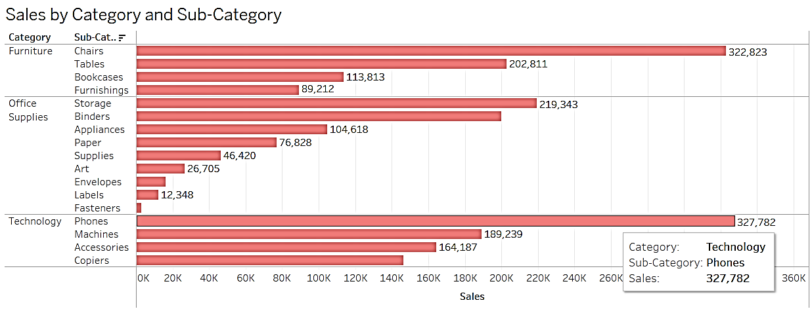
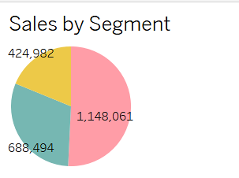
Key Visualizations
Line Chart: Sales trend over time.
Bar Chart: Sales by Category & Sub-Category.
Highlight Table: Sales by State.
Pie Chart: Segment-wise sales distribution.

Slide 5
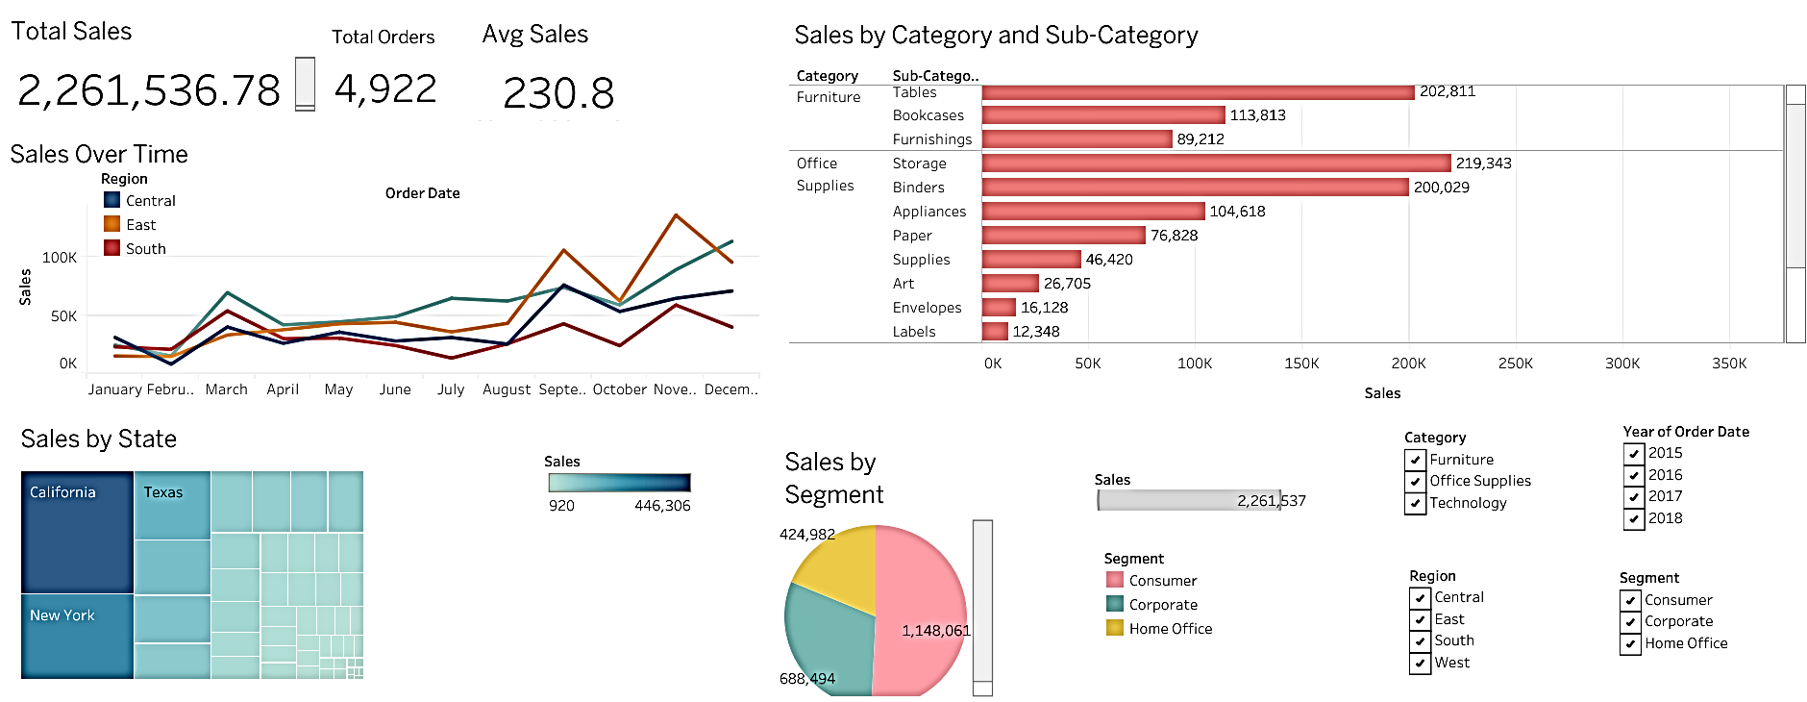
Dashboard Interactivity
✅ Filters: Category, Region, Segment, Date
✅ Tooltips: Show product/category level details
✅ Dynamic titles based on selections
✅ Clean layout and consistent color theme

Slide 6
Insights & Observations
The Office Supplies category had the highest order volume but the lowest average sales.
The West region consistently leads in sales across most months.
The corporate segment has higher average order values than the Consumer.

Slide 7
Tech Used & Submission
Tool: Tableau Desktop
Repo: https://github.com/Infoanirban12/Task-4-Sales-Dashboard-Tableau-Project-/blob/main/README.md
Files Included:
train.csv
Tableau Dashboard (.twbx)
Screenshots
README.md
This PPT
THANK YOU

