Slide 1
Generative Pre-trained Transformer 3
GPT-3
BY: Sachit Upreti (91900103094)
Suman Jha (91900103127)
Yog Raj Dhakal (91900103097)
Sangram Roka Chettri (91900103120)

Slide 2
Introduction
What is GPT3?
Generative Pre-trained Transformer 3 is an autoregressive language model that uses deep learning to produce human-like text. It is the third-generation language prediction model in the GPT-n series created by OpenAI, a San Francisco-based artificial intelligence research laboratory.

Slide 3
What we know
GPT-3, or the third generation Generative Pre-trained Transformer, is a neural network machine learning model trained using internet data to generate any type of text. Developed by OpenAI, it requires a small amount of input text to generate large volumes of relevant and sophisticated machine-generated text.
GPT-3's deep learning neural network is a model with over 175 billion machine learning parameters. To put things into scale, the largest trained language model before GPT-3 was Microsoft's Turing NLG model, which had 10 billion parameters As a result, GPT-3 is better than any prior model for producing text that is convincing enough to seem like a human could have written it.

Slide 4
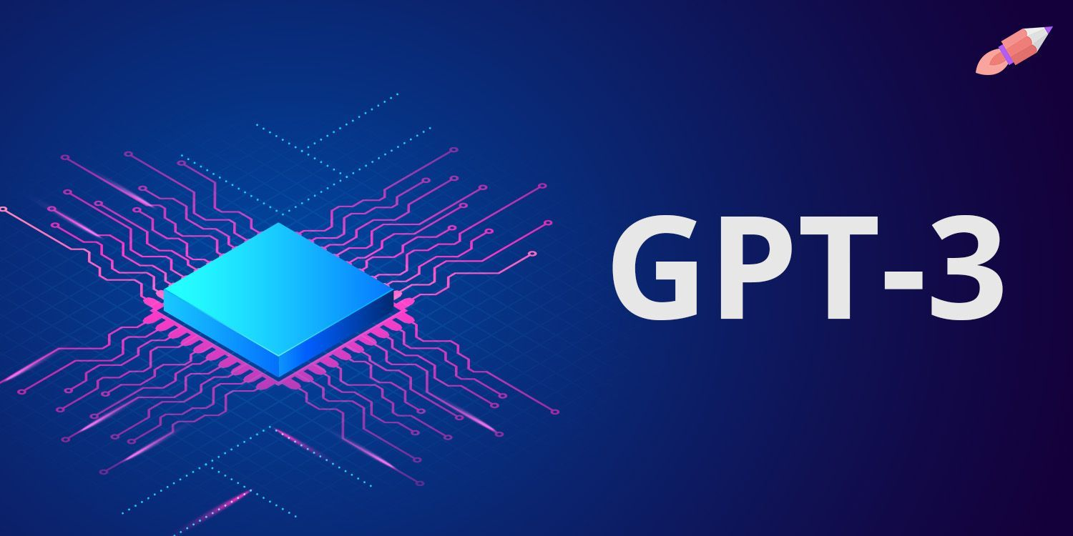
What can GPT-3 do?
Generating human language natural text. Using text on the internet, GPT-3 is trained to generate realistic human text.
GPT-3 has been used to create articles, poetry, stories, news reports and dialogue using just a small amount of input text that can be used to produce large amounts of quality copy.
GPT-3 is also being used for automated conversational tasks, responding to any text that a person types into the computer with a new piece of text appropriate to the context.
It can also automatically generate text summarizations and even programming code.

Slide 5
How does GPT-3 work!!!
GPT-3 has 175 billion learning parameters that allow it to perform almost any task assigned to it, making it larger than the second most effective language model, Microsoft Corp.'s Turing- NLG algorithm, which has 17 billion parameters for learning.

Slide 6
How does GPT-3 work!!!
When a user provides text input, the system analyzes the language and uses a text predictor to create the most likely output. Even without much additional tuning or training, the model generates high-quality output text that feels similar to what humans would produce.

Slide 7
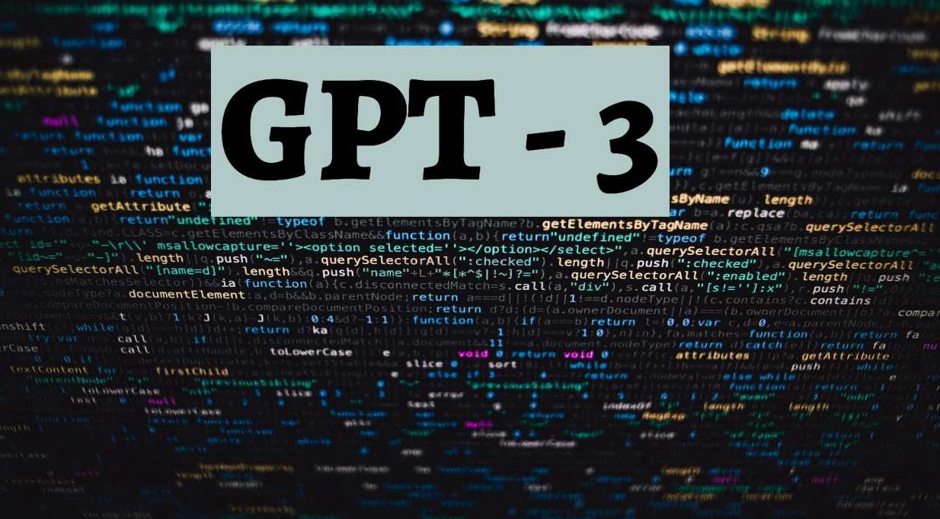
What are the benefits of GPT-3?
Whenever a large amount of text needs to be generated from a machine based on some small amount of text input, GPT-3 provides a good solution.
There are many situations where it's not practical or efficient to have a human on hand to generate text output, or there might be a need for automatic text generation that seems human.
For example, customer service centers can use GPT-3 to answer customer questions or support chatbots; sales teams can use it to connect with potential customers; and marketing teams can write copy using GPT-3.

Slide 8
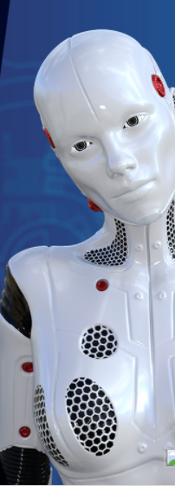
Predecessor GPT-2
OpenAI reported its observations and tests in February 2019 on their unsupervised language model, GPT-2, which was trained in 40Gb texts and was able to predict words in close proximity.
GPT-2, a language based on transformers applied to self-attention, allowed researchers to produce very persuasive and coherent texts.
The program, which is a common-purpose language algorithm, used machine learning to translate text, answer questions and write text predicatively

Slide 9
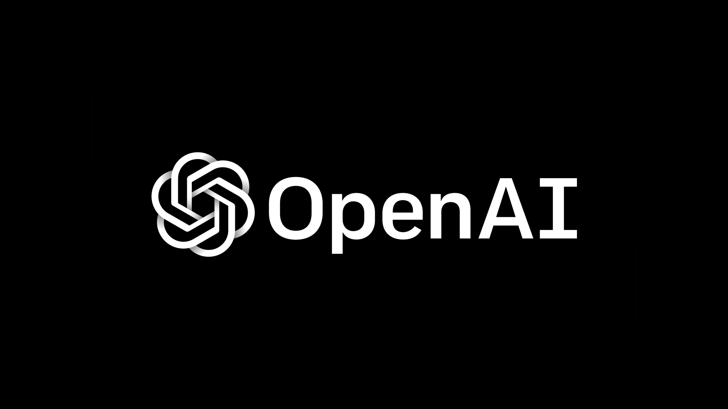
Why Is GPT-3 Such A Big Deal?
As people are still wondering why GPT-3 is so hyped, the response is simple- it is the largest model that has been educated. The 175 learning parameters outweigh any previous non-sparse language model by 10 times.
GPT-3 is used for all tasks without the need for gradient changes or fine tuning. It just takes a few-shot demonstrations of the model through textual interaction.

Slide 10
Application
Rightly answer trivia questions
Predict the final word of sentences by knowing the paragraph's meaning
For a story pick the best ending out of many
Translate modern languages, which GPT-2 initially found difficult
Using reasoning which involves common sense
Perform with precision 5 optical arithmetics
Write news articles with human nature from a title

Slide 11
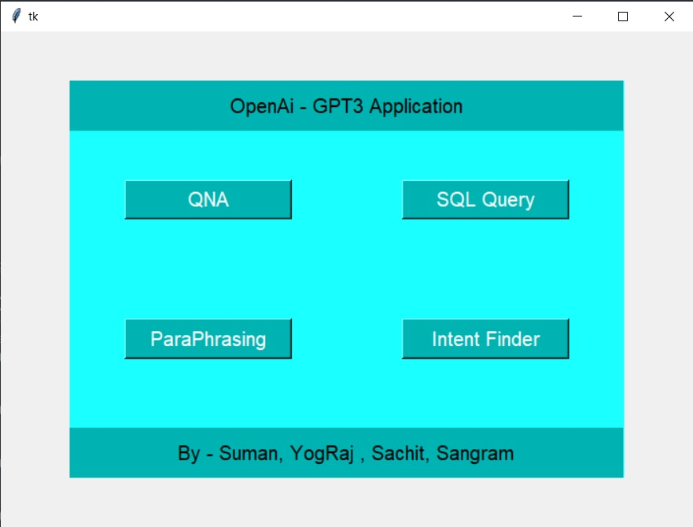
Demo

Slide 12
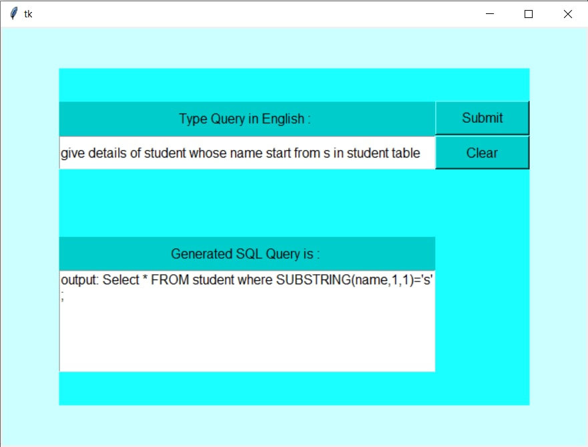
Demo

Slide 13
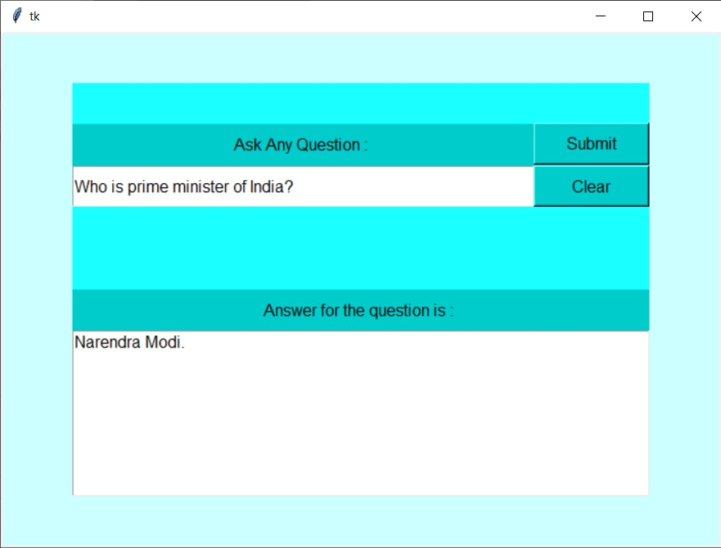
Demo

Slide 14
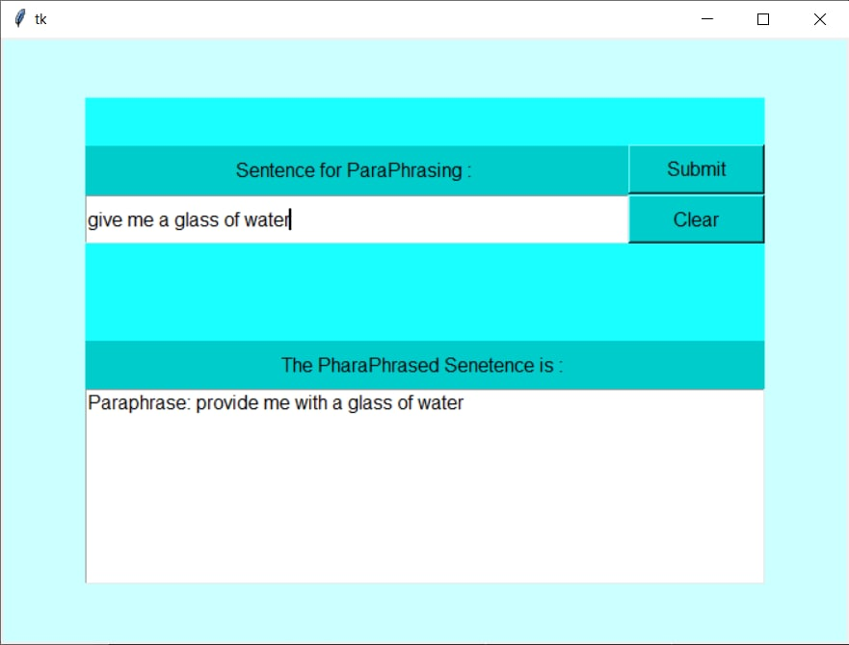
Demo

Slide 15
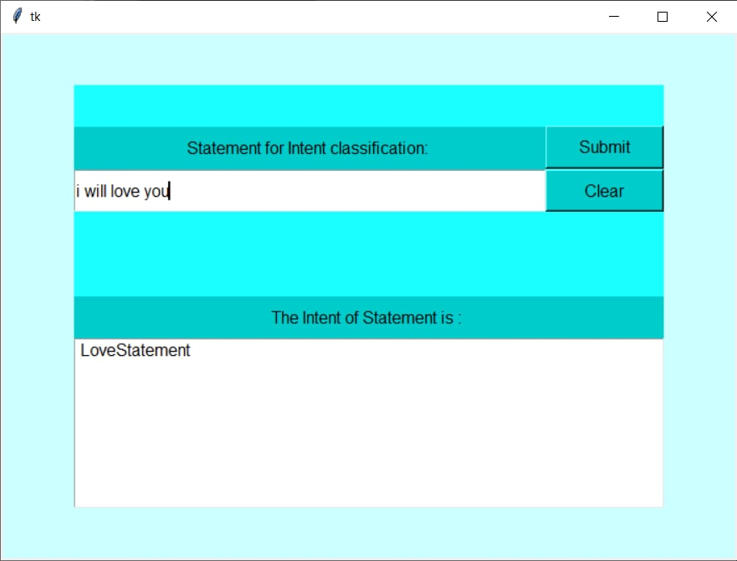
Demo

Slide 16
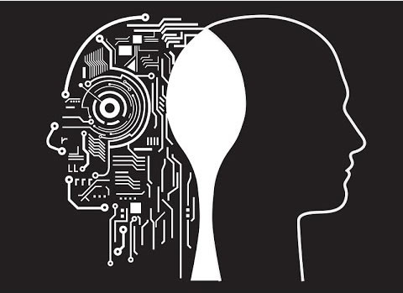
Future of GPT-3
OpenAI and others are working on even more powerful and large models. There are a number of open source efforts in play to provide a free and non-licensed model as a counterweight to the Microsoft exclusive ownership. OpenAI is planning larger and more domain-specific versions of its models trained on different and more diverse kinds of texts. Others are looking at different use cases and applications of the GPT-3 model. However, Microsoft's exclusive license poses challenges for those looking to embed the capabilities in their applications.

Slide 17
Conclusion
The new version of their GPT-3 natural language processing platform is only available in private beta, and OpenAI only offers access to its API on invitation.
A long waiting list exists for the paid version, which is scheduled to be released in the next two months.

Slide 18
Reference
Open AI
GeeksforGeeks
Tkinter documentation
Github

Slide 19
Thank You

