Slide 1
Enterprise Data Catalog: Update Custom attributes for Tables from Excel
^{Darren Wrigley} ^{Senior Product Specialist}

Slide 2
Current Problem
Excel templates are used to define properties for database objects (tables, columns)
See example: Dataset Definition Portfolio Reference - Historical Reference.xlsx
EDC currently only allows export to excel at the resource level – not a for a single table (or multiple) and it’s children elements (columns)
Exported file can be very large – when thousands of tables are stored
Ideally – read the excel files directly (assuming using the same structure) and update the catalog where needed

Slide 3
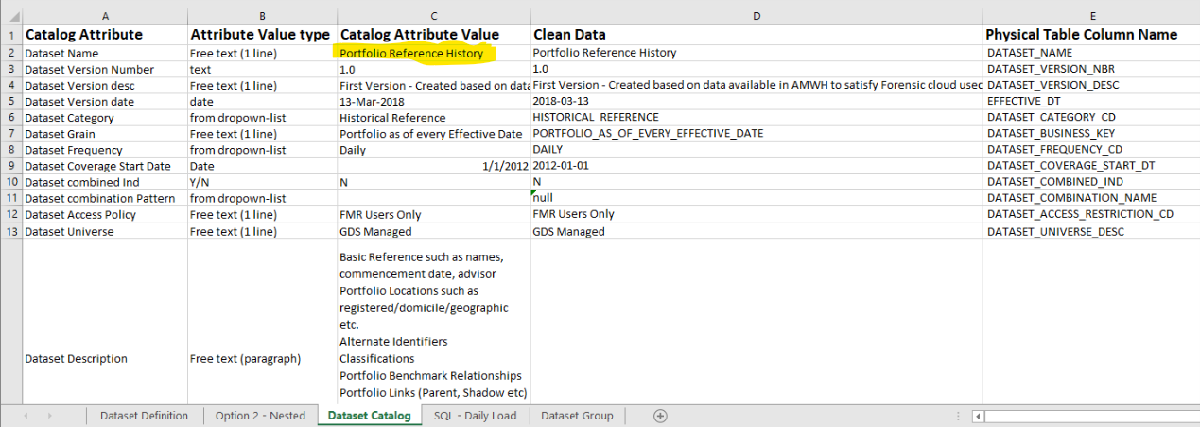
Sample File: ‘Dataset Catalog’ worksheet
Attribute Names: ‘Catalog Attribute’ column: A2-An
Attribute Values: ‘Catalog Attribute Value’ column: C2-Cn
Assumption: ‘Portfolio Reference History’ the table name here? The catalog has is a table named: portfolio_reference_history – assume replace “ “ with _
?

Slide 4
Proposed Process: Dataset Catalog Worksheet
Connect to the Catalog – and get a list of all custom attributes (need id & label) - GET/access/2/catalog/models/attributes
For each *.xlsx file – in a specified folder
Read the excel file: open the ‘Dataset Catalog’ worksheet
Extract all of the properties from columns A & C
Lookup the object in the catalog GET /access/2/catalog/data/objects q=+core.classType:com.infa.ldm.relational.Table +core.name:Portfolio_Reference_History
If exactly 1 item found (error if 0 or > 1)
For each attribute collected from excel (row in ‘Catalog Attribute’ column)
Validate that the attribute exists in the model
If attribute is valid but empty: prepare to add new attribute content
If attribute value already exists & incoming value is different, prepare to replace attribute content
If update is needed
Update the object in the catalog PUT /access/2/catalog/data/objects/<object href>

Slide 5
Sample Script: importDataSetAttributes_fromExcel.py
Edit script – set values for
#--------------- settings start here -------------------------
excelFolder="."
excelWorksheet="Dataset Catalog"
catalogServer='http://napslxapp01:9085'
uid='Administrator'
pwd='<password>'
# if your catalog server uses https - get the certificate as a .cer or .pem and reference here
# default uses the cert from the current folder
sslCert="psrl65dsg018_base64.pem"
#--------------- settings end here -------------------------
Run from windows/linux/mac
Note: mainly tested with python 3.6+, works with 2.7 but ‘legacy’ python not heavily tested
If pwd is set to “<prompt>” - the user will be prompted to enter on the console

Slide 6
Example: excel spreadsheet (again)

Slide 7
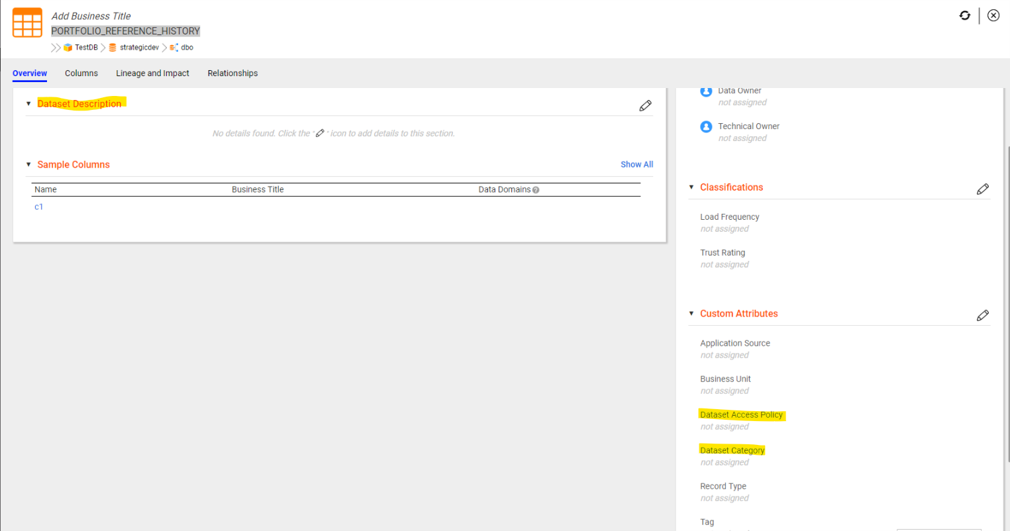
Example: PORTFOLIO_REFERENCE_HISTORY - before

Slide 8
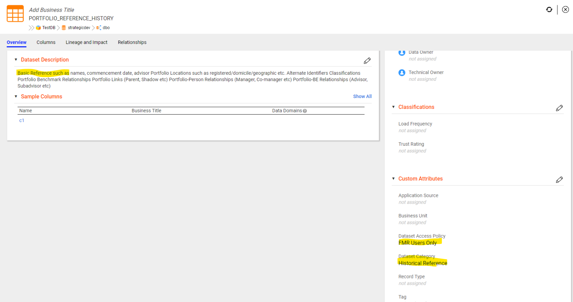
Example: PORTFOLIO_REFERENCE_HISTORY - after

Slide 9
Download the Files
import_DataSetAttribites_fromExcel_example.zip
Contains the following files
importDataSetAttributes_fromExcel.py (the sample script referenced in this presentation)
edcutils.py (some helper methods – from https://github.com/Informatica-EIC/REST-API-Samples )
Dataset Definition Portfolio Reference - Historical Reference.xlsx (the example file)
To Download
https://tinyurl.com/edcExcelImport-example (Note: this link is no longer valid – use github) https://github.com/Informatica-EIC/REST-API-Samples/blob/master/python/excel/import_DataSetAttribites_fromExcel_example.zip?raw=true
Recorded video link: https://www.youtube.com/watch?v=ztiJZEKNufI
or from linux/mac wget https://github.com/Informatica-EIC/REST-API-Samples/blob/master/python/excel/import_DataSetAttribites_fromExcel_example.zip?raw=true
Unzip, modify importDataSetAttributes_fromExcel.py setting catalog service, userid & sslCert (if needed)
Run:
python3 importDataSetAttributes_fromExcel.py

Slide 10
Python config notes
Required packages:
requests & openpyxl
Virtual environments are best here
Update pip and install virtualenv (via sudo)
sudo pip install --upgrade pip
sudo pip install virtualenv
Create a virtual environment (isolates the dependent libraries – cannot affect other environments) from any folder:-
virtualenv edcPython
source edcPython/bin/activate
pip install openpyxl
pip install requests

Slide 11
Other Notes
Settings for catalog url & user id are hard-coded, not passed as parameters (out of scope)
Only the attributes that are created in the catalog will be written, others skipped until they are created
No attempt has been made to format any attributes
examples
newlines in rich-text attributes
Any date formats
No datatype enforcement
This can all be done – but would be up to whoever implements (out of scope for this example)
Error checking is minimal – enough to show the concept. Any errors on rest calls will be printed to the console
E.g. if connection settings (id, pwd) are wrong – you will see the following message error! 401{'code': 401, 'message': 'Authentication failed. Make sure that the password is correct or the username exists in the security domain.'}

Slide 12


Thank You
Darren Wrigley
dwrigley@informatica.com

