Slide 1
2024/08/16

Slide 2
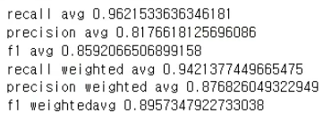
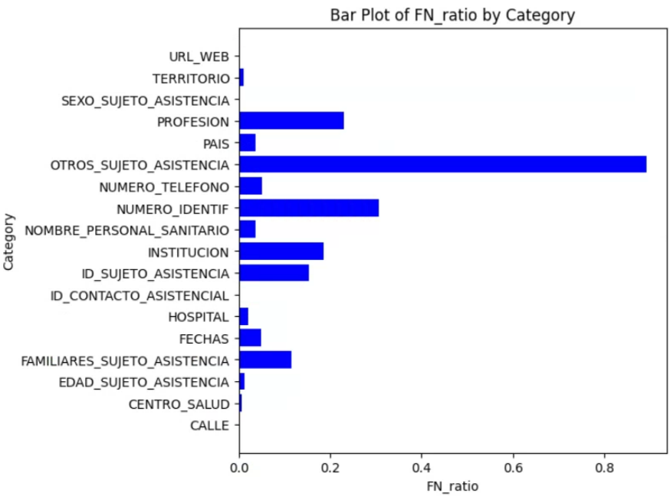
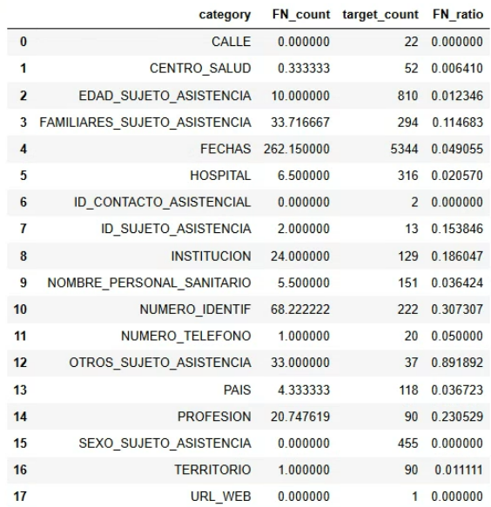
Ran the entire process using the complete CARMEN dataset
Notes:
OTROS_SUJETO_ASISTENCIA
NUMERO_IDENTIF

Slide 3
False negative - OTROS_SUJETO_ASISTENCIA
Perhaps because there was no instruction related to anonymizing “EMRs”, “pharmacy records”, etc in teh prompt?

Slide 4
False negative - NUMERO_IDENTIF
There was intruction in the prompt related to anonymizing identification numbers

Slide 5








False positives
GPT was not able to fully avoid anonymizing common nouns, general terms, durations, etc
(PPT last weak) Gave more instructions in the prompt
Anonymize only the specific element:
For example,
Dates (e.g., in "Fecha frotis SARS-Cov2: 12/11/2024," only anonymize "12/11/2024" as "[**12/11/2024**]", not the surrounding text).
Place names (e.g., in "Natural de la región de Samara (Rusia)," anonymize as "Natural de la región de [**Samara**] ([**Rusia**])," not the entire phrase).
Do not anonymize the following:
Common nouns (e.g., "pacient" (patient), "trucada" (call))
Medical and anatomical terms (e.g., "amigdalas" (tonsils), "epicóndilo" (epicondyle), "corazón" (heart), "fémur" (femur), "diabetes"))
General terms that are not unique identifiers (e.g., "doctor" unless followed by a name, "hospital" unless it is a specific named hospital)
Durations and time frames (e.g., "hace 30 años" when referring to a time period, not the age of a person)

