Slide 1
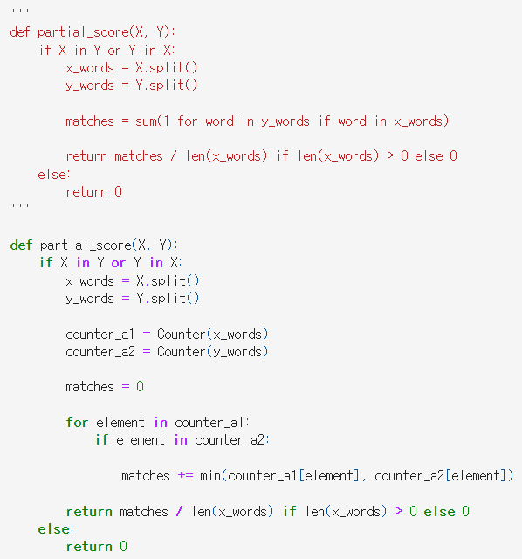
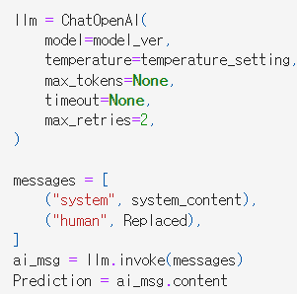
Changed to langchain
Minor adjustment to the partial_score
Example)
Ground truth
[**20/7/2024**] 20:30:00
Partial score
Sensitivity (before): 1.33
Sensitivity (after): 1.0
Prediction
[**20/7/2024 20:30:00**]

Slide 2
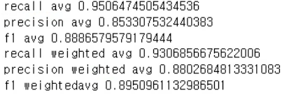
The results were similar to the last time.
i’ve also calculated the Levenshtein distances and the cosine similarities

Slide 3

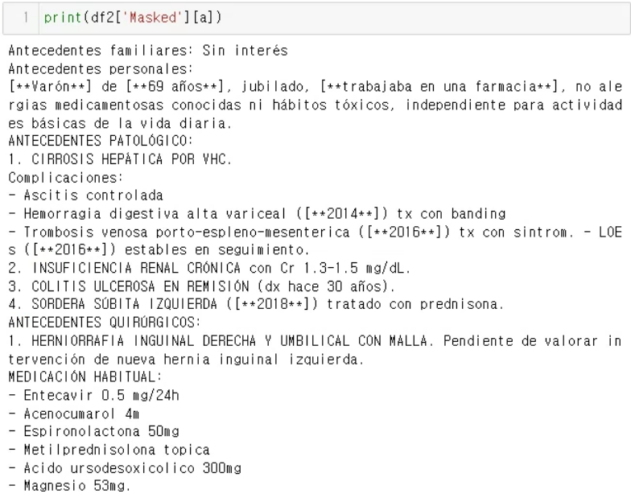
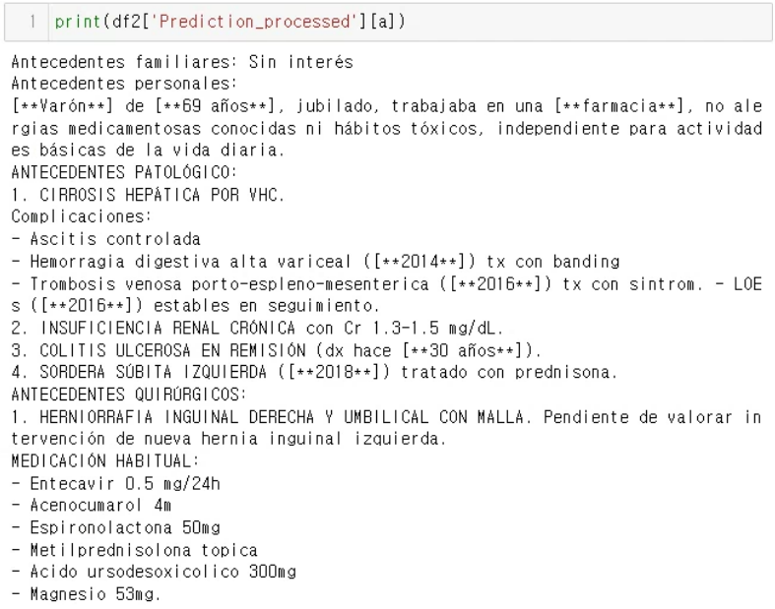
How should we evaluate anonymization errors?
The Levenshtein distance between two words is the minimum number of single-character edits (insertions, deletions or substitutions) required to change one word into the other.
The levenshtein distance is simply evaluating the number of difference parts between the masked text and the prediction text
A more manual approach? qualitative evaluation? human annotation of error types?

Slide 4
Next steps
RAG?
Make LLM perform anonymization by referring to the anonymization guideline document using langchain.

