Slide 1
2024/08/09

Slide 2
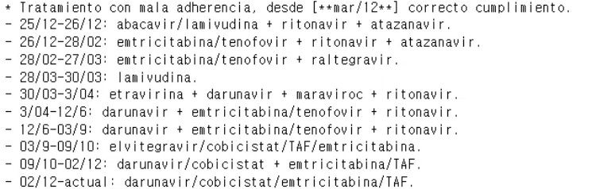
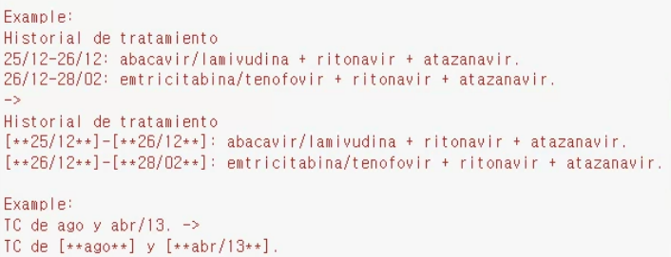
False negatives
listed dates
Months written in text
Gave more instructions in the prompt

Slide 3





False positives
Gave more instructions in the prompt
year, but not age
Anonymize only the specific element:
For example,
Dates (e.g., in "Fecha frotis SARS-Cov2: 12/11/2024," only anonymize "12/11/2024" as "[**12/11/2024**]", not the surrounding text).
Place names (e.g., in "Natural de la región de Samara (Rusia)," anonymize as "Natural de la región de [**Samara**] ([**Rusia**])," not the entire phrase).
Do not anonymize the following:
Common nouns (e.g., "pacient" (patient), "trucada" (call))
Medical and anatomical terms (e.g., "amigdalas" (tonsils), "epicóndilo" (epicondyle), "corazón" (heart), "fémur" (femur), "diabetes"))
General terms that are not unique identifiers (e.g., "doctor" unless followed by a name, "hospital" unless it is a specific named hospital)
Durations and time frames (e.g., "hace 30 años" when referring to a time period, not the age of a person)
common nouns
medical and anatomical terms
general terms that are not unique identifiers
surrounding info

Slide 4
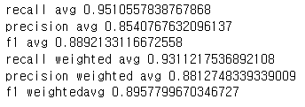
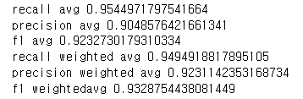
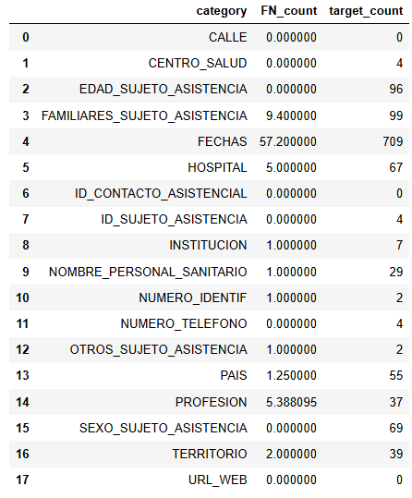
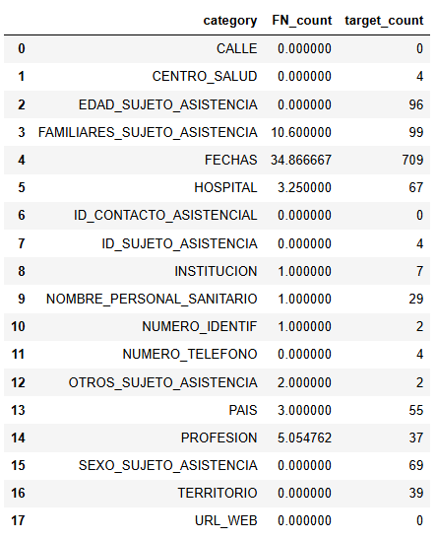
before
after

