Slide 1
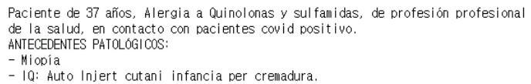
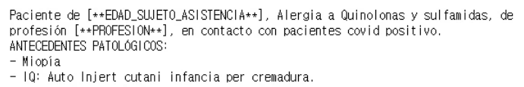
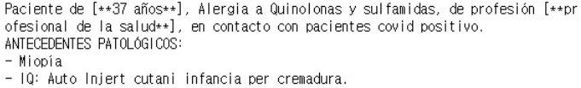
For performance evaluation, i first had to mark the anonymized parts in the “replaced” version.
Replaced
Masked
A python function to
identify all masked patterns enclosed within [** and **] in the masked data.
then find the corresponding parts in the original data, and enclose these parts with [** and **]
Replaced_enclosed

Slide 2
Told GPT to anonymize the “replaced” version
system_content='''You are an anonimization tool in identifying attributes in texts that can identify or quasi-identify a user.
Return only the original text with the identification and labeling of the patient's personal information by adding it between [** and **].
For example, names such as John Doe should be given as [**John Doe**].
Dates such as 2024/07/01 should be given as [**2024/07/01**].
Other information such as the sex, words that can identify a person's sex, occupation, place of residence, contact information, identifiable numbers, medical history , etc should also be anonymized.
Do not comment anything else.
'''
The jupyter notebook and the results that i’ve uploaded on Github last week was wrong
(I told GPT to anonymize the “replaced_enclosed” version instead of the “replaced” version)
I’ve uploaded the corrected jupyter notebook and results on Github.

Slide 3
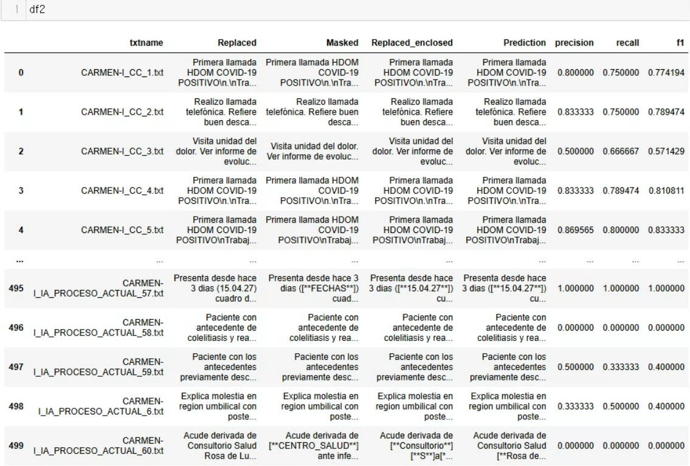
results

Slide 4
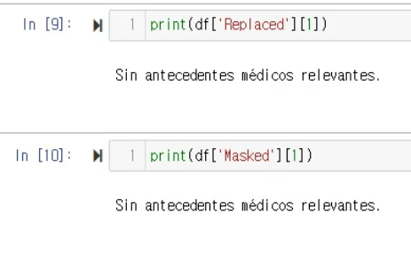
Discussion 1
It may be necessary to exclude very short text data.
Perhaps, text with less than 50 characters including spaces?
Because it is also important for GPT not to anonymize text data that does not contain any personal information,
text data without anonymized parts should not be excluded simply because they do not contain anonymized parts?

Slide 5
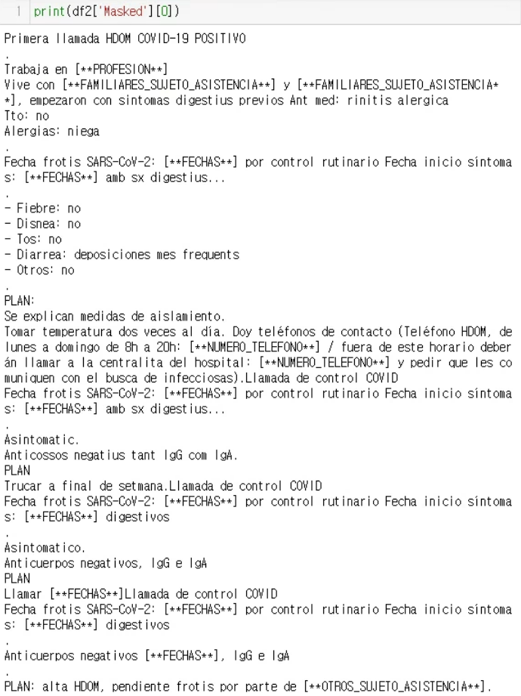
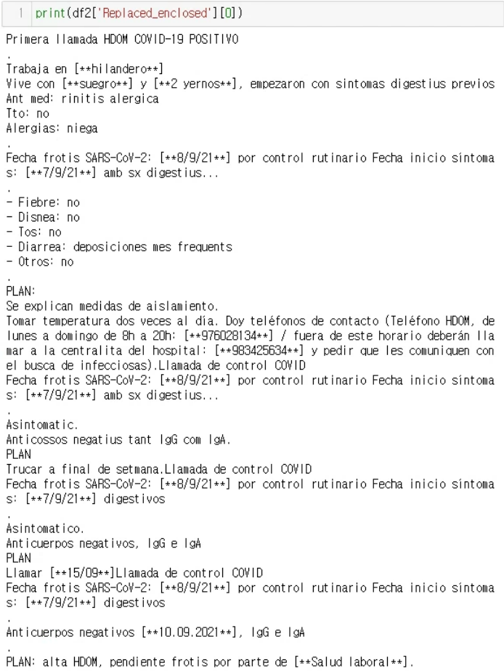
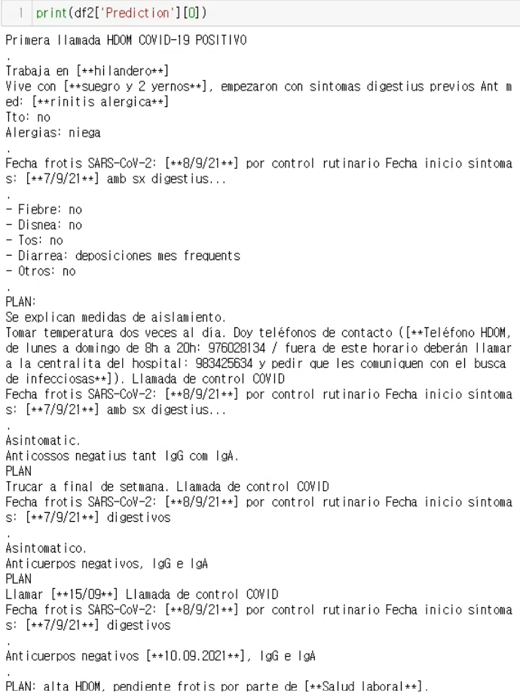
Discussion 2
Currently, this is counted as wrong
GPT failed to target phone numbers only
We shouldn’t tell GPT to anonymize past medical history

Slide 6
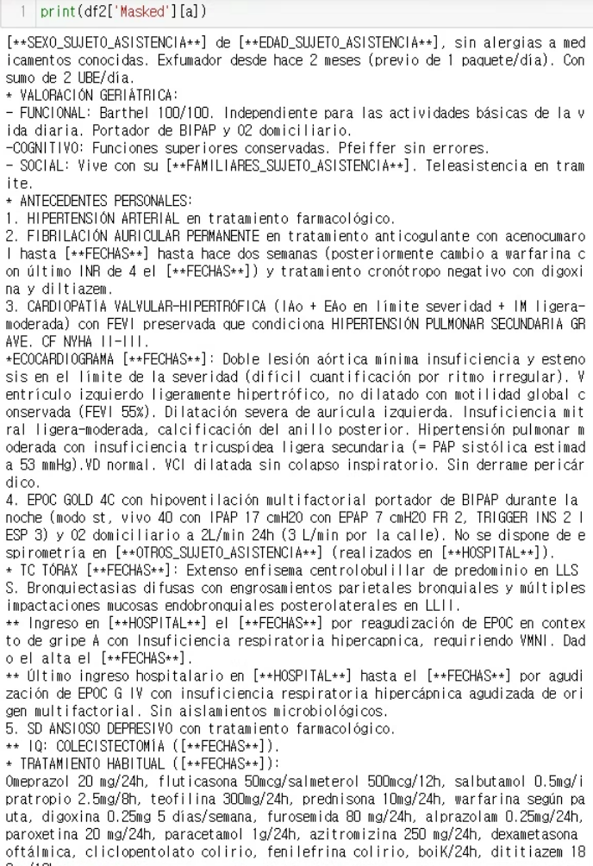
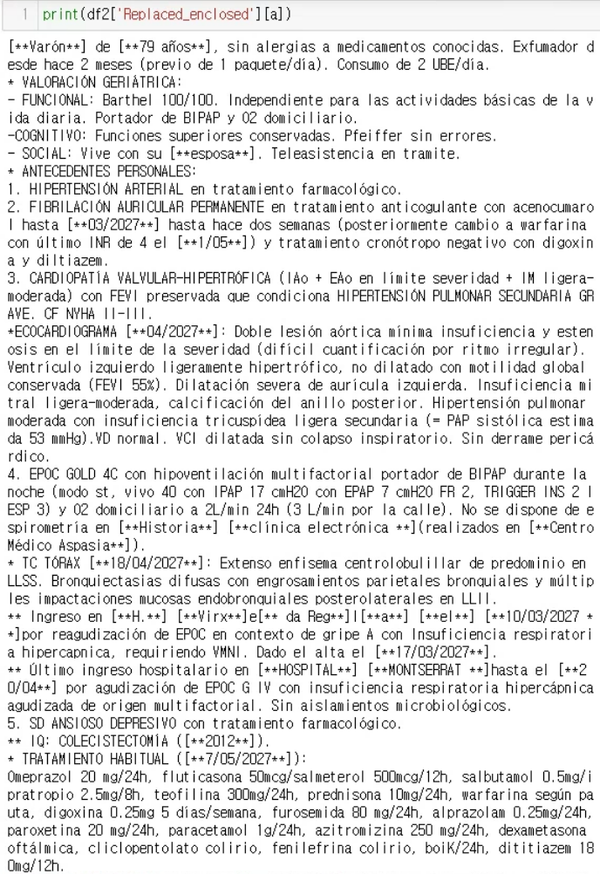
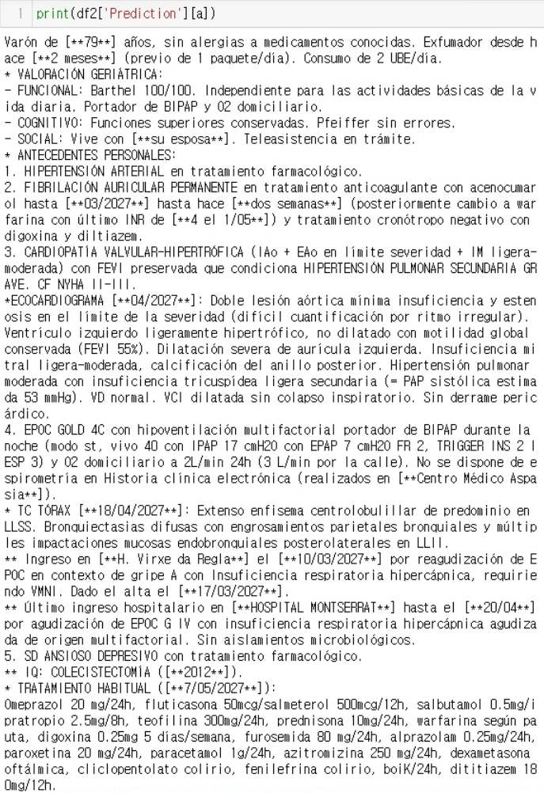
Discussion 3
Currently, this is counted as wrong
GPT failed to anonymize this

Slide 7
Discussion summary
It is necessary to refine the prompt further.
Detailed instructions in the prompt regarding the scope of anonymization?
And provide examples for each anonymization item?
system_content='''You are an anonimization tool in identifying attributes in texts that can identify or quasi-identify a user.
Return only the original text with the identification and labeling of the patient's personal information by adding it between [** and **].
For example, names such as John Doe should be given as [**John Doe**].
Dates such as 2024/07/01 should be given as [**2024/07/01**].
Other information such as the sex, words that can identify a person's sex, occupation, place of residence, contact information, identifiable numbers, medical history , etc should also be anonymized.
Do not comment anything else.
'''
More flexibility in counting what is correct
ex) [**79**] años vs. [**79 años **]
ex) [**suegro**] y [**2 yernos**] vs. [**suegro y 2 yernos**]
ex) su [**esposa**] vs. [** su esposa**]
ex) 4 el [**1/05**] vs. [**4 el 1/05**]

