Slide 1
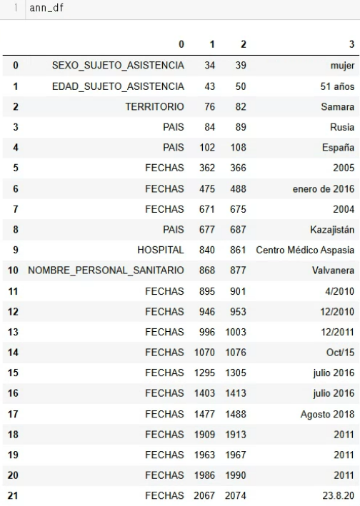
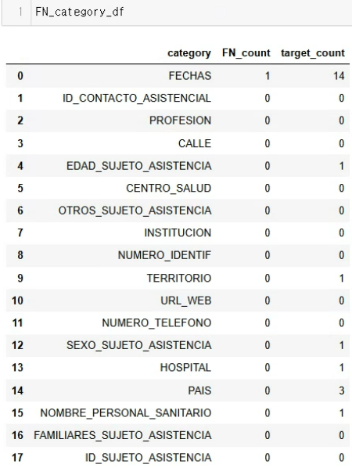
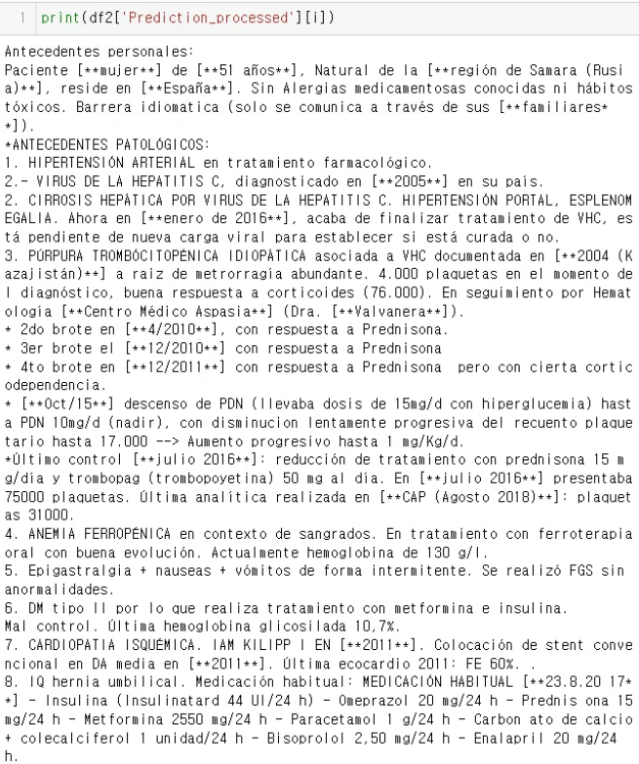
1. False negatives
the labeling of false negatives can be done automatically with the “annotation” info
annotation info
(data\processed\ann)
False negatives
(FN+TP)
Prediction

Slide 2
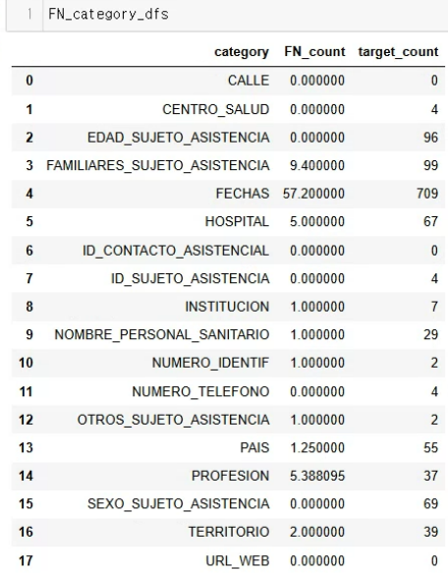
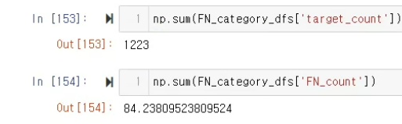
1. False negatives
the labeling of false negatives can be done automatically with the “annotation” info
False negative summary of 100 CARMEN samples
(FN+TP)
Most FNs were dates

Slide 3
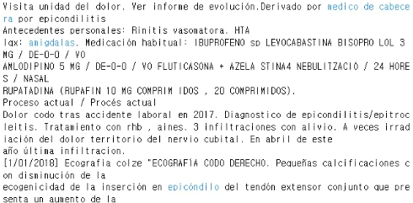
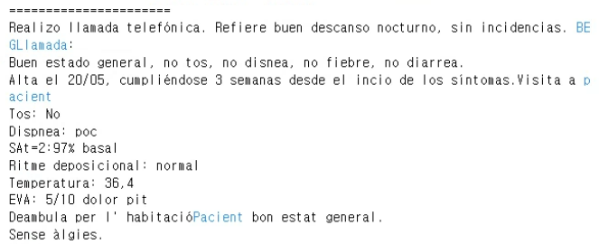
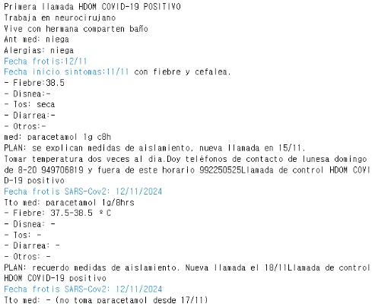
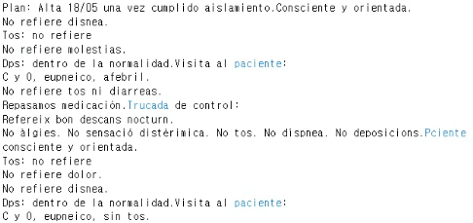
2. False positives
We do not have labels for false positives
In my Jupyter notebook, i have printed the false positives as blue.
examples)

Slide 4
2. False positives
We do not have labels for false positives
In my Jupyter notebook, i have printed the false positives as blue.
Manual labeling (human annotation) of false positives?
or
manual identification of false positive categories first, and then ask the LLM to categorize them?

