Slide 1

SCHOOL BASED DISTRIBUTION 2026
ATTENDANCE TAB

Slide 2
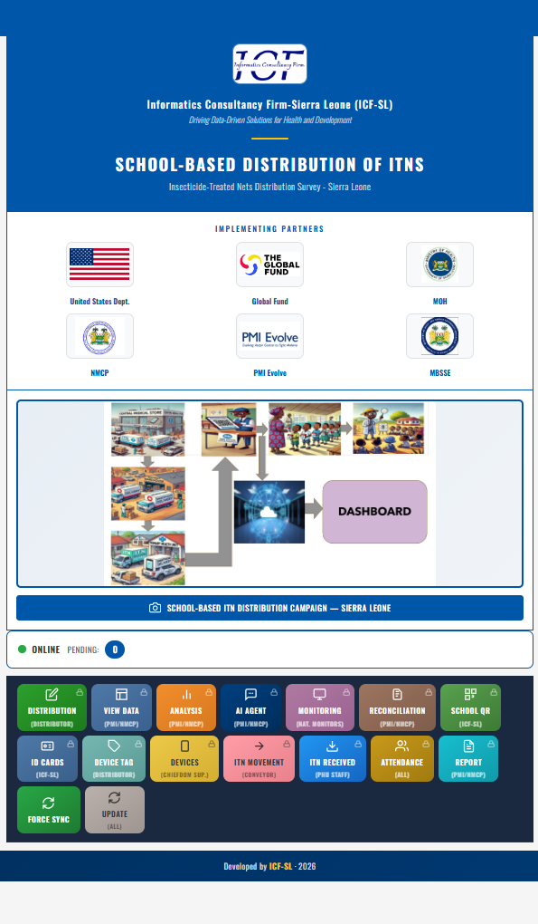
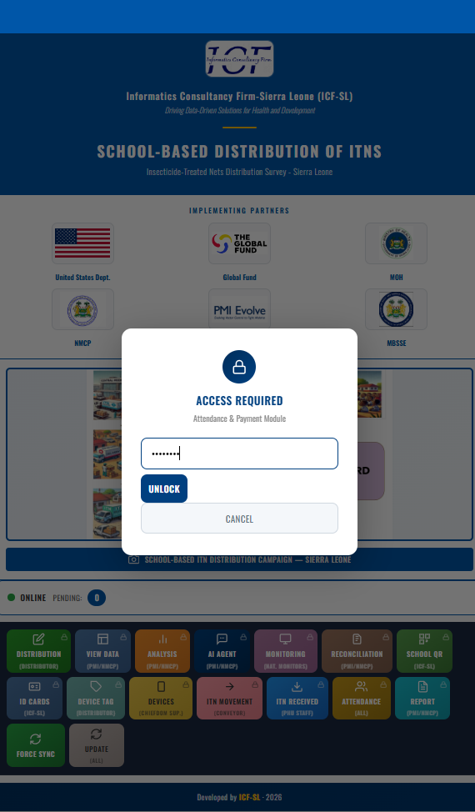
STEP 1 and STEP 2
Click Attendance
input password

Slide 3
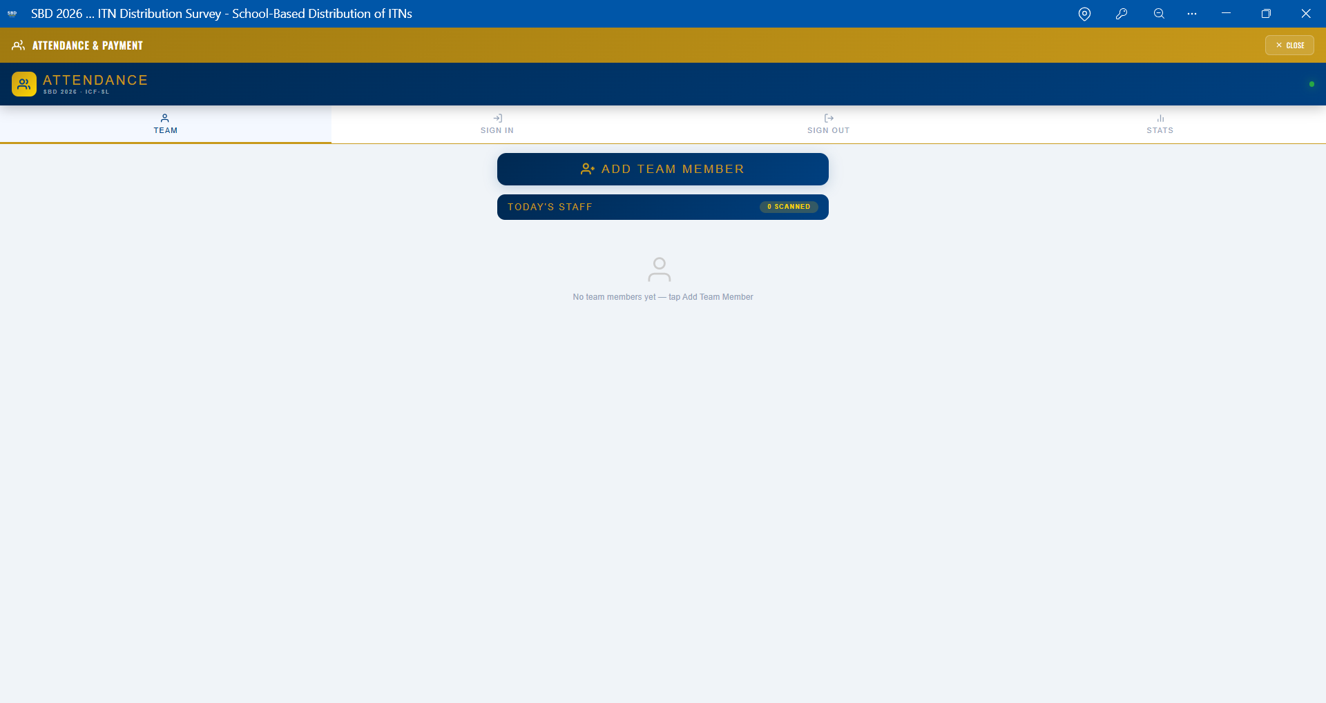
STEP 3
Click on Add Team Member

Slide 4
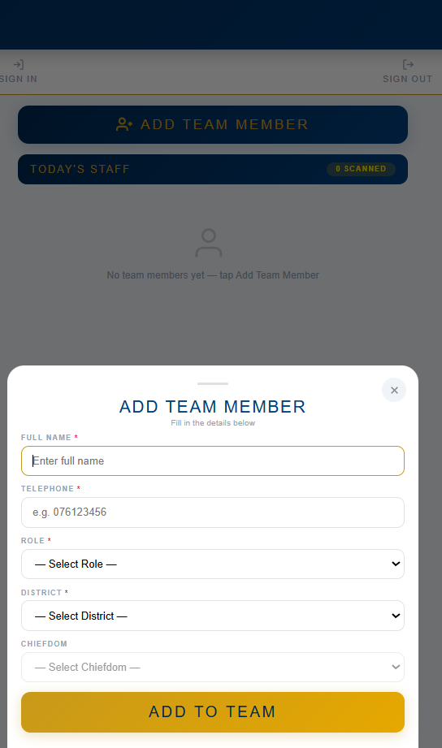
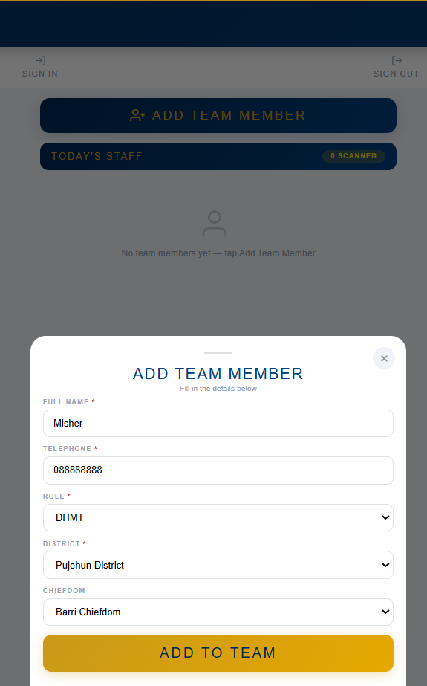
STEP 4 & 5
Click Add to Team
Enter Team Member details

Slide 5
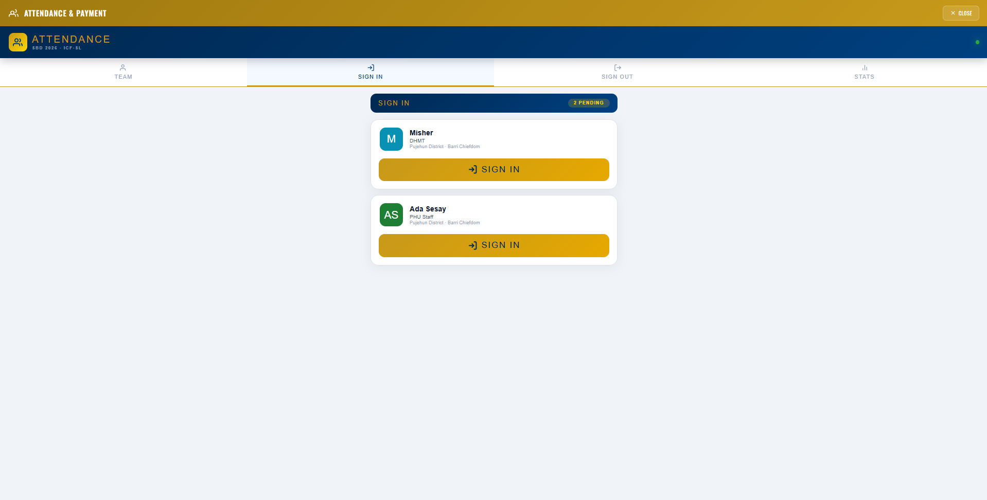
STEP 6
Click Sign In

Slide 6
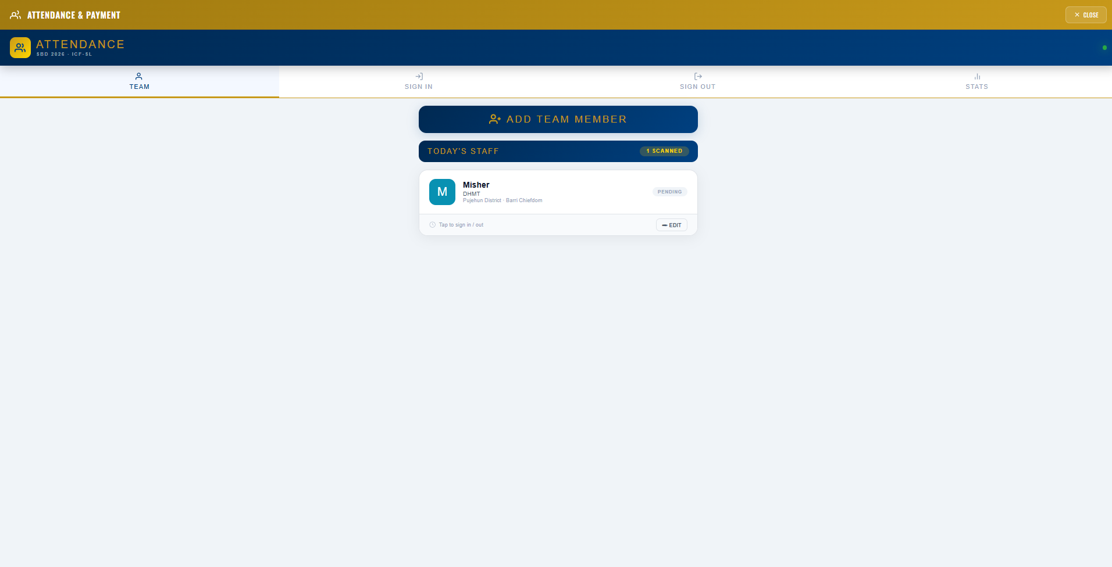
STEP 7
Staff Login display

Slide 7
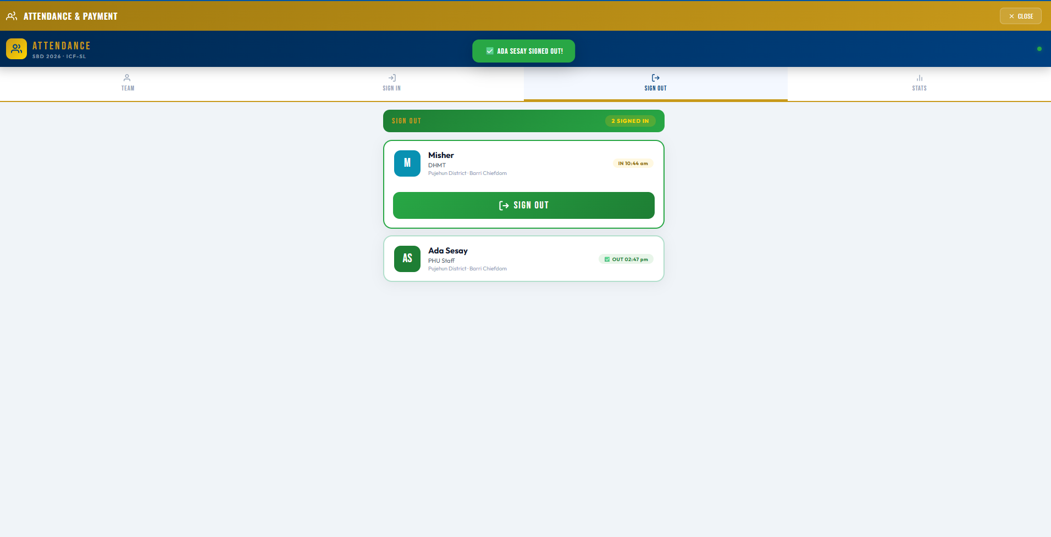
STEP 8
Click Sign Out

Slide 8
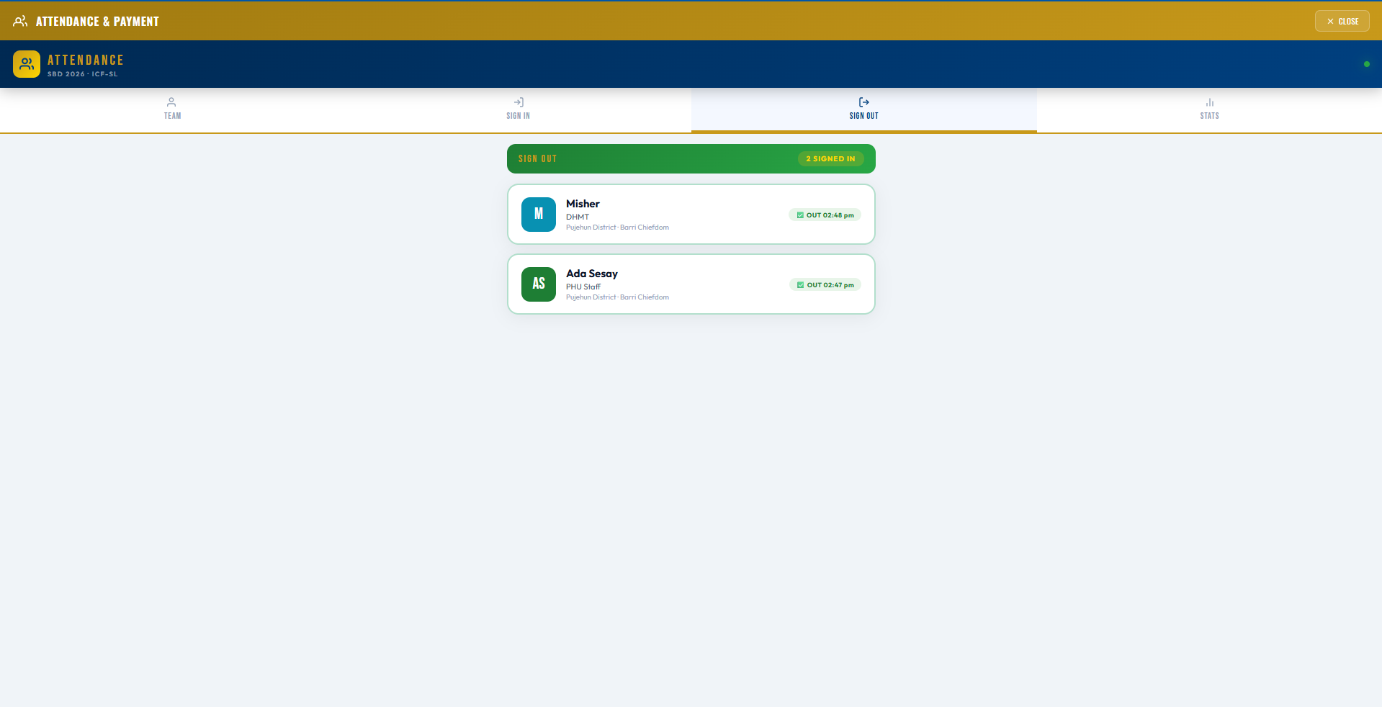
STEP 9
Staff sign out display

