Slide 1


Data Management
Miguel Gonzalez Sanchez
Research Software Engineer – JIC Informatics
William Redding
Research Software Engineer – JIC Informatics
(Please start your computers)

Slide 2
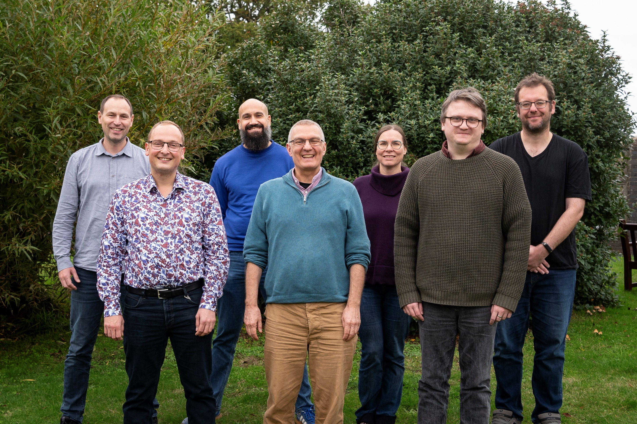
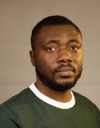

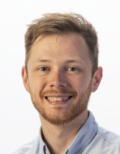
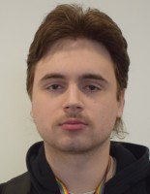


Slide 3
[Disclaimer]
This training offers general information about data management.
Although most of these principles apply to all institutes, I work at JIC, so the content of the training may not align 100% with your institute’s policies.
I encourage you to follow up with your bioinformatics teams and/or with your line manager at your institute to learn more about data management and the institute’s specific policies.
This is the JIC document for Procedures and Best Practices:
  https://intranet.nbi.ac.uk/apps/documents/download.php?docID=66239

Slide 4
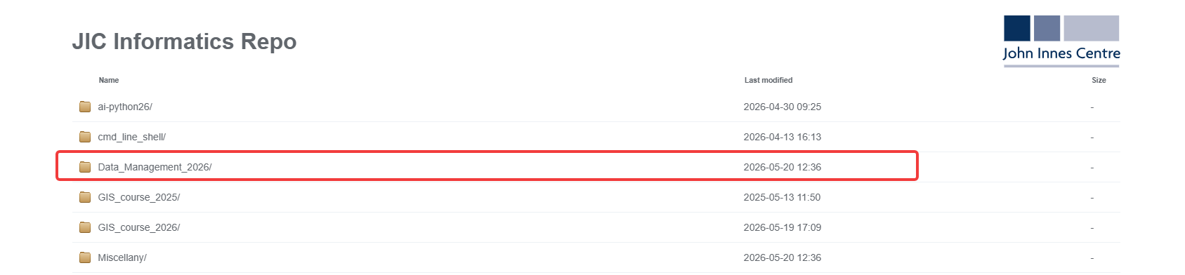
[Presentation available at:]
https://repo.informatics.jic.ac.uk/

Slide 5
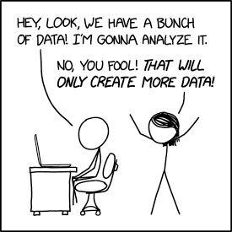
[Course Content]
Part 1: Theory and open discussion.
    Data ownership and governance
    FAiR and AI-ready data
    Filesystems
    Bad practices
    Metadata
    Instrument network
    Recovering data
    Sharing data
Part 2: Hands-on practice.
    Command Line file manipulation
    File integrity
    Big data
    Uploading data to remote repositories

Slide 6
[Reflections]
Who are the stakeholders of data?​
Who owns data?

Slide 7
[Who are the stakeholders of data​]
Researcher (PI/GL, postdoc, PhD student)​.
Institution (JIC/EI/QIB/TSL). ​
Collaborators​.
Funders (UKRI/BBSRC/Industry)​.
Publishers​.
The taxpayer​.
Humanity.

Slide 8
[Data Ownership​]
The Institute​.
The Funder​ (BBSRC requires data retention for a minimum of 10 years).
Intellectual Property​.
Commercial Partners​.
Collaborators.
The responsibility for maintaining and securing data always resides with the Project Leader/GL.

Slide 9

[As a user]
Ensure the data is available, secure, correct, understandable, reproducible, defensible​.
The other stakeholders of the data you create, and work with, will have their own policies on how data should be treated​.
UKRI Outline Data Management Plan
  https://www.ukri.org/councils/nerc/guidance-for-applicants/what-to-include-in-your-application/outline-data-management-plan/

Slide 10

[GDPR and Human data]
General Data Protection Regulation (GDPR)​
  Regulates the collection and processing of personal data from individuals.
  https://gdpr-info.eu
Genetic data is a "special category" under GDPR​.
  Guidelines from your institute/funder​.
  Speak to your data manager​.
  Read your data management plan​.
  Special considerations for publishing and anonymizing human data.

Slide 11

[BioFAiR]
BioFAIR is a UKRI funded federated digital research infrastructure (£34million over 5 years). BioFAIR will deliver a step change in ‘Findable, Accessible, Interoperable and Re-usable’ (FAIR) research data management, providing end-to-end FAIR research data management & analysis capabilities along with the necessary support and training for UK researchers working in the life sciences.

Slide 12
[BioFAiR Pillars]
Unified Data Architecture
  Standardised column names across all experiments
  Vendor outputs converted to common industry units
  Controlled vocabularies for genes, cell lines, and samples
Contextual Metadata Frameworks
  Capture experimental context and provenance
  Include baseline settings and environmental conditions
  Enable direct integration with public data platforms
  Maintain full traceability from raw data to analysis
Shared Computational Workflows
  Replace isolated scripts with shared executable notebooks
  Build reproducible and versioned analysis pipelines
  Automate submission to public repositories
  Register workflows in centralised workflow registries

Slide 13
[AI-Ready Data]
AI models cannot guess context. Data must be structured so algorithms can automatically parse, clean, and link it at scale.
Key Criteria for AI-Ready Data
  Open, machine-readable formats -> (JSON, CSV, Parquet instead of PDFs or proprietary files).
  Harmonised features and units -> Consistent column names and standardised measurements across datasets.
  Rich metadata and provenance -> Explicitly capture experimental variables, instrument settings, and environmental conditions.
  High data integrity -> Remove duplicates, undocumented gaps, and unclear file naming conventions.
  Scalable interoperability -> Data designed for automated integration with workflows, repositories, and AI pipelines.

Slide 14
[What is a filesystem?]
Is what we use to organise and store data on hardware devices like hard drives, SSDs, and network storage.
Manages how data is written, read, and accessed efficiently.
Uses a hierarchical structure of directories (folders) and files.
Provides access control and permissions, defining who can read, write, or execute files.
Different types exist, optimised for different use cases.
In Windows, you use \ to separate the folders; in Linux and macOS, you use /

Slide 15
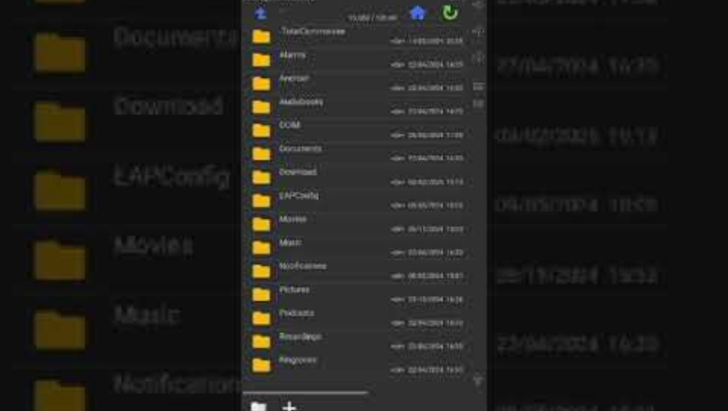
[Example: The file system behind android]

Slide 16
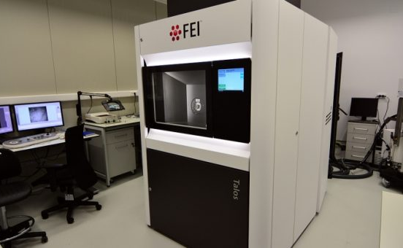

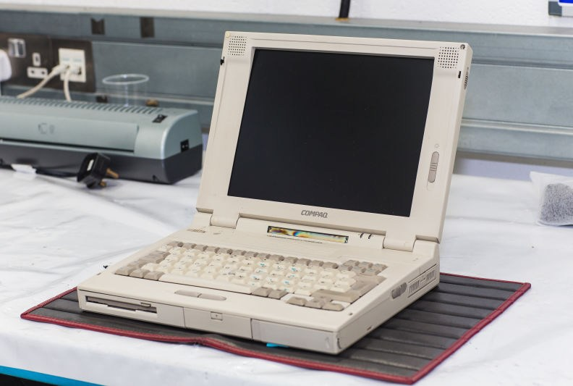
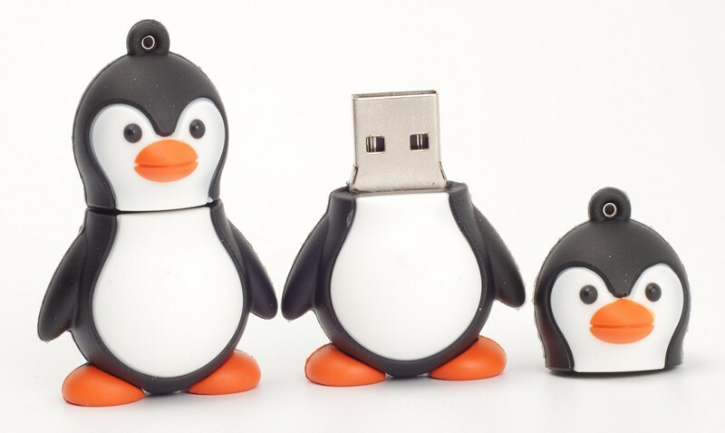
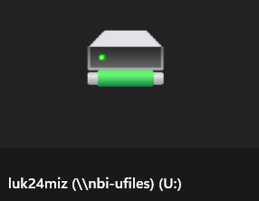

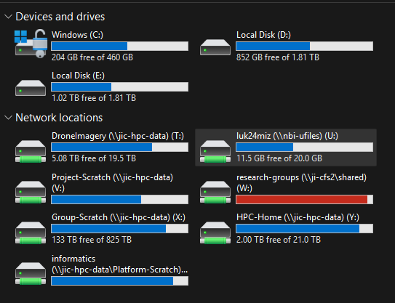
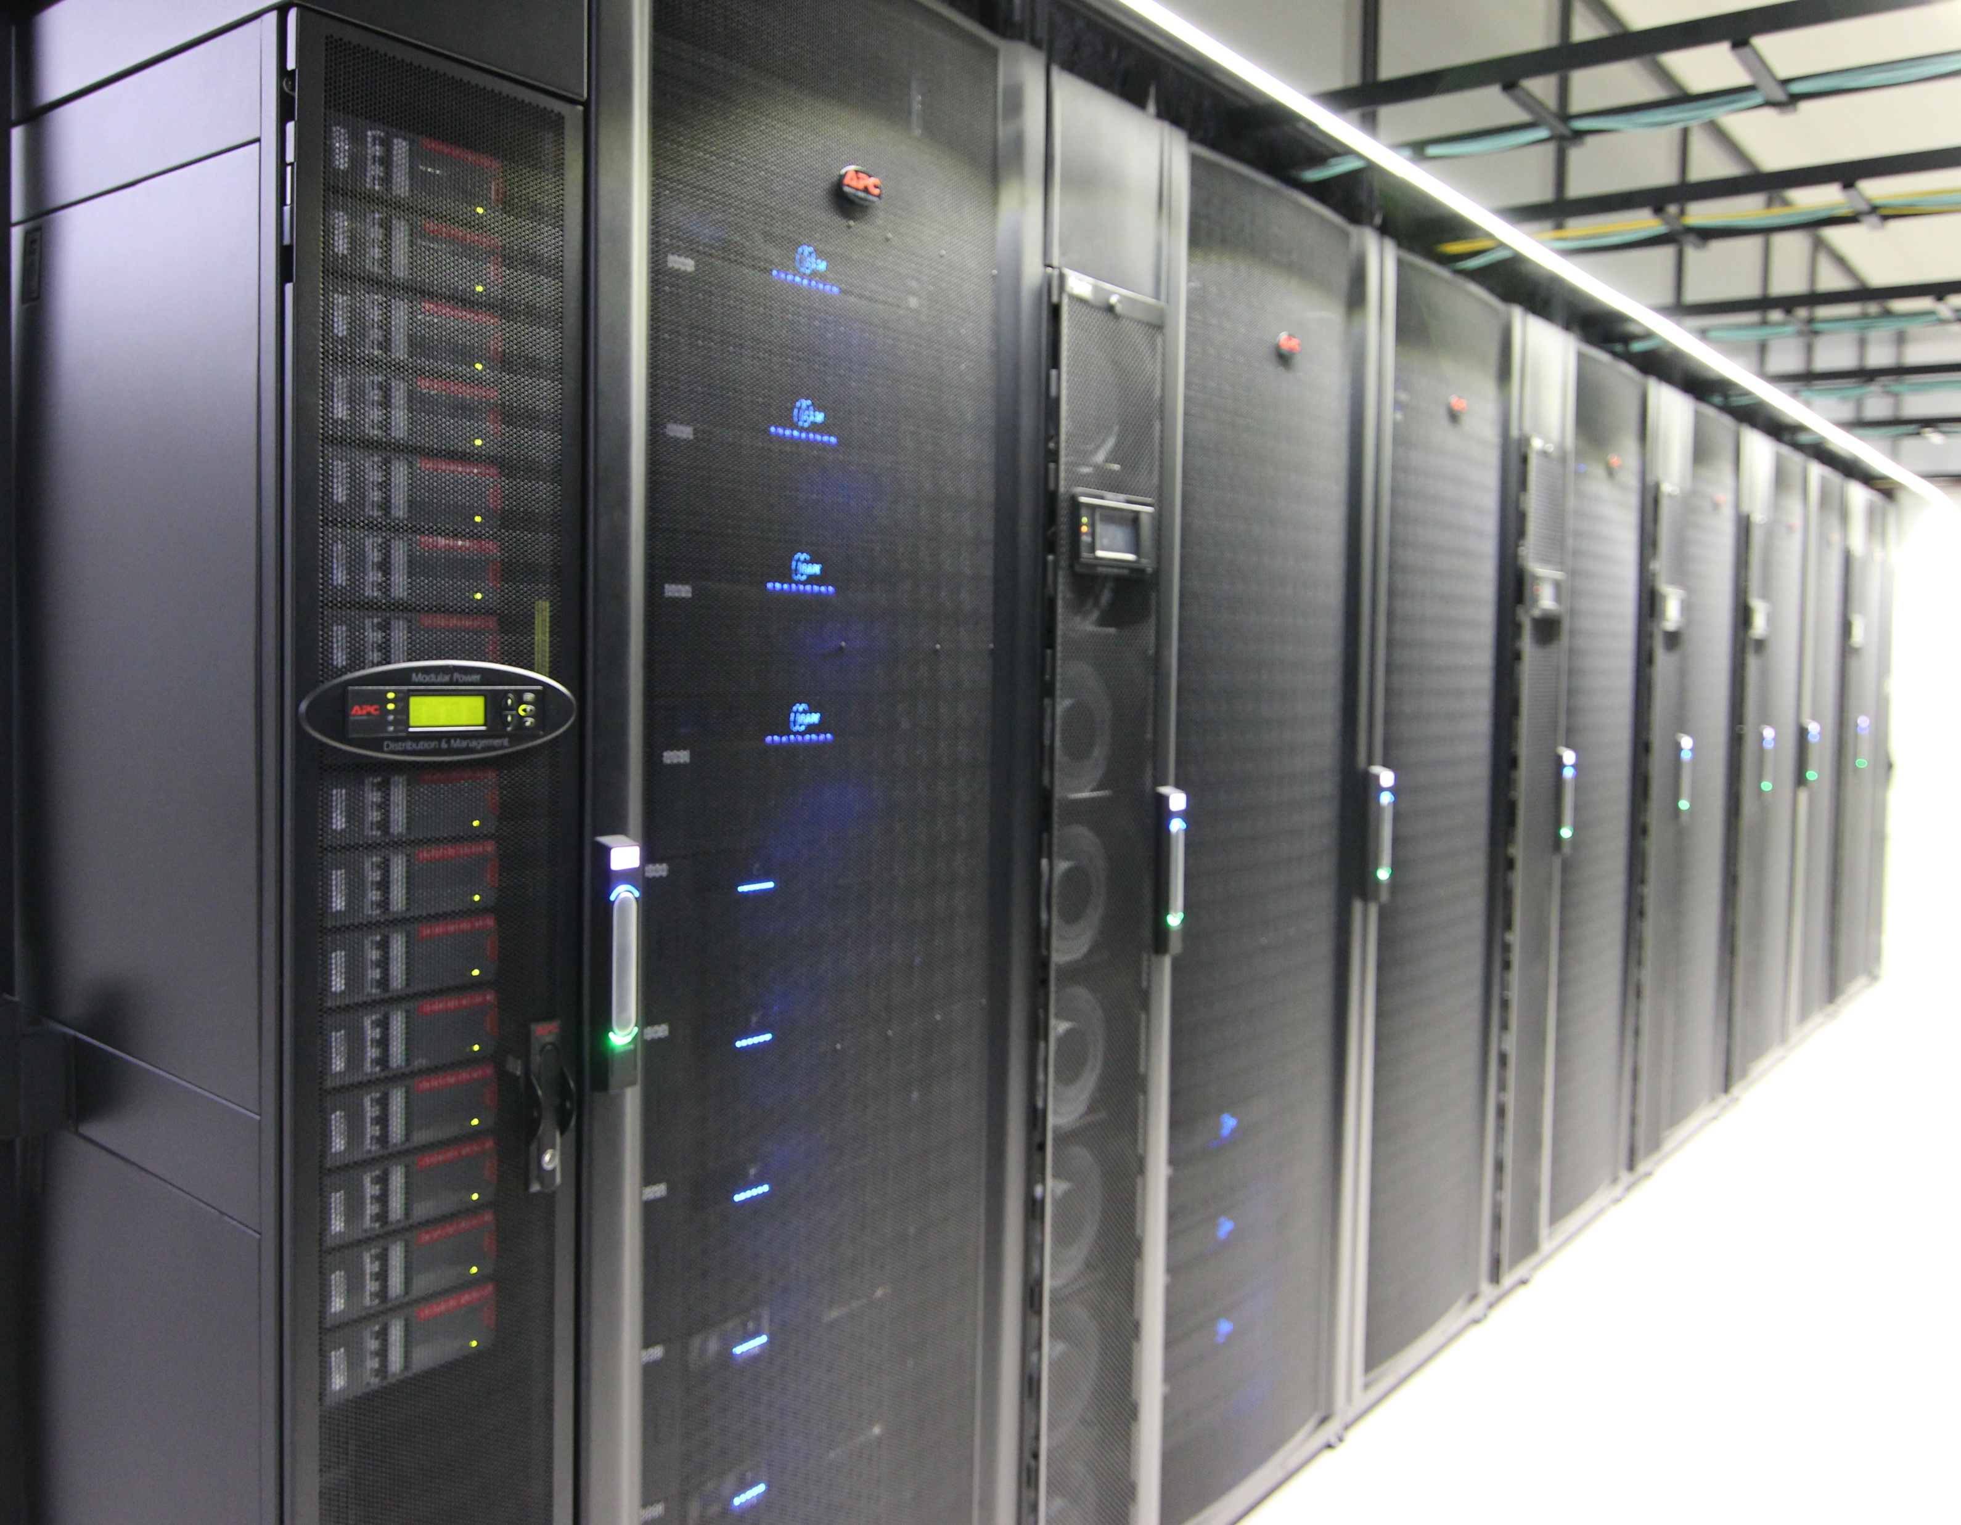
[Storage locations available at the NBI]
HERE YOUR DATA
IS NOT SAFE
Instruments and the computers attached to them.
Employee devices, laptops, desktops, but also phones, etc…
External devices (hard drives, USB sticks, SD cards)
U drive.
OneDrive and SharePoint.
Computing network shared storage \\nbi-cfs2
HPC storage (Also known as Isilon). \\jic-hpc-data

Slide 17
[U drive and Computing shared locations]
The U drive
  Can store up to 20G
  Good for documents that do not require sharing
  Fully backed up and snapshots
  Automatically mapped
  Access: \\nbi-ufiles\username
Computing shared folders
  Quota varies but is small, not designed for big data.
  Good for shared documents like protocols, SOPs
  Fully backed up and snapshots
  Needs manual mapping
  Access: \\files \\ji-cfs2

Slide 18
[OneDrive - SharePoint]
Good for sharing drafts, writing protocols, and collaborating on office documents with colleagues.
Fully backed up, secure, and officially supported by NBI Computing.
Ideal for real-time co-authoring and managing team file access across internal JIC/NBI groups.
IMPORTANT:
  Do not use it to store or sync raw bioinformatics data or large file trees; it will break metadata, choke bandwidth, and trigger endless sync conflicts.
  Be organised, create folders and compartmentalise your data; it is easy to have all the data in the root of your OneDrive folder.

Slide 19
[Omero – Image Storage]
Managing, viewing, and organising microscopy and high-dimensional biological images.
Centralised NBI storage that preserves data integrity, avoids local loss, and is fully backed up.
Easily share datasets, annotations, and metadata across internal groups without copying huge files.
Do not use standard filesystems or personal cloud drives for images; they strip away essential acquisition metadata and break traceability.
omero.nbi.ac.uk
(ask your bioinformatics team or microscopy)

Slide 20
[Data Access/Permissions]
At the JIC, Group Leaders have private spaces at Computing’s Shared folders and the HPC​.
Group members can then get access​.
Speak to informatics for more complex arrangements​.
  Collaborators’ access​.
  Project storage across groups/members​.
  Institute-wide resource​.
  External access.
It may not be the case for your institute; consult your line manager or your bioinformatics teams to learn more.

Slide 21
[Bad practices]
Local-Only Storage. Storing data solely on external drives or laptops risks total loss (e.g., hardware failure or theft). Use our institutional and backed-up storage systems.
Editing Raw Data. Working directly on raw files endangers data integrity and reproducibility. Make copies; treat raw data as read-only.
No Backups. A single copy is a single point of failure. Automate regular backups in multiple locations. A snapshot is not a backup!
Running analysis in Group Folders. Use JIC-Scratch for heavy I/O!
Disorganized Files, Cryptic filenames like new_final2_real.bam confuse everyone—including you. Use clear, consistent naming conventions and folder structures.
No Metadata or Documentation, Unlabelled data becomes unusable. Document sample origins, processing steps, and tool versions.

Slide 22
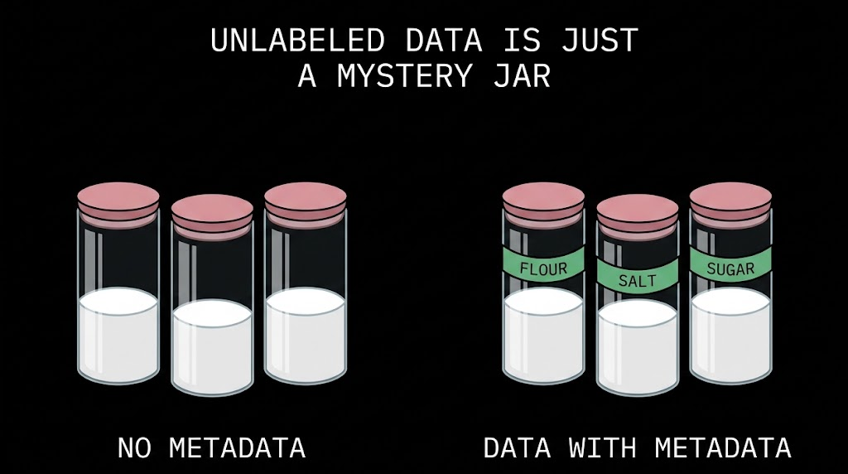
[Metadata]

Slide 23
[Metadata]
Your final results are only as useful as your documentation!
Documenting your analysis ensures reproducibility, collaboration, and future understanding.
Best Practices:
  Store your analysis scripts (e.g., Python, R, Bash)
  Include notes on:
    Data sources and versions.
    Parameters and tools used.
    Rationale for choices and any caveats.
Use Tools Like Git, GitLab or GitHub, for version control and collaboration.
You will be the first person to find your descriptions of the data useful.

Slide 24
[Metadata - template]
https://repo.informatics.jic.ac.uk/Data_Management_2025/Metadata_template.txt
  General Information.
  Sample Information.
  Experimental Information.
  File Information.
  Ethical & Access Information.
Customise it or create your own template; check the requirements of the platforms where your data will be uploaded for guidance, and remember, we are here to help.
  ASK your bioinformatics team, different institutes have different policies.

Slide 25
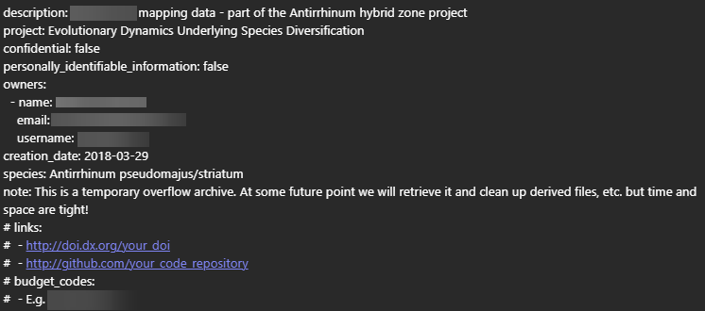
[Metadata - template]

Slide 26
[The Instrument Network]
Some computers connected to instruments like microscopes are not fully connected to the NBI network because they do not comply with basic security requirements, such as regular updates, a supported operating system, and antivirus software.
Moving data around on USB sticks is neither efficient nor safe; I discourage it.
Because of this, all these instruments have access to NBI’s central storage and can be used to upload raw data and results to your group’s shared location or personal folder, following the steps from the previous slides.
You need to contact computing.helpdesk@nbi.ac.uk:
  If the instrument you work with is not connected to the Instrument Network.
  If you need remote access to an instrument from your institute workstation. This can be arranged by contacting the helpdesk.
Notes:
PC on the instrument network \\n114403

Slide 27
[How to recover data, if possible]
The Isilon automatically takes snapshots of the data. However, depending on the folder, the number of snapshots and the retention policies may vary.
Computing’s locations and OneDrive also have retention policies.
If you have recently deleted (or modified a file), the chances of recovering it are high. The more time passes, the lower the chances of getting it back.
Permissions apply identically to the snapshots as they did to the original data.
Snapshots can be accessed from any device.
The best way of understanding what is available is to navigate through the snapshots
Notes:
Hourly's where scheduled are usually taken every two hours, between 8am and 6pm, and are available for ~26 hours
Daily's where scheduled are taken usually at midnight, and are available for ~8 days
Weekly's where scheduled are taken usually at midnight on Sundays, and are available for ~5 weeks
and Monthly's where scheduled are taken usually on the first of the month at midnight, and are available for between ~4 to 7 months

Slide 28
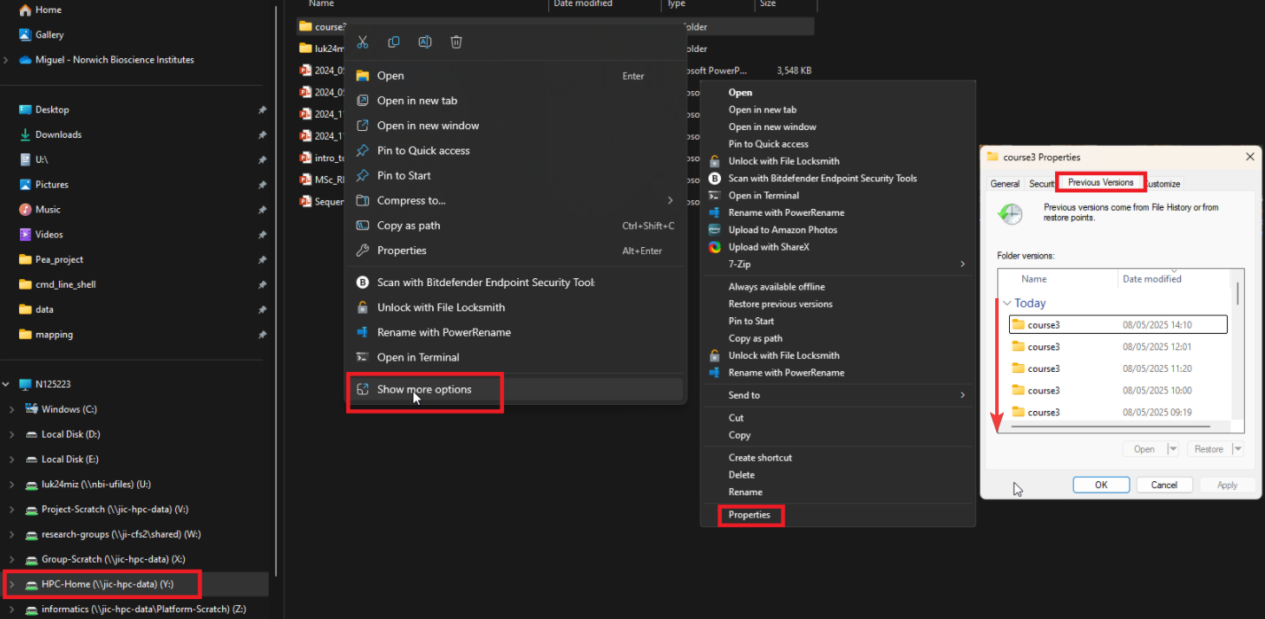
[Recovering data from Windows]
Notes:
Hourly's where scheduled are usually taken every two hours, between 8am and 6pm, and are available for ~26 hours
Daily's where scheduled are taken usually at midnight, and are available for ~8 days
Weekly's where scheduled are taken usually at midnight on Sundays, and are available for ~5 weeks
and Monthly's where scheduled are taken usually on the first of the month at midnight, and are available for between ~4 to 7 months

Slide 29
[Recovering Exercise]
Explore the different snapshots using your Windows device.
Compare the snapshot folder with the “current” folder.
Recover some data from any of the snapshots (be careful and do not overwrite anything).

Slide 30
[NIB Tools for sharing data]
Alongside OneDrive, which is recommended only for sharing small amounts of data, NBI provides two dedicated data transfer services:
Dropoff: Easy-to-use web-based transfer service for datasets up to 300 GB.
  https://dropoff.nbi.ac.uk/
Globus: High-performance data transfer platform with no practical data size limit. Ideal for large datasets and automated transfers.
  https://www.globus.org/
Choose the right tool:
  Small files → OneDrive
  Up to 300 GB → Dropoff
  Large datasets or recurring transfers → Globus

Slide 31
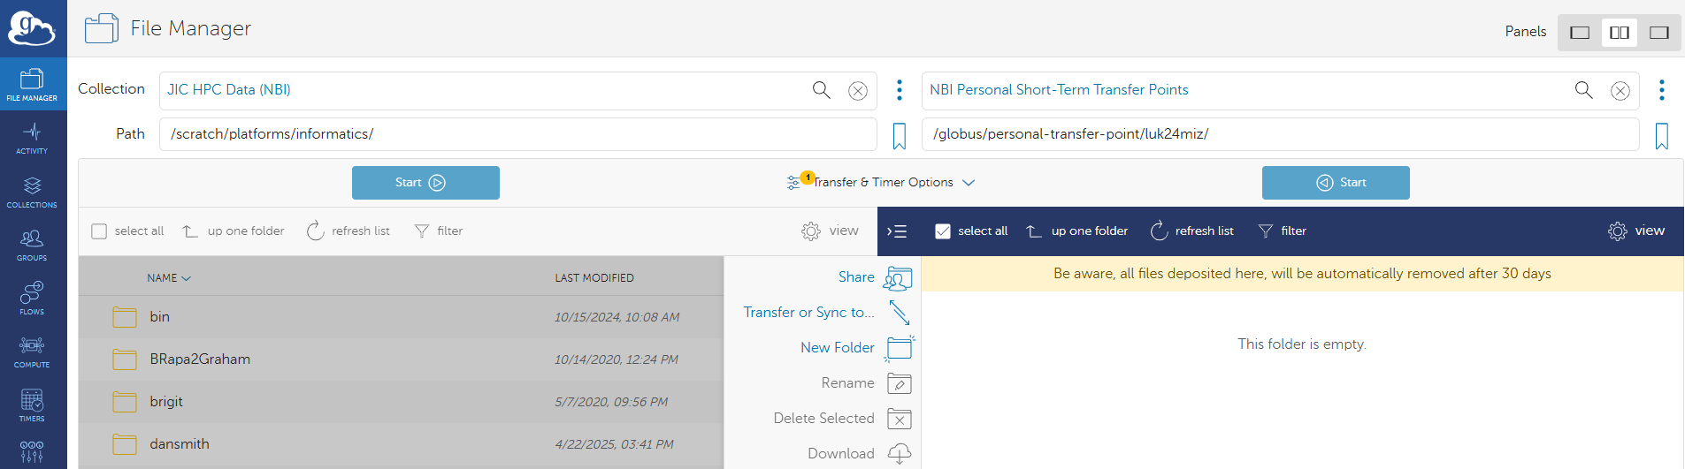
[Globus]
Globus now has access to the JIC storage, collection: JIC HPC Data (NBI).
User’s shared collection are in NBI Personal Short-Term Transfer Points.
You can create your own guest collections and share with your collaborators.

Slide 32
[Globus – how to share]
In Globus, data is organised and accessed through collections.
You cannot share data directly from the HPC storage; it must first be moved to the external endpoint.
You can create a guest collection to share data with your collaborators.
Detailed instructions are available in the Research Computing documentation.
Globus - Research Computing Support – Confluence

Slide 33
[Git – protect your scripts]
Keeps a history of changes
Lets you go back to an older version
Protects against accidental changes/deletion
Makes it easier to share and collaborate
Records who changed what and when
# Go to your scripts directory
cd my_project
# Start Git
git init
# Add your script
git add my_script.py
# Save a version
git commit -m "Initial version"
# Connect to your remote repository
git remote add origin https://github.com/USERNAME/my_project.git
# Push to the remote repository
git branch -M main
git push -u origin main
Edit script
↓
git add
↓
git commit
↓
Git repository
↓
Safe version history

Slide 34
[Working Remotely]
  Remote Access & VPN
    VPN: Works from NBI and non-NBI devices.
    NBI device: Nearly full network access; folders can be mapped.
    Non-NBI device: Restricted access; no folder mapping and limited VM/server access.
    Both: Remote Desktop and winrds.nbi.ac.uk available.
  WFH recommendation:
  If possible, remote into an office computer — better connection to NBI resources and less risk of losing work due to disconnections.

Slide 35
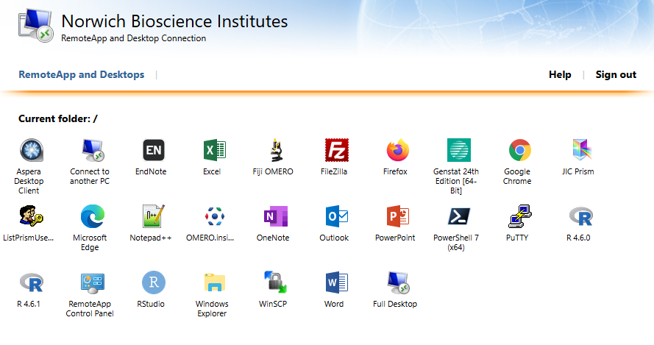
[Working Remotely]
winrds.nbi.ac.uk
  Provides Remote Desktop through a temporary Windows VM.
  Access to most NBI resources.
  Volatile: the VM is temporary; don't store data or work locally.
  Ideal if you don't have an office PC to remote into.

Slide 36
[Sharing Exercise]
Upload some data into Dropoff and share it with your personal email account. Download the data using your personal email to oversee the full process.
Create a file with your username in your U drive, uploaded into a new folder in Globus and share it with me luk24miz@nbi.ac.uk
Explore your access. Create a folder in your external NBI short-term endpoint and transfer some data from your institute’s HPC endpoint
Notes:
U drive \\ji-cfs2\luk24miz
HPC-home \\jic-hpc-data\HPC-Home

Slide 37
[New Data Centre]
NGI new data centre coming next year.
This is a great opportunity to:
  Reduce the footprint of our data storage.
  Archive, organise, and properly annotate current datasets.
  Review, standardise, and improve existing metadata.
  Adopt and apply best practices for data generation, management, and storage.
  Improve long-term data accessibility, reproducibility, and sustainability.
  Prepare workflows and datasets for future scalability and collaboration.
  And apply best practices going forward.

Slide 38
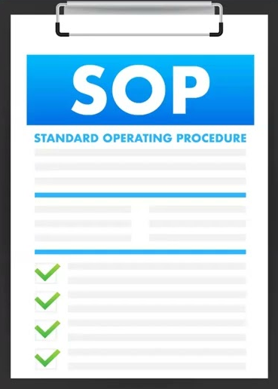







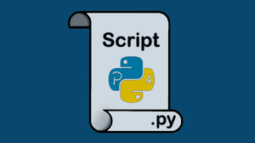

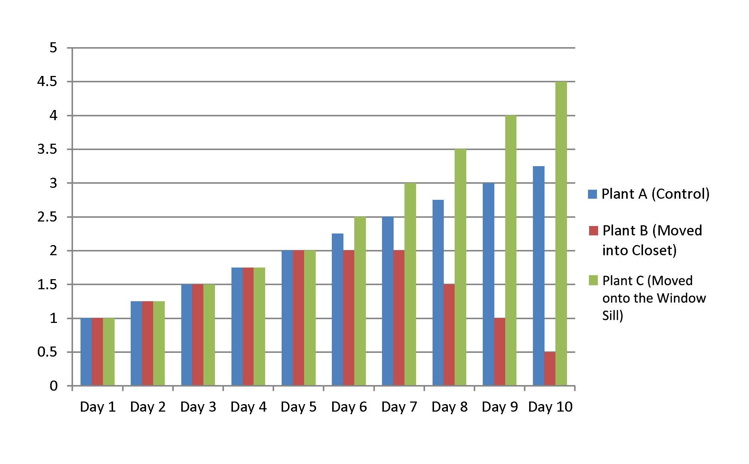
[Ideal Data Pipeline]
SOP AND PROCEDURES
RESULTS
REMOVED
ISILON ARCHIVE
RAW DATA
HEAVY INTERMEDIATE FILES
ISILON SCRATCH
PUBLICATION
ISILON ARCHIVE
SCRIPTS AND WORKFLOWS
HPC HOME DIRECTORY
ONLINE REPOSITORY

Slide 39

[Questions?]
Notes:
THIS IS THE LAST SLIDE!!!

Slide 40
Data Management
Part 2
Hands-on training

Slide 41
[The command line]$
Computers only speak in 0 and 1, but we use layers of abstraction to interact with them.
From assembly to GUI, different layers simplify programming and system control.
Command line tools provide direct access to system resources, making tasks faster and more efficient.
Essential for automation, scripting, and HPC, where GUI access is limited.
Commands can be combined (piped) to create powerful workflows, boosting productivity.

Slide 42
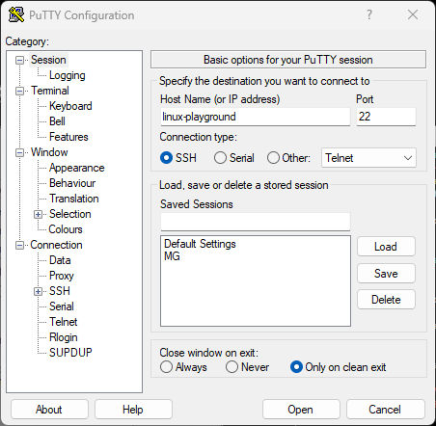
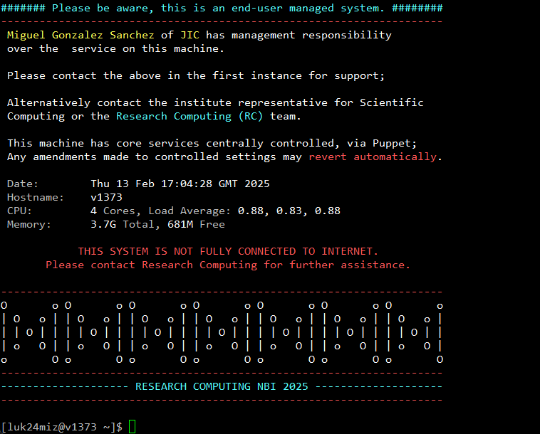
[Linux-playground]
Using PuTTY to access HPC or VMs (linux-playground)
Notes:
To create a tmux session use ctraining, for the attendees to attach to the session (read only) they have to use atraining, kill-training will kill an open session if there is already one.

Slide 43
[Setting up today’s lab]$
Open the browser in your workstation and create a folder in your U Drive named “informatics”.
After ssh into linux-playground run these two commands:
  mountu will mount the recently created informatics folder in the /home/username/u_drive directory.
  atraining will attach your screen to the presenter’s ssh session.
Open another ssh session using PuTTY or termina and ssh into linux-playground.
The folder informatics from your U drive should be linked with the u_drive in your home directory, create a text file in Windows and check if is visible in your u_drive directory.
Notes:
.

Slide 44
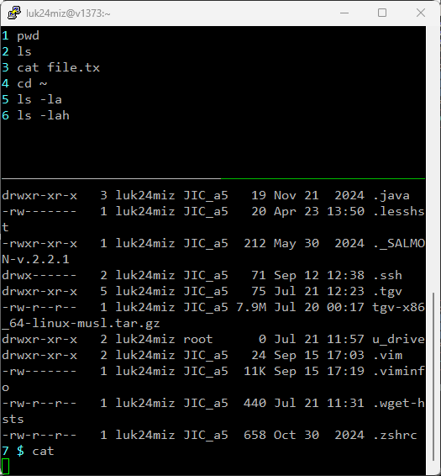
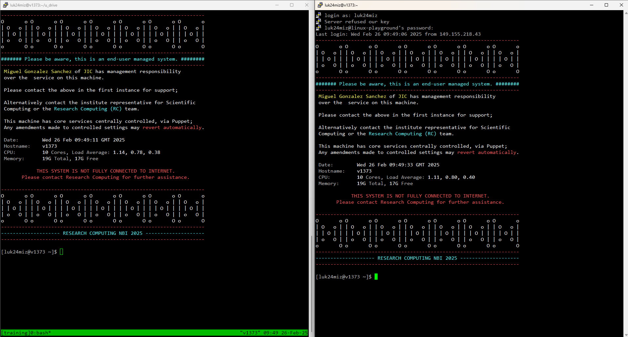
[The lab:]
Notes:
.

Slide 45
[Prompt, Home and \ (root)]
Prompt ($ or #) – The start of the command-line interface.
Home Directory (/home/username/) – Each user’s personal space. Shortcut: ~ (tilde).
Root Directory (/) – The top-level directory, containing all system files.
root user owns / (everything) and has its home in /root
Key System Folders – /bin (commands), /etc (configs), /home (users), /root (admin), /var (logs).

Slide 46
[Command structure]
$command –o –-options argument1 argument2 argumenx...
command application that we are calling.
-o –-option these are the flag or options that we are using (can be grouped).
arguments these are the files or directories the command will use.
$cp –r dir1/file1.txt dir2/file1.txt

Slide 47
[Moving around]
pwd print working directory
ls list content of current directory (flags –l –h –r)
cd change into specified directory
cd .. takes you to the previous level
cd ~ takes you to your home directory
cd - takes you to the previous directory you were at

Slide 48
[Exercise 1]
Change directory to the root of the filesystem.
You can use ls to list files in the root directory.
What happens if we add option -l?
What if we use both -l and -h
If you run the command with –t it will sort ls output by time of last change instead of alphabetically. -r will reverse the sort order. What happens if we use both at the same time?

Slide 49

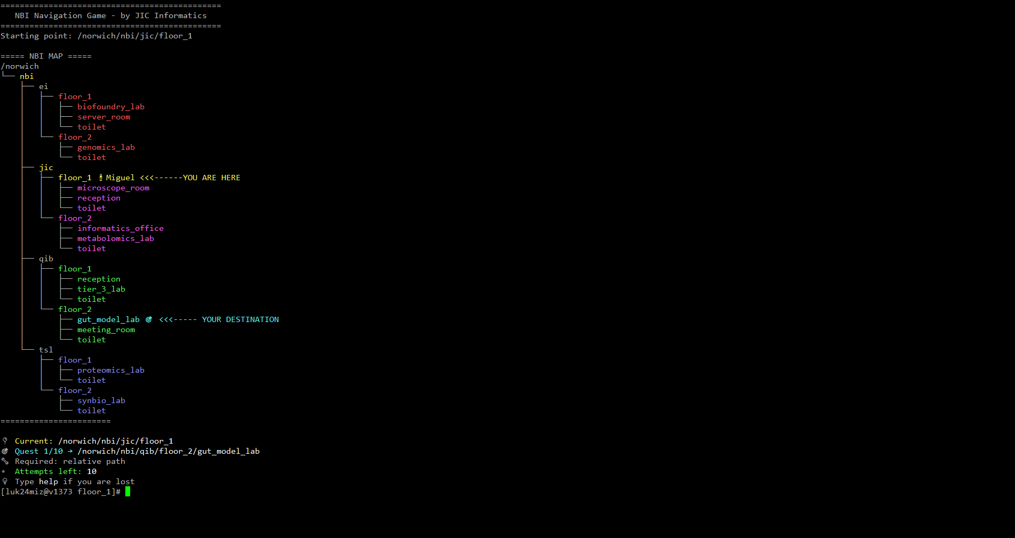
[Relative and absolute paths]
Relative paths:
  ../tsl/floor_1/proteomics_lab
  ./nbi/ei/floor_2/genomics_lab
  toilet
Absolute paths:
  /Norwich/nbi/jic/floor_1
  /Norwich/
  /Norwich/nbi/qib/floor2/toilet

Slide 50
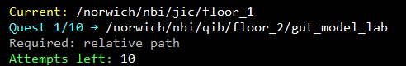
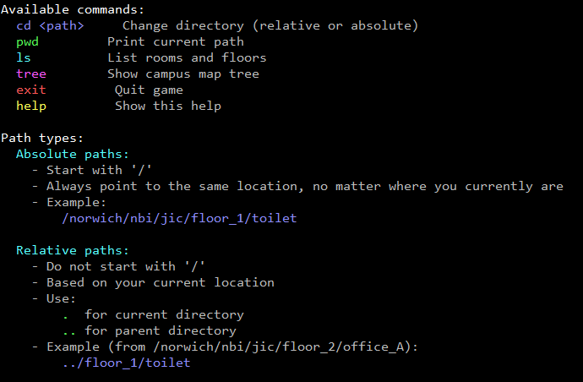
[Exercise 2]
Type nbipath on the terminal and play the path game.

Slide 51
[Creating, moving and copying]
mkdir make a new directory
rmdir remove an empty directory
cp copy a source to a destination (-r for directories)
mv move a source to a destination
rm remove a file (-r for directories)
touch update the access date and/or modification date of a file, but if it does not exist the file is created, quite useful sometimes to reserve a filename.

Slide 52
[Exercise 3]
Inside your u_drive directory create a new directory named house.
Inside the house directory create a few directories named living-room, toilet, dining-room and kitchen
Create a file named chair.file inside the toilet, then move it to the dining-room.
Copy the chair.file from the dining-room to the kitchen.
Create a new file inside the kitchen named shower.file, after that copy the shower.file into the toilet and then remove the shower.file from the kitchen.
Create more rooms/furniture and move and copy them around the house.

Slide 53
[rsync]
Unlike cp, which copies files in full each time, rsync detects and transfers only the parts of files that have changed. This makes it significantly faster and more efficient for repeated or large-scale syncs. Additionally, rsync supports powerful features and resume capabilities, which cp does not.
Works locally or over SSH for remote sync.
Supports exclusions, compression, and dry-run options.
Commonly used for backups and mirroring
Basic flags:
  -a (archive): Enables recursive copy and preserves symbolic links, permissions, timestamps, group, and owner.
  -v (verbose): Shows detailed output of what rsync is doing.
  -z (compress): Compresses data during transfer (useful for slow network connections).

Slide 54
[rsync – Command Structure & Examples]
Basic Syntax:
  rsync [options] source destination
Examples:
  Local sync:
    rsync -av /data/source/ /backup/data/
  Remote sync over SSH:
    rsync -avz /data/ user@remote:/backup/
  With exclusions:
    rsync -av --exclude '*.tmp' /data/ /backup/
  Dry run (preview changes):
    rsync -av --dry-run /data/ /backup/

Slide 55
[Working with compressed data]
Bioinformatics files are huge, and compression reduces storage needs, speeds up transfers, and minimises I/O bottlenecks. Many tools can process compressed files directly, improving efficiency.
gzip — compress a file and adds .gz extension.
gunzip — decompress .gz files.
zcat — view or concatenate compressed files without decompressing.
tar — archive multiple files into one (a tarball).
Tar examples:
  tar -cvf archive.tar file1 file2 → create a tarball containing file1 and file2
  tar -xvf archive.tar → extract contents from archive.tar
  tar -czvf archive.tar.gz dir/ → compress a directory into a .tar.gz archive
  tar -xzvf archive.tar.gz → extract a .tar.gz archive

Slide 56
[Exercise 4]
Exercise 1: copy the folder compressing_exercise using rsync from / into your u_drive directory in your home.
Exercise 2: Compress reference.fastq using gzip.
Exercise 3: View the contents without decompressing.
Exercise 4: Uncompress the file.
Exercise 5: compress the data/ folder. Check the size using du -sh data/ data_archive.tar.gz.
Exercise 6: Remove the current data/ folder and extract it from the archive.

Slide 57
[md5sum – File Integrity Check]
Calculates a 128-bit hash (checksum) for files.
Used to verify file integrity after transfers or backups.
Simple to use:
  md5sum filename (can be piped to a file > checksum.txt).
Compare with expected checksum:
  md5sum -c checksums.txt
Note: Recompressing or uncompressing a file changes its MD5 — even if the original content remains the same.

Slide 58
[Exercise 5]
Create the md5sum from reference.fastq.
Copy the file and get the md5sum from the new file and compare it to the old one.
Add a space to the file and get the md5sum, compare it to the original.
Remove the space and get again the md5sum. What has happened?

Slide 59
[Find]
. → current directory
-iname → case-insensitive name search
-mtime → files modified in last N days
Search for files and directories based on name, type, size, or other attributes.
find [path] [options] [expression]
Find by name: find /home/user -name "file.txt"
Find by type: find /var -type d (directories) / find /var -type f (files)
Find by size: find / -size +100M (files larger than 100 MB)
Tips:
    . → current directory
    -iname → case-insensitive name search
    -mtime → files modified in the last N days
- Examples:
  find . -name "*.fastq.gz"
  find . -name "*.fastq“
  find . -type f -size +100M
  find . -type f -size +1M
  find . -type f -mtime +5000

Slide 60
[Exercise 6]
Copy /datamanagement to your ~/u_drive folder.
Find uncompressed fasta files in there and compress them.
Find any file bigger than 100MB
Find the files older than a year in the original /datamanagement directory
Notes:
find . -name "*.fastq.gz"
find . -name "*.fastq“
find . -type f -size +100M
find . -type f -size +1M
find . -type f -mtime +5000

Slide 61

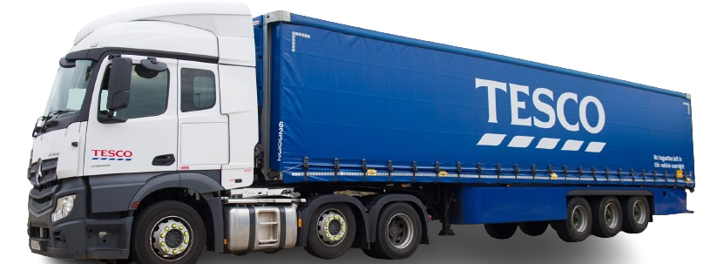
[Big data -> HPC Storage]
So far, the scope has been restricted to small datasets, but the aim of this course is to handle large sequences, big batches of images… in other words, big scientific data.
As mentioned earlier, the data should be stored on the NBI HPC storage.
Research Computing manages between all of the institutes’ resources more than 40PB of data storage across over 3500 disk drives, with an additional over 600TB used solely for performance.

Slide 62
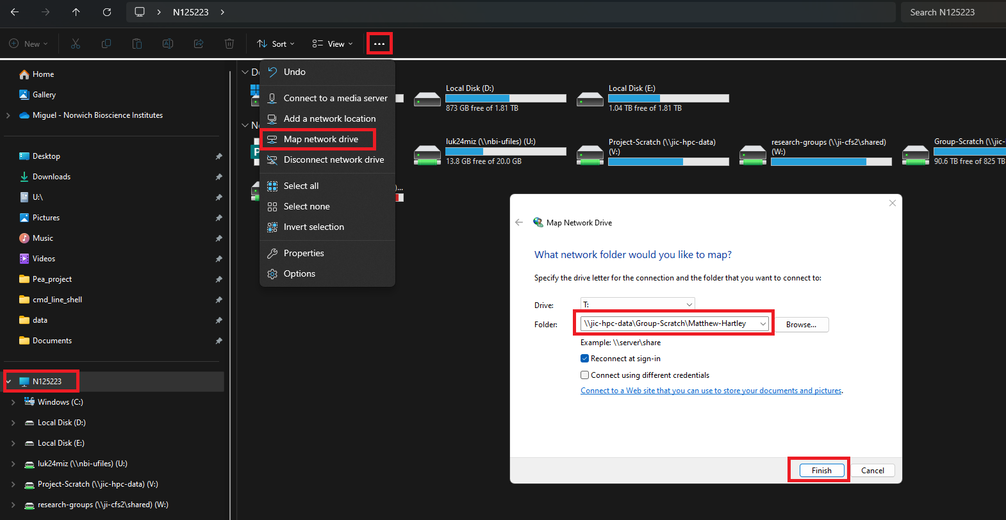
[Accessing HPC storage from Windows ]
\\jic-hpc-data\HPC-Home for the home directory
Notes:
\\jic-hpc-data\HPC-Home for the home directory

Slide 63
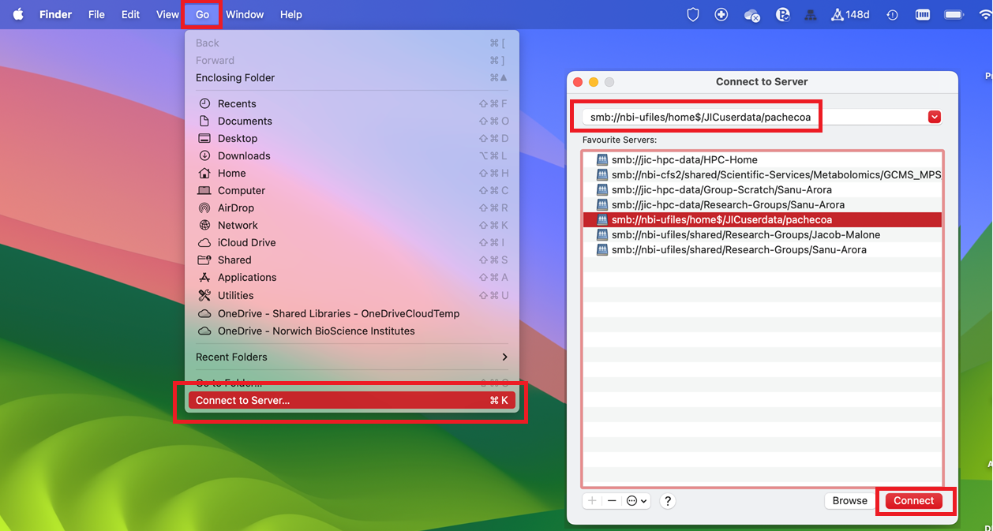

[Accessing HPC storage from macOS ]

Slide 64
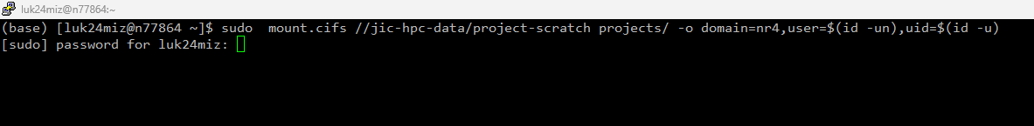
[Accessing HPC storage from Linux ]
As a Linux user you are brave enough and you are on your own.
Jokes aside, you need sudo rights at least to run the “mount” command.
This is an example on hoy to mount the project scratch folder:

Slide 65
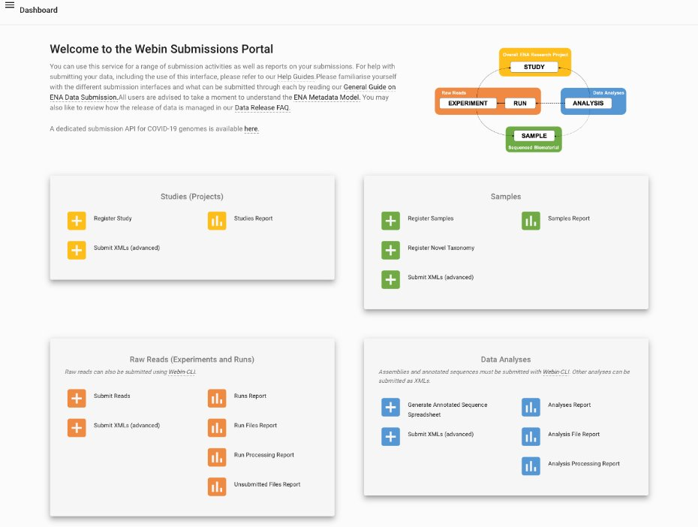
[Uploading to EBI]
Two main systems of interest
ENA – for sequence data
  https://www.ebi.ac.uk/ena/submit/webin/
Array Express
  https://www.ebi.ac.uk/biostudies/arrayexpress.
  For raw sequence data + processed results.
  Array Express links processed data to the raw sequenced data.
https://www.youtube.com/watch?v=ANr2PTVy7JA
Make sure your raw data file names contain only letters, numbers, dots and underscores. Nothing else.
You will need to fill in a lot of metadata and upload using FTP.
Support response time frame is 3 weeks currently – so start early!!

Slide 66

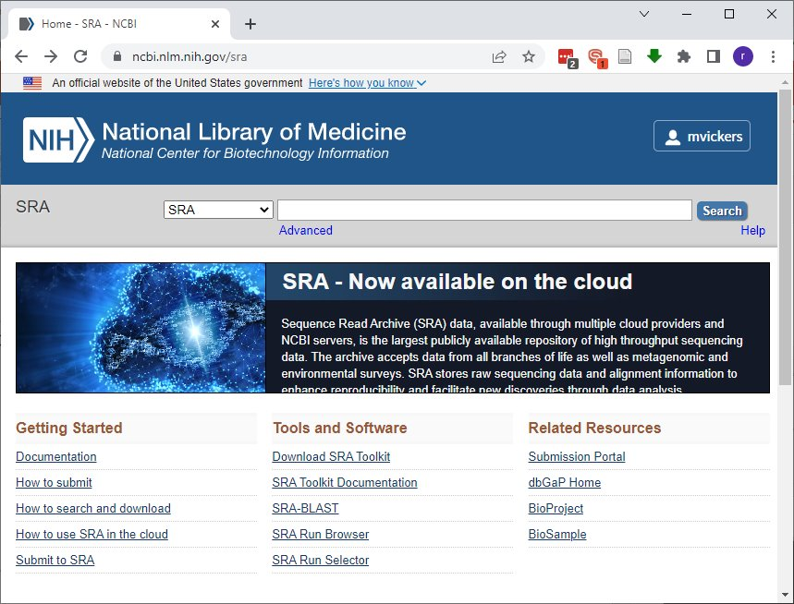
[Uploading to SRA]
For RAW data​.
Perfect for NGS sequencing​.
Enforces some basic metadata.

Slide 67
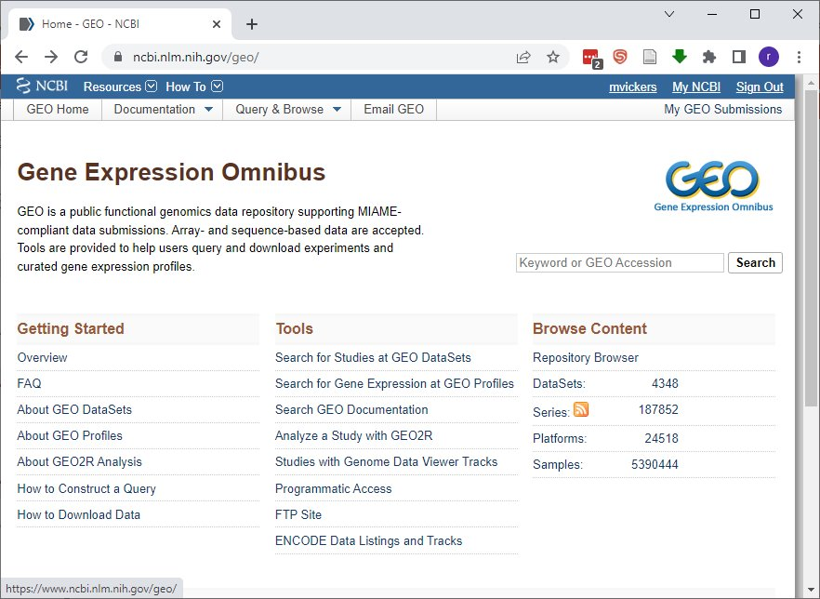
[Uploading to GEO]
Great for NGS experiments​.
  RAW + processed data​.
Automatically uploads raw data to SRA​.
Pretty good at enforcing metadata​.
Queries often answered within a working day​.
Brief look at metadata sheet (included in your resources).

Slide 68
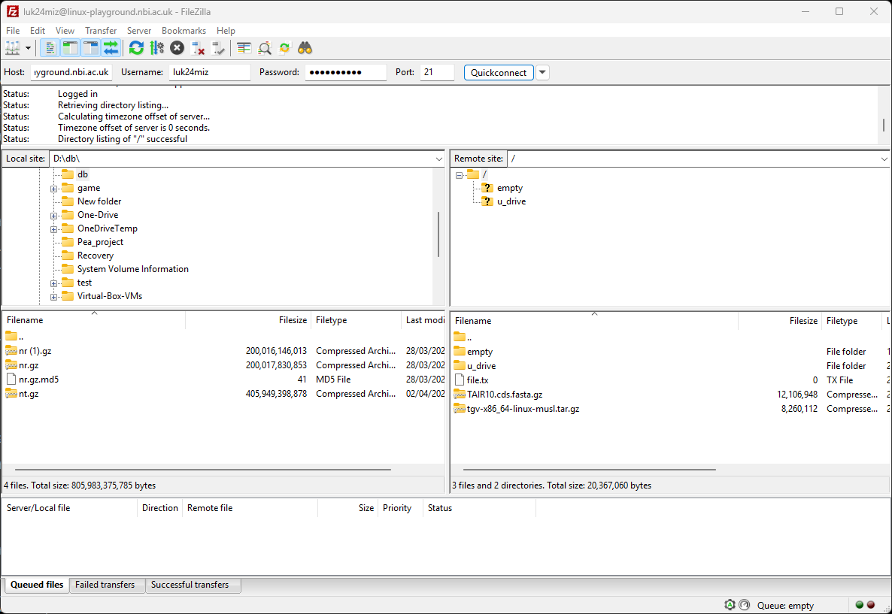
[FTP Filezilla]
Host
Username
Password
Port
YOUR DEVICE
REMOTE SITE
PROGRESS
Notes:
It's not really used much anymore because it's not encrypted; however, it’s fast (because it doesn’t have the encryption overhead), so it's still used to transfer data to NCBI and EBI. That's why we are showing it to you. Other than uploading data to NCBI/EBI, don't use it in normal operation"

Slide 69
[Downloading data into the HPC]
Accessing the HPC Storage:
  Users must use their own devices as a gateway to interact with the HPC storage.
  External access from the HPC is limited, with only a few exceptions (online databases/repositories) permitted.
Download partition:
  JIC informatics, Research Groups, Data champions and designated users can download data into the HPC storage through the download partition.
Sharing data in/out:
  Dropoff (https://dropoff.nbi.ac.uk/) up to 300GB, easy to use.
  Globus (https://www.globus.org/) No data limit.

Slide 70
[Exercise 7]
Map your HPC-home folder.
Create a file with your username in your U drive
Use Filezilla to upload the file to the ftp version of linux-playground
Notes:
U drive \\ji-cfs2\luk24miz
HPC-home \\jic-hpc-data\HPC-Home

Slide 71
[JIC archive – Data Champion]
jic-data-mover{01..06} is accessible only by data champions and is the only way to write to /jic/archive.
/jic/{scratch,research-groups} etc. read only on jic-data-mover{01..06} to prevent accidental deletion.
/jic/archive is read only to group members across HPC.
/jic/archive has snapshots.

Slide 72
[TSL Users]
TSL has specific policies and metadata requirements:
To find out more, you can visit:
  https://bioinformatics.tsl.ac.uk/posts/workflows-and-literate_compute/
  https://bioinformatics.tsl.ac.uk/ )
  https://intranet.nbi.ac.uk/cms/6741
But as I said earlier, please contact the TSL Bioinformatics teams if you have any doubts.

Slide 73
[Concluding Recommendations]
Data integrity Quality Checks before analyses​.
Check that you've downloaded the data correctly​.
Keep raw data and derived data separate​.
Compress your sequence data​.
Keep redundancy low. Remove intermediate files. Regular cleanup.​
Use your resources wisely​.
Archive important data.
Follow BioFAiR recommendations.
Get your data ready for A.I.
Ask, we are here to help.

Slide 74
[Take home message]
Know your institution's data policy.
Talk to your informatics team early and often.
Consider becoming a data champion in your group.
Develop and align on common data practices within your group.
Store data on resilient, backed-up infrastructure.
Organise your metadata clearly and consistently.
Keep your data safe. Annotate it. Don’t waste storage resources.
Notes:
THIS IS THE LAST SLIDE!!!

Slide 75

[Bioinformatics Drop-in Sessions]
Wednesdays at 11:00-12:00 in the Rec.
Free Biscuits available.
Come and ask questions/talk Bioinformatics:
Some things we may be able to help with right away, some we may need to think about. We can do some thinking before the session.
(and may give better answers) if you email us beforehand at informatics@jic.ac.uk
ALL WELCOME

Slide 76
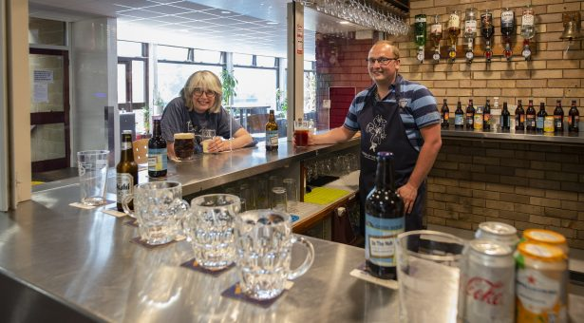
[REC]
I organise the REC-ROTA. We are always welcoming volunteers to join us to help on Fridays at the bar, and we pay in drinks!

Slide 77
[Upcoming courses]
16-06-2026 Introduction to Python – Part 1.
17-06-2026 Introduction to Python – Part 2.
18-06-2026 Introduction to Python – Part 3.
23-09-2026 Invitation to AI.
14-10-2026 Bioinformatics and how to learn it.
Notes:
THIS IS THE LAST SLIDE!!!

Slide 78
[Ideal Data Pipeline]
SOP AND PROCEDURES
RESOULTS
REMOVED
ISILON ARCHIVE
RAW DATA
HEAVY INTERMEDIATE FILES
ISILON SCRATCH
PUBLICATION
ISILON ARCHIVE
SCRIPTS AND WORKFLOWS
HPC HOME DIRECTORY
ONLINE REPOSITORY
Notes:
THIS IS THE LAST SLIDE!!!

Slide 79
[Questions?]
Notes:
THIS IS THE LAST SLIDE!!!

