Slide 1
































Reconnaissance
Resource Development
Initial Access
Execution
Persistence
Privilege Escalation
Defense Evasion
Command and
Scripting Interpreter
Account Manipulation
File and Directory
Permissions Modification
Active Scanning
Acquire Infrastructure
Drive-by Compromise
Access Token Manipulation
Exploit Public-
Facing Application
Event Triggered
Execution
Gather Information
Hide Artifacts
Compromise Accounts
Native API
Create or Modify System Process
Hardware Additions
Office Application Startup
Modify Authentication
Process
Supply Chain
Compromise
Search Sources
Compromise Infrastructure
System Services
Process Injection
External Remote
Services
Scheduled Task/Job
Impair Defenses
Search Open Websites/Domains
Obtain Capabilities
Phishing
User Execution
Valid Accounts
Signed Binary
Proxy Execution
Pre-OS Boot
Gather Victim Network Information (6)
Gather Victim Org Information (4)
Phishing for Information (3)
Search Closed Sources (2)
Search Open Technical Databases
Search Open Websites/Domains (2)
Search Victim-Owned Websites
Acquire Infrastructure (6)
Compromise Accounts (2)
Compromise Infrastructure (6)
Develop Capabilities (4)
Establish Accounts (2)
Obtain Capabilities (6)
Drive-by Compromise
Exploit Public-Facing Application
External Remote Services
Hardware Additions
Phishing (3)
Replication Through Removable Media
Supply Chain Compromise (3)
Trusted Relationship
Valid Accounts (4)
Command and Scripting Interpreter (7)
Exploitation for Client Execution
Inter-Process Communication (2)
Native API
Scheduled Task/Job (5)
Shared Modules
Software Deployment Tools
System Services (2)
User Execution (2)
Windows Management Instrumentation
Account Manipulation (4)
BITS Jobs
Boot or Logon Autostart Execution (11)
Boot or Logon Initialization Scripts (5)
Browser Extensions
Compromise Client Software Binary
Event Triggered Execution (15)
External Remote Services
Hijack Execution Flow (11)
Implant Container Image
Office Application Startup (6)
Pre-OS Boot (3)
Scheduled Task/Job (5)
Server Software Component (3)
Traffic Signaling (1)
Valid Accounts (4)
Abuse Elevation Control Mechanism (4)
Boot or Logon Autostart Execution (11)
Boot or Logon Initialization Scripts (5)
Create or Modify System Process (4)
Event Triggered Execution (15)
Exploitation for Privilege Escalation
Group Policy Modification
Hijack Execution Flow (11)
Process Injection (11)
Scheduled Task/Job (5)
Valid Accounts (4)
Access Token Manipulation (5)
BITS Jobs
Direct Volume Access
Exploitation for Defense Evasion
Hide Artifacts (6)
Hijack Execution Flow (11)
Impair Defenses (6)
Indicator Removal on Host (6)
Indirect Command Execution
Masquerading (6)
Subvert Trust Controls (4)
Template Injection
Traffic Signaling (1)
Unused/Unsupported Cloud Regions
Valid Accounts (4)
Virtualization/Sandbox Evasion (3)
Notes:
ATT&CK简介：ATT&CK是美国研究机构MITRE于2014年推出的新型攻击框架。ATT&CK将已知攻击者的行为汇总成一种包含战术和技术的结构化列表，由于此列表相当全面的呈现了攻击者再攻击网络时所采用的行为，因此对于各种进攻性和防御性考量机制十分有用。简单来说，ATT&CK是MITRE提供的“对抗战术、技术和常识”框架，是由攻击者在攻击企业时会利用的14种战术和301种企业技术组成的精选知识库。
页面内容：本页直观地展示了ATT&CK涉及的前7种攻击战术，分别是“Reconnaissance（侦查）”、“Resource Development（资源开发）”、“Initial Access（初试访问）”、“Execution（执行）”、“Persistence（持续）”、“Privilege Escalation（特权提升）”、“Defense Evasion（防御规避）”，攻击战术展示在页面顶部，每列下面以图标和文字方式列出了单独的技术。其中括号表示该项技术下具体的企业技术数量。一个攻击序列按照战术，至少包含一个技术，并且通过从左侧（初始访问）向右侧（影响）移动，就构建了一个完整的攻击序列。

Slide 2

































Credential Access
Discovery
Lateral Movement
Collection
Command
and Control
Exfiltration
Impact
Network Sniffing
Account Discovery
Lateral Tool Transfer
Data from Local System
Proxy
Account Access
Removal
Exfiltration Over
Physical Medium
Cloud Service Discovery
Encrypted Channel
Firmware Corruption
Man-in-the-Middle
Remote Services
Email Collection
Exfiltration Over
Alternative Protocol
Credentials from
Password Stores
Software Discovery
Application Layer
Protocol
Service Stop
Data from
Information Repositories
Permission Groups
Discovery
Exfiltration Over
Physical Medium
Steal or Forge
Kerberos Tickets
Replication Through
Removable Media
Network Denial
of Service
Data Encoding
Browser Bookmark Discovery
Archive Collected Data
Traffic Signaling
Exfiltration Over
Other Network Medium
System Shutdown/
Reboot
Steal Web Session Cookie
Remote Service Session Hijacking
Input Capture
Brute Force (4)
Credentials from Password Stores (3)
Exploitation for Credential Access
Forced Authentication
Input Capture (4)
Man-in-the-Middle (1)
Modify Authentication Process (3)
Network Sniffing
Steal Application Access Token
Steal or Forge Kerberos Tickets (3)
Steal Web Session Cookie
Account Discovery (4)
Application Window Discovery
Browser Bookmark Discovery
Cloud Service Dashboard
Cloud Service Discovery
Domain Trust Discovery
File and Directory Discovery
Network Service Scanning
Password Policy Discovery
Peripheral Device Discovery
System Network Connections Discovery
System Owner/User Discovery
System Service Discovery
System Time Discovery
Virtualization/Sandbox Evasion (3)
Exploitation of Remote Services
Internal Spearphishing
Lateral Tool Transfer
Remote Service Session Hijacking (2)
Remote Services (6)
Replication Through Removable Media
Software Deployment Tools
Taint Shared Content
Use Alternate Authentication Material (4)
Archive Collected Data (3)
Audio Capture
Automated Collection
Clipboard Data
Data from Cloud Storage Object
Data from Information Repositories (2)
Data from Local System
Data from Network Shared Drive
Data Staged (2)
Email Collection (3)
Input Capture (4)
Man in the Browser
Man-in-the-Middle (1)
Screen Capture
Video Capture
Application Layer Protocol (4)
Communication Through Removable Media
Data Encoding (2)
Data Obfuscation (3)
Dynamic Resolution (3)
Encrypted Channel (2)
Fallback Channels
Ingress Tool Transfer
Multi-Stage Channels
Non-Standard Port
Protocol Tunneling
Proxy (4)
Remote Access Software
Traffic Signaling (1)
Web Service (3)
Automated Exfiltration
Exfiltration Over Alternative Protocol (3)
Exfiltration Over C2 Channel
Exfiltration Over Other Network Medium (1)
Exfiltration Over Physical Medium (1)
Exfiltration Over Web Service (2)
Scheduled Transfer
Transfer Data to Cloud Account
Data Destruction
Data Manipulation (3)
Defacement (2)
Disk Wipe (2)
Endpoint Denial of Service (4)
Firmware Corruption
Inhibit System Recovery
Network Denial of Service (2)
Resource Hijacking
Service Stop
System Shutdown/Reboot
Notes:
本页承接上页，直观地展示了ATT&CK涉及的后7种攻击战术，分别是“Credential Access（凭证访问）”、“Discovery（发现）”、“Lateral Movement（横向运动）”、“Collection（采集）”、“Command and Control（命令与控制）”、“Exfiltration（渗出提升）”、“Impact（影响力）”，攻击战术同样地展示在页面顶部，每列下面是单独的技术项名称和数量。一个攻击序列按照战术，至少包含一个技术，并且通过从上页第一项攻击战术Reconnaissance（侦查）逐步向Impact（影响力）移动，就构建了一个完整的攻击序列。一种战术可能使用多种技术。例如，攻击者可能同时尝试鱼叉式网络钓鱼攻击中的钓鱼附件和钓鱼链接。
本项目正式基于ATT&CK框架的主要攻击战术展开攻击行为分析和攻击溯源研究。

Slide 3
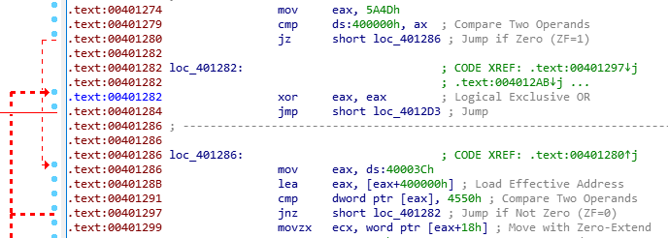
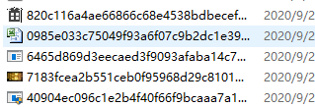

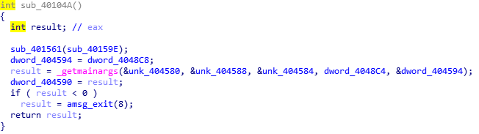
静 态 分 析
APT组织写的代码都有自己的特色，我们通过对比这些汇编指令与先前攻击的汇编指令的相似性或特征，能够判断其攻击的来源。
通过学习这些伪代码的函数方法，分析其执行结果，与先前攻击的伪代码对比，分析其相似性进而溯源。
利用Ida等反编译工具来解析APT攻击样本，通过分析其生成的汇编指令与伪代码等底层特征，与先前攻击样本相应特征进行对比，分析相似性来进行溯源。

Slide 4



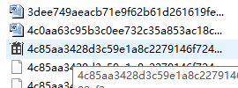
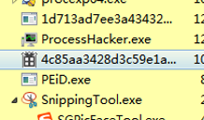

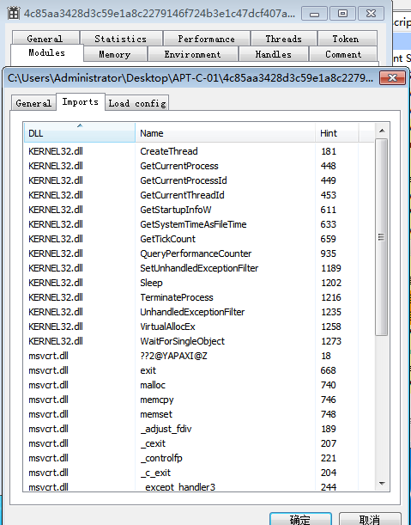
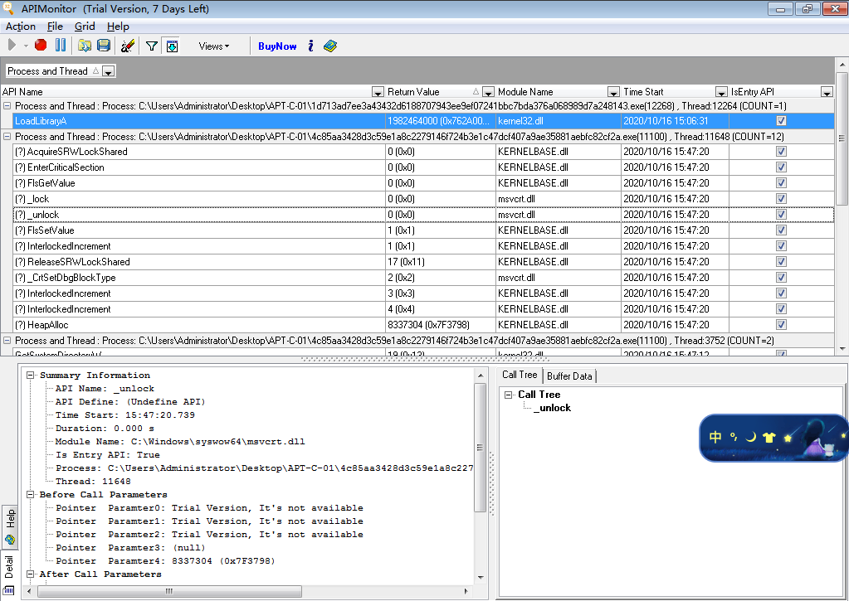
动 态 分 析
监控系统中创建的可疑文件，以及创建的可疑进程
恶意文件所创建的的相关线程
查看恶意文件影响的dll文件
监视和控制应用程序和服务，看到的应用程序和服务是如何工作的，或跟踪应用程序的问题
利用Everything、 Process Hacker、 API Monitor等监控工具来多方位分析apt攻击样本，了解其恶意软件对用户电脑和环境所造成的影响。

Slide 5
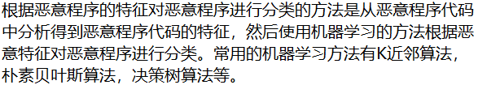
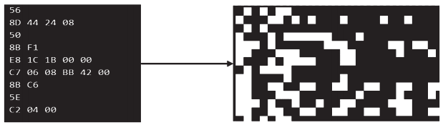

恶意程序分类
恶意程序分类的方法包括传统的分类方法和基于机器学习的分类方法两大类：
恶意程序的传统分类方法包括静态检测技术和动态检测技术两大类。
基于机器学习的恶意程序分类方法包括根据恶意程序的特征对恶意程序进行分类的方法和将恶意程序代码转化为恶意代码特征图，然后对恶意代码特征图进行分类的方法。

Slide 6
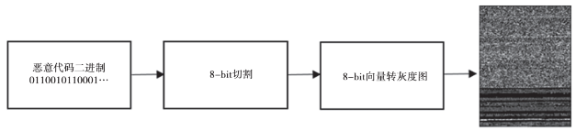

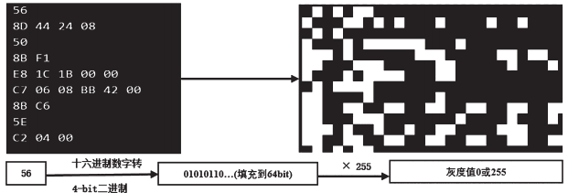

基于恶意程序代码特征图的恶意程序分类
2011年，Nataraj提出了恶意代码图像化的方法，这种方法在处理恶意代码时无需解析PE文件格式、无需动态执行恶意代码、同时具有较好的对抗能力。
2015年黑帽大会上，Andrew提出了另一种基于反汇编文件的恶意代码矢量化思路，与Nataraj的方法相比，Andrew矢量化具有更好的视觉可解释性。
而在恶意代码特征图的分类模型方面，目前大多数方法都是使用卷积神经网络或者根据任务的需要对卷积神经网络进行一定的修改。

