Slide 1

TOTAL BODY THERAPY & WELLNESS
Lymphedema & Lipedema
SCAN TO FOLLOW ALONG
Staging, Differential Diagnosis, and Physical Therapy Management
Dr. Sara S. Morrison
PT, DPT, CDT, Cert DN, PCES, CFT, FMT
Founder & Lead Physical Therapist
Presentation, outline & self-check quiz
260 Pine State Street, Lillington, NC 27546 · (910) 893-2850 · tbtwonline.com
Notes:
Welcome. Point the room at the QR code before you start — it opens this presentation, the outline, and a 12-question self-check quiz.
Educational use only. Not a substitute for individualized medical evaluation or care.

Slide 2
ABOUT
About Total Body Therapy & Wellness
Founded in Lillington, NC in 2008 with the goal of bringing exceptional "Big City Care" to a small-town community. Physical therapy in Harnett County since 2002.
Patient-centered, one-on-one treatment every visit
Certified Lymphedema Therapists (CLT) on staff
Whole-person approach — we treat the total body, not just the part
Patient education as a core part of the plan of care
260 Pine State Street, Lillington, NC 27546 · (910) 893-2850 · tbtwonline.com
2
Notes:
Establish credibility briefly, then move on. Both therapists are CLTs.

Slide 3
OBJECTIVES
On completion you will be able to
1. Describe the structure and function of the lymphatic system
2. Differentiate primary from secondary lymphedema and identify risk factors
3. Recognize the symptomatology and clinical presentation of lymphedema
4. Perform and interpret key diagnostic tests, including Stemmer's sign
5. Stage lymphedema using ISL criteria, Stage 0 through Stage III
6. Apply the four components of Complete Decongestive Therapy
7. Select an appropriate long-term compression garment, including adjustable wrap and custom options
8. Distinguish lipedema from lymphedema and stage lipedema appropriately
9. Identify red flags requiring physician referral
10. Identify gait, balance, and orthopedic needs that persist after decongestion
3
Notes:
Read these quickly — they double as the roadmap for the session.

Slide 4
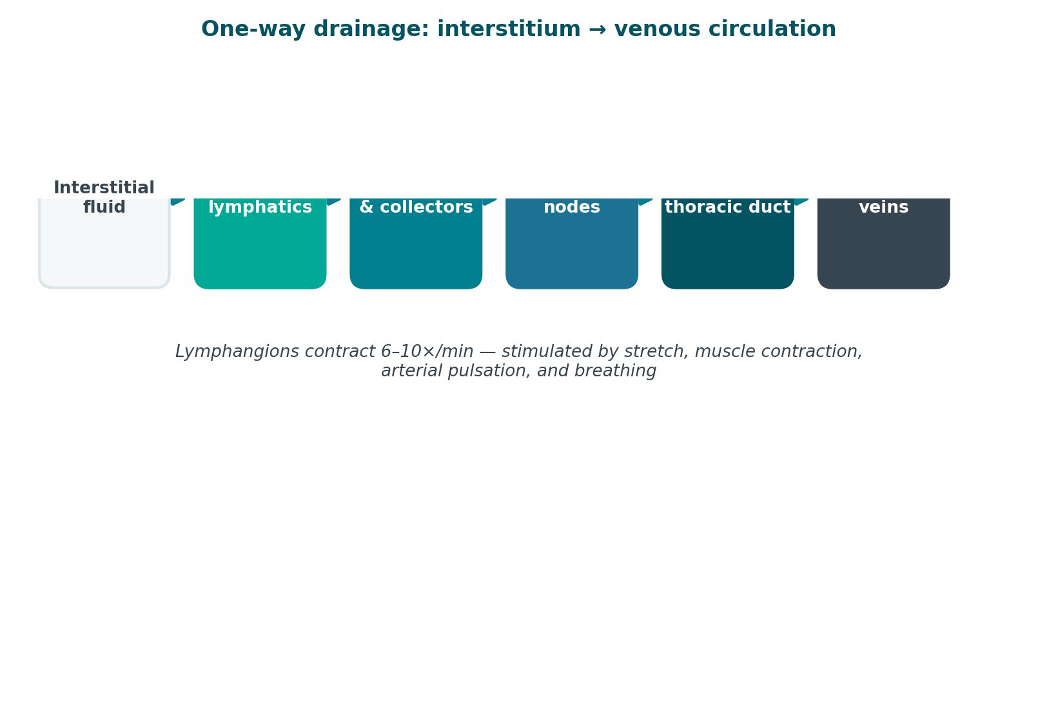
FOUNDATIONS
The Lymphatic System
A one-way drainage network running parallel to the venous system, returning fluid, protein, and immune cells to circulation.
Three jobs
Fluid balance — returns 2–4 L/day to circulation
Protein transport — the only route back for large proteins
Immune surveillance — nodes filter, host lymphocytes
The pathway
Initial lymphatics collect interstitial fluid
Collectors move lymph via lymphangions
Regional nodes filter the load
Thoracic duct → subclavian veins
4
Notes:
Lymphangion contraction is the primary pump. It is stimulated by stretch, muscle contraction, arterial pulsation, and breathing — which is exactly why exercise and diaphragmatic breathing are treatment, not just adjuncts.

Slide 5
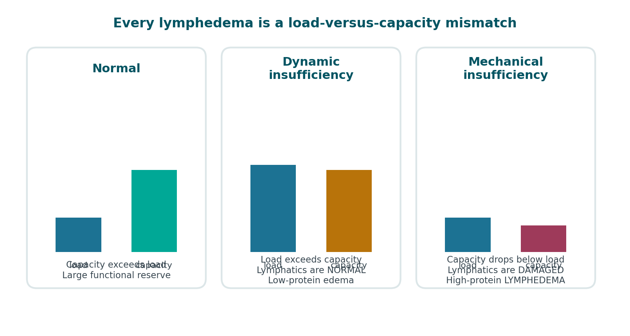
FOUNDATIONS
Lymph Load vs. Transport Capacity
Every case of lymphedema is a mismatch between how much fluid needs to move and how much the system can move.
Combined insufficiency — high load AND damaged system — is common in the patients you will actually see.
5
Notes:
[OPTIONAL — safe to cut]
Combined insufficiency — high load AND damaged system — is common in the patients you will actually see.

Slide 6
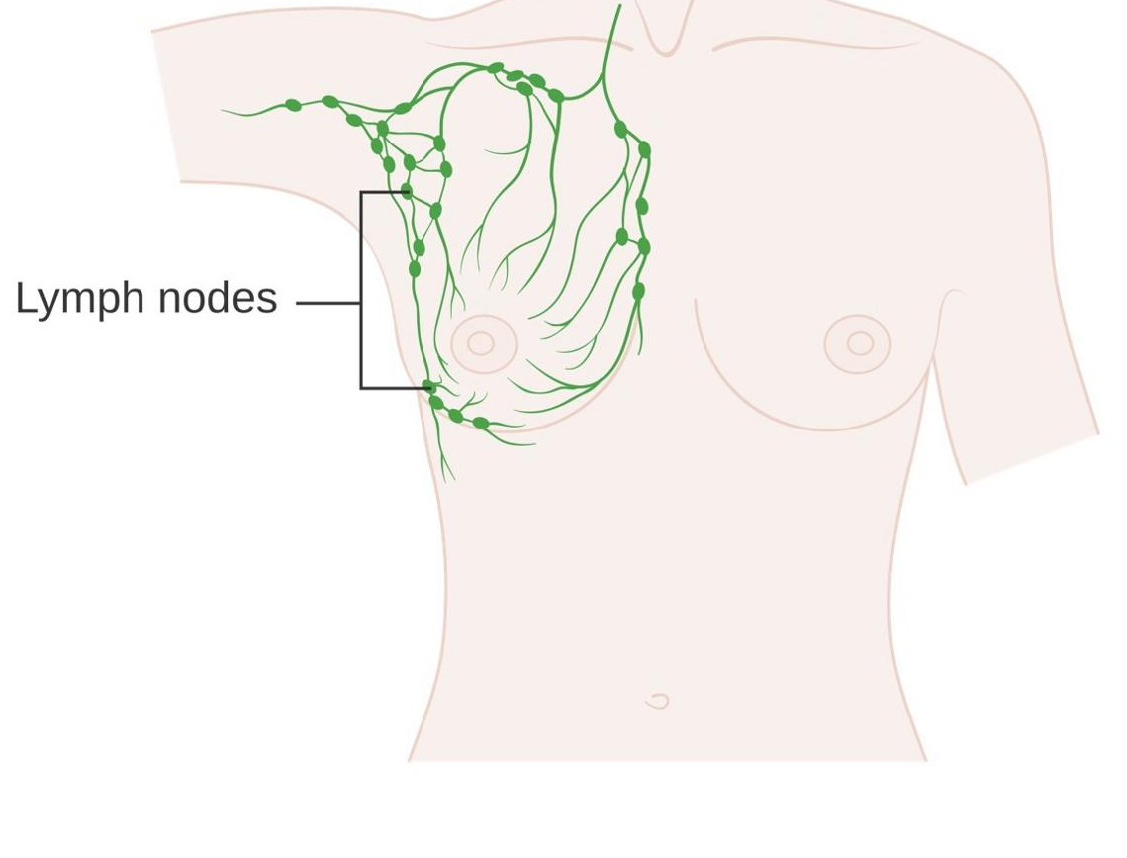
ETIOLOGY
Primary vs. Secondary Lymphedema
Primary lymphedema arises from congenital lymphatic dysplasia. Secondary lymphedema follows anatomical disruption of a previously normal system.
Primary — developmental
Congenital — birth to age 2, incl. Milroy disease
Praecox — puberty to 35. Most common primary form.
Tarda — after 35
Secondary — acquired
Cancer treatment — node dissection and/or radiation. Leading cause here.
Filariasis — leading cause worldwide
Trauma, surgery, burns
Chronic venous insufficiency → phlebolymphedema
Recurrent infection and obesity
6
Notes:
Risk multipliers after cancer treatment: extent of node dissection, regional radiation, elevated BMI, post-op infection, wound complications, and taxane-based chemotherapy.

Slide 7
PRESENTATION
Symptomatology
Subjective symptoms frequently precede visible swelling by months. Do not wait for a measurable difference to take a patient seriously.
Early — often reported before anything is visible
Established
Do not overlook
Heaviness, fullness, tightness
Clothing, rings or shoes fitting differently
Aching without a mechanical cause
Swelling that resolves overnight
Persistent swelling, no longer resolving with elevation
Pitting → non-pitting as fibrosis develops
Skin thickened and firm
Positive Stemmer's sign
Recurrent cellulitis
Psychosocial burden — body image, social withdrawal
Functional loss — grip, reach, gait, footwear
Occupational impact and garment cost
7
Notes:
Lymphedema is typically painless early. New or significant pain suggests infection, DVT, malignancy — or lipedema, which is painful by definition.

Slide 8
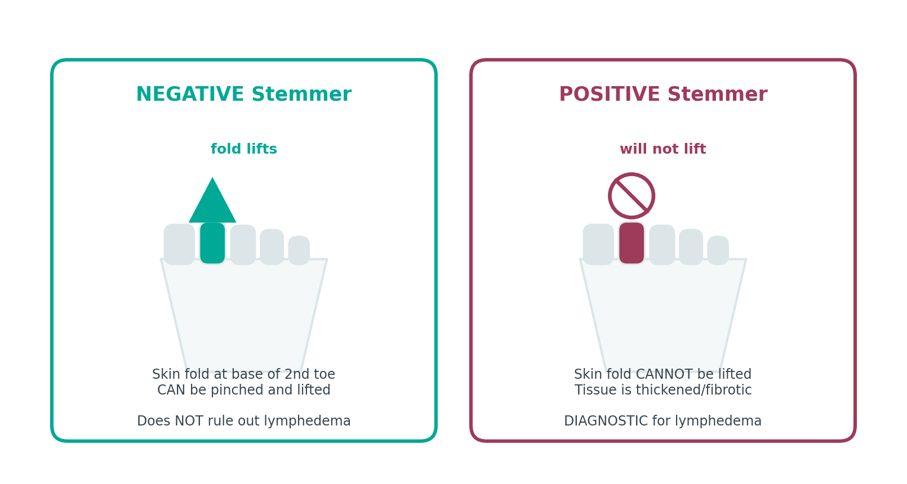
ASSESSMENT
Diagnosis — History & Examination
Diagnosis is primarily clinical. History and physical examination identify the great majority of cases.
History
Onset, duration, whether it resolves overnight
Surgical and oncologic history — nodes, radiation fields
Every episode of cellulitis
Family history; travel history
Physical examination
Stemmer's sign — cannot lift the skin fold = positive = lymphedema
Pitting — depth and rebound, graded 1+ to 4+
Skin — texture, papillomas, fissures, fungal infection
Compare sides — symmetry, foot involvement
8
Notes:
Severity by volume difference vs. the contralateral limb: minimal <20%, moderate 20–40%, severe >40%.

Slide 9
ASSESSMENT
Diagnosis — Measurement & Imaging
Objective measurement
Imaging — when the picture is unclear
Circumferential tape at 4 cm intervals — cheap, reliable
Volumetry — water displacement
Perometry — infrared, fast and reproducible
Bioimpedance (L-Dex) — can detect Stage 0
Lymphoscintigraphy — the imaging standard
ICG lymphography — maps superficial vessels
Duplex US — rule out DVT
MRI / CT — rule out malignancy
9
Notes:
Severity by volume difference vs. the contralateral limb: minimal <20%, moderate 20–40%, severe >40%.

Slide 10
ASSESSMENT
What Else Swells a Limb
Before you treat it as lymphedema, rule these out.
Condition | Distinguishing features
Deep vein thrombosis | Acute unilateral onset, pain, warmth, erythema. URGENT — do not perform MLD.
Chronic venous insufficiency | Hemosiderin staining, varicosities, medial malleolar ulceration, improves with elevation
Congestive heart failure | Bilateral, dependent, pitting, dyspnea, JVD, orthopnea
Hypoproteinemia | Bilateral, generalized, may include ascites/periorbital edema
Lipedema | Bilateral, symmetrical, painful, bruises easily, SPARES THE FEET, negative Stemmer
Malignant lymphedema | Rapid onset, pain, proximal-first, neurologic signs. Requires imaging.
Cellulitis | Fever, spreading erythema, heat, pain. Antibiotics first — MLD contraindicated.
Medication-induced | Calcium channel blockers, NSAIDs, steroids, gabapentin, some diabetes drugs
Malignant lymphedema and DVT are the two that must not be missed. Both are referrals, not treatment plans.
10
Notes:
[OPTIONAL — safe to cut]
Malignant lymphedema and DVT are the two that must not be missed. Both are referrals, not treatment plans.
SUGGESTED IMAGES FOR THIS SLIDE
· Wikimedia — “deep vein thrombosis leg”
https://commons.wikimedia.org/w/index.php?search=deep%20vein%20thrombosis%20leg&title=Special:MediaSearch&type=image
· Wikimedia — “chronic venous insufficiency”
https://commons.wikimedia.org/w/index.php?search=chronic%20venous%20insufficiency&title=Special:MediaSearch&type=image
· Wikimedia — “cellulitis leg”
https://commons.wikimedia.org/w/index.php?search=cellulitis%20leg&title=Special:MediaSearch&type=image

Slide 11
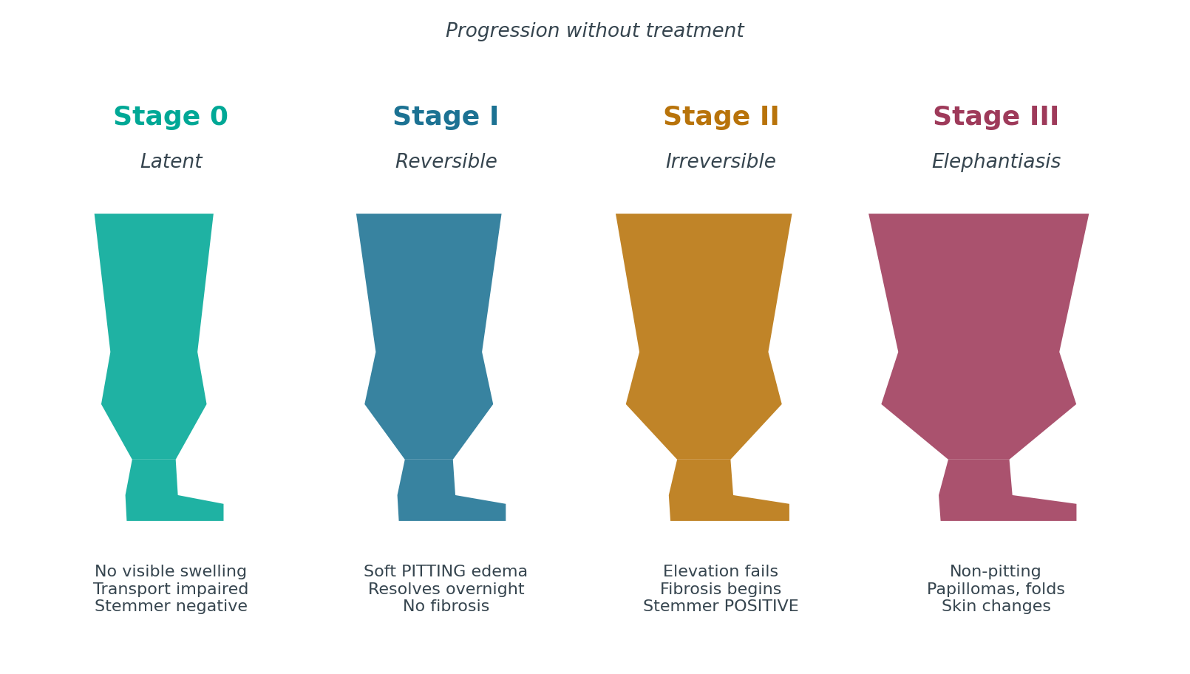
STAGING
ISL Staging — Overview
The International Society of Lymphology defines four stages. Stage 0 is latent — the lymphatics are already impaired before anything is visible.
Staging describes tissue condition, not size. A small Stage III limb is still Stage III. Severity is graded separately by volume difference.
11
Notes:
Staging describes tissue condition, not size. A small Stage III limb is still Stage III. Severity is graded separately by volume difference.

Slide 12
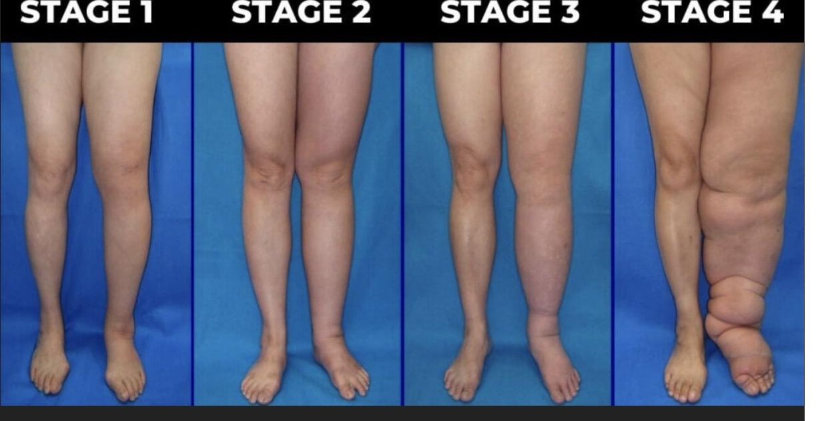
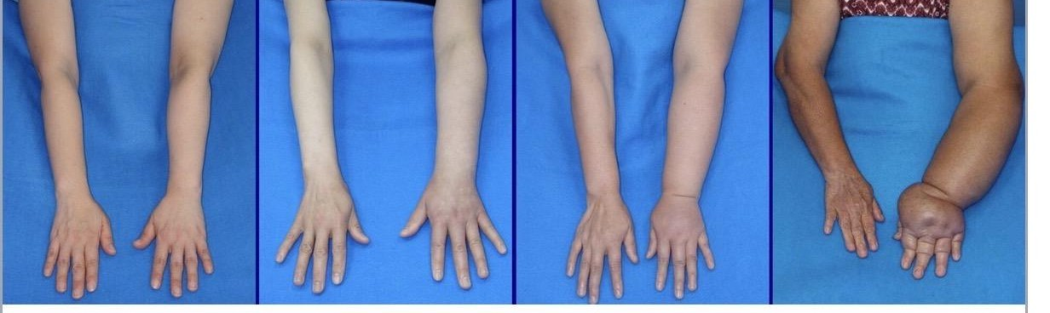
STAGING
Staging — Clinical Appearance
Upper limb, Stages I–IV left to right
Lower limb, Stages I–IV left to right
12
Notes:
Staging describes tissue condition, not size. A small Stage III limb is still Stage III. Severity is graded separately by volume difference.
Images supplied by the practice / open sources.

Slide 13
STAGE 0
Latent / Subclinical
Lymph transport is already impaired. No visible swelling. May persist for months or years before progressing.
Findings
PT implications
No visible or palpable edema
Subjective heaviness, tightness, or fullness may be reported
Reduced transport capacity detectable by bioimpedance or lymphoscintigraphy
Normal tissue consistency
Negative Stemmer's sign
This is the highest-value window for intervention
Baseline measurement pre-operatively makes this stage detectable at all
Surveillance program, risk-reduction education, early compression if indicated
Prophylactic PT after node dissection has been shown to reduce progression
13
Notes:
Photo slot: Stage 0 — no visible change; consider a limb-surveillance/measurement photo instead
SUGGESTED IMAGES FOR THIS SLIDE
· Wikimedia — “bioimpedance lymphedema”
https://commons.wikimedia.org/w/index.php?search=bioimpedance%20lymphedema&title=Special:MediaSearch&type=image
· Wikimedia — “limb measurement tape”
https://commons.wikimedia.org/w/index.php?search=limb%20measurement%20tape&title=Special:MediaSearch&type=image

Slide 14
STAGE I
Spontaneously Reversible
Early accumulation of protein-rich fluid. Swelling reduces with elevation — often resolving completely overnight.
Findings
PT implications
Soft, pitting edema
Subsides with elevation; frequently gone by morning
No secondary tissue changes — no fibrosis yet
Stemmer's sign usually negative
Limb feels heavy; may be visibly larger by end of day
Highly responsive to CDT
Compression garments often sufficient for maintenance
Patient education on self-management is decisive here
Goal: prevent the transition to fibrosis
14
Notes:
Photo slot: Stage I — soft pitting edema, dorsum of foot or hand
SUGGESTED IMAGES FOR THIS SLIDE
· Wikimedia — “pitting edema foot”
https://commons.wikimedia.org/w/index.php?search=pitting%20edema%20foot&title=Special:MediaSearch&type=image
· Wikimedia — “lymphedema early stage”
https://commons.wikimedia.org/w/index.php?search=lymphedema%20early%20stage&title=Special:MediaSearch&type=image

Slide 15
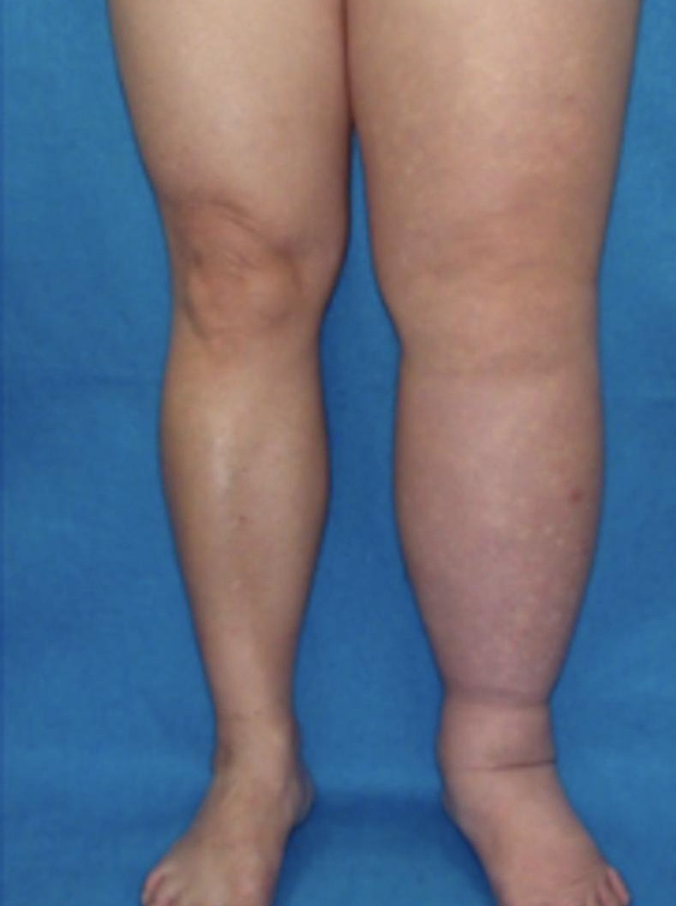
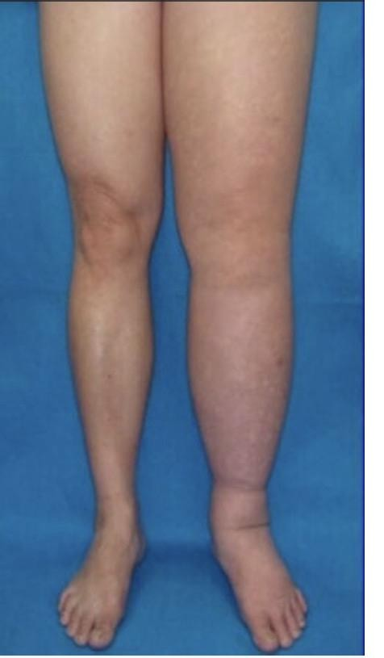
STAGE II
Spontaneously Irreversible
Elevation alone no longer reduces the swelling. Lymphostatic fibrosis has begun and the tissue is changing character.
Findings
PT implications
Elevation rarely reduces the limb
Early Stage II — pitting is manifest and pronounced
Late Stage II — pitting may be absent as fibrosis replaces fluid
Tissue feels firm; Stemmer's sign becomes positive
Increasing frequency of cellulitis
Skin thickening becomes apparent
Full intensive-phase CDT is indicated
Fibrosis requires manual work plus foam/chip padding under bandaging
Realistic goal is volume reduction and stabilization, not cure
Aggressive infection-prevention education
Early unilateral involvement
Unilateral lower limb lymphedema
The presence or absence of pitting is what separates early from late Stage II — not the size of the limb.
15
Notes:
The presence or absence of pitting is what separates early from late Stage II — not the size of the limb.
Photo slot: Stage II — firm non-pitting swelling, positive Stemmer, early skin thickening

Slide 16
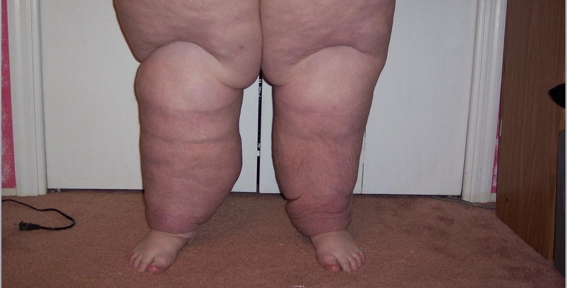
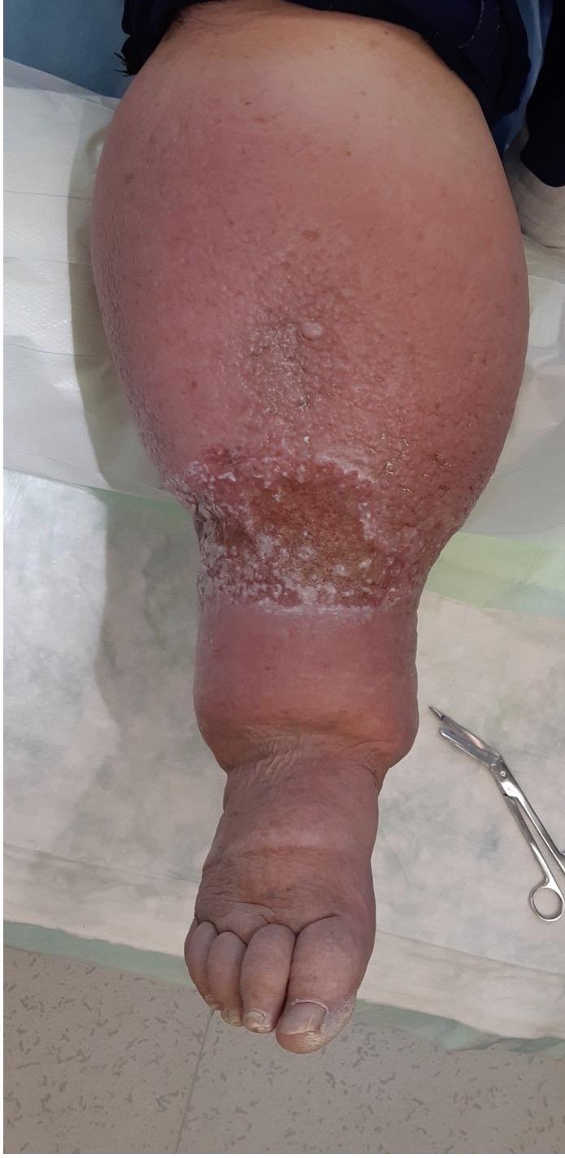
STAGE III
Lymphostatic Elephantiasis
Extreme volume increase with characteristic trophic skin changes. Pitting is typically absent.
Findings
PT implications
Marked volume increase and limb distortion
Pitting absent
Trophic skin changes — acanthosis, hyperkeratosis
Papillomas and warty overgrowth
Deep skin folds, fat deposition
Lymphorrhea — weeping of lymph fluid through the skin
Strongly positive Stemmer's sign
Frequent, sometimes life-threatening infection
Extended intensive phase; often requires wound care alongside CDT
Meaningful volume reduction is still achievable — do not write these patients off
Multilayer bandaging with substantial padding
Coordinate with physician; surgical options may be considered after conservative management
Stage III — lymphostatic elephantiasis
Stage III skin changes with lymphorrhea
Stage III is not a treatment failure to be managed passively. Significant reduction is well documented with sustained CDT.
16
Notes:
Stage III is not a treatment failure to be managed passively. Significant reduction is well documented with sustained CDT.
Photo slot: Stage III — elephantiasis, papillomas, deep skin folds

Slide 17
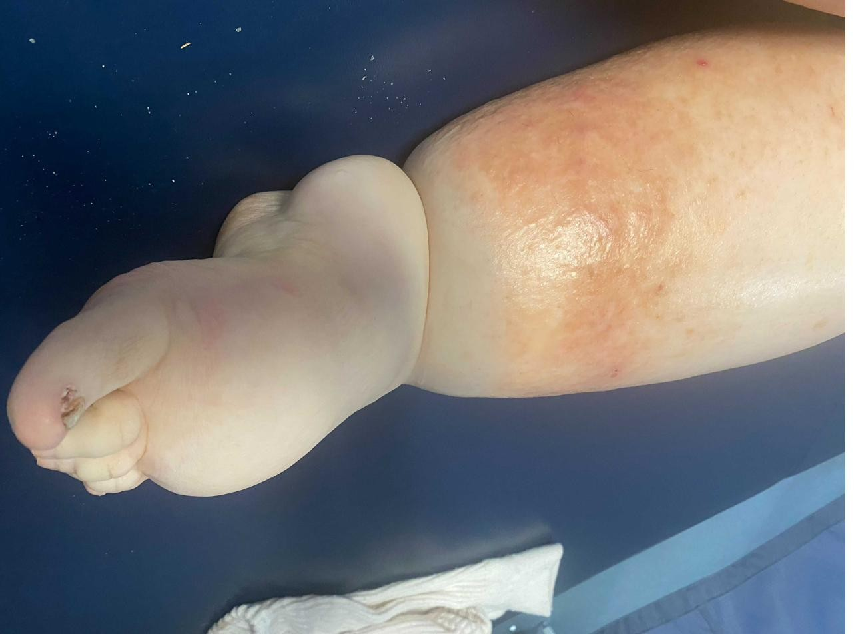
STAGING
Stage III — Clinical Appearance
Stage III — lymphostatic elephantiasis
Severe foot and ankle involvement
Stage III skin changes with lymphorrhea
17
Notes:
Stage III is not a treatment failure to be managed passively. Significant reduction is well documented with sustained CDT.
Images supplied by the practice / open sources.

Slide 18
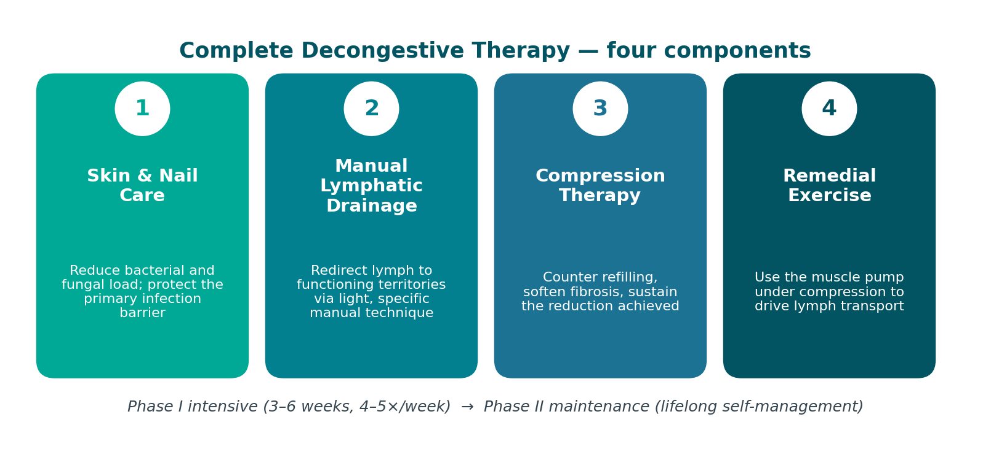
TREATMENT
Complete Decongestive Therapy
CDT is the internationally accepted standard of care. It has four components, delivered in two phases.
Phase II is where outcomes are actually won or lost. Adherence, not technique, is the usual determinant of long-term result.
18
Notes:
Phase II is where outcomes are actually won or lost. Adherence, not technique, is the usual determinant of long-term result.

Slide 19
TREATMENT
CDT — Two Phases
Phase I — Intensive / Reductive
Phase II — Maintenance / Self-Management
Typically 3–6 weeks, treatment 4–5x/week, sessions 1–2 hours
MLD, multilayer short-stretch bandaging worn 23 hours/day, exercise, skin care
Re-measure at every visit
Ends when volume plateaus across consecutive sessions
Fitted compression garment during the day; night garment or bandaging as needed
Self-MLD and home exercise program
Daily skin care and self-inspection
Ongoing surveillance; garments replaced every 4–6 months
Return for a short intensive phase if the limb regresses
Phase II is where outcomes are actually won or lost. Adherence, not technique, is the usual determinant of long-term result.
19
Notes:
Phase II is where outcomes are actually won or lost. Adherence, not technique, is the usual determinant of long-term result.

Slide 20
TREATMENT · CDT 1 OF 4
Skin & Nail Care
A lymphedematous limb is immunocompromised tissue. The skin is the last barrier, and every infection causes further lymphatic damage.
Daily routine
Prevention
Teach the patient to recognize cellulitis
Wash with low-pH, fragrance-free cleanser — lymphedematous skin is alkaline-shifted
Dry thoroughly, especially between the toes and in skin folds
Apply low-pH emollient to keep the barrier intact
Inspect the entire limb daily, including between digits and the posterior surface
Treat tinea pedis and onychomycosis aggressively — a common cellulitis entry point
Nails cut straight across; avoid cutting cuticles
Avoid blood draws, IVs, and BP cuffs on the at-risk limb where an alternative exists
Protect during gardening, cooking, pet handling; gloves and insect repellent
Prompt antiseptic care for any break in the skin
Spreading redness, heat, tenderness, sudden limb enlargement
Fever, chills, malaise, flu-like onset
Seek care same-day. Stop MLD and compression until treated.
Recurrent cellulitis may warrant prophylactic antibiotics — physician decision
20

Slide 21
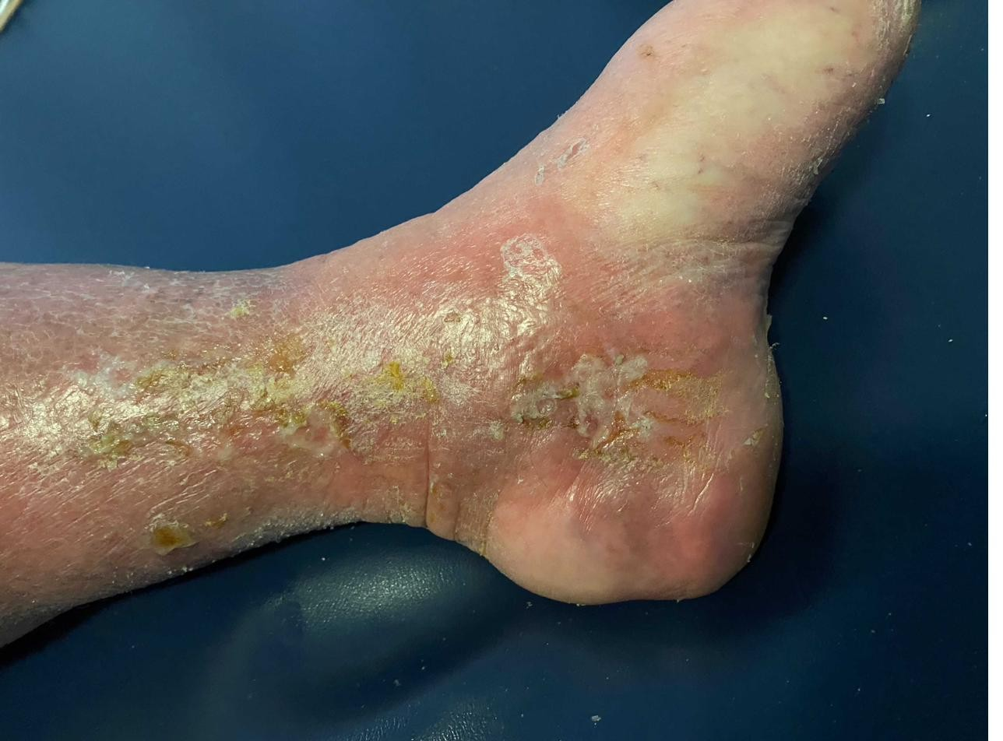
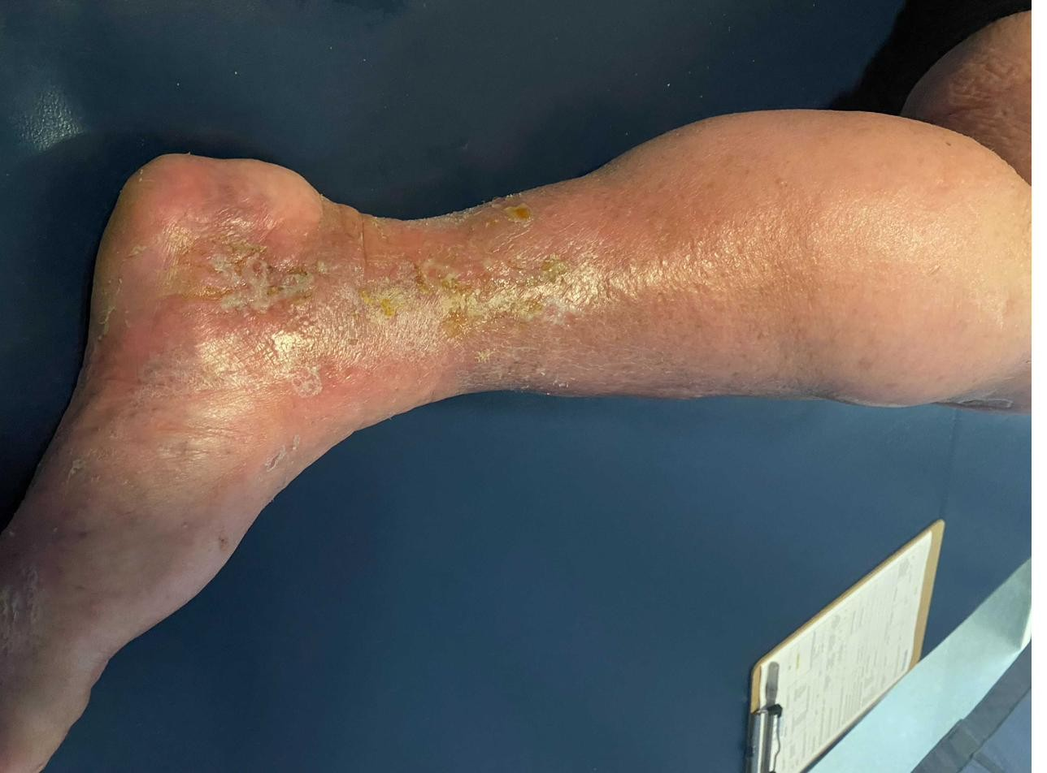
TREATMENT · CDT 1 OF 4
Skin Breakdown — What to Watch For
Crusting and weeping at the ankle
Lymphorrhea and crusting, lower leg
21
Notes:
Images supplied by the practice / open sources.

Slide 22
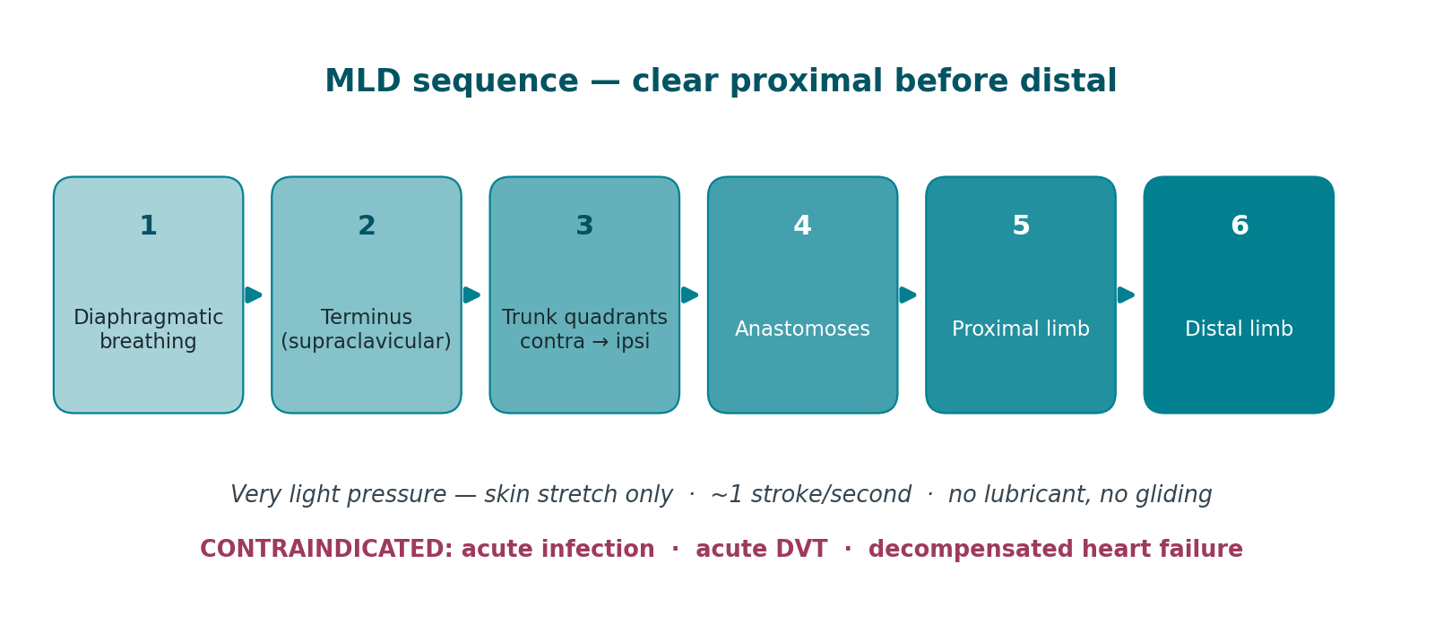
TREATMENT · CDT 2 OF 4
Manual Lymphatic Drainage
A specific, very light manual technique that stimulates lymphangion contraction and redirects lymph across watersheds into functioning territories.
Technique principles
Very light pressure — skin stretch only
~1 stroke/second — matches lymphangion rate
Clear proximal before distal
Skin moves with the hand — no lubricant, no gliding
Contraindications
Acute cellulitis or infection
Acute DVT
Decompensated heart failure
Caution: active malignancy — coordinate with oncology
22
Notes:
MLD alone produces modest results. Its value is greatest when combined with compression — the evidence supports CDT as a package, not MLD in isolation.
SUGGESTED IMAGES FOR THIS SLIDE
· Wikimedia — “manual lymphatic drainage”
https://commons.wikimedia.org/w/index.php?search=manual%20lymphatic%20drainage&title=Special:MediaSearch&type=image
· Servier (CC BY) — “lymphatic drainage”
https://smart.servier.com/?s=lymphatic%20drainage
· Wikimedia — “lymphatic watershed”
https://commons.wikimedia.org/w/index.php?search=lymphatic%20watershed&title=Special:MediaSearch&type=image

Slide 23
TREATMENT · CDT 3 OF 4
Compression Therapy
The single most important component for maintaining reduction. Without compression, gains from MLD reverse within hours.
Phase I — short-stretch bandaging
Phase II — garments
Precautions
Short-stretch — low resting, high working pressure
Never long-stretch/ACE — tourniquet risk
Layered: stockinette, digits, padding, bandage
Foam over fibrosis; gradient higher distally
Worn 23 hrs/day
Class 1 (20–30) — upper limb, mild, prophylaxis
Class 2 (30–40) — most lower limb
Class 3 (40–50) — severe lower limb
Flat-knit preferred; custom for irregular shape
Replace every 4–6 months
Check ABI. < 0.8 caution, < 0.5 contraindicated
Decompensated heart failure
Acute DVT, acute infection, severe neuropathy
23
Notes:
Intermittent pneumatic compression may be a useful adjunct but does not replace MLD or bandaging, and must not be used over an untreated proximal obstruction.

Slide 24
TREATMENT · CDT 4 OF 4
Remedial Exercise
The skeletal muscle pump is a primary driver of lymph transport. Exercise performed under compression is decongestive therapy.
Principles
Programme components
The resistance training question — settled
Always with compression in place
Start with diaphragmatic breathing
Proximal to distal
Slow and rhythmic; no Valsalva
Low resistance, higher repetition
Diaphragmatic breathing to start and finish
Cervical and shoulder girdle mobility
Trunk and core activation
Active ROM, proximal → distal
Aerobic — walking, cycling, aquatic
Progressive resistance training does not cause or worsen lymphedema
The PAL trial demonstrated safety
May reduce flare incidence
Do not tell patients to avoid using the limb
24
Notes:
Aquatic exercise is particularly effective — hydrostatic pressure provides uniform external compression while the patient moves.
SUGGESTED IMAGES FOR THIS SLIDE
· Wikimedia — “aquatic therapy pool”
https://commons.wikimedia.org/w/index.php?search=aquatic%20therapy%20pool&title=Special:MediaSearch&type=image
· Wikimedia — “resistance training rehabilitation”
https://commons.wikimedia.org/w/index.php?search=resistance%20training%20rehabilitation&title=Special:MediaSearch&type=image
· Wikimedia — “diaphragmatic breathing”
https://commons.wikimedia.org/w/index.php?search=diaphragmatic%20breathing&title=Special:MediaSearch&type=image

Slide 25
TREATMENT · LONG-TERM
Long-Term Compression Garments
Phase II is where the result is held. The garment has to fit the limb, the diagnosis, and the patient's hands — a garment that cannot be donned will not be worn.
Lower limb options
Velcro adjustable wraps
Flat-knit vs. circular-knit
Knee-high — most common; easiest to don, best adherence
Thigh-high — swelling above the knee; needs a silicone band
Pantyhose / waist-high — bilateral or genital involvement
Capri — thigh and knee, spared calf. Common in lipedema.
Inelastic, overlapping Velcro straps
Patient-adjustable through the day
Far easier with arthritis, weak grip, or limited reach
Available for calf, foot/ankle, and upper limb
Juzo Wrap, Jobst FarrowWrap, Circaid
Flat-knit — seamed, made to measure, stiffer. Preferred for lymphedema.
Circular-knit — thinner, more cosmetic, tourniquets at folds
Any distortion, fibrosis, or deep folds → flat-knit
25
Notes:
The most common cause of Phase II failure is not the wrong pressure class — it is a garment the patient cannot physically get on. Assess grip, reach, and vision before prescribing, and reach for an adjustable wrap when donning is the limiting factor.

Slide 26
TREATMENT · LONG-TERM
Custom Garments & Prescribing
Custom garments — when off-the-shelf will not do
Practical prescribing
Measurements outside standard sizing
Marked distortion, deep folds, lobules
Toe caps, gauntlets, gloves, sleeves
Compression bras for trunk and chest wall
Genital, head and neck; 2–3 weeks to fabricate
Two garments so one is always clean
Replace every 4–6 months — elastic fatigues before it looks worn
Check arterial status first; ABI < 0.8 caution
Donning aids: rubber gloves, donner, slip-sock
The most common cause of Phase II failure is not the wrong pressure class — it is a garment the patient cannot physically get on. Assess grip, reach, and vision before prescribing, and reach for an adjustable wrap when donning is the limiting factor.
26
Notes:
The most common cause of Phase II failure is not the wrong pressure class — it is a garment the patient cannot physically get on. Assess grip, reach, and vision before prescribing, and reach for an adjustable wrap when donning is the limiting factor.

Slide 27
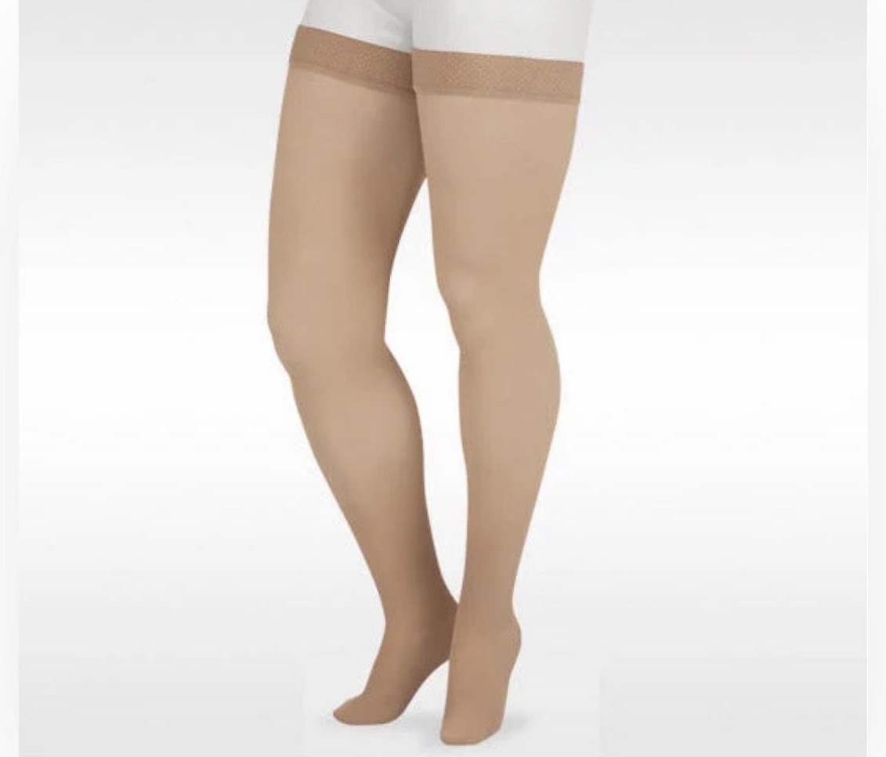
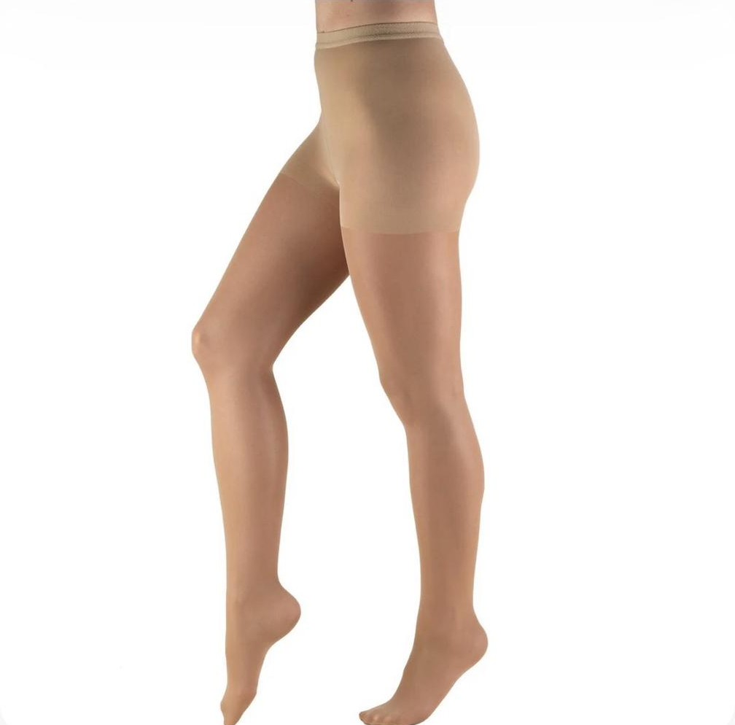
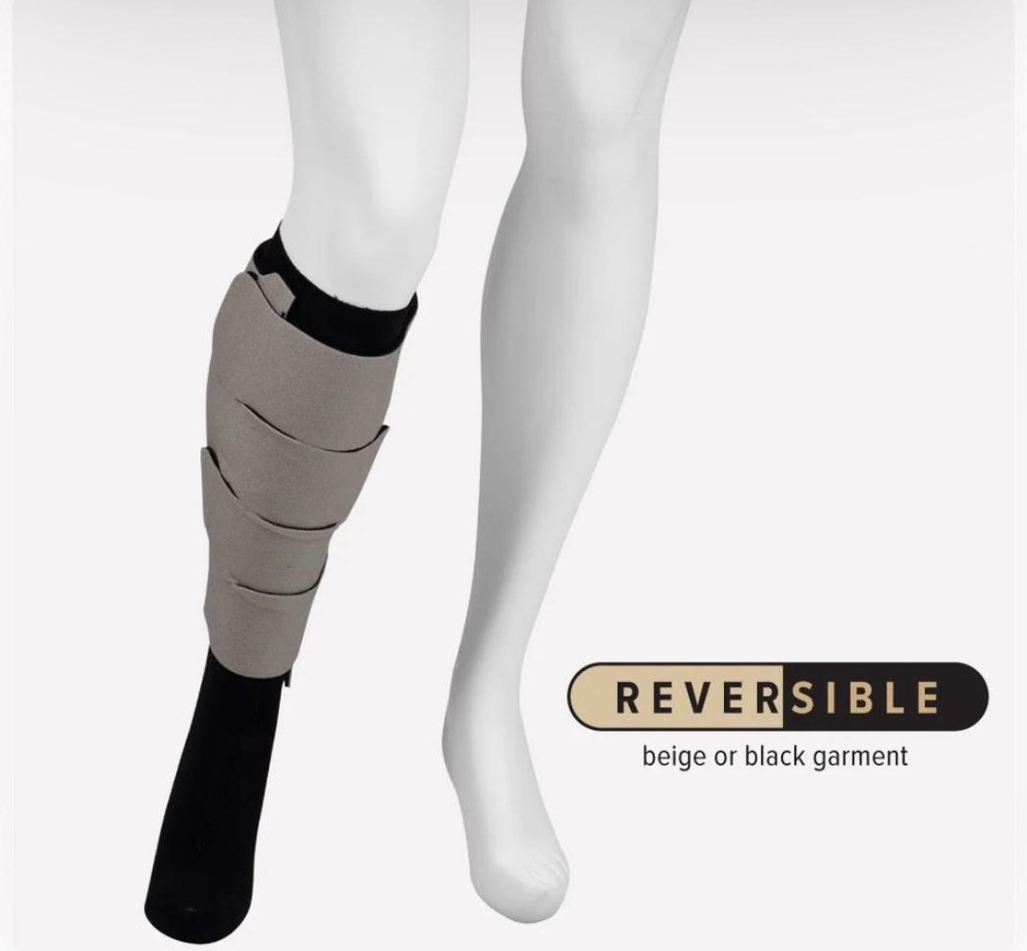
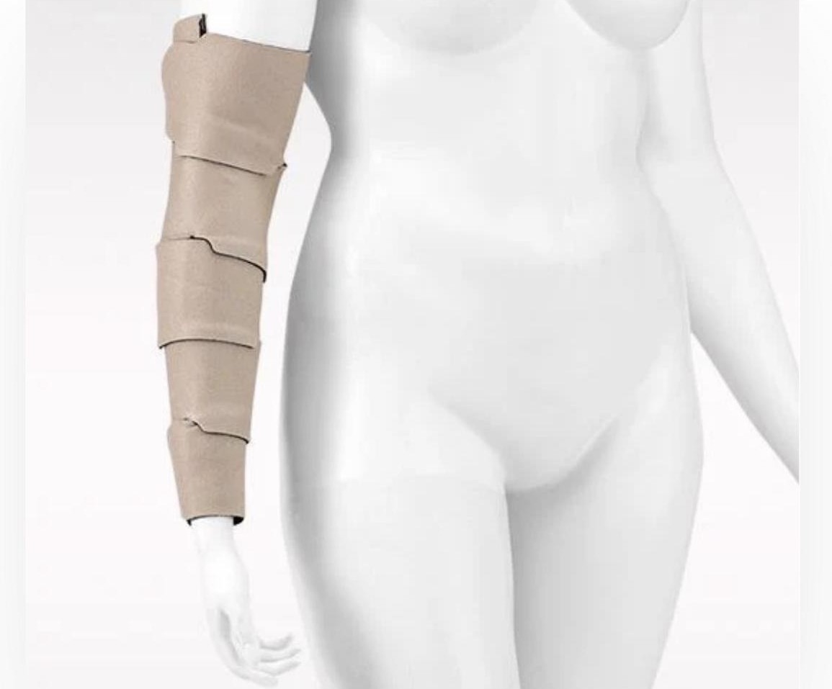
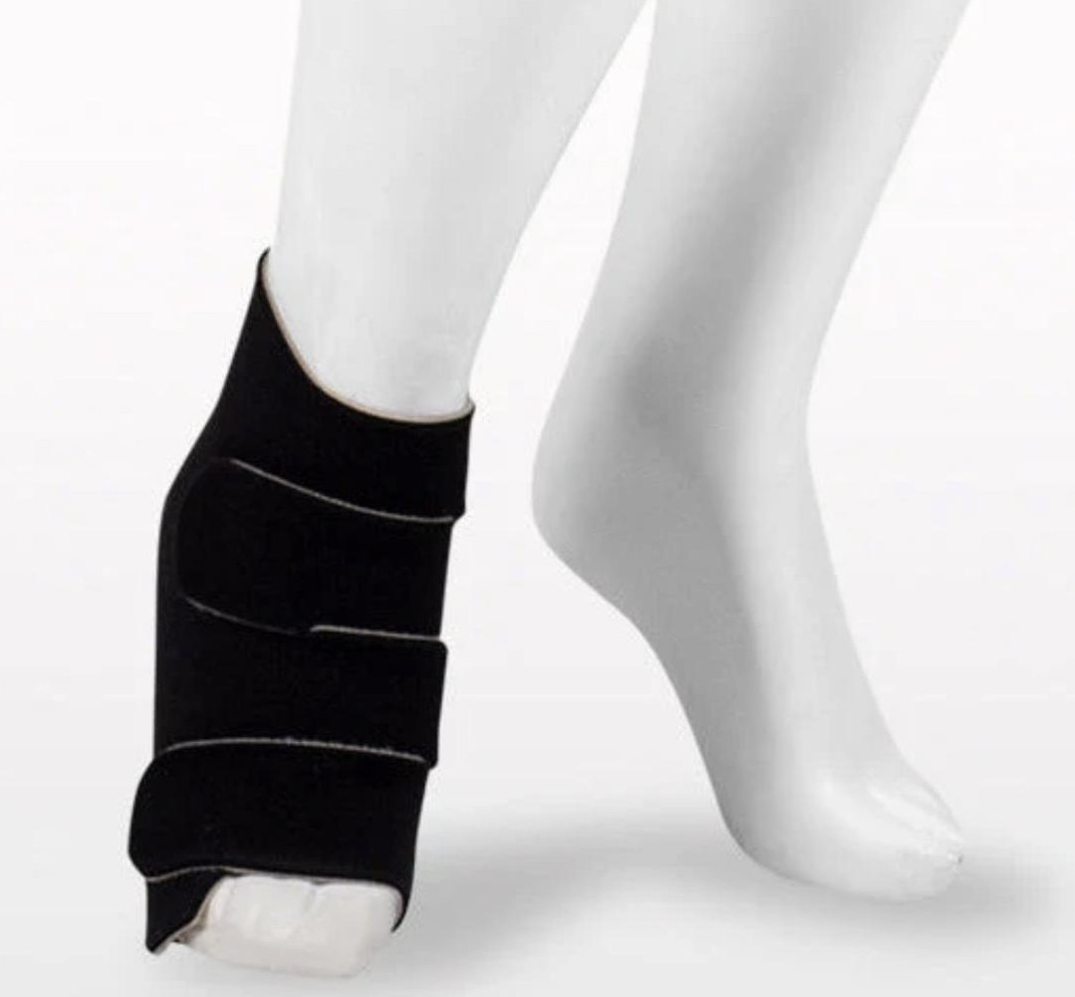
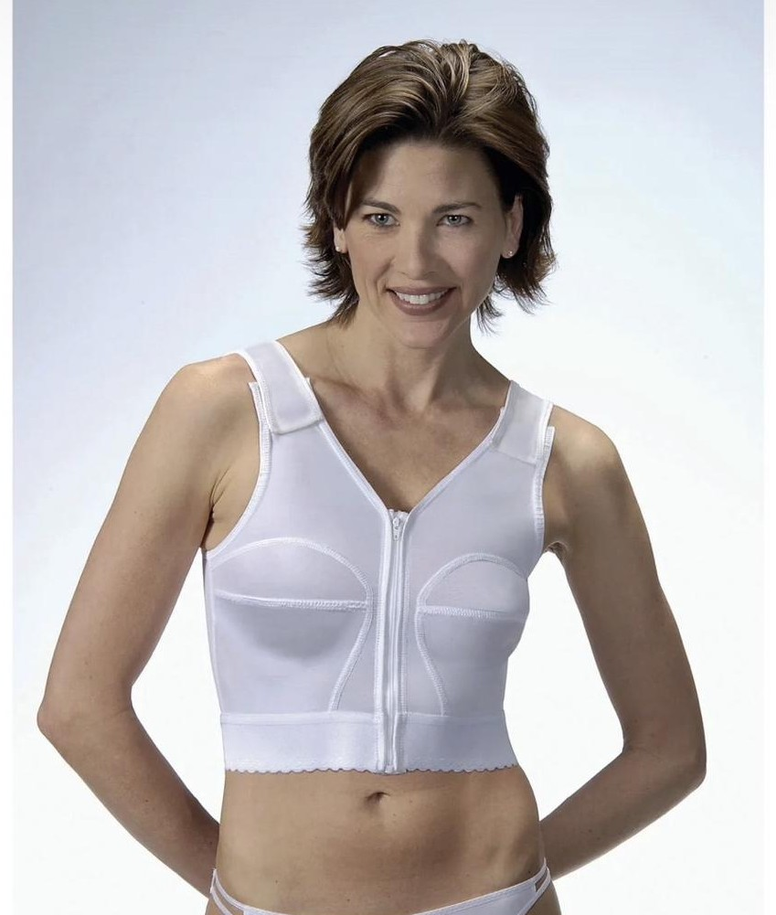
TREATMENT · LONG-TERM
Garment Types
Thigh-high with silicone band
Pantyhose / waist-high
Velcro adjustable wrap — calf
Velcro adjustable wrap — upper limb
Velcro adjustable wrap — foot and ankle
Compression bra — trunk and chest wall
27
Notes:
The most common cause of Phase II failure is not the wrong pressure class — it is a garment the patient cannot physically get on. Assess grip, reach, and vision before prescribing, and reach for an adjustable wrap when donning is the limiting factor.
Images supplied by the practice / open sources.

Slide 28
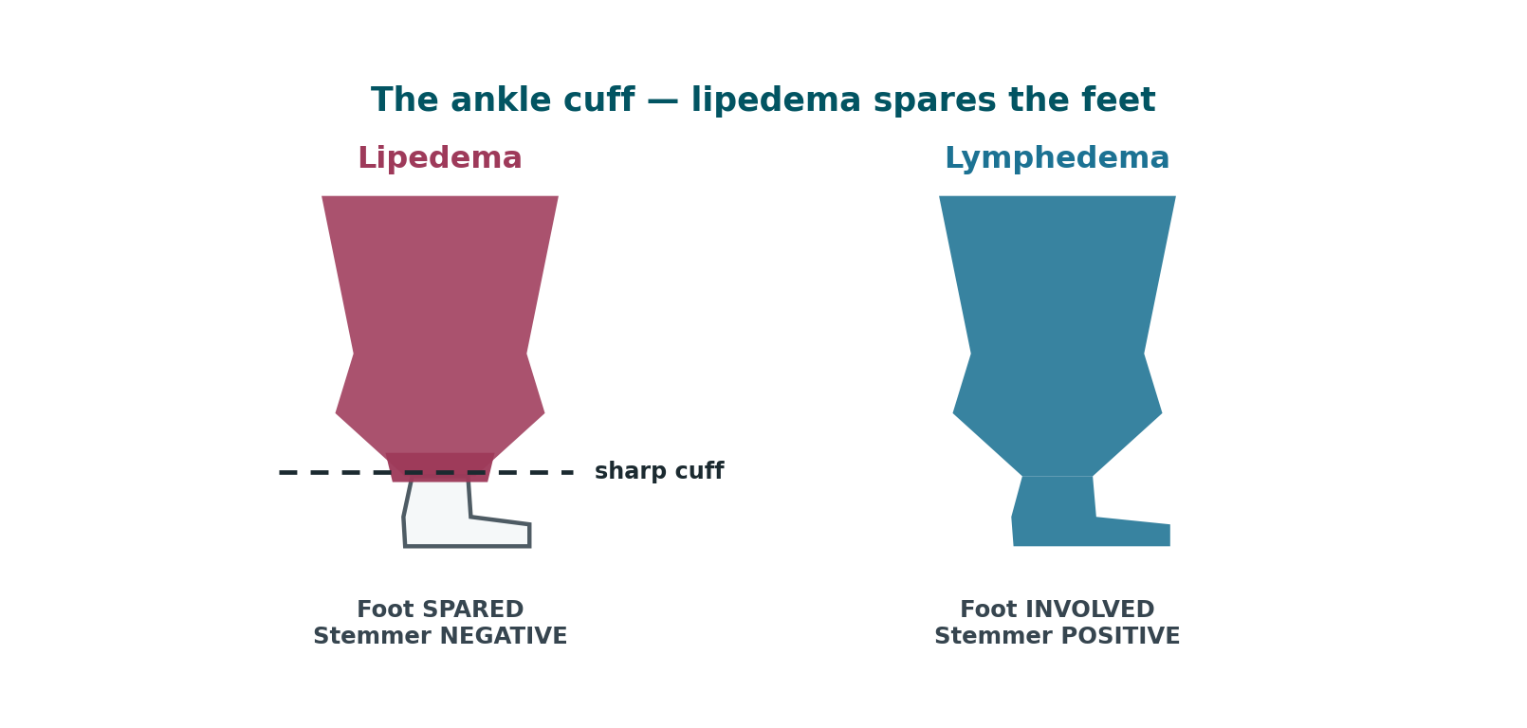
LIPEDEMA
Lipedema — A Different Disease
A chronic disorder of adipose tissue, almost exclusively affecting women, routinely misdiagnosed as obesity or lymphedema for years before recognition.
Defining features
Bilateral and symmetrical
Painful — tender to pressure. Diagnostic, not incidental.
Bruises easily
Spares the feet — sharp ankle cuff
Diet-resistant; negative Stemmer's
28
Notes:
Sarah Bramblette and patient advocacy groups have driven recent recognition, but average time to diagnosis remains measured in years.

Slide 29
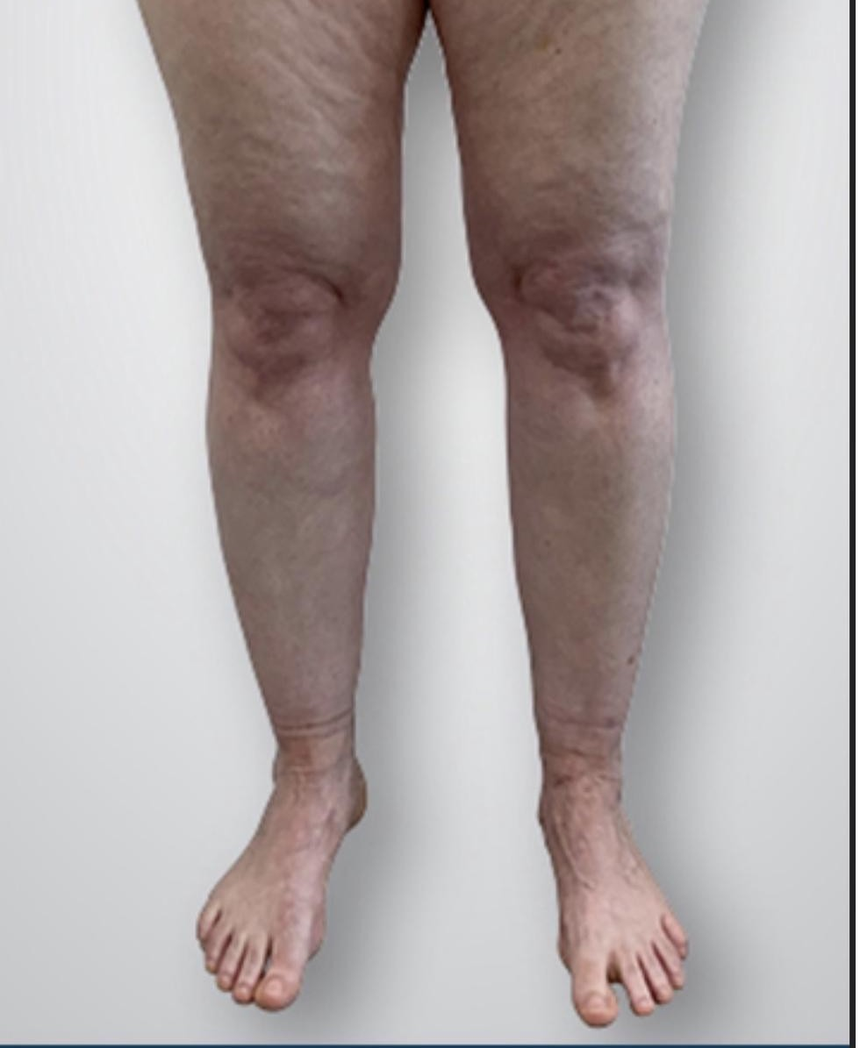
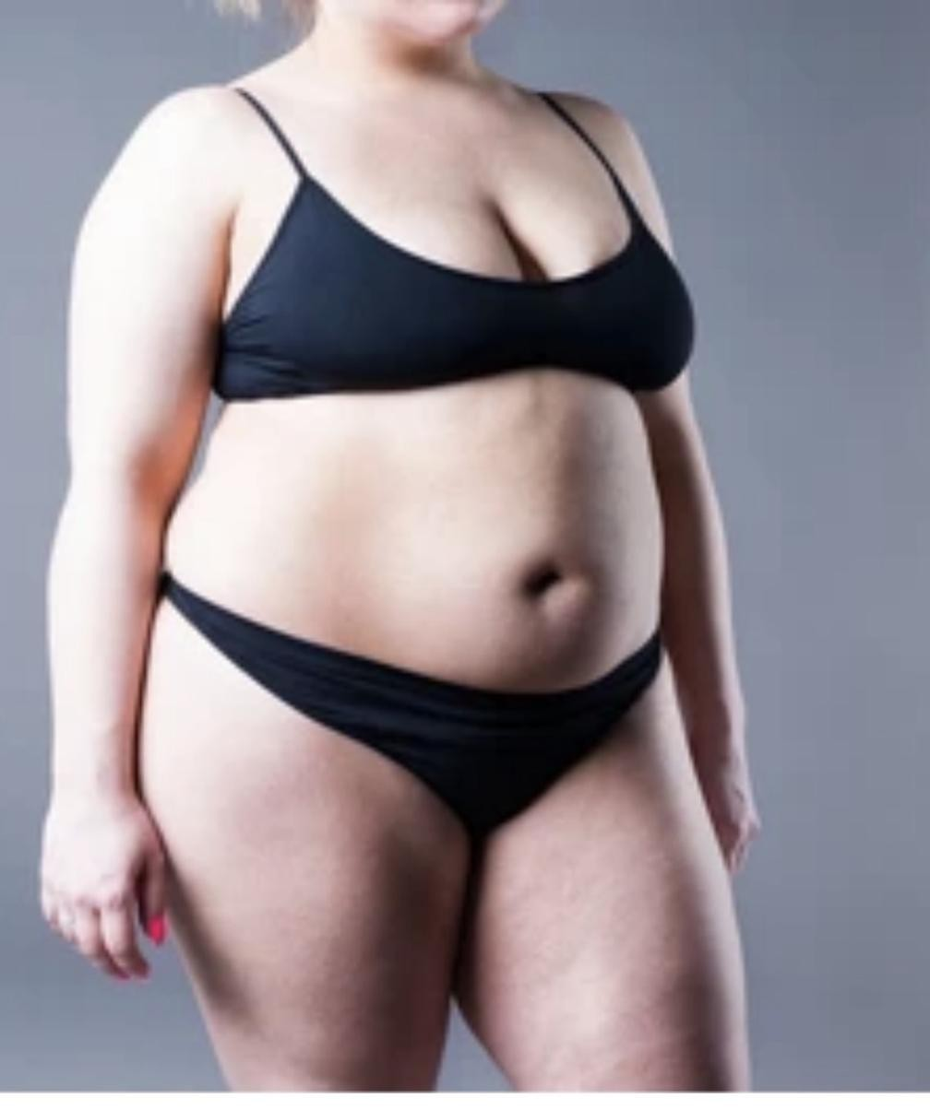
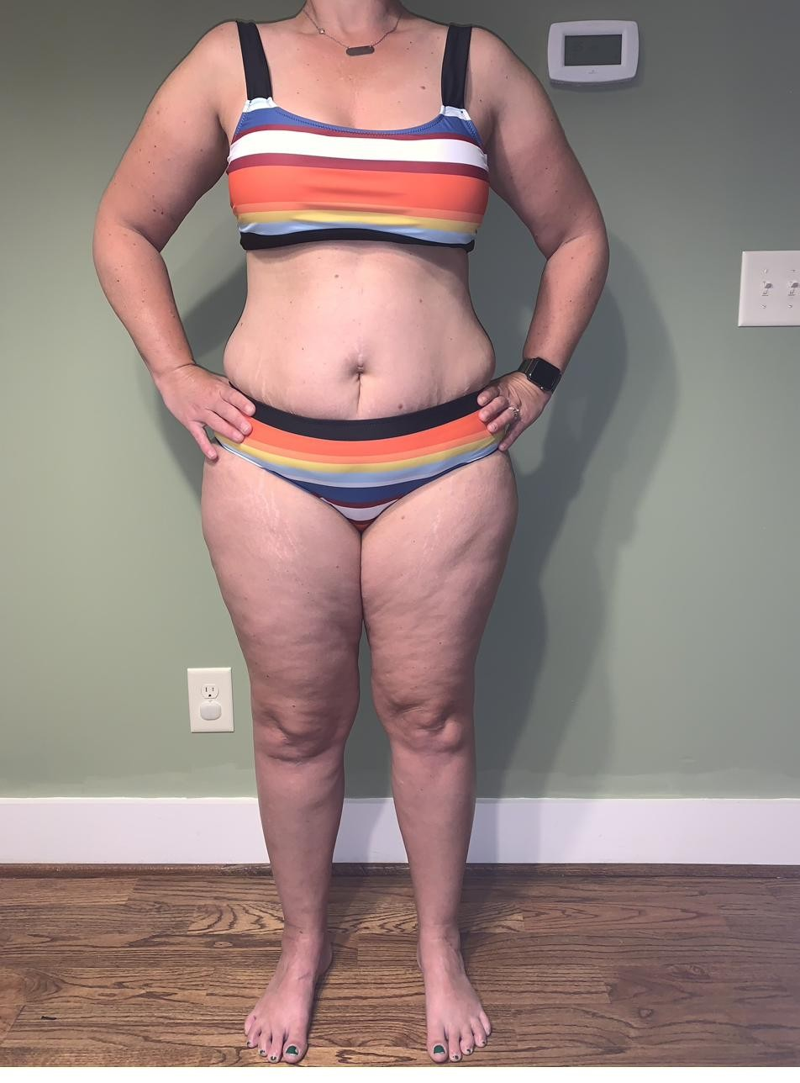
LIPEDEMA
Lipedema — Clinical Appearance
Lipedema — note the ankle cuff and spared feet
Disproportionate lower-body distribution
Before diagnosis — anterior
29
Notes:
Sarah Bramblette and patient advocacy groups have driven recent recognition, but average time to diagnosis remains measured in years.
Images supplied by the practice / open sources.

Slide 30
LIPEDEMA
Lipedema — Etiology & Misdiagnosis
Etiology
Why the misdiagnosis matters
Cause unknown; strong familial pattern
Hormonally triggered — puberty, pregnancy, menopause
Evidence points to a connective tissue component
Reported in up to ~11% of women
Patients are told to lose weight — it does not work
Years of shame and ineffective treatment
Delay allows progression to lymphatic involvement
A correct diagnosis is itself therapeutic
30
Notes:
Sarah Bramblette and patient advocacy groups have driven recent recognition, but average time to diagnosis remains measured in years.

Slide 31
LIPEDEMA
Lipedema Staging — Stages 1 & 2
Classically staged 1 through 3 by skin and tissue architecture. A fourth stage — lipo-lymphedema — is widely used clinically but is contested.
STAGE 1
Smooth skin surface
STAGE 2
Uneven, dimpled skin
Skin surface normal and smooth
Enlarged hypodermis; homogeneous thickening of subcutaneous tissue
Fat is often soft; small nodules may be palpable — described as rice-like or pearl-sized
Fat accumulation around pelvis, buttocks, and hips
Limbs tender and prone to bruising
Swelling may improve with rest and elevation
Skin surface becomes bumpy and wave-like with indentations
Nodular structures in the thickened subcutis — lipomas, angiolipomas
Subcutaneous tissue feels tougher and more nodular
Fat build-up extends down the legs toward the ankles
Swelling less responsive to rest and elevation than Stage 1
Symptoms range from mild to severe
31
Notes:
IMPORTANT CAVEAT: The Lipedema Foundation no longer uses a 'Stage 4' designation, on the grounds that the lymphatic system can be compromised at any stage — lymphatic impairment is documented in Stages 2 and 3. Present Stage 4 as lipo-lymphedema, and note the debate. This is the intellectually honest framing and it will be the question a sharp student asks.

Slide 32
LIPEDEMA
Lipedema Staging — Stage 3 & Lipo-lymphedema
STAGE 3
Large deformations
STAGE 4
Lipo-lymphedema
Further hardening of connective tissue
Bulky, overhanging extrusions of skin and fat
Marked deformation of thighs and around the knees
Persistent swelling not resolving with rest or elevation
Mobility significantly impaired; highest rate of orthopedic complication
May be associated with secondary lymphedema
Lipedema plus secondary lymphedema in the same limbs
The feet begin to swell — the defining change
Stemmer's sign becomes positive
Skin over the toes thickens; pitting appears
Diagnosis moves from lipedema to lipo-lymphedema
Lymphoscintigraphy can document the degree of drainage impairment
IMPORTANT CAVEAT: The Lipedema Foundation no longer uses a 'Stage 4' designation, on the grounds that the lymphatic system can be compromised at any stage — lymphatic impairment is documented in Stages 2 and 3. Present Stage 4 as lipo-lymphedema, and note the debate. This is the intellectually honest framing and it will be the question a sharp student asks.
32
Notes:
IMPORTANT CAVEAT: The Lipedema Foundation no longer uses a 'Stage 4' designation, on the grounds that the lymphatic system can be compromised at any stage — lymphatic impairment is documented in Stages 2 and 3. Present Stage 4 as lipo-lymphedema, and note the debate. This is the intellectually honest framing and it will be the question a sharp student asks.

Slide 33
LIPEDEMA
Lipedema vs. Lymphedema
The differential that matters most in practice — and the one most often gotten wrong.
Feature | Lipedema | Lymphedema
Sex | Almost exclusively women | Either sex
Symmetry | Bilateral, symmetrical | Often unilateral; symmetry not required
Feet | SPARED — sharp ankle cuff | INVOLVED — swelling includes feet/toes
Stemmer's sign | Negative | Positive
Pain | Painful, tender to pressure | Painless early; tension pain when advanced
Bruising | Bruises easily | Not characteristic
Pitting | Typically non-pitting | Pitting early; non-pitting when fibrotic
Distribution | Proximal-dominant, disproportionate | Distal parts always more affected
Family history | Commonly positive | Positive only in primary lymphedema
Response to diet | Affected fat is diet-resistant | Not primarily fat; weight loss reduces risk
Onset trigger | Puberty, pregnancy, menopause | Surgery, radiation, infection, trauma
They co-exist. Lipedema does not itself cause lymphedema — but central obesity, which frequently accompanies it, substantially raises lymphedema risk. Treat what you find.
33
Notes:
They co-exist. Lipedema does not itself cause lymphedema — but central obesity, which frequently accompanies it, substantially raises lymphedema risk. Treat what you find.

Slide 34
LIPEDEMA
PT Management of Lipedema
Conservative management does not remove lipedema fat. It manages pain, controls fluid, preserves mobility, and slows progression.
What PT can achieve
Interventions
Set expectations honestly
Pain reduction — often the patient's priority
Control of the fluid component
Preserve joint mechanics and gait
Prevent progression to lipo-lymphedema
Flat-knit compression
MLD for fluid and for pain
Aquatic exercise — buoyancy plus hydrostatic compression
Low-impact aerobic and resistance work
Nutritional referral
Conservative care does not remove the fat
Liposuction is the only intervention that does
PT before and after surgery improves outcomes
Insurance coverage remains inconsistent
34
Notes:
[OPTIONAL — safe to cut]
The single most valuable thing you may do is tell the patient this is a recognized disease and not a personal failure of willpower.

Slide 35
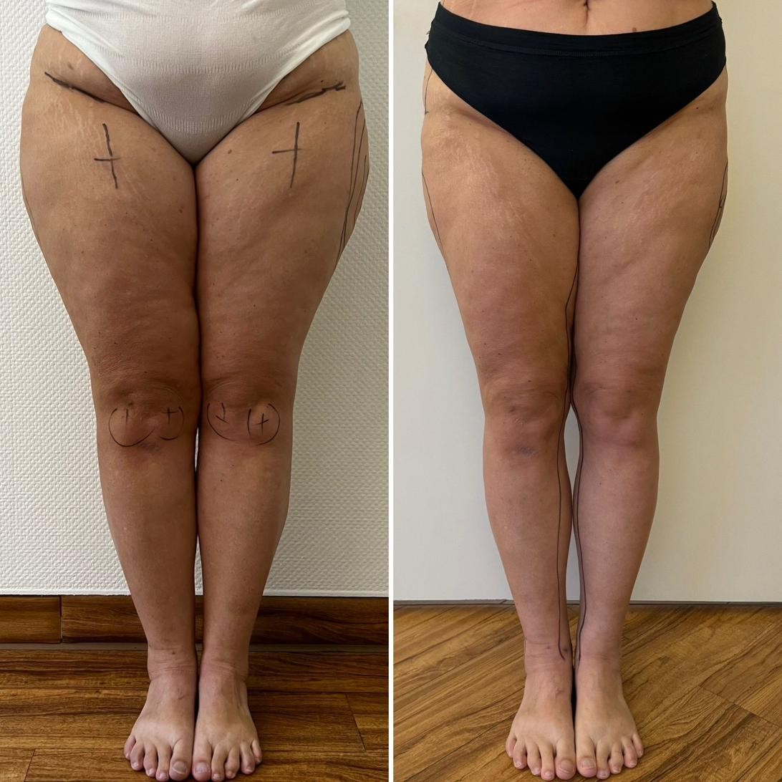
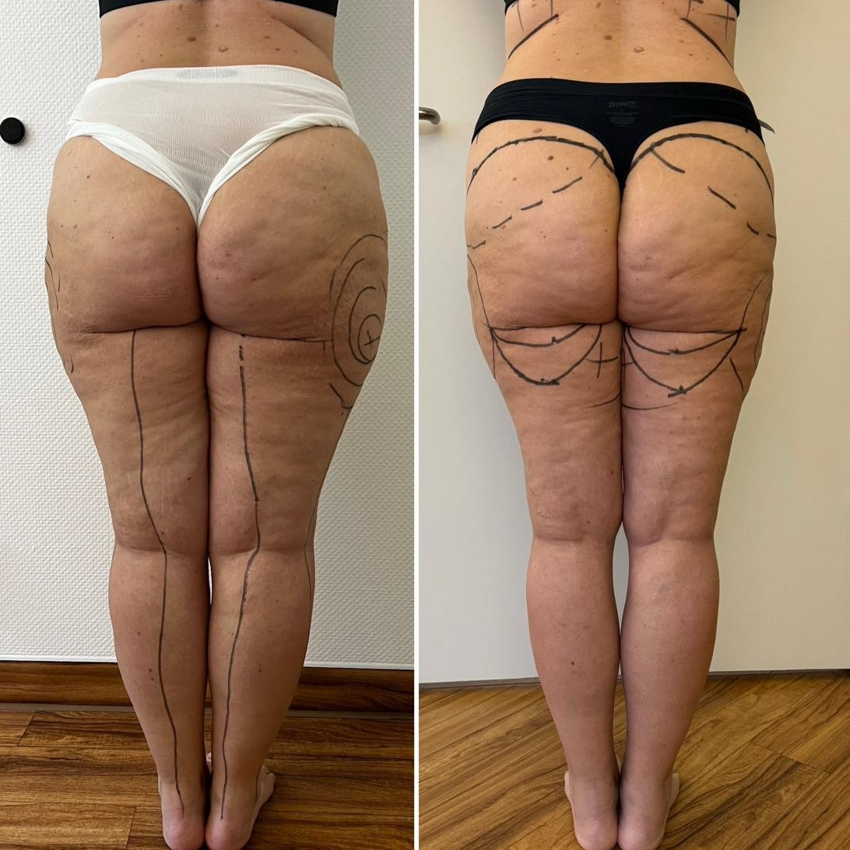
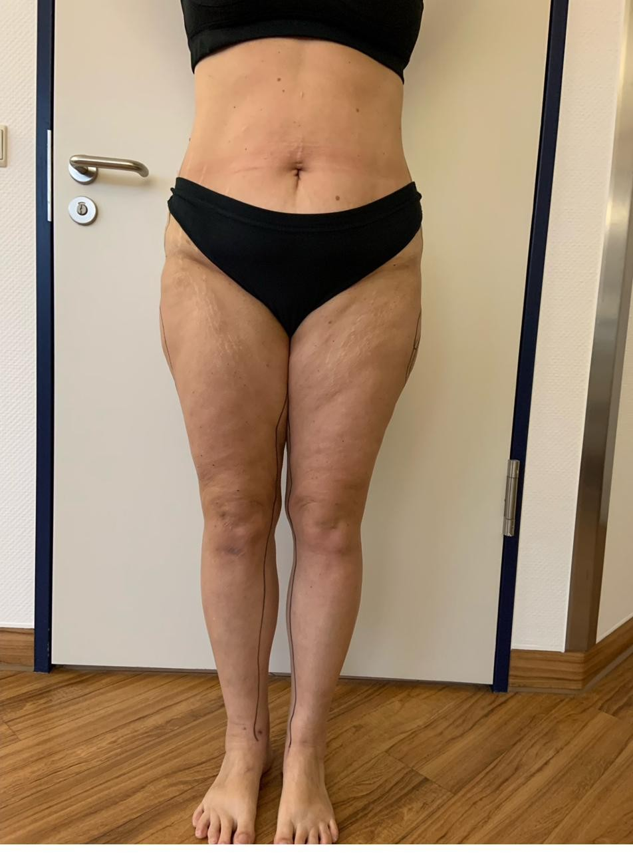
LIPEDEMA
Lipedema — Surgical Outcomes
Before and after — anterior
Before and after — posterior
Pre-operative markings
35
Notes:
The single most valuable thing you may do is tell the patient this is a recognized disease and not a personal failure of willpower.
Images supplied by the practice / open sources.

Slide 36
BEYOND CDT
Other Considerations After Lymphatic PT
Decongestion is not the end of the episode of care. Once volume is controlled, what remains is often what limits the patient most.
Gait training
Balance therapy
Orthopedic pain not relieved by CDT
Gait adapted around a heavy limb persists after decongestion
Reassess step length, cadence, base of support
Shoe size often changes after Phase I
Calf pump is both a gait and a lymphatic goal
Review the assistive device
Altered limb mass and distal sensation degrade postural control
Screen falls risk — rarely done in this population
Static → dynamic, then dual-task
Proprioceptive retraining at ankle and hip
A fall breaking skin is a cellulitis risk
If pain persists once volume is controlled, treat it as a separate problem
Knee and hip OA; low back pain from gait asymmetry
Post-axillary-dissection shoulder — capsule, scar, cording
Plantar fasciitis from changed weight-bearing
Disproportionate bilateral tenderness → consider lipedema
36
Notes:
Patients are frequently discharged the moment limb volume plateaus. The gait, balance, and orthopedic findings underneath are what determine whether they actually return to their life — and they are squarely within PT scope.Patients are frequently discharged the moment limb volume plateaus. The gait, balance, and orthopedic findings underneath are what determine whether they actually return to their life — and they are squarely within PT scope.
ONGOING SURVEILLANCE
· Re-measure at regular intervals; catch regression early
· Garment replacement every 4–6 months
· Short repeat intensive phase if the limb regresses — this is expected, not failure
· Annual skin and nail review
· Re-screen falls risk and function, not just limb volume

Slide 37
SAFETY
Red Flags & Referral
Stop treatment and refer when you see these.
Urgent — same day
Refer for workup
Screen before starting
Cellulitis — spreading erythema, heat, fever
Suspected DVT — acute unilateral swelling, calf pain
Decompensated heart failure — dyspnea, orthopnea
Systemic illness — fever, rigors, hypotension
Rapid-onset or proximal-first swelling — possible malignancy
New neurological deficit
Non-healing wound or ulceration
Failure to respond to well-delivered CDT
ABI before lower limb compression
Cardiac and renal status
Active malignancy — coordinate with oncology
Peripheral neuropathy and sensory testing
37
Notes:
MLD is contraindicated in acute infection, acute DVT, and decompensated heart failure. When in doubt, do not treat — refer.

Slide 38
APPENDIX
Source Decks & Reference Material (1 of 2)
The existing presentations and documents this deck was built from. Open any of them to review how others have structured the same material.
ISL 2023 Consensus Document
PDF · primary source
The staging authority. Stages 0–III, diagnosis, and treatment.
https://www.isl.arizona.edu/sites/default/files/2024-11/THE-DIAGNOSIS-AND-TREATMENT-OF-PERIPHERAL-LYMPHEDEMA-2023-CONSENSUS-DOCUMENT-OF-THE-INTERNATIONAL-SOCIETY-OF-LYMPHOLOGY.pdf
Linda Koehler, PT, CLT-LANA — Univ. of Minnesota
Slide deck
Best PT-focused deck found. CDT components, wound care, pain management.
https://www.slideserve.com/collin/lymphedema-overview-and-treatment-considerations
Christina Hankins, PT, CLT, CWS — Lymphedema
Slide deck
Good objectives and outline structure to model.
https://www.slideserve.com/lilly/lymphedema
Lymphedema Therapy (compiled decks)
Slide deck
Several decks on one page, incl. stage descriptions and exercise evidence.
https://www.slideserve.com/lael/lymphedema-therapy
Lymphedema — assorted author decks
Slide deck
Ernandez, Richter, Arslan, Johansson. Mixed quality; useful for framing.
https://www.slideserve.com/shoshana-reynolds/lymphedema-powerpoint-ppt-presentation
Clinical Outcomes After PT for Secondary Lymphedema
Case report
Zuther & Norton staging language in plain English.
38
https://www.ncbi.nlm.nih.gov/pmc/articles/PMC6666846/
Lipedema Foundation — Staging
Reference + photos
Best lipedema staging photos. Note: they no longer use “Stage 4”.
https://www.lipedema.org/staging
Notes:
Reviewing these is fine. Reusing their figures in a published deck is not — most contain third-party images the authors did not clear for redistribution. Use the per-slide image links instead; those are openly licensed. Structure, sequencing, and teaching approach are free to borrow from anyone.
Links are clickable in slideshow mode.

Slide 39
APPENDIX
Source Decks & Reference Material (2 of 2)
Understanding Stage 4 Lipedema: Lipo-Lymphedema
Article
The transition from lipedema to lipo-lymphedema.
https://www.totallipedemacare.com/understanding-stage-4-lipedema-lipo-lymphedema/
Differential diagnostics of lipedema and lymphedema
PubMed
Practical guideline. Basis for the differential table.
https://pubmed.ncbi.nlm.nih.gov/30280233/
Lipedema vs lymphedema — Northwell Health
Article
Plain-language framing useful for patient education.
https://www.northwell.edu/news/insights/lipedema-vs-lymphedema-what-to-know
39
Notes:
Reviewing these is fine. Reusing their figures in a published deck is not — most contain third-party images the authors did not clear for redistribution. Use the per-slide image links instead; those are openly licensed. Structure, sequencing, and teaching approach are free to borrow from anyone.
Links are clickable in slideshow mode.

Slide 40
CLOSE
Key Takeaways
1. Lymphedema is mechanical insufficiency — high-protein, progressive, and self-reinforcing if untreated.
2. Symptoms precede visible swelling. Stage 0 is real and is the best time to intervene.
3. Stemmer's sign is fast, free, and diagnostic when positive.
4. Four ISL stages: 0 latent, I reversible, II irreversible/fibrotic, III elephantiasis.
5. CDT has four components. Compression is the one that holds the result.
6. Exercise under compression is treatment. Resistance training is safe.
7. Garment choice is decided as much by whether the patient can don it as by pressure class.
8. Lipedema is painful, symmetrical, spares the feet, and has a negative Stemmer.
9. Lipedema is staged 1–3, with lipo-lymphedema as a contested Stage 4.
10. Every episode of cellulitis makes the underlying disease worse.
11. Patient education and Phase II adherence determine long-term outcome.
12. Decongestion is not discharge — reassess gait, balance, and orthopedic pain afterwards.
40
Notes:
Ten takeaways. If you are short on time, 3, 5 and 7 are the ones they must leave with.

Slide 41
Questions
Scan for the full presentation, outline, and a 12-question self-check.
Dr. Sara S. Morrison, PT, DPT, CDT, Cert DN, PCES, CFT, FMT
Total Body Therapy & Wellness
260 Pine State Street, Lillington, NC 27546
(910) 893-2850 · tbtwonline.com
information-vs-energy-vs-matter.github.io/Total_body_therapy_-_wellness/lymphedema/
Educational use only. Not a substitute for individualized medical evaluation or care.
Notes:
Close here. Remind them the QR opens the quiz.

