Slide 1

TOTAL BODY THERAPY & WELLNESS
Lymphedema & Lipedema
SCAN TO FOLLOW ALONG
Staging, Differential Diagnosis, and Physical Therapy Management
Dr. Sara S. Morrison
PT, DPT, CDT, Cert DN, PCES, CFT, FMT
Founder & Lead Physical Therapist
Presentation, outline & self-check quiz
260 Pine State Street, Lillington, NC 27546 · (910) 893-2850 · tbtwonline.com
Notes:
Welcome. Point the room at the QR code before you start — it opens this presentation, the outline, and a 12-question self-check quiz.
Educational use only. Not a substitute for individualized medical evaluation or care.

Slide 2
ABOUT
About Total Body Therapy & Wellness
Founded in Lillington, NC in 2008 with the goal of bringing exceptional "Big City Care" to a small-town community. Physical therapy in Harnett County since 2002.
Patient-centered, one-on-one treatment every visit
Certified Lymphedema Therapists (CLT) on staff
Whole-person approach — we treat the total body, not just the part
Patient education as a core part of the plan of care
260 Pine State Street, Lillington, NC 27546 · (910) 893-2850 · tbtwonline.com
2
Notes:
Establish credibility briefly, then move on. Both therapists are CLTs.

Slide 3
OBJECTIVES
On completion you will be able to
1. Describe the structure and function of the lymphatic system
2. Differentiate primary from secondary lymphedema and identify risk factors
3. Recognize the symptomatology and clinical presentation of lymphedema
4. Perform and interpret key diagnostic tests, including Stemmer's sign
5. Stage lymphedema using ISL criteria, Stage 0 through Stage III
6. Apply the four components of Complete Decongestive Therapy
7. Distinguish lipedema from lymphedema and stage lipedema appropriately
8. Identify red flags requiring physician referral
3
Notes:
Read these quickly — they double as the roadmap for the session.

Slide 4
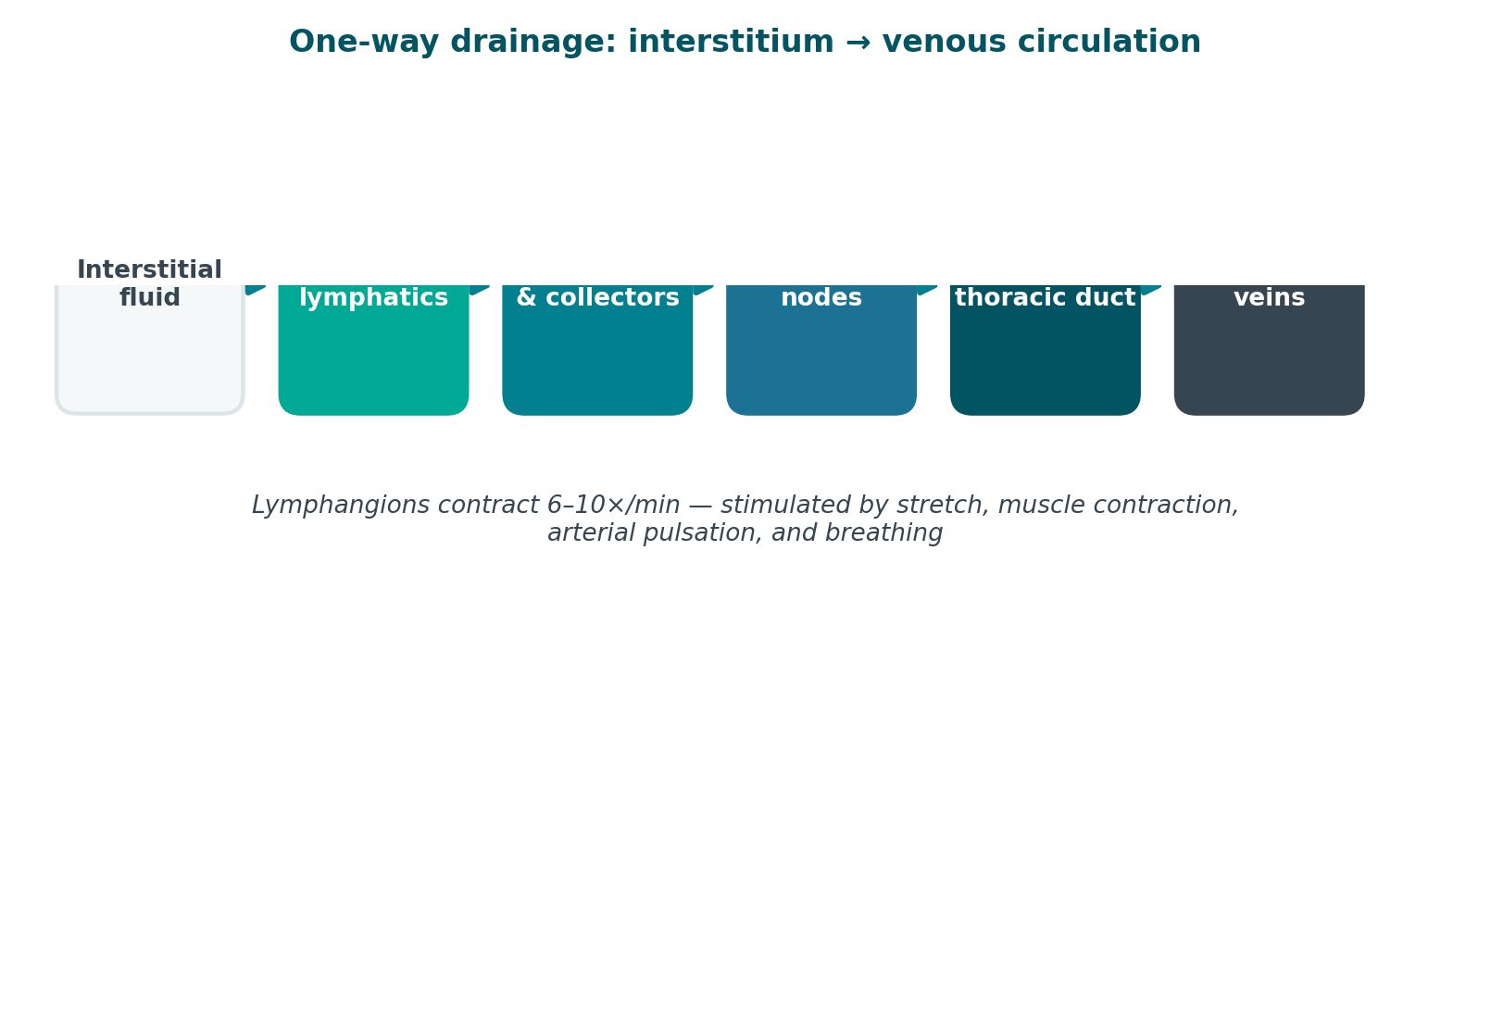
FOUNDATIONS
The Lymphatic System
A one-way drainage network running parallel to the venous system, returning fluid, protein, and immune cells to circulation.
Lymphangion contraction is the primary pump. It is stimulated by stretch, muscle contraction, arterial pulsation, and breathing — which is exactly why exercise and diaphragmatic breathing are treatment, not just adjuncts.
4
Notes:
Lymphangion contraction is the primary pump. It is stimulated by stretch, muscle contraction, arterial pulsation, and breathing — which is exactly why exercise and diaphragmatic breathing are treatment, not just adjuncts.
SUGGESTED IMAGES FOR THIS SLIDE
Save as: anat_lymphatic_system.png, anat_openstax_system.png, anat_grays_thoracic_duct.png
· Servier (CC BY) — “lymphatic system”
https://smart.servier.com/?s=lymphatic%20system
· OpenStax Ch.21 (CC BY)
https://openstax.org/books/anatomy-and-physiology-2e/pages/21-1-anatomy-of-the-lymphatic-and-immune-systems
· Wikimedia — “lymphatic system diagram”
https://commons.wikimedia.org/w/index.php?search=lymphatic%20system%20diagram&title=Special:MediaSearch&type=image
· NCI (public domain) — “lymphatic system”
https://visualsonline.cancer.gov/search.cfm?criteria=lymphatic%20system

Slide 5
FOUNDATIONS
Lymphatic System — Pathway & Function
A one-way drainage network running parallel to the venous system, returning fluid, protein, and immune cells to circulation.
Three jobs
The pathway
Fluid balance — returns roughly 2–4 L of interstitial fluid to the bloodstream daily
Protein transport — the only route by which large interstitial proteins return to circulation
Immune surveillance — lymph nodes filter pathogens and host lymphocytes
Initial lymphatics (blind-ended capillaries) collect interstitial fluid
Precollectors and collectors move lymph via lymphangions — segments that contract 6–10x/min
Regional lymph nodes filter the load
Trunks drain to the thoracic duct (left, and entire lower body) and right lymphatic duct
Both empty at the subclavian veins — back into venous circulation
5
Notes:
Lymphangion contraction is the primary pump. It is stimulated by stretch, muscle contraction, arterial pulsation, and breathing — which is exactly why exercise and diaphragmatic breathing are treatment, not just adjuncts.
SUGGESTED IMAGES FOR THIS SLIDE
Save as: anat_lymphatic_system.png, anat_openstax_system.png, anat_grays_thoracic_duct.png
· Servier (CC BY) — “lymphatic system”
https://smart.servier.com/?s=lymphatic%20system
· OpenStax Ch.21 (CC BY)
https://openstax.org/books/anatomy-and-physiology-2e/pages/21-1-anatomy-of-the-lymphatic-and-immune-systems
· Wikimedia — “lymphatic system diagram”
https://commons.wikimedia.org/w/index.php?search=lymphatic%20system%20diagram&title=Special:MediaSearch&type=image
· NCI (public domain) — “lymphatic system”
https://visualsonline.cancer.gov/search.cfm?criteria=lymphatic%20system

Slide 6
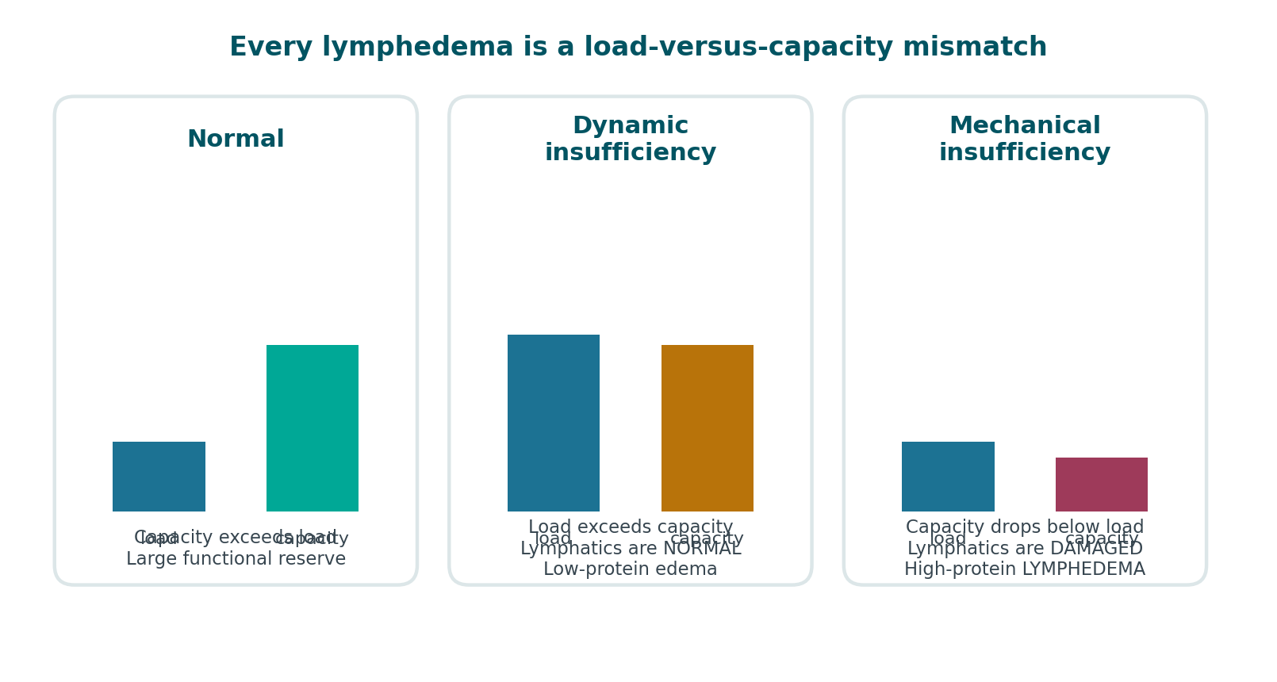
FOUNDATIONS
Lymph Load vs. Transport Capacity
Every case of lymphedema is a mismatch between how much fluid needs to move and how much the system can move.
Combined insufficiency — high load AND damaged system — is common in the patients you will actually see.
6
Notes:
[OPTIONAL — safe to cut]
Combined insufficiency — high load AND damaged system — is common in the patients you will actually see.
SUGGESTED IMAGES FOR THIS SLIDE
Save as: anat_lymph_capillary.png
· Servier (CC BY) — “lymphatic capillary”
https://smart.servier.com/?s=lymphatic%20capillary
· Wikimedia — “lymph capillary interstitial fluid”
https://commons.wikimedia.org/w/index.php?search=lymph%20capillary%20interstitial%20fluid&title=Special:MediaSearch&type=image
· OpenStax Ch.21 (CC BY)
https://openstax.org/books/anatomy-and-physiology-2e/pages/21-1-anatomy-of-the-lymphatic-and-immune-systems

Slide 7
ETIOLOGY
Primary vs. Secondary Lymphedema
Primary lymphedema arises from congenital lymphatic dysplasia. Secondary lymphedema follows anatomical disruption of a previously normal system.
Primary — developmental
Secondary — acquired
Congenital — present at birth or within the first 2 years. Includes Milroy disease.
Praecox — onset at puberty through age 35. The most common primary form.
Tarda — onset after age 35
Mechanisms: aplasia, hypoplasia, hyperplasia, or valvular incompetence of lymphatics
Cancer treatment — lymph node dissection and/or radiation. The leading cause in developed countries.
Filariasis — *Wuchereria bancrofti*. The leading cause worldwide.
Trauma or surgery — burns, vein harvest, orthopedic procedures
Chronic venous insufficiency — progresses to phlebolymphedema
Recurrent infection — each episode of cellulitis causes further lymphatic damage
Obesity — central obesity significantly raises risk independently
7
Notes:
Risk multipliers after cancer treatment: extent of node dissection, regional radiation, elevated BMI, post-op infection, wound complications, and taxane-based chemotherapy.
SUGGESTED IMAGES FOR THIS SLIDE
Save as: anat_axillary_nodes.png, anat_node_regions.png
· NCI (public domain) — “axillary lymph node”
https://visualsonline.cancer.gov/search.cfm?criteria=axillary%20lymph%20node
· Servier (CC BY) — “lymph node”
https://smart.servier.com/?s=lymph%20node
· Wikimedia — “lymph node dissection”
https://commons.wikimedia.org/w/index.php?search=lymph%20node%20dissection&title=Special:MediaSearch&type=image

Slide 8
PRESENTATION
Symptomatology
Subjective symptoms frequently precede visible swelling by months. Do not wait for a measurable difference to take a patient seriously.
Early — often reported before anything is visible
Established
Do not overlook
Heaviness, fullness, or tightness in the limb
Clothing, sleeves, rings, or shoes fitting differently
Aching or discomfort without a clear mechanical cause
Reduced flexibility at the wrist, hand, or ankle
Transient swelling that resolves overnight
Persistent swelling, initially distal, that no longer resolves with elevation
Pitting edema — later becoming non-pitting as fibrosis develops
Skin feels thickened, firm, or leathery
Positive Stemmer's sign
Deepened natural skin folds
Recurrent cellulitis
Psychosocial burden — body image, clothing, social withdrawal, anxiety
Functional loss — grip, reach, gait, footwear, ADLs
Occupational impact and cost of ongoing garments
8
Notes:
Lymphedema is typically painless early. New or significant pain suggests infection, DVT, malignancy — or lipedema, which is painful by definition.
SUGGESTED IMAGES FOR THIS SLIDE
Save as: stage_clinical_leg.png
· Wikimedia — “lymphedema arm”
https://commons.wikimedia.org/w/index.php?search=lymphedema%20arm&title=Special:MediaSearch&type=image
· Wikimedia — “lymphedema leg”
https://commons.wikimedia.org/w/index.php?search=lymphedema%20leg&title=Special:MediaSearch&type=image
· Servier (CC BY) — “edema”
https://smart.servier.com/?s=edema

Slide 9
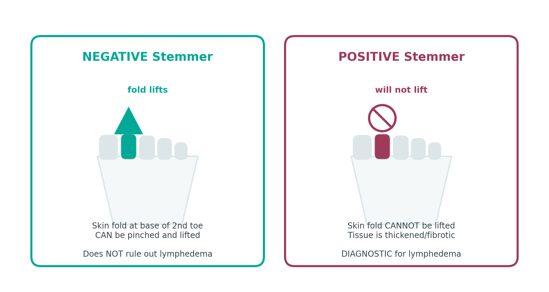
ASSESSMENT
Diagnosis — History & Examination
Diagnosis is primarily clinical. History and physical examination identify the great majority of cases.
History
Onset, duration, progression, and whether it resolves overnight
Surgical and oncologic history — nodes removed, radiation fields
Infection history — every episode of cellulitis
Family history (suggests primary lymphedema or lipedema)
Travel history (filariasis), cardiac, renal, and hepatic history
Physical examination
Stemmer's sign — attempt to pinch and lift the skin fold at the base of the 2nd toe or finger. Cannot lift = positive = lymphedema. Positive is diagnostic; negative does not rule it out.
Pitting assessment — depth and rebound time, graded 1+ to 4+
Skin inspection — texture, temperature, color, papillomas, fissures, wounds, fungal infection between digits
Bilateral comparison — symmetry, foot involvement, where the swelling stops
9
Notes:
Severity by volume difference vs. the contralateral limb: minimal <20%, moderate 20–40%, severe >40%.
SUGGESTED IMAGES FOR THIS SLIDE
Save as: dx_stemmer_positive.png
· Wikimedia — “Stemmer sign”
https://commons.wikimedia.org/w/index.php?search=Stemmer%20sign&title=Special:MediaSearch&type=image
· Wikimedia — “pitting edema”
https://commons.wikimedia.org/w/index.php?search=pitting%20edema&title=Special:MediaSearch&type=image
· Servier (CC BY) — “lymphoscintigraphy”
https://smart.servier.com/?s=lymphoscintigraphy
· Wikimedia — “limb circumference measurement”
https://commons.wikimedia.org/w/index.php?search=limb%20circumference%20measurement&title=Special:MediaSearch&type=image

Slide 10
ASSESSMENT
Diagnosis — Measurement & Imaging
Objective measurement
Imaging — when the picture is unclear
Circumferential tape — at fixed 4 cm intervals from a bony landmark. Low cost, good reliability if landmarks are consistent.
Volumetry — water displacement. Historically the gold standard; impractical with open wounds.
Perometry — infrared optical scanning. Fast and reproducible.
Bioimpedance spectroscopy (L-Dex) — detects extracellular fluid change; can identify subclinical Stage 0.
Lymphoscintigraphy — the imaging standard for confirming lymphatic dysfunction
ICG lymphography — maps superficial lymphatics; guides MLD and surgical planning
Duplex ultrasound — rule out DVT and venous insufficiency
MRI / CT — rule out malignancy or extrinsic compression
10
Notes:
Severity by volume difference vs. the contralateral limb: minimal <20%, moderate 20–40%, severe >40%.
SUGGESTED IMAGES FOR THIS SLIDE
Save as: dx_stemmer_positive.png
· Wikimedia — “Stemmer sign”
https://commons.wikimedia.org/w/index.php?search=Stemmer%20sign&title=Special:MediaSearch&type=image
· Wikimedia — “pitting edema”
https://commons.wikimedia.org/w/index.php?search=pitting%20edema&title=Special:MediaSearch&type=image
· Servier (CC BY) — “lymphoscintigraphy”
https://smart.servier.com/?s=lymphoscintigraphy
· Wikimedia — “limb circumference measurement”
https://commons.wikimedia.org/w/index.php?search=limb%20circumference%20measurement&title=Special:MediaSearch&type=image

Slide 11
ASSESSMENT
What Else Swells a Limb
Before you treat it as lymphedema, rule these out.
Condition | Distinguishing features
Deep vein thrombosis | Acute unilateral onset, pain, warmth, erythema. URGENT — do not perform MLD.
Chronic venous insufficiency | Hemosiderin staining, varicosities, medial malleolar ulceration, improves with elevation
Congestive heart failure | Bilateral, dependent, pitting, dyspnea, JVD, orthopnea
Hypoproteinemia | Bilateral, generalized, may include ascites/periorbital edema
Lipedema | Bilateral, symmetrical, painful, bruises easily, SPARES THE FEET, negative Stemmer
Malignant lymphedema | Rapid onset, pain, proximal-first, neurologic signs. Requires imaging.
Cellulitis | Fever, spreading erythema, heat, pain. Antibiotics first — MLD contraindicated.
Medication-induced | Calcium channel blockers, NSAIDs, steroids, gabapentin, some diabetes drugs
Malignant lymphedema and DVT are the two that must not be missed. Both are referrals, not treatment plans.
11
Notes:
[OPTIONAL — safe to cut]
Malignant lymphedema and DVT are the two that must not be missed. Both are referrals, not treatment plans.
SUGGESTED IMAGES FOR THIS SLIDE
· Wikimedia — “deep vein thrombosis leg”
https://commons.wikimedia.org/w/index.php?search=deep%20vein%20thrombosis%20leg&title=Special:MediaSearch&type=image
· Wikimedia — “chronic venous insufficiency”
https://commons.wikimedia.org/w/index.php?search=chronic%20venous%20insufficiency&title=Special:MediaSearch&type=image
· Wikimedia — “cellulitis leg”
https://commons.wikimedia.org/w/index.php?search=cellulitis%20leg&title=Special:MediaSearch&type=image

Slide 12
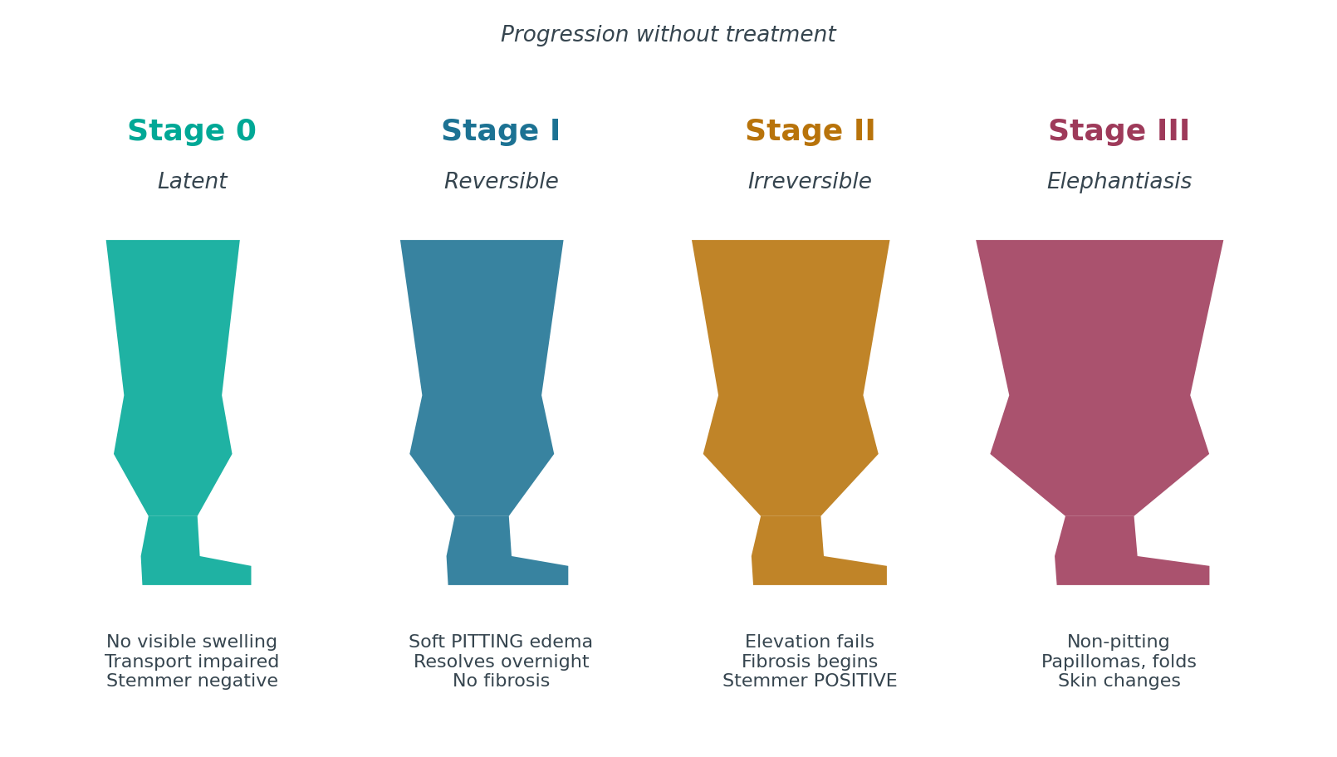
STAGING
ISL Staging — Overview
The International Society of Lymphology defines four stages. Stage 0 is latent — the lymphatics are already impaired before anything is visible.
Staging describes tissue condition, not size. A small Stage III limb is still Stage III. Severity is graded separately by volume difference.
12
Notes:
Staging describes tissue condition, not size. A small Stage III limb is still Stage III. Severity is graded separately by volume difference.
SUGGESTED IMAGES FOR THIS SLIDE
Save as: stage_clinical_leg.png
· Wikimedia — “lymphedema stages”
https://commons.wikimedia.org/w/index.php?search=lymphedema%20stages&title=Special:MediaSearch&type=image
· Servier (CC BY) — “lymphedema”
https://smart.servier.com/?s=lymphedema

Slide 13
STAGE 0
Latent / Subclinical
Lymph transport is already impaired. No visible swelling. May persist for months or years before progressing.
Findings
PT implications
No visible or palpable edema
Subjective heaviness, tightness, or fullness may be reported
Reduced transport capacity detectable by bioimpedance or lymphoscintigraphy
Normal tissue consistency
Negative Stemmer's sign
This is the highest-value window for intervention
Baseline measurement pre-operatively makes this stage detectable at all
Surveillance program, risk-reduction education, early compression if indicated
Prophylactic PT after node dissection has been shown to reduce progression
13
Notes:
Photo slot: Stage 0 — no visible change; consider a limb-surveillance/measurement photo instead
SUGGESTED IMAGES FOR THIS SLIDE
· Wikimedia — “bioimpedance lymphedema”
https://commons.wikimedia.org/w/index.php?search=bioimpedance%20lymphedema&title=Special:MediaSearch&type=image
· Wikimedia — “limb measurement tape”
https://commons.wikimedia.org/w/index.php?search=limb%20measurement%20tape&title=Special:MediaSearch&type=image

Slide 14
STAGE I
Spontaneously Reversible
Early accumulation of protein-rich fluid. Swelling reduces with elevation — often resolving completely overnight.
Findings
PT implications
Soft, pitting edema
Subsides with elevation; frequently gone by morning
No secondary tissue changes — no fibrosis yet
Stemmer's sign usually negative
Limb feels heavy; may be visibly larger by end of day
Highly responsive to CDT
Compression garments often sufficient for maintenance
Patient education on self-management is decisive here
Goal: prevent the transition to fibrosis
14
Notes:
Photo slot: Stage I — soft pitting edema, dorsum of foot or hand
SUGGESTED IMAGES FOR THIS SLIDE
Save as: stage1_photo.png
· Wikimedia — “pitting edema foot”
https://commons.wikimedia.org/w/index.php?search=pitting%20edema%20foot&title=Special:MediaSearch&type=image
· Wikimedia — “lymphedema early stage”
https://commons.wikimedia.org/w/index.php?search=lymphedema%20early%20stage&title=Special:MediaSearch&type=image

Slide 15
STAGE II
Spontaneously Irreversible
Elevation alone no longer reduces the swelling. Lymphostatic fibrosis has begun and the tissue is changing character.
Findings
PT implications
Elevation rarely reduces the limb
Early Stage II — pitting is manifest and pronounced
Late Stage II — pitting may be absent as fibrosis replaces fluid
Tissue feels firm; Stemmer's sign becomes positive
Increasing frequency of cellulitis
Skin thickening becomes apparent
Full intensive-phase CDT is indicated
Fibrosis requires manual work plus foam/chip padding under bandaging
Realistic goal is volume reduction and stabilization, not cure
Aggressive infection-prevention education
The presence or absence of pitting is what separates early from late Stage II — not the size of the limb.
15
Notes:
The presence or absence of pitting is what separates early from late Stage II — not the size of the limb.
Photo slot: Stage II — firm non-pitting swelling, positive Stemmer, early skin thickening
SUGGESTED IMAGES FOR THIS SLIDE
Save as: stage2_photo.png
· Wikimedia — “lymphedema fibrosis”
https://commons.wikimedia.org/w/index.php?search=lymphedema%20fibrosis&title=Special:MediaSearch&type=image
· Wikimedia — “Stemmer sign positive”
https://commons.wikimedia.org/w/index.php?search=Stemmer%20sign%20positive&title=Special:MediaSearch&type=image

Slide 16
STAGE III
Lymphostatic Elephantiasis
Extreme volume increase with characteristic trophic skin changes. Pitting is typically absent.
Findings
PT implications
Marked volume increase and limb distortion
Pitting absent
Trophic skin changes — acanthosis, hyperkeratosis
Papillomas and warty overgrowth
Deep skin folds, fat deposition
Lymphorrhea — weeping of lymph fluid through the skin
Strongly positive Stemmer's sign
Frequent, sometimes life-threatening infection
Extended intensive phase; often requires wound care alongside CDT
Meaningful volume reduction is still achievable — do not write these patients off
Multilayer bandaging with substantial padding
Coordinate with physician; surgical options may be considered after conservative management
Stage III is not a treatment failure to be managed passively. Significant reduction is well documented with sustained CDT.
16
Notes:
Stage III is not a treatment failure to be managed passively. Significant reduction is well documented with sustained CDT.
Photo slot: Stage III — elephantiasis, papillomas, deep skin folds
SUGGESTED IMAGES FOR THIS SLIDE
Save as: stage3_photo.png
· Wikimedia — “elephantiasis leg”
https://commons.wikimedia.org/w/index.php?search=elephantiasis%20leg&title=Special:MediaSearch&type=image
· Wikimedia — “lymphostatic elephantiasis”
https://commons.wikimedia.org/w/index.php?search=lymphostatic%20elephantiasis&title=Special:MediaSearch&type=image
· Wikimedia — “papillomatosis skin”
https://commons.wikimedia.org/w/index.php?search=papillomatosis%20skin&title=Special:MediaSearch&type=image

Slide 17
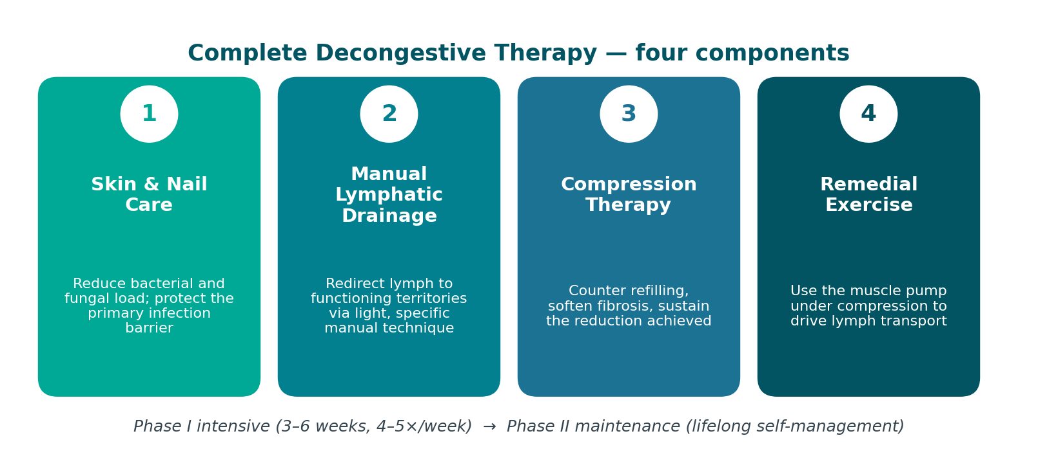
TREATMENT
Complete Decongestive Therapy
CDT is the internationally accepted standard of care. It has four components, delivered in two phases.
Phase II is where outcomes are actually won or lost. Adherence, not technique, is the usual determinant of long-term result.
17
Notes:
Phase II is where outcomes are actually won or lost. Adherence, not technique, is the usual determinant of long-term result.
SUGGESTED IMAGES FOR THIS SLIDE
Save as: tx_before_after.png
· Wikimedia — “complete decongestive therapy”
https://commons.wikimedia.org/w/index.php?search=complete%20decongestive%20therapy&title=Special:MediaSearch&type=image
· Wikimedia — “lymphedema before after treatment”
https://commons.wikimedia.org/w/index.php?search=lymphedema%20before%20after%20treatment&title=Special:MediaSearch&type=image

Slide 18
TREATMENT
CDT — Two Phases
Phase I — Intensive / Reductive
Phase II — Maintenance / Self-Management
Typically 3–6 weeks, treatment 4–5x/week, sessions 1–2 hours
MLD, multilayer short-stretch bandaging worn 23 hours/day, exercise, skin care
Re-measure at every visit
Ends when volume plateaus across consecutive sessions
Fitted compression garment during the day; night garment or bandaging as needed
Self-MLD and home exercise program
Daily skin care and self-inspection
Ongoing surveillance; garments replaced every 4–6 months
Return for a short intensive phase if the limb regresses
Phase II is where outcomes are actually won or lost. Adherence, not technique, is the usual determinant of long-term result.
18
Notes:
Phase II is where outcomes are actually won or lost. Adherence, not technique, is the usual determinant of long-term result.

Slide 19
TREATMENT · CDT 1 OF 4
Skin & Nail Care
A lymphedematous limb is immunocompromised tissue. The skin is the last barrier, and every infection causes further lymphatic damage.
Daily routine
Prevention
Teach the patient to recognize cellulitis
Wash with low-pH, fragrance-free cleanser — lymphedematous skin is alkaline-shifted
Dry thoroughly, especially between the toes and in skin folds
Apply low-pH emollient to keep the barrier intact
Inspect the entire limb daily, including between digits and the posterior surface
Treat tinea pedis and onychomycosis aggressively — a common cellulitis entry point
Nails cut straight across; avoid cutting cuticles
Avoid blood draws, IVs, and BP cuffs on the at-risk limb where an alternative exists
Protect during gardening, cooking, pet handling; gloves and insect repellent
Prompt antiseptic care for any break in the skin
Spreading redness, heat, tenderness, sudden limb enlargement
Fever, chills, malaise, flu-like onset
Seek care same-day. Stop MLD and compression until treated.
Recurrent cellulitis may warrant prophylactic antibiotics — physician decision
19
Notes:
SUGGESTED IMAGES FOR THIS SLIDE
· Wikimedia — “emollient application skin”
https://commons.wikimedia.org/w/index.php?search=emollient%20application%20skin&title=Special:MediaSearch&type=image
· Wikimedia — “tinea pedis”
https://commons.wikimedia.org/w/index.php?search=tinea%20pedis&title=Special:MediaSearch&type=image
· Wikimedia — “cellulitis leg”
https://commons.wikimedia.org/w/index.php?search=cellulitis%20leg&title=Special:MediaSearch&type=image

Slide 20
TREATMENT · CDT 2 OF 4
Manual Lymphatic Drainage — Technique
A specific, very light manual technique that stimulates lymphangion contraction and redirects lymph across watersheds into functioning territories.
Technique principles
Sequence for an affected limb
Very light pressure — stretches skin only. Heavy pressure collapses initial lymphatics and is counterproductive.
Slow, rhythmic — roughly one stroke per second, matching lymphangion contraction rate
Clear proximal before distal. Empty the receiving area first or there is nowhere for fluid to go.
Begin with the neck/terminus, then trunk quadrants, then the affected limb
Work root-to-tip to clear, then tip-to-root to drain
Skin must move with the hand — no gliding, no lubricant
Diaphragmatic breathing — drives thoracic duct flow
Terminus (supraclavicular) clearing
Contralateral, then ipsilateral trunk quadrants
Anastomoses — axillo-axillary, axillo-inguinal, inguino-inguinal
Proximal limb, then progressively distal
Finish with a distal-to-proximal drainage sequence
20
Notes:
MLD alone produces modest results. Its value is greatest when combined with compression — the evidence supports CDT as a package, not MLD in isolation.
SUGGESTED IMAGES FOR THIS SLIDE
Save as: tx_mld_hands.png
· Wikimedia — “manual lymphatic drainage”
https://commons.wikimedia.org/w/index.php?search=manual%20lymphatic%20drainage&title=Special:MediaSearch&type=image
· Servier (CC BY) — “lymphatic drainage”
https://smart.servier.com/?s=lymphatic%20drainage
· Wikimedia — “lymphatic watershed”
https://commons.wikimedia.org/w/index.php?search=lymphatic%20watershed&title=Special:MediaSearch&type=image

Slide 21
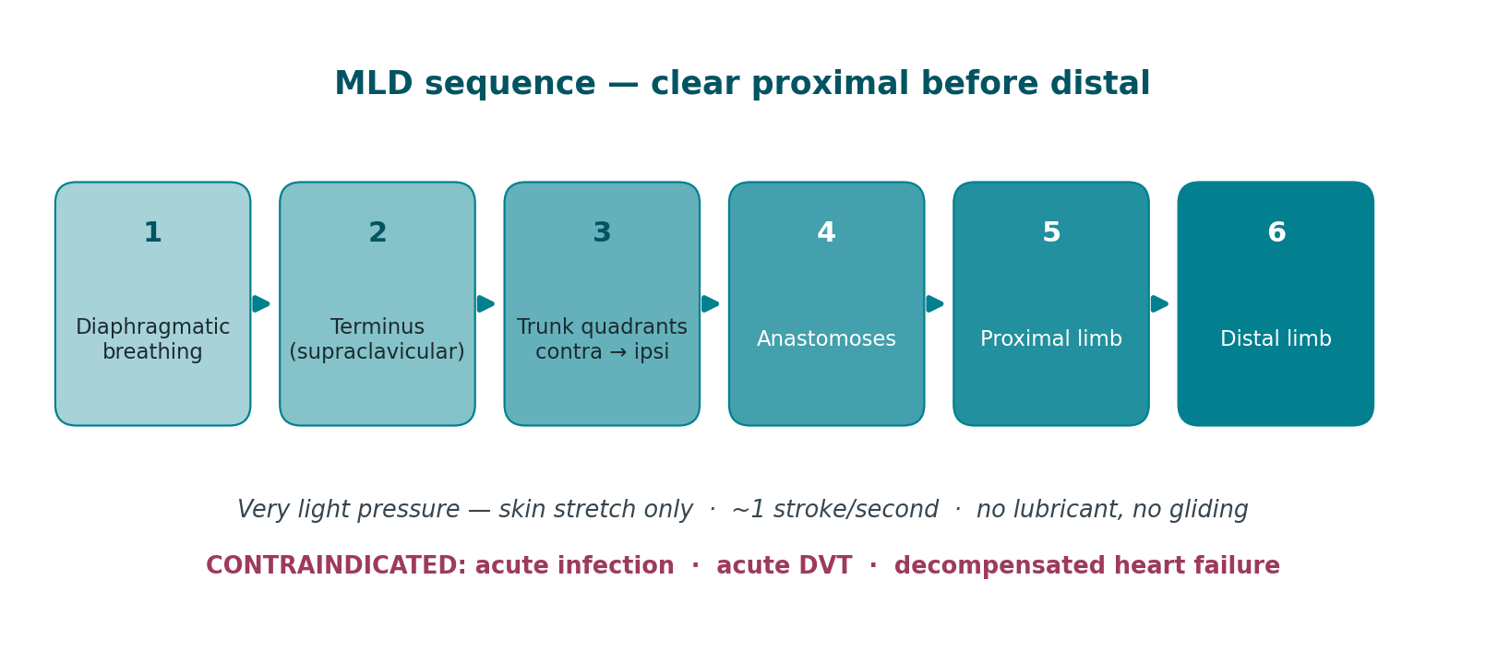
TREATMENT · CDT 2 OF 4
MLD — Sequence & Contraindications
A specific, very light manual technique that stimulates lymphangion contraction and redirects lymph across watersheds into functioning territories.
MLD alone produces modest results. Its value is greatest when combined with compression — the evidence supports CDT as a package, not MLD in isolation.
21
Notes:
MLD alone produces modest results. Its value is greatest when combined with compression — the evidence supports CDT as a package, not MLD in isolation.
SUGGESTED IMAGES FOR THIS SLIDE
Save as: tx_mld_hands.png
· Wikimedia — “manual lymphatic drainage”
https://commons.wikimedia.org/w/index.php?search=manual%20lymphatic%20drainage&title=Special:MediaSearch&type=image
· Servier (CC BY) — “lymphatic drainage”
https://smart.servier.com/?s=lymphatic%20drainage
· Wikimedia — “lymphatic watershed”
https://commons.wikimedia.org/w/index.php?search=lymphatic%20watershed&title=Special:MediaSearch&type=image

Slide 22
TREATMENT · CDT 3 OF 4
Compression Therapy
The single most important component for maintaining reduction. Without compression, gains from MLD reverse within hours.
Phase I — short-stretch bandaging
Phase II — garments
Precautions
Short-stretch bandages: low resting pressure, high working pressure
Never use long-stretch/ACE — high resting pressure risks a tourniquet effect
Layered: stockinette, digit wrap, padding, then short-stretch
Foam or chip padding over fibrotic areas to soften tissue
Gradient must be higher distally than proximally
Worn 23 hours/day, reapplied at each visit
Class 1: 20–30 mmHg — mild/early, upper limb, prophylaxis
Class 2: 30–40 mmHg — most lower limb lymphedema
Class 3: 40–50 mmHg — severe lower limb
Flat-knit generally preferred over circular-knit for lymphedema — better containment, no tourniquet at folds
Custom fit for irregular limb shape
Replace every 4–6 months; two garments so one is always clean
Check arterial status. ABI < 0.8 requires caution; < 0.5 is a contraindication to standard compression.
Decompensated heart failure — sudden fluid return can precipitate overload
Acute DVT, acute infection, severe peripheral neuropathy
Recheck skin integrity at every application
22
Notes:
Intermittent pneumatic compression may be a useful adjunct but does not replace MLD or bandaging, and must not be used over an untreated proximal obstruction.
SUGGESTED IMAGES FOR THIS SLIDE
Save as: tx_bandaging.png, tx_garment_flatknit.png
· Wikimedia — “compression bandage leg”
https://commons.wikimedia.org/w/index.php?search=compression%20bandage%20leg&title=Special:MediaSearch&type=image
· Wikimedia — “compression stocking”
https://commons.wikimedia.org/w/index.php?search=compression%20stocking&title=Special:MediaSearch&type=image
· Wikimedia — “short stretch bandage”
https://commons.wikimedia.org/w/index.php?search=short%20stretch%20bandage&title=Special:MediaSearch&type=image

Slide 23
TREATMENT · CDT 4 OF 4
Remedial Exercise
The skeletal muscle pump is a primary driver of lymph transport. Exercise performed under compression is decongestive therapy.
Principles
Programme components
The resistance training question — settled
Always perform with compression in place — bandages or garment
Begin with diaphragmatic breathing to open the thoracic duct
Proximal to distal — clear the trunk and proximal limb first
Slow, rhythmic, controlled; no breath-holding or Valsalva
Low resistance, higher repetition
End with elevation and further breathing
Diaphragmatic breathing — 5–10 repetitions to start and finish
Cervical and shoulder girdle mobility (upper limb cases)
Trunk and core activation
Active ROM progressing proximal to distal through the limb
Ankle pumps and calf work for lower limb cases
Aerobic conditioning — walking, cycling, aquatic therapy
Slowly progressive resistance training does not cause or worsen lymphedema
The PAL trial demonstrated safety in breast cancer survivors
It may reduce flare incidence and improve limb symptoms
Progress gradually, wear compression, monitor and stop for symptom change
Do not tell patients to avoid using the limb. That advice is outdated and causes deconditioning.
23
Notes:
Aquatic exercise is particularly effective — hydrostatic pressure provides uniform external compression while the patient moves.
SUGGESTED IMAGES FOR THIS SLIDE
· Wikimedia — “aquatic therapy pool”
https://commons.wikimedia.org/w/index.php?search=aquatic%20therapy%20pool&title=Special:MediaSearch&type=image
· Wikimedia — “resistance training rehabilitation”
https://commons.wikimedia.org/w/index.php?search=resistance%20training%20rehabilitation&title=Special:MediaSearch&type=image
· Wikimedia — “diaphragmatic breathing”
https://commons.wikimedia.org/w/index.php?search=diaphragmatic%20breathing&title=Special:MediaSearch&type=image

Slide 24
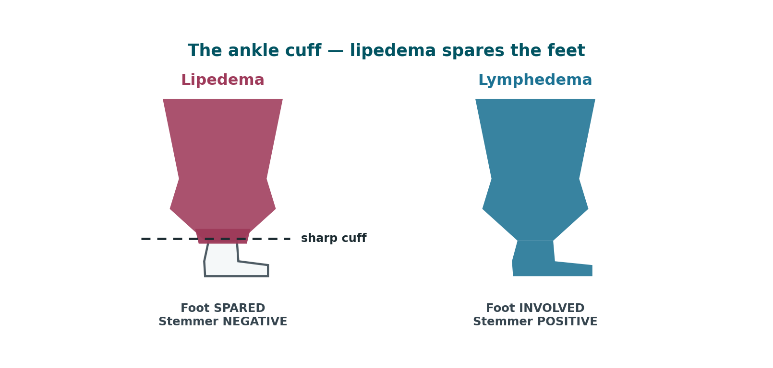
LIPEDEMA
Lipedema — A Different Disease
A chronic disorder of adipose tissue, almost exclusively affecting women, routinely misdiagnosed as obesity or lymphedema for years before recognition.
Defining features
Bilateral and symmetrical fat deposition — legs, hips, buttocks, sometimes arms
Painful — tenderness, aching, pressure sensitivity. This is diagnostic, not incidental.
Bruises easily — capillary fragility
Spares the feet — a sharp cuff or 'bracelet' at the ankle
Disproportionate — lower body markedly larger than trunk
Diet-resistant — the affected fat does not respond to caloric restriction or exercise
Negative Stemmer's sign (until lymphatic involvement develops)
24
Notes:
Sarah Bramblette and patient advocacy groups have driven recent recognition, but average time to diagnosis remains measured in years.
SUGGESTED IMAGES FOR THIS SLIDE
Save as: lip_clinical_legs.png
· Wikimedia — “lipedema”
https://commons.wikimedia.org/w/index.php?search=lipedema&title=Special:MediaSearch&type=image
· Wikimedia — “lipedema legs”
https://commons.wikimedia.org/w/index.php?search=lipedema%20legs&title=Special:MediaSearch&type=image
· Servier (CC BY) — “adipose tissue”
https://smart.servier.com/?s=adipose%20tissue

Slide 25
LIPEDEMA
Lipedema — Etiology & Misdiagnosis
Etiology
Why the misdiagnosis matters
Cause is unknown; strong familial pattern suggests genetic contribution
Hormonally triggered — onset and acceleration cluster at puberty, pregnancy, and menopause
Evidence points toward a connective tissue disorder component
Reported in up to ~11% of women
Men are affected rarely, usually with hormonal alteration
Patients are frequently told to lose weight — which does not resolve the affected fat
Years of unnecessary shame and ineffective treatment
Delayed diagnosis allows progression toward lymphatic involvement
A correct diagnosis is itself therapeutic — it reframes the patient's understanding
25
Notes:
Sarah Bramblette and patient advocacy groups have driven recent recognition, but average time to diagnosis remains measured in years.
SUGGESTED IMAGES FOR THIS SLIDE
Save as: lip_clinical_legs.png
· Wikimedia — “lipedema”
https://commons.wikimedia.org/w/index.php?search=lipedema&title=Special:MediaSearch&type=image
· Wikimedia — “lipedema legs”
https://commons.wikimedia.org/w/index.php?search=lipedema%20legs&title=Special:MediaSearch&type=image
· Servier (CC BY) — “adipose tissue”
https://smart.servier.com/?s=adipose%20tissue

Slide 26
LIPEDEMA
Lipedema Staging — Stages 1 & 2
Classically staged 1 through 3 by skin and tissue architecture. A fourth stage — lipo-lymphedema — is widely used clinically but is contested.
STAGE 1
Smooth skin surface
STAGE 2
Uneven, dimpled skin
Skin surface normal and smooth
Enlarged hypodermis; homogeneous thickening of subcutaneous tissue
Fat is often soft; small nodules may be palpable — described as rice-like or pearl-sized
Fat accumulation around pelvis, buttocks, and hips
Limbs tender and prone to bruising
Swelling may improve with rest and elevation
Skin surface becomes bumpy and wave-like with indentations
Nodular structures in the thickened subcutis — lipomas, angiolipomas
Subcutaneous tissue feels tougher and more nodular
Fat build-up extends down the legs toward the ankles
Swelling less responsive to rest and elevation than Stage 1
Symptoms range from mild to severe
26
Notes:
IMPORTANT CAVEAT: The Lipedema Foundation no longer uses a 'Stage 4' designation, on the grounds that the lymphatic system can be compromised at any stage — lymphatic impairment is documented in Stages 2 and 3. Present Stage 4 as lipo-lymphedema, and note the debate. This is the intellectually honest framing and it will be the question a sharp student asks.

Slide 27
LIPEDEMA
Lipedema Staging — Stage 3 & Lipo-lymphedema
STAGE 3
Large deformations
STAGE 4
Lipo-lymphedema
Further hardening of connective tissue
Bulky, overhanging extrusions of skin and fat
Marked deformation of thighs and around the knees
Persistent swelling not resolving with rest or elevation
Mobility significantly impaired; highest rate of orthopedic complication
May be associated with secondary lymphedema
Lipedema plus secondary lymphedema in the same limbs
The feet begin to swell — the defining change
Stemmer's sign becomes positive
Skin over the toes thickens; pitting appears
Diagnosis moves from lipedema to lipo-lymphedema
Lymphoscintigraphy can document the degree of drainage impairment
IMPORTANT CAVEAT: The Lipedema Foundation no longer uses a 'Stage 4' designation, on the grounds that the lymphatic system can be compromised at any stage — lymphatic impairment is documented in Stages 2 and 3. Present Stage 4 as lipo-lymphedema, and note the debate. This is the intellectually honest framing and it will be the question a sharp student asks.
27
Notes:
IMPORTANT CAVEAT: The Lipedema Foundation no longer uses a 'Stage 4' designation, on the grounds that the lymphatic system can be compromised at any stage — lymphatic impairment is documented in Stages 2 and 3. Present Stage 4 as lipo-lymphedema, and note the debate. This is the intellectually honest framing and it will be the question a sharp student asks.

Slide 28
LIPEDEMA
Lipedema vs. Lymphedema
The differential that matters most in practice — and the one most often gotten wrong.
Feature | Lipedema | Lymphedema
Sex | Almost exclusively women | Either sex
Symmetry | Bilateral, symmetrical | Often unilateral; symmetry not required
Feet | SPARED — sharp ankle cuff | INVOLVED — swelling includes feet/toes
Stemmer's sign | Negative | Positive
Pain | Painful, tender to pressure | Painless early; tension pain when advanced
Bruising | Bruises easily | Not characteristic
Pitting | Typically non-pitting | Pitting early; non-pitting when fibrotic
Distribution | Proximal-dominant, disproportionate | Distal parts always more affected
Family history | Commonly positive | Positive only in primary lymphedema
Response to diet | Affected fat is diet-resistant | Not primarily fat; weight loss reduces risk
Onset trigger | Puberty, pregnancy, menopause | Surgery, radiation, infection, trauma
They co-exist. Lipedema does not itself cause lymphedema — but central obesity, which frequently accompanies it, substantially raises lymphedema risk. Treat what you find.
28
Notes:
They co-exist. Lipedema does not itself cause lymphedema — but central obesity, which frequently accompanies it, substantially raises lymphedema risk. Treat what you find.
SUGGESTED IMAGES FOR THIS SLIDE
· Wikimedia — “lipedema lymphedema comparison”
https://commons.wikimedia.org/w/index.php?search=lipedema%20lymphedema%20comparison&title=Special:MediaSearch&type=image
· Wikimedia — “Stemmer sign”
https://commons.wikimedia.org/w/index.php?search=Stemmer%20sign&title=Special:MediaSearch&type=image

Slide 29
LIPEDEMA
PT Management of Lipedema
Conservative management does not remove lipedema fat. It manages pain, controls fluid, preserves mobility, and slows progression.
What PT can achieve
Interventions
Set expectations honestly
Pain reduction — often the patient's highest priority
Control of any fluid component through MLD and compression
Preservation of joint mechanics and gait
Prevention of progression to lipo-lymphedema
Weight-bearing tolerance and conditioning
Compression — flat-knit garments, generally better tolerated than in lymphedema
MLD for the fluid component and for pain relief
Aquatic exercise — highly effective; buoyancy plus hydrostatic compression
Low-impact aerobic and resistance conditioning
Manual therapy for associated joint dysfunction
Nutritional referral — anti-inflammatory patterns, not caloric restriction alone
Conservative care does not eliminate the fat
Liposuction (tumescent/water-assisted) is the only intervention that removes it
PT before and after liposuction improves outcomes
Insurance coverage remains inconsistent — this is a real barrier
29
Notes:
[OPTIONAL — safe to cut]
The single most valuable thing you may do is tell the patient this is a recognized disease and not a personal failure of willpower.
SUGGESTED IMAGES FOR THIS SLIDE
· Wikimedia — “compression stocking leg”
https://commons.wikimedia.org/w/index.php?search=compression%20stocking%20leg&title=Special:MediaSearch&type=image
· Wikimedia — “aquatic therapy”
https://commons.wikimedia.org/w/index.php?search=aquatic%20therapy&title=Special:MediaSearch&type=image

Slide 30
SAFETY
Red Flags & Referral
Stop treatment and refer when you see these.
Urgent — same day
Refer for workup
Screen before starting
Cellulitis — spreading erythema, heat, fever, sudden limb enlargement
Suspected DVT — acute unilateral swelling, calf pain, warmth
Decompensated heart failure — dyspnea, orthopnea, rapid bilateral swelling
Systemic illness — fever, rigors, malaise, hypotension
Rapid-onset or proximal-first swelling — possible malignant lymphedema
Any new neurological deficit in the limb
Non-healing wound or ulceration
Unexplained weight loss, night sweats, palpable mass
Failure to respond to appropriately delivered CDT
Arterial status — ABI before lower limb compression
Cardiac and renal status
Active malignancy — coordinate with oncology
Peripheral neuropathy and sensory testing
30
Notes:
MLD is contraindicated in acute infection, acute DVT, and decompensated heart failure. When in doubt, do not treat — refer.
SUGGESTED IMAGES FOR THIS SLIDE
· Wikimedia — “cellulitis leg”
https://commons.wikimedia.org/w/index.php?search=cellulitis%20leg&title=Special:MediaSearch&type=image
· Wikimedia — “deep vein thrombosis”
https://commons.wikimedia.org/w/index.php?search=deep%20vein%20thrombosis&title=Special:MediaSearch&type=image

Slide 31
APPENDIX
Source Decks & Reference Material (1 of 2)
The existing presentations and documents this deck was built from. Open any of them to review how others have structured the same material.
ISL 2023 Consensus Document
PDF · primary source
The staging authority. Stages 0–III, diagnosis, and treatment.
https://www.isl.arizona.edu/sites/default/files/2024-11/THE-DIAGNOSIS-AND-TREATMENT-OF-PERIPHERAL-LYMPHEDEMA-2023-CONSENSUS-DOCUMENT-OF-THE-INTERNATIONAL-SOCIETY-OF-LYMPHOLOGY.pdf
Linda Koehler, PT, CLT-LANA — Univ. of Minnesota
Slide deck
Best PT-focused deck found. CDT components, wound care, pain management.
https://www.slideserve.com/collin/lymphedema-overview-and-treatment-considerations
Christina Hankins, PT, CLT, CWS — Lymphedema
Slide deck
Good objectives and outline structure to model.
https://www.slideserve.com/lilly/lymphedema
Lymphedema Therapy (compiled decks)
Slide deck
Several decks on one page, incl. stage descriptions and exercise evidence.
https://www.slideserve.com/lael/lymphedema-therapy
Lymphedema — assorted author decks
Slide deck
Ernandez, Richter, Arslan, Johansson. Mixed quality; useful for framing.
https://www.slideserve.com/shoshana-reynolds/lymphedema-powerpoint-ppt-presentation
31
Notes:
Reviewing these is fine. Reusing their figures in a published deck is not — most contain third-party images the authors did not clear for redistribution. Use the per-slide image links instead; those are openly licensed. Structure, sequencing, and teaching approach are free to borrow from anyone.
Links are clickable in slideshow mode.

Slide 32
APPENDIX
Source Decks & Reference Material (2 of 2)
Clinical Outcomes After PT for Secondary Lymphedema
Case report
Zuther & Norton staging language in plain English.
https://www.ncbi.nlm.nih.gov/pmc/articles/PMC6666846/
Lipedema Foundation — Staging
Reference + photos
Best lipedema staging photos. Note: they no longer use “Stage 4”.
https://www.lipedema.org/staging
Understanding Stage 4 Lipedema: Lipo-Lymphedema
Article
The transition from lipedema to lipo-lymphedema.
https://www.totallipedemacare.com/understanding-stage-4-lipedema-lipo-lymphedema/
Differential diagnostics of lipedema and lymphedema
PubMed
Practical guideline. Basis for the differential table.
https://pubmed.ncbi.nlm.nih.gov/30280233/
Lipedema vs lymphedema — Northwell Health
Article
Plain-language framing useful for patient education.
https://www.northwell.edu/news/insights/lipedema-vs-lymphedema-what-to-know
32
Notes:
Reviewing these is fine. Reusing their figures in a published deck is not — most contain third-party images the authors did not clear for redistribution. Use the per-slide image links instead; those are openly licensed. Structure, sequencing, and teaching approach are free to borrow from anyone.
Links are clickable in slideshow mode.

Slide 33
CLOSE
Key Takeaways
1. Lymphedema is mechanical insufficiency — high-protein, progressive, and self-reinforcing if untreated.
2. Symptoms precede visible swelling. Stage 0 is real and is the best time to intervene.
3. Stemmer's sign is fast, free, and diagnostic when positive.
4. Four ISL stages: 0 latent, I reversible, II irreversible/fibrotic, III elephantiasis.
5. CDT has four components. Compression is the one that holds the result.
6. Exercise under compression is treatment. Resistance training is safe.
7. Lipedema is painful, symmetrical, spares the feet, and has a negative Stemmer.
8. Lipedema is staged 1–3, with lipo-lymphedema as a contested Stage 4.
9. Every episode of cellulitis makes the underlying disease worse.
10. Patient education and Phase II adherence determine long-term outcome.
33
Notes:
Ten takeaways. If you are short on time, 3, 5 and 7 are the ones they must leave with.

Slide 34
Questions
Scan for the full presentation, outline, and a 12-question self-check.
Dr. Sara S. Morrison, PT, DPT, CDT, Cert DN, PCES, CFT, FMT
Total Body Therapy & Wellness
260 Pine State Street, Lillington, NC 27546
(910) 893-2850 · tbtwonline.com
information-vs-energy-vs-matter.github.io/Total_body_therapy_-_wellness/lymphedema/
Educational use only. Not a substitute for individualized medical evaluation or care.
Notes:
Close here. Remind them the QR opens the quiz.

