Slide 1
An Empirical Exploration of Perceived Similarity between News Article Texts and Images
Lucien Heitz, Abraham Bernstein, Luca Rossetto University of Zurich, Switzerland
MediaEval Workshop 1-2 February 2024, Amsterdam, Netherlands and Online

Slide 2
Takeaway Message
We evaluate perceived image fit of articles empirically in a crowd-sourced experiment
We find that while the ground-truth mostly matches well, other images can match and in parts outperform it
We recommend alternative evaluation methods for the task that do account for multiple image matches

Slide 3
Motivation & Related Work
NewsImages uses a dataset of article-image pairs…
with a 1:1 correspondence of articles and images
all ‘incorrect’ images in the dataset are an equally bad fit
Looking at press agencies, however, stories are often published by different outlets with different images
Does the current evaluation reflect the tasks intent?
Explore different measurements (e.g., TRECVID’s InfMAP)
MediaEval Workshop 1-2 February 2024, Amsterdam, Netherlands and Online

Slide 4
Approach
We sample a subset of the challenge datasets
For every sampled article, we showed 4 images:
Ground-truth
External Stock image (retrieved from unsplash.com)
AI-generated image (generated using Stable Diffusion)
CLIP-retrieved image (best non-ground-truth result)
We conduct a survey where participants (N=73) rated the fit between article & lead with an image on a 7-point scale
MediaEval Workshop 1-2 February 2024, Amsterdam, Netherlands and Online

Slide 5
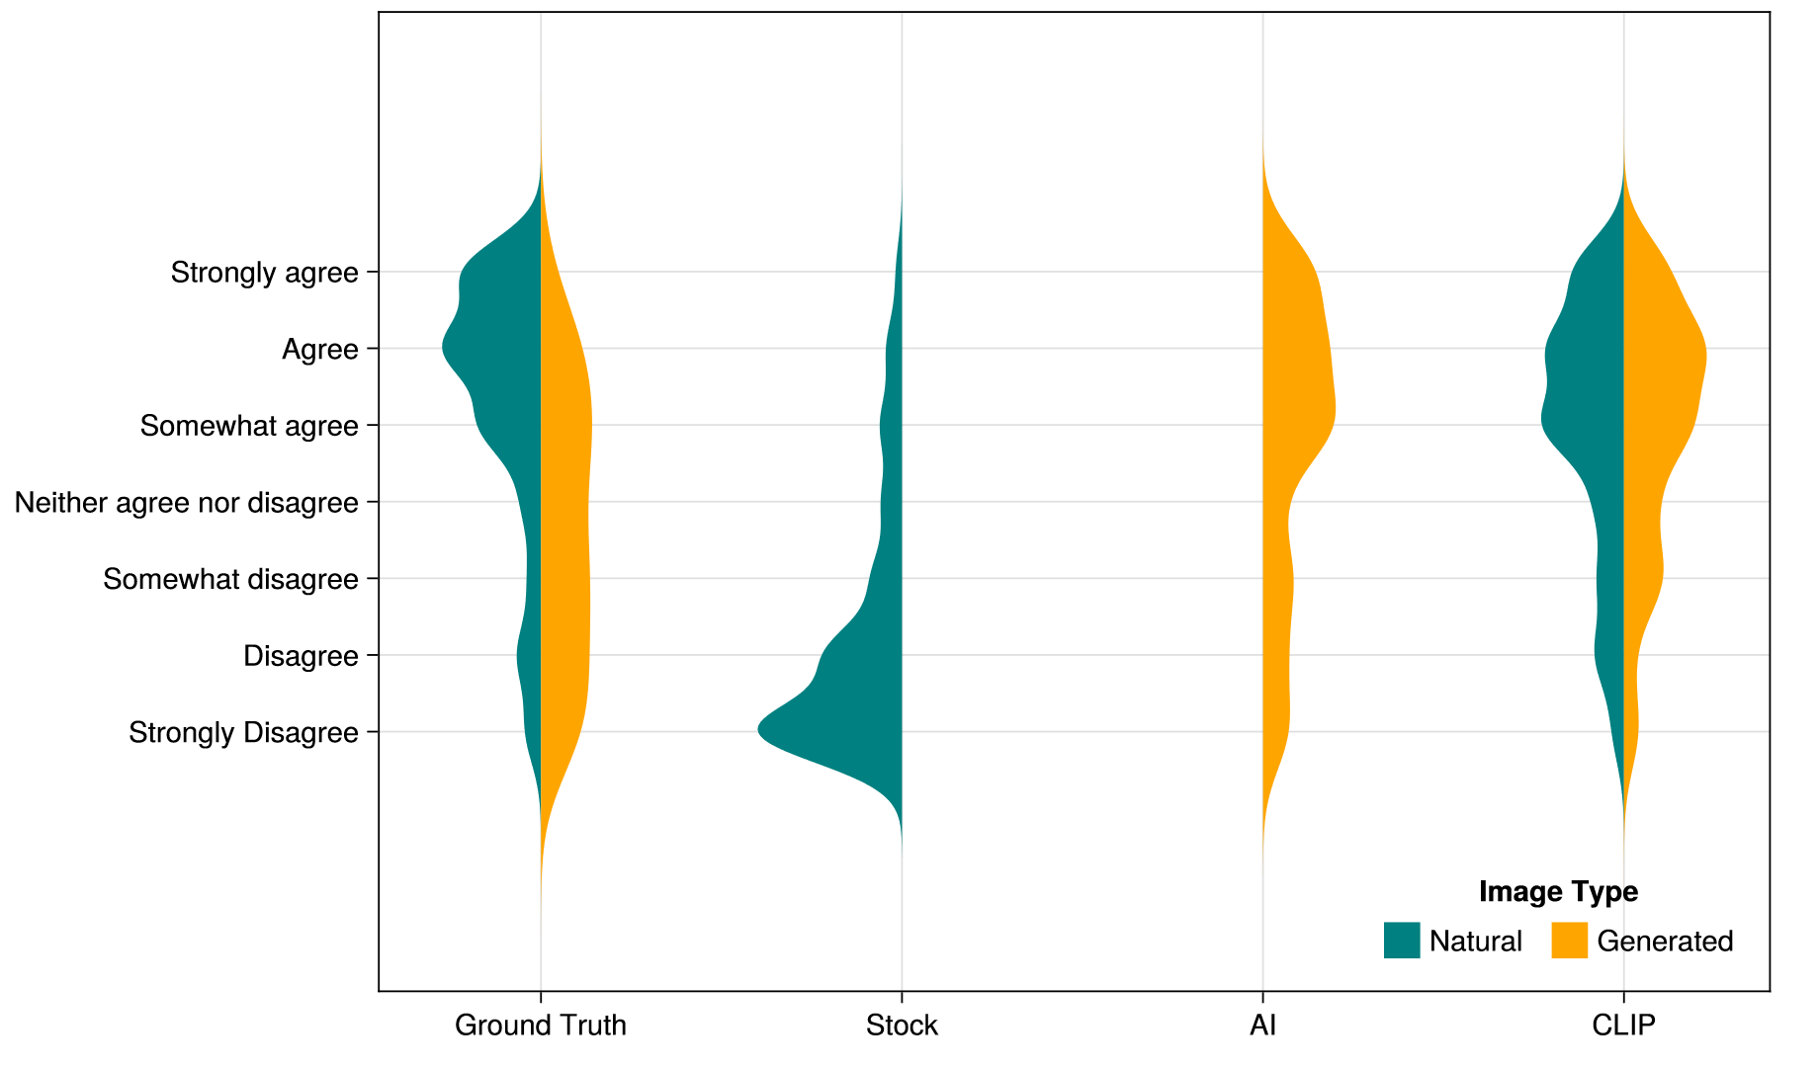
VIRUS ICON PACK
Results
MediaEval Workshop 1-2 February 2024, Amsterdam, Netherlands and Online

Slide 6
Lessons Learned: Insight
Ground-truth is often perceived as a good fit, but…
other dataset images perform equally well or better
AI image generated for a different article sometimes rated as a better fit than for article it was generated for
Large variability in ratings of AI images, model selection is important

Slide 7
Lessons Learned: Outlook
AWESOME WORDS
The 1:1 matching assumption cannot be confirmed empirically
Discrepancies between task targets and measurements!
Goal discrepancy: Alternative evaluation: ex-post rather than ex-ante evaluation with humans in the loop
Methodology discrepancy: Separation of editorially and AI-generated content needed

Slide 8
Questions?
Lucien Heitz, heitz@ifi.uzh.ch
Luca Rossetto, rossetto@ifi.uzh.ch
MediaEval Workshop 1-2 February 2024, Amsterdam, Netherlands and Online

