Slide 1

INFOSYS INTELLIGENT ASSISTANT
Navigating your Next in Service Desk Automation

Slide 2


Challenges in working with tickets
L2 TEAM
Troubleshooting of L2 level issue based on SOPs
Share to L3 team
?
?
?
L1 TEAM
End User
L3 TEAM
End user witness an issue
Calls Service Desk OR raises ticket
Monitors the queue for incoming tickets
Raises ticket for any issues, witnessed through monitoring
Monitoring
Classify
Assign
Manual monitoring of ticket queue
Misroute ticket in wrong queue
Whom to assign ticket?
Support different time zones
Mapping to incorrect support category
Who is on the floor in current shift?
Tickets with incomplete information
Mapping to incorrect group
Who is SME of application?
Manual effort spent in getting more information
Mapping to incorrect application
What is workload of support engineer staff?

Slide 3
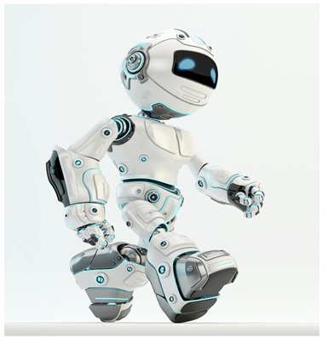
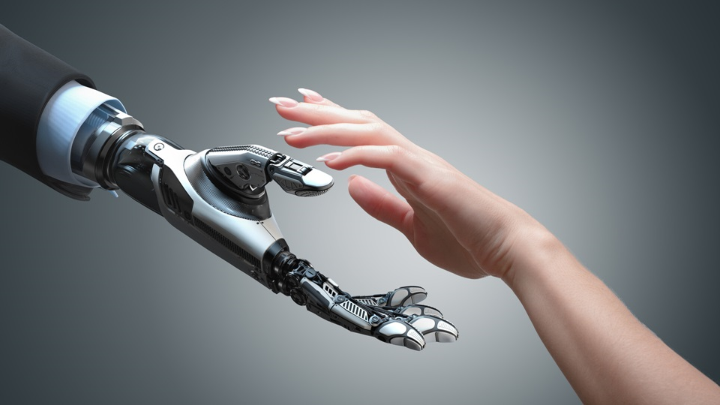
Why Infosys Intelligent Assistant (IIA)?
?
?
?
USER
Infosys Intelligent Assistant
ITSM tool
End user witness an issue
Calls Service Desk OR raises ticket
Service Now, Remedy, JIRA, Manage Engine
IIA Process
Automated
Automated
Automated
Automated
Assisted
Assisted
Detect
Validate & Enrich
Classify
Assign
Troubleshoot
Resolve
Traditional Process
Manual

Slide 4











Capabilities of Infosys Intelligent Assistant
Seamless Extraction of tickets from ITSM tool – ServiceNow, Remedy, JIRA, ManageEngine, OTRS, email
Validate & Enrich ticket information by recognizing named entities from ticket description & image attached
Classify based on trained ML algorithms / whitelisted words
Assign tickets to correct assignment groups / support engineer
Assisted resolution based on historical tickets, KEDB, KMDB.
Auto resolution using Bots - Script or RPA
Notifications using Twilio – Calls, SMS, WhatsApp, MSTeams
Problem Management and Analysis
Advanced Exploratory Data Analysis

Slide 5


Summary - IIA
IIA is an AI/ML based automation solution for application management
Capable of automating ticket extraction, classification, assignment, troubleshooting & auto- resolution
Provide faster ticket resolution along with other aspects of service management like follow ups, ticket creation using emails, notifications, PMA.
Key Features
Zero touch resolution
Named Entity Recognition.
Image Analytics
Prediction
Explainable Assignment.
Seamless extraction of tickets from ITSM tool – ServiceNow, Remedy, JIRA, ManageEngine
Validate & Enrich ticket information by recognizing Named Entities
Classify based on trained ML algorithms / whitelisted words
Assign tickets to correct assignment groups / support engineer
Assisted resolution based on historical tickets, KEDB, KMDB
Auto resolution and self-healing using bots (RPA, Script)
Automated
Automated
Automated
Automated
Assisted/Auto
Assisted/Auto
Detect
Validate and Enrich
Classify
Assign
Resolve
Automated Ticket Routing
Troubleshoot

