Slide 1
Automated Dormant account closure system Design

Slide 2
Login Page
Username
Password
Submit
Reset

Slide 3
Read/Write User Access

Slide 4
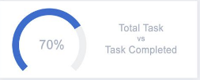
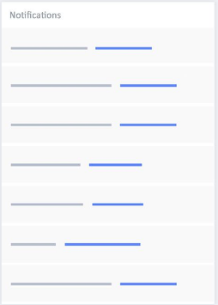
Landing Page
Import Export
Audit
File
Report
List of Dormant Accounts
Search
 |  |  | Assign to me
 |  |  | Assign to me
My Open Activities
 |  |  | Select row

Slide 5
Details page
Customer Info
Activity history
Customer name: Sachin Kothavade
Action Taken
Account number: 07864569349
Account Type: Saving
Contact number: 9923605568
Action Taken
Email Id: sachin.kothavade @gmail.com
Customer Feedback
Action Taken
Feedback
Based on action reason populate
Action Taken
Next Reminder
Action
Action Taken
Reason
Continue …

Slide 6
Checklist
abc
xyz
Submit
Cancel

Slide 7
Admin User Access

Slide 8
Approval Pane
Pending for Approval
 |  |  | Select row
Only for Admin
All the required details
Comment
Approve
Reject

Slide 9
Thank You

