Slide 1
ANTENATAL & POSTNATAL HYDRONEPHROSIS
USG IMAGING & CLASSIFICATION

Slide 2
NOMENCLATURE
PYELECTASIS
PELVIECTASIS
PROMINENT PELVICALYCEAL SYSTEM
HYDRONEPHROSIS (Mild/moderate/severe/gross)
URONEPHROSIS

Slide 3
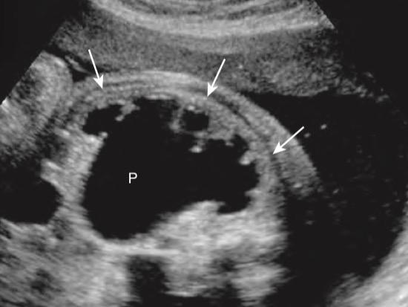
Image Credits: DIAGNOSTIC ULTRASOUND 6TH E
Oblique sagittal view of the right kidney in a 22 week fetus

Slide 4
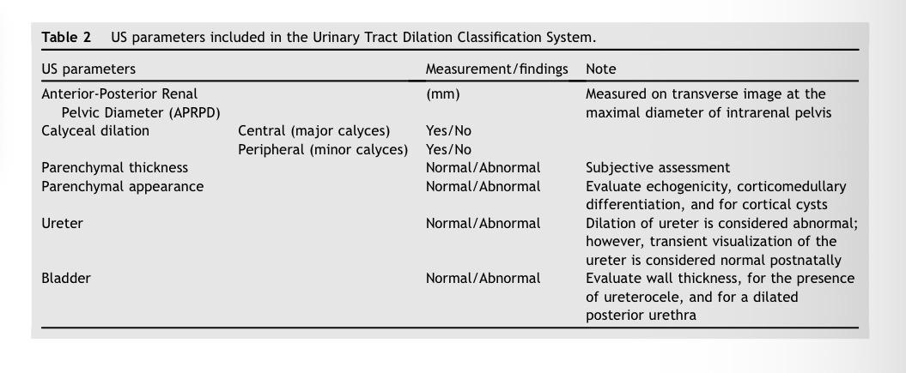

Slide 5
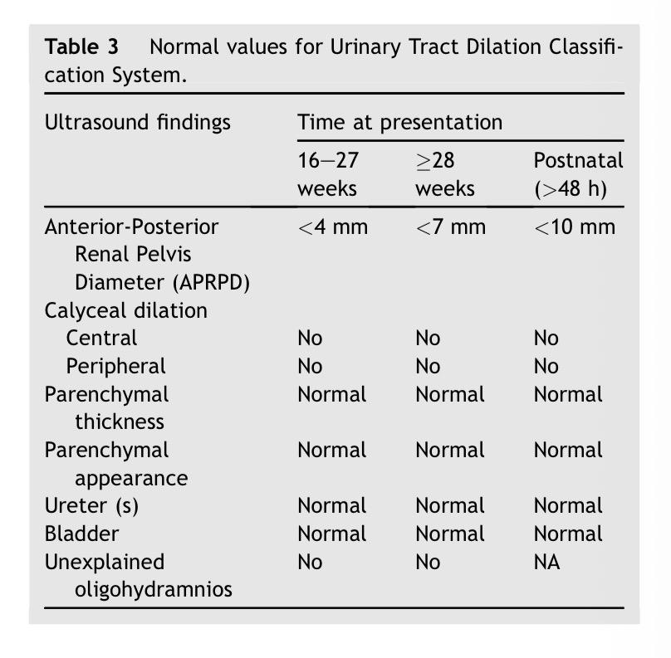

Slide 6
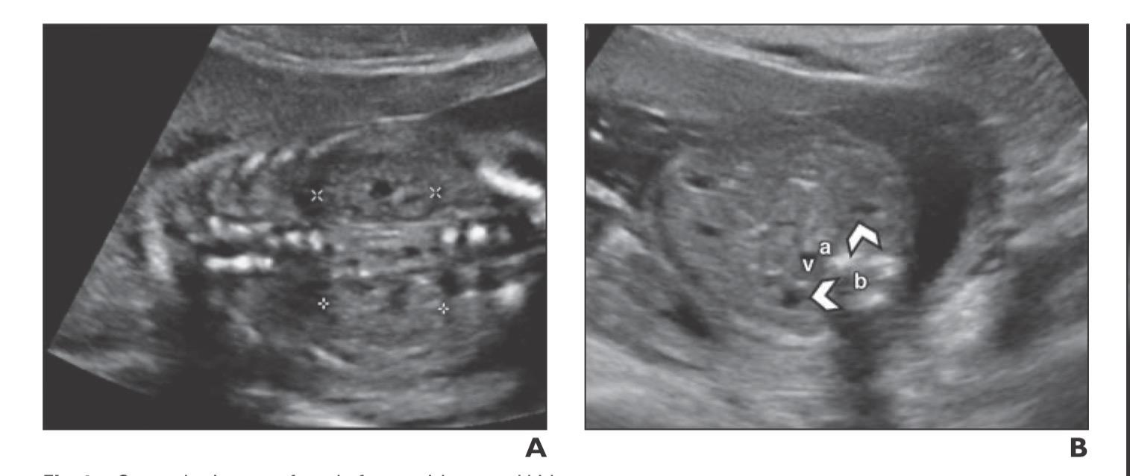
Sonographic appearance of the normal fetal kidneys in 2nd trimester

Slide 7
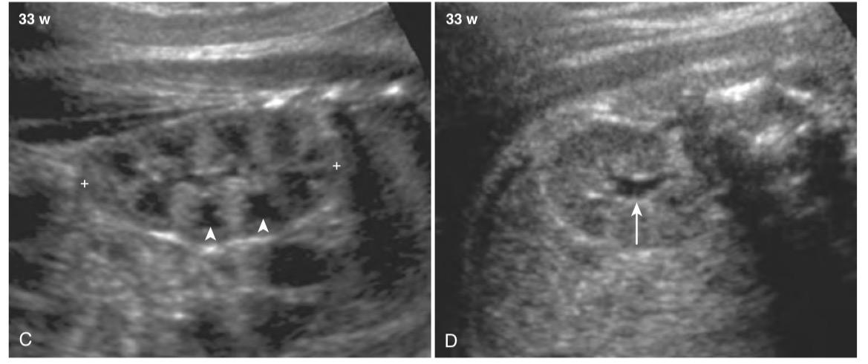
Sonographic appearance of the normal fetal kidneys in 3rd trimester

Slide 8
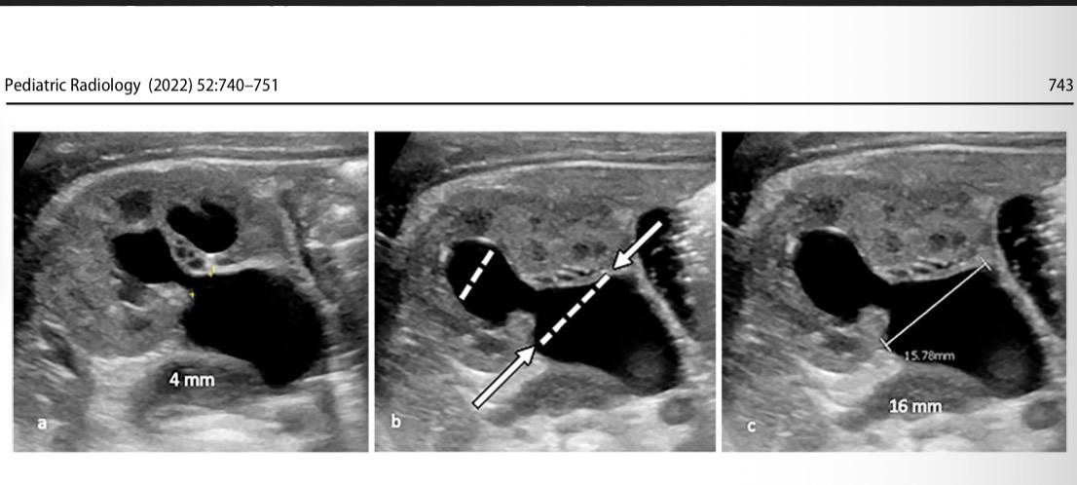

Slide 9
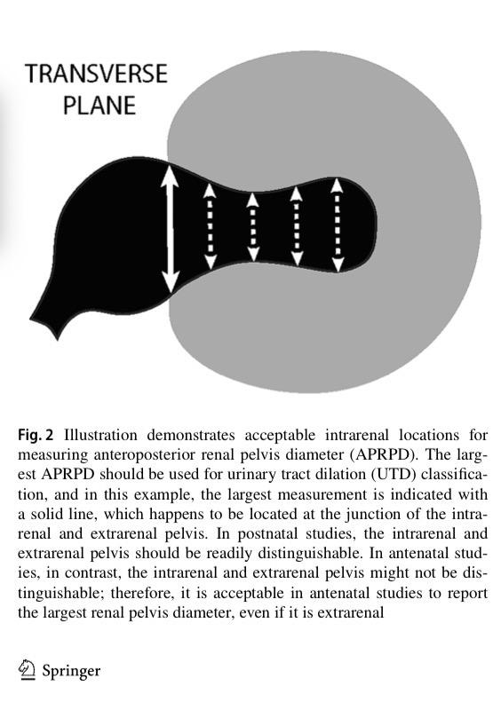

Slide 10
Measuring the APRPD
Ideally the fetal spine should be at 12 o’clock position / 6 o’clock position
In postnatal patients the AP RPD should be measured with the patient in prone position.The prone position tends to increase the width of the pelvis compared to the supine position. However in case this is not feasible, it should be documented that the measurement has been done in supine position. Subsequent measurements in serial USGs should be taken in the same patient position.

Slide 11
Calyceal dilatation
Central vs peripheral calyceal dilatation

Slide 12
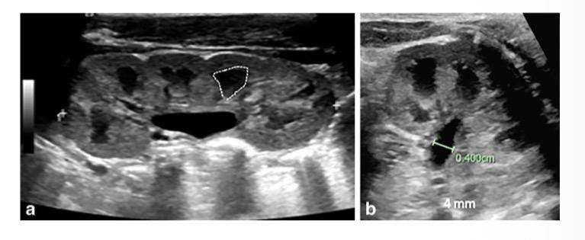
Calyceal dilation : Central or peripheral ?

Slide 13
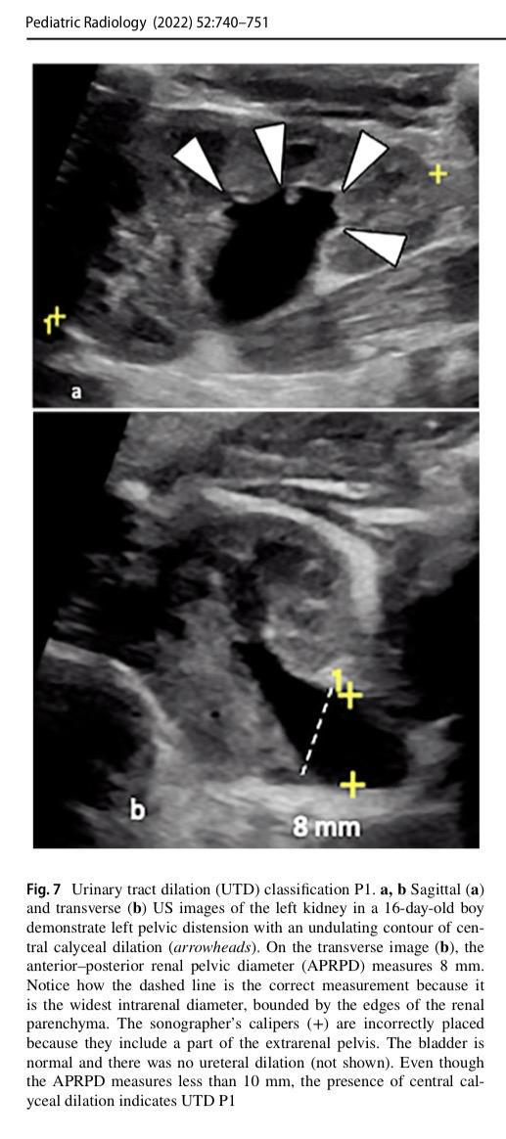
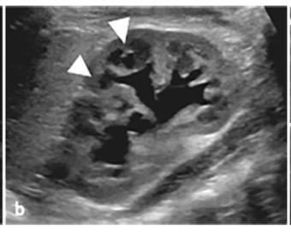
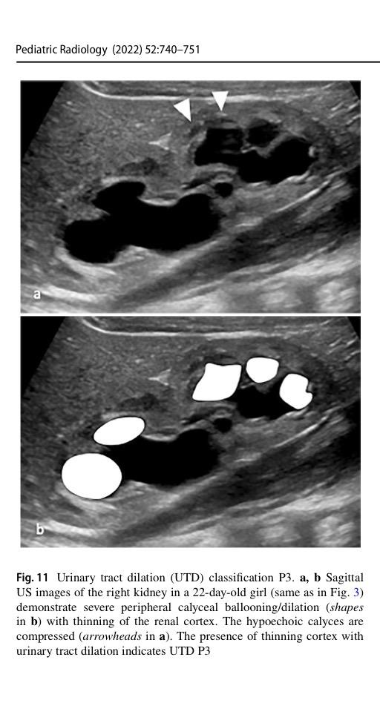
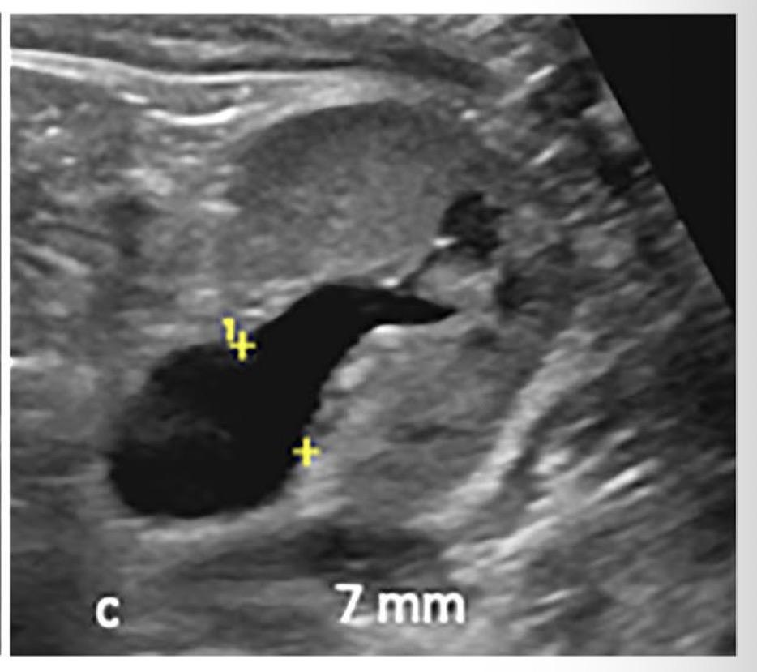

Slide 14
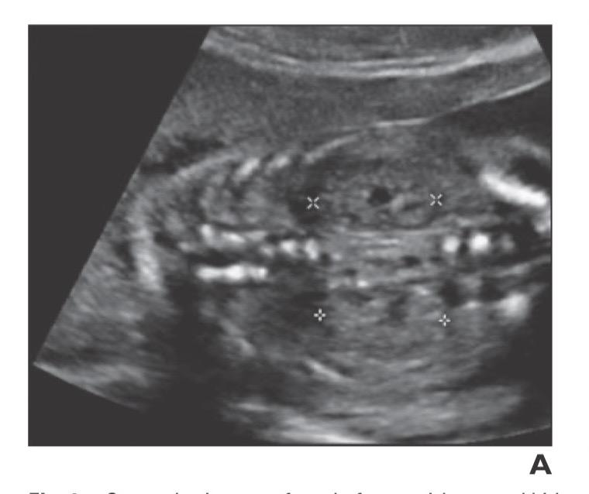
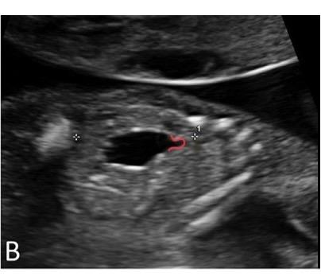
C
A: Sagittal view of normal appearance of fetal kidneys at 18 w POG
B: Sagittal view showing presence of central calyceal dilation.
C: Sagittal view showing presence of …….

Slide 15
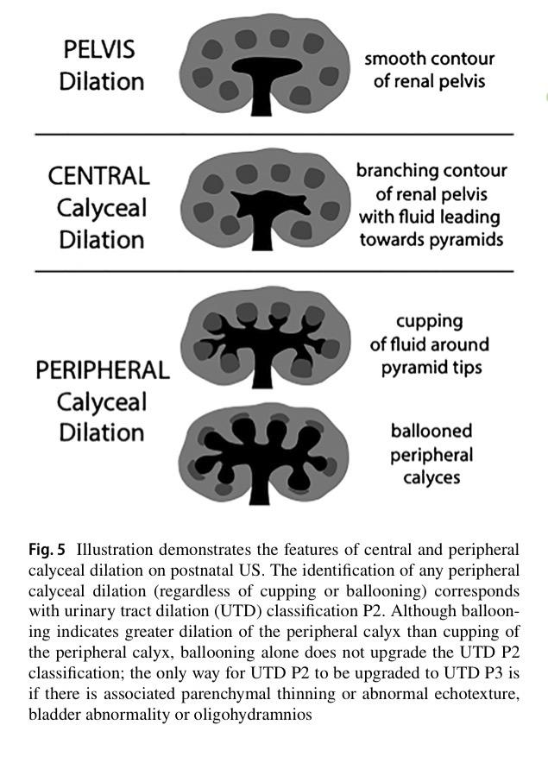
Summing up Pelvicalyceal dilation
*Absence of Pelvicalyceal dilation precludes usage of UTD classification system

Slide 16
Parenchymal thickness

Slide 17
Parenchymal appearance
Normal vs hyperechoic (w.r.t.?)
Antenatal vs postnatal appearance

Slide 18
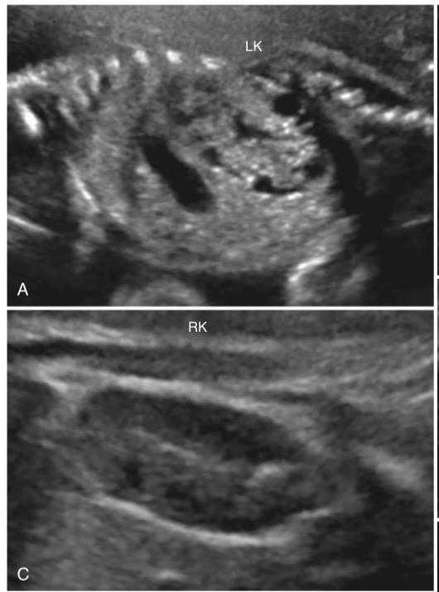
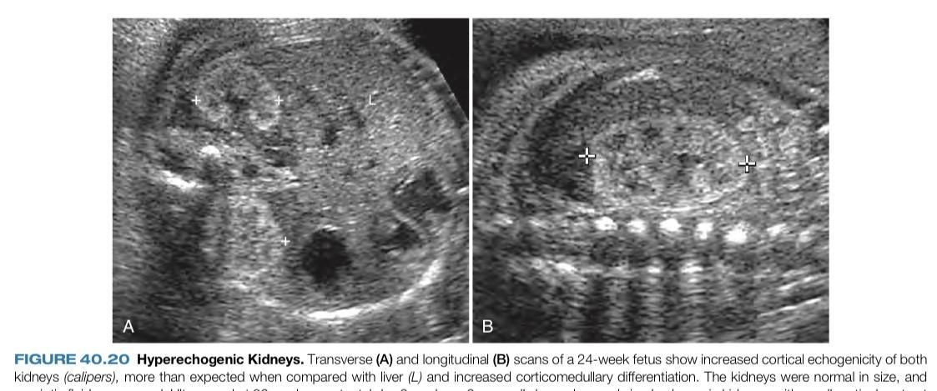

Slide 19
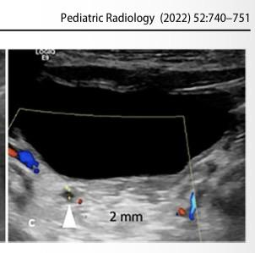
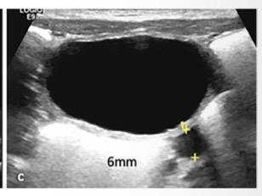
Ureters
Cutoff values for dilated/prominent/normal ureters
Bladder distension

Slide 20
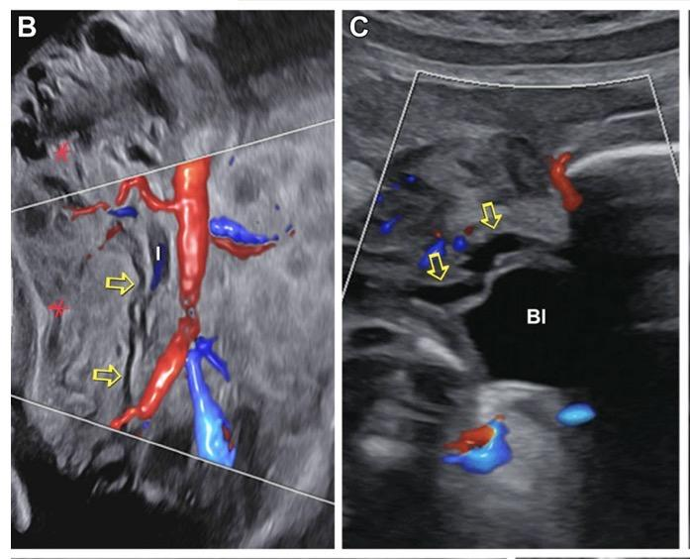
In Antenatal scans:-
Visualisation of ureter(s) is considered abnormal irrespective of the ureteric calibre

Slide 21
In postnatal patients:-
“Normal ureters are distended by urine, and visualizing this does not mean that the ureter is abnormally dilated”
Ureters should be evaluated in both prevoid as well as postvoid states
Distal ureter calibre >4 mm is considered abnormal

Slide 22
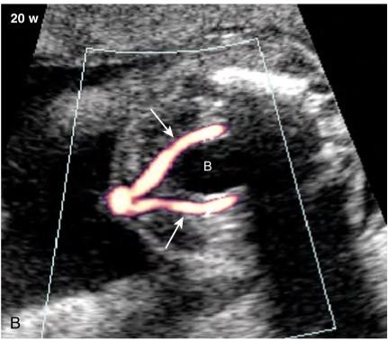
Urinary Bladder
Normally distended (Cutoff values)
Normal voiding cycle in antenatal UBs
Abnormal (Megacystis/Thickened wall/Ureterocoele)

Slide 23
In the first trimester, megacystis is defined as a urinary bladder measuring greater than 7 mm in diameter
Beyond the first trimester sagittal bladder dimension (in millimeters) greater than gestational age (in weeks) plus 12 may be used to define megacystis

Slide 24
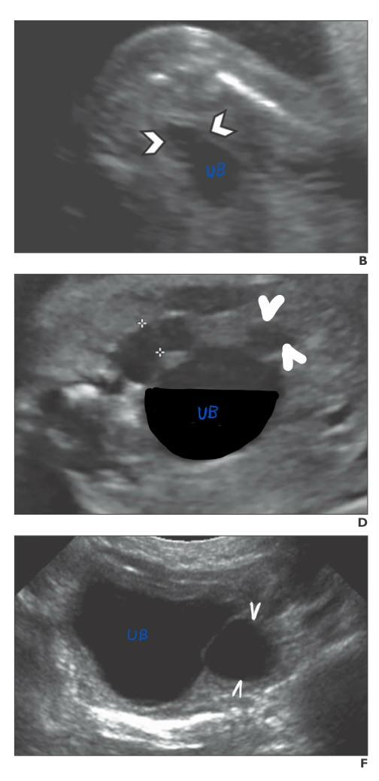
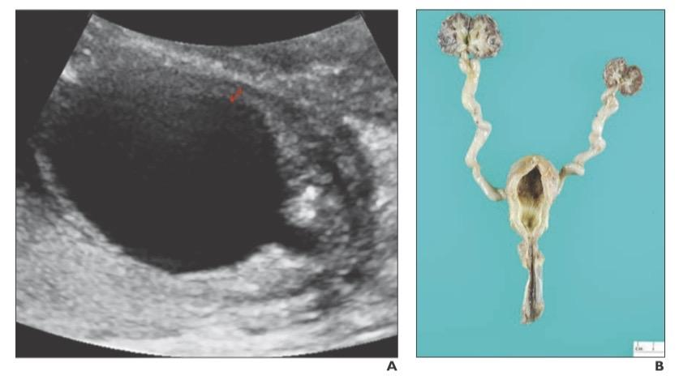

Slide 25
Unexplained Oligohydramnios
That is oligohydramnios suspected from fetal GU cause
Amniotic fluid production (switches over from placenta to fetal kidneys at around 15-16 weeks POG)
Causes of oligohydramnios

Slide 26
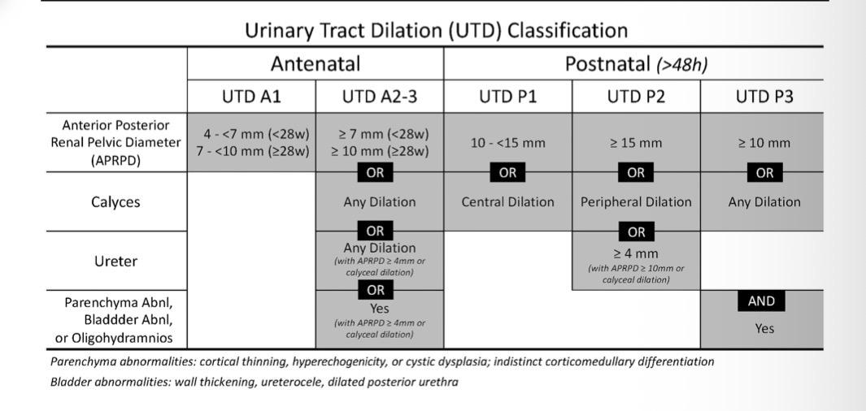

Slide 27
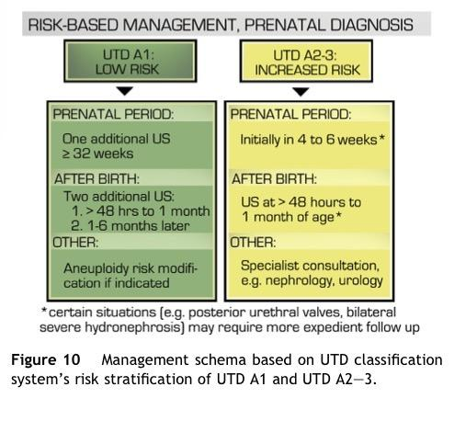

Slide 28
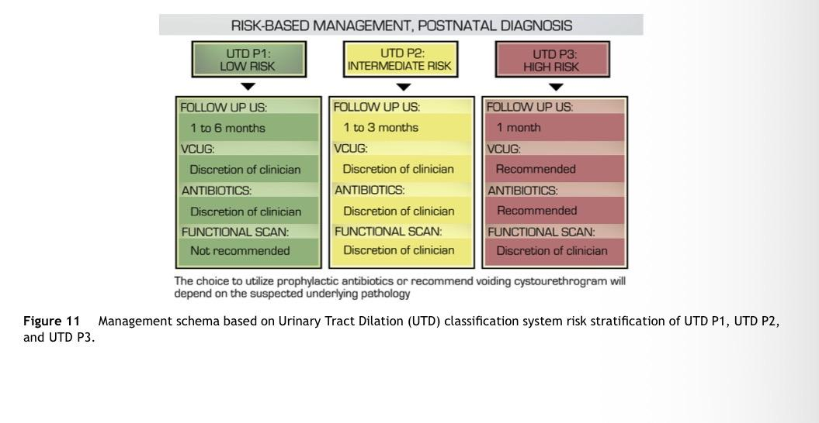

Slide 29
Sample report
APRPD in mm
Calyceal dilation (central or peripheral)
Renal parenchymal thickness (normal or abnormal)
Renal parenchymal echogenicity (normal or abnormal)
Ureteral dilation (present or absent) and
Bladder abnormality (present or absent)
Unexplained Oligohydramnios
IMPRESSION : UTD A/P
Advised Clinical correlation and (enumerate management strategy)

Slide 30
Sources/Further reading
Nguyen HT, Benson CB, Bromley B, Campbell JB, Chow J, Coleman B, et al. Multidisciplinary consensus on the classification of prenatal and postnatal urinary tract dilation (UTD classification system). Journal of Pediatric Urology [Internet]. 2014 Nov 17;10(6):982–98
Nguyen HT, Phelps A, Coley B, Darge K, Rhee A, Chow JS. 2021 update on the urinary tract dilation (UTD) classification system: clarifications, review of the literature, and practical suggestions. Pediatric Radiology [Internet]. 2022 Jan 4;52(4):740–51.
Griffith AM, Woodward PJ, Kennedy AM. Troubleshooting tips for diagnosing complex fetal genitourinary malformations. Radiographics [Internet]. 2023 Dec 21;44(1):e230084.
Carol M. Rumack and Deborah Levine: Diagnostic Ultrasound, 2-Volumes, 6th edition. 2024 Jan 11;51(7):1799.

Slide 31
THANK YOU !

