Slide 1
IMAGING OF SOLITARY PULMONARY NODULE (SPN)
PRESENTOR : Dr. Youpesh Kumar
Notes:
Good morning to all today i am presenting a topic on IMAGING OF SOLITARY PULMONARY NODULE

Slide 2
DEFINITION
A solitary pulmonary nodules (SPN) usually is defined as a focal opacity on chest radiograph or CT, which has following criteria:
1. It is relatively well defined.
2. It is surrounded, at least partially, by lung.
3. It is roughly spherical in shape.
4. It is 3 cm or less in diameter.

Slide 3
IMAGING OF SPN
CHEST RADIOGRAPH
CT SCAN
MRI
FDG-PET / SPECT (Single photon emission CT)

Slide 4
SPURIOUS LESIONS ON CXR
NIPPLE SHADOW
PLEURAL BASED LESIONS
CHEST WALL LESIONS
SKIN NODULES
ARTIFACTS DUE TO CLOTHING
SCREEN ARTIFACTS

Slide 5
MORPHOLOGICAL CHARACTERISTICS OF SPN
SIZE: maximum transverse diameter on CT
Significance:
<6mm: very low malignancy risk
6-8mm: intermediate risk- require follow up
8mm- increased risk of malignancy-further evalaution needed.
DIAMETER | MALIGNANCY RATE
<1 CM | 35 %
1-2 CM | 50%
2-3CM | 80%
>3CM | 97%

Slide 6
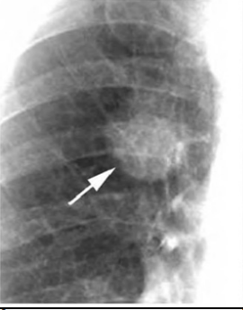
Right upper nodules repesenting an adenocarcinoma
Notes:
This is a chest radiograph showing a right upper lobe opacity, the opacity is classified as nodule because it is relatively well defined and at least partially surrounded by lung and 3 cm or less.

Slide 7
2.SHAPE
IRREGULAR/LOBULATED/NOTCHED- CARCINOMAS
ROUND/OVAL- Benign or malignant possible.
Polygonal/triangular-may suggest perifissural intrapulmonary nodule.
Linear/angular- Scar/atelectasis

Slide 8
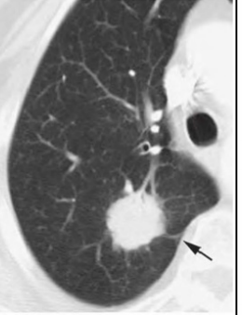
Notes:
this is a Ct image showing lobulated suggesting more likelihood of malignancy

Slide 9
3.LOCATION
CENTRAL TUMORS : SMALL CELL CA, SQUAMOUS CELL CA
PERIPHERAL TUMORS : ADENO CA, LARGE CELL CA
Lobar distribution:
Upper lobe-Primary Lung cancer, TB
Lower Lobe- Metastasis, AVM, round atelectasis.
METASTASIS USUALLY AT BASAL AND SUBPLEURAL LOCATION
BENIGN LESIONS ARE EQUALLY DISTRIBUTED THROUGHOUT THE LUNG

Slide 10
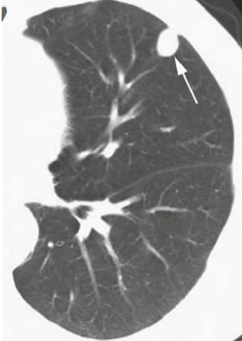
Notes:
This is a Solitary metastasis Nodule from head and neck Ca at subpleural location

Slide 11
4.EDGE CHARACTERSTICS
IRREGULAR/SPICULATED/LOBULATED: MALIGNANT
( spiculated-radial extension of the tumor cells seen along the lymphatics, small airways or blood vessels)
SMOOTH/SHARP: usually benign
ILL defined/ Fuzy: may indicate infection or inflammation.
Halo sign
Pleural reteraction-Malignancy
Metastases and carcinoid tumors have sharp and smooth edges

Slide 12
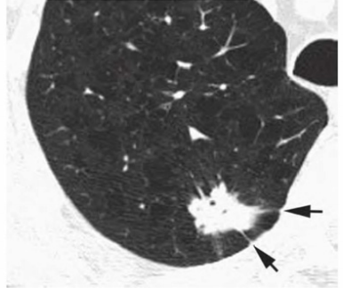
Adenocarcinoma with spiculated margin seen on CT.
Notes:
This ct imgae showing nodule with Two pleural tails extend to the pleural surface. This apperence has been termed corona radiata or corona maligna. several lucencies within the nodule represent air brochograms or areas of pseudocavitation- Typical finding in adenocarcinoma and Brochioalveolar carcinoma.

Slide 13
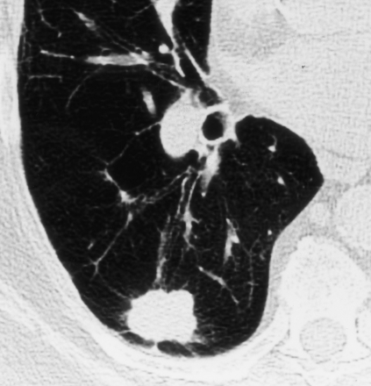
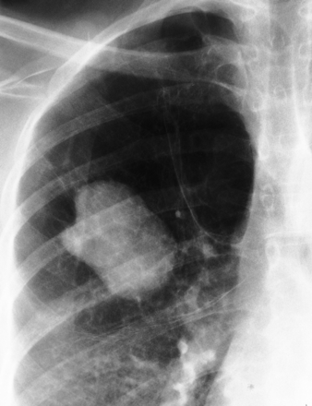
LOBULATED MARGINS
Notes:
This is a image showing chest x ray and CT radiograps with nodule having lobulated margin.

Slide 14
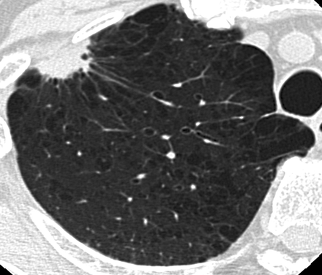
CORONA RADIATA/CORONA MALIGNA
Presence of spiculation associated with a nodule or a mass : fine,linear strands extending outward due to fibrosis surrounding the tumor/desmoplastic reaction

Slide 15
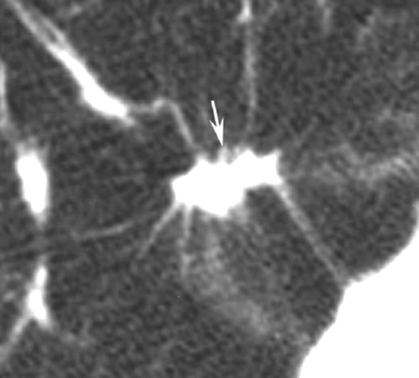
PLEURAL TAIL
Carcinomas have a thin linear opacity extending from the edge of a nodule to the pleural surface : due to fibrosis
Can be seen in benign lesions too (in Various granulomatous disease)

Slide 16
HALO SIGN
Halo of ground glass opacity surrounding a nodule
Seen in:
Leukemic patients with invasive aspergillosis due to haemorrage.
Bronchioalveolar Carcinoma due to lepidic spread of tumor.
Wegeners granulomatosis
Tuberculoma

Slide 17
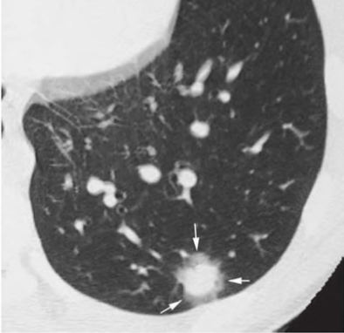
Halo sign in invasive asperigillosis
Notes:
This is a image of invasive aspergillosis where (halo represent hemorrage surrounding the septic infarction)

Slide 18
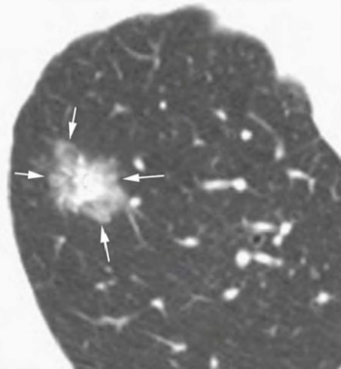
Halo sign in Brochioalveolar carcinoma
Notes:
This is a Hrct image showing dense central nodule in brochioalveolar carcinoma surrounded by halo (In BAC halo reprsent the presence of lepidic tumor growth)

Slide 19
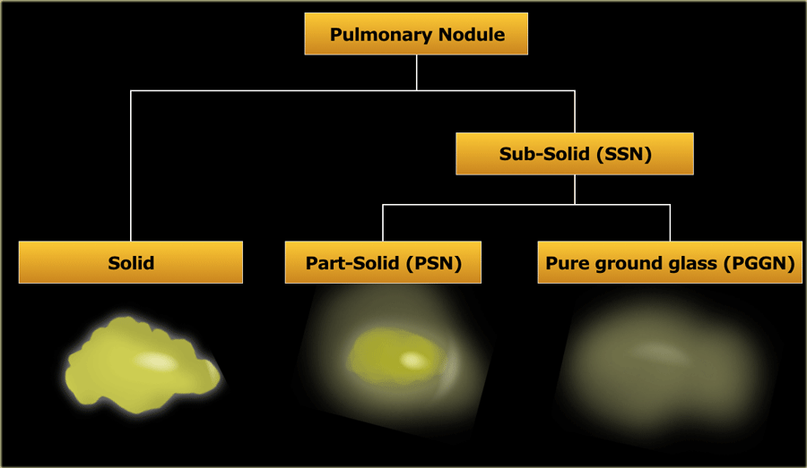
INTERNAL CHARACTERISTICS OF SPN
1. Attenuation:
Solid nodule:
Homogenous soft tissue denity completely obscuring lung parenchyma behind.
Most common type of SPN.
can be benign or malignant.
Subsolid Nodule:
A) Pure Ground glass nodule.
Hazy opacity without obscuring underlying lung parenchyma.
can represent inflammation or infection.
often pre invasive or early adenocarcinoma.
B) Part Solid Nodule.
Ground glass component with soid portion inside.
Highly likelihood of malignancy than pure GGO.

Slide 20

2. CALCIFICATION:
BENIGN NODULES
Notes:
In benign nodule type of calciifcations are

Slide 21
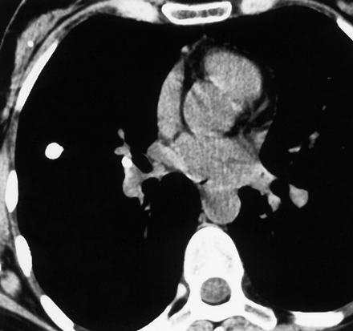
HOMOGENOUS/UNIFORM/DIFFUSE/SOLID
DIFFUSE,SOLID: GRANULOMA
Notes:
This is a image showing homogenous diffuse calcification-seen in healed granuloma or hamartoma

Slide 22
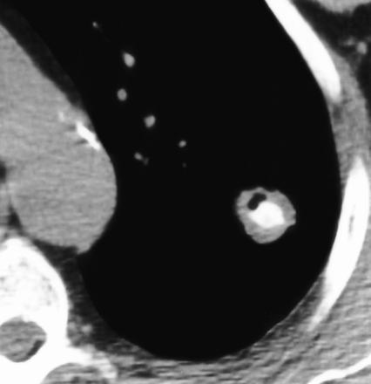
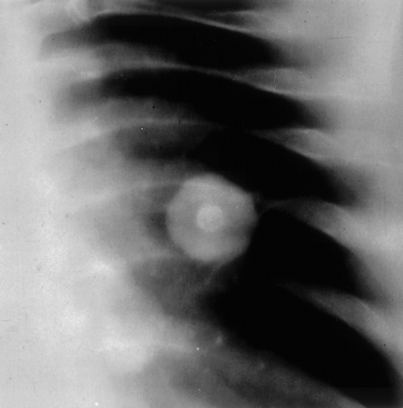
CENTRAL CALCIFICATION/BULLS EYE
Notes:
These image showing central calcifcation giving bull eye appearence seen in healed granuloma.

Slide 23
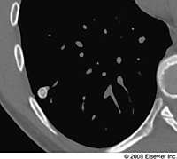
CONCENTRIC RINGS/LAMINATED/TARGET : Tb, fungal granulomas
Notes:
Image showing CONCENTRIC RINGS/LAMINATED/TARGET calcification : in Tb, fungal granulomas

Slide 24
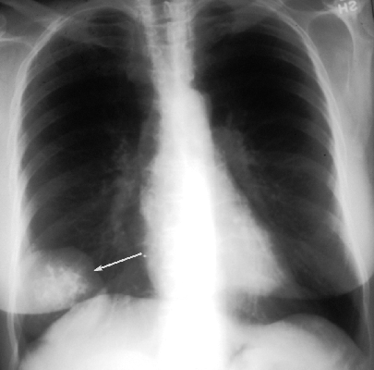
POPCORN CALCIFICATION
POPCORN : Hamartomas, cartilage tumors
Notes:
Image showing POPCORN CALCIFICATION in Hamartomas and cartilage tumors

Slide 25
CALCIFICATION: INTERMEDIATE
STIPPLED/PUNCTATE: Metastatic osteosarcoma, chondrosarcoma.
ECCENTRIC DENSE : malignant tumor engulfing prior granuloma.
DIFFUSE / AMORPHOUS: Scar carcinoma, partially calcified granuloma.

Slide 26

CALCIFICATION: MALIGNANCY
DYSTROPHIC : in areas of necrosis
PSAMMOMATOUS : metastases from mucin secreting tumors such as colon and ovarian cancers.
CENTRAL CALCIFICATION IN SPICULATED SPN.
Peripheral Rim: Metastasis.
Metastasis from osteogenic sarcoma or ostochondroma can show homogenous calcification, but history of primary tumor allows correct diagnosis
Notes:
Here are type of calcifcation seen in malignancy

Slide 27
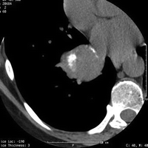
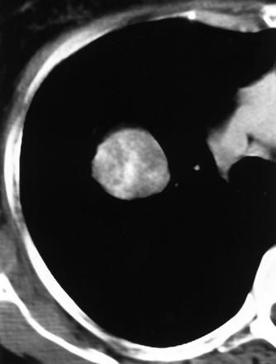
Carcinoid showing cccentric dense calcification in right lower lobe.
Amorphous calcification in non small cell ca lung
Notes:
Ct image showing

Slide 28
2. FAT
HAMARTOMA
LIPIOD PNEUMONIA
METASTATIC LIPOSARCOMA
Notes:
Fat seen in

Slide 29
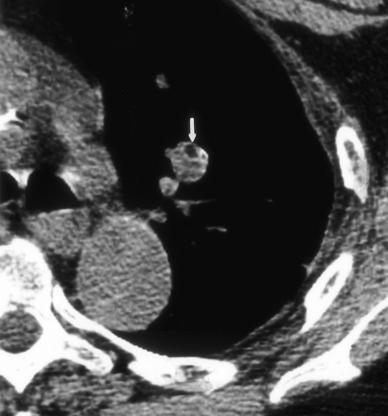
AREA OF FAT ATTENUATION IN NODULE : HAMARTOMA
Notes:
image showing

Slide 30
3. CAVITATION
CAVITATORY LESION WITH WALL THICKNESS
< 3 mm -LIKELY BENIGN
3-15 MM – INDETERMINATE
> 15 mm- LIKELY MALIGNANT
IRREGULAR WALL – LIKELY MALIGNANT
THIN SMOOTH WALL– LIKELY BENIGN

Slide 31
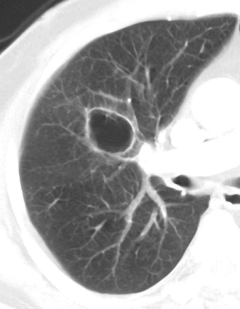
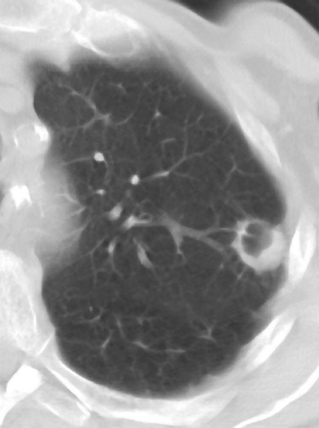
Benign cavitation
Malignant cavitation
A
B
Notes:
Image A showing benign cavitation with thin smooth wall
Image B showing Malignant calcification with thick and irregular wall

Slide 32
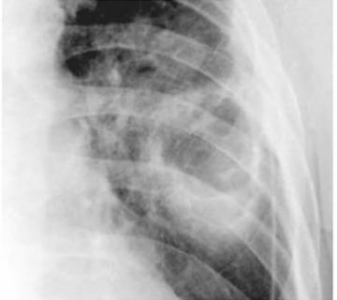
This mass that represents
a squamous cell carcinoma.
Notes:
This is plain chest radiograph showing cavitatory lesion in left lung which has irrgular margins.

Slide 33
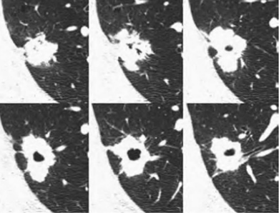
Cavitary adenocarcinoma shown on HRCT in six
contiguous scans.
Notes:
This is HRCT image of cavitatory adenocarcinoma showing the nodule containing an irregular cavity; lobulated in shape, notched, spiculated; and is associated with pleural tails.

Slide 34
4. PSEUDOCAVITATION
Seen as small air containing luciencies within the mass.
Represent:
Dilated brochi/alveoli.
Small cystic spaces.
Early cavitation.
same significance as air brochogram
favours malignancy.

Slide 35
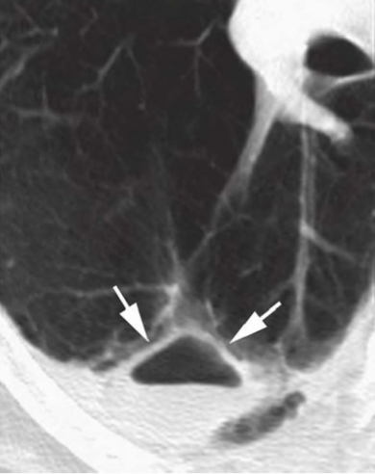
5. AIR CRESCENT SIGN
Air outlining or capping the superior
aspect of the mass results in a
crescent-shaped collection of air,
termed the air cresent sign.
Causes are
Aspergilloma
Blood clot in a cyst
Complicated hydatid disease
Carcinoma arising in a cyst
Rasmussen aneurysm (mycotic pulmonary artery aneurysm in tubercular cavity)
Mucus plug in cystic bronchiectasis
CT of a lung abscess with air fluid level.

Slide 36
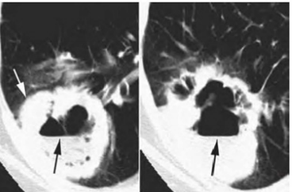
7. AIR FLUID LEVEL
Usually seen in benign lesions like lung abscess, infected cyst or cavity
Can be seen in cavitary carcinoma suggesting Intracavitary hemorrhage
Cavitary squamous cell carcinoma shown at two levels.
Notes:
The wall of the cavity is irregular, with several thick nodular regions (as shown by white arrow). The cavity contains an air-fluid
level (as shown by black arrows). This is uncommon in malignancy and may represent hemorrhage or superadded infection in malignancy.

Slide 37
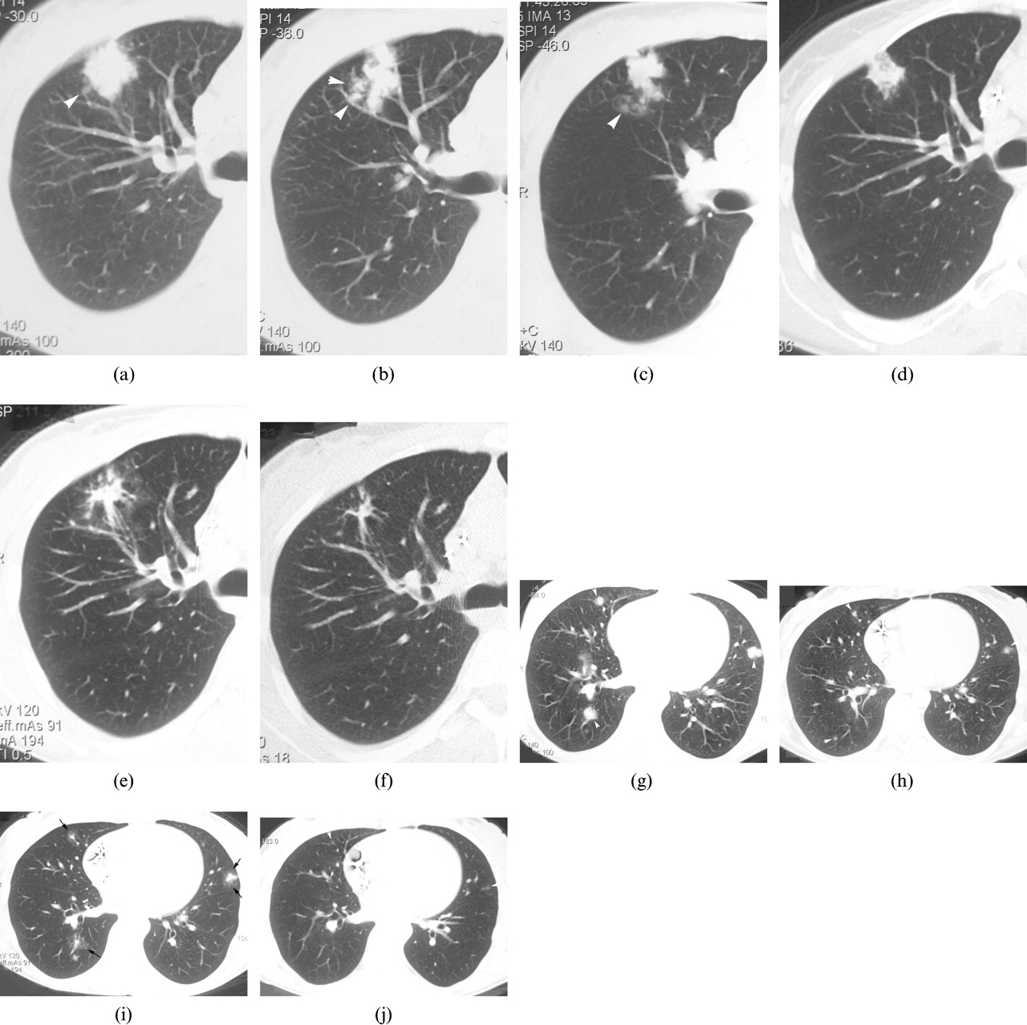
8. SATELLITE NODULES
Small nodules adjacent to larger nodule or mass
Predictor of benign disease like granulomatous diseases
Galaxy sign : satellite nodules in sarcoidosis
Presence of satellite nodules in lung tumors is considered as locally advanced tumor

Slide 38
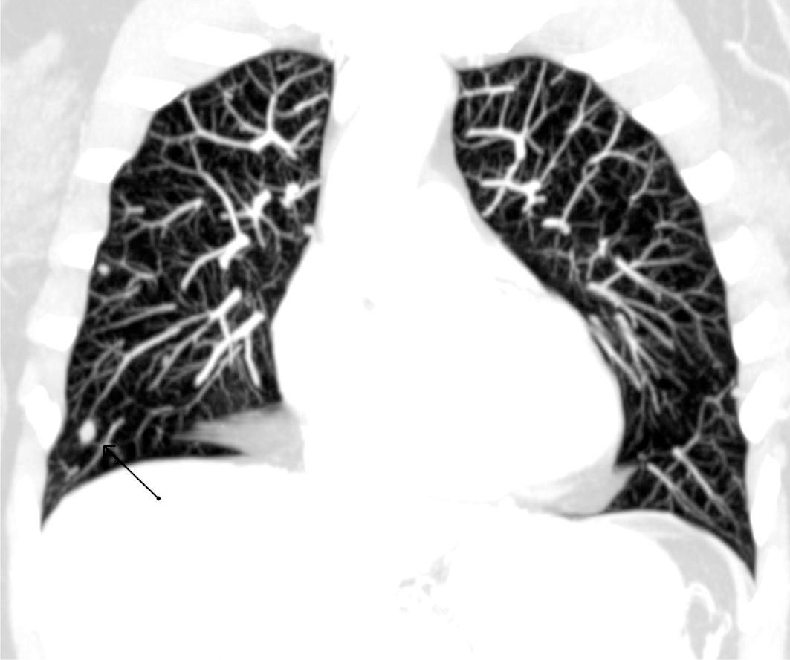
9. FEEDING VESSEL SIGN
Small pulmonary artery leading directly to a nodule
Seen in hematogenous metastasis, infarct and Artiovenous fistula.

Slide 39
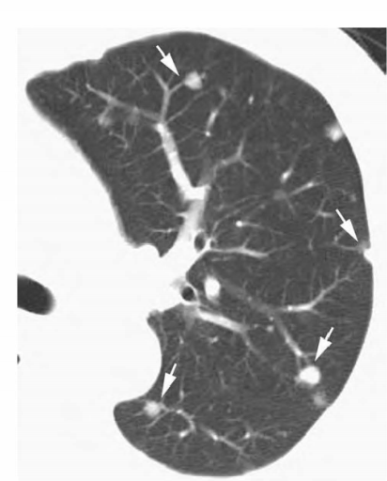
Notes:
This image represents a case of pulmonary metastases from nasopharyngeal carcinoma, characterized by multiple nodules (indicated by arrows) demonstrating a feeding vessel sign.

Slide 40
10. POSITIVE BRONCHUS SIGN
A pulmonary lesion that directly abuts, narrows or occludes bronchial lumen is more likely to be malignant
Also seen in tuberculoma, pulmonary infarcts and Inflammatory masses
This sign helps in whether transbronchial or trans thoracic biopsy helps in histological diagnosis

Slide 41
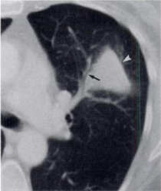
POSITIVE BRONCHUS SIGN
Notes:
image showing mass lesion abutting the bronchus giving positive brochus sign.

Slide 42
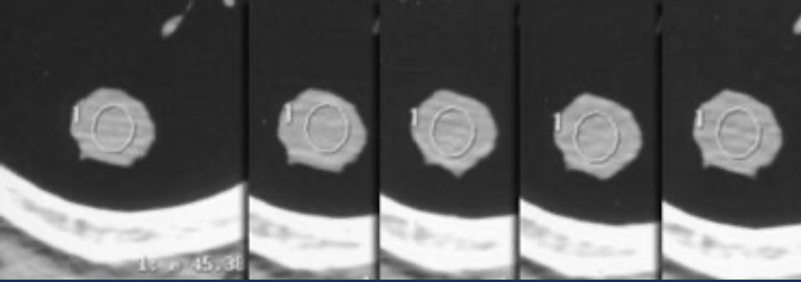
CONTRAST ENHANCEMENT
Recommended Protocol:
Scan at 1 min intervals for 4 minutes following the start of injection.
A region of interest include about 60% of nodule diameter is use to measure enhancement.
NODULE ENHANCEMENT < 15 HU - S/O BENIGN LESION
NODULE ENHANCEMENT 15-20 HU - S/O INDETERMINATE LESION
NODULE ENHANCEMENT > 20 HU – S/O MALIGNANT LESION
SENSITIVITY - 95 -100%
SPECIFICITY -70 -93 %
This applies only for nodules with the following selection criteria:
Nodule > 5mm
Relatively spherical
Homogeneous, no necrosis, fat or calcification
No motion or beam hardening artifacts
Notes:
contrast enhancement helps to differentiate benign vs malignant

Slide 43
15 MIN DELAY
Malignant nodules:
wash-in of >25 HU
washout of 5-31 HU
Benign nodules:
wash-in of < 25 H
wash-in of >25 HU in combination with a washout of > 31 HU
wash-in of > 25 HU and persistent enhancement without washout
Notes:
after 15 min delay

Slide 44
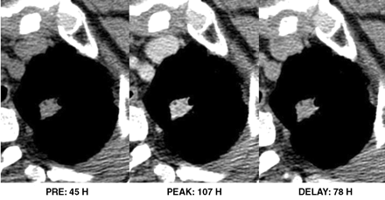
Net enhancement of > 25 HU
Washout of 5-31 HU
Notes:
This is a image showing Net enhancement of > 25 HU with Washout of 5-31 HU representing a malignant nodule.

Slide 45
FALSE NEGATIVE CONTRAST ENHANCEMENT:
Central necrosis
Mucin producing tumors

Slide 46
GROWTH RATE ASSESSMENT
Volume doubling time is the time required for a lesion to double its volume
VDT = t * log2
log Vt/Vo
t= time difference
Vt= volume at time t
Vo= initial volume
1 VDT = 26% increase in the diameter of the nodule

Slide 47
Absence of growth over at least 2 yrs period : reliable Indicator of benignity, however exception is BAC.
DT (Doubling time) less than 1 month – Infection, infarction, lymphoma
DT 1 -18 months : bronchial carcinoma
DT more than 18 months : Granuloma, Hamartoma, Bronchial carcinoids
The range of doubling time ranging from 1 to 200 days encompass most cancers.
Slowest growing BACs have VDT of more than 3 years
Mets from testicular tumors and sarcomas have VDT of less than a month

Slide 48
COMPUTER AIDED DIAGNOSIS (AI)
Integrated computer system that supports nodule identification, analysis of nodule size, morphology and textural analysis of internal structure of nodule by analysis of high resolution CT data.
The CAD system recognizes opacity lesions surrounded by lung parenchymal attenuation as nodules. Therefore, nodules in the subpleural, fissural and costophrenic angle areas might be missed.
Not helpful to pick up lesions less than 4mm
Cannot replace the radiologist ; only supporting tool

Slide 49
ROLE OF DUAL ENERGY CT IN SPN
DECT can decompose enhanced structures into soft tissue and iodine
Allows for differentiation of calcification from enhancing tissue by subtraction of iodine component
By single scanning after iodine injection, we can measure the degree of enhancement without an additional non enhanced CT

Slide 50
ROLE OF CONTRAST ENHANCED DYNAMIC MRI IN SPN
Dynamic contrast-enhanced MRI is helpful in differentiating benign from malignant solitary pulmonary nodules
Absence of significant enhancement is a strong predictor that a lesion is benign.
Presence of rim enhancement seen in –granuloma and network or rim enhancement seen in–hamartoma
Presence of homogeneous/heterogenous enhancement : malignancy

Slide 51
FEATURE | MALIGNANT | BENIGN
Time to peak | ≤ 4 min | > 4 min / no peak
Pattern | Rapid enhancement | Gradual
Vascularity | High | Low

Slide 52
Maximum relative enhancement ratio:
It is a normalised measure of how much a nodules enhance after contrast.
It tells you percentage increase in enhancement relative to baseline.
Why it is important?-- because it differntiate malignant vs benign and malignant vs infective nodules.
MRER>0.15 is the adopted threshold for a positive differentiation between malignant and benign SPN ( >0.15 = malignant )
0.80 is the adopted threshold between malignant and infective SPN ( <0.80 = Malignant )
Dynamic MRI has been used to assess tumor vascularity (microvessel counts) and interstitium (degree of elastic and collagen fibers)

Slide 53
ROLE OF DW-MRI IN SPN
SCALE ( study by Satoh et al ) are:
Nearly no signal intensity
Signal intensity between 1 and 3
Signal intensity almost equal to the spinal cord at thoracic spine
Higher signal than spinal cord
SCORE OF 3 IS THRESHOLD FOR DIFFERENTIATING BENIGN AND MALIGNANT NODULES

Slide 54
Disadvantages of MRI
Poor resolution
Cardiac and respiratory motion artifacts
Difficulty in detecting lesion < 1 cm lesion
Not useful in peripheral SPN due to signal loss

Slide 55
ROLE OF FDG-PET
Malignant cells have upregulated metabolisms and proliferate rapidly.This results in marked uptake of FDG
PET-CT plays an increasingly important role in the evaluation of solitary nodules.
PET has a very high sensitivity 95%, but a lesser specificity of only 81%
False negative results due to - Carcinoids , BAC , Adeno with BAC component , SPN < 10 mm
False positive results are due to –Active TB , Histoplasmosis , Rhematoid nodules ,Aspergillosis , wegeners granulomatosis
Possibility of malignancy with negative FDG-PET is <5%
The SUV (Standarized uptake value) is more that 2.5 for lung cancers.

Slide 56
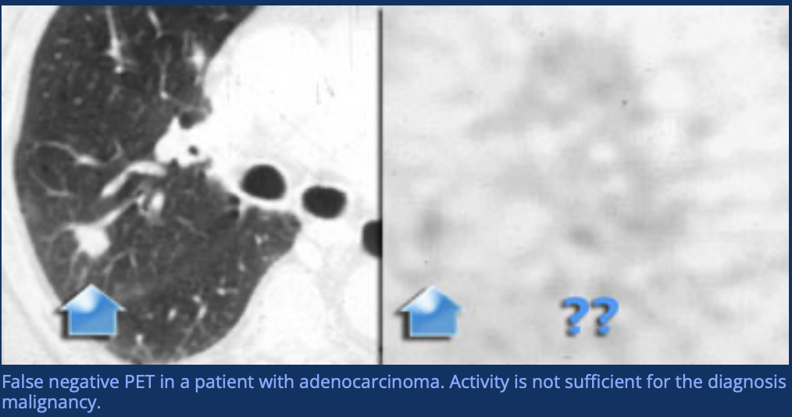
Notes:
this is a image showing Adenocarcinoma, that was not hypermetabolic on the PET, so it is a false negative on PET.

Slide 57
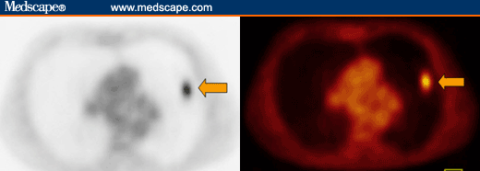
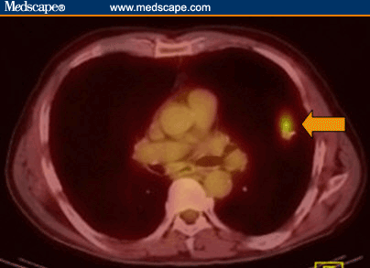
Axial CT Axial PET
Notes:
This image showing Axial ct and PET CT with uptake of FDG in nodule.

Slide 58
ROLE OF SPECT IN SPN
The diagnostic ability of SPECT has been reported, with sensitivity (85 to 100%), specificity (90 to 100%) and accuracy of 85 to 100%.
Diagnostic accuracy for the pulmonary nodules over 2 cm in size between SPECT and FDG-PET is almost the same, However less sensitive than PET for nodules smaller than 2 cm

Slide 59
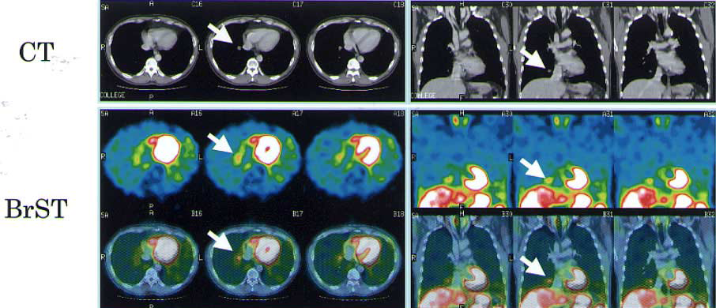
THALLIUM SPECT IN SPN
Notes:
Top row image: Ct image showing a lung nodule
Bottom row Thallium SPECT image: shown tracer uptake in that nodule.

Slide 60
For Inderterminate SPN, method fo biopsy include:
Transthoracic needle aspiration biopsy (TTNB) for peripheral nodules
Fibreoptic bronchoscopy with transbronchial biopsy for endobronchial lesions
Video assisted thoracic surgery

Slide 61
Fleischner Guideline 2017
These new guidelines should reduce the number of unnecessary follow-up examinations and provide clear management decisions.
Nodule characterization should be performed on thin-slice CT images ≤1.5 mm, since a small solid nodule may appear to have groundglass density on a thick slice due to partial-volume effect.

Slide 62
Risk Factors of Pulmonary Nodule Malignancy are
History of heavy smoking
Exposure to asbestos.
Family history of lung cancer
Older age
Sex: Females > Males
Marginal spiculation
Upper lobe location
Multiplicity (< 5 nodules increases risk for malignancy)
Emphysema and pulmonary fibrosis.

Slide 63
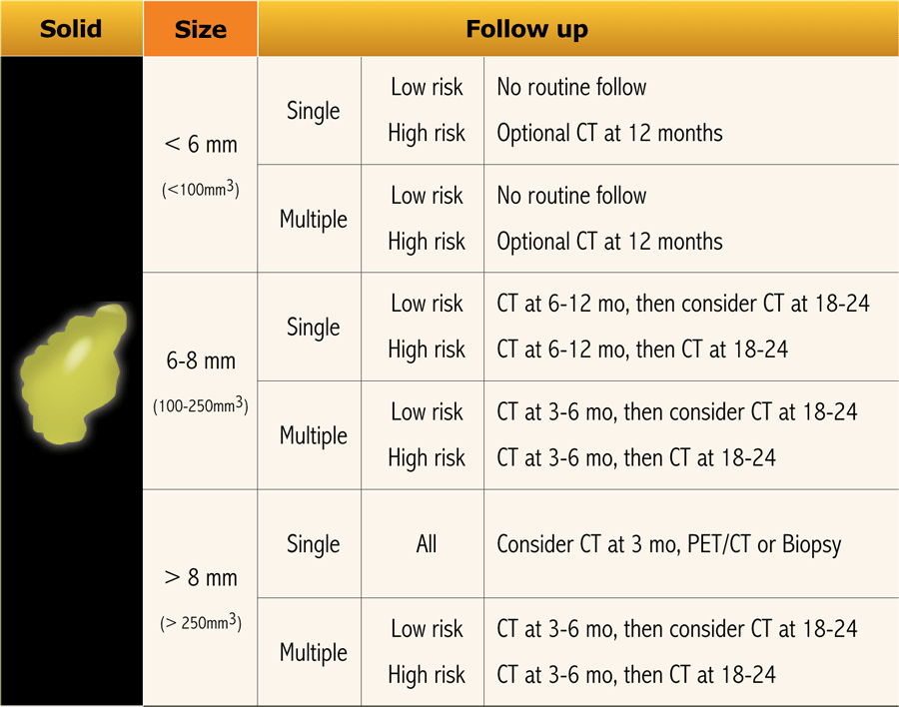
Notes:
For solid nodule criteria is

Slide 64
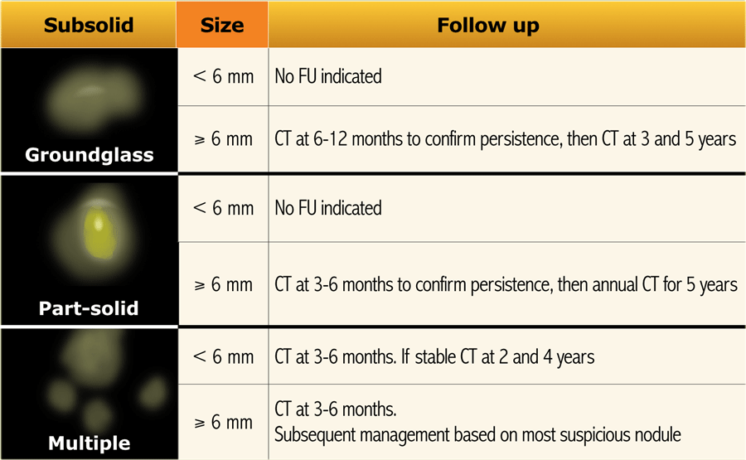

Slide 65
Notes using 2017 Fleischner guideline for pulmonary nodule management
﻿Only apply in subjects 35 years or older
﻿﻿Do not apply in immunocompromised subjects, or patients with a known or suspected malignancy
﻿﻿Use thin-slice (low-dose) CT imaging with off-axis reconstructions to characterize and follow-up lung nodules
﻿﻿Manual nodule measurements should be based on the average of long- and short-axis diameters (obtained on the same image in any plane).
Keep imaging technique and software constant during follow-up
﻿﻿The new guideline requires risk-stratification on both patient- and nodule-characteristics.

Slide 66
DIFFERNTIAL DIAGNOSIS OF SPN
MALIGNANT NEOPLASMS
CARCINOMA
LYMPHOMA
LYMPHOPROLIFERATIVE DISEASES
SOLITARY METASTATIC NEOPLASM (MELANOMA,OSTEOSARCOMA,PROSTATE, COLON,BREAST,RCC,TESTICULAR CARCINOMA)
BRONCHIAL CARCINOID
SARCOMA

Slide 67
BRONCHIAL CARCINOID
Typical triad –
Well defined round lobulated lesion
At the bifurcation
Eccentric calcification

Slide 68
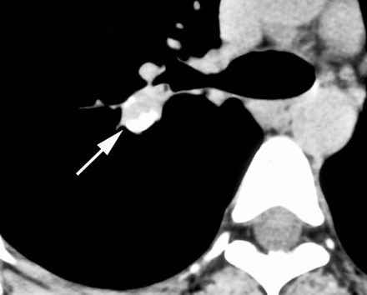
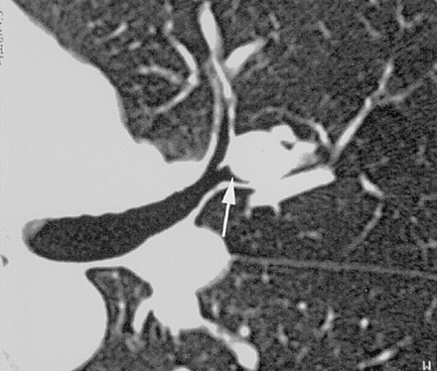
A
B
Notes:
image A there is a nodule with eccentric calcifications as shown by arrow obstructing the posterior segmental bronchus of the right upper lobe.
Image B showing High-resolution CT scan with a well-defined, round, partially endobronchial nodule shown by arrow in the left upper lobe.

Slide 69
BENIGN NEOPLASM AND NEOPLASM LIKE CONDITION
HAMARTOMA
ENDOMETRIOMA
MESENCHYMAL TUMOR

Slide 70
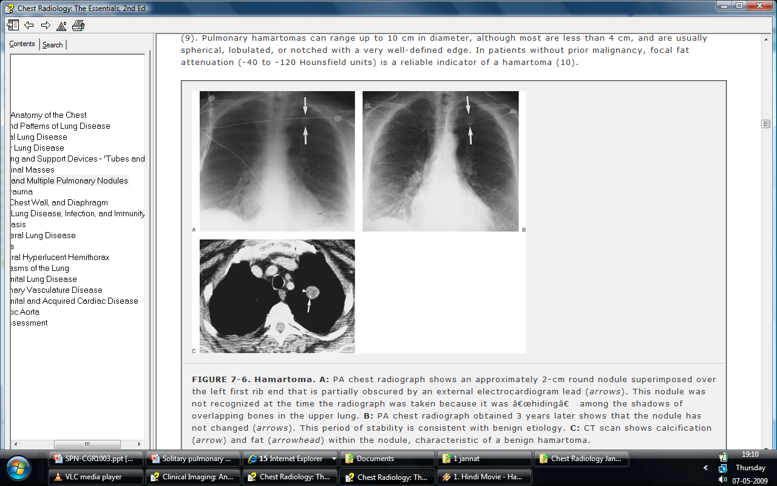
PULMONARY HAMARTOMA
Benign pulmonary mass containing connective tissue ,cartilage, fat , smooth muscle, marrow and bone.
Most common location – periphery of the lung
X ray chest – spherical ,lobulated and well defined nodule
Popcorn like calcification
Fat density within the mass is a diagnostic feature and can be seen on CT

Slide 71
Notes:
x ray image showing pulmonary hamartoma at periphery of lung with calcifications.

Slide 72
INFECTIVE CAUSES
GRANULOMATOUS (TB)
MYCETOMA
ASPERGILLOMA
ECHINOCOCCUS/HYDATID CYST
FOCAL ROUND PNEUMONIA
LUNG ABSCESS

Slide 73
GRANULOMA
Commonest are Tuberculomas
Features
Single
1-3 cm in diameter
Well defined
Smooth
Regular outline
Commonest location is close to pleural surface
Satellite lesions can be sometimes seen
Commonly seen in upper lobes

Slide 74
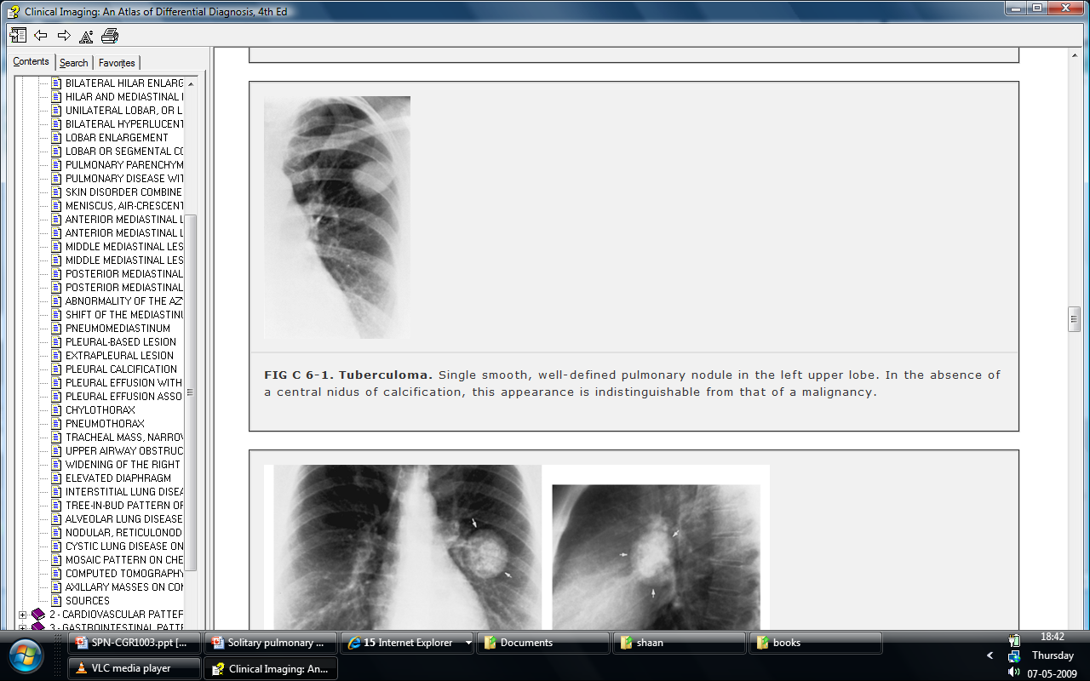
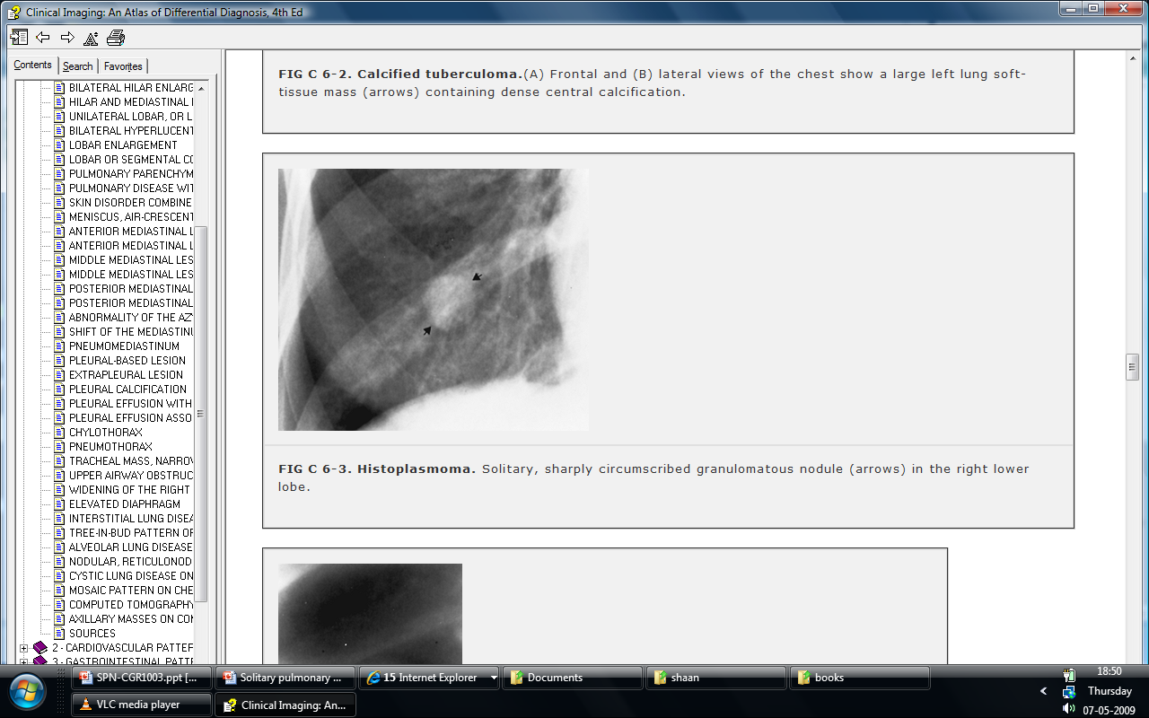
Granuloma
Notes:
These are x ray images showing opacity which is Single Well defined with Regular outline suggesting grauloma

Slide 75
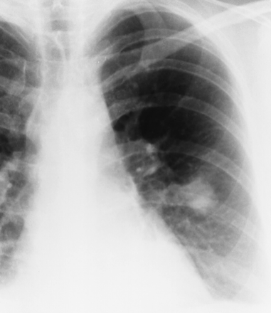
FOCAL ROUND PNEUMONIA
It is form of pneumonia in which consolidation appears as a rounded mass like opacity mimicking a tumor hence called Inflammatory pseudotumour
Careful study reveals irregular margin and air bronchogram
Common in children
May persists after recovery from infection

Slide 76
INFLAMMATORY (NON INFECTIOUS)
RHEUMATOID NODULES
SARCOIDOSIS
WEGENERS GRANULOMATOSIS

Slide 77
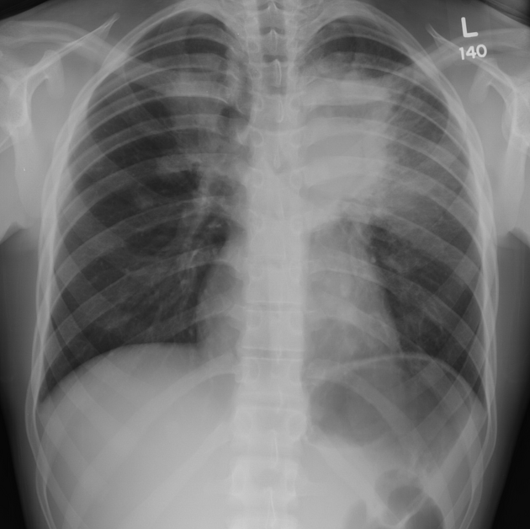
Notes:
This is x chest ray image showing Confluent air space opacities in the medial parts of both upper zones, more on the left. Obliteration of the aortic arch silhouette. No pneumothorax, effusion seen. On biopsy proven as granulomatosis with polyangiitis.

Slide 78
VASCULAR LESIONS
ARTERIOVENOUS FISTULA
HEMATOMA
INFARCTION
PULMONARY ARTERY ANEURYSM
PULMONARY VEIN VARIX
SEPTIC EMBOLISM

Slide 79
AVM
X ray – well circumscribed lesion with lobulated outline
X ray/CT - Feeding vessels and draining vein can be seen
It can be confirmed on CT
PULMONARY ANGIOGRAPHY RARELY INDICATED

Slide 80
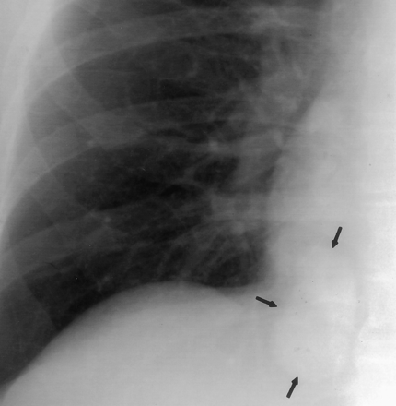
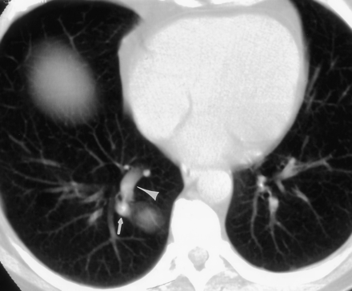
AVM
B
A
Notes:
image A showing Lobulated,well marginated nodule in the right lower lobe
image B showing Feeding artery by arrow and an enlarged draining vein by arrowhead.

Slide 81
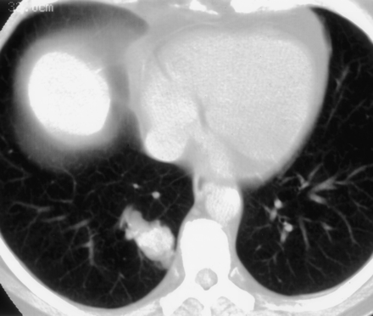
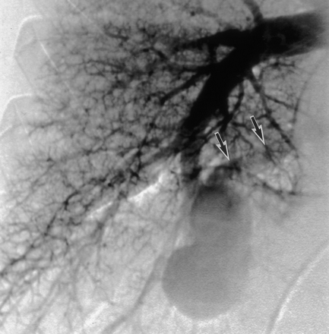
Nidus of malformation
Pulmonary angiogram
A
B
Notes:
Image A Ct image showing Nidus of malformation in right lung.
Image B showing Pulmonary angiogram helps confirm arteriovenous malformation. here we can seen early draining vein marked by arrows.

Slide 82
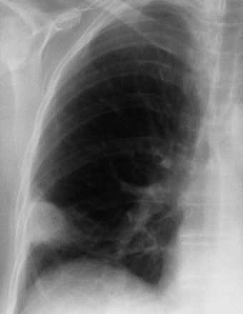
INFARCT
poorly marginated nodule peripherally of the right lower lung zone
Notes:
This is a x ray chest image showing poorly marginated nodule at periphery of the right lower lung zone.

Slide 83
CONGENITAL
BRONCHOGENIC CYST
CCAM (Congenital Cystic adenomatoid malformation)
INTRAPULMONARY LYMPH NODE
SEQUESTRATION

Slide 84
IDIOPATHIC/MISCELLANEOUS
AMYLOIDOSIS
FLUID FILLED BULLA
ROUND ATELECTASIS

Slide 85
ROUND ATELECTASIS
FOLDED LUNG
Chronic atelectasis that resembles mass
X ray and ct – Peripherily located , wedge shaped opacity
Based against focally thickened pleura, commonly at lung base
Crow feet / comet tail of vessels sweeping into the margin of this opacity
A rapidly forming pleural effusion produces an adjacent area of passive atelectasis
A groove of visceral pleura may infold into the area of atelectasis and come to surround a part of it

Slide 86
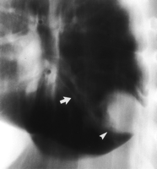
Notes:
This is Conventional tomographic scan of the chest in a lateral projection shows a largemass by arrowhead in the right lower lobe of the lung. A curvilinear opacity mark by arrow, arises from the inferior pole of the mass and courses toward the hilum.

Slide 87
THANK YOU

