Slide 1
MRI SEQUENCES
PRESENTER: Dr Sabah
Junior Resident
Department of radiodiagnosis
GMC & RH Patiala

Slide 2
PULSE SEQUENCE
Is a sequence of events, which are needed to acquire MRI images.
These events are: RF pulses, gradient switches and signal collecting

Slide 3
PULSE SEQUENCES
SPIN ECHO(SE)
GRADIENT ECHO(GE)
INVERSION RECOVERY(IR)
ECHO PLANAR IMAGING(EPI) – BOLD, DWI, PI
MR SPECTROSCOPY
MR ANGIOGRAPHY

Slide 4
The NMR Phenomenon – Bo

Slide 5
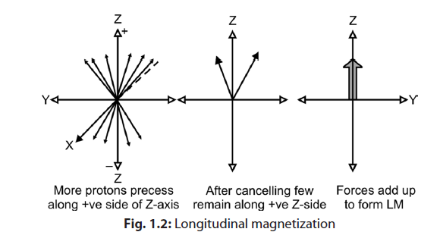

Slide 6
To localize from where in the body signals are coming three more magnetic fields are superimposed on main magnetic field along X, Y, and Z axes
Consists of three sets of coils that produce field with changing strength in X, Y, Z directions.
The three gradients are:
1. Z-axis—Slice selection gradient
2. Y-axis—Frequency encoding gradient
3. X-axis—Phase encoding gradient.
These gradients are applied at different stages

Slide 7
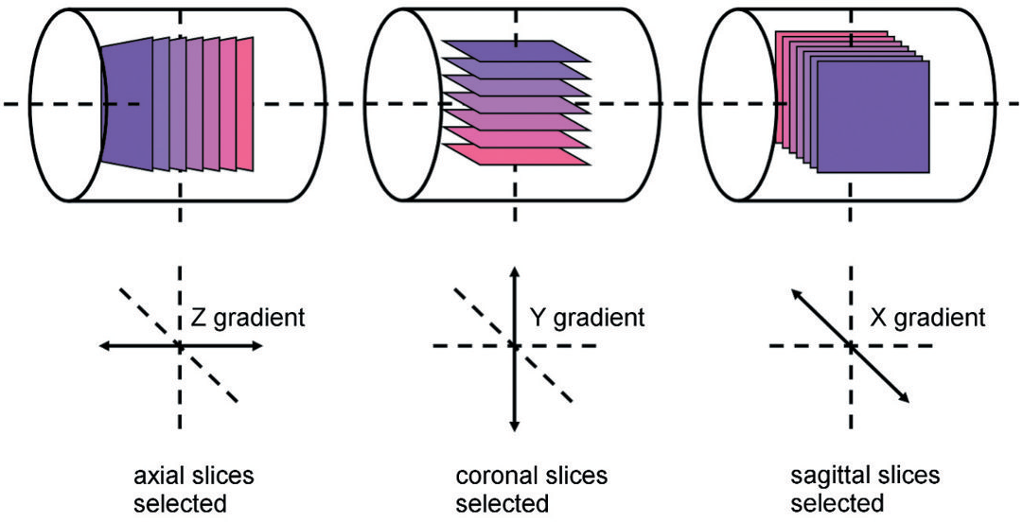

Slide 8
IMAGE FORMATION :
Image formation can be divided into the following steps :
Excitation,
Relaxation,
Acquisition,
Computing and Display.

Slide 9
BASIC SEQUENCE
1) Switching on the slice select gradient (G^{SS}).
2) Simultaneously a 90º RF-pulse was given to ‘flip’ the net-magnetization into the x-y plane.
3) The phase encoding gradient (g^{pe}) was switched on to do the first phase encoding.
4) The frequency encoding or read out gradient (g^{ro}) was switched on during which →the signal, the free induction decay (fid), was sampled.

Slide 10
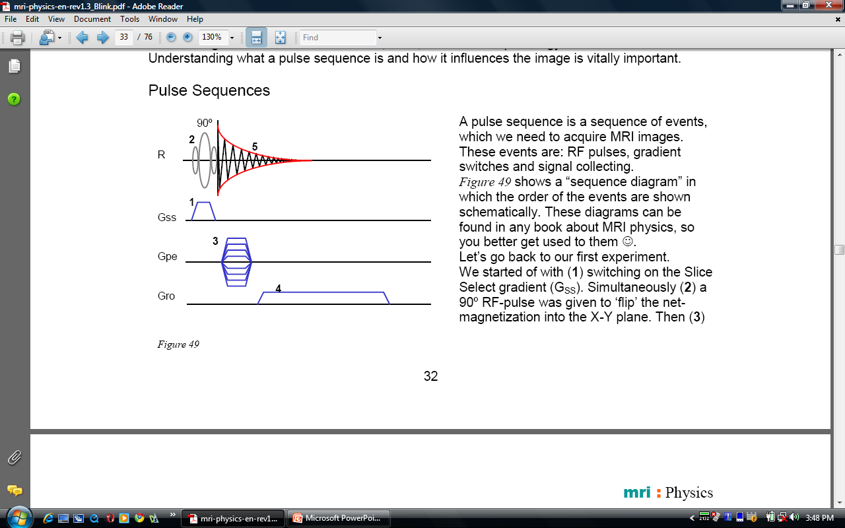
“SEQUENCE DIAGRAM”

Slide 11
Very simple and basic sequence.
The signal dies out very quickly.
Entire signal couldnt be sampled.
In order to improve the amount of signal they came up SPIN ECHO SEQUENCE .

Slide 12
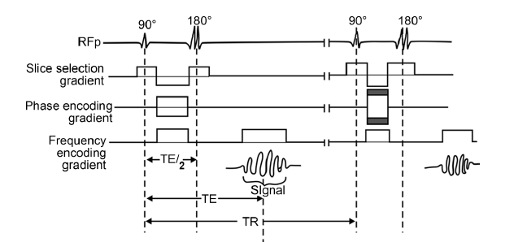
SPIN ECHO SEQUENCE
It consists of 90º and 180º RF pulses
After the 90º-excitation pulse, the net-magnetization is in the X-Y plane (Transverse plane).
It immediately starts to dephase due to T2 relaxation (spin-spin interactions).
It is because of this dephasing that the signal drops
Therefore,a short time after the 90º RF-pulse, a rephasing 180° pulse is sent to bring protons back into phase.
The 180º pulse causes the spins to rephase. When all the spins are rephased the signal is high again-which is sampled.
The time between 90° pulse and reception of echo (signal) is TE (time to echo).
For localization of signal, slice selection gradient is turned on when pulse is sent. Phase encoding gradient is turned on between excitation pulse (90° pulse) and signal measurement. Phase encoding gradient has different strength for each TR. Frequency encoding (read out Gradient) is turned out during signal measurement.

Slide 13
Advantages:
• The signal is strong
• Compensation for local field inhomogeneities: less artifacts.
Disadvantages:
• It takes time to do the rephasing step- The total scan time is increased.

Slide 14
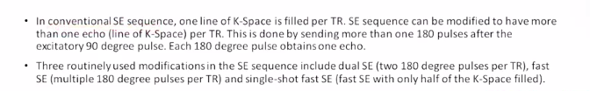
Modifications of SE sequences

Slide 15
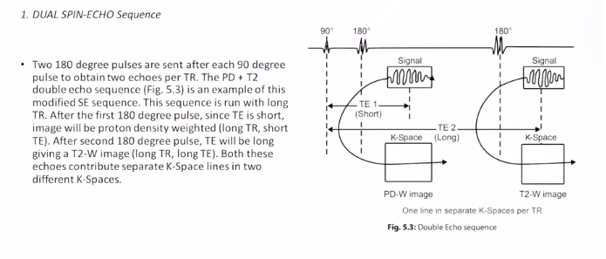


1. DUAL SPIN ECHO Sequence

Slide 16
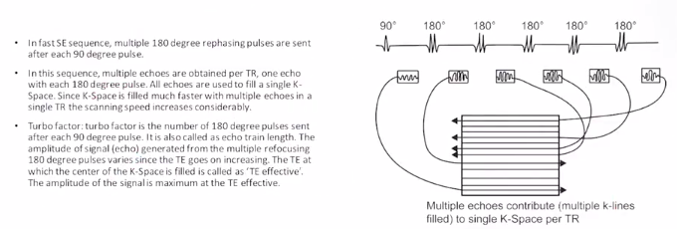
2. FAST (TURBO) SPIN ECHO Sequence

Slide 17
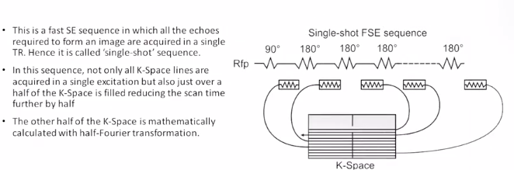
3. SINGLE SHOT FAST SPIN ECHO Sequence

Slide 18
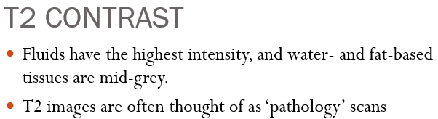
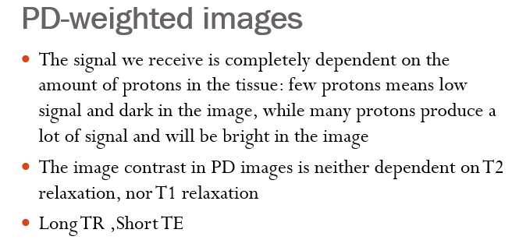
T1 Contrast
T1-weighted images usually have excellent contrast: fluids are very dark (unless they are flowing into the imaging volume), water-based tissues are mid-grey and fat-based tissues are very bright.

Slide 19
PROTON DENSITY
Proton Density (PD) with Fat Saturation: It offers high spatial resolution and excellent contrast for imaging of articular cartilage which appear bright against dark joint fluid and subchondral bone.
2D fast spin echo (FSE) fat-suppressed intermediate-weighted (IW) sequences are considered the cornerstone for clinical morphological assessment of articular cartilage, offering the best balance of sensitivity and specificity for detecting defects, synovitis, and bone marrow changes.

Slide 20
Other sequences used for imaging cartilages-
3D Spoiled Gradient Echo (SPGR/FLASH): Provides high spatial resolution and isotropic voxels for multiplanar reformatting, though it may have lower contrast between cartilage and fluid.
Dual Echo in the Steady State (DESS): A 3D coherent gradient echo sequence with high contrast between cartilage and synovial fluid, commonly used in large studies like the Osteoarthritis Initiative.
3D Balanced Steady-State Free Precession (SSFP): Offers high signal-to-noise ratio and good cartilage-fluid contrast but is vulnerable to off-resonance artifacts.

Slide 21
Advanced compositional sequences
T2 mapping : Assesses collagen orientation and organization.
T1 rho and Sodium imaging: Evaluares gyycosaminoglycan (GAG) content.
dGEMRIC (delayed gadolinium-enhanced MRI of cartilage): Measures GAG content by assessing the distribution of contrast agents.

Slide 22
SS FSE/HASTE
The HASTE sequence allows acquisitions of 2D slices in less than a second. Because of its long echo train (all the echoes take place in a single TR), HASTE images will be T2-weighted.
USES:
The HASTE sequence provides strong T2 weighting and is used in MR cholangiopancreatography and MR urography to demonstrate stones and other filling defects as areas of low signal intensity within bright fluid-filled structures .
High speed makes the HASTE sequence a suitable choice for uncooperative patients, Bowel, Cardiac MRI and Fetal imaging.
LIMITATIONS:
Less signal to noise ratio and resolution, (E.g CMD is not well appretiated)

Slide 23
PROPELLER/ BLADE
MRI sequence that uses a radial k-space sampling technique designed to reduce motion artifacts and improve image quality. Instead of acquiring data line-by-line, BLADE collects it in rotating rectangular strips—or “blades”—that overlap at the center of k-space, which is sampled repeatedly to enhance signal averaging and artifact suppression. This method is commonly applied to turbo spin echo (TSE) sequences, including T2-weighted, T1-weighted, and FLAIR imaging.
USES:
Minimize motion-related artifacts from patient movement, respiration, or swallowing, making it highly valuable in applications such as brain, spine, head and neck, and pediatric imaging.
Particularly useful in patients who have difficulty remaining still.

Slide 24
Gradient Echo Sequence
They differ from the Spin Echo sequence in the way the echo is formed.
Basic differences between SE and GRE sequences-
1. There is no 180 degree pulse in GRE. Rephasing is done by gradients; particularly by reversal of the frequency encoding gradient. Since rephasing by gradient gives signal, this sequence is called as Gradient echo sequence.
2. Th flip angle in GRE is smaller than 90°. Since flip angle is smaller there will be early recovery of longitudinal magnetization (LM) such that TR can be reduced, and hence the scanning time.
3. Transverse relaxation can be caused by-
Irreversible dephasing of TM resulting from nuclear, molecular and macromolecular magnetic interactions with protons.
Dephasing caused by magnetic field inhomogeneties which translates into the presence of artifacts in the image.
Because gradients do not refocus field inhomogeneities, GRE sequences with long TEs are T2* weighted (because of magnetic susceptibility) rather than T2 weighted like SE sequences

Slide 25
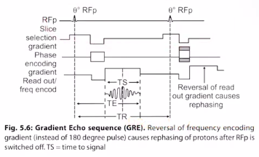


Slide 26
IMAGE CONTRAST
The image contrast of GE sequences is determined mainly by FA (Flip angle) and TE .
A high FA and short TE gives T1 weighted contrast.
A medium FA and short TE gives pd contrast.
A low FA and long TE gives T2 weighted contrast.

Slide 27
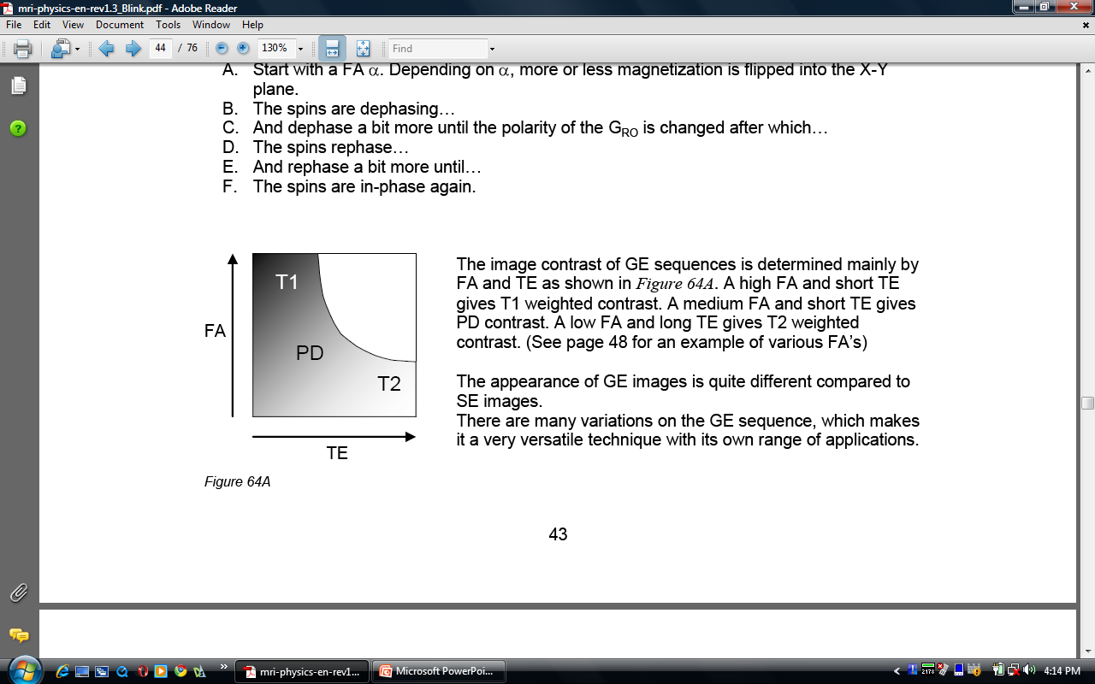
GE

Slide 28
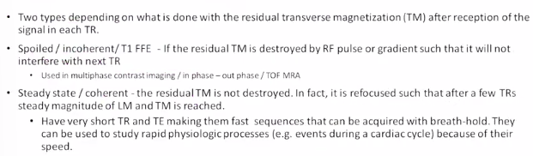
TYPES OF GRE Sequences

Slide 29
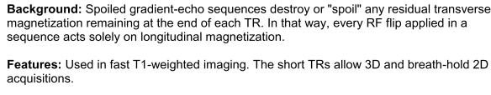
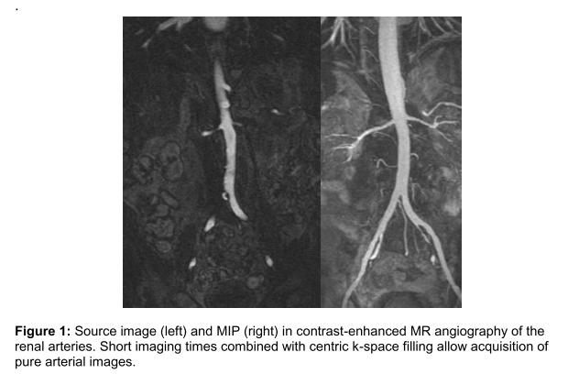
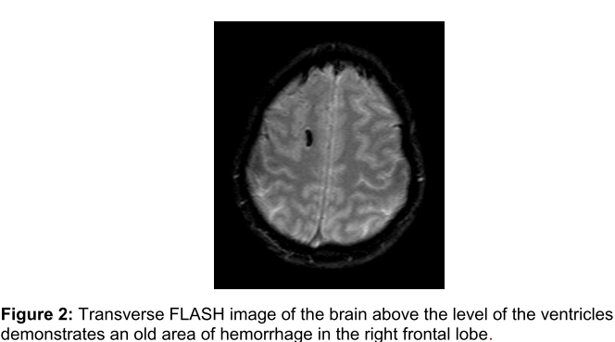
1. Spoiled gradient echo- SPGR
FLASH | SEIMENS
SPGR | GE
T1 FFE | PHILLIPS

Slide 30
2. Balanced SSFP- FID Steady state GRE sequence
FISP | SEIMENS
FIESTA | GE
Balanced FFE | PHILLIPS
It’s a T2WI Sequence
Residual TM is rephased like in coherent GRE.
Fast sequence. Hence, can be used in breath holding. Signal to noise ratio is better than that of a spoiled gradient-echo (FLASH) sequence.
Motion insensitive as all three axes gradients are balanced.
Sequence of choice in :
Cardiac MRI
Imaging of bowel.
Fetal imaging
To demonstrate vascular anatomy.
Limitations: Poor internal spatial resolution. CMD and G-W matter junction differentiation ill-defined.

Slide 31
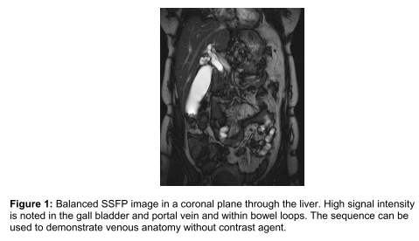
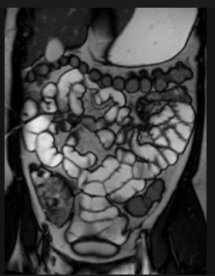
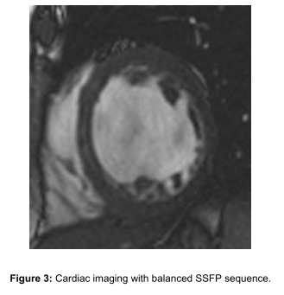
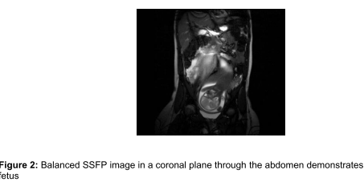
Enterography MRI

Slide 32
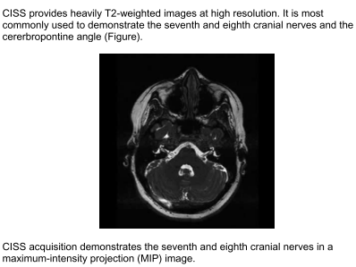
CISS- Constructive Interference in the steady State.
Balanced SSFP sequences are subject to a "banding artifact." In the CISS sequence, two balanced SSFP images in each acquisition are obtained. One image is acquired with an "alternating phase" RF pulse as in a standard balanced SSFP sequence, and the other is acquired with a non–alternating phase RF pulse. The banding artifact in each image will be displaced relative to the banding artifact in the other image. By combining the two images, the banding artifact is eliminated.
Features:
The CISS sequence provides T2-weighted 3D images with submillimeter resolution and is used for imaging the cochlea, labyrinth, and cerebellum.
Also useful in imaging of CP angle, Internal acoustic meatus and optic nerves.
Slower than balanced SSFP, it uses a longer TR.

Slide 33
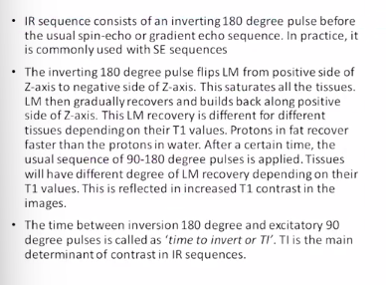
Inversion Recovery Sequence

Slide 34
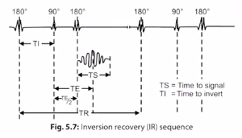
INVERSION RECOVERY
Notes:
Inversion recovery (IR) is a conventional spin echo (SE) sequence preceded by a 180° inverting pulse.
The time between the 180° inverting pulse and the 90°-pulse is called the inversion time (TI). The repetition time (TR) and echo time (TE) are defined as they are for spin echo.

Slide 35
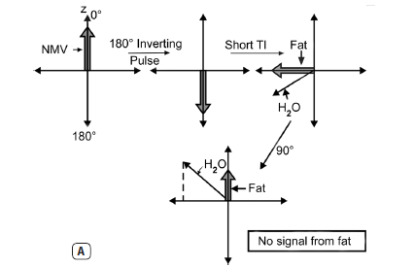
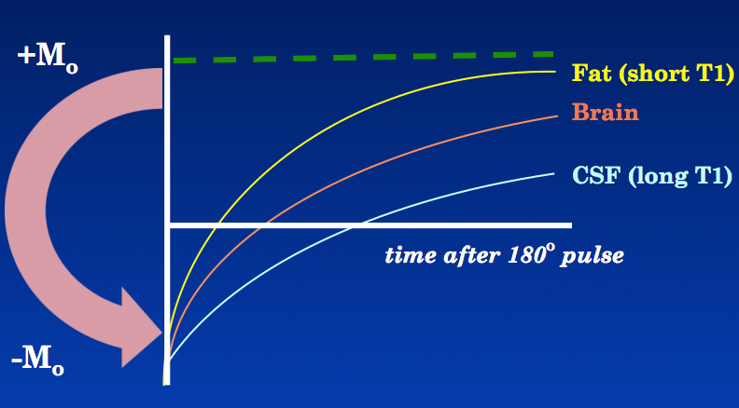

Slide 36
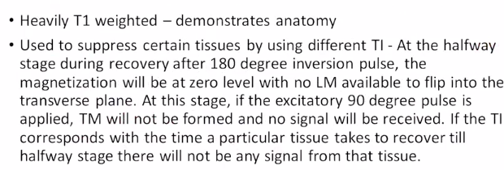

Slide 37
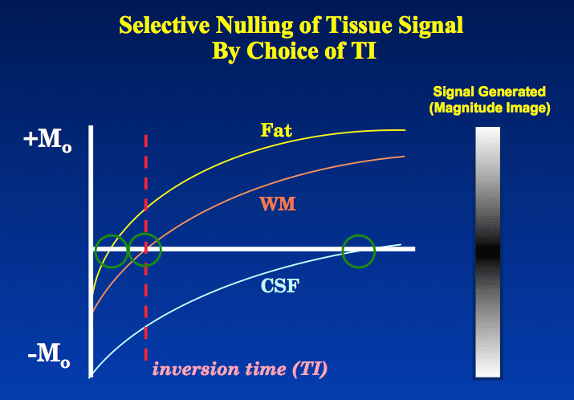
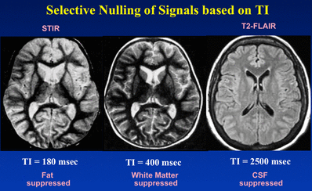
INVERSION RECOVERY
Selective Tissue Suppression

Slide 38
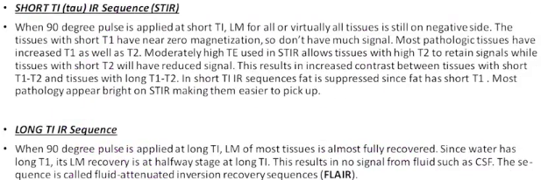

Slide 39
STIR- Short TI Inversion Recovery
An inversion-recovery pulse is used to null the signal from fat .TI of 140ms is used.
STIR sequences provide excellent depiction of bone marrow edema which may be the only indication of an occult fracture.
Unlike conventional fat-saturation sequences , STIR sequences are not affected by magnetic field inhomogeneities, so they are more efficient for nulling the signal from fat
USES:
Bone marrow- Edema, Bony metastasis in whole body MRI
Optic neuritis in multiple sclerosis
Ankylosing spondylitis- Sacroiliac joint edema.

Slide 40
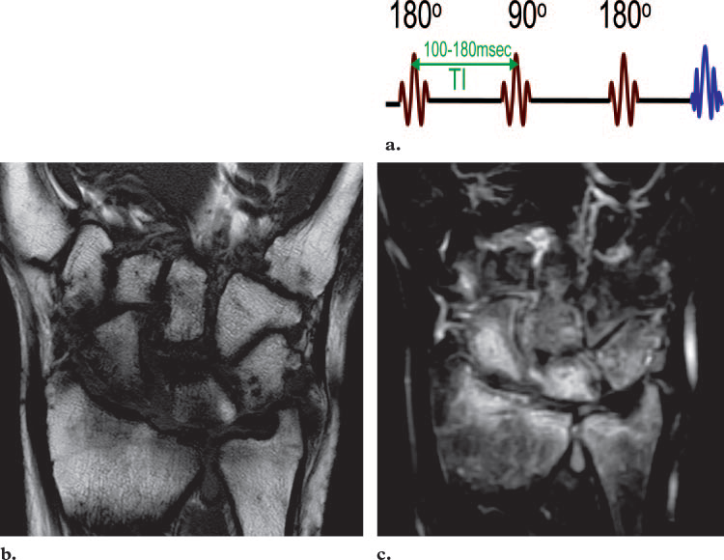
(a) Diagram of the STIR sequence (TI 100–180 msec for fat). (b, c) Coronal
T1-weighted fast SE image (b) and coronal STIR image (c) both show pancarpal rheumatoid
arthritis; however, the extent of bone marrow edema throughout the carpal bones, distal
radius, and ulna is better depicted in c than in b.

Slide 41
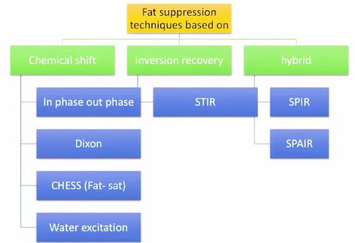
OTHER FAT SUPPRESSION METHODS

Slide 42
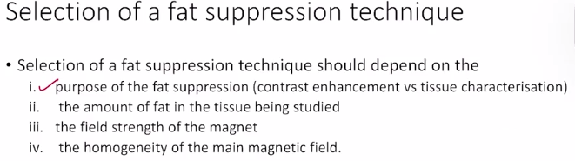

Slide 43
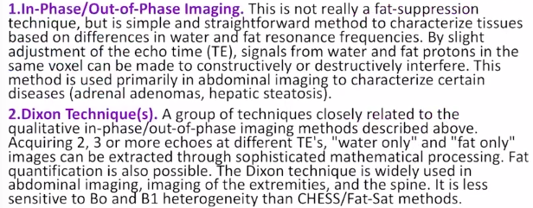
CHEMICAL SHIFT TECHNIQUES

Slide 44
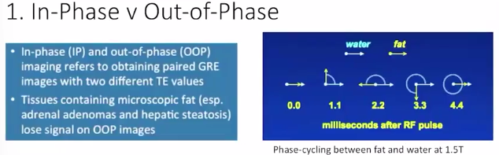

Slide 45
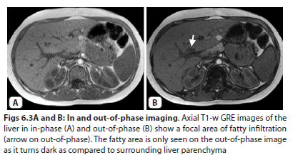
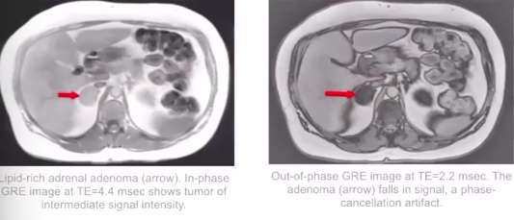

Slide 46
2. DIXON METHOD
Based on in phase and out of phase imaging
Two sets of images are acquired – one at ‘ in phase ‘ TE and other at ‘ out of phase ‘ TE
Addition of these two sets = ‘ water only” image
Subtraction of these two sets = “ fat only “ image

Slide 47
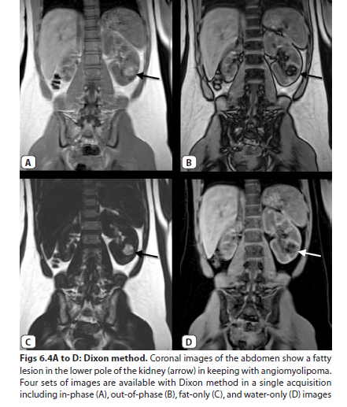

Slide 48
FLAIR
An inversion recovery pulse is used to null the signal from cerebrospinal fluid .
TI of 1700 to 2200 ms is used
Elimination of the signal from cerebrospinal fluid is useful for detecting lesions that otherwise are not easily distinguishable or for delineating hyperintense lesions that border fluid-containing spaces such as sulci or ventricles in the brain
USES:
CSF partial volume effects and artifacts are removed.
Perilesional edema.
Brain infarcts.
MS.
Mesial temporal sclerosis.
SAH.

Slide 49
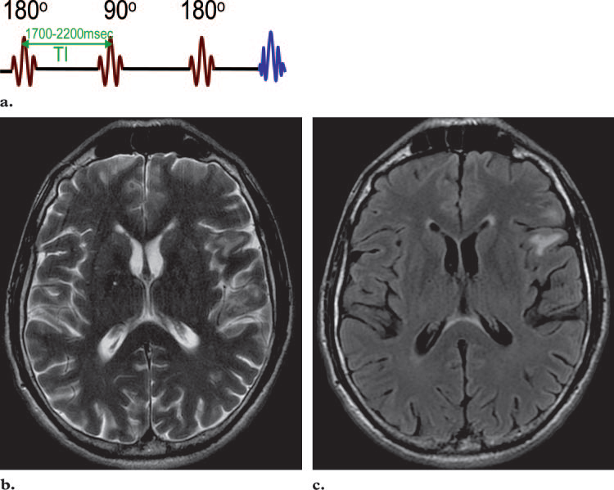
(a) Diagram of the FLAIR sequence shows a TI of 1700–2200 msec for
cerebrospinal fluid. (b) Axial T2-weighted fast SE image shows white matter abnormalities
in the left temporal lobe. (c) Axial T2-weighted FLAIR image obtained with nulling of the
signal from cerebrospinal fluid shows the metastatic lesions more clearly.

Slide 50
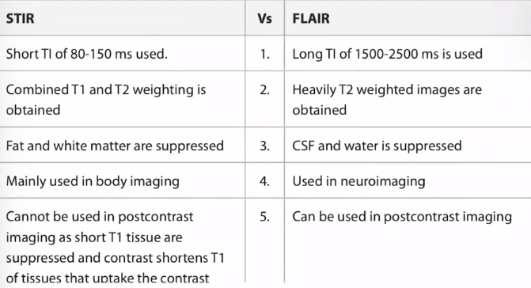

Slide 51
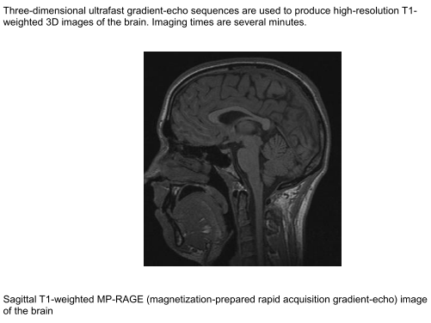
MEDIUM TI IR sequence E.g- MPRAGE
Shows anatomy very well as there is increased contrast between gray-white matter.
USES:
Epilepsy
Cortical dysplasias.

Slide 52
ECHO PLANAR IMAGING
A single echo train is used to collect data from all lines of k-space during one TR.
Use of this technique shortens the acquisition time substantially.
There are two types of echo-planar imaging sequences: SE and GRE sequences.
All the lines of k-space can be acquired in a single TR (in single-shot echo-planar imaging) or in two or more TRs (in multishot echo-planar imaging).

Slide 53
In single-shot EPI, TR is effectively infinite.
Thus one can obtain very highly T2- or T2*-weighted contrast with no T1 contribution at all.
Gradient-echo EPI is T2*-weighted and spin-echo EPI is T2 weighted.
T1 weighting can be obtained by the addition of an inversion prepulse.
In single-shot EPI, image slices are acquired sequentially, a whole slice at a time from a single RF excitation, usually at modest spatial resolution.

Slide 54
USES:
DWI
PERFUSION IMAGING
FUNCTIONAL IMAGING
REAL TIME CARDIAC IMAGING
INTERVENTIONAL TECHNIQUES
BREATH HOLD TECHNIQUES

Slide 55
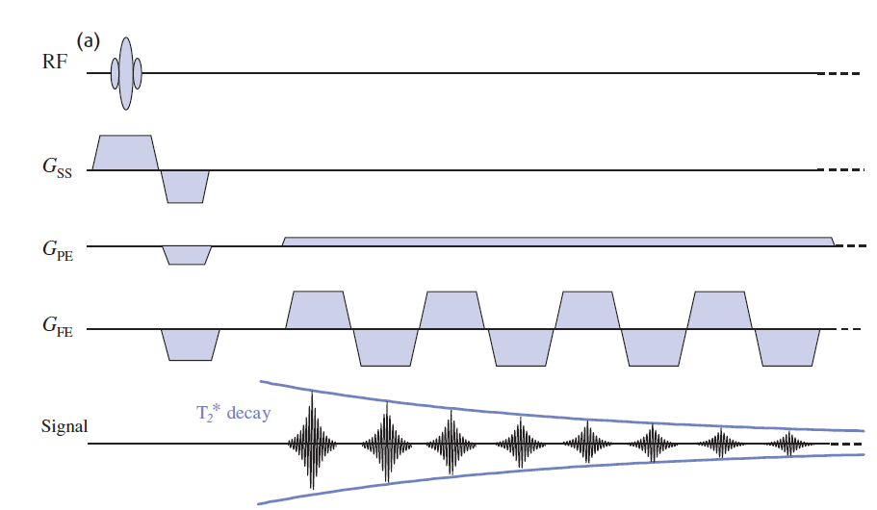
Gradient echo sequence – first 8 of typically 64 or 128 readout gradient lobes shown. The dotted lines indicate continuance of the sequence.

Slide 56
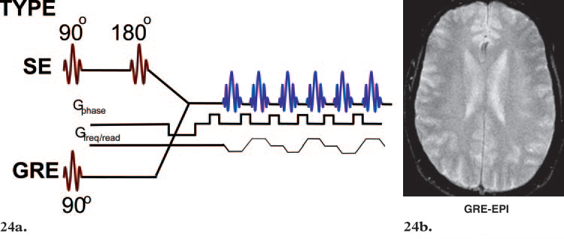
(24a) Echo-planar imaging sequence diagram. (24b) Axial T2-weighted echo-planar image (EPI) of the brain, obtained with the pulse sequence shown in 24a.

Slide 57
Diffusion-weighted Imaging
Enables one to distinguish between rapid diffusion of protons (unrestricted diffusion) and slow diffusion of protons (restricted diffusion) .
For diffusion-weighted imaging, either an echo-planar or a fast GRE sequence is used , and two equal gradient pulses are applied (one on each side of the 180° RF pulse in echo-planar sequences).

Slide 58
If no net movement of spinning nuclei occurs between the applications of the gradient pulses, the first gradient dephases the spins and the second rephases them; therefore, high signal intensity is seen.
If there is net movement, the protons are not affected by both gradients (they may undergo dephasing but not rephasing, or vice versa); therefore, the signal intensity is decreased

Slide 59
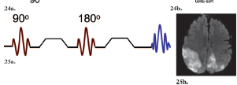
Diffusion-weighted imaging sequence diagram. (25b) Axial diffusion-weighted brain image shows areas of restricted diffusion with high signal intensity.

Slide 60
One of the major uses for diffusion-weighted imaging sequences is in the diagnosis of recent stroke.
However, diffusion-weighted sequences are usually applied in conjunction with apparent diffusion coefficient (ADC) mapping techniques
For the calculation of ADC maps, two sets of images are required: one set obtained without application of a diffusion gradient (which have an appearance similar to that of T2-weightedimages), and one obtained with a diffusion gradient.

Slide 61
The ADC calculation is based on the negative logarithm of the ratio of those two image sets (images obtained with diffusion weighting compared with those obtained without diffusion weighting).
For this reason, areas of restricted diffusion appear dark on ADC maps

Slide 62
Sometimes, the appearance of high signal intensity on diffusion-weighted images also may be due to T2 effects, or so-called T2 shine-through.
The absence of these effects on ADC maps allows areas of restricted diffusion from recent stroke to appear dark and areas of unrestricted diffusion in remote tissues (or areas of older stroke) to appear relatively bright .
Therefore, diffusion weighted images and ADC maps together allow the determination of the age of a stroke.

Slide 63
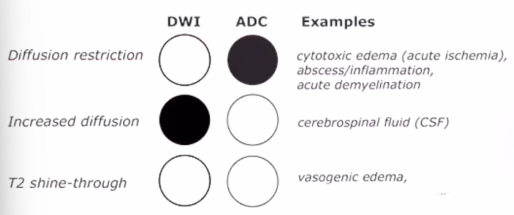
USES OF DWI:
Stroke Acute infarct will show diffusion restriction due to cytotoxic edema.
Epidermoid cyst vs Arachnoid Cyst- Epidermoid cyst will show restriction diffusion.
To distinguish between abscess and cystic lesion- Abscess will show diffusion restriction.
Brain tumors due to high cellularity show restricted diffusion.

Slide 64
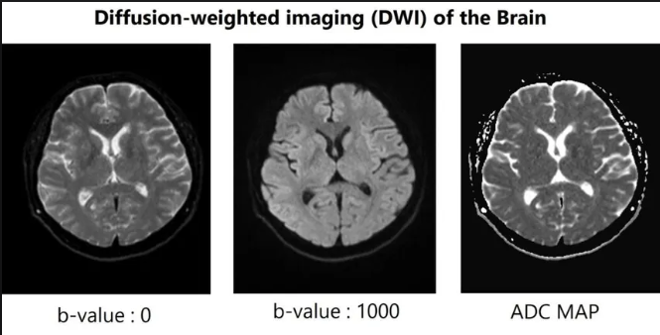

Slide 65
Combination of FLAIR and diffusion-weighted imaging with ADC mapping for depiction of effects of multiple strokes. (a) Axial T2-weighted FLAIR image shows three areas affected by strokes (arrows). (b, c) Axial diffusion-weighted echo-planar image (b) and ADC map (c) allow determination of the age of the strokes: The affected areas of the right frontal operculum and left frontal lobe (single arrows) show no evidence of restricted diffusion;
Notes:
this finding indicates that the stroke is old. In contrast, the affected area of the left parietal lobe (double arrows) appears bright in b and dark in c, evidence of restricted diffusion indicative of the most recent stroke. The area of the second most recent stroke, that in the left frontal lobe (single arrow), appears bright in both b and c; and the area of the oldest stroke, that in the right frontal operculum (single arrow),appears dark in b and bright in c.

Slide 66
PERFUSION IMAGING
Perfusion refers to the capillary blood supply to a tissue
Two MRI techniques for imaging perfusion have been developed in the last few years, both using a contrast agent to distinguish perfused tissue from unperfused, primarily for neurological applications.

Slide 67
The quicker method is to image the required slices rapidly and repeatedly during the first pass of a gadolinium bolus, sometimes referred to as ‘dynamic susceptibility contrast MRI’ (DSC-MRI).
The other technique tags protons in the arterial blood supply with a magnetic ‘label’, then images the required slices with and without the labelling

Slide 68
Dynamic susceptibility contrast MRI
In DSC-MRI a volume of tissue, usually only a few slices, is imaged repeatedly using an EPI sequence.
After a few images have been collected as a baseline, a bolus of gadolinium is injected as fast as possible.
During the first pass through the intracranial circulation the gadolinium remains in the vasculature, causing a reduction of T2 and T2*.
The second pass may also be detected as a slight drop in intensity, before the signal returns to baseline.

Slide 69
The whole imaging sequence takes no more than 2–3 min.
The signal drop is assumed to be proportional to the perfusion.
rCBV, rMTT and rCBF are calculated.

Slide 70
There should be at least five images (time points) in the baseline section for analysis purposes; since a bolus injection in the antecubital vein typically takes 8–10 s to reach the brain, the injection should be started soon after the start of the imaging sequence.
Using a power injector an injection rate of 3–5 ml/s is necessary to achieve a good bolus

Slide 71
USES OF PERFUSION IMAGING
1. PWI is more sensitive than DWI for detecting ischemia in early period after the onset of arterial occlusion.
2. Grading Tumours
3 Guiding biospies
4 . Differentiation of recurrent tumour vs radiation necrosis

Slide 72
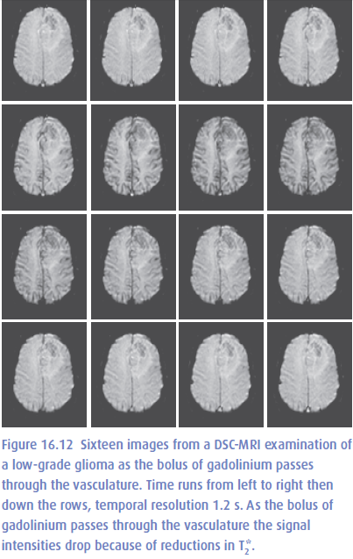

Slide 73
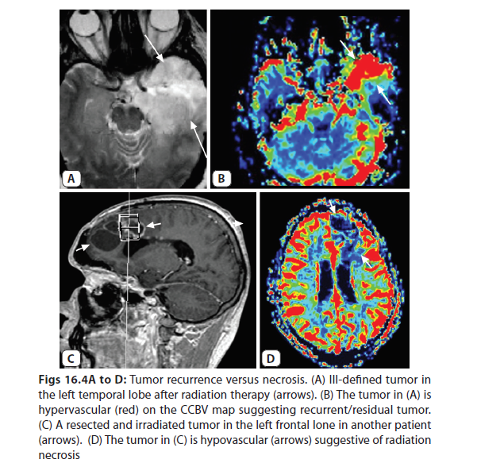
Pic of perfusion imaging

Slide 74
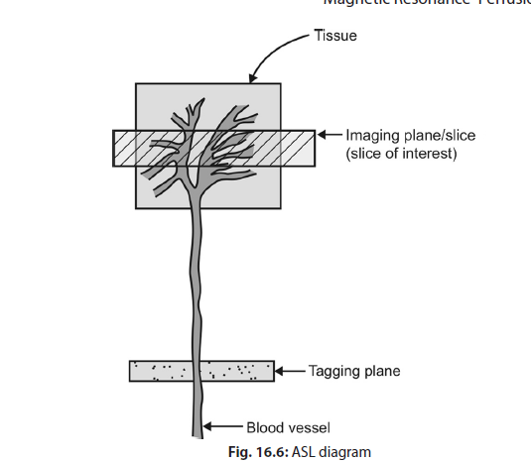
ARTERIAL SPIN LABELLING
TAGGED IMAGE – CONTROL IMAGE = TAGGED BLOOD

Slide 75
Functional MRI
In recent years the term functional MRI or fMRI has become synonymous with brain activation imaging using the BOLD effect.

Slide 76
The BOLD effect
BOLD (BloodOxygenation Level Dependent)
Oxyhaemoglobin is diamagnetic (i.e. essentially nonmagnetic) and that deoxyhaemoglobin is paramagnetic.
This means that deoxygenated blood has a shorter T2* and hence lower MR signal than fully oxygenated blood.
That the opposite was observed in visual cortex during sensory stimulation was initially surprising – the MR signal increasing or ‘lighting up’ at times when oxygen consumption was heightened due to neuronal activity

Slide 77
The scientific consensus is now that the increased consumption of oxygen by neurons during activation is accompanied by a disproportionate increase in the supply of fully oxygenated blood, so that downstream from the site of activation the concentration of deoxyhaemoglobin decreases and so T2* is elevated and the MR signal increases.
Gradient-echo EPI, with its strong T2 * weighting, is the sequence of choice for many fMRI examinations.

Slide 78
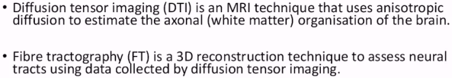
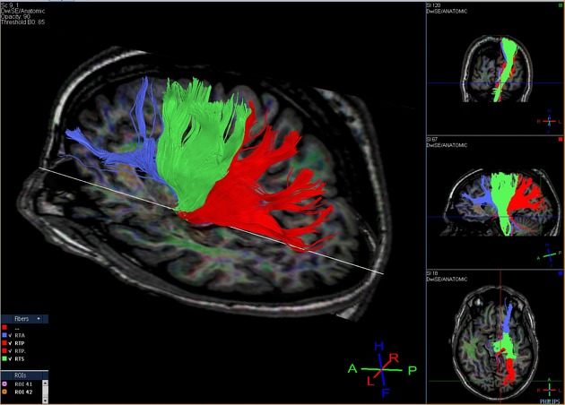
DTI – DIFFUSION TENSOR IMAGING

Slide 79



Slide 80



SWI- Susceptibility weighted imaging

Slide 81




Slide 82




Slide 83
MR Angiography
The most common MR angiographic
techniques are
Time-of-flight imaging, multiple overlapping thin-slab acquisitions (MOTSA)
Phase-contrast imaging,
Contrast-enhanced MR angiography.

Slide 84
Time-of-Flight Imaging and MOTSA
In these sequences, multiple RF pulses applied with short TRs saturate the spins in stationary tissues
This results in suppression of the signal from stationary tissues in the imaging slab.
Inflowing blood is unaffected by the repetitive RF pulses; therefore, as it enters the imaging slab, its signal is not suppressed and appears hyperintense compared with that of stationary tissue.

Slide 85
Time-of flight imaging may be 2D, with section-by-section acquisition or 3D, with acquisition of a larger volume.
MOTSA is the hybrid result of 2D and 3D time-of-flight imaging

Slide 86
Phase-Contrast Imaging
Provides information about the phase (or direction) of flow and the velocity (or magnitude) of flow.
It requires two measurements that are sensitized to flow in different directions; typically, one measurement is sensitized to flow in one direction, and the second is sensitized equally to flow in the opposite direction.
Both measurements are subtracted to eliminate any contribution to image phase that does not arise from flow or motion.
As a result, no signal is detected from stationary tissue; signal is received only from flowing blood.

Slide 87
Subtraction of the phase data yields spatial measures of flow velocity.
Phase-contrast images can be either 2D or 3D.

Slide 88
Different conventions exist for the interpretation of signal seen on directional and velocity phase-contrast images.
One convention is that high signal is seen from flow that moves from a superior location to an inferior one, from right to left, and from an anterior to a posterior location.
No signal (a signal void) is seen from flow that moves from an inferior to a superior location, from left to right, or from a posterior to an anterior location

Slide 89
Contrast-enhanced MR Angiography
An intravenous contrast material (usually gadopentetate dimeglumine or another gadolinium-based agent) is used .
Such agents typically shorten the T1 of blood (ie, hasten the recovery of longitudinal magnetization), so a higher-magnitude net magnetization vector is available to be flipped with the next TR, a condition that results in high signal intensity on T1-weighted images .
Contrast- enhanced MR angiography also can be performed with 2D or 3D methods

Slide 90
Comparison of MR angiographic images obtained with different sequences. (a) Maximum
intensity projection from 2D time-of-flight imaging of the cerebral veins. (b) Axial image obtained with
MOTSA. (c) Maximum intensity projection from MOTSA data (same examination as b).

Slide 91
(d) Phasecontrast image shows left subclavian steal syndrome. In this example, caudal-to-cranial flow appears
dark, and cranial-to-caudal flow appears bright. The left vertebral artery appears bright (arrow), a feature
that indicates subclavian steal. (e) Maximum intensity projection from contrast-enhanced MR angiography
at the level of the heart, aorta, and vessels of the aortic arch.

Slide 92


Slide 93
Thank you

