Slide 1
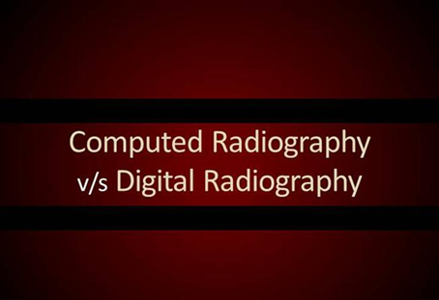
Computer Radiography
Vs
Digital Radiography
Prepared by:
Dr Ramandeep Kaur
JR Radiodiagnosis
GMCH Patiala

Slide 2
DIGITAL PROJECTION RADIOGRAPHY
COMPUTED RADIOGRAPHY (CR)
DIGITAL RADIOGRAPHY (DR)

Slide 3
COMPUTED RADIOGRAPHY (CR)
Been around since 1980-81
Uses same radiographic equipment
Uses an imaging plate
Need a cassette reader
Very similar to conventional radiographic cassette.
Same amount of time to produce the image as with film processing time
Increased exposure

Slide 4
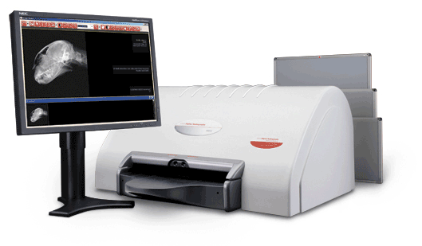
CR SYSTEM

Slide 5
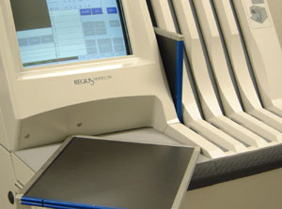
CR PLATE

Slide 6
CASETTE CONSTRUCTION
Light weight aluminum
Plastic
Steel frame
Front panel made of low attenuation carbon fiber
Back panel contains lead foil to protect the plate from backscatter.
Back panel also contains chip to record patient demographic information.

Slide 7
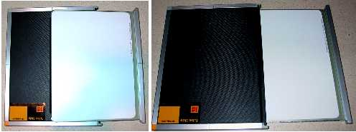

Slide 8
CROSS-SECTION OF CR PLATE
PROTECTIVE LAYER
PHOSPHOR LAYER
ANTI-HALO & REFLECTIVE LAYER
BASE
BACKING LAYER

Slide 9
DIGITAL RADIOGRAPHY (DR)
Works like a digital camera
Two options
CCD
Digital flat plate detector
Can be sent to PACS

Slide 10
DIGITAL FLAT PLATE DETECTORS
Expensive ($80,000-120,000)
Exposure is decreased thus improving radiation safety
Do not use grid but use image software

Slide 11
CCD
Is sold with an X-ray machine
Camera is placed in machine before install – fits underneath the table
Less expensive than the Flat Plate Detector
Cause increase in exposure by 2 times
Double the mAs

Slide 12
ADVANTAGES OF DR
No film costs
No darkroom space
No processor to maintain
No films to search for or file
No expense for film jackets
Increased productivity
Decreased retakes
Decreased exposure

Slide 13
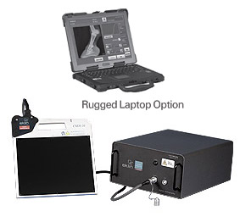
DR PORTABLE SYSTEM

Slide 14
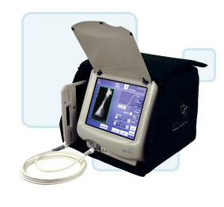
DR – PORTABLE WITH CARRIER

Slide 15
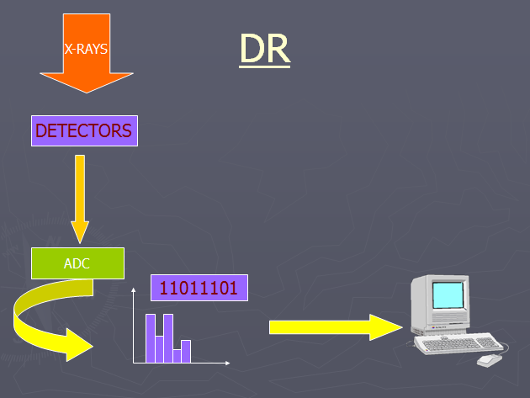

Slide 16
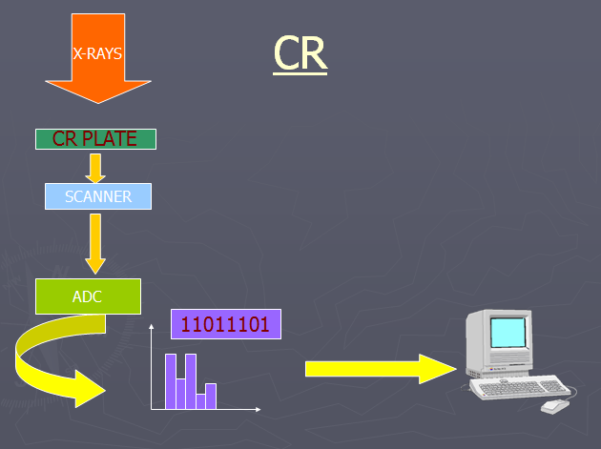

Slide 17
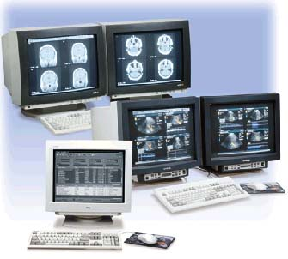
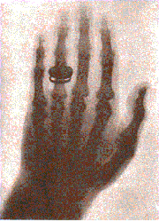
Radiology 1895 Radiology 2001

Slide 18
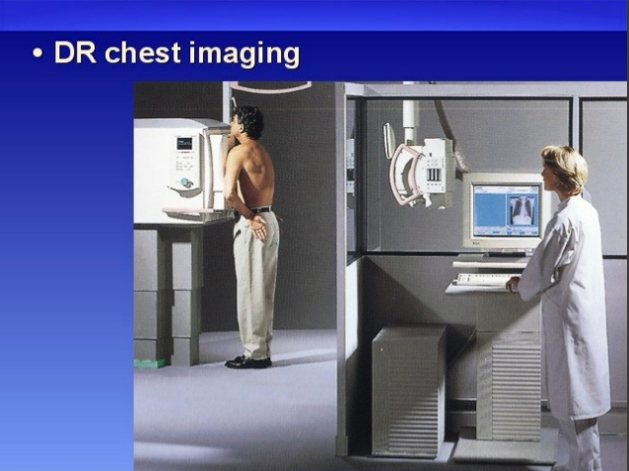
DR IMAGING TECHNIQUE

Slide 19
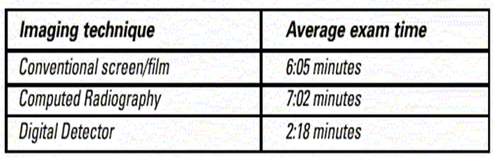

Slide 20
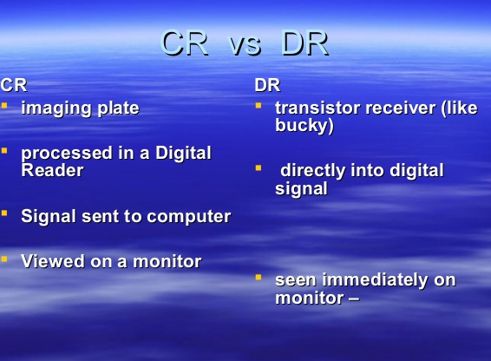
COMPARISON

Slide 21
MANUFACTURERS

Slide 22
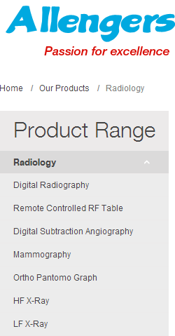
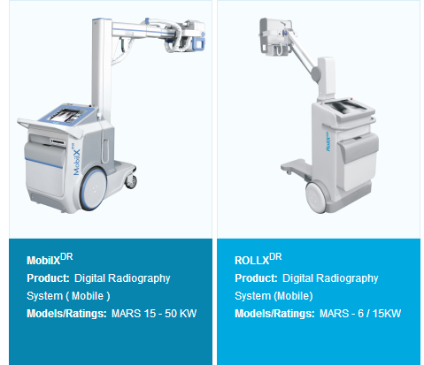
DIGITAL RADIOGRAPHY

Slide 23
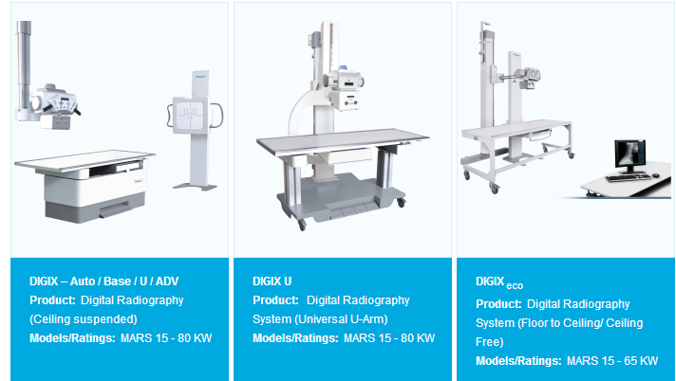

Slide 24
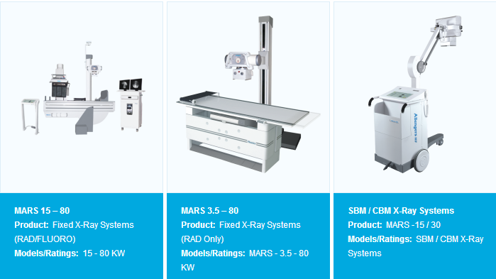
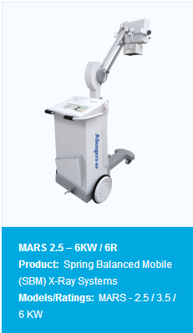
HF X-RAY

Slide 25

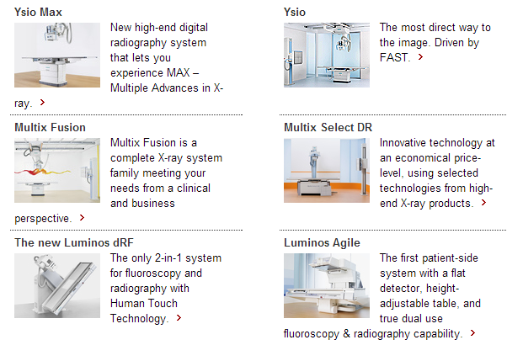

Slide 26
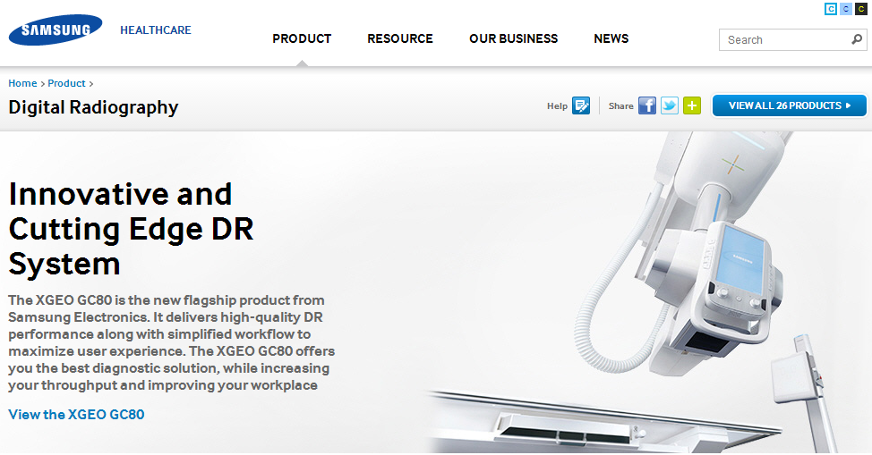

Slide 27
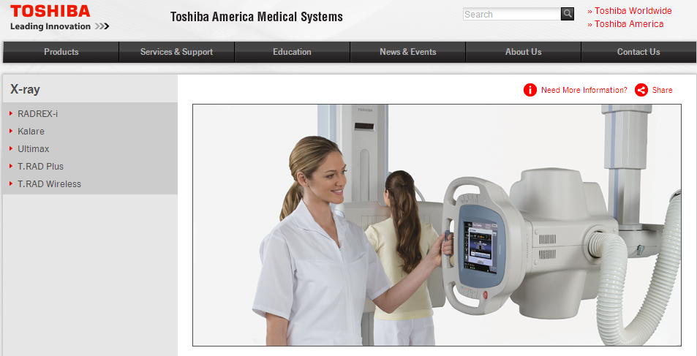

Slide 28
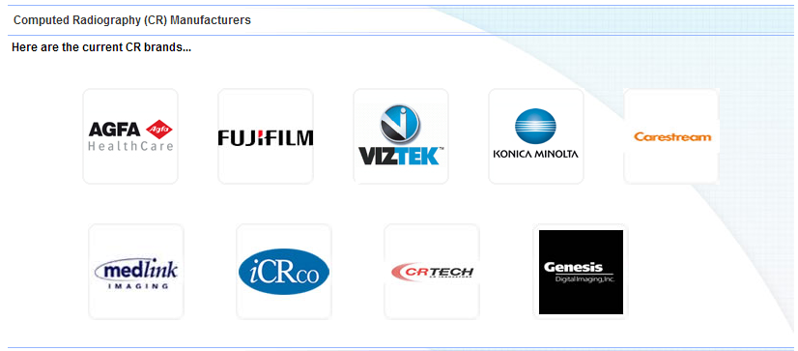
CR MANUFACTURERS

Slide 29
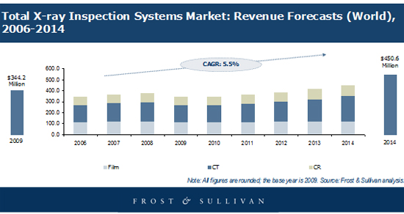
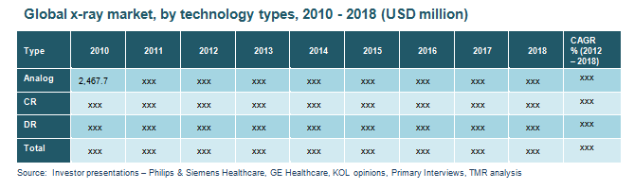
MARKETING

Slide 30
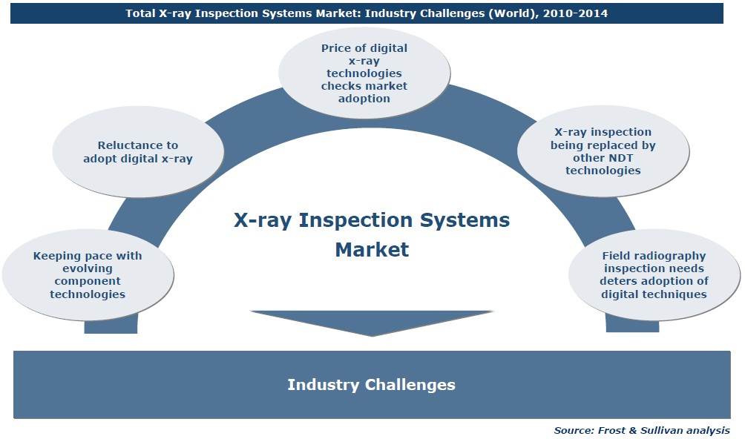

Slide 31
VIDEOS
https://www.youtube.com/watch?v=V9Mi8tqGQlo
https://www.youtube.com/watch?v=Bc0eOjWkxpU
https://www.youtube.com/watch?v=upogkGz6D6U

Slide 32


