Slide 1
COMPUTER RADIOGRAPHY
& DIGITAL RADIOGRAPHY
A Comprehensive Overview
Prepared by
Dr. Ramandeep Kaur
Junior Resident
Department of Radiodiagnosis
Government Medical College & Hospital, Patiala

Slide 2
Presentation Outline
1
Introduction to Digital Projection Radiography
2
Computed Radiography (CR) -- History and Overview
3
CR Cassette and Plate Construction
4
Digital Radiography (DR) -- Overview
5
Flat Plate Detectors and CCD Technology
6
Advantages of Digital Radiography
7
CR vs DR -- Comparative Analysis

Slide 3
01
DIGITAL PROJECTION RADIOGRAPHY
Computed Radiography (CR)
Digital Radiography (DR)
PSP plate | Cassette-based | Requires plate reader
FPD or CCD | Direct capture | Instant display

Slide 4
Computed Radiography (CR) -- History and Overview
• Introduced in 1980-81 by Fuji Photo Film -- a landmark in digital diagnostic imaging • Uses the same conventional X-ray equipment -- no hardware replacement required • Replaces radiographic film with a Photostimulable Phosphor (PSP) imaging plate • Requires a dedicated cassette reader (plate digitizer) for image processing • Cassette design is nearly identical to conventional radiographic cassettes • Processing time is comparable to conventional film-screen systems • Slightly higher radiation exposure than standard film-screen systems

Slide 5
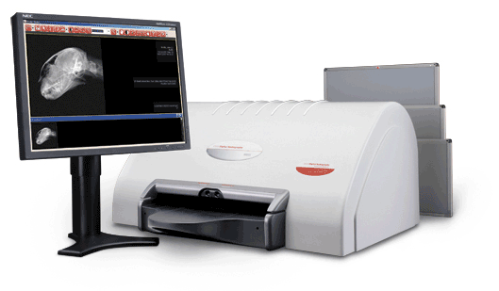
Computed Radiography (CR) System
CR reader unit with imaging plates and diagnostic workstation
A complete CR system pairs a plate reader (digitizer) with a review workstation. Exposed PSP imaging plates are fed into the reader, scanned by a laser, and the digital image is displayed for interpretation.

Slide 6
CR Cassette Construction
HOUSING AND FRONT PANEL
BACK PANEL AND CHIP
Materials: • Lightweight aluminium • Plastic casing • Steel frame Front Panel: • Low attenuation carbon fibre • Minimises beam attenuation • Comparable to conventional cassette
Back Panel: • Lead foil lining • Shields PSP from backscatter radiation Embedded Chip: • Stores patient demographic data • Auto image-to-patient matching • Ergonomic design for daily use

Slide 7
Cross-Section of the CR Imaging Plate
Anti-Halo and Reflective Layer
Prevents fogging; reflects stimulated light back to phosphor
Protective Layer
Guards phosphor from physical damage and contamination
Phosphor Layer -- BaFBr:Eu
Core diagnostic layer -- stores latent image as trapped electrons
Base
Structural support; transparent to the reading laser beam
Backing Layer
Protects the plate from mechanical stress from the rear

Slide 8
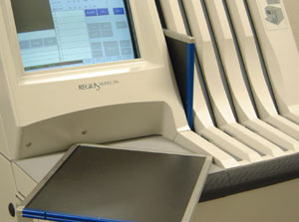
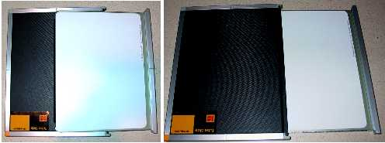
CR Reader and Imaging Plates
Tabletop CR plate reader
Reusable PSP imaging plates

Slide 9
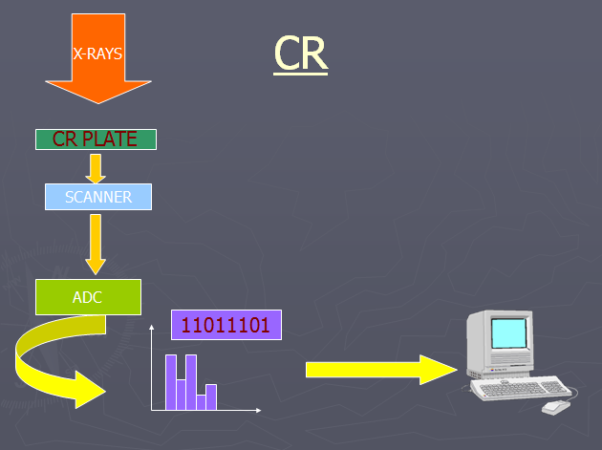
CR Image Acquisition Workflow
X-rays → CR plate → laser scanner → ADC → digital image

Slide 10
Digital Radiography (DR) -- Overview
• Operates on the same principle as a digital camera -- direct electronic image capture • Eliminates wet processing, PSP plate handling, and cassette transport entirely • Two primary detector technologies: -- CCD (Charge-Coupled Device) detectors -- Digital Flat Plate Detectors (FPD) • Images appear on the workstation display within seconds of exposure • Fully compatible with PACS (Picture Archiving and Communication System) • Enables teleradiology, multi-site image sharing, and electronic reporting

Slide 11
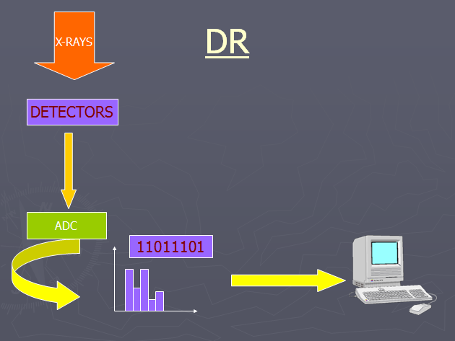
DR Image Acquisition Workflow
X-rays → detector → ADC → instant digital image — no plate handling

Slide 12
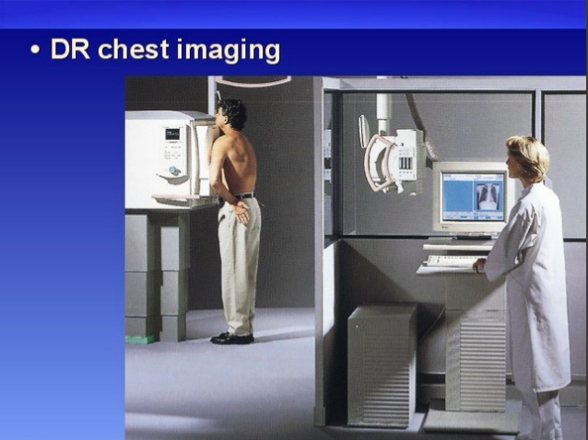
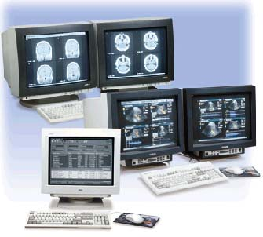
Digital Radiography in Practice
DR chest imaging suite
Multi-monitor reporting workstation

Slide 13
Digital Flat Plate Detectors (FPD)
• High capital cost -- typically USD 80,000 to 120,000 • Significantly reduced patient radiation dose • No anti-scatter grid required -- software compensates for scatter CONVERSION METHODS: DIRECT : X-rays -> Electrical signal (amorphous selenium a-Se) INDIRECT: X-rays -> Light (CsI scintillator) -> Electrical signal (a-Si TFT) • Superior spatial resolution and dynamic range versus CR and film-screen

Slide 14
CCD (Charge-Coupled Device) Technology
• Sold as an integrated component bundled with the X-ray system • CCD camera is mounted beneath the examination table prior to installation • Considerably less expensive than digital flat plate detector systems • Uses optical coupling (lens/mirror) between scintillator and CCD chip LIMITATION: • Requires approximately 2x the mAs compared to flat plate detectors (increased patient radiation dose -- a significant clinical consideration) • Best suited for fixed radiography rooms and fluoroscopy suites

Slide 15
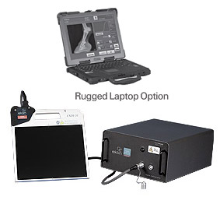
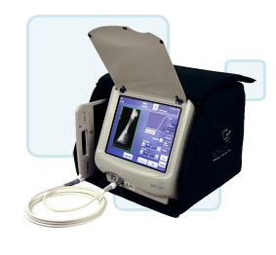
DR Portable Systems
Portable DR with rugged laptop option
Portable DR with carrier

Slide 16
Advantages of Digital Radiography
CLINICAL ADVANTAGES
OPERATIONAL ADVANTAGES
• Reduced patient radiation dose • Lower retake rate • Immediate image availability • Wide dynamic range • Post-processing capability • Image enhancement and window-levelling • No film-related artefacts
• No film or chemical processing costs • No darkroom space required • No processor maintenance • No physical film storage or filing • No film jacket expenses • Increased departmental throughput • PACS / HIS / RIS integration

Slide 17
CR vs DR -- Comparative Analysis
Parameter | Computed Radiography (CR) | Digital Radiography (DR)
Detector | PSP Imaging Plate (cassette) | FPD or CCD detector
Processing | Plate reader required (2-5 min) | Near-instantaneous (<5 sec)
Radiation Dose | Slightly higher than film-screen | 30-50% lower than CR
Image Quality | Good -- comparable to film | Excellent -- higher DQE
Initial Cost | Low to moderate | High -- USD 80,000 to 120,000
Portability | High -- cassette-based system | Limited -- mostly fixed
Workflow | Moderate throughput | High throughput

Slide 18
CR vs DR -- Performance Score Comparison
Image Quality
78%
95%
Workflow Speed
60%
97%
Dose Reduction
55%
88%
Portability
95%
42%
Cost Efficiency
88%
55%
PACS Integration
70%
98%
0%
25%
50%
75%
100%
Computed Radiography (CR)
Digital Radiography (DR)

Slide 19
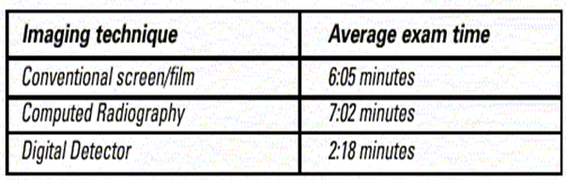
Comparative Exam Times
Average examination time by imaging technique
Digital detectors dramatically cut examination time versus conventional screen-film and even CR, improving departmental throughput.

Slide 20
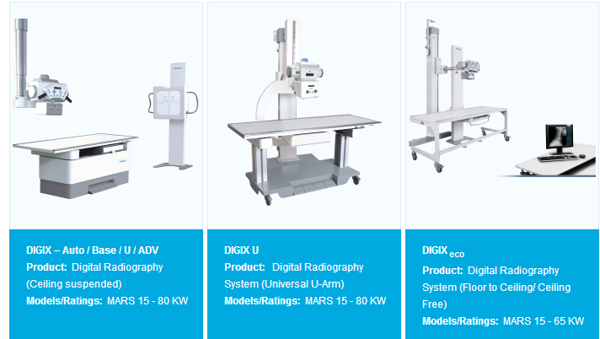
DR Systems — Representative Product Range
Fixed and mobile digital radiography systems across power ratings

Slide 21
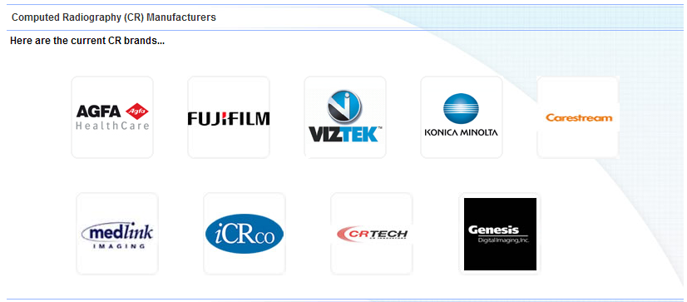
CR System Manufacturers
Leading vendors in the computed radiography market

Slide 22
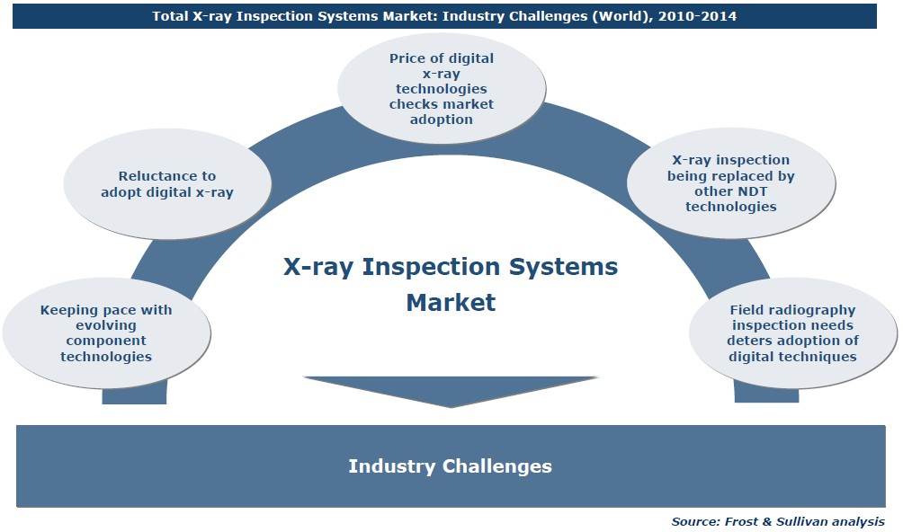
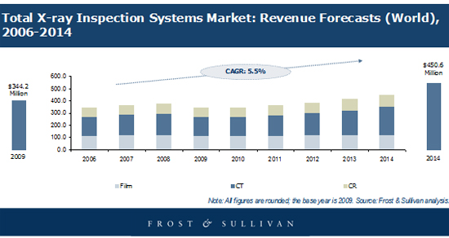
Global X-Ray Market Outlook
X-ray systems revenue forecast
Market drivers and industry challenges

Slide 23

Radiation Safety
Controlled-area warning signage
Although digital systems can lower dose, radiation protection remains essential: controlled access, ALARA practice, shielding, and dose monitoring apply to every CR and DR installation.

Slide 24
CONCLUSION
Digital radiography -- both CR and DR -- represents a paradigm shift in diagnostic imaging. CR provides an affordable entry point using existing X-ray hardware, while DR delivers superior workflow efficiency and the lowest achievable patient radiation dose. Understanding the technical basis of each modality empowers radiologists and clinicians to select the most appropriate system for their practice setting.
Thank You
Dr. Ramandeep Kaur | Junior Resident | Dept. of Radiodiagnosis | GMCH Patiala

Slide 25
References
1. Bushberg JT, Seibert JA, Leidholdt EM, Boone JM. The Essential Physics of Medical Imaging. 3rd ed. Lippincott Williams and Wilkins; 2012. ISBN 978-0-7817-8057-5. 2. Rowlands JA. The physics of computed radiography. Phys Med Biol. 2002;47(23):R123-R166. DOI: 10.1088/0031-9155/47/23/201 3. Chotas HG, Dobbins JT, Ravin CE. Principles of digital radiography with large-area electronically readable detectors. Radiology. 1999;210(3):595-599. 4. Fischbach F, et al. Comparison of indirect CsI/a-Si flat panel and screen film radiography. Eur Radiol. 2002;12(12):2949-2956. 5. Seibert JA. Digital Radiography: The bottom line comparison of CR and DR technology. Applied Radiology. 2009;38(5):21-30. 6. American College of Radiology (ACR). ACR-AAPM-SIIM Practice Parameter for Digital Radiography. 2017.

