Slide 1
USG Physics
Dr. Swapnil Sidana
Junior Resident
M.D. Radiodiagnosis

Slide 2
What is ultrasound?
Ultrasound is a diagnostic imaging technique that uses high frequency sound waves and their echoes to generate real time images of internal body structures.
Key Features:
Non-Ionizing radiation
Provides real-time imaging
Useful for soft tissues, fluid filled structures, vascular flow

Slide 3
Types of ultrasound
A (amplitude) mode is one dimensional representation of structures and is used In ophthalmology to measure the axial length of the eyeball.
B (brightness) mode Displays two dimensional images in which echo amplitude is depicted as dots of different brightness. The routine Grayscale ultrasound examination is B mode USG.
M (motion) mode shows movement as a function of time And is used in Cardiac imaging.
Doppler mode Is used to measure blood flow and velocity.

Slide 4
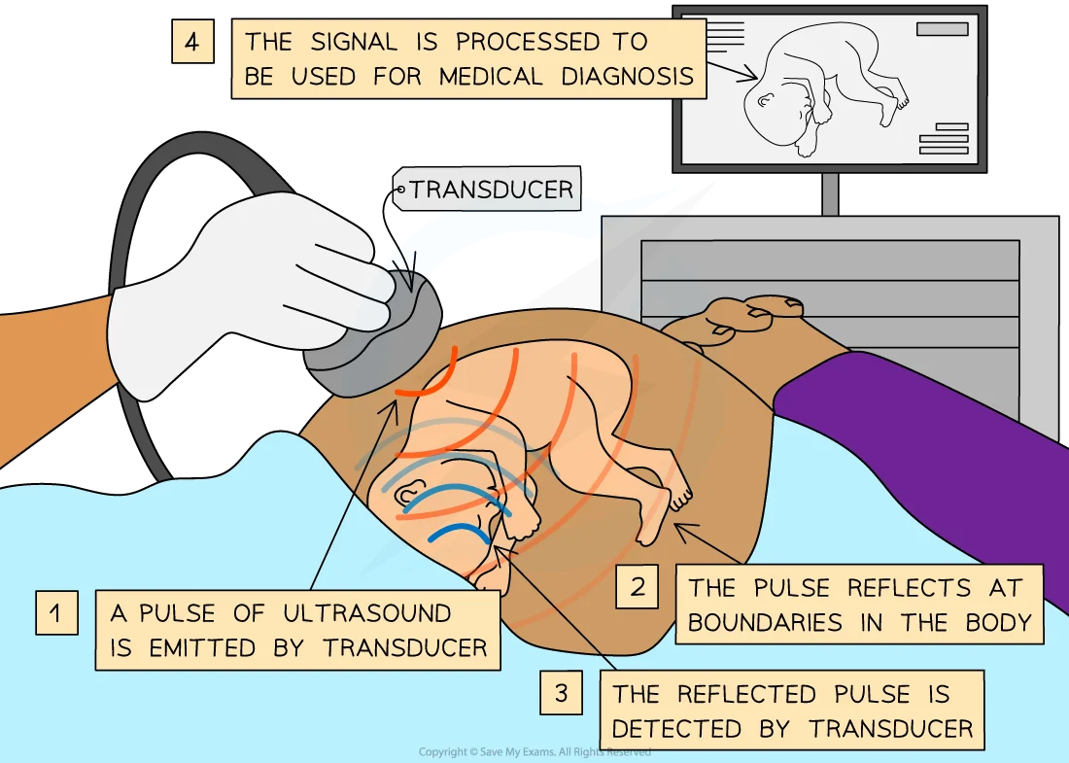
Principle of ultrasound
Ultrasound works on the principle of pulse echo principle which is facilitated by Piezoelectric material in the ultrasound probe crystal. When piezoelectric crystal is electrically pulsed, it changes shape and vibrates, producing a sound beam that propagates through the tissues. The reflected echoes reach the transducer causing its vibrations which produces electrical voltage comparable to the returning echo.

Slide 5
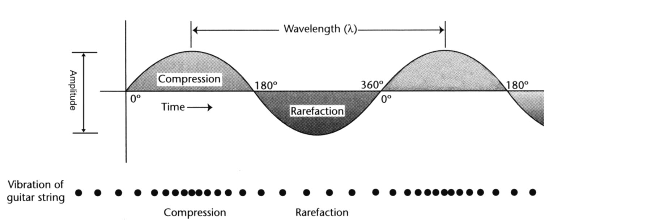
Properties of sound
Unlike X Rays, the sound is a mechanical energy that requires a medium for travel, it has tissue dependent velocity and does not cause ionisation. Sound wave travels as a longitudinal wave with peaks and troughs.

Slide 6
The propagation velocity depends on Tissue and is constant for a particular tissue. It is inversely proportional to the compressibility and density of the tissue And is directly proportional to The stiffness of tissue. Thus, the velocity of sound is less in air, which has high compressibility and in soft tissues it is 1540 m/s. Thus, To get best images of soft issues USG machines are calibrated to this speed (1540 m/s).
Material | Speed of sound (m/s)
Air | 330
Fat | 1450
Water | 1480
Soft tissues (average) | 1540

Slide 7

Acoustic Impedence and Acoustic Impedence Mismatch
The resistance offered by the tissues to the movement of particles caused by ultrasound waves is called the acoustic impedance.
Z = $ρ$c, $ρ$ is the density of tissue and c is the speed of ultrasound wave in the tissue.
Measured in Rayl/kg/m²s
Thus, acoustic impedance is directly proportional to the density, rigidity of tissue and speed of sound in a material.
Acoustic impedance mismatch is the difference in acoustic impedance at interface of two tissues and determines the amount of energy reflected at the interface which in turn is detected and is displayed as images in ultrasound imaging.

Slide 8
If the mismatch is high (air-bone interface) almost 100 % sound is reflected back with almost no transmission.
If the mismatch is low (fat muscle interface) there is better sound transmission with decreased reflection.
Piezoelectric crystals at the transducer head have very high acoustic impedances compared with skin. Therefore, the matching layer is used in front of the piezoelectric crystal to reduce this difference and allow for better sound transmission into the body

Slide 9
Interactions with Tissues
Absorption: it is the major mechanism, the higher the frequency the greater the absorption.
Reflection: the higher the acoustic impedance mismatch, the greater the reflection. Thus, to decrease the acoustic impedance mismatch and thereby allow better sound transmission between the transducer and the skin, the ultrasound gel is used. It also decreases the amount of trapped air between the transducer and the skin. The other practical application is when examining the pelvis, the urinary bladder should be as full as possible to lift the intestine out of the way.
Ultrasound reflection also depends on the size and surface features of the interface, reflecting surfaces can be specular or diffuse reflectors.
The specular reflector is large and smooth like the mirror and forms an image only when incident sound wave is perpendicular to the surface because with an oblique incident sound wave, the reflected sound is reflected away from the transducer and no image is formed. For example diaphragm, foetal skull & vessel wall.

Slide 10
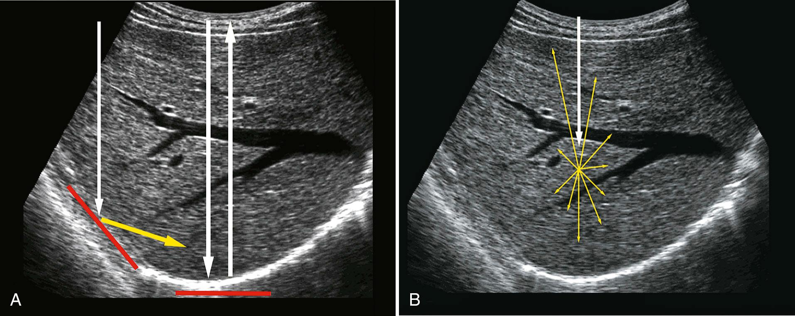
Diffuse reflector: It is more frequently encountered and is made up of small interfaces, each being much smaller than the incident sound wavelength, echo is scattered in all directions with only a portion of reflected waves reaching the transducer and forming an image. The characteristic echopattern of solid organs and tissues such as liver is attributable to the diffuse reflection.

Slide 11
Refraction: The change in velocity and angle as beam crosses an interface.
Scatter: Small surfaces scatter sound in many directions because of reflection and refraction. Examples are the liver and kidney perinchyma Based on the amount of scatter Compared with background signal A tissue or lesion is categorised as hyperechoic, hypoechoic, or anechoic when the amount of scatter is more, less or no scatter at all respectively.
The result of all interactions is sound attenuation that is the decrease in the intensity of ultrasound waves as they pass through tissues, similar to the sound that becomes fainter when one moves away from it. Attenuation is directly related to the frequency of the sound wave Thus, for deeper tissues lower frequency transducers should be used to allow adequate penetration without attenuation but for superficial organs high frequency transducers are better.

Slide 12
Transducer
An ultrasound transducer converts electrical energy into mechanical (sound) energy and back again, based on the piezoelectric effect. It is the hand-held part of the ultrasound machine that is responsible for the production and detection of ultrasound waves.
Components
A transducer consists of five main components:
Crystal/ceramic element with piezoelectric properties
usually lead zirconate titanate (PbZT)
may consist of a single element or be a broadband transducer with multiple elements
piezoelectric polyvinylidene fluoride (PVDF) is useful in those high frequency, high bandwidth transducer that needs focusing to a certain region. PVDF also has low acoustic impedance similar to water, thus is useful in making ultrasound pulses with good temporal resolution.

Slide 13
element thickness is determined by what resonance frequency is desired
equal to half the wavelength.
a thicker element produces a lower frequency oscillation while a thinner element produces a higher frequency oscillation
Positive and ground electrodes on the faces of the element
this allows for electrical connection
positive electrode is in the back of the element
ground electrode is on the front of the element
Damping (backing) block
adhered to the back of the crystal (behind the positive electrode)
absorbs ultrasound energy directed backward and attenuates stray ultrasound signals from the housing
Dampens the resonant vibrations in the element which creates a shorter spatial pulse length, this allows for better axial resolution for imaging of organs and high bandwidth to receive reflected echoes

Slide 14
Matching layer
Interface between the transducer element and the tissue
allows close to 100% transmission of the ultrasound from the element into the tissues by minimizing reflection due to traversing different mediums (acoustic impedance)
Achieves this by consisting of layers of material with acoustic impedances that are between soft tissue and transducer material
May consist of one or multiple layers
Each layer is one-quarter wavelength thick
Housing
electrical insulation and protection of the element
includes a plastic case, metal shield and acoustic insulator

Slide 15
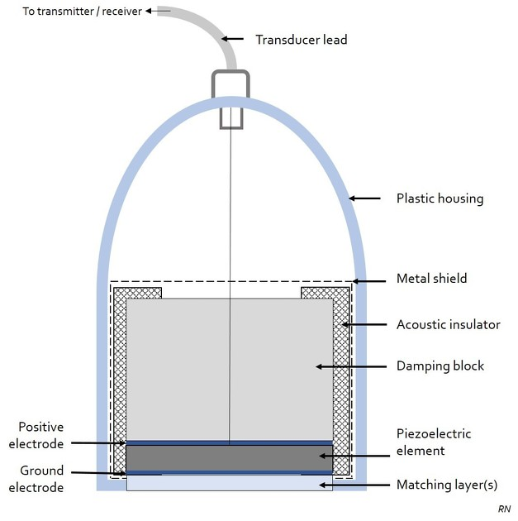

Slide 16
Ultrasound beam production
Ultrasound transducers typically consist of 128-512 piezoelectric elements arranged in linear or curvilinear arrays. Each element is individually insulated.
Transducers can produce an ultrasound beam by mechanical or electronic means. In mechanical transducers, either oscillating or rotating wheels is used. In electronic transducers, there are two ways to generate ultrasound beam :
Linear vs Phased Array
What is the Ultrasound Beam?
The ultrasound beam is the directed propagation of acoustic waves from the transducer into tissue and back.
Key Beam Components
Main lobe → useful signal
Side lobes / grating lobes → artifacts
Near field (Fresnel zone) → beam converges
Far field (Fraunhofer zone) → beam diverges
🔹

Slide 17
Linear Array Transducer
How it Works?
Multiple elements arranged in a straight line, groups of elements are fired sequentially and beam travels perpendicular (straight) to probe
Beam Characteristics
Parallel scan lines
Rectangular image
Minimal beam steering
Image Shape
Rectangular field of view
Advantages
Excellent lateral resolution
Uniform image across depth
Limitations
Limited penetration
Large footprint (not good between ribs)

Slide 18
Phased Array Transducer
How it Works?
All elements fire almost simultaneously, with time delays (phasing) → beam is steered electronically.
Beam Characteristics
Beam steering + focusing
Scan lines diverge from a point
Image Shape
Sector (pie-shaped)
Advantages
Small footprint → fits between ribs
Can image deep structures
Limitations
Lower resolution compared to linear
More artifacts (side lobes)

Slide 19
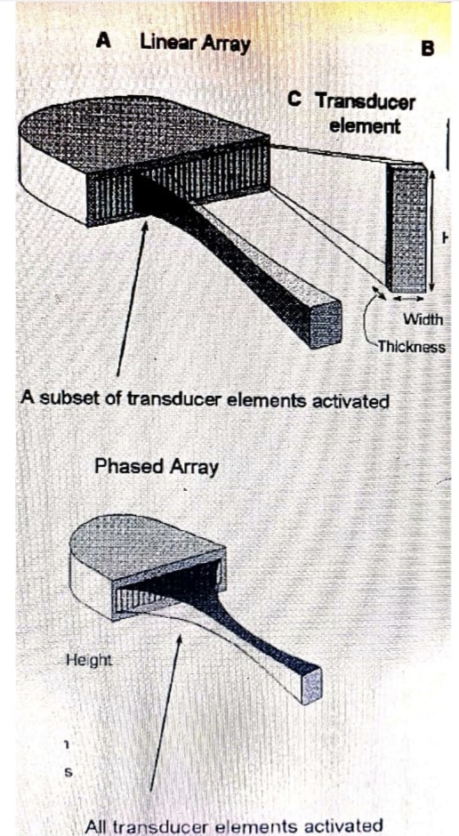
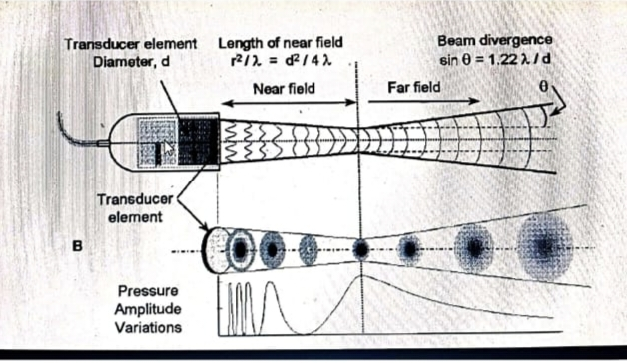

Slide 20
Image Quality
The quality of an ultrasound image is determined by spatial resolution, contrast resolution, temporal resolution and absence of certain artefacts.
Spatial resolution is the ability to differentiate too closely situated Objects as distinct structures. It is considered in three planes With different determinants of resolution for each. Resolution along the axis of the ultrasound beam is axial resolution, resolution in the plane perpendicular to the beam and parallel to the transducer is lateral resolution, and resolution in the plane perpendicular to the beam and to the transducer is azimuth or elevational resolution or slice thickness.
Axial Resolution is the ability to separate two objects lying along the axis of the beam. It can be improved by a higher frequency and shorter length of pulse. But the problem with the high frequency transducers is poor penetration.

Slide 21
Lateral resolution is the ability to resolve two adjacent objects and is best achieved within the focal zone. Its key determinant is width of the ultrasound beam, which can be altered by focusing the beam usually by electronic phasing. It can be improved by using focused transducers, a distinct focal position and using multiple focal lengths. However, this reduces frame rate.
Elevational resolution and slice thickness are directly related to the transducer height and are fixed for standard 2D transducers.
Temporal resolution is the ability of the system to display events occurring at different times as separate images and is measured in frames per second. Factors that decrease temporal resolution include a greater number of focal zones, imaging a deep deeper object (Echo takes longer to return), doppler and a large sector width (more space to scan).
Contrast resolution is the ability of a grayscale display distinguish between echoes of slightly different intensities. Contrast resolution depends on the number of bits per pixel in the image and can be improved by increasing the number of bits per pixel.

Slide 22
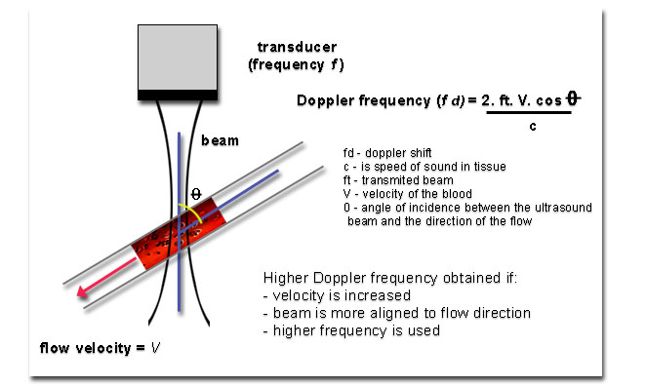
Doppler Physics
Core Principle – Doppler effect: the doppler effect is the change in frequency of a wave when the source or reflector is moving relative to the observer.
Ultrasound waves hit moving RBCs → reflected waves return with changed frequency.
Doppler Shift Equation

Slide 23
Types of Doppler
Continuous Wave (CW) Doppler
Uses 2 crystals (one transmit, one receive)
Measures very high velocities
No depth resolution
Used in cardiology (valvular stenosis)
Pulsed Wave (PW) Doppler
Single crystal alternates transmit/receive
Has sample volume (gate) → depth specific
Limited by aliasing
Used in obstetrics, carotids, abdominal vessels

Slide 24
Color Doppler
Maps flow over grayscale image
Convention: Red = toward probe, Blue = away (not artery vs vein!)
Quick assessment of presence & direction of flow
Power Doppler
Displays amplitude (not direction)
More sensitive to low flow
No directional information
Useful in:
Tumors
Placental flow
Small vessels

Slide 25
Key parameters to be taken care of:
Doppler Angle
Ideal: < 60°
At 90° → cos90 = 0 → no Doppler signal
Never report velocity without angle correction
Aliasing
Occurs when doppler shift is more than half of PRF (Nyquist limit)
Appearance:
Wrap-around of waveform
How to Fix it:
Increase PRF (scale)
Lower frequency
Shift baseline

Slide 26
Spectral Doppler
Shows velocity vs time waveform
Key indices:
PSV (Peak systolic velocity)
EDV (End diastolic velocity)
Derived indices:
RI = (S − D) / S
PI = (S − D) / Mean
PI is more reliable than RI, because it incorporates the entire waveform (Mean velocity) and it works even when there is absent diastolic flow.
Used in:
Umbilical artery
MCA
Uterine artery

Slide 27
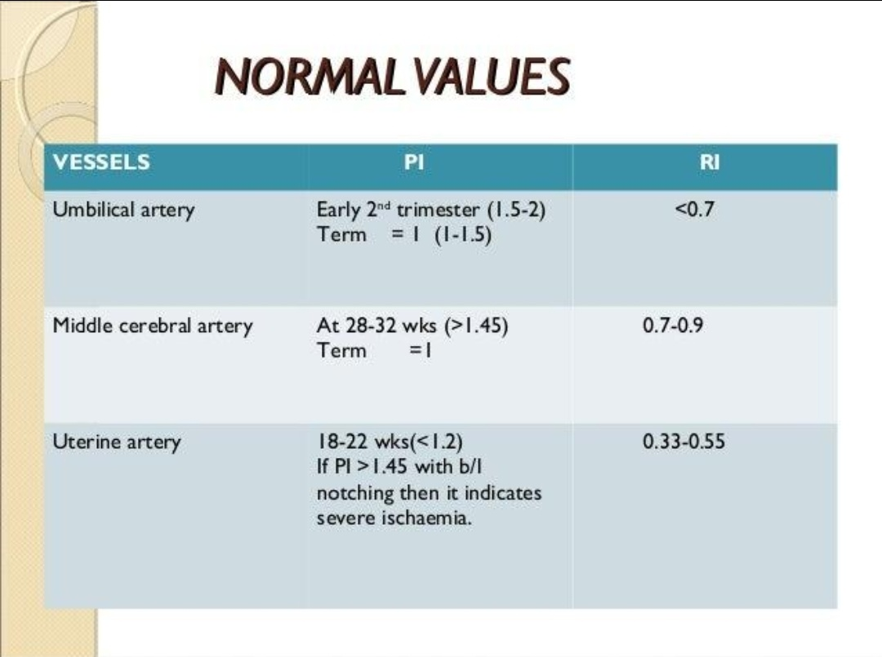
Practical Obstetric Applications
Umbilical Artery
Normally: it is a low resistance vessel
Abnormal: decreased/absent/reversed diastolic flow → placental insufficiency
Middle Cerebral Artery (MCA)
↓ resistance (PI) in fetal hypoxia (brain sparing)
↑ PSV → fetal anemia ( PSV > 1.5 MoM )
Uterine Artery
Look for:
Early diastolic notch
High PI → risk of preeclampsia/IUGR

Slide 28
Ultrasound Gel
Gel is needed to remove pockets of air between probe and patient’s skin, which would otherwise prevent sound transmission into patient’s body. Thus Ultrasound gel acts as a medium to transmit sound And as a lubricant.
Liquids such as water and alcohols are suitable media, however, being volatile and having low viscosity makes them inappropriate. That is why specific gels have been developed.
Ingredients of ultrasound gel include: Distilled water, Carbomer, Ethylenediamine tetra-acetic acid (EDTA), Propylene glycol, glycerin and trolamine. Occasionally, a colourant is used, usually a blue colour.
In case of a patient having an open wound or a skin rash or any other risk of infection, the transducer or patient’s skin should be covered with plastic and gel should be used on both sides of the plastic.
The transducer must be cleaned after every patient.

Slide 29
Artefacts
Artefacts are incorrect representation of anatomy or function which can enhance or degrade the diagnostic value of the ultrasound image.
The causes are machine & operator related, as well as intrinsic to the characteristics and interaction of ultrasound with the tissues. So, removing the potentially avoidable artefacts is important for maximising image quality and thereby increasing the diagnostic accuracy.

Slide 30
Assumptions in ultrasound imaging
Sonographic instruments are based on following assumptions, violation of which results in artefacts.
Velocity of sound: Sound travels at uniform speed of 1540 m/s throughout the tissues. Alteration in the velocity results in propagation velocity artefact. It is also assumed that the longer the round trip travel time of ultrasound wave the deeper the object or target is situated.
Attenuation of sound: Sound waves decrease in intensity at constant rate as they travel through tissues. If the wave travels through tissues that do not attenuate much or attenuate more then artefacts like increased through transmission/enhancement (PAE) and shadowing (DAS) arise respectively.
Path of sound: Soundwave travels in a straight line, is reflected off a reflector only once Returns directly back to the probe at the same angle, exactly to the point from which it left the probe And echoes originate only from objects located along the beam axis. If the sound wave undergoes more than one reflection then artefacts such as mirror image, reverberation or comet-tail occur. And if the direction of the beam or its echo is altered, Refraction or anisotropy artefact may be produced.
Beam Profile: Sound beam generated by the transducer is a narrow line. Violation results in Side lobe or Grating lobe artefacts.

Slide 31
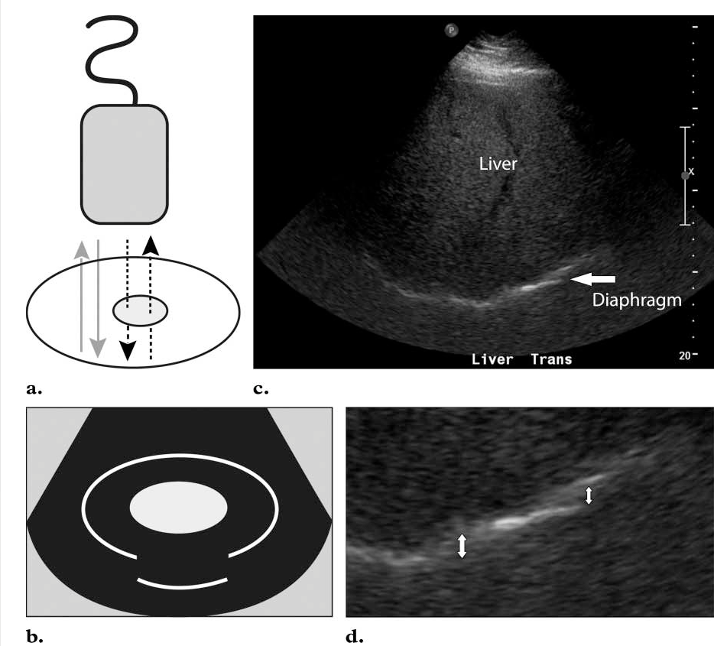
Classification of ultrasound artefacts
Propagation of velocity artefacts: In the case of a fatty lesion, the slow speed of propagation
(1450 m/s) means that the echo take longer to return to the transducer, thus the lesion is displayed deeper in the image then its true location (e.g. focal fatty lesion in liver). This can be minimised by using multibeam features and improved signal processing.

Slide 32
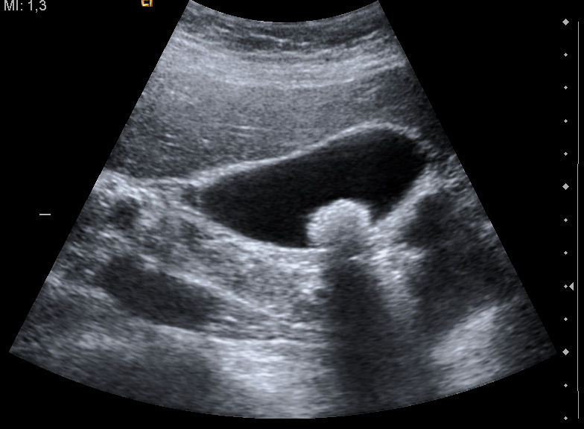
Attenuation Errors
Shadowing results when there is marked reduction in the intensity of the ultrasound deep to a strong reflector, consequently, no information received from the area behind that structure.

Slide 33
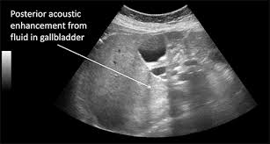
Enhancement is seen when there is less attenuating object as compared to the surrounding tissues. Consequently, increased amplitude of beam reaches and is returned from the area deep to this object as compared to the surrounding tissues. Therefore, this area appears bright as compared to the surrounding tissues.

Slide 34
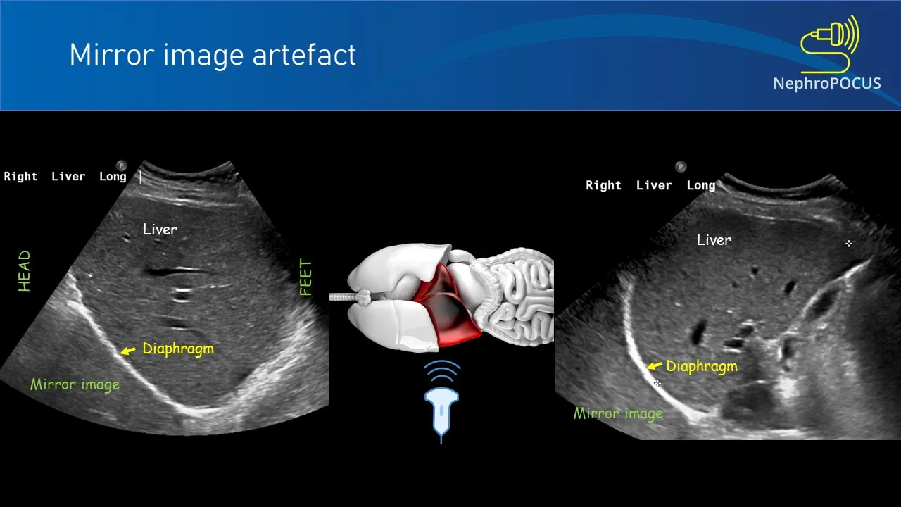
Path of sound related artefacts
Mirror image artefact/multipath artefact : When the ultrasound beam encounters a highly reflective surface, the reflected echoes then encounter another reflective structure on their way back and are reflected back towards the reflective interface before being reflected to the transducer, where they are detected. This display show a duplicate structure equidistant but on opposite side of the reflector creating a mirror image. This most often happens at the diaphragm wherein the liver is seen in the chest cavity due to sound waves being reflected off the diaphragm.

Slide 35
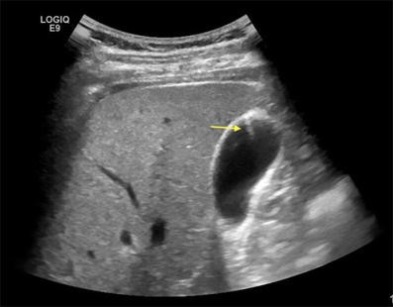
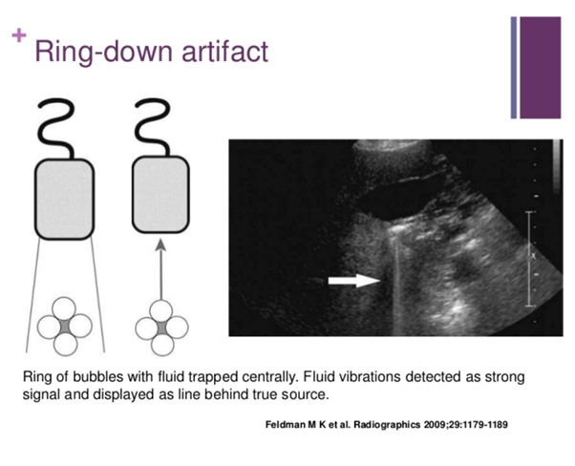
Reverbration artefact: It arises when the ultrasound signal reflects repeatedly between highly reflective interfaces near the transducer, resulting in delayed echo return to the transducer. This appears in the image as a series of regularly spaced echoes at increasing depth. It can be reduced by changing the scanning angle or placing the transducer in such a way so as to widen the parallel interface that contribute to the artefact. Reverberation may be helpful In identification of a specific type of reflectors such as surgical clip or needle during biopsy.
There are two types of reverberation artefacts:
Comet-tail Artefact: It occurs when the repetitive reflections occur within very small structures such as, in tiny crypts in the wall of Gall bladder in case of adenomyomatosis.
Ring down artefact: It occurs when the ultrasound waves cause oscillation within fluid trapped by a tetrahedron of gas bubbles.

Slide 36
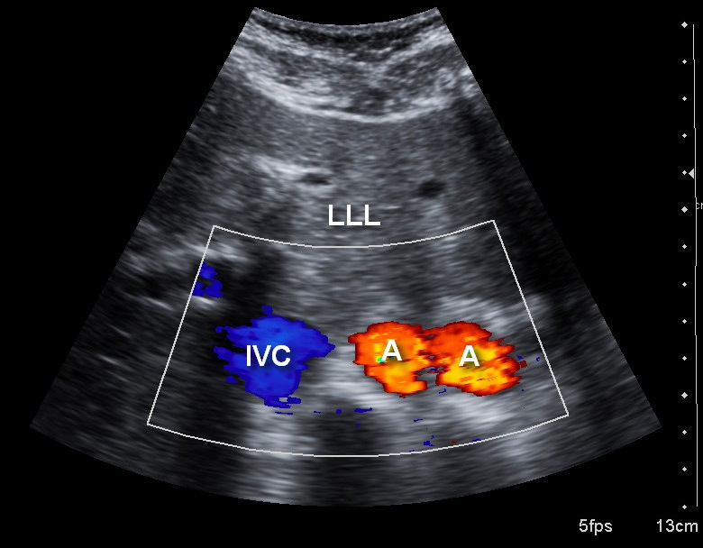
Refraction: When an ultrasound beam is incident on a boundary between two tissues at an angle other than 90 degree and if these tissues do not have same speed of sound, there is a change in the direction of ultrasound beam, this results in artifactual representation of objects on the display even when they are not truly in the scanned field of view (Refraction). Thus, refraction can cause object misregistration or duplication or lateral defocusing at the edge of curved structures. This artefact is most often observed in pelvic structures deep to the rectus muscles and midline fat. It can be minimised by increasing the scan angle so that sound waves travel perpendicular to the interface.

Slide 37
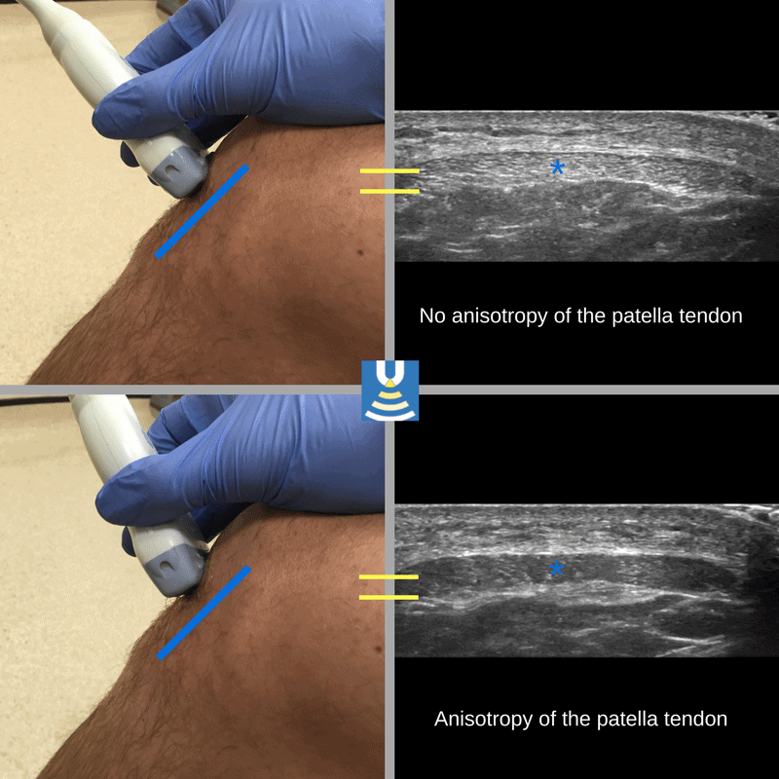
Anisotropy: Anisotropy is an artefact caused by structures that are composed of bundles of highly reflective fibres running parallel to each other such as tendons and ligaments. If the sound beam hits the tendon or ligament fibres perpendicular to their length, it is reflected directly back resulting in an echogenic appearance but if the angle of insonation is not perpendicular to the tendon fibres, the beam is reflected away from transducer leading to generation of an image with an artifactual hypoechogenicity within the tendon

Slide 38
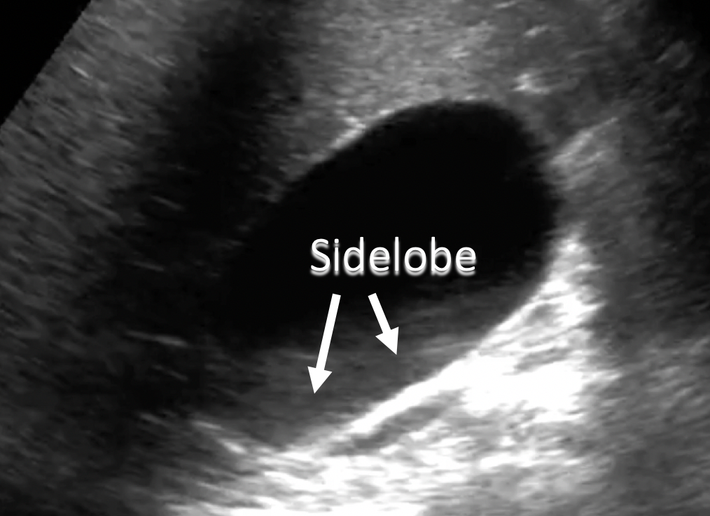
Beam width Artefact/ Side lobe and grating lobe : Although most of the energy generated by a transducer is emitted in a beam along the central axis of the transducer However some energies also emitted at the periphery of the primary beam. These are called side lobes or grating lobes and are lower in intensity than the primary beam. Side lobes or grating lobes may interact with strong reflector that lie outside scan plane and produce artefacts that are displayed in the ultrasound image. They are more evident when misplaced echoes overlap and expected anechoic structure. It can be minimised by placing the transducer at the centre of the object of interest and adjusting the focal zone to appropriate depth.

Slide 39
Doppler Artefacts
Aliasing
Mechanism: Occurs when Doppler shift exceeds Nyquist limit (PRF/2)
Appearance
Spectral: waveform “wraps around” baseline
Color: mosaic pattern (red-blue mix)
Seen in : High velocity flow (stenosis) and Low PRF settings
Correction: ↑ PRF (scale), ↓ transducer frequency and by Shift baseline
Spectral Broadening
Mechanism: Range of velocities within sample volume and Large gate or turbulent flow.
Appearance
Filling of spectral window (loss of clear black window)
Causes : True turbulence (stenosis) and Instrumental (large sample volume, high gain)

Slide 40
Mirror Image Artifact
Mechanism: Reflection from strong specular reflector (e.g., diaphragm)
Appearance:
Duplicate vessel on opposite side
Doppler waveform duplicated
Common site: Liver–diaphragm interface
Twinkling Artifact
Mechanism: Rapid color alternation due to rough reflective surface
Appearance: Color “twinkling” behind structure
It is seen in: Renal stones and calcifications (Often more sensitive than acoustic shadowing)
Blooming Artifact
Mechanism: it occurs due to excessive doppler gain
Appearance: Color is seen outside vessel margins, it can be fixed by reducing the gain.

Slide 41
Range Ambiguity (PW Doppler)
Mechanism: Echoes from deeper structures assigned incorrectly, it is seen in high PRF settings.
Flash Artifact (Motion Artifact)
Mechanism: Tissue/probe motion
Appearance: Sudden color bursts not related to flow, it is seen in case of Fetal movement, breathing, probe pressure.

Slide 42
Ultrasound safety and Bioeffects
Although ultrasound is generally safe, there are some theoretical risks. To reduce the probability of these risks, a few values that must be monitored and kept within certain limits as follows:
Thermal index: It measures the ability of the ultrasound wave to heat up the local tissue. Its value should be </= 0.7 (very safe), can be used upto 1.0 in routine scans and ANC scans. (2.0 is the upper limit – use ALARA principle)
Mechanical Index: Measures the maximum amplitude of pressure pulse indicates the risk of cavitation
(should not be > 1.0)
Complications of ultrasound:
Local heating :This is more with Doppler imaging because of large duration of pulse and high PRF are used Thereby increasing The amount of energy introduced in scanning.
Cavitation: This is the action of acoustic field within a fluid to generate bubbles. The pressure changes causes microbubbles in a liquid to expand increasingly and then collapse. For example: Gas containing structures such as bowel & lungs.

Slide 43
Thank You!
If you don’t understand something, it’s probably physics….not you.

