Slide 1
SOFT TISSUE INJURIES
Department of Orthopaedics
Government Medical College,
Amritsar

Slide 2
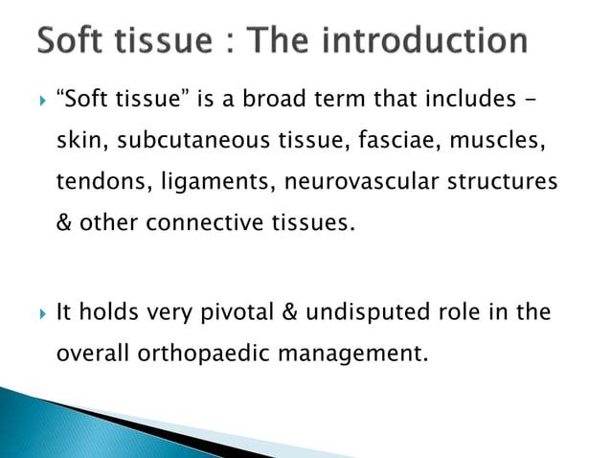

Slide 3
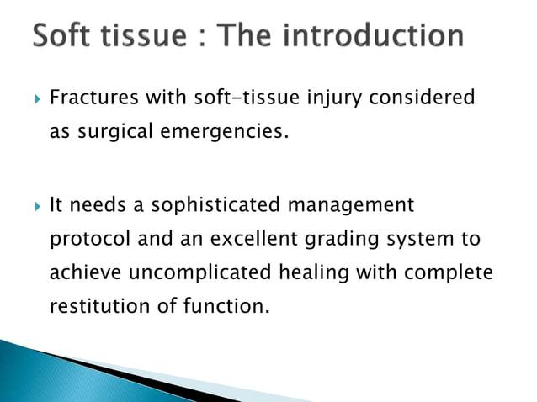

Slide 4
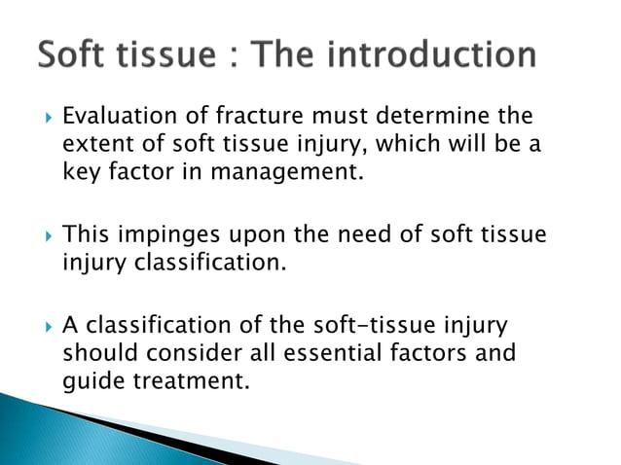

Slide 5
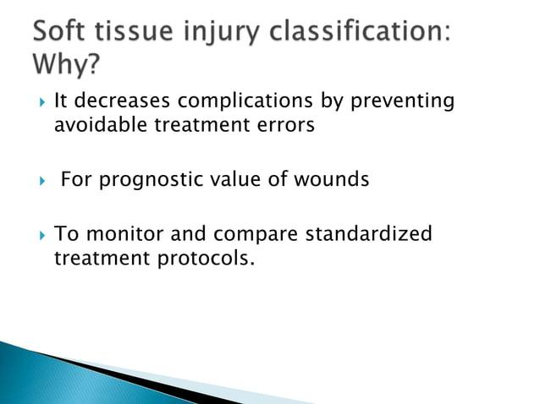

Slide 6
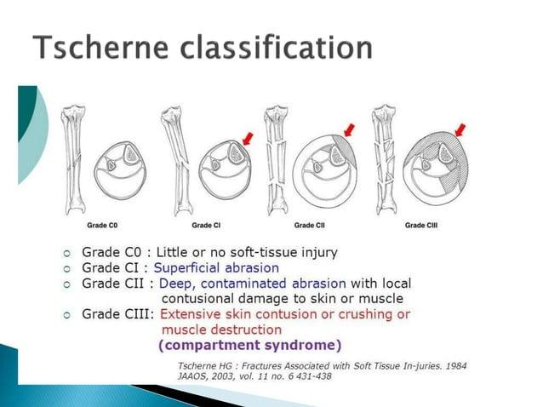

Slide 7
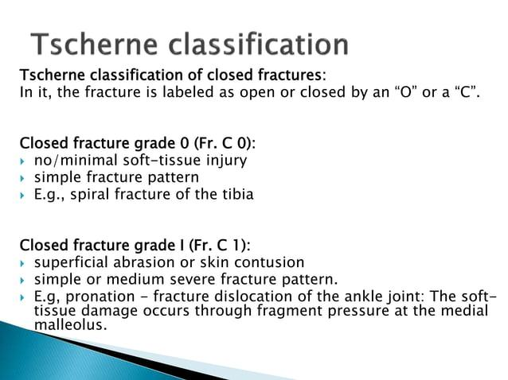

Slide 8
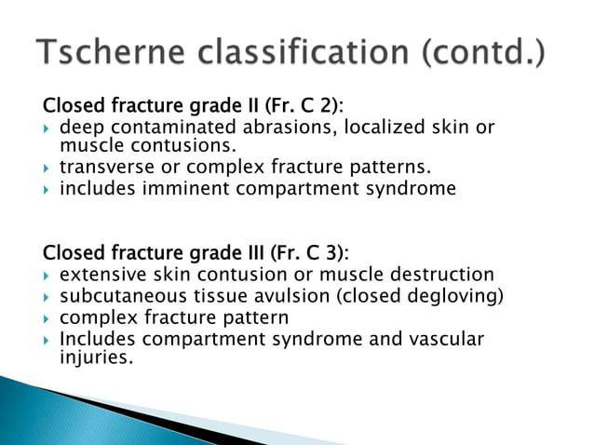

Slide 9
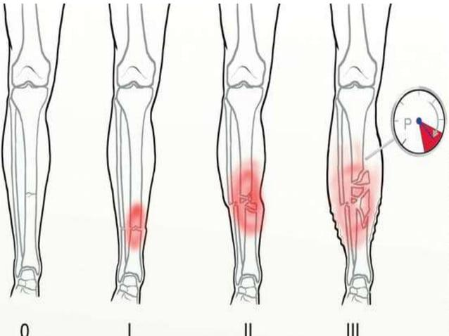

Slide 10
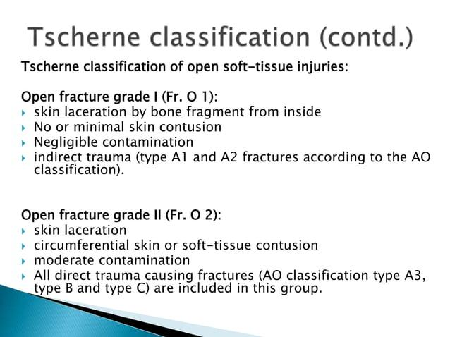

Slide 11
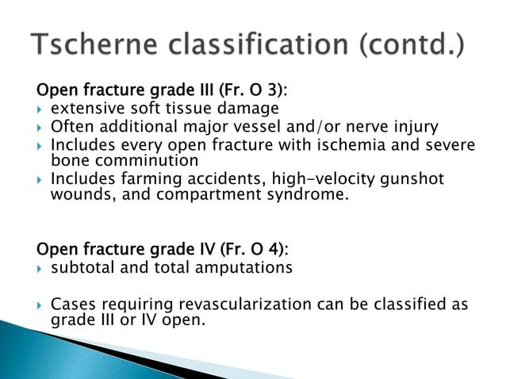

Slide 12
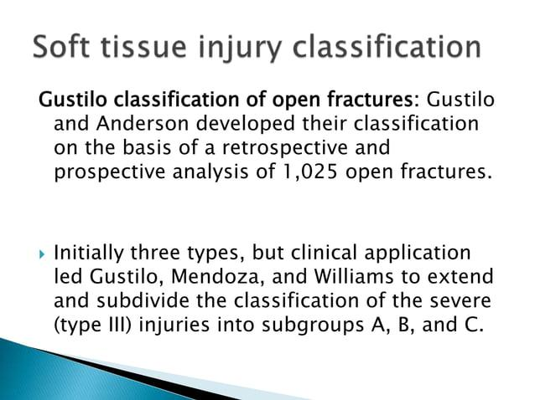

Slide 13
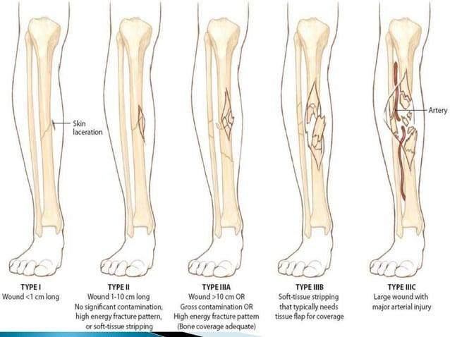

Slide 14
Types of Wounds -
1. Closed wounds -
Damage to tissues bneath the skin
No break in skin
Swelling and Pain with discoloration present
For example - Tears, Sprains, Contusion
2. Open Wounds -
Break in skin present
oozing of blood present
risk of infection high
For example - Incision, lacerations, abrasions

Slide 15
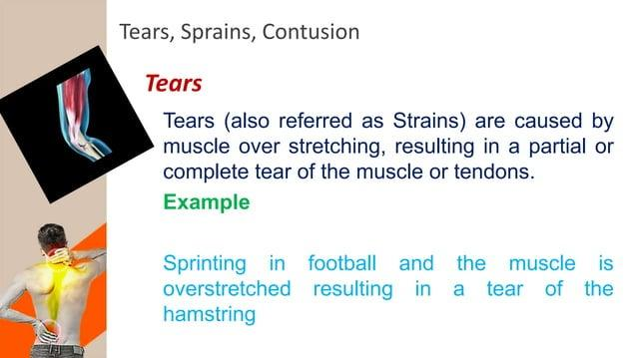

Slide 16
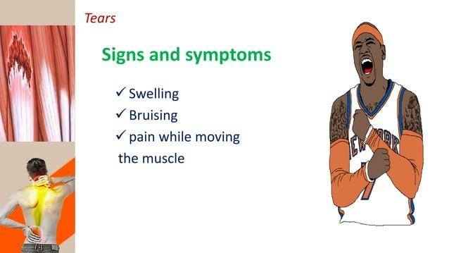

Slide 17
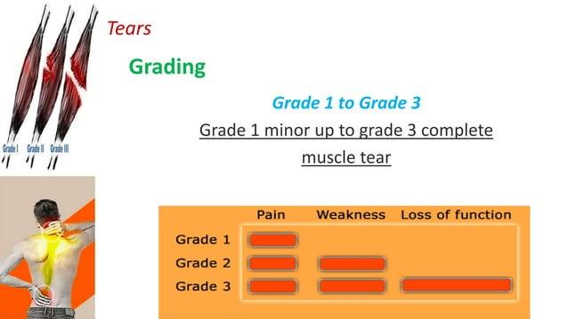

Slide 18
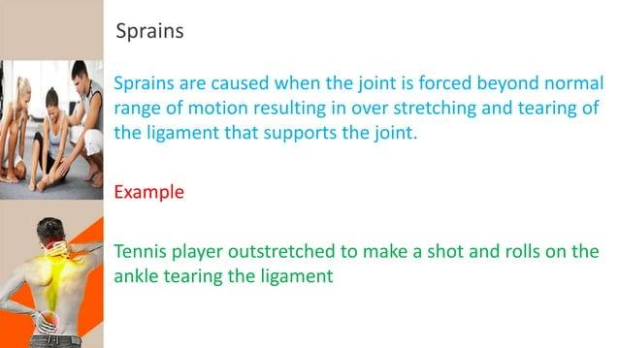

Slide 19
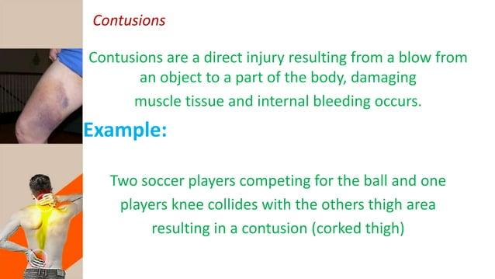

Slide 20
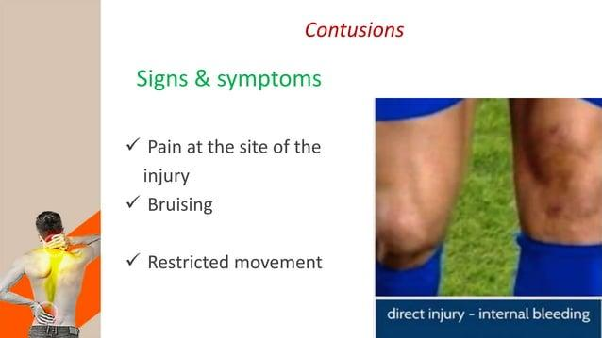

Slide 21
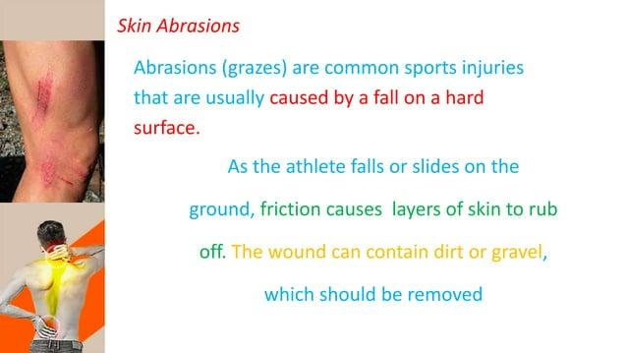

Slide 22
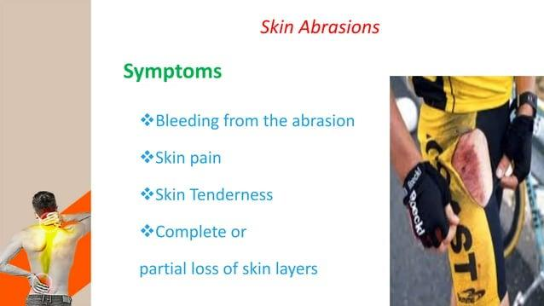

Slide 23
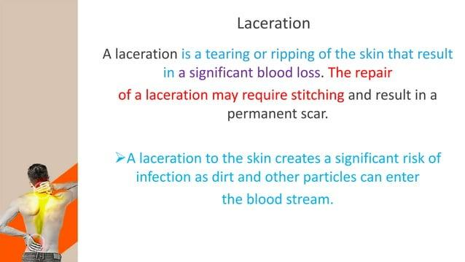

Slide 24
Trauma Scoring Systems -
Several scoring systems are used to classify trauma patients and predict the outcome. Following are some of the commonly used scoring systems –
Revised Trauma Score –
Calculated from sum of Patient’s Respiratory rate, Systolic BP and GCS.
Score ranges from 0 to 12
Helps in triage as 12 is labelled Green (delayed Rx), 11 as Yellow (urgent) and 0-10 as Red (Immediate)
2. Mangled Extremity Severity Score –
Score used to predict chances of amputation after severe extremity trauma.
Contains 4 variables – Skeletal and soft tissue injury, Ishemia of limb, Shock and Age.

Slide 25
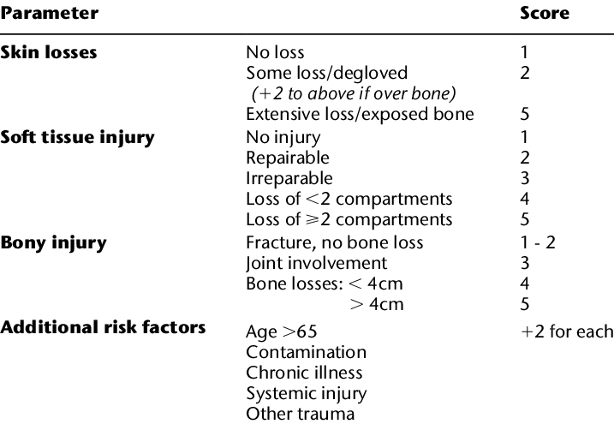
Ganga Hospital Open Injury Severity Score -
Assesses 3 areas – Skin and Fascia, the musculotendinous unit and the Bones.

Slide 26
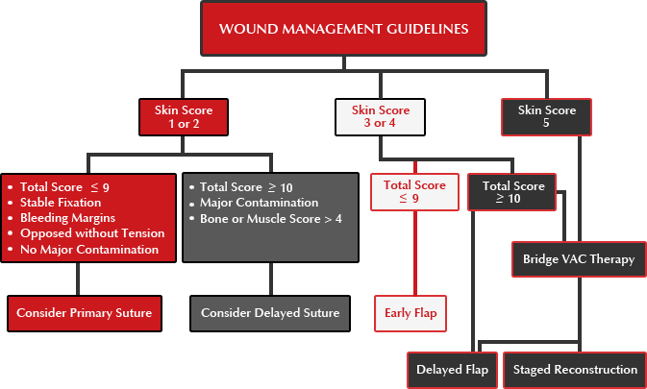

Slide 27
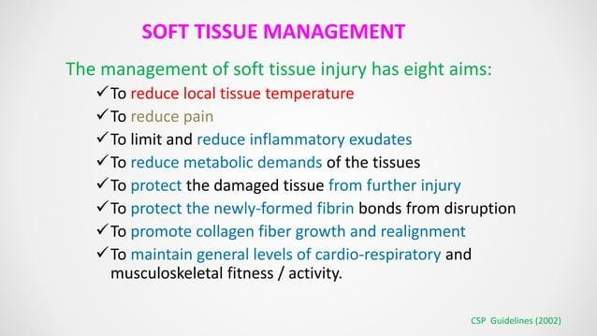

Slide 28
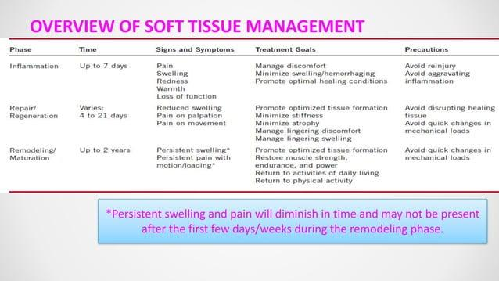

Slide 29
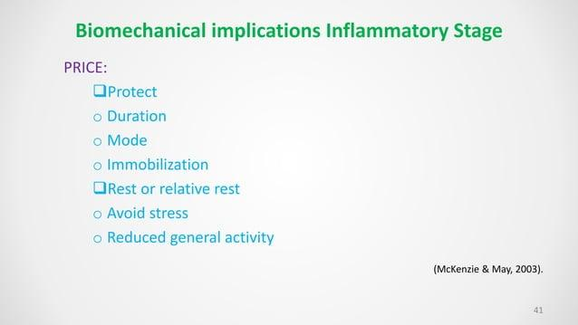

Slide 30
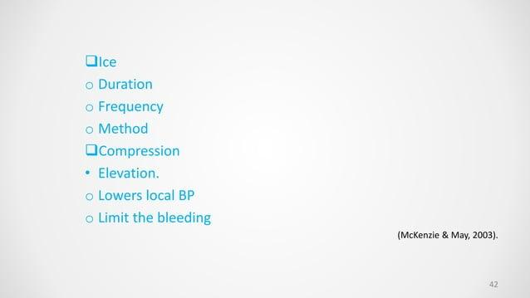

Slide 31
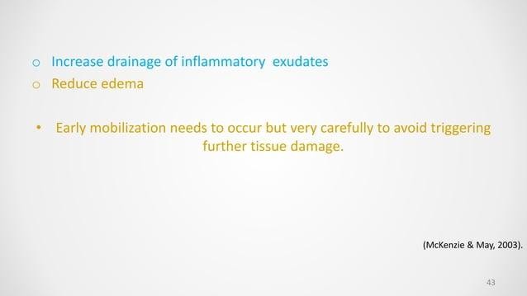

Slide 32
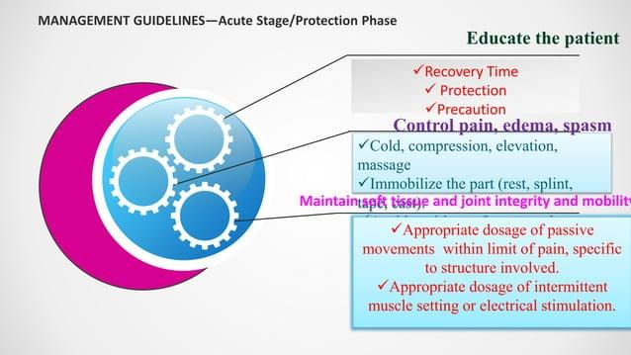

Slide 33
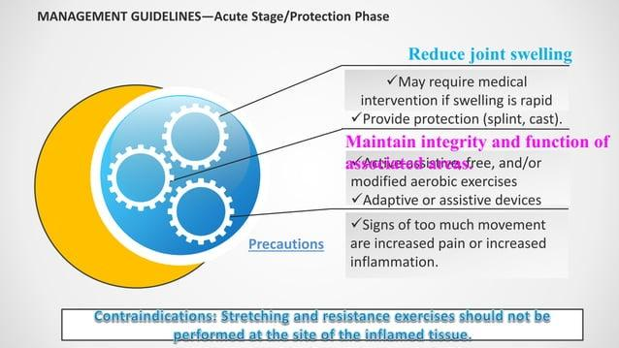

Slide 34
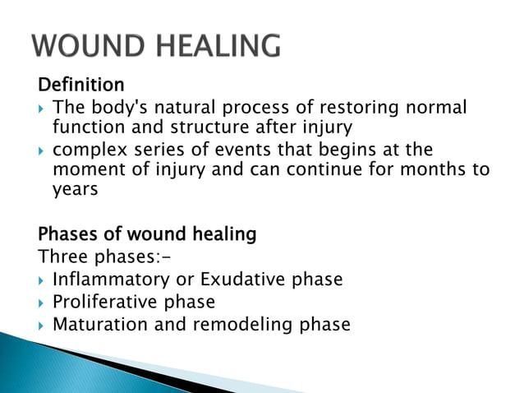

Slide 35
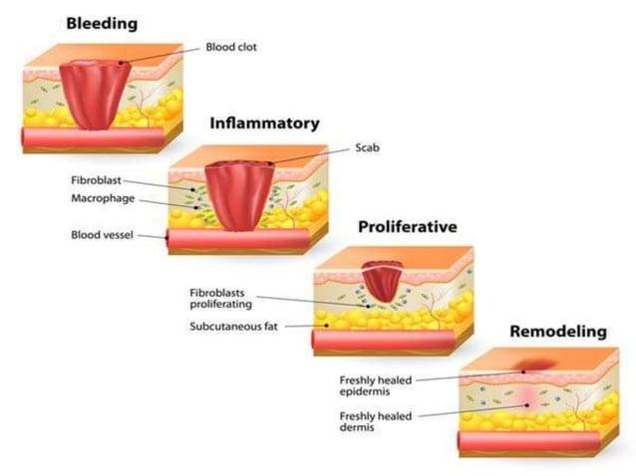

Slide 36
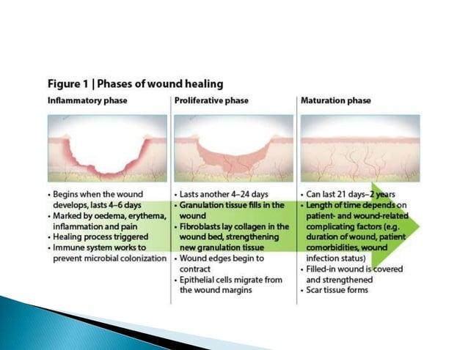

Slide 37
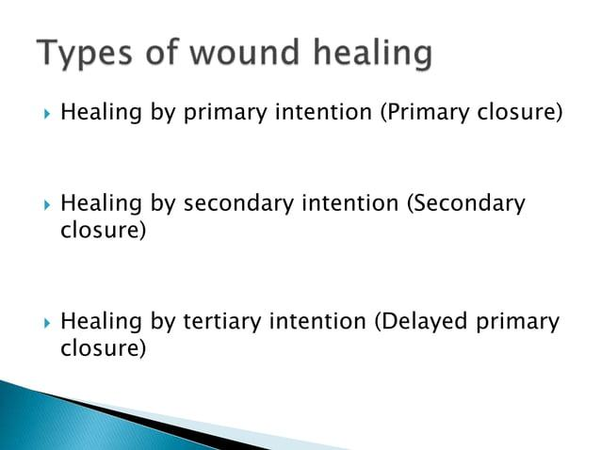

Slide 38
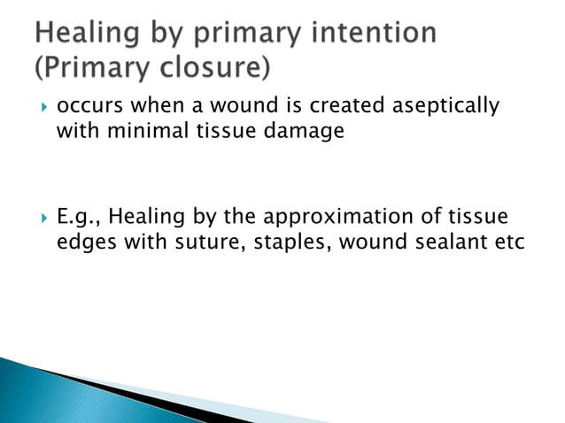

Slide 39
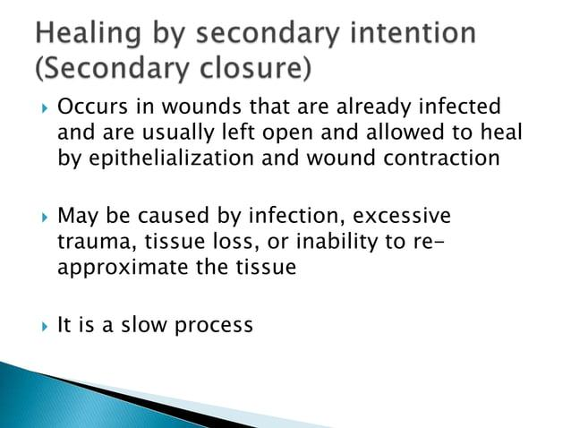

Slide 40
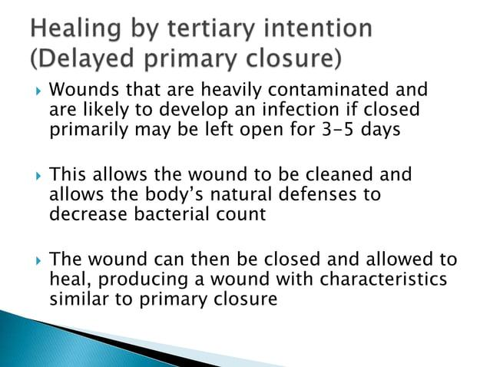

Slide 41
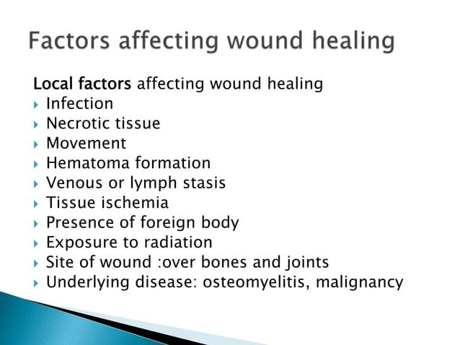

Slide 42
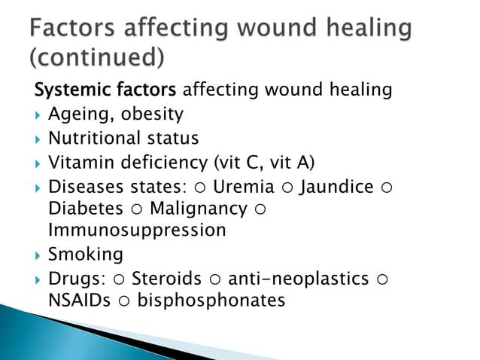

Slide 43
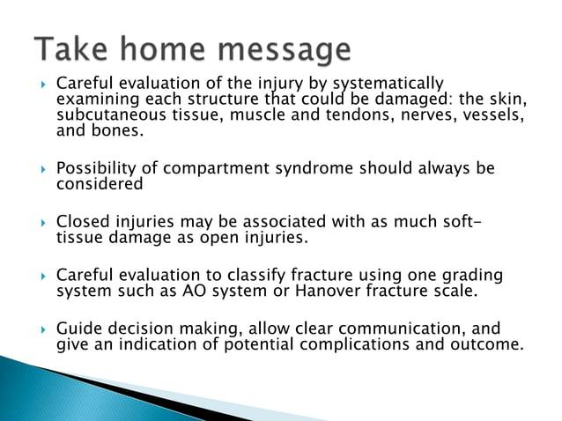

Slide 44


