Slide 1
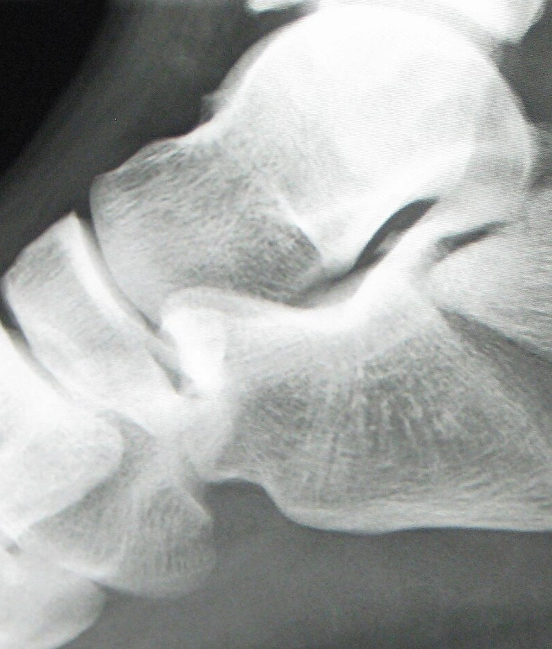
ORTHOPAEDICS · PG SEMINAR
Calcaneum
Fractures
Applied anatomy · Classifications · Management · Complications
Presented by :
Dr Pawanpreet Singh
Junior Resident
Orthopaedics deptt.
GMC Amritsar
G
Lateral radiograph: intra-articular calcaneal fracture
Notes:
Case image: J. Heilman MD, CC BY-SA 3.0 (Wikimedia Commons). Full credits on the last slide.

Slide 2
ROADMAP
What we will cover
1
2
3
Applied anatomy
Pathoanatomy
Assessment & imaging
Osteology, radiographic angles, soft-tissue envelope, function
Mechanism, primary & secondary fracture lines, associated injuries
Clinical exam, radiographic views, CT, MRI
4
5
6
Classifications
Management
Complications & outcome
Rowe, Essex-Lopresti, Sanders, Crosby-Fitzgibbons, AO/OTA
Non-operative, ORIF, minimally invasive, primary fusion, rehab
Wound, infection, malunion, arthritis, evidence, viva points
Calcaneum Fractures · Orthopaedics PG Seminar
2

Slide 3
WHY IT MATTERS
The commonest tarsal fracture, a disabling one
~2%
~60%
~75%
~10%
of all fractures
of all tarsal fractures
are intra-articular
bilateral; a similar share have a spine injury
Typical patient
Why we worry
Men aged 20 to 45, manual workers
Fall from height or road-traffic accident
Axial load: the talus is driven into the heel
Thin soft-tissue envelope, so wound problems are common
Subtalar joint is easily damaged; post-traumatic arthritis follows
Long disability: many patients are off work for 6 to 12 months
Calcaneum Fractures · Orthopaedics PG Seminar
3
Notes:
Numbers are approximate and vary between series. The key message: a young, working-age, high-energy injury with a poor natural history when the subtalar joint is malreduced.

Slide 4
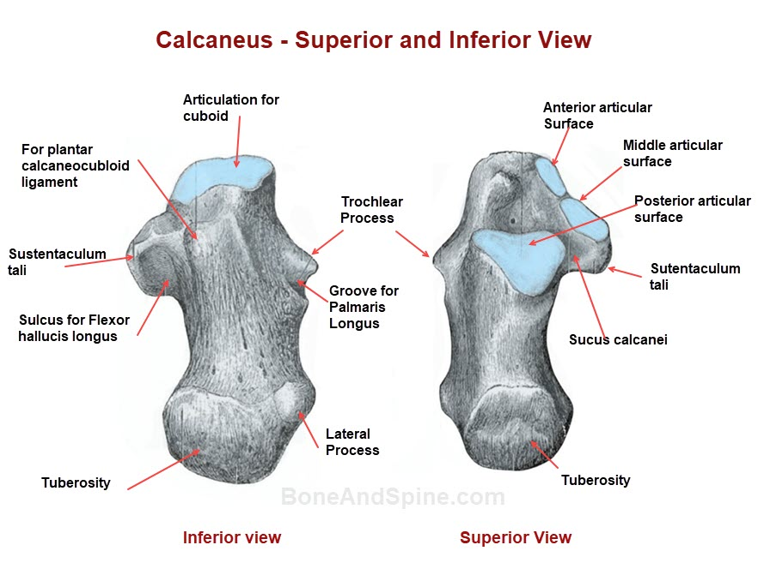
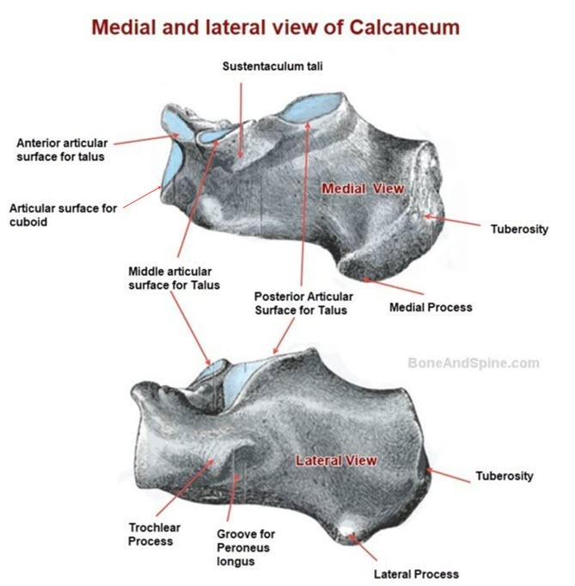
APPLIED ANATOMY
Osteology:
4

Slide 5
APPLIED ANATOMY
APPLIED ANATOMY
Largest tarsal bone and the keystone of the lateral column;
it carries body weight to the ground
Posterior facet articulates with the talus: the subtalar joint,
key to inversion and eversion
Thin cortex, cancellous body with a sparse "neutral triangle" beneath
the angle of Gissane
Ossification: primary centre before birth; posterior apophysis appears
about 7 to 9 years (Sever's disease)
Calcaneum Fractures · Orthopaedics PG Seminar

Slide 6
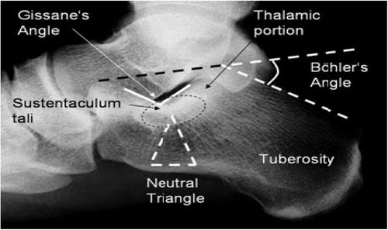
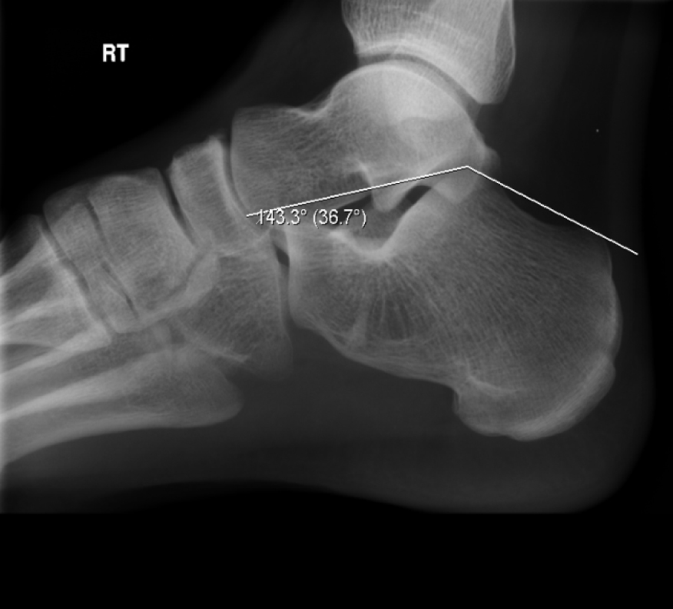
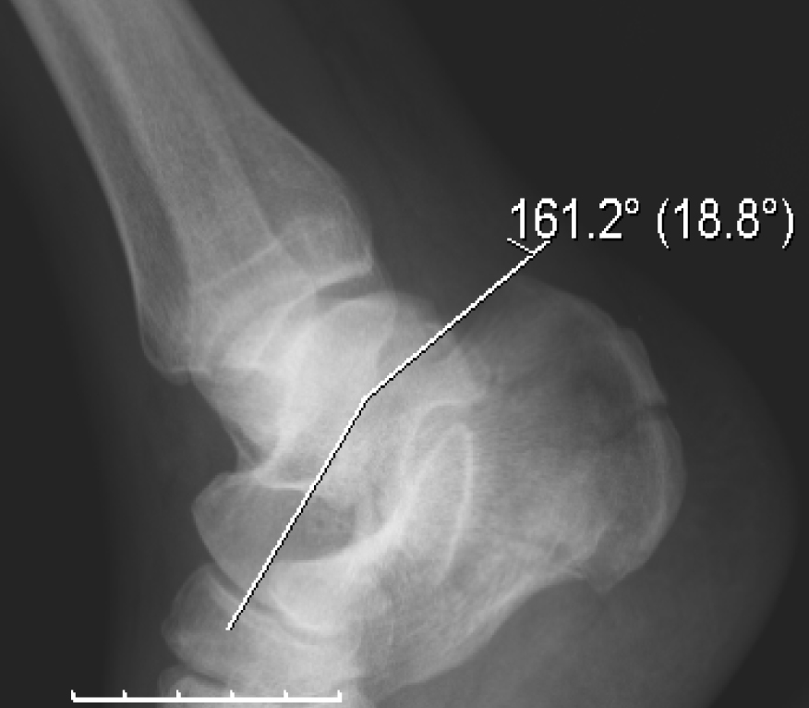
APPLIED ANATOMY
Radiographic anatomy: Böhler and Gissane
Normal: Böhler 36.7°
Fracture: Böhler 18.8°
Real radiographs · Gilo1969 · CC BY-SA 3.0
Böhler <20° means the posterior facet has collapsed and the heel has lost height
Gissane >145° or disrupted means the facet is depressed into the body
Compare with the other foot when the fracture is bilateral
Calcaneum Fractures · Orthopaedics PG Seminar
5
Notes:
Böhler: from the highest point of the anterior process to the highest point of the posterior facet, then on to the highest point of the posterior tuberosity. Normal 20 to 40 degrees. Gissane: the two cortical struts (lateral process of the talus sits in the notch) meeting at the sulcus.

Slide 7
APPLIED ANATOMY
Soft-tissue envelope and relations
1
Lateral wall
2
Medial side
Skin is thin with almost no muscle cover
Sural nerve lies just behind the malleolus and is at risk in the vertical limb
Peroneal tendons run in the retinaculum over the lateral wall and can be trapped
Lateral calcaneal artery (peroneal branch) feeds the lateral flap
Tarsal tunnel: tibial nerve, posterior tibial vessels, FDL, FHL
FHL runs beneath the sustentaculum tali
Sustentaculum stays tied to the talus by deltoid and interosseous ligaments
Open wounds are usually medial
3
Plantar and posterior
4
Sinus tarsi
Achilles inserts on the posterior tuberosity
Plantar fascia arises from the medial tubercle
Heel pad is a fibrofatty shock absorber; damage causes chronic heel pain
Compartments: the calcaneal compartment can bleed and tense
Interosseous and cervical ligaments hold talus to calcaneum
Calcaneofibular ligament and the peroneal tubercle sit laterally
Sinus tarsi window shows the posterior facet through a small incision
Calcaneum Fractures · Orthopaedics PG Seminar
6
Notes:
The lateral calcaneal artery (branch of the peroneal artery) supplies the lateral flap; the corner of the L incision is the most vulnerable point. Full-thickness flap, no-touch technique, K-wire retraction rather than forceps.

Slide 8
APPLIED ANATOMY
What the calcaneum does, and what its loss costs
1
Heel height
Keeps the talus tilted upwards (talar declination)
Loss: anterior ankle impingement, restricted dorsiflexion
2
Tuberosity lever arm
Gives the triceps surae its push-off
Loss: weak plantarflexion and limp
3
Posterior facet
Subtalar motion: inversion, eversion, adapts to uneven ground
Loss: stiff hindfoot, post-traumatic arthritis
4
Heel width and lateral wall
Clearance for the peroneal tendons and the fibula
Loss: peroneal impingement, shoe-fitting problems
5
Hindfoot alignment
Neutral to slight valgus under the tibia
Loss: varus heel, lateral overload of the foot
Goal of treatment: restore height, width, alignment and a congruent posterior facet.
Calcaneum Fractures · Orthopaedics PG Seminar
7

Slide 9
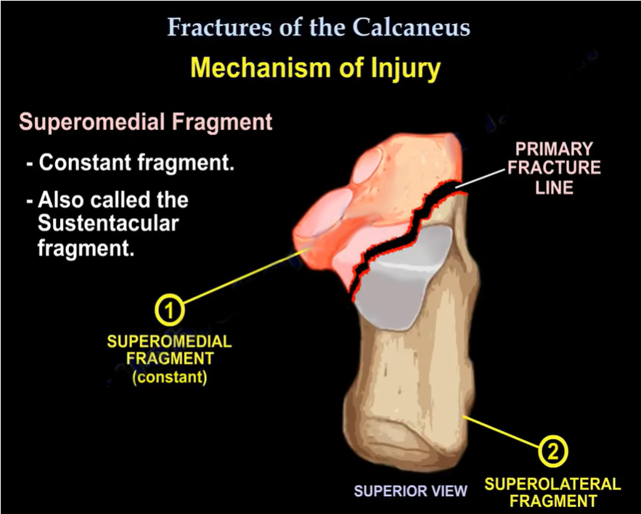
PATHOANATOMY
Mechanism and the primary fracture line
1
Axial load
A fall from height or a road-traffic accident drives the talus down into the calcaneum.
2
Primary fracture line
The lateral process of the talus acts as a wedge at the crucial angle. The line runs obliquely from lateral to medial through the posterior facet.
3
Two main fragments
The sustentacular (constant) fragment stays on the talus. The posterolateral fragment carries the tuberosity and lateral facet.
4
Secondary lines
Continued force adds secondary lines (joint depression or tongue) and comminutes the facet.
Calcaneum Fractures · Orthopaedics PG Seminar
8
Notes:
Superior view of a right calcaneum. The oblique primary fracture line is produced by the lateral process of the talus acting as a wedge at the crucial angle. The sustentacular fragment is the constant fragment.

Slide 10
ASSESSMENT
Clinical assessment and associated injuries
Examine
Look for the associated injuries
Look: swelling, heel widening and shortening, varus, loss of the normal heel contour
Bruising: plantar arch ecchymosis (Mondor's sign) points to a calcaneal fracture
Skin: fracture blisters (clear or blood-filled), open wounds (usually medial), the wrinkle test
Feel and move: tenderness on heel squeeze, painful subtalar motion, foot compartments
Neurovascular: sural and tibial nerve, dorsalis pedis and posterior tibial pulses
Thoracolumbar spine: about 1 in 10
Other lower-limb injuries: tibial plateau, pilon, ankle, talus
Pelvis, acetabulum and hip after a fall
Contralateral calcaneum: about 1 in 10
Red flags
Tense swelling and pain on passive toe stretch: compartment syndrome
Skin tenting over a posterior fragment: urgent
Open wound: antibiotics and debridement
Calcaneum Fractures · Orthopaedics PG Seminar
9
Notes:
Always treat the patient first: ATLS. A fall from height should prompt a full spine and pelvis survey.

Slide 11
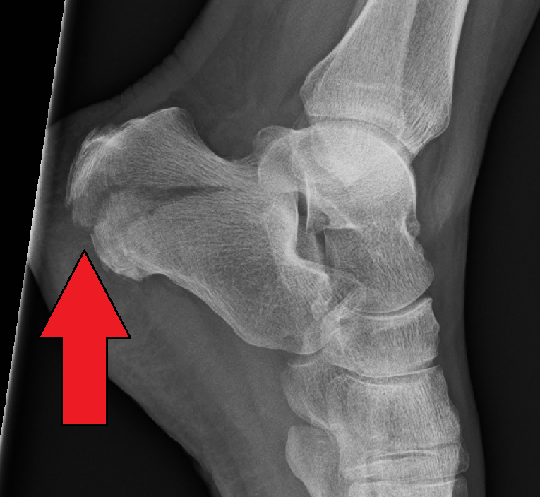
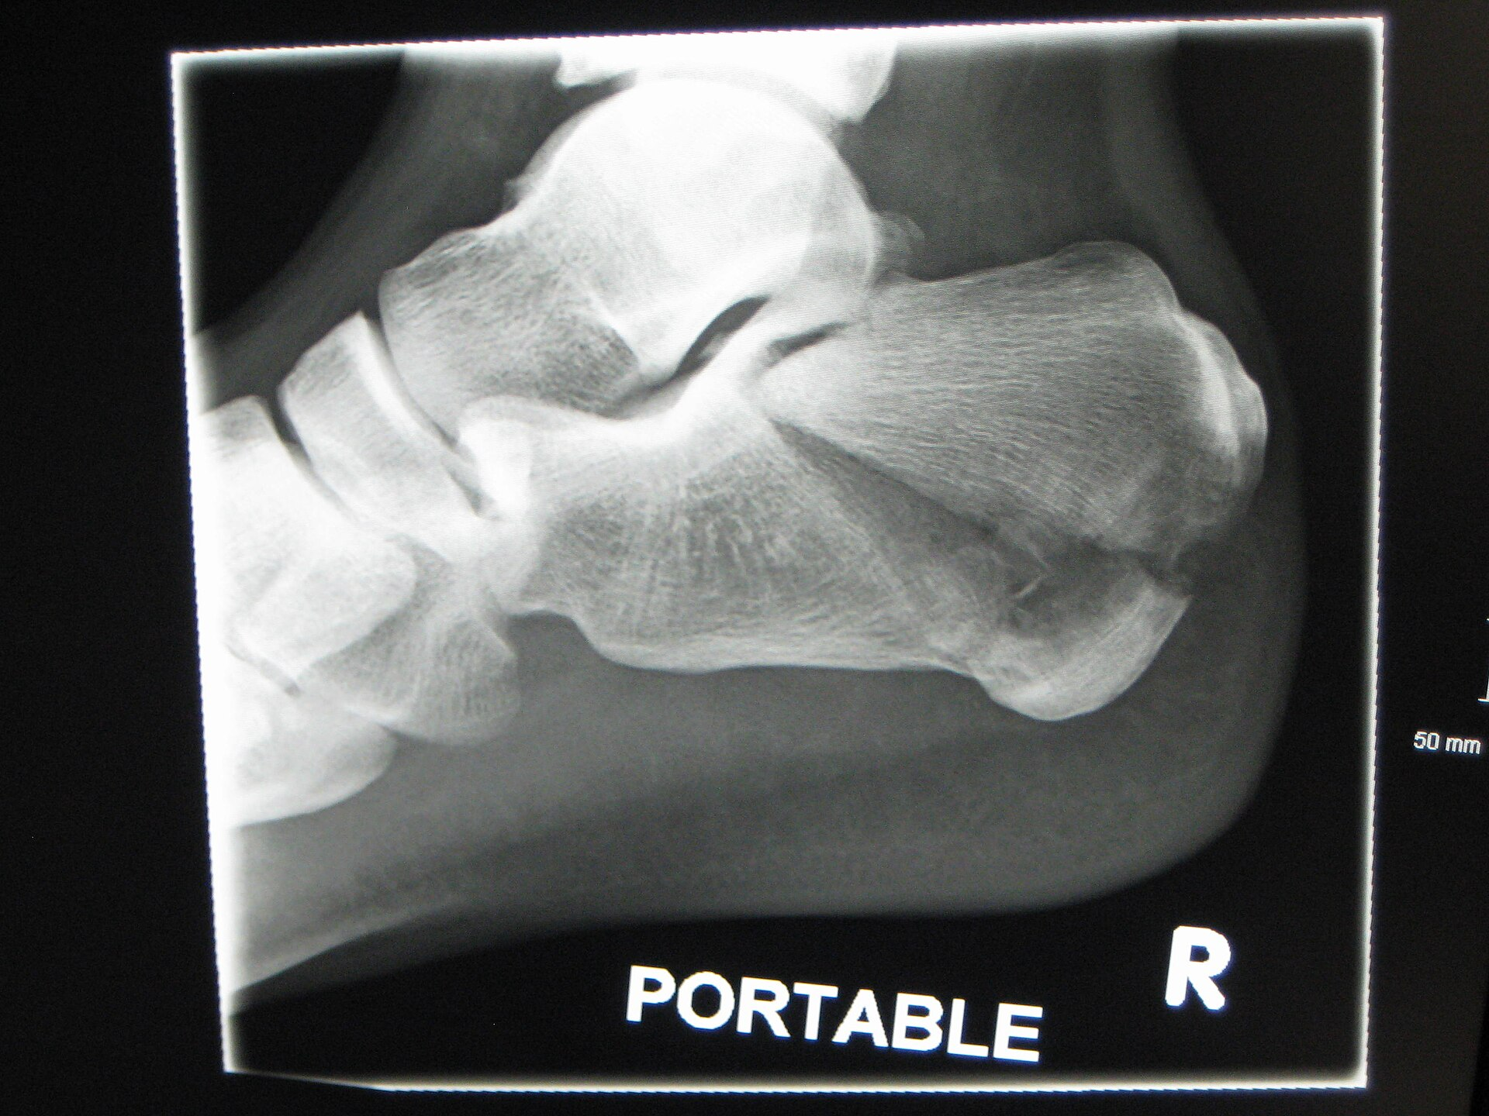
IMAGING
Plain radiographs: views and what to look for
View | How | What it shows
Lateral | Foot neutral, beam on the heel | Böhler and Gissane angles, heel height, facet depression, tongue fragment
Harris axial | Beam 45° cephalad, heel on the plate | Heel width, varus, tuberosity displacement, lateral wall
Broden | Leg internally rotated, beam tilted 10° to 40° | Posterior facet congruity, best used on the table
Anthonsen | Lateral oblique, beam tilted | Sustentaculum and middle facet
AP foot and ankle | Standard views | Calcaneocuboid joint, associated fractures
Lateral views. Arrow: step in the posterior tuberosity. James Heilman · CC BY-SA 4.0
Portable lateral: comminuted, depressed facet, heel height lost. James Heilman · CC BY-SA 3.0
Always image the ankle and the whole foot
Radiographs can under-call the injury, so get a CT for anything intra-articular
Do the spine films for any fall from height
Calcaneum Fractures · Orthopaedics PG Seminar
10

Slide 12
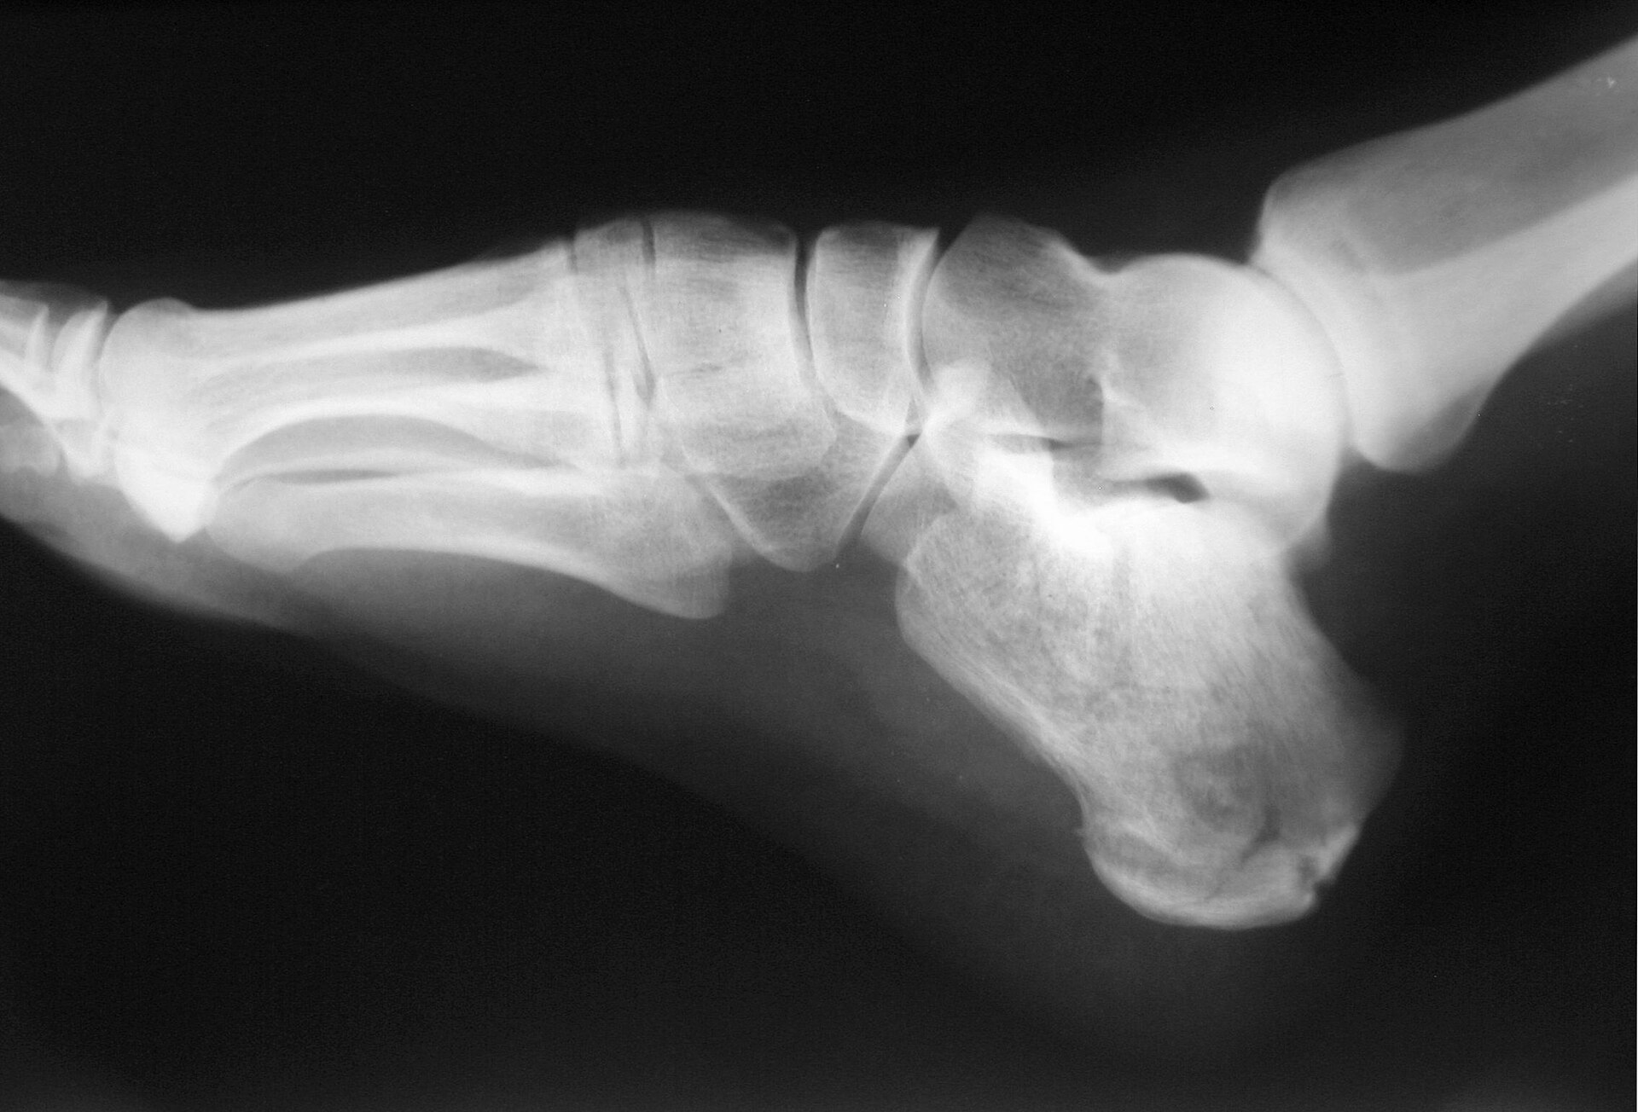
IMAGING
Case gallery: what do you see?
Case 1: posterior tuberosity
Case 2: intra-articular
Case 3: joint depression
Lateral view. Irregular posterior and plantar tuberosity with the posterior facet largely preserved, an extra-articular pattern.
Lateral view. Comminuted fracture with a depressed, rotated facet fragment, a flat Böhler angle and shortened heel.
Lateral view. Step-off at the posterior tuberosity (arrow) with the facet driven into the body.
Jojo · CC BY-SA 3.0
James Heilman · CC BY-SA 3.0
James Heilman · CC BY-SA 4.0
Calcaneum Fractures · Orthopaedics PG Seminar
11

Slide 13
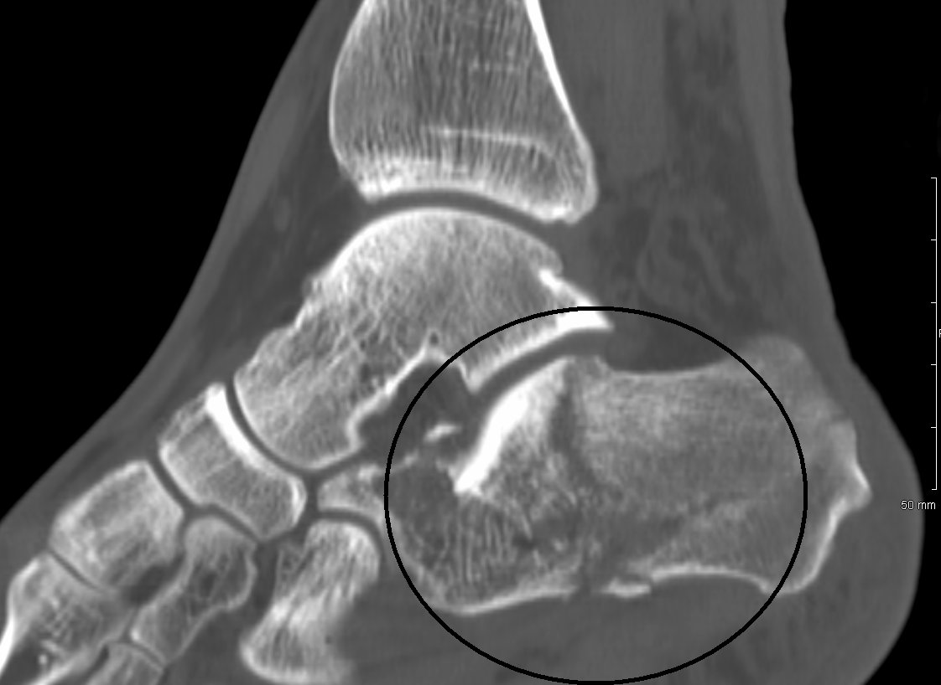
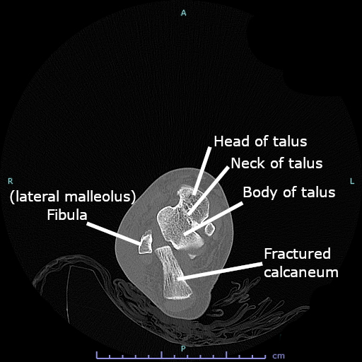
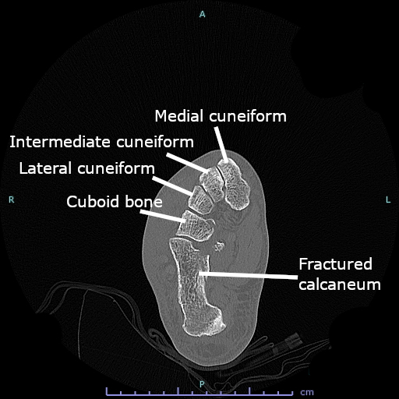
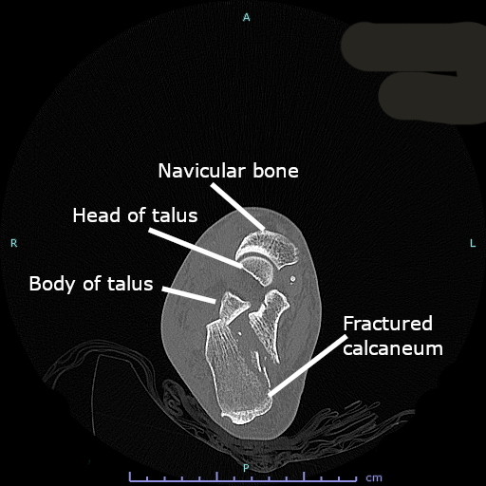
IMAGING
CT is the gold standard for intra-articular fractures
Axial CT at three levels, labelled. Cerevisae · CC BY-SA 4.0
Coronal cuts through the posterior facet: needed for the Sanders class
Axial shows the calcaneocuboid joint, sustentaculum, lateral wall blow-out
Sagittal shows the tongue fragment and facet depression
3D reconstruction helps the surgeon plan reduction
Sagittal CT: fracture through the posterior facet (circled). James Heilman · CC BY-SA 3.0
Calcaneum Fractures · Orthopaedics PG Seminar
12
Notes:
CT: the sagittal reformat shows facet depression and tuberosity position; coronal (perpendicular to the posterior facet) is the one used for Sanders; axial shows the calcaneocuboid joint, sustentaculum and lateral wall.

Slide 14
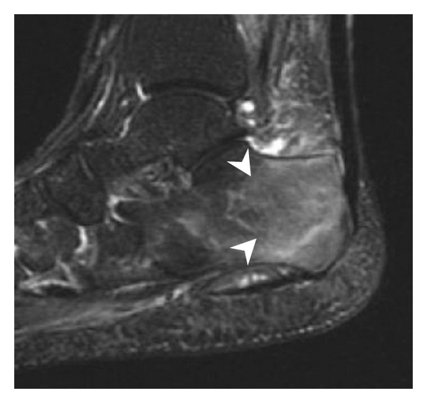
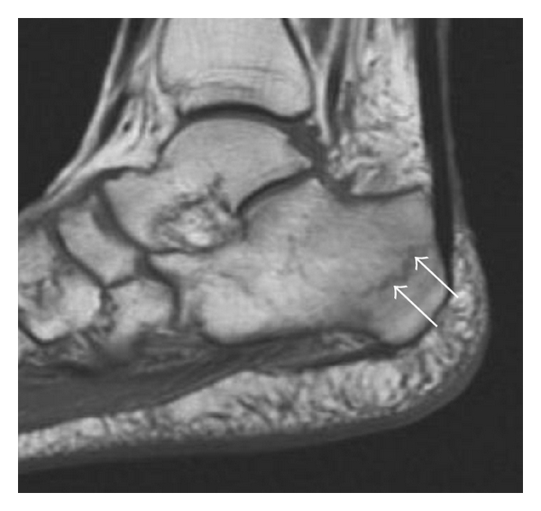
IMAGING
MRI: the problem-solver
When to use it
Occult or stress fracture with normal radiographs
Insufficiency fracture in osteoporosis or diabetes
Suspected osteomyelitis
Peroneal, Achilles or plantar fascia injury
Bone bruise around a talar injury
STIR: marrow oedema (arrowheads). Mohamed Jarraya · CC BY 3.0
T1: low-signal fracture lines (arrows). Mohamed Jarraya · CC BY 3.0
Not used routinely for acute displaced fractures: CT answers the surgical question faster.
Calcaneum Fractures · Orthopaedics PG Seminar
13

Slide 15
CLASSIFICATIONS
Classification systems at a glance
System | Based on | Best used for
Rowe (1963) | Anatomy on radiographs: extra-articular vs intra-articular | Extra-articular fractures
Essex-Lopresti (1952) | Fracture pattern on the lateral view | Mechanism: tongue vs joint depression
Sanders (1993) | Coronal CT through the widest part of the posterior facet | Intra-articular fractures; guides surgery and prognosis
Crosby-Fitzgibbons | CT: displacement and comminution | Simple three-type grouping
AO/OTA 82 | Extra-articular, partial or complete articular | Research and registries
In practice: describe the fracture as extra-articular or intra-articular, name the pattern (tongue or joint depression), and grade the intra-articular fracture by Sanders.
Calcaneum Fractures · Orthopaedics PG Seminar
14

Slide 16
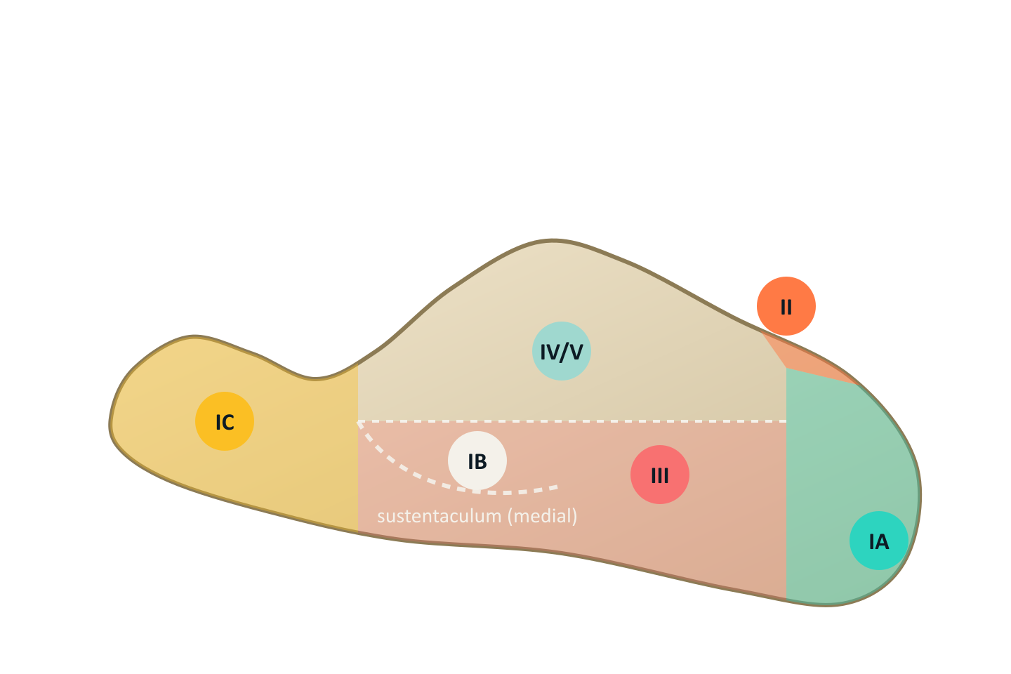
CLASSIFICATIONS
Rowe: extra-articular and intra-articular groups
Type | Fracture | Notes
IA | Tuberosity | Beak and medial process fractures
IB | Sustentaculum tali | Medial; FHL and the tunnel at risk
IC | Anterior process | Inversion injury; mimics ankle sprain
II | Beak or Achilles avulsion | Skin threatened, urgent
III | Body without subtalar joint | Oblique body fracture
IV | Subtalar joint involved | Intra-articular
V | Central depression, comminuted | Worst pattern
Lateral schematic. Tags match the rows of the table.
Most extra-articular fractures with little displacement are treated without surgery. Displaced tuberosity and beak fractures are the exception.
Calcaneum Fractures · Orthopaedics PG Seminar
15

Slide 17
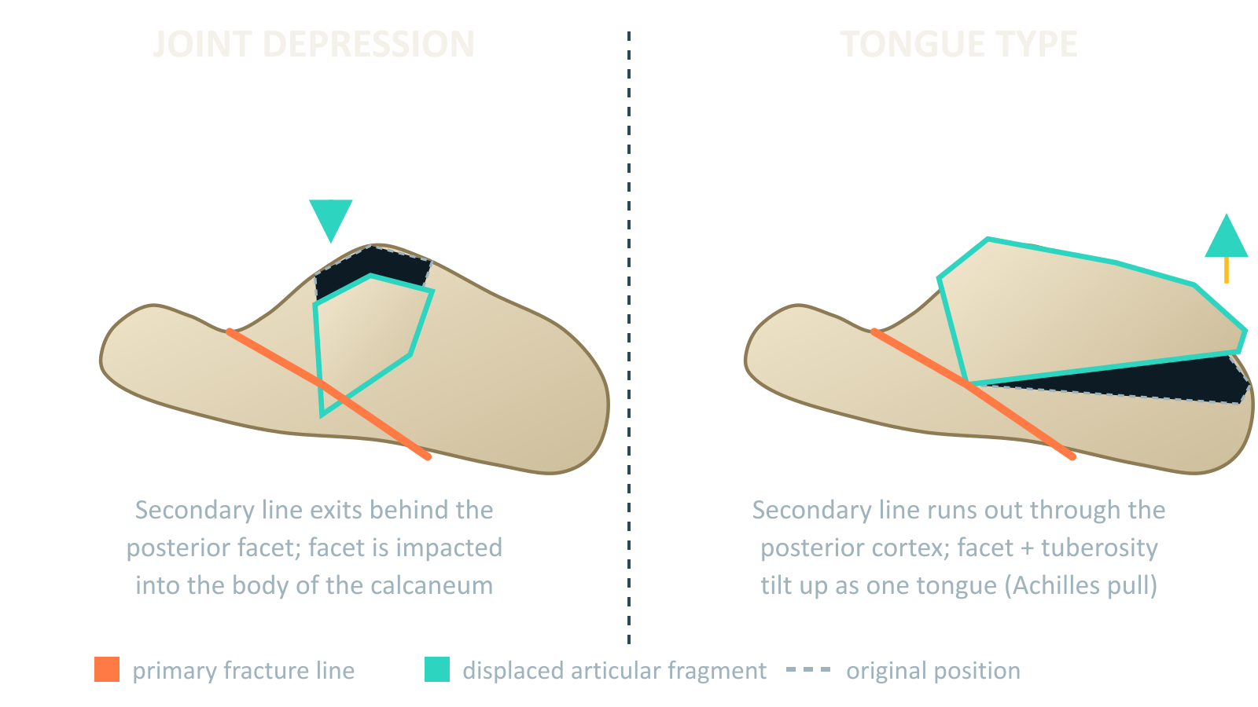
CLASSIFICATIONS
Essex-Lopresti: joint depression vs tongue
Joint depression
Secondary line exits behind the facet
Facet is impacted into the body
Commoner; needs CT for the details
Tongue type
Line runs out of the posterior cortex
Facet and tuberosity tilt up as one tongue
Achilles pull tents the posterior skin: an emergency when skin is at risk
Same primary line in both; only the secondary line differs.
Calcaneum Fractures · Orthopaedics PG Seminar
16
Notes:
The secondary fracture line decides the pattern. Tongue-type: the line exits through the posterior cortex, so the facet and tuberosity move as one piece pulled upward by the Achilles. This tents the skin and is urgent.

Slide 18
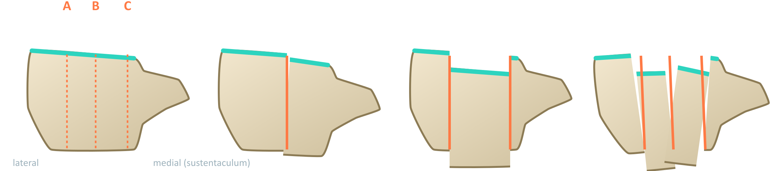
CLASSIFICATIONS
Sanders classification (coronal CT)
Type I
Type II
Type III
Type IV
All fractures <2 mm displaced, however many lines
Two-part fracture of the posterior facet: IIA lateral, IIB central, IIC medial
Three-part with a centrally depressed piece: IIIAB, IIIAC, IIIBC
Four or more parts, comminuted articular surface
Calcaneum Fractures · Orthopaedics PG Seminar
17
Notes:
Sanders: choose the coronal CT slice where the posterior facet is widest. Divide the facet into three columns A, B, C from lateral to medial. Count the articular pieces. Type II is IIA, IIB or IIC by the column of the fracture line. Type III has a centrally depressed piece: IIIAB, IIIAC, IIIBC. Type IV has four or more pieces.

Slide 19
CLASSIFICATIONS
Sanders type and what it means for management
Type | Typical plan | Prognosis
I | Non-operative; functional protocol | Good if the facet is truly undisplaced
II | ORIF if displaced >2 mm (lateral, sinus tarsi or percutaneous) | Best results after anatomic reduction
III | ORIF; expect a depressed central piece to lift and graft | Fair; depends on the quality of the reduction
IV | Consider primary subtalar fusion, or ORIF for height and width | Poorest; late fusion is frequent
Strengths
Limits
Prognostic, reproducible enough to guide surgery, and ties the class to the joint surface.
Ignores the tuberosity, calcaneocuboid joint and lateral wall; inter-observer agreement is only moderate.
Calcaneum Fractures · Orthopaedics PG Seminar
18

Slide 20
CLASSIFICATIONS
Other systems
Other systems
Crosby-Fitzgibbons: I undisplaced, II two-part displaced, III comminuted
AO/OTA 82: A extra-articular, B partial articular, C complete articular
Zwipp (Hannover) score: points for the number of fragments and joints involved
Schmidt-Weiner: the paediatric groups
Calcaneum Fractures · Orthopaedics PG Seminar
19

Slide 21
MANAGEMENT
Management algorithm
Injury: ATLS, spine and limb survey
Elevate, ice, splint, foot pump. CT scan
Open? Compartment? Tongue?
Emergency: wash out, fasciotomy, percutaneous reduction
No: functional non-operative care
Displaced intra-articular, or heel deformed?
Poor host or Sanders IV: non-op or primary fusion
Yes: soft tissues and host fit?
Wrinkle sign present: operate
Timing: operate when swelling settles (about 7 to 14 days, before early consolidation at about 3 weeks)
Calcaneum Fractures · Orthopaedics PG Seminar
20
Notes:
Follow the arrows: display, assess soft tissues and host, decide. Emergency branches are shown in red.

Slide 22
MANAGEMENT
Emergencies: do not wait for the wrinkle sign
1
Open fracture
2
Compartment syndrome
Usually a medial wound
IV antibiotics and tetanus, urgent wash-out
Stabilise (external fixator or wires); definitive fixation when the soft tissues allow
Plan cover early
Tense swelling, pain on passive toe stretch
Measure pressure if unclear
Decompress the foot compartments through a medial and dorsal approach
Untreated: claw toes and fixed contracture
3
Tongue-type with skin threat
4
Neurovascular compromise
Blanched skin over the posterior fragment
Reduce as an emergency (Essex-Lopresti manoeuvre)
Fix percutaneously with screws
Skin necrosis makes later surgery hazardous
Check pulses and plantar sensation
Reduce gross displacement, splint
Vascular opinion for absent pulses
Calcaneum Fractures · Orthopaedics PG Seminar
21

Slide 23
MANAGEMENT
Non-operative treatment
Indications
Protocol
Extra-articular fractures with little displacement
Intra-articular displacement under 2 mm (Sanders I)
Anterior process fractures under a quarter of the calcaneocuboid joint
Poor host: insulin-dependent diabetes, peripheral vascular disease, neuropathy, heavy smoking
Non-ambulatory or medically unfit patients
Severely swollen or blistered soft tissues that do not settle
Days 0 to 14: elevation, ice, compression and a splint
From week 2: remove the splint several times a day for ankle and subtalar range of motion
First 8 to 12 weeks: non-weight-bearing
After that: progressive weight-bearing once callus forms
Footwear: a wide shoe, and expect some heel widening
Counsel: permanent stiffness and later subtalar arthritis are possible
Calcaneum Fractures · Orthopaedics PG Seminar
22

Slide 24
MANAGEMENT
Operative vs non-operative: what the trials say
Buckley 2002 (JBJS Am)
UK Heel Fracture Trial 2014 (BMJ)
Randomised multicentre trial in Canada.
Randomised trial: ORIF vs conservative care.
No difference overall
Surgery favoured: women, younger age, lighter work, not on compensation, isolated injury, low Böhler angle
Non-operative group about 5 times more likely to need later subtalar fusion
No significant difference in patient-reported function at 2 years
More wound complications after surgery
Argues against routine surgery for every displaced fracture
Take-home: choose the patient, not the fracture. Young, otherwise healthy, with a reducible Sanders II or III and good skin gain most from an anatomic reduction.
Calcaneum Fractures · Orthopaedics PG Seminar
23
Notes:
Selection matters more than dogma. The Canadian trial showed subgroup benefit; the UK trial questioned routine surgery.

Slide 25
MANAGEMENT
Operative indications and timing
Indications
Relative contraindications
Intra-articular step-off over 2 mm in the posterior facet
Heel varus over 5° or marked widening
Böhler angle flattened, height lost
Lateral wall blow-out with peroneal impingement
Displaced calcaneocuboid joint fracture
Displaced tongue-type or beak fracture with skin threat
Insulin-dependent diabetes, vascular disease, neuropathy
Heavy smoking or drug misuse
Poor soft tissues: blisters, no wrinkle sign
Elderly, low-demand or non-ambulatory patients
Severe comminution (consider fusion)
Timing
Operate once the swelling has gone, usually 7 to 14 days after injury. The wrinkle test (skin creases when the ankle is dorsiflexed) is the practical guide. Do not leave it beyond about 3 weeks, or early union makes reduction harder.
Calcaneum Fractures · Orthopaedics PG Seminar
24

Slide 26
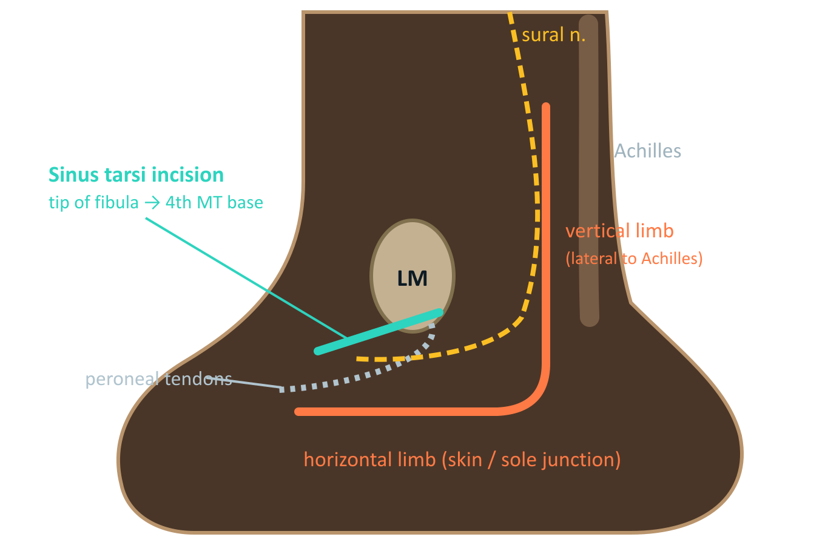
MANAGEMENT
Surgical approaches
Approach | Advantages | Drawbacks
Extensile L (lateral) | Full view of the lateral wall, facet and calcaneocuboid joint | Wound breakdown (about 10 to 25%), sural nerve injury
Sinus tarsi | Small wound, direct facet view, fewer wound problems | Limited view of the tuberosity; needs good fluoroscopy
Medial | Sustentaculum and medial wall | Tibial neurovascular bundle nearby
Percutaneous | Least soft-tissue damage | Blind reduction; only for simpler patterns
Lateral hindfoot. Orange: extensile L. Teal: sinus tarsi. Amber: sural nerve.
Whatever the approach: handle the flap as one layer (no-touch), retract with K-wires, close over a drain, and expect the corner of the L to be the weakest point.
Calcaneum Fractures · Orthopaedics PG Seminar
25
Notes:
Extensile L: vertical limb midway between the fibula and Achilles, then along the skin/sole junction toward the fifth metatarsal base. Full-thickness flap, no-touch. Sinus tarsi: from the tip of the fibula toward the fourth metatarsal base.

Slide 27
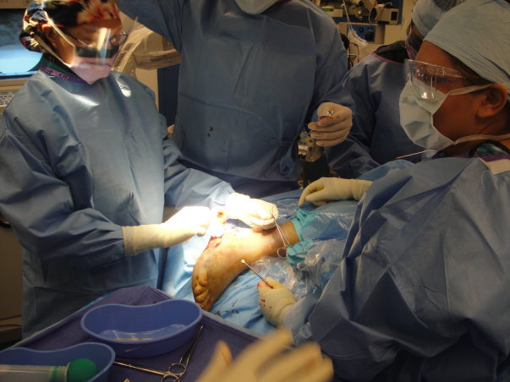
MANAGEMENT
ORIF: step by step
1
Position and prep
2
Expose
Lateral decubitus, tourniquet, image intensifier from above, contralateral views for comparison
Full-thickness flap, K-wires in the fibula and talus to hold it back, protect the sural nerve and peroneals
3
Restore height and varus
4
Reduce the facet
Schanz pin in the tuberosity: pull, correct varus, restore length
Open the lateral wall, lift the posterior facet to the sustentacular fragment, graft the void if needed
Operating theatre. Ladyde12 · Public domain
Check on the image
Böhler angle restored
Broden: congruent facet
Axial: varus corrected
Calcaneocuboid joint
5
Fix
6
Confirm and close
Provisional K-wires, then a lateral plate with screws into the sustentaculum and under the facet
Broden, lateral and axial views; layered closure over a drain; bulky splint
Calcaneum Fractures · Orthopaedics PG Seminar
26
Notes:
Steps: position, exposure, height and varus first (Schanz pin), then the facet, then fix. Confirm with Broden, lateral and axial images before closing.

Slide 28
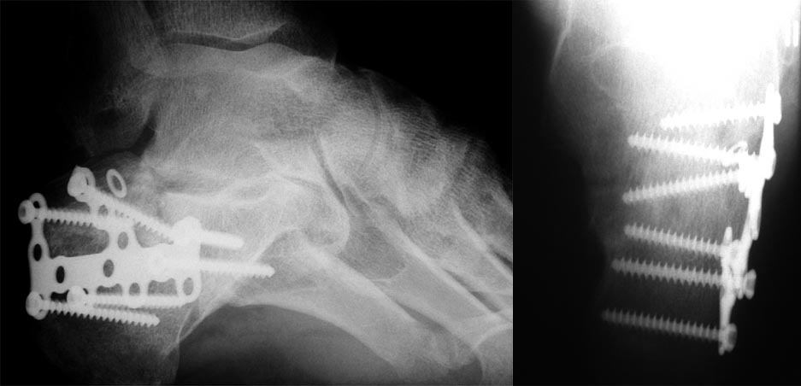
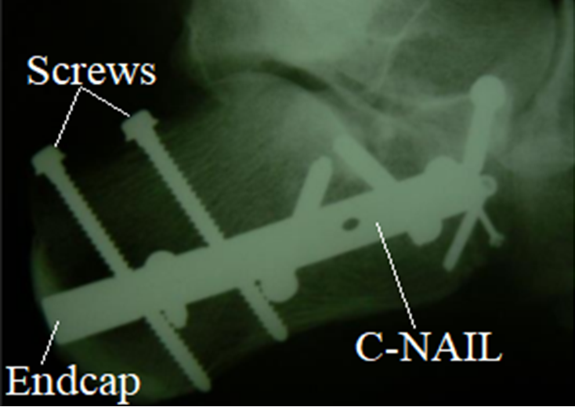
MANAGEMENT
Fixation constructs
Post-operative lateral and axial views: plate and screws. Bran at de.wikipedia · Public domain
Intra-osseous C-nail (percutaneous option). Fry72 Karel Frydrýšek · CC BY-SA 4.0
Plates: low-profile lateral or locking calcaneal plate; screws into the sustentaculum (constant fragment) are the anchor
Screws: subchondral facet screws hold the facet; calcaneocuboid screws only if that joint is displaced
Graft: optional for a large void; not proven to improve outcome
Calcaneum Fractures · Orthopaedics PG Seminar
27

Slide 29
MANAGEMENT
Minimally invasive options
Essex-Lopresti manoeuvre
Sinus tarsi and arthroscopy-assisted
Tongue type: Steinmann or Schanz pin into the tongue fragment from behind
Reduce: plantarflex the forefoot and lever the tongue down and forward
Fix: percutaneous 6.5 to 7.0 mm cannulated screws from the tuberosity into the anterior process
Check: lateral and axial images; facet must be congruent
Best when: the facet is reducible and the skin is at risk
Small oblique incision from the fibular tip toward the fourth metatarsal base
Direct look at the posterior facet, with fluoroscopy for the tuberosity
Fewer wound problems than the extensile L
Best in Sanders II and III with limited comminution
Learning curve: reduction of the tuberosity depends on percutaneous pins
Calcaneum Fractures · Orthopaedics PG Seminar
28

Slide 30
MANAGEMENT
Primary subtalar arthrodesis
Consider when
Technique in brief
Sanders type IV, a facet that cannot be rebuilt
Severe crush with cartilage destruction
Older patients with pre-existing subtalar arthritis
Failed ORIF with a collapsed facet
Restore height, width and varus first
Prepare the subtalar surfaces, bone graft as needed
Fix with two cannulated screws from the calcaneal tuberosity into the talus
Confirm talar declination and heel alignment on the image
Non-weight-bearing until union (about 10 to 12 weeks)
Why fuse at the index operation
One operation instead of two; the correct geometry is set once, and the patient avoids a later salvage.
Calcaneum Fractures · Orthopaedics PG Seminar
29

Slide 31
MANAGEMENT
Post-operative protocol
0 to 2 weeks
2 to 3 weeks
6 weeks
10 to 12 weeks
3 to 6 months
6 to 12 months
1
2
3
4
5
6
Elevate, drain out at 48 h, splint, wound check
Sutures out; start ankle and subtalar range of motion
Radiographs; keep non-weight-bearing
Progress to full weight-bearing when callus shows
Strengthen, gait training, normal footwear
Return to work; heavy labourers later
Remove prominent hardware only for symptoms, after union.
Calcaneum Fractures · Orthopaedics PG Seminar
30

Slide 32
COMPLICATIONS
Complications at a glance
When | Complication | Notes
Early | Wound edge necrosis and dehiscence | About 10 to 25% after an extensile L; smokers and diabetics highest
Early | Deep infection | About 1 to 5%; staphylococcal; hardware often retained until union
Early | Compartment syndrome, sural nerve injury, haematoma | Foot pump and early recognition reduce the risk
Late | Post-traumatic subtalar arthritis | The commonest long-term problem
Late | Malunion: varus, widening, height loss | Peroneal and fibular impingement, stiff foot
Late | Peroneal tendon problems, heel-pad pain, CRPS, hardware pain | Persistent heel pain is common
Calcaneum Fractures · Orthopaedics PG Seminar
31

Slide 33
COMPLICATIONS
Wound complications and infection
Prevention
Superficial edge necrosis
1
Wait for the wrinkle sign
No-touch technique, full-thickness flap
K-wire retraction, not forceps
Layered closure over a drain
Stop smoking; optimise glucose
Dressings, splint, elevation; most heal
Dehiscence with exposed hardware
2
Negative-pressure dressing, debridement, early flap cover
Deep infection
3
Debridement, cultures, IV antibiotics; keep stable hardware until union
Osteomyelitis
4
Radical debridement; hardware out, stabilise, prolonged antibiotics
Calcaneum Fractures · Orthopaedics PG Seminar
32

Slide 34
COMPLICATIONS
Malunion and post-traumatic arthritis
Type | Findings | Treatment
I | Lateral wall exostosis with peroneal impingement, little arthritis | Lateral wall exostectomy, peroneal decompression
II | Subtalar arthritis with acceptable heel alignment | In-situ subtalar arthrodesis
III | Subtalar arthritis with heel varus (about 10° or more) and height loss | Bone-block distraction subtalar arthrodesis (Carr)
Assess before you operate
Counsel the patient
Weight-bearing lateral and axial views: height and varus
CT for the subtalar joint and the lateral wall
Gait, shoe wear, peroneal function
Fusion trades pain for stiffness
Restoring height and alignment matters as much as fusing
Wound healing and smoking status decide the timing
Calcaneum Fractures · Orthopaedics PG Seminar
33
Notes:
Stephens-Sanders classification of calcaneal malunion. Match the operation to the lesion: exostectomy, in-situ fusion, or bone-block distraction fusion.

Slide 35
COMPLICATIONS
Other complications and pearls
1
Peroneal tendon problems
2
Sural neuralgia
3
Heel pad and plantar pain
Trapped, subluxed or torn over a widened lateral wall. Decompress and repair.
Neuroma after the lateral approach. Desensitise, neurolysis or resection.
Fibrofatty pad damage and plantar fascia; cushioned insoles, shoe modification.
4
CRPS
5
Calcaneofibular abutment
6
Non-union
Disproportionate pain, swelling and colour change. Early mobilisation and pain team.
Pain over the lateral malleolus from a widened heel; exostectomy.
Rare; usually in smokers; fix and graft.
Calcaneum Fractures · Orthopaedics PG Seminar
34

Slide 36
SPECIAL SITUATIONS
Special situations
1
Children
2
Stress fracture
3
Achilles avulsion (Rowe II)
Usually extra-articular; remodel well; most are treated in a cast. Adolescents with intra-articular fractures behave like adults.
Runners and recruits: pain on heel squeeze, normal early films. MRI shows oedema; protect until healed.
Posterior beak pulled up by the Achilles; skin threat; fix urgently.
4
Bilateral or polytrauma
5
Diabetes, elderly, neuropathy
6
Open fracture
Prioritise life and limb; stage the feet; consider non-operative for one side.
High wound and infection risk; favour non-operative care or primary fusion.
Wash-out, antibiotics, temporary stabilisation, early cover.
Calcaneum Fractures · Orthopaedics PG Seminar
35

Slide 37
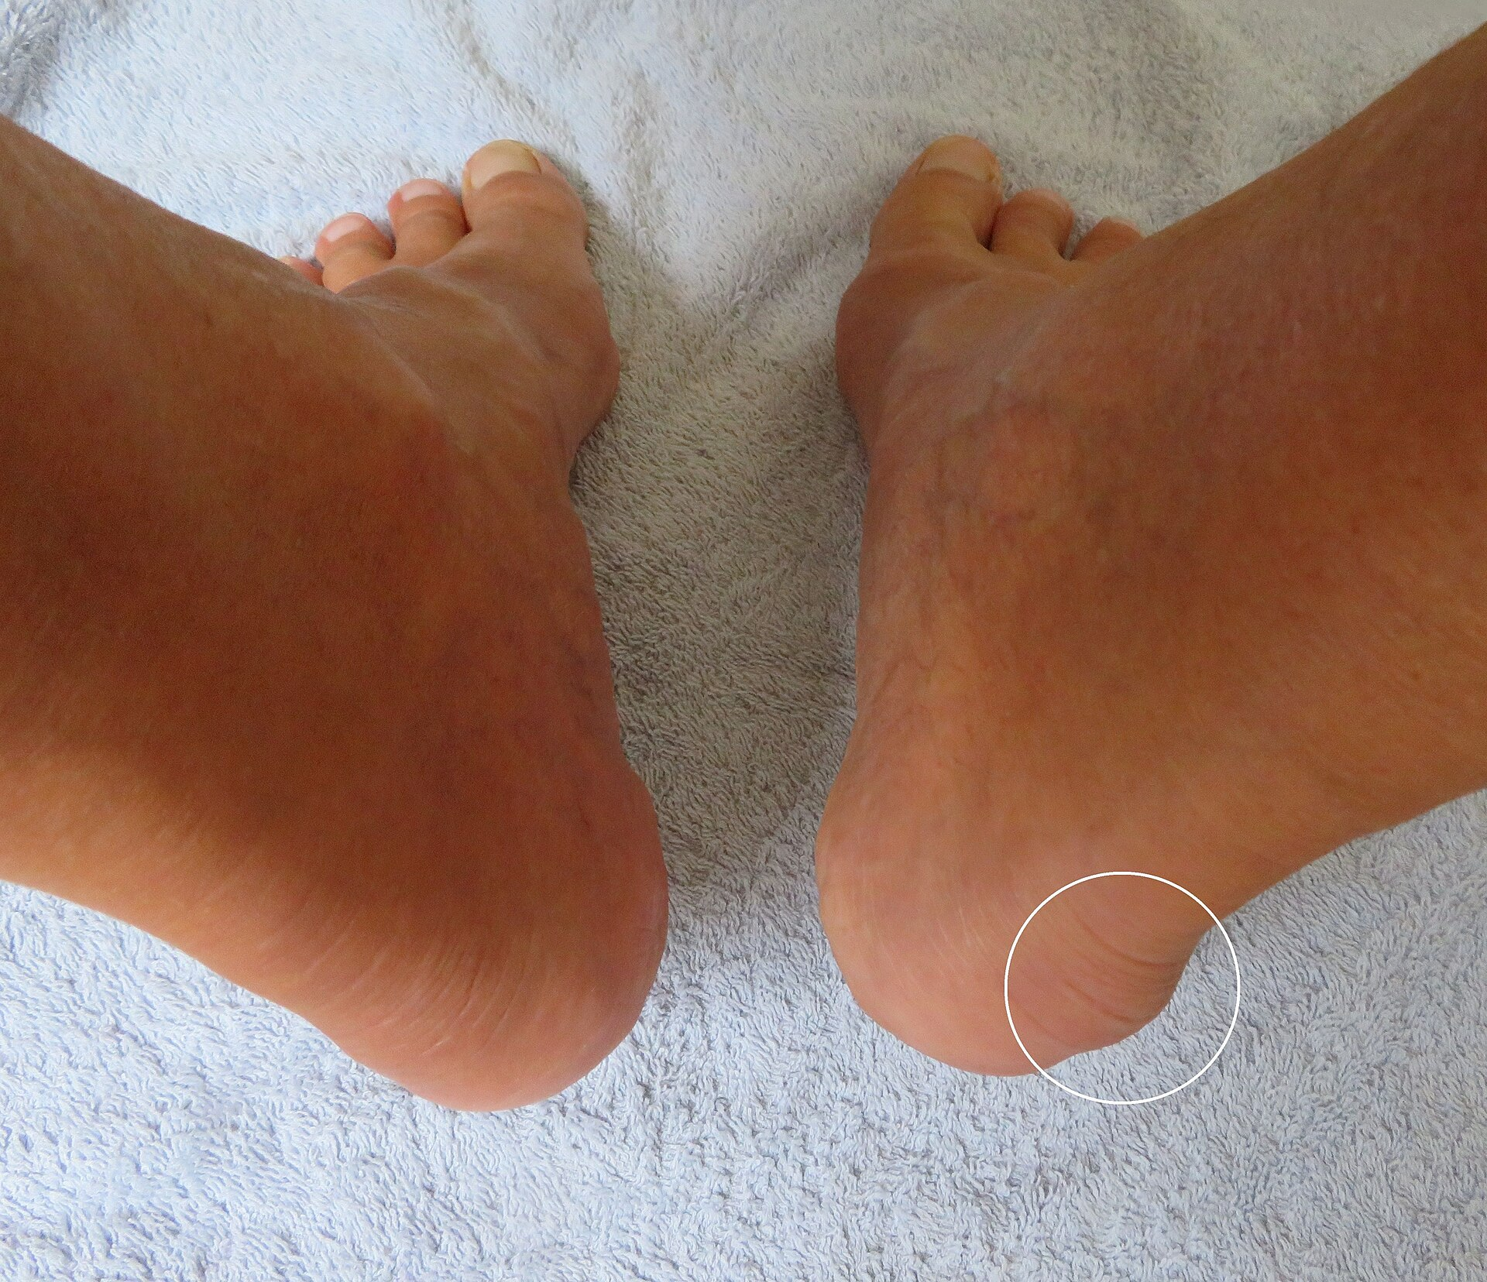
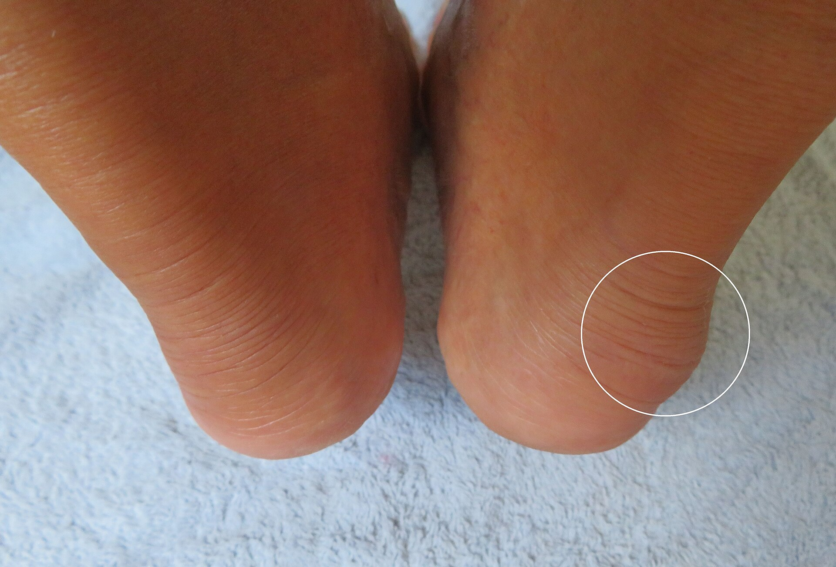
SPECIAL SITUATIONS
Heel mimics: the posterior heel bump
Do not confuse
Haglund: posterosuperior prominence and retrocalcaneal bursitis
Malunited tuberosity or Rowe I fragment
Stress fracture
Plantar fasciitis and heel spur
Sever's disease in children
Haglund's deformity, posterior heel prominence. Sciencia58 · CC0
Same patient, circle marks the prominence. Sciencia58 · CC0
A history of trauma, a positive squeeze test and a fracture line on the film separate a fracture from a chronic prominence.
Calcaneum Fractures · Orthopaedics PG Seminar
36

Slide 38
OUTCOME
Prognostic factors and what to tell the patient
Worse outcome
Better outcome
Sanders type IV; Böhler angle under 0° at presentation
Heavy manual work and workers' compensation
Older age, obesity, smoking, diabetes
Bilateral or polytrauma
Residual step-off, varus or widening
Anatomic reduction of the posterior facet (under 2 mm step)
Restored height and neutral or valgus heel
Younger, non-manual work
Early motion and a compliant patient
Counselling
Even with a good result, expect months off work, some permanent heel pain and stiffness, and possibly a later subtalar fusion. Wide, cushioned footwear helps.
Calcaneum Fractures · Orthopaedics PG Seminar
37

Slide 39
EVIDENCE
Landmarks in calcaneal fracture surgery
Böhler
Rowe
Benirschke and Sangeorzan
Buckley
Böhler's angle and early reduction
146 patients followed long term; anatomic groups
Extensile lateral approach
Randomised trial: subgroups benefit
1931
1963
1993
2002
1
2
3
4
5
6
7
8
1952
1993
1996
2014
Essex-Lopresti
Sanders
Stephens and Sanders
Griffin (UK)
Mechanism and the tongue and joint depression types
Prognostic CT classification
Malunion classification
Randomised trial: no overall benefit at 2 years
Calcaneum Fractures · Orthopaedics PG Seminar
38

Slide 40
EXAM PEARLS
High-yield viva points
Normal Böhler angle?
Constant fragment?
20 to 40°; lower means facet collapse
Sustentacular fragment, tied to the talus by ligaments
Best CT plane for Sanders?
Approach with the sural nerve at risk?
Coronal, through the widest posterior facet
Extensile lateral (L-shaped) approach
Who needs urgent surgery?
Best timing for ORIF?
Open, compartment syndrome, tongue with skin threat
When wrinkle sign appears, about 7 to 14 days
Sanders type with poorest results?
Commonest late complication?
Type IV; think primary subtalar fusion
Post-traumatic subtalar arthritis
Sanders type if nothing is displaced?
Trial message?
Type I: all fragments <2 mm apart, any number of lines
Selected patients gain; routine ORIF for all is not proven
Calcaneum Fractures · Orthopaedics PG Seminar
39

Slide 41
SUMMARY
Take-home messages
1
Anatomy
2
Imaging
The posterior facet, sustentaculum and thin lateral skin dictate everything.
Lateral, axial and Broden films, then a CT for any intra-articular fracture.
3
Classify
4
Decide
Rowe, Essex-Lopresti and Sanders; Sanders type predicts the result.
Choose the patient: soft tissues, host, demand and fracture pattern.
5
Operate late, not last
6
Complications
Wait for the wrinkle sign; hurry only for skin, compartments and open injuries.
Wound, infection, malunion and subtalar arthritis: plan for them.
Calcaneum Fractures · Orthopaedics PG Seminar
40

Slide 42
SOURCES
Image credits and key references
Image | Author | Licence
Calcaneus Fracture | Jojo | CC BY-SA 3.0
FracturedCal2008 | James Heilman | CC BY-SA 3.0
CalcanealfractCT | James Heilman | CC BY-SA 3.0
CalFrac | James Heilman | CC BY-SA 4.0
STIR MRI of of calcaneal fracture | Mohamed Jarraya | CC BY 3.0
T1 MRI of calcaneal fracture | Mohamed Jarraya | CC BY 3.0
CT scan of calcaneal fracture | Cerevisae | CC BY-SA 4.0
CT scan of calcaneocuboid joint with calcaneal fract | Cerevisae | CC BY-SA 4.0
Image | Author | Licence
CT scan of talonavicular joint with fractured calcan | Cerevisae | CC BY-SA 4.0
Bohler's angle | Gilo1969 | CC BY-SA 3.0
Intraoseous calcaneal nail C-Nail - rtg | Fry72 Karel Frydrýšek | CC BY-SA 4.0
Heel with Haglund exotose 1 | Sciencia58 | CC0
Heel with Haglund exotose 2 | Sciencia58 | CC0
Calcfx | Ladyde12 | Public domain
Ferse rs | Bran at de.wikipedia | Public domain
Calcaneus Vue supérieure | Berichard | CC BY-SA 3.0
All images from Wikimedia Commons under the licences shown. The diagrams (angles, fracture lines, Sanders, approaches) were drawn for this deck.
Key references: Essex-Lopresti P, Br J Surg 1952 · Sanders R et al, Clin Orthop 1993;290:87 · Benirschke SK, Sangeorzan BJ, Clin Orthop 1993;292:128 · Stephens HM, Sanders R, Foot Ankle Int 1996 · Buckley R et al, J Bone Joint Surg Am 2002;84:1733 · Griffin D et al, BMJ 2014;349:g4483.
Calcaneum Fractures · Orthopaedics PG Seminar
41

Slide 43
Thanks

