Slide 1
PRACTICE WITH BOOTSTRAP
BY
TEJASWI REDDY KANDULA
RAVICHANDER REDDY GOLI
ROHITH CHITTIMALLA
VIGNESHWAR REDDY LENKALA

Slide 2




RAVICHANDER REDDY GOLI https://github.com/ravichanderreddy-goli
TEJASWI REDDY KANDULA
https://github.com/Teju2404
VIGNESHWAR REDDY LENKALA
https://github.com/vigneshwar6666
ROHITH CHITTIMALLA
https://github.com/rohith0696

Slide 3
WHAT IS BOOTSTRAP?
Bootstrap is a free front-end framework for faster and easier web development.
Bootstrap is famous for being developed with components that have the ability to follow the property of responsive designs.
Responsive Design is about using CSS and HTML to resize, hide, enlarge, or move the content to make it look good on any screen.
They provide additional user interface elements such as dialog boxes, tooltips.

Slide 4
Use of bootstrap
Easy to use
Responsiveness
Speed of the development
Customizable bootstrap
Consistency
Support
Packaged JavaScript components
Simple integration
Grid
Pre-styled components

Slide 5
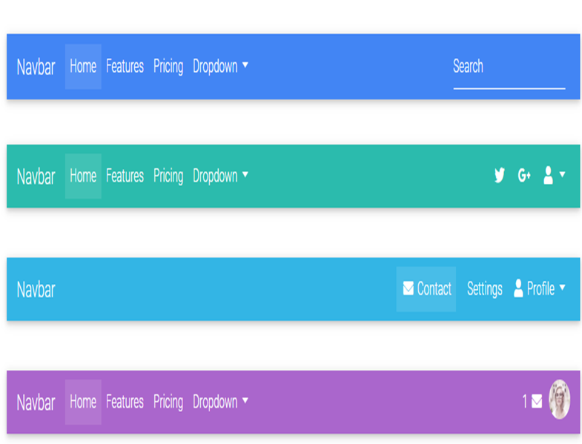
Bootstrap navbar
Documentation and examples for bootstrap powerful, responsive navigation header, the Navbar. It includes support for branding navigation and more, including support for our collapse plugin.

Slide 6

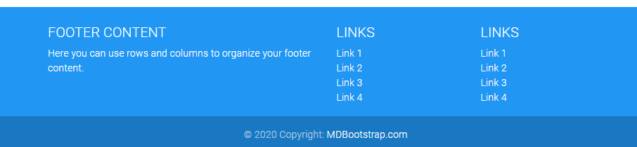
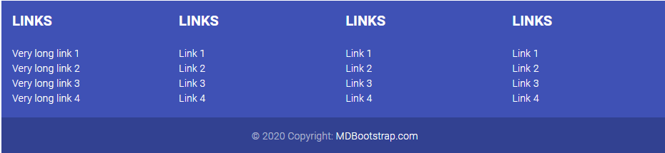

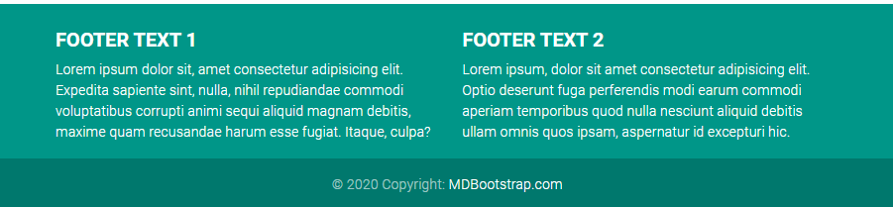
Bootstrap footer

Slide 7
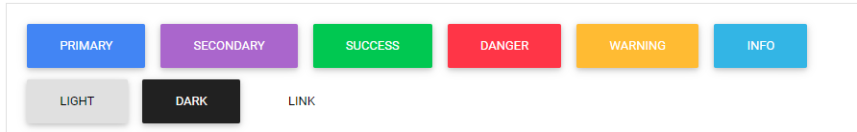
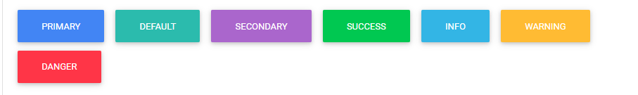
BOOTSTRAP BUTTONS
Examples:

Slide 8
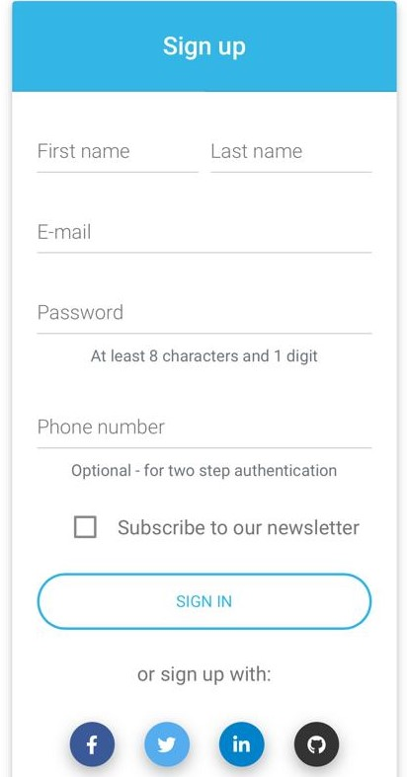
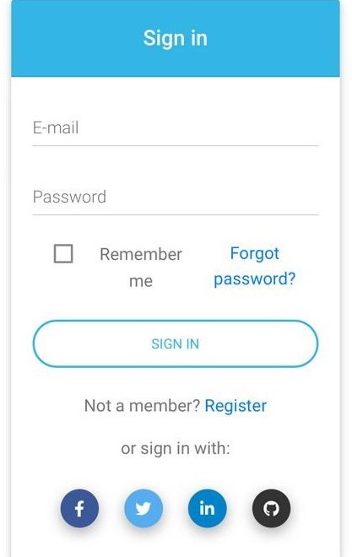
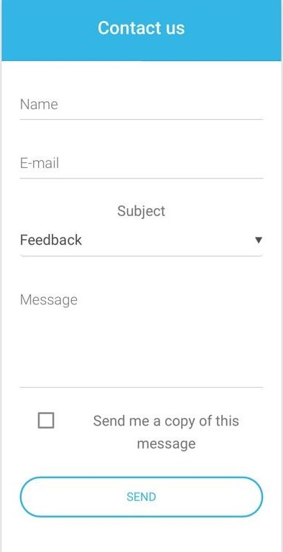
BOOTSTRAP FORMS

Slide 9
Bootstrap versus css
CSS
A style sheet language used for describing the presentation of a document written as HTML.
There is no grid system.
Has CSS 1,2,3 versions.
Helps to create presentable web pages.
BOOTSTRAP
A free and open source front end framework for designing websites and web applications.
Provides a grid system, which creates a page layout through a series of rows and columns.
Has Bootstrap 3,4 versions.
Helps to create responsive designs that are more presentable.

Slide 10
Bootstrap versus html
BOOTSTRAP
Bootstrap is HTML, CSS and JavaScript open-source framework.
Using bootstrap we can create responsive, mobile first websites or web applications.
HTML
HTML is the standard markup language for creating webpages and web applications.
HTML is the markup language that web browsers used to interpret and compose text , images and other material into visual web pages.

Slide 11
Versions of bootstrap
Bootstrap 1 was developed by Mark Otto and Jacob Thornton as open source project on August 19, 2011.
Bootstrap 2 was released on January 31, 2012 for built in support to several components.
Bootstrap 3 was released on August 19, 2013. It is used to redesign components to use flat design and mobile first approach.
Bootstrap 4 was announced on October 29, 2014 by Mark Otto.
Bootstrap 5 is the upcoming major version of the framework.

Slide 12
HISTORY
Bootstrap was initially developed by former Twitter employees Mark Otto and Jacob Thornton to improve consistency and efficiency.
Mark Otto announced Bootstrap 4 on October 29,2014. The first alpha version of bootstrap 4 was released on August 19,2015. The first beta version was released on August 10,2017.
Bootstrap was released as an open source project on GitHub and quickly became the most popular repository on the platform.

Slide 13
REFEReNCES
https://www.tutorialrepublic.com/twitter-bootstrap-tutorial/
https://getbootstrap.com/docs/4.4/getting-started/introduction/
https://mdbootstrap.com/

Slide 14


