Slide 1
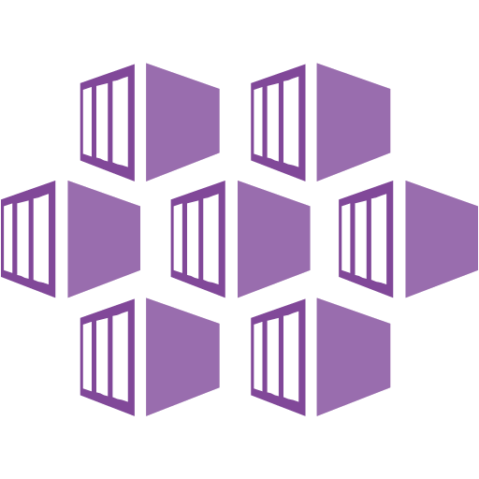

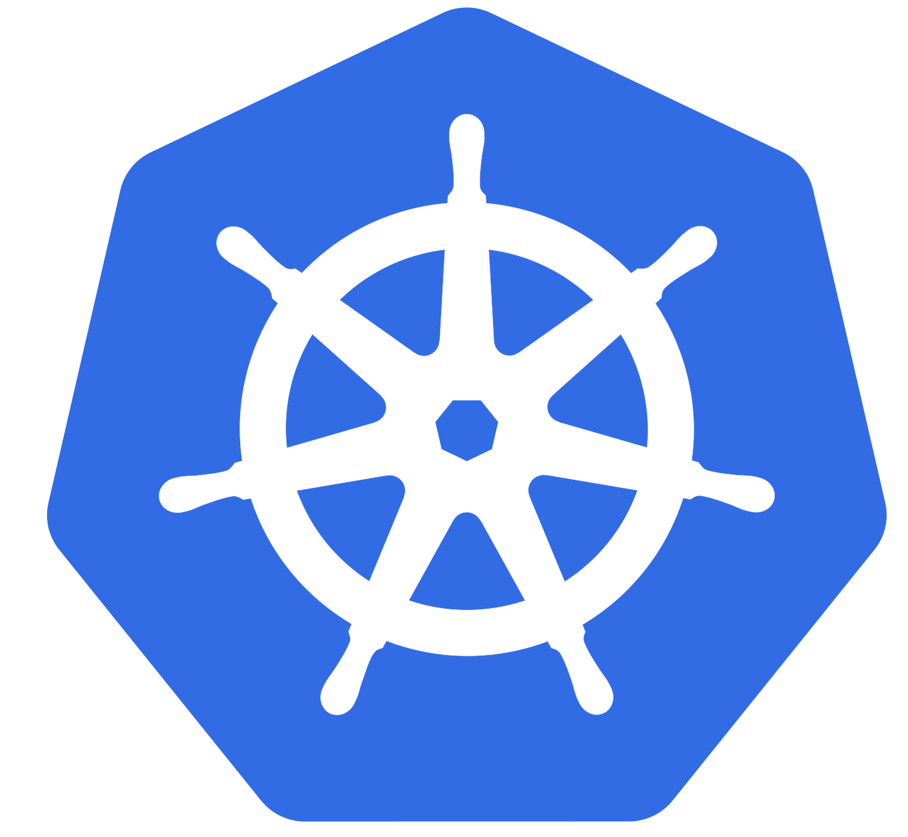
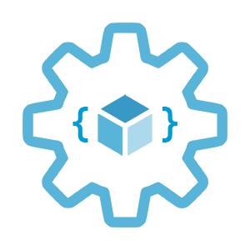

WiFi: ensoGuests
Pwd: Amiga500
Kubernetes 101
eRate edition
Enso and Infrastructure as Code User Group Oslo
29.06.2022
Evgeny Borzenin

Slide 2
Agenda
09:00 – welcome and some practicalities
09:10 – Working with labs
10:30 – Coffee break
10:40 – Working with labs
12:00 – Lunch
13:00 – Working with labs
14:30 – Coffee break
14:40 – Working with labs
15:45 – QA
16:00 – social with beers
17:30 – end of workshop

Slide 3


About myself
Evgeny Borzenin
Consultant at Enso
Microsoft Azure MVP
Azure Certified Solutions Architect Expert
Infrastructure as Code Usergroup Oslo

Slide 4
Infrastructure as Code User Group workshops
AKS workshops roadmap:
[x] AKS and Kubernetes 101
[x] Advanced AKS configuration
[x] Implement Immutable AKS Infrastructure on Azure with Bicep
[x] GitOps in AKS with Flux
[x] Scaling options for applications and clusters in AKS
[x] Monitoring options in AKS
[ ] Service mesh in AKS with linkerd
[ ] Security in AKS
https://github.com/evgenyb/aks-workshops

Slide 5
Practical information
Mix of slides and labs with focus on labs
Let’s help each other, the one who finished earlier can help others
Keep the same resource names as in labs -> easier to troubleshot
Feel free to contribute with PR to the labs content by fixing gramma, typos, wrong commands etc…
Labs are available after the event
Cluster(s) can be available after the event for some time by request

Slide 6
Workshop theoretical blocks
Kubernetes and AKS introduction (10 min)
Introduce our "guinea pig" app
Pods, Namespaces
Kubernetes Resource Management
Readiness and Liveness probes
Kubernetes Deployments
Services, Labels, Selectors
Configmaps and secrets
Kubernetes Ingress
Scaling options in Kubernetes
Kubernetes Event-driven Autoscaling KEDA
GitOps with Flux (optional)

Slide 7
Workshop labs
Lab-01 connecting to AKS cluster
Lab-02 Setting up your shell (powershell and zsh/bash) for better AKS/kubectl experience
Lab-03 Containerizing your application
Lab-04 Creating, managing and testing pods
Lab-05 Working with namespaces
Lab-06 Working with Kubernetes Resource Management
Lab-07 Configuring Readiness and Liveness probes
Lab-08 Deployments
Lab-09 Creating and Managing Services
Lab-10 Working with ConfigMaps and secrets
Lab-11 Configuring ingress with nginx
Lab-12 Scale applications manually
Lab-13 Use Horizontal Pod Autoscaling (HPA) to automatically scale applications

Slide 8
Kubernetes and AKS introduction

Slide 9
What is Kubernetes (k8s)?
Kubernetes is a Container Management and Orchestration System and Cluster technology
Manage applications, not machines
Open source, open API container orchestrator
Inspired by Google’s experiences and internal systems
Greek for pilot or Helmsman – the person who steers a ship
Kubernetes -> k(ubernete)s -> len(ubernete) = 8 -> k8s
Notes:
Kubernetes is a portable, extensible open-source platform for managing and orchestrating containerized workloads.
Kubernetes abstracts away complex container management tasks and provides you with declarative configuration to orchestrate containers in different computing environments.
Container management is the process of organizing, adding, removing, or updating a significant number of containers.
A container orchestrator is a system that automatically deploys and manages containerized apps.
Kubernetes provides an open, pluggable API that can work with containers across multiple cloud providers.
Kubernetes is based on learnings from how Google itself has been running applications and containers, internally.
3 Google employee in 2014 and in production v1 in 2015
These learnings have given rise to new primitives, new ways of looking at orchestrating the cloud in order to abstract away the underlying machines. So that you can Manage applications, not machines

Slide 10
Kubernetes benefits
Self healing
Dynamic scaling
Rolling updates
Notes:
Self-healing of containers. An example would be restarting containers that fail or replacing containers.
Scaling deployed container count up or down dynamically, based on demand.
Automation of rolling updates and rollbacks of containers.
Management of storage.
Management of network traffic.
Storage and management of sensitive information, such as usernames and passwords.

Slide 11
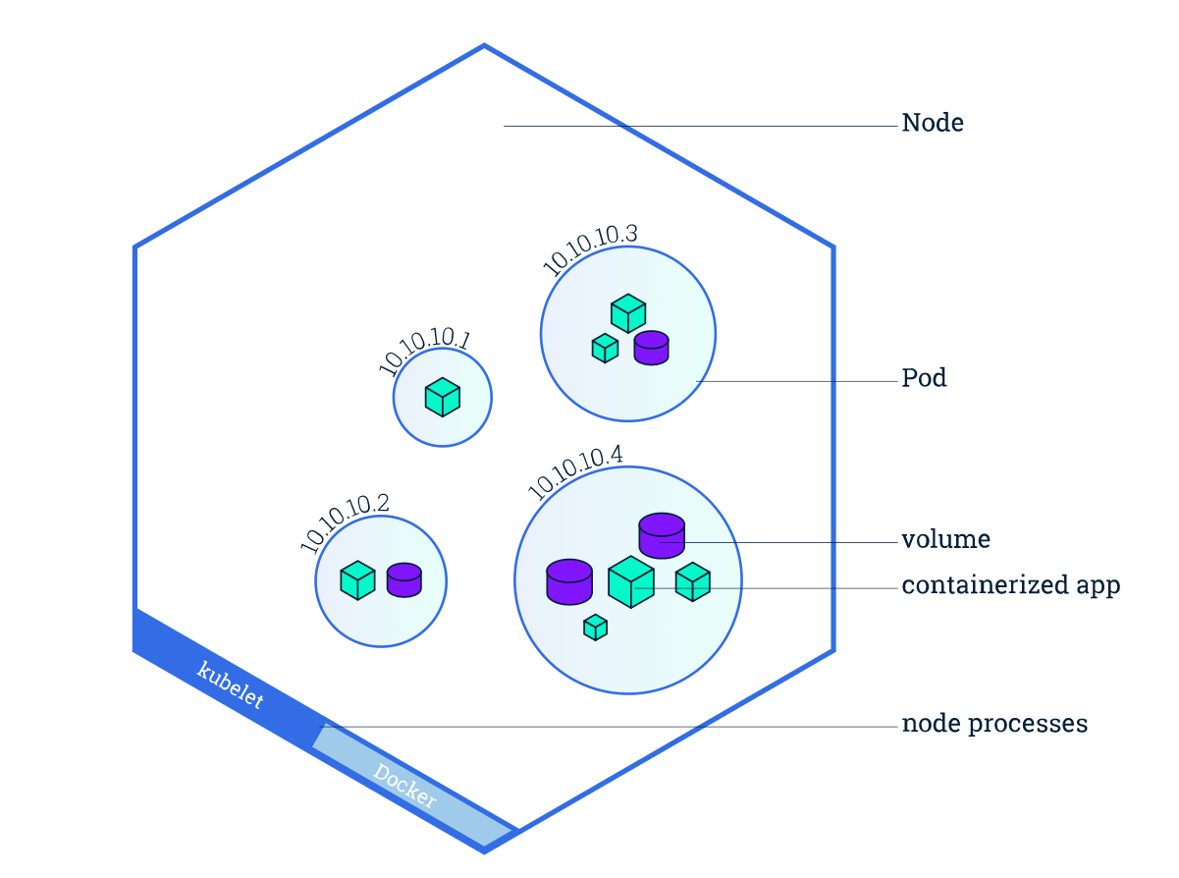
Kubernetes concepts
Cluster
Nodes
Pods
Desired state (Imperative vs. Declarative)
Deployments
Services and Ingress
Image from https://kubernetes.io/docs/tutorials/kubernetes-basics/explore/explore-intro/

Slide 12
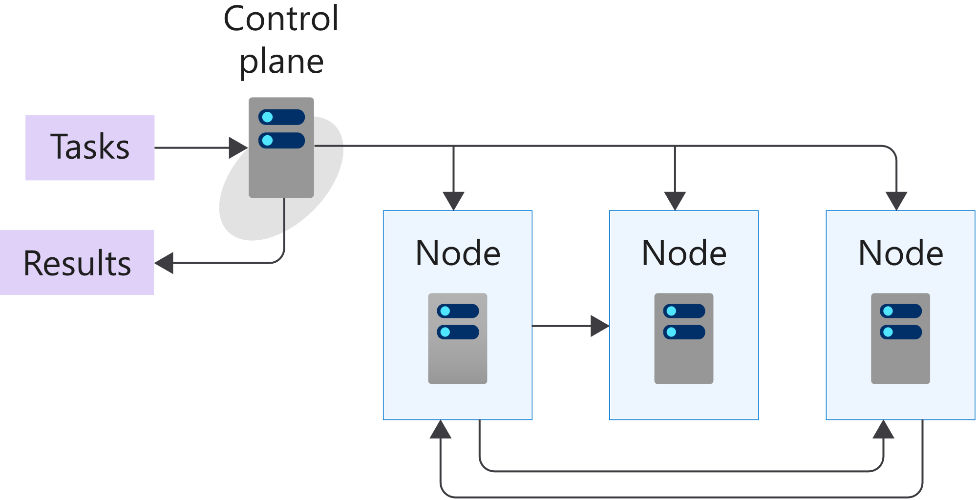
K8s 101: Cluster and Nodes
Azure-managed
Nodes are machines (VM) in your cluster
Nodes are where your workloads run
Nodes can come and go
Customer-managed
Image from https://docs.microsoft.com/en-us/learn/modules/intro-to-kubernetes/3-how-kubernetes-works
Notes:
A cluster is a set of computers that you configure to work together and view as a single system. The computers configured in the cluster will typically do different type of tasks. For example, they'll host websites, APIs, or run compute-intensive batches.
A cluster uses centralized software that's responsible for scheduling and controlling these tasks. The computers in a cluster that run the tasks are called nodes, and the computers that run the scheduling software are called control planes.
A node in a Kubernetes cluster is where your compute workloads run.
Each node communicates with the control plane via the API server to inform it about state changes on the node.

Slide 13
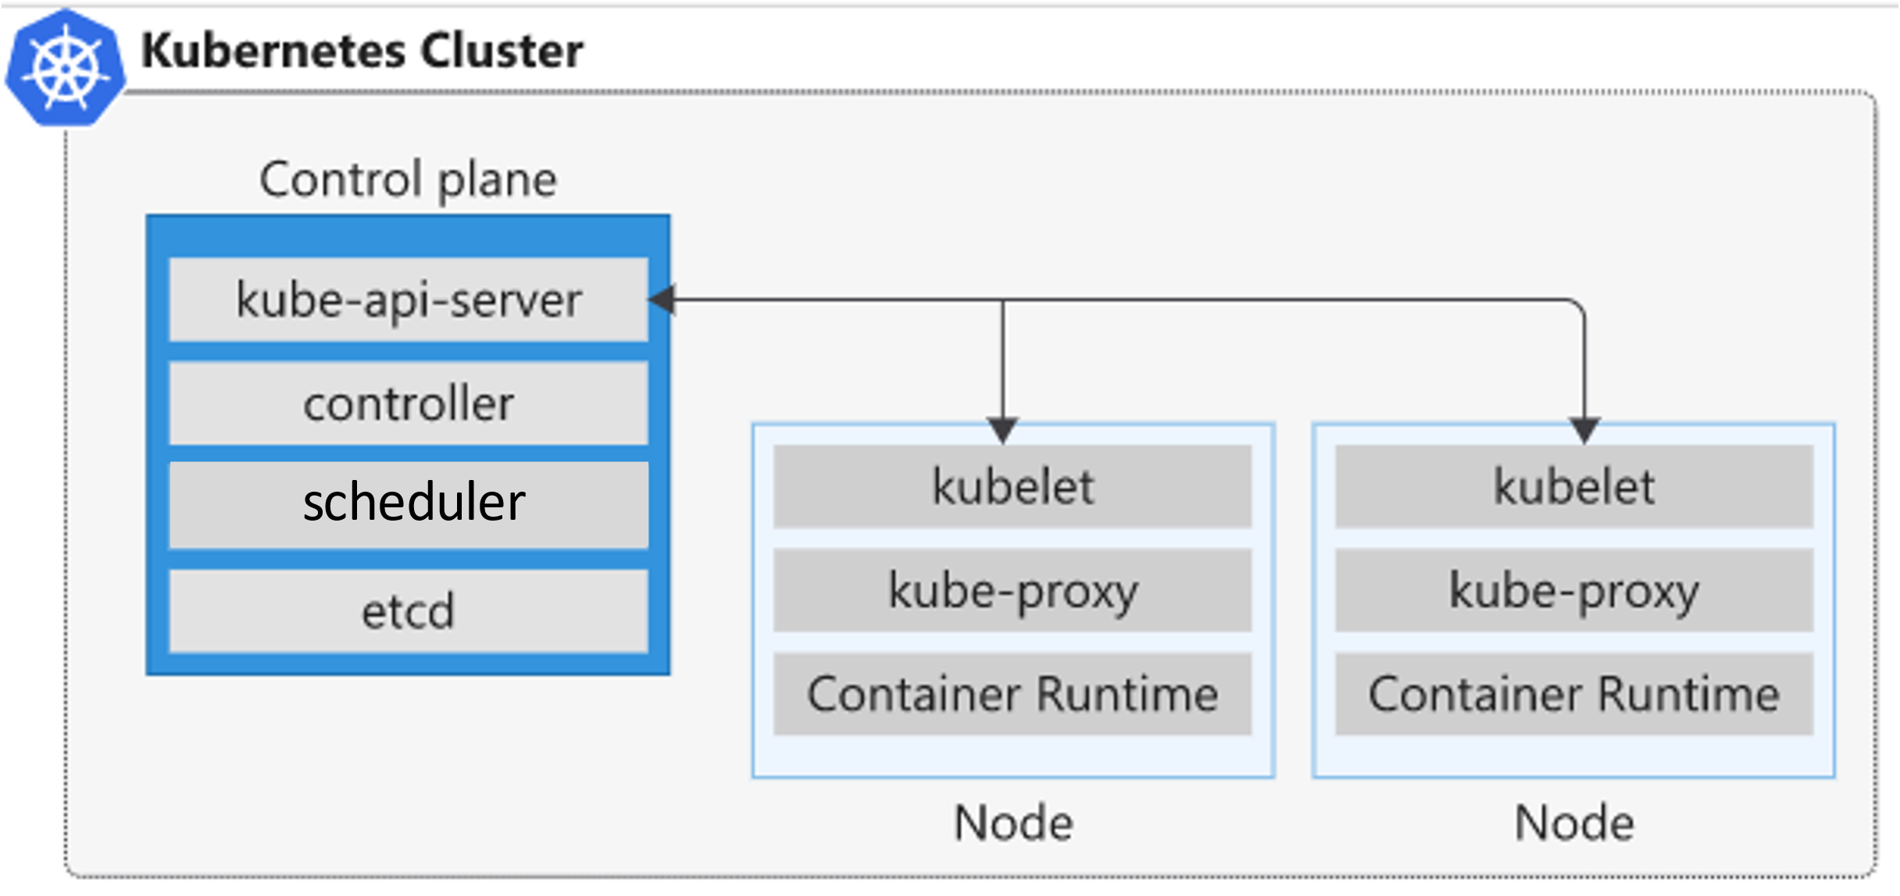
K8s 101: Nodes
Control plane node
API server
Backing store (etcd)
Scheduler
Controller manager
Node
Kubelet
Kube-proxy
Container runtime
Image from https://docs.microsoft.com/en-us/learn/modules/intro-to-kubernetes/3-how-kubernetes-works
Notes:
API server
You can think of the API server as the front end to the control plane in your Kubernetes cluster. All the communication between the components in Kubernetes is done through this API.
This component provides the interaction for management tools, such as kubectl
etcd - highly available, distributed, and reliable key/value store within Kubernetes
This key-value store stores the current state and the desired state of all objects within your cluster.
kube-scheduler - When you create or scale applications, the Scheduler determines what nodes can run the workload and starts them.
The scheduler is the component that's responsible for the assignment of workloads across all nodes. The scheduler monitors the cluster for newly created containers and assigns them to nodes.
kube-controller-manager - The Controller Manager oversees a number of smaller Controllers that perform actions such as replicating pods and handling node operations.
The controller communicates with the API server to determine the state of the object. If the current state is different from the wanted state of the object, then the controller will take action to ensure the wanted state.
Assume that one of three containers running in your cluster stops responding and has died. In this case, a controller decides whether you need to launch new containers to ensure that your apps are always available. If the desired state is to run three containers at any time, then a new container is scheduled to run.
kubelet
The kubelet is the agent that runs on each node in the cluster, and monitors work requests from the API server. It makes sure that the requested unit of work is running and healthy.
The kubelet monitors the nodes and makes sure that the containers scheduled on each node run, as expected.
kube-proxy
The kube-proxy component is responsible for local cluster networking and runs on each node. It ensures that each node has a unique IP address. It also implements rules to handle routing and load balancing of traffic by using iptables and IPVS.
container runtime
The container runtime is the underlying software that runs containers on a Kubernetes cluster. The runtime is responsible for fetching, starting, and stopping container images. Kubernetes supports several container runtimes, including but not limited to Docker, rkt, CRI-O, containerd, and frakti.

Slide 14

K8s 101: Nodes
Nodes are machines (VM) in your cluster
Nodes are where your workloads run
Nodes can come and go
Node1
Node2
Node3
Notes:
A node in a Kubernetes cluster is where your compute workloads run.
Each node communicates with the control plane via the API server to inform it about state changes on the node.

Slide 15
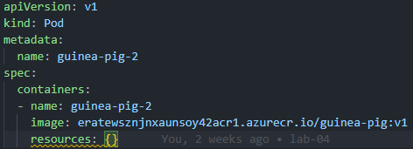
K8s 101: Pods
Pod is the smallest object that you can create
A single Pod can hold a group of one or more containers
Node1
Node2
Node3
pod
pod
pod
pod
app-a
app-b
app-b
app-a
app-d
Notes:
Unlike in a Docker environment, you can't run containers directly on Kubernetes.
You package the container into a Kubernetes object called a pod. A pod is the smallest object that you can create in Kubernetes.
A single pod can hold a group of one or more containers. However, a pod typically doesn't contain multiples of the same app.
You use Kubernetes pod templates to define the information about the pods that run in your cluster.
Pod templates are YAML-coded files
A pod includes information about the shared storage and network configuration, and a specification about how to run its packaged containers.

Slide 16
K8s 101: Desired State
Imperative vs. Declarative - tell Kubernetes what you want, not what to do
Kubernetes always tries to steer the cluster to its desired state
You: “Hey, k8s, I want 3 replicas of app-a”
K8s: “Here are 3 replicas of app-a”
K8s: “Upps, one replica just died, I will try to find a node where I can spin up a new replica”
K8s: “Here are 3 replicas of app-a”
Notes:
(Imperative vs. Declarative)
One of the core concepts of Kubernetes - Desired State. Tell Kubernetes what you want, not what to do.

Slide 17
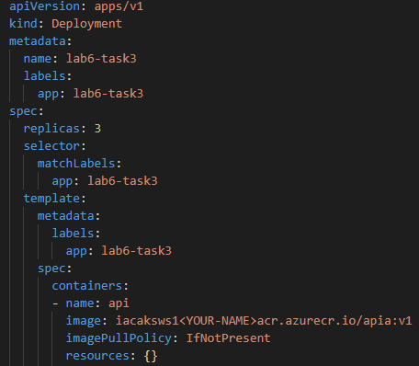
K8s 101: Deployment
Pod templates
Replica Sets
Deployments
Notes:
There are several options to manage the deployment of pods in a Kubernetes cluster
A pod template enables you to define the configuration of the pod you want to deploy.
The template contains information, such as the name of container image, and which container registry to use to fetch the images.
The template may also include runtime configuration information, such as ports to use.
Templates are defined by using YAML.
You can use templates to deploy pods manually. However, a manually-deployed pod isn't relaunched after it fails, is deleted, or is terminated.
To manage the lifecycle of a pod, you need to create a higher-level Kubernetes object.
A replica set uses pod templates and defines a specified number of pods that must run
A deployment creates a management object one level higher than a replica set and enables you to deploy and manage updates for pods in a cluster.

Slide 18
K8s 101: Deployment
Deployments are requirements you give to Kubernetes regarding your applications (Pods)
k8s: I need 2 replicas of app-a and 3 replicas of app-b
Node1
Node2
Node3
pod
pod
pod
pod
pod
app-a
app-b
app-b
app-a
app-b

Slide 19
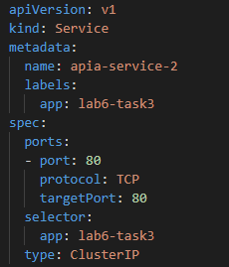
K8s 101: Services
Service is an abstract way to expose an application running on a set of Pods
A Service has a name and maps to a dynamic set of Pods defined by a label selector
service-a
service-b
Node1
Node2
Node3
pod
pod
pod
pod
pod
app-a
app-b
app-b
app-a
app-b
Notes:
A Kubernetes service is a Kubernetes object that provides stable networking for pods. A Kubernetes service enables communication between nodes, pods, and users of your app, both internal and external, to the cluster.

Slide 20

Azure Kubernetes Service (AKS)
+
=
Notes:
Azure Kubernetes Service (AKS) is a managed Kubernetes offering that simplifies container-based application deployment and management.
Azure Kubernetes Service (AKS) provides a managed Kubernetes service that reduces the complexity for deployment and core management tasks, including coordinating upgrades.

Slide 21
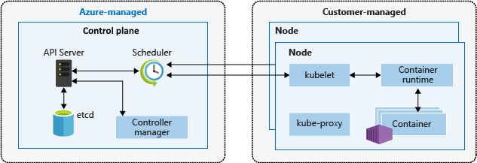
AKS cluster architecture
Image from https://docs.microsoft.com/en-us/azure/aks/concepts-clusters-workloads
Notes:
The AKS control plane is managed by the Azure platform, and you only pay for the AKS nodes that run your applications. AKS is built on top of the open-source Azure Kubernetes Service Engine (aks-engine).
When you create an AKS cluster, a control plane is automatically created and configured. This control plane is provided as a managed Azure resource abstracted from the user. There's no cost for the control plane, only the nodes that are part of the AKS cluster.
API server
You can think of the API server as the front end to the control plane in your Kubernetes cluster. All the communication between the components in Kubernetes is done through this API.
This component provides the interaction for management tools, such as kubectl or the Kubernetes dashboard.
etcd - highly available, distributed, and reliable key/value store within Kubernetes
The backing store is a persistence store that your Kubernetes cluster uses to save the complete configuration of a Kubernetes cluster
This key-value store stores the current state and the desired state of all objects within your cluster.
kube-scheduler - When you create or scale applications, the Scheduler determines what nodes can run the workload and starts them.
The scheduler is the component that's responsible for the assignment of workloads across all nodes. The scheduler monitors the cluster for newly created containers and assigns them to nodes.
kube-controller-manager - The Controller Manager oversees a number of smaller Controllers that perform actions such as replicating pods and handling node operations.
The controller communicates with the API server to determine the state of the object. If the current state is different from the wanted state of the object, then the controller will take action to ensure the wanted state.
Assume that one of three containers running in your cluster stops responding and has died. In this case, a controller decides whether you need to launch new containers to ensure that your apps are always available. If the desired state is to run three containers at any time, then a new container is scheduled to run.

Slide 22
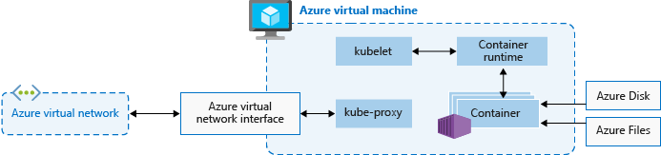
AKS nodes
Image from https://docs.microsoft.com/en-us/azure/aks/concepts-clusters-workloads
Notes:
To run your applications and supporting services, you need a Kubernetes node. An AKS cluster has one or more nodes, which is an Azure virtual machine (VM) that runs the Kubernetes node components and container runtime.
The kubelet is the Kubernetes agent that processes the orchestration requests from the control plane and scheduling of running the requested containers.
Virtual networking is handled by the kube-proxy on each node. The proxy routes network traffic and manages IP addressing for services and pods.
The container runtime is the component that allows containerized applications to run and interact with additional resources such as the virtual network and storage.

Slide 23
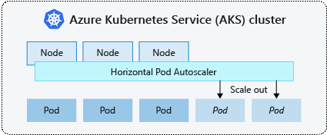
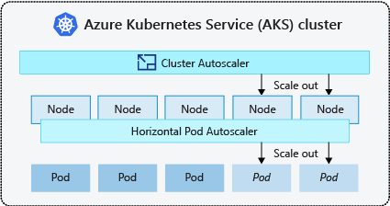
AKS scaling options
Manually scale pods or nodes
Horizontal pod autoscaler
KEDA
Cluster autoscaler
https://docs.microsoft.com/en-us/azure/aks/concepts-scale

Slide 24
Lab-01, 02, 03

Slide 25
Pause

Slide 26
k8s 101: Pods

Slide 27
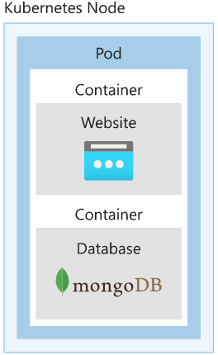
Pods
A Pod is an abstraction that represents:
a group of one or more application containers
Shared storage, as Volumes
Networking, as a unique cluster IP address
Information about image version and specific ports to use
10.240.0.3
pod
app-a
app-b
Config
map
Secrets
Notes:
A pod represents a single instance of an app running in Kubernetes. The workloads that you run on Kubernetes are containerized apps. Unlike in a Docker environment, you can't run containers directly on Kubernetes. You package the container into a Kubernetes object called a pod. A pod is the smallest object that you can create in Kubernetes.
A single pod can hold a group of one or more containers. However, a pod typically doesn't contain multiples of the same app.
A pod includes information about the shared storage and network configuration, and a specification about how to run its packaged containers. You use pod templates to define the information about the pods that run in your cluster. Pod templates are YAML-coded files that you reuse and include in other objects to manage pod deployments.

Slide 28
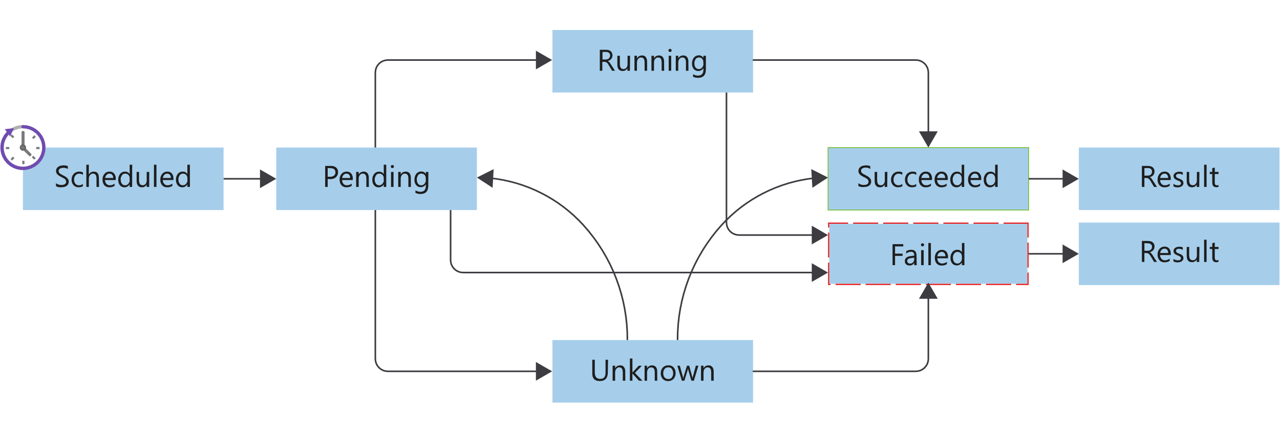
Pods lifecycle
Image from https://docs.microsoft.com/en-us/learn/modules/intro-to-kubernetes/3-how-kubernetes-works
Notes:
Kubernetes pods have a distinct lifecycle that affects the way you deploy, run, and update pods. You start by submitting the pod YAML manifest to the cluster. After the manifest file is submitted and persisted to the cluster, it defines the desired state of the pod. The scheduler schedules the pod to a healthy node that has enough resources to run the pod.
Pending
After the pod run is scheduled, the container runtime downloads container images, and starts all containers for the pod.
Running
The pod transitions to a running state after all of the resources within the pod are ready.
Succeeded
The pod transitions to a succeeded state after the pod completes its intended task, and runs successfully.
Failed
Pods can fail for various reasons. A container in the pod may have failed, leading to the termination of all other containers. Or, maybe an image wasn't found during preparation of the pod containers. In these types of cases, the pod can go to a failed state. Pods can transition to a failed state from either a pending state or a running state. A specific failure can also place a pod back in the pending state.
Unknown
If the state of the pod can't be determined, the pod is an unknown state.

Slide 29
k8s 101:Kubernetes Resource Management

Slide 30
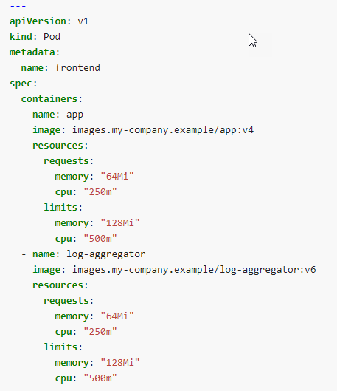
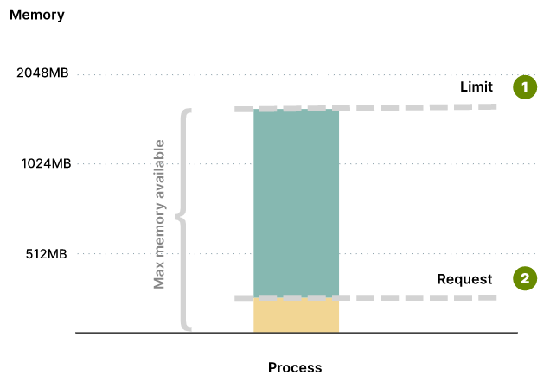
K8s 101: Resource Management
Requests - define the minimum amount of resources that containers need
Limits - define the max amount of resources that the container can consume
Image from https://learnk8s.io/setting-cpu-memory-limits-requests
Notes:
When you specify a Pod or Deployment, you should specify how much of each resource a container needs. The most common resources to specify are CPU and memory (RAM); there are others.
When you specify the resource request for containers in a Pod, the kube-scheduler uses this information to decide which node to place the Pod on.
When you specify a resource limit for a container, the kubelet enforces those limits so that the running container is not allowed to use more of that resource than the limit you set. The kubelet also reserves at least
the request amount of that system resource specifically for that container to use
Your application might require at least 256MB of memory, but you might want to be sure that it doesn't consume more than 1GB of memory.
Setting limits is useful to stop over-committing resources and protect other deployments from resource starvation

Slide 31
K8s 101: CPU and memory units
CPU units
One CPU = 1 physical CPU core (or virtual core) = 1 = 1000 m (millicores or millicpu)
0.1 = 100m
400m = 0.4
Memory units
measured in bytes
128974848, 129e6, 129M, 128974848000m, 123Mi
Notes:
In Kubernetes, the CPU is not assigned in percentages, but in millicpu (or millicores)

Slide 32
Lab-06

Slide 33
k8s 101: Readiness and Liveness probes

Slide 34
Liveness probe
On every node is a daemon called a Kubelet
One of the Kubelet’s jobs is to ensure that pods are healthy
Kubelet sends out a liveness probe to a pod
app-a, are you alive?
No
Node
kubelet
pod
app-a

Slide 35
Liveness probe
If the Kubelet gets back multiple bad responses
app-a, restart!
Node
kubelet
pod
app-a

Slide 36
Liveness probe
This cycle then starts all over again
app-a, are you alive?
Yes!
Node
kubelet
pod
app-a

Slide 37
Readiness probe
app-a is already alive
kubelet sends readiness probe
If app-a is not ready, wait and send new request
service-a
app-a, are you ready?
Node
kubelet
pod
pod
pod
app-a
app-a
app-a
Not yet

Slide 38
Readiness probe
This cycle then starts all over again
Send traffic to app-a
service-a
app-a, are you ready?
Node
kubelet
pod
pod
pod
app-a
app-a
app-a
Yes!

Slide 39
Lab-07

Slide 40
k8s 101: Deployments

Slide 41
Deployments
Drive current state towards desired state
app: app-a
replicas: 3
app: app-a
replicas: 1
Node1
Node2
Node3
Node3
pod
pod
pod
pod
app-a
app-a
app-a
app-a
Notes:
There are several options to manage the deployment of pods in a Kubernetes cluster
A pod template enables you to define the configuration of the pod you want to deploy.
The template contains information, such as the name of container image, and which container registry to use to fetch the images.
The template may also include runtime configuration information, such as ports to use.
A manually-deployed pod isn't relaunched after it fails, is deleted, or is terminated.
To manage the lifecycle of a pod, you need to create a higher-level Kubernetes object.
A replica set uses pod templates and defines a specified number of pods that must run
A deployment creates a management object one level higher than a replica set and enables you to deploy and manage updates for pods in a cluster.

Slide 42
Rolling Update
service-a
Node1
Node1
Node1
pod
pod
pod
pod
app-a: v1
app-a: v1
app-a: v1
app-a: v2

Slide 43
Rolling Update
service-a
Node1
Node1
Node1
pod
pod
pod
pod
app-a: v1
app-a: v1
app-a: v1
app-a: v2

Slide 44
Rolling Update
service-a
Node1
Node1
Node1
pod
pod
pod
pod
app-a: v1
app-a: v2
app-a: v1
app-a: v2

Slide 45
Rolling Update
service-a
Node1
Node1
Node1
pod
pod
pod
pod
app-a: v1
app-a: v2
app-a: v1
app-a: v2

Slide 46
Rolling Update
service-a
Node1
Node1
Node1
pod
pod
pod
pod
app-a: v2
app-a: v1
app-a: v2
app-a: v2

Slide 47
Rolling Update
service-a
Node1
Node1
Node1
pod
pod
pod
pod
app-a: v2
app-a: v1
app-a: v2
app-a: v2

Slide 48
Rolling Update
service-a
Node1
Node1
Node1
pod
pod
pod
app-a: v2
app-a: v2
app-a: v2

Slide 49
Lab-08

Slide 50
k8s 101: Services, Labels, Selectors

Slide 51
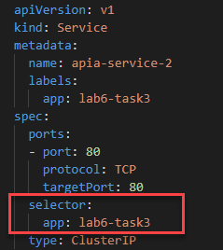
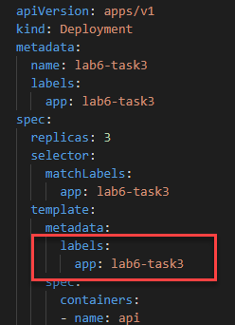
Services
Persistent Endpoint for Pods
Use Labels and Selectors to select Pods
service-a
pod
pod
pod
lab6-task3
lab6-task3
lab6-task3
labels:
app: lab6-task3
labels:
app: lab6-task3
labels:
app: lab6-task3
Notes:
A Kubernetes service is a Kubernetes object that provides stable networking for pods. A Kubernetes service enables communication between nodes, pods, and users of your app, both internal and external, to the cluster.
Kubernetes assigns a service an IP address on creation, just like a node or pod. These addresses get assigned from a service cluster's IP range. An example is 10.96.0.0/12. A service is also assigned a DNS name based on the service name, and an IP port.
Managing pods by IP address isn't practical. Pod IP addresses change as controllers re-create them, and you might have any number of pods running.

Slide 52
Labels and selector
selector:
app: app-a
service-a
pod
pod
pod
app-a
app-a
app-a
labels:
app: app-a
version: v1
labels:
app: app-a
version: v1
labels:
app: app-a
version: v2
Notes:
A service object enables you to target and manage specific pods in your cluster by using selector labels. You set the selector label in a service definition to match the pod label defined in the pod's definition file.

Slide 53
Labels and selector
selector:
app: app-a
version: v1
service-a
pod
pod
pod
app-a
app-a
app-a
labels:
app: app-a
version: v1
labels:
app: app-a
version: v1
labels:
app: app-a
version: v2

Slide 54
Lab-09

Slide 55
k8s 101: Configmaps and secrets
Notes:
We don’t want to hard code sensitive credentials directly into our code or configuration.
Secrets allow you to mount sensitive data as either a file in a volume, or directly into environment variables. The next few slides animates how it works in k8s. The same applicable for ConfigMaps

Slide 56
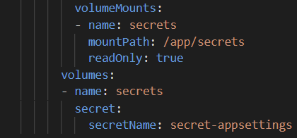
Secrets and ConfigMaps
kubectl create secret / kubectl cerate cm
Node
10.240.0.3
pod
kubelet
app-a
/app/secrets
secret
Notes:
Kubernetes uses the same storage volume concept that you find when using Docker. Docker volumes are less managed than the Kubernetes volumes because Docker volume lifetimes aren't managed. The Kubernetes volume's lifetime is an explicit lifetime that matches the pod's lifetime. This lifetime match means a volume outlives the containers that run in the pod. However, if the pod is removed, so is the volume.

Slide 57
Lab-10

Slide 58
k8s 101: Scaling options

Slide 59
K8s 101: AKS scaling options
Manually scale pods and nodes
Horizontal Pod Autoscaler (HPA)
Vertical Pod Autoscaler (VPA)
Cluster autoscaler
Kubernetes Event Driven Autoscaling (KEDA)
https://docs.microsoft.com/en-us/azure/aks/concepts-scale

Slide 60
K8s 101: Manually scale pods and nodes
Manually scale pods
kubectl scale deployment/guinea-pig --replicas=3
kubectl scale deployment/guinea-pig --replicas=0
Manually scale nodes
az aks scale -g iac-ws5-rg -n iac-ws5-aks --node-count 2

Slide 61
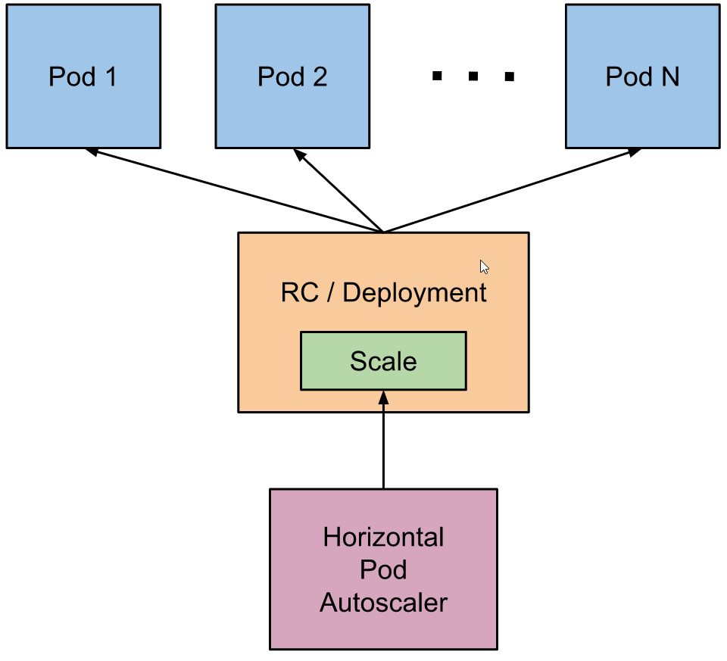
K8s 101: Horizontal Pod Autoscaler
checks the metrics server for resource usage every 30 sec
calculates the desired number of replicas required
scales up the application to the desired number of replicas
Image from: https://kubernetes.io/docs/tasks/run-application/horizontal-pod-autoscale/
Notes:
Kubernetes uses the horizontal pod autoscaler (HPA) to monitor the resource demand and automatically scale the number of replicas.
By default, the horizontal pod autoscaler checks the Metrics API every 30 seconds for any required changes in replica count.
When changes are required, the number of replicas is increased or decreased accordingly.

Slide 62
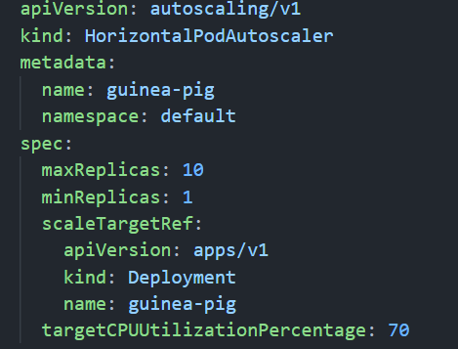
K8s 101: Horizontal Pod Autoscaler
kubectl autoscale deployment guinea-pig
--cpu-percent=70 --min=1 --max=10
Notes:
When you configure the horizontal pod autoscaler for a given deployment, you define the minimum and maximum number of replicas that can run.
You also define the metric to monitor and base any scaling decisions on, such as CPU usage.

Slide 63
Lab-12, 13

Slide 64
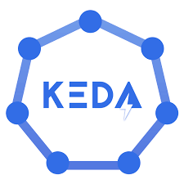
Kubernetes Event Driven Autoscaling KEDA

Slide 65

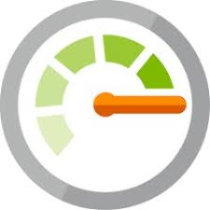

KEDA concepts
Prometheus
Metric Adapter
Azure Monitor
Metric Adapter
Autoscaling infra
Kubernetes Custom Metrics
Horizontal Pod Autoscaler
(HPA)
Horizontal Pod Autoscaler
(HPA)
Horizontal Pod Autoscaler
(HPA)
Customer
Deployment
Order
Deployment
Shipment
Deployment

Slide 66

KEDA concepts
Autoscaling infra
Prometheus
Scaler
Azure Service Bus
Scaler
Scale Controller
Horizontal Pod Autoscaler
(HPA)
ScaledObject
ScaledObject
ScaledObject
Customer
Deployment
Order
Deployment
Shipment
Deployment

Slide 67
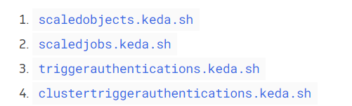
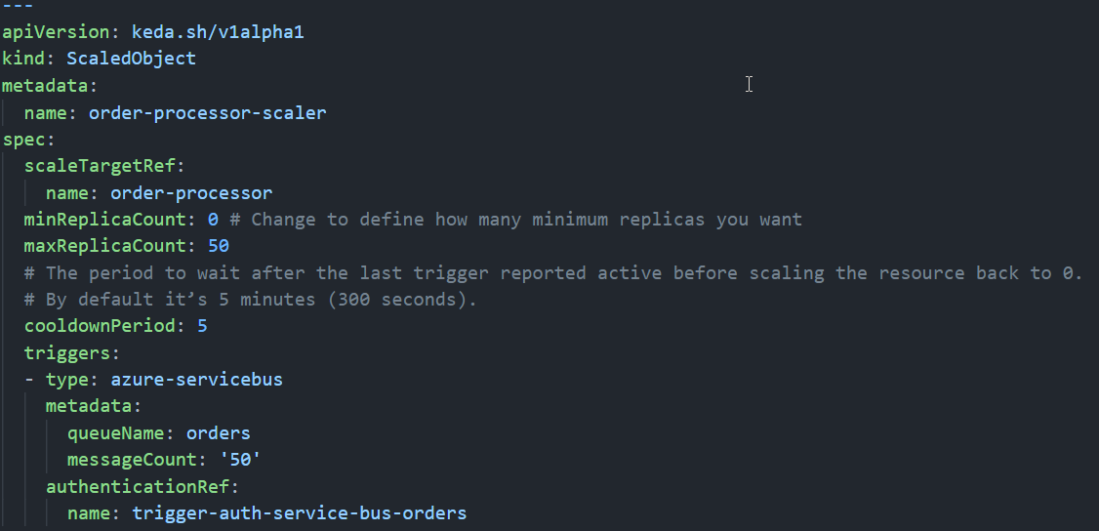
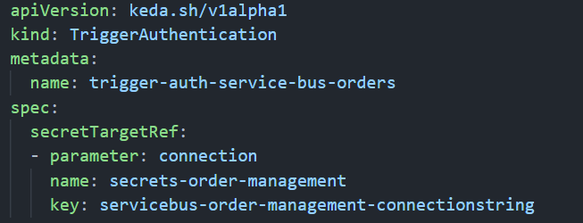
KEDA custom resources
Image from https://keda.sh/docs/2.5/concepts/

Slide 68

GitOps with flux

Slide 69
Typical k8s configuration and maintenance
Provision AKS
Prepare manifest / helm. Possible with “master scripts”
Run master script and kubectl apply –f configuration to the cluster
Change k8s configuration:
Change configuration -> push to git -> kubectl apply –f from local PC
Issues – human factor:
Configuration drift
Risk of deploying things to the wrong cluster
Risk of deploying wrong recourses
Risk of forgetting to commit changes to the repository

Slide 70
GitOps principles
GitOps is a set of practices to manage infrastructure and application configurations using Git
Declarative description of system
Git as the single source of truth for all environments
Automatically apply approved changes
All changes via PR -> are observable/verifiable

Slide 71
flux overview
Flux is a set of continuous and progressive delivery solutions for Kubernetes that are open and extensible
Flux provides GitOps for both apps and infrastructure
Just push to Git and Flux does the rest
Flux works with your existing tools
Flux alerts and notifies
Users trust Flux

Slide 72
Who is Flux for?
cluster operators
platform engineers
app developers

Slide 73
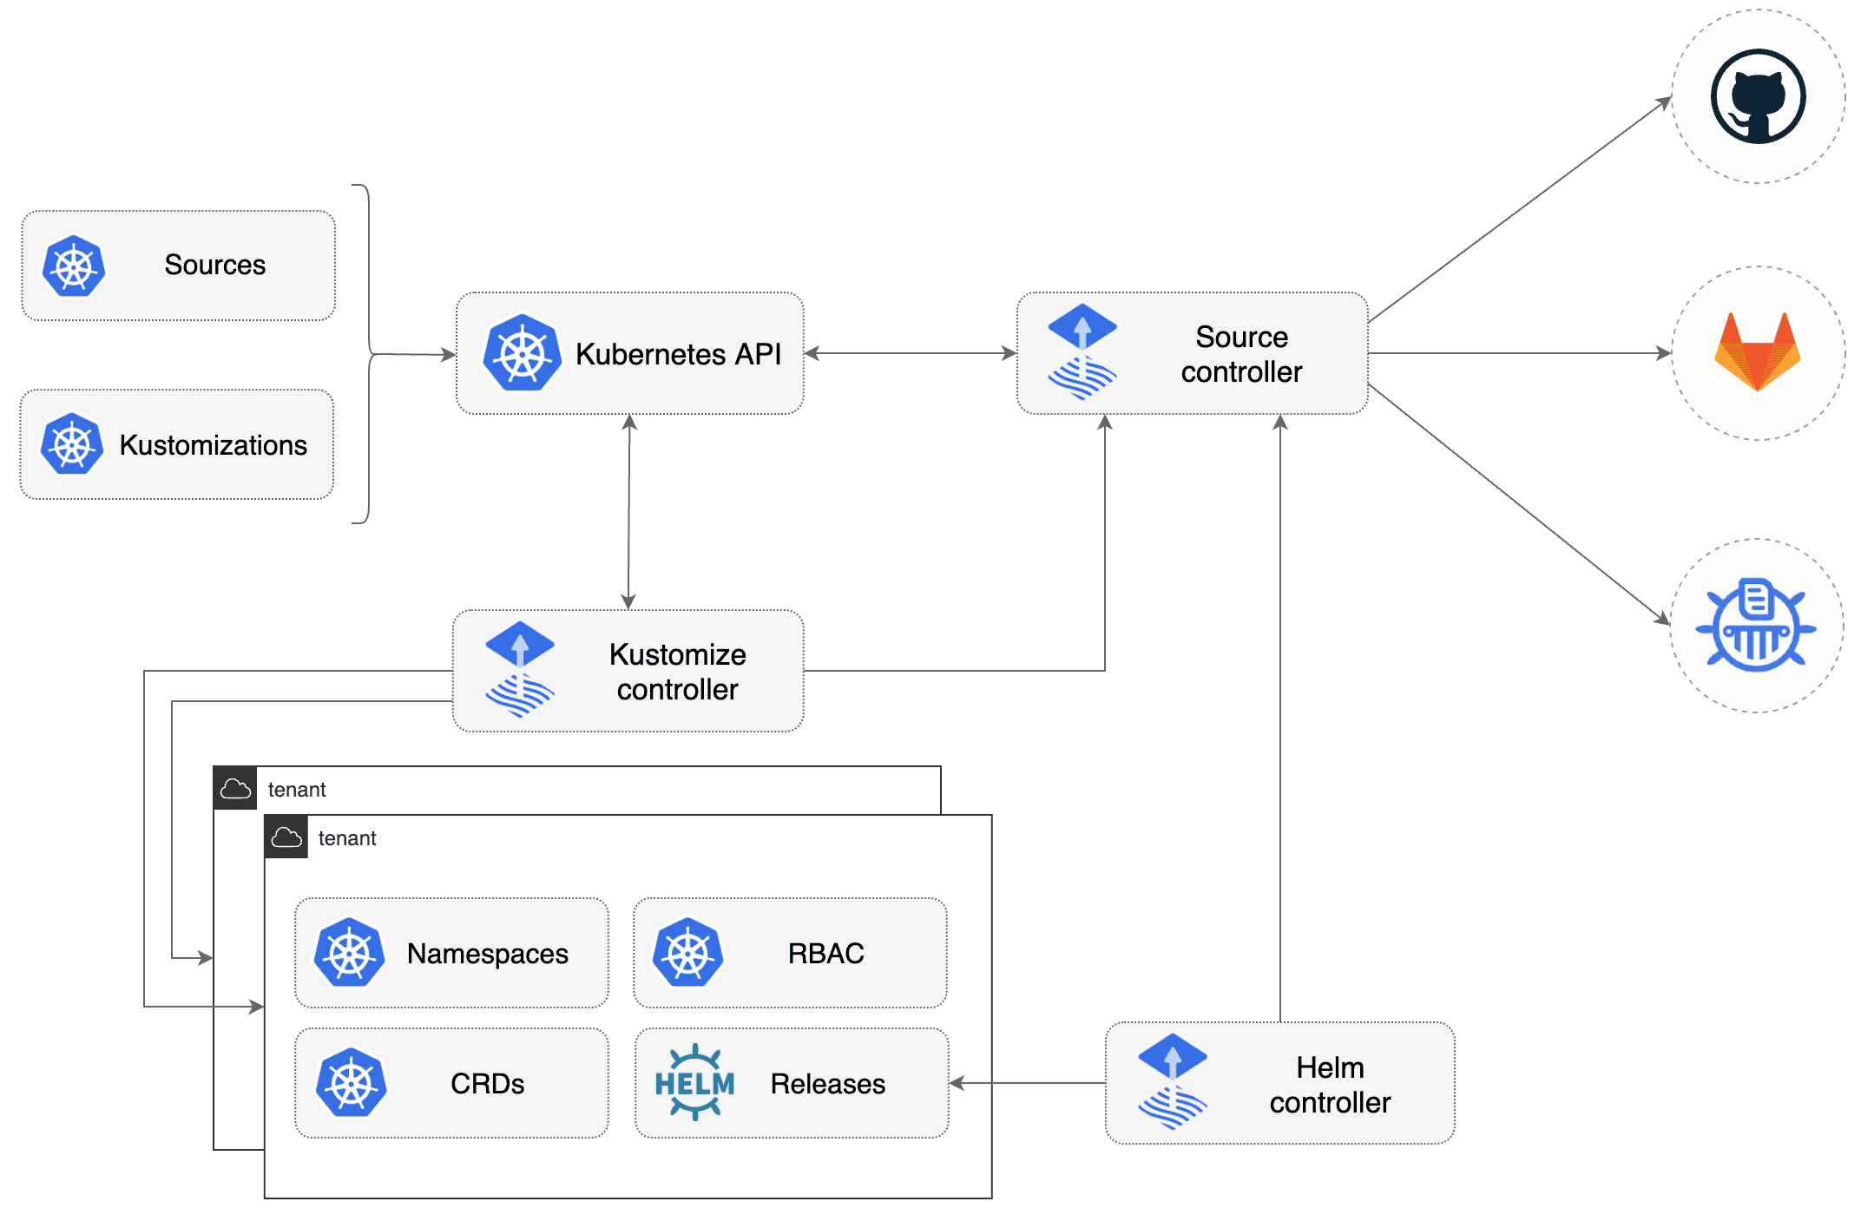
Flux components
Notes:
Flux is based on a set of Kubernetes API extensions (“custom resources”), which control how git repositories and other sources of configuration are applied into the cluster (“synced”). For example, you create a GitRepository object to mirror configuration from a Git repository, then a Kustomization object to sync that configuration.
Flux works with Kubernetes' role-based access control (RBAC), so you can lock down what any particular sync can change. It can send notifications to Slack and other like systems when configuration is synced and ready, and receive webhooks to tell it when to sync.
The flux command-line tool is a convenient way to bootstrap the system in a cluster, and to access the custom resources that make up the API.

Slide 74
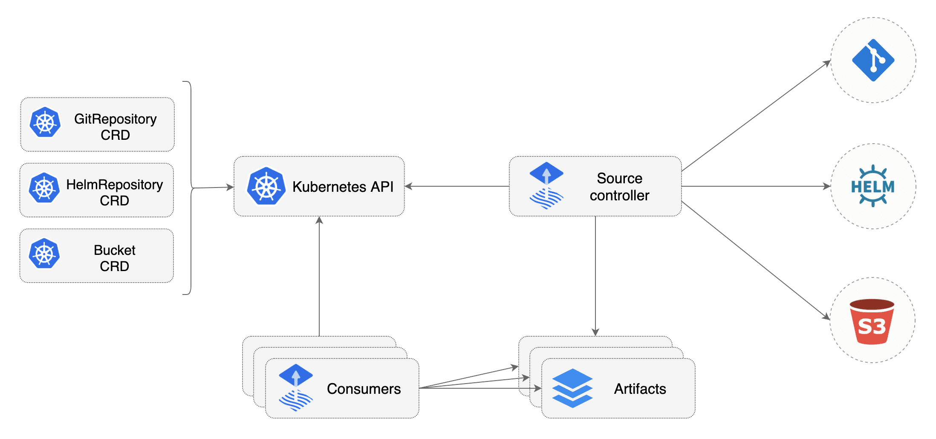
Source Controller
Notes:
The main role of the source management component is to provide a common interface for artifacts acquisition. The source API defines a set of Kubernetes objects that cluster admins and various automated operators can interact with to offload the Git and Helm repositories operations to a dedicated controller.
Validate source definitions
Authenticate to sources (SSH, user/password, API token)
Detect source changes based on update policies (semver)
Fetch resources on-demand and on-a-schedule
Package the fetched resources into a well-known format (tar.gz, yaml)
Make the artifacts addressable by their source identifier (sha, version, ts)
Make the artifacts available in-cluster to interested 3rd parties
Notify interested 3rd parties of source changes and availability (status conditions, events, hooks)

Slide 75
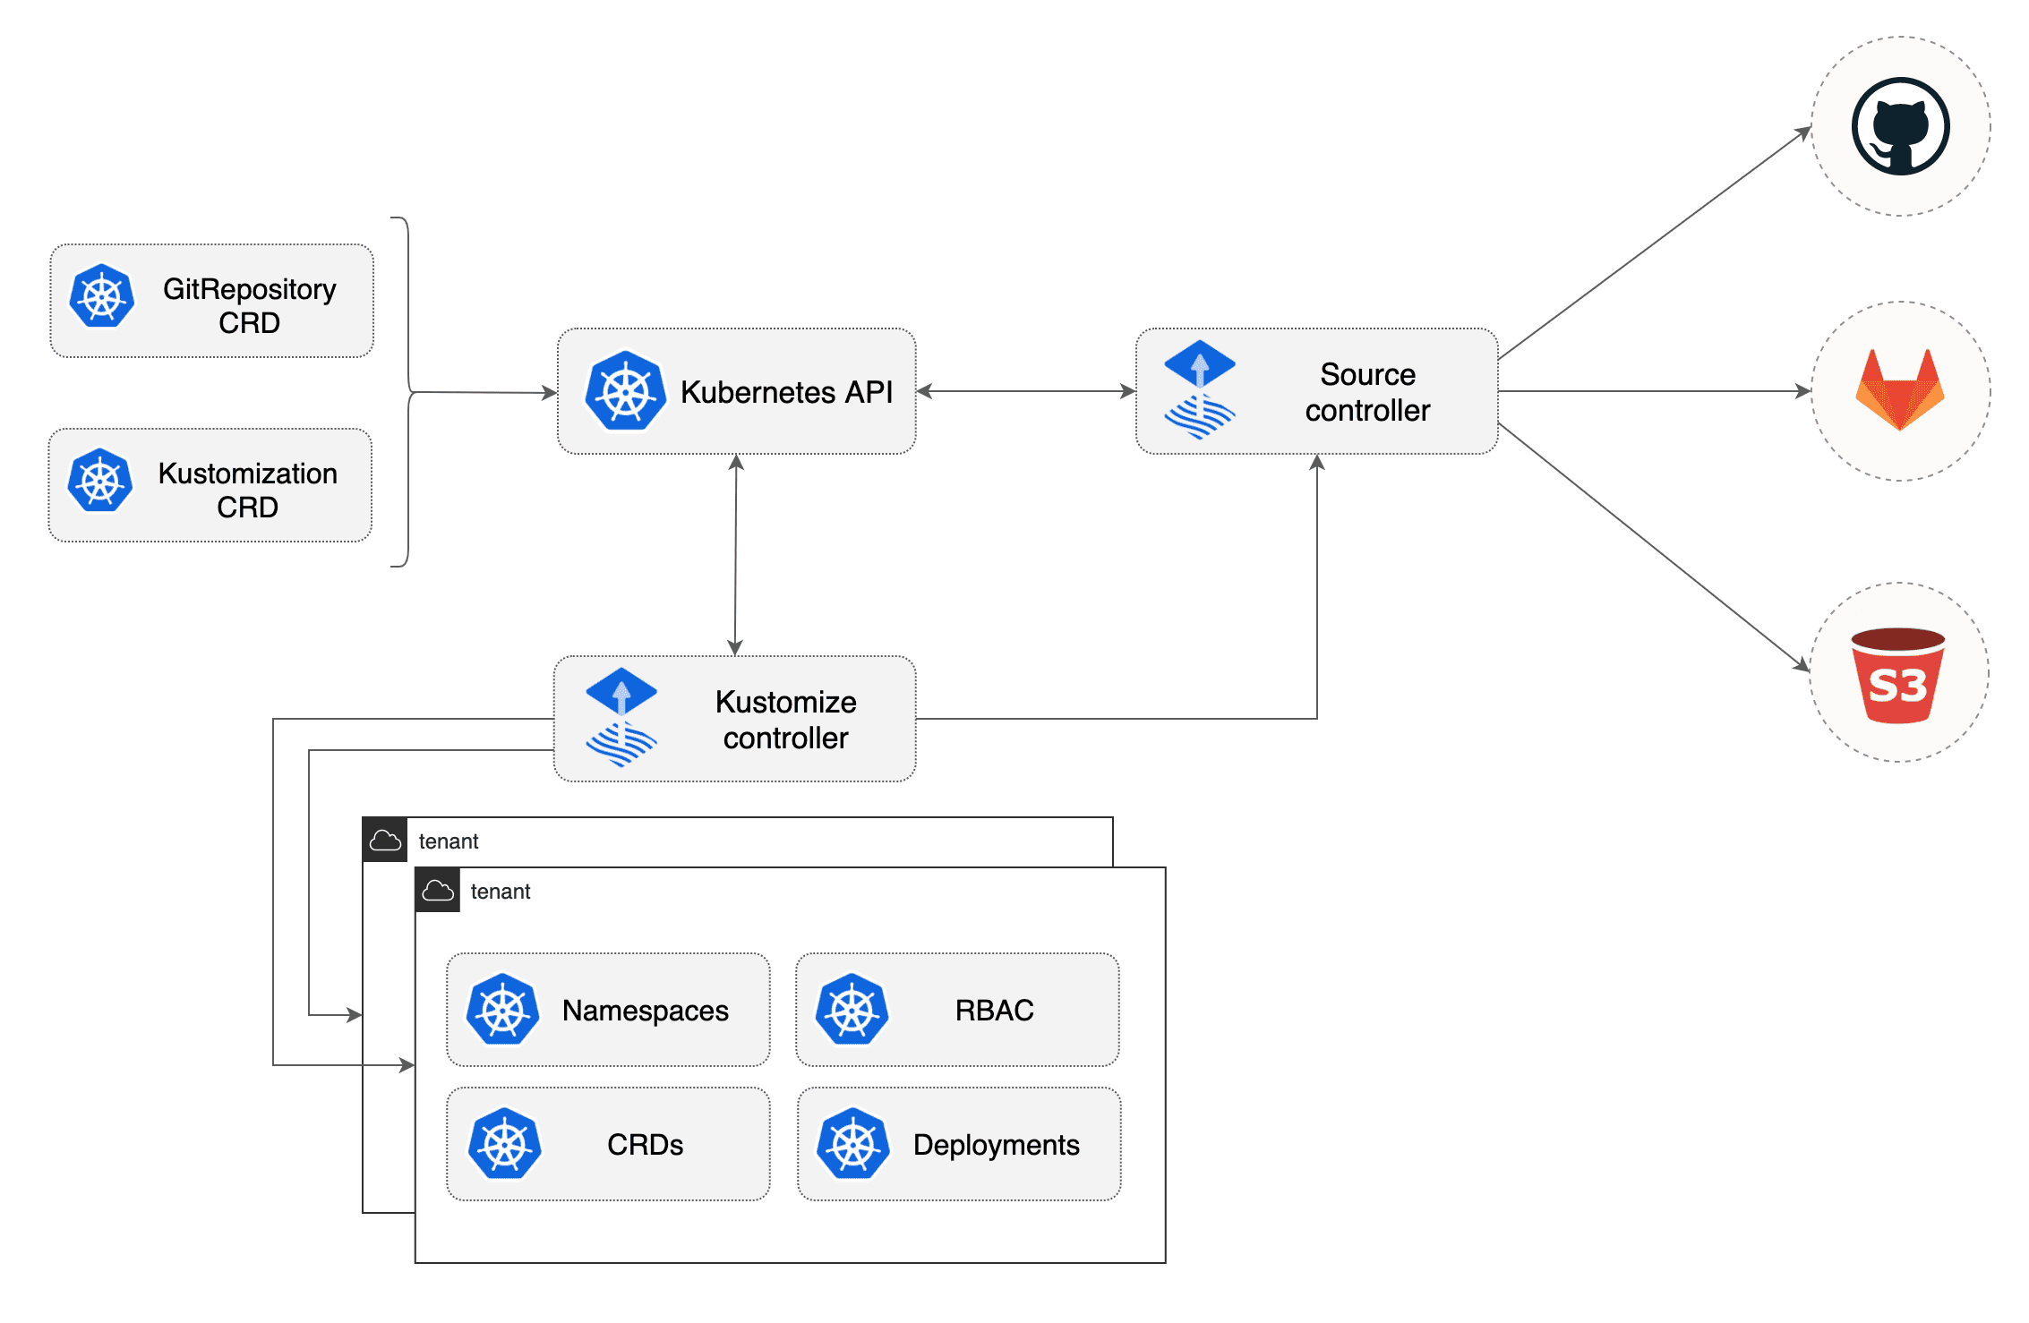
Kustomize Controller
Notes:
The kustomize-controller specialized in running continuous delivery pipelines for infrastructure and workloads defined with Kubernetes manifests and assembled with Kustomize.
Reconciles the cluster state from multiple sources (provided by source-controller)
Generates manifests with Kustomize (from plain Kubernetes yamls or Kustomize overlays)
Validates manifests against Kubernetes API
Impersonates service accounts (multi-tenancy RBAC)
Health assessment of the deployed workloads
Runs pipelines in a specific order (depends-on relationship)
Prunes objects removed from source (garbage collection)
Reports cluster state changes (alerting provided by notification-controller)

Slide 76
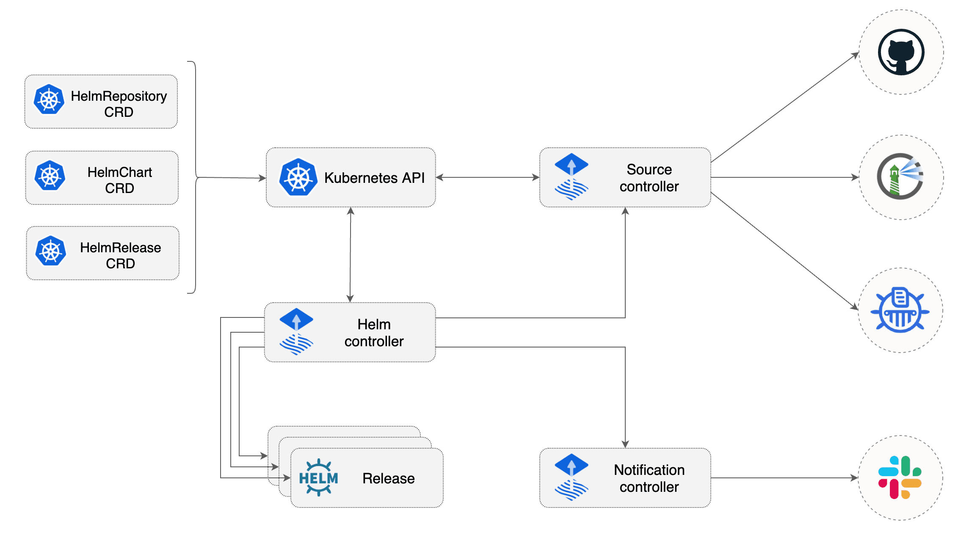
Helm Controller
Notes:
The Helm Controller is a Kubernetes operator, allowing one to declaratively manage Helm chart releases with Kubernetes manifests.
Watches for HelmRelease objects and generates HelmChart objects
Supports HelmChart artifacts produced from HelmRepository and GitRepository sources
Fetches artifacts produced by source-controller from HelmChart objects
Watches HelmChart objects for revision changes (including semver ranges for charts from HelmRepository sources)
Performs automated Helm actions, including Helm tests, rollbacks and uninstalls
Offers extensive configuration options for automated remediation (rollback, uninstall, retry) on failed Helm install, upgrade or test actions
Runs Helm install/upgrade in a specific order, taking into account the depends-on relationship defined in a set of HelmRelease objects
Prunes Helm releases removed from cluster (garbage collection)
Reports Helm releases statuses (alerting provided by notification-controller)
Built-in Kustomize compatible Helm post renderer, providing support for strategic merge, JSON 6902 and images patches

Slide 77
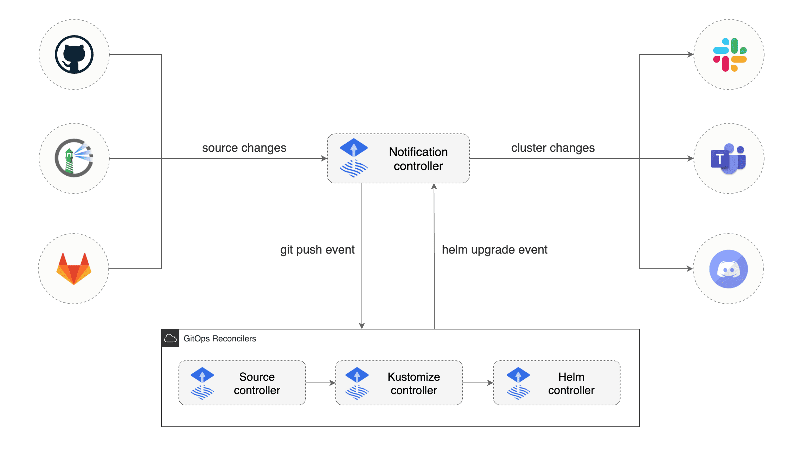
Notification Controller
Notes:
The Notification Controller is a Kubernetes operator, specialized in handling inbound and outbound events.
The controller handles events emitted by the GitOps toolkit controllers (source, kustomize, helm) and dispatches them to external systems (Slack, Microsoft Teams, Discord, Rocker) based on event severity and involved objects.

Slide 78
QA

