Slide 1








Working with Azure Policies
Infrastructure as Code User Group Oslo
28.11.2023
with Evgeny Borzenin

Slide 2
Infrastructure as Code User Group roadmap
IaC workshops roadmap:
[x] 2021-2022 - AKS workshops 6 out of 8
[x] Automate workload provisioning with Azure DevOps
[x] Load-balancing options on Azure
[x] Automate DNS and certificates management on Azure
[ ] Working with Azure Container Apps
[x] Working with Azure Private Links
[ ] Working with Azure Policies
[ ] ???
“regular” events - very unlikely ☺, but ping me if you have interesting topic to present

Slide 3
Workshops in your organization
Infrastructure as Code (Bicep, ARM, Azure Landing Zones, Automation with Azure DevOps or GitHub Actions)
AKS workshops
Workshops can be adapted for your organization use-case
List of past workshops: https://borzenin.com/workshops/
Commercial offer from Enso AS
Contact me at evgeny@enso.no if any interest

Slide 4
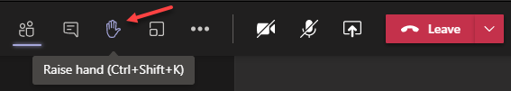
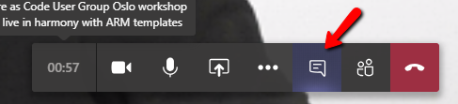

Microsoft Teams 101
Mute your mic (but don’t forget to unmute when you speak)
«Rise your hand» if you need some attention
Conversation/chat
Share screen

Slide 5
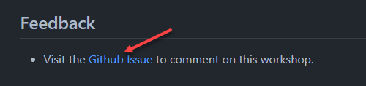
Practical information
Use the same naming conventions
When you done working with lab, post to the Conversation channel
lab-01 (lab-02, lab-03 etc…)
Feel free to contribute to the labs content
Feel free to left your comments on workshop main page

Slide 6
Working with Azure Policies

Slide 7
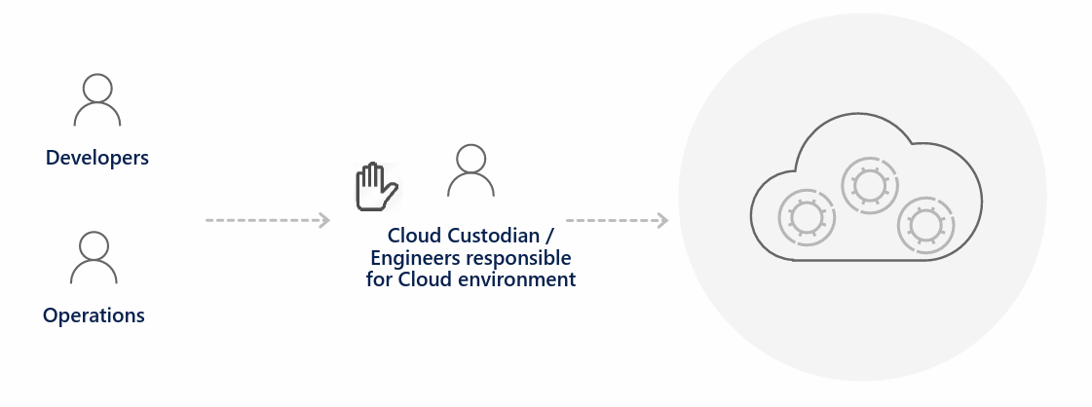
Traditional approach

Slide 8
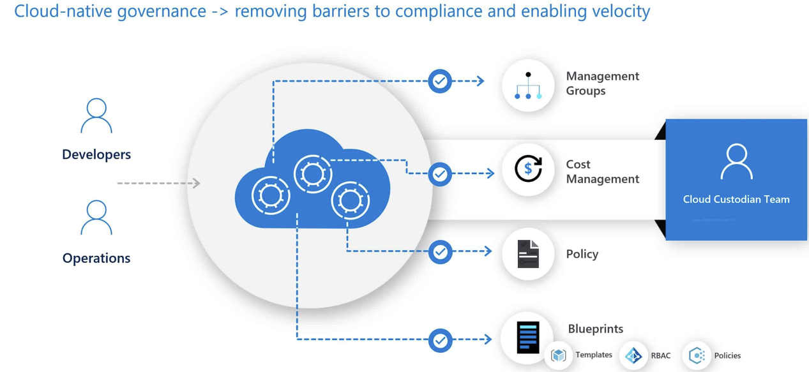
Cloud-native governance

Slide 9
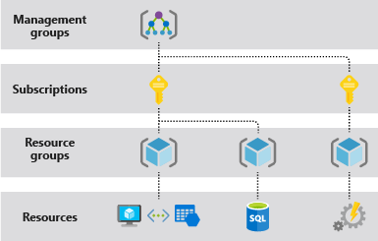
How resources are organized on Azure
Resource
Resource Group
Subscription
Management Group
Notes:
resource - A manageable item that is available through Azure. Virtual machines, storage accounts, web apps, databases, and virtual networks are examples of resources. Resource groups, subscriptions, management groups, and tags are also examples of resources.

Slide 10
How to manage resources on Azure?
Azure Portal
az cli (Azure Command Line Interface)
PowerShell (AZ Module)
SDKs (python, .net, go, etc…)
Bicep / ARM
Terraform

Slide 11
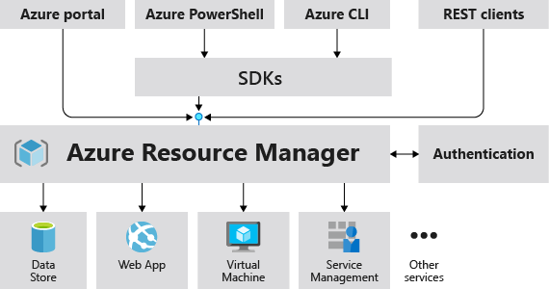
Azure Resource Manager
Notes:
resource provider - A service that supplies Azure resources. For example, a common resource provider is Microsoft.Compute, which supplies the virtual machine resource. Microsoft.Storage is another common resource provider. See Resource providers and types.

Slide 12
What is Azure policy
It helps to enforce organizational standards
Azure Policy evaluates resources and actions in Azure by comparing the properties of those resources to business rules.
Rules are JSON
Policy effects (not completed):
Deny
Audit
Modify
DeployIfNotExists

Slide 13




Key Concepts / Components
Scope
Policy Definition
Policy Parameters
Policy Assignment
Assigned to
Management Group
Policy Definition
Subscription
Assigned to
Resource Group
Notes:
Policy Definition: The journey of creating and implementing a policy in Azure Policy begins with creating a
policy definition. Every policy definition has conditions under which it is enforced. And, it has an
accompanying effect that takes place if the conditions are met.
Policy Assignment :
A policy assignment is a policy definition that has been assigned to take place within a
specific scope. This scope could range from a management group to a resource group. The term scope
refers to all the resource groups, subscriptions, or management groups that the policy definition is assigned
to. Policy assignments are inherited by all child resources. This means that if a policy is applied to a resource
group, it is applied to all the resources in that resource group. However, you can exclude a sub-scope from
the policy assignment.
Policy Parameters :Policy parameters help simplify your policy management by reducing the number of policy
definitions you must create. You can define parameters when creating a policy definition to make it more
generic. Then you can reuse that policy definition for different scenarios. You do so by passing in different
values when assigning the policy definition. For example, specifying one set of locations for a subscription

Slide 14
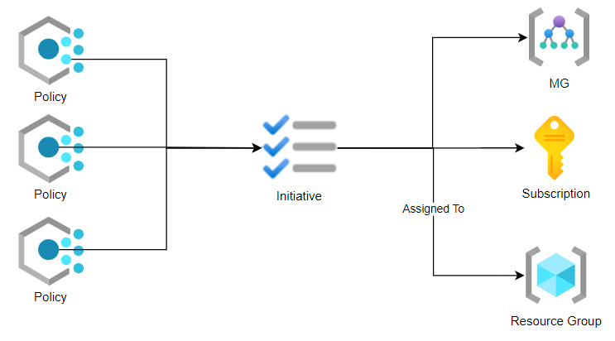
Azure Policy Initiatives
Policy Initiative Definition
Policy Initiative Parameters
Policy Initiative Assignment
Notes:
Initiative Definition : An initiative definition is a collection of policy definitions that are tailored towards achieving a singular overarching goal. Initiative definitions simplify managing and assigning policy definitions. They simplify by grouping a set of policies as one single item. For example, you could create an initiative titled “Secure Azure VM”, under this Initiative you can group Policy Definitions such “Allowed VM SKUs, Restrict IP Public Interface, Enforce Managed Disks, Enforce use of Hybrid Benefit…etc”
Initiative Parameters : Like policy parameters, initiative parameters help simplify initiative management by reducing redundancy. Initiative parameters are essentially the list of parameters being used by the policy definitions within the initiative
Initiative Assignment : Like a policy assignment, an initiative assignment is an initiative definition assigned to a specific scope. Initiative assignments reduce the need to make several initiative definitions for each scope. This scope could also range from a management group to a resource group. From the preceding example, the “Secure Azure VM” initiative can be assigned to different scopes.

Slide 15
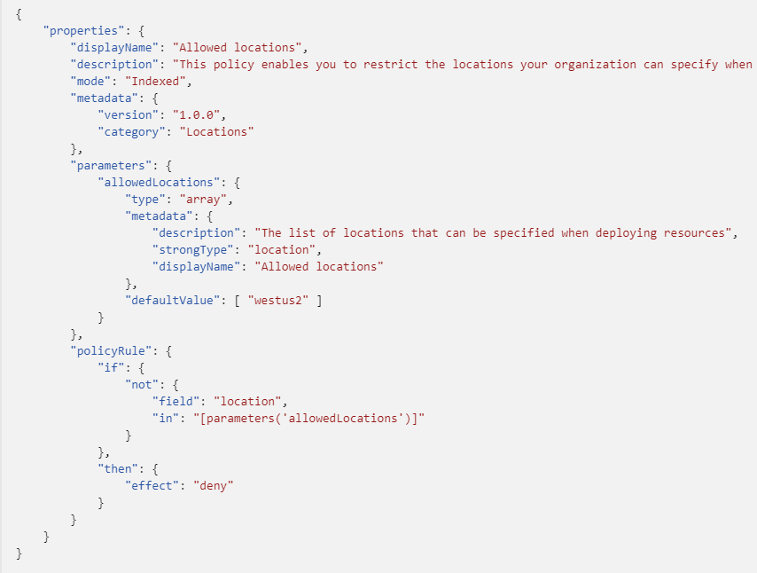
Policy Definition structure
JSON
display name
description
mode
metadata
parameters
policy rule
logical evaluation
effect
Notes:
Mode
all: evaluate resource groups, subscriptions, and all resource types
indexed: only evaluate resource types that support tags and location

Slide 16
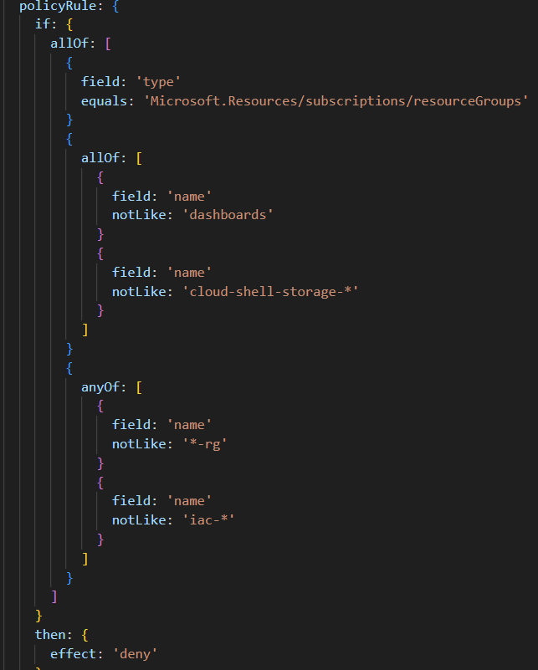
Policy Definition structure: pulicyRules
Logical operators
"not": {condition or operator}
"allOf": [{condition or operator},{condition or operator}]
"anyOf": [{condition or operator},{condition or operator}]
Notes:
Mode
all: evaluate resource groups, subscriptions, and all resource types
indexed: only evaluate resource types that support tags and location

Slide 17
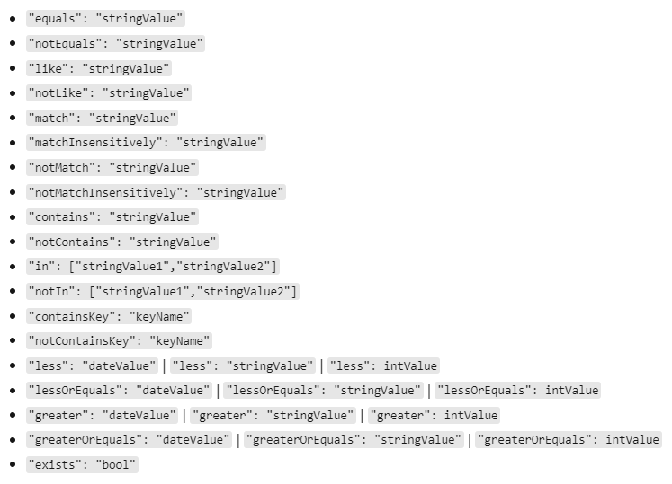
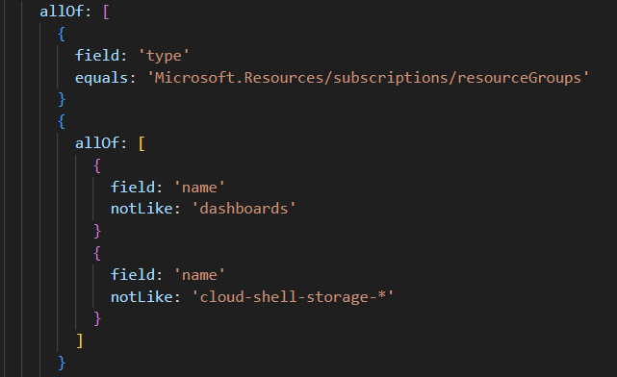
Policy pulicyRules: Conditions

Slide 18
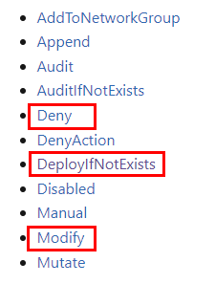
Azure Policy effects
Notes:
DenyAction is used to block requests based on intended action to resources at scale. The only supported action today is DELETE. This effect and action name helps prevent any accidental deletion of critical resources.

Slide 19
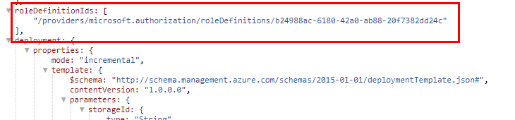
Azure Policy effects: DINE, Modify
Requires Managed Identity for remediation
Requeres configure RBAC at the scope of policy assignment
Required Role is part of Policy Definition
Notes:
DeployIfNotExists policy definition executes a template deployment when the condition is met. Policy assignments with effect set as DeployIfNotExists require a managed identity to do remediation.

Slide 20
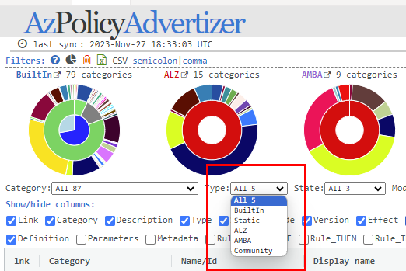
Azure Policy Definition
Build-In
Custom
ALZ
AMBA (Azure Monitor Baseline Alerts)
Community

Slide 21
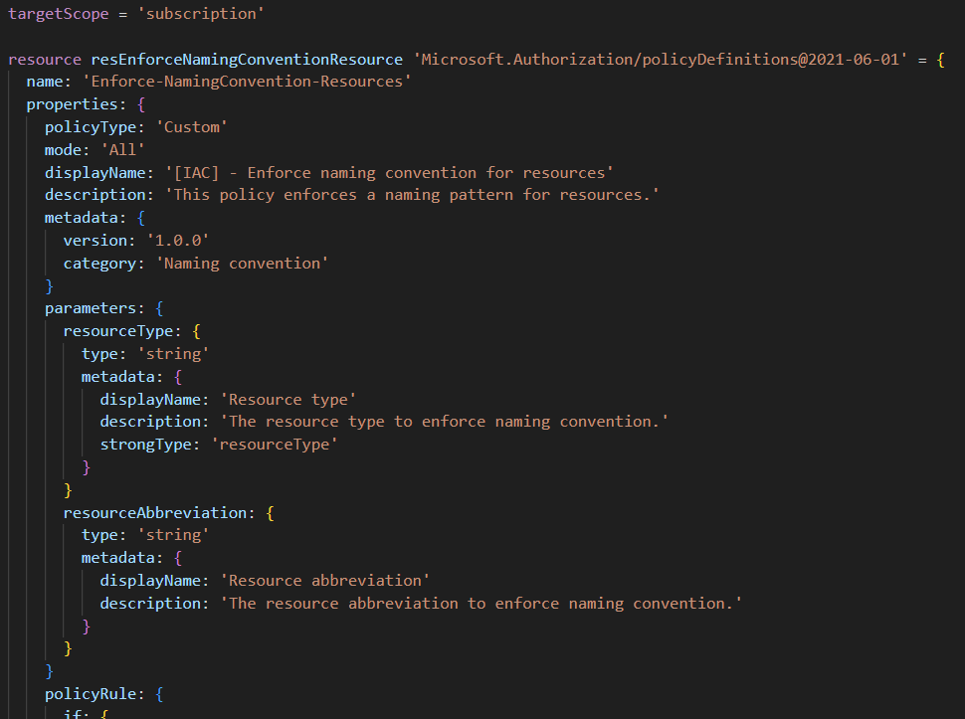
Azure Policy Definition: Custom
Implement with Portal, ARM, Bicep, az cli, etc...
Deploy to Subscription or Management Group

Slide 22
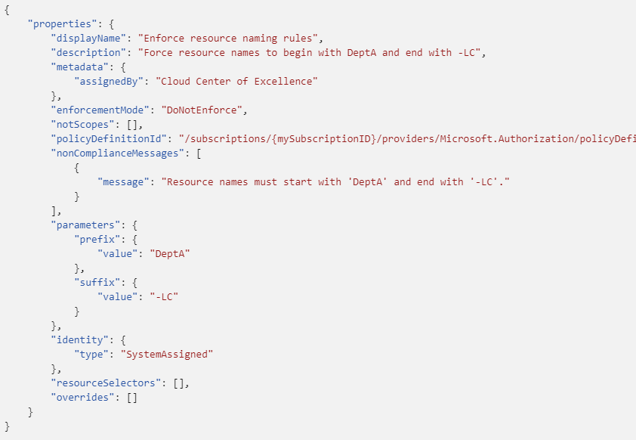
Policy assignment structure
display name
description
metadata
enforcement mode
excluded scopes
policy definition
non-compliance messages
parameters
identity

Slide 23
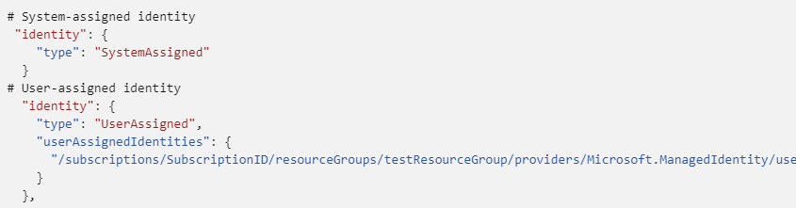
Policy assignment for DINE, Modify
Requires Managed Identity for remediation
Requeres configure RBAC at the scope of policy assignment

Slide 24
Azure Policy scope
Policy Definition location
Management Group
Subscription
Policy Assignment scopes
Management Group
Subscription
Resource Group
Notes:
There are many settings that determine which resources are capable of being evaluated and which resources are evaluated by Azure Policy. The primary concept for these controls is scope. Scope in Azure Policy is based on how scope works in Azure Resource Manager.

Slide 25
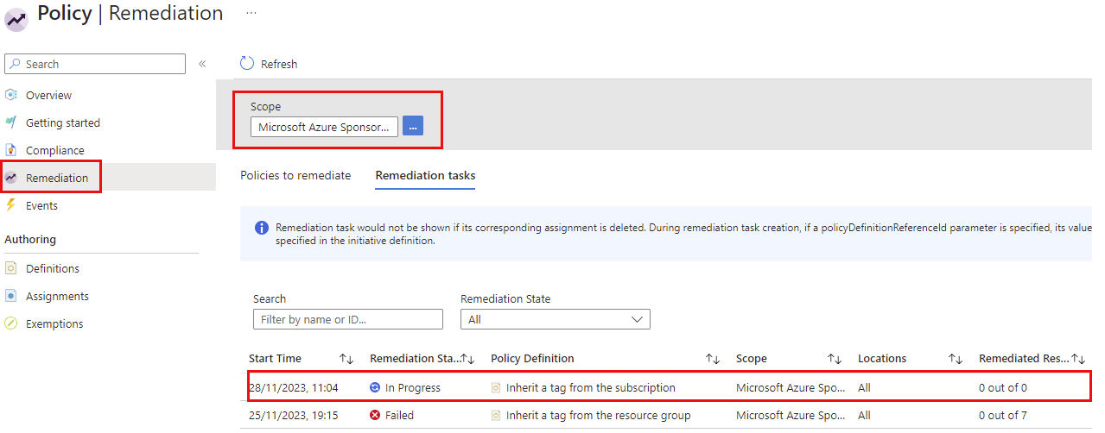
Azure Policy Remediation
A way to put non-compliant resources into a complaint state
Remediation tasks
Notes:
Resources that are non-compliant to policies with deployIfNotExists or modify effects can be put into a compliant state through Remediation.
Remediation is accomplished through remediation tasks that deploy the deployIfNotExists template or the modify operations of the assigned policy on your existing resources and subscriptions, whether that assignment is on a management group, subscription, resource group, or individual resource.

Slide 26
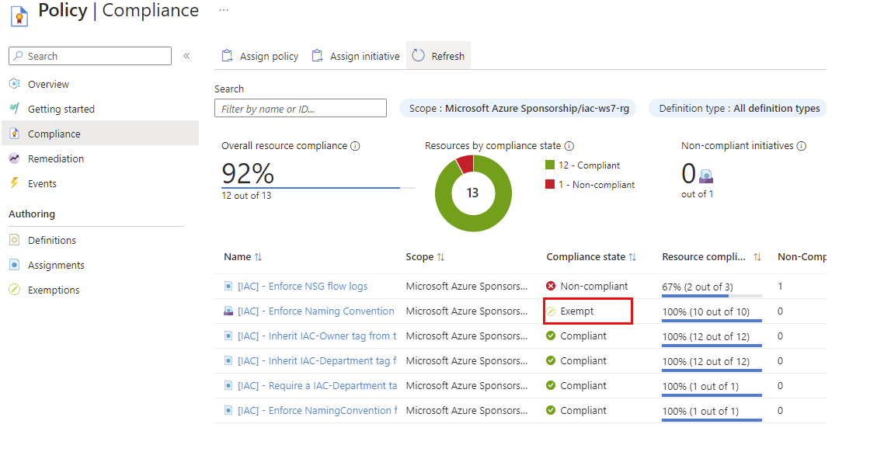
Azure Policy Exemption
used to exempt a resource hierarchy or an individual resource from evaluation of initiatives or definitions
Resources that are exempt count toward overall compliance
Notes:
The Azure Policy exemptions feature is used to exempt a resource hierarchy or an individual resource from evaluation of initiatives or definitions.
Resources that are exempt count toward overall compliance, but can't be evaluated or have a temporary waiver.

Slide 27
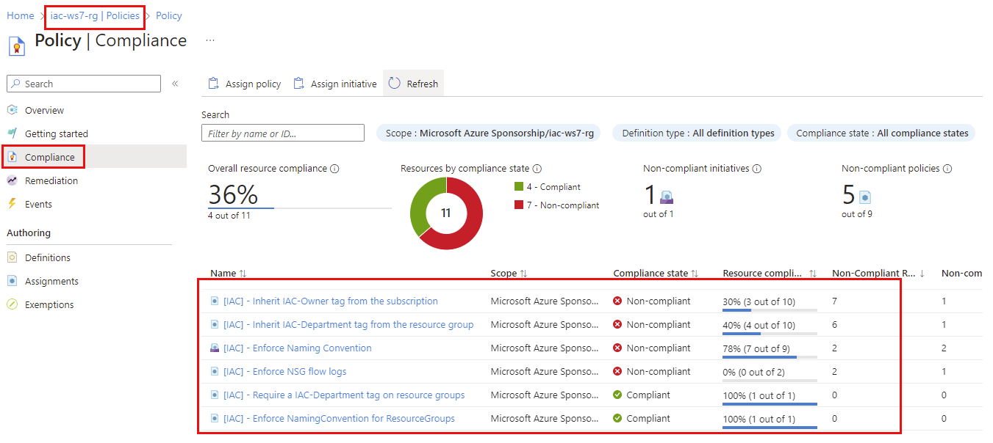
Azure Policy Complaince
Notes:
When initiative or policy definitions are assigned, Azure Policy determines which resources are applicable then evaluates those which haven't been excluded or exempted.
Evaluation yields compliance states based on conditions in the policy rule and each resources' adherence to those requirements.
Keep in mind that a policy re-evaluation happens about once an hour, which means that if you make changes to your policy definition (or initiative definition) after implementing the policy (creating a policy assignment or initiative assignment) it will be re-evaluated over your resources within the hour

Slide 28
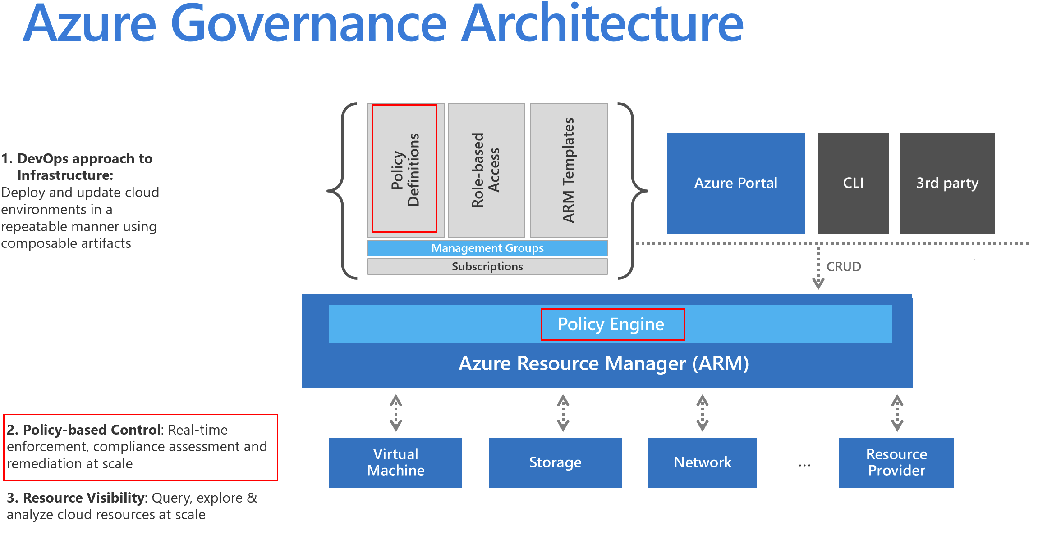

Slide 29
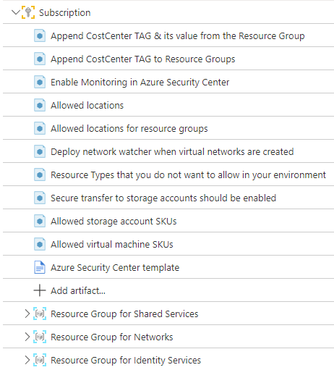
Azure Policy: examples
Ensure mandatory Tags
Append mandatory Tags from the Resource Group
Limit allowed location(s)
Enforce naming conventions
Allow VMs, Storage account etc… SKUs
Allowed Resource Types
Requiring resources to send diagnostic logs to a Log Analytics workspace
Notes:
Azure Policy helps to enforce organizational standards and to assess compliance at-scale. Through its compliance dashboard, it provides an aggregated view to evaluate the overall state of the environment, with the ability to drill down to the per-resource, per-policy granularity. It also helps to bring your resources to compliance through bulk remediation for existing resources and automatic remediation for new resources.

Slide 30
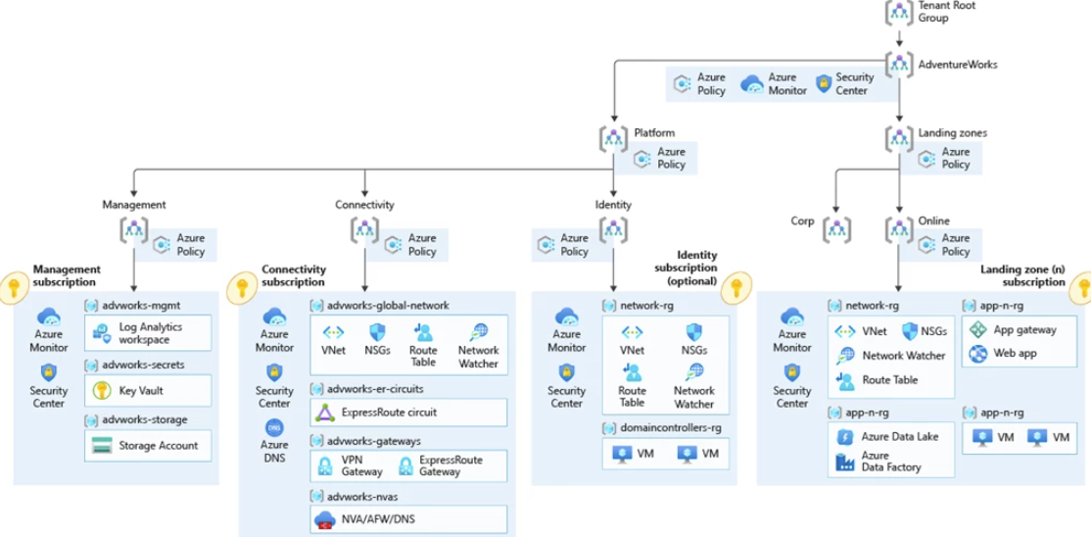
Azure Policy: Azure Landing Zone
Notes:
Azure landing zones are the output of a multisubscription Azure environment that accounts for scale, security governance, networking, and identity.
Azure landing zones enable application migration, modernization, and innovation at enterprise-scale in Azure.
These zones consider all platform resources that are required to support the customer’s application portfolio and don’t differentiate between infrastructure as a service or platform as a service.
An Azure landing zone uses subscriptions to isolate and scale application resources and platform resources. Subscriptions for application resources are called application landing zones, and subscriptions for platform resources are called platform landing zones.
Sandbox The dedicated management group for subscriptions that will only be used for testing and exploration by an organization. These subscriptions will be securely disconnected from the corporate and online landing zones. Sandboxes also have a less restrictive set of policies assigned to enable testing, exploration, and configuration of Azure services.

Slide 31
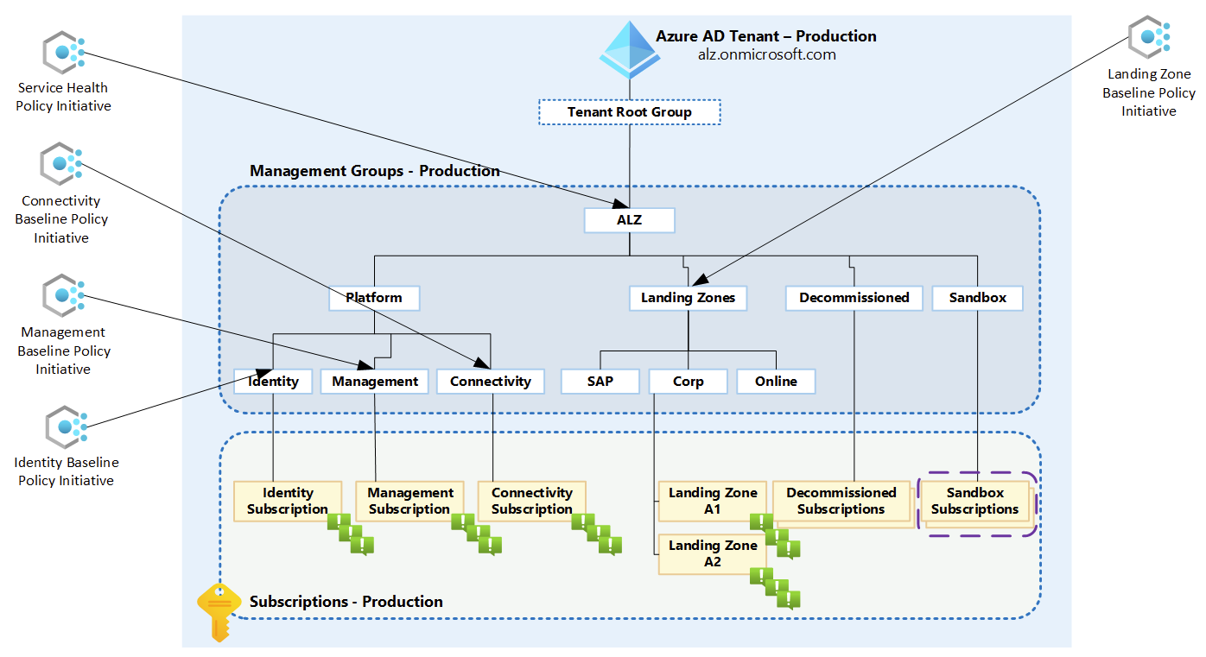
Azure Policy: AMBA
https://azure.github.io/azure-monitor-baseline-alerts/welcome/

Slide 32
Policies included in ALZ and AMBA
ALZ – 126 policies / Initiatives
AMBA – 98 policies / Initiatives
Notes:
Azure landing zones are the output of a multisubscription Azure environment that accounts for scale, security governance, networking, and identity.
Azure landing zones enable application migration, modernization, and innovation at enterprise-scale in Azure.
These zones consider all platform resources that are required to support the customer’s application portfolio and don’t differentiate between infrastructure as a service or platform as a service.
An Azure landing zone uses subscriptions to isolate and scale application resources and platform resources. Subscriptions for application resources are called application landing zones, and subscriptions for platform resources are called platform landing zones.
Sandbox The dedicated management group for subscriptions that will only be used for testing and exploration by an organization. These subscriptions will be securely disconnected from the corporate and online landing zones. Sandboxes also have a less restrictive set of policies assigned to enable testing, exploration, and configuration of Azure services.

Slide 33
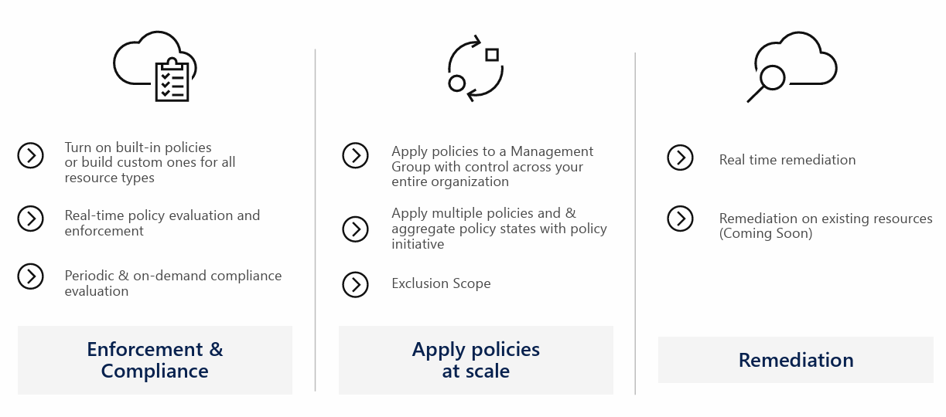
Enerprice level compliance

Slide 34
How to implement and adopt policies
Think what scope you deploy them to
Start with Resource Groups
If you already using ALZ, create Sandbox subscription and experiment there
Start with audit effect, then switch to modify / DINE at the smaller scope (RG)
Use Policy Initiative
Use IaC with CI/CD automation
Easier to scope the problem
Easier to rollback
Good practice

Slide 35
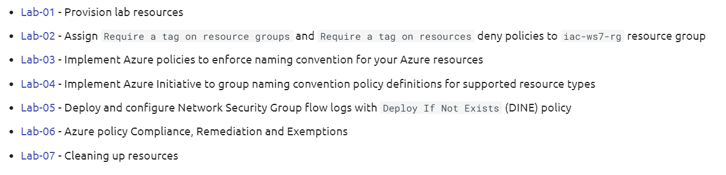
Labs
6 labs (plus lab-1 to deploy and lab-7 to cleanup)

Slide 36

Labs
Do not use your company Subscritpion
Some of the policies are deny policies and it can block creation of your resources
Do lab-07 to cleanup everything we created!

Slide 37


