Slide 1




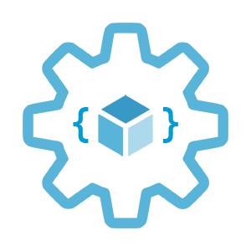

Working with Azure Private Links
Infrastructure as Code User Group Oslo
27.06.2023
with Evgeny Borzenin

Slide 2
Infrastructure as Code User Group roadmap
IaC workshops roadmap:
[x] 2021-2022 - AKS workshops 6 out of 8
[x] Automate workload provisioning with Azure DevOps
[x] Load-balancing options on Azure
[x] Automate DNS and certificates management on Azure
[ ] Working with Azure Container Apps
[ ] Working with Azure Private Links (June)
[ ] Working with Azure Policy (August)
[ ] Azure Landing Zones 101 (September)
“regular” events - very unlikely ☺, but ping me if you have interesting topic to present

Slide 3
Workshops in your organization
Infrastructure as Code (Bicep, ARM, Azure Landing Zones, Automation with Azure DevOps or GitHub Actions)
AKS workshops
Workshops can be adapted for your organization use-case
List of past workshops: https://borzenin.com/workshops/
Commercial offer from Enso AS
Contact me at evgeny@enso.no if any interest

Slide 4
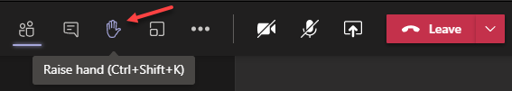
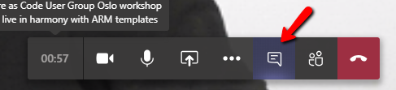

Microsoft Teams 101
Mute your mic (but don’t forget to unmute when you speak)
«Rise your hand» if you need some attention
Conversation/chat
Share screen

Slide 5
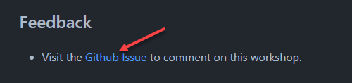
Practical information
Use the same naming conventions
When you done working with lab, post to the Conversation channel
lab-01 (lab-02, lab-03 etc…)
Feel free to contribute to the labs content
Feel free to left your comments on workshop main page

Slide 6
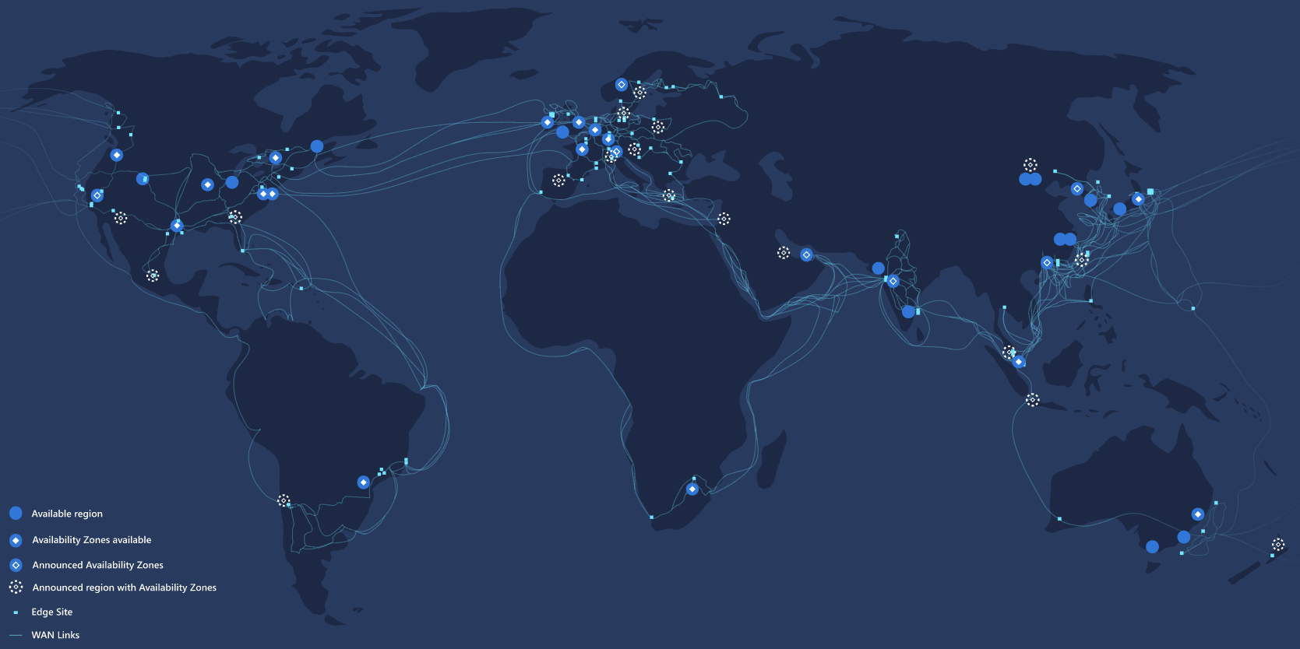
Azure Global Network

Slide 7

Azure Virtual Network (aka VNet)
fundamental building block
secure communication
with Internet
between Azure resources
on-premises
Filter network traffic
Route network traffic
integration for Azure services
Notes:
Azure Virtual Network (VNet) is the fundamental building block for your private network in Azure.
VNet enables many types of Azure resources, such as Azure Virtual Machines (VM), to securely communicate with each other, the internet, and on-premises networks.
VNet is similar to a traditional network that you'd operate in your own data center, but brings with it additional benefits of Azure's infrastructure such as scale, availability, and isolation.

Slide 8





Azure Virtual Network
Scoped to a subscription
Regional resource
Address space (IPv4 CIDR)
At least one subnet
-5 IPs from subnet (0-3, 255)
Min subnet size - /29 (3 IPs)
app-snet 10.20.0.0/23
api-snet 10.20.2.0/23
10.20.0.4
ndx-appa-vnet 10.20.0.0/22
ndx-foobar-rg
Sweden East
Subscription B

Slide 9
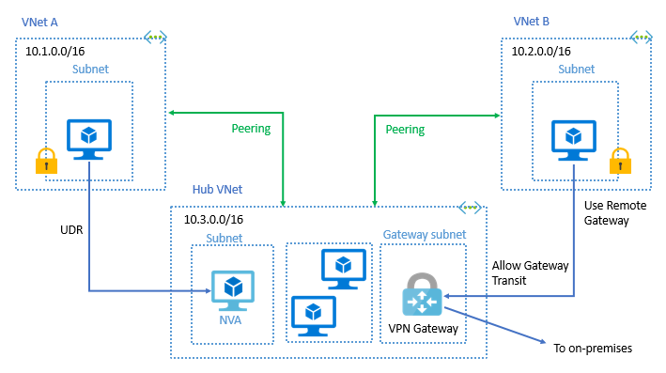
Azure Virtual Network
Virtual network peering
Global Virtual network peering (cross region)

Slide 10
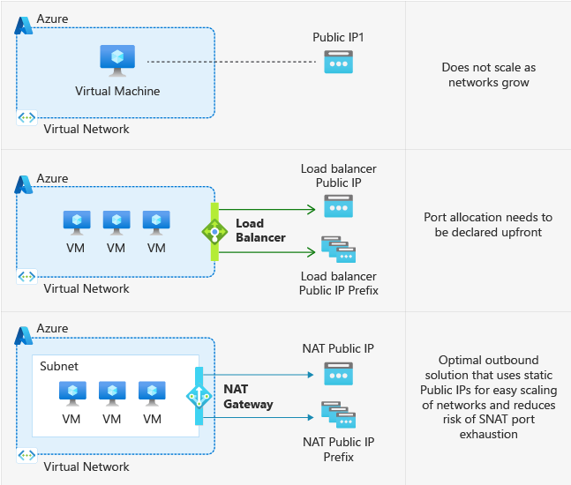
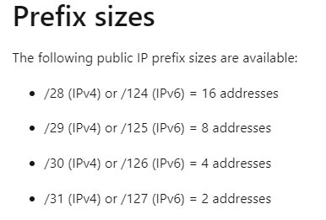
Outbound access
Implicit
Explicit

Slide 11

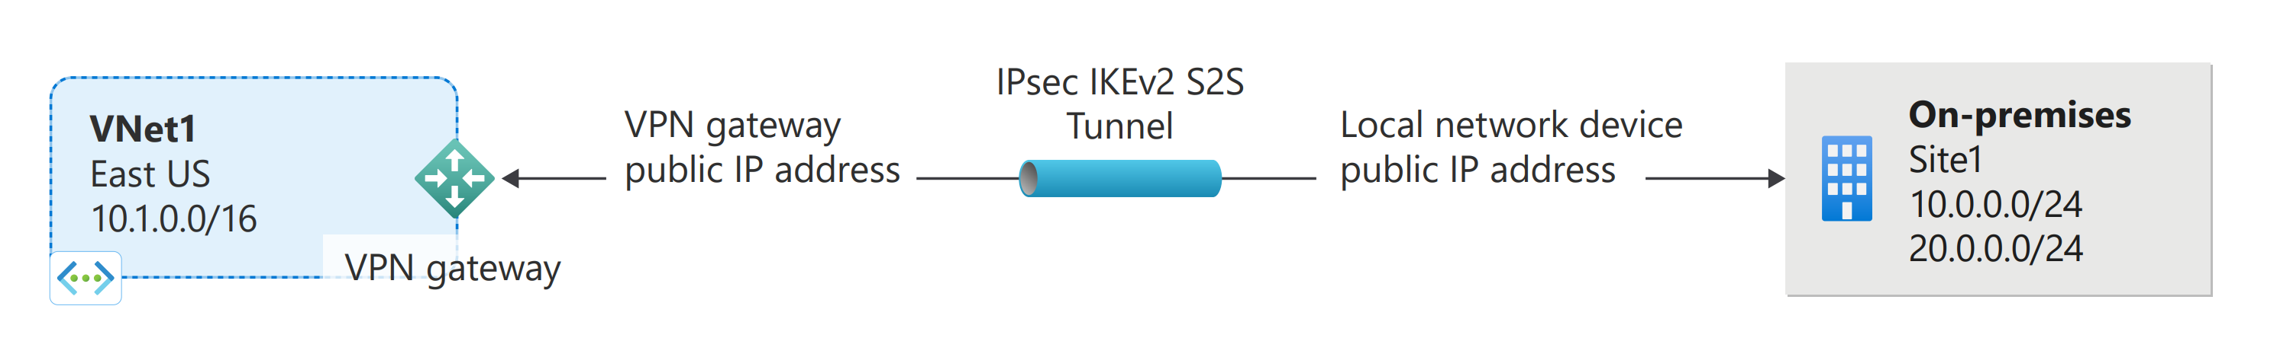
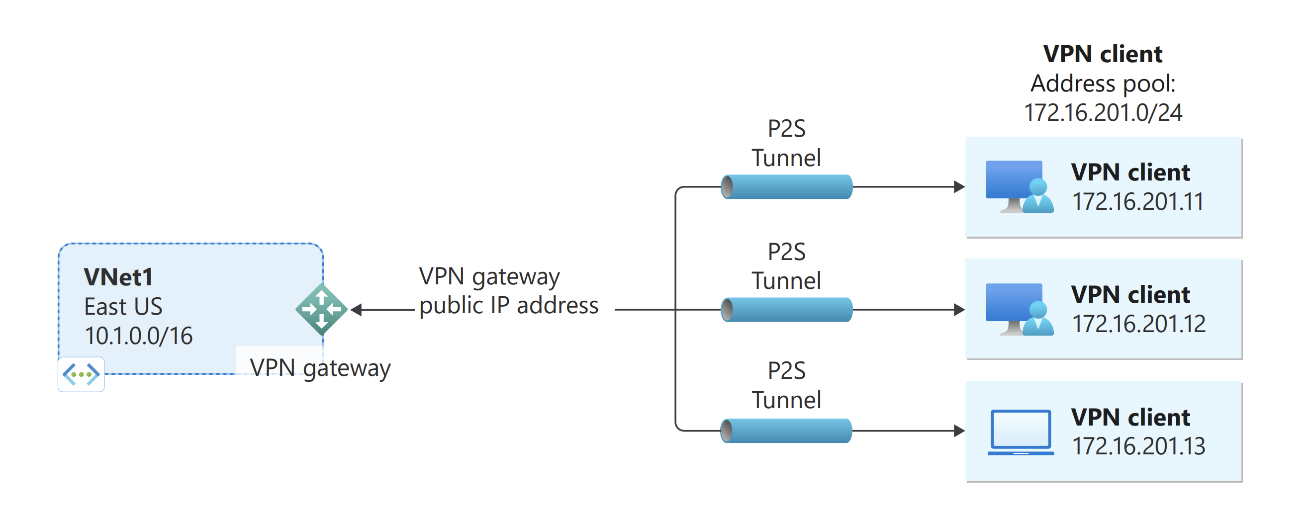
Inbound access: VPN Gateway
Site-to-site
Point-to-site
Notes:
https://learn.microsoft.com/en-us/azure/vpn-gateway/vpn-gateway-about-vpngateways
Azure VPN Gateway is a service that uses a specific type of virtual network gateway to send encrypted traffic between an Azure virtual network and on-premises locations over the public Internet. You can also use VPN Gateway to send encrypted traffic between Azure virtual networks over the Microsoft network.

Slide 12

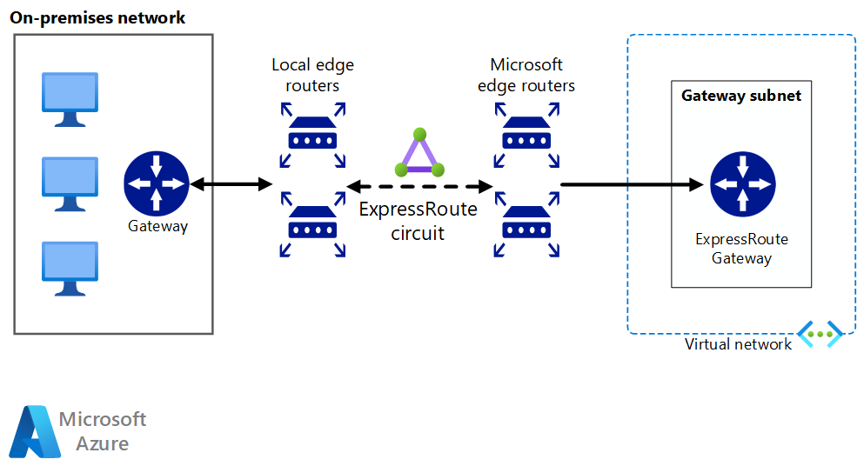
Inbound access: Azure Express Route
Notes:
ExpressRoute lets you extend your on-premises networks into the Microsoft cloud over a private connection with the help of a connectivity provider.

Slide 13
Application protection services
Network security groups (NSG)
Service endpoints
Private Links, Private Endpoints
Azure Firewall (AFW)
Web Application Firewall (WAF)
DDoS Protection

Slide 14

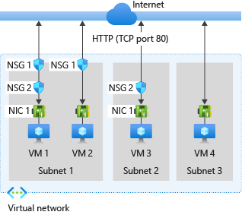
Network Security Group - NSG
NSG rule properties
Name
Priority
Source and Destination
Protocol
Direction (inbound | outbound)
Port range
Action (allow | deny)
https://learn.microsoft.com/en-us/azure/virtual-network/network-security-groups-overview
Notes:
You can use an Azure network security group to filter network traffic between Azure resources in an Azure virtual network. A network security group contains security rules that allow or deny inbound network traffic to, or outbound network traffic from, several types of Azure resources. For each rule, you can specify source and destination, port, and protocol.

Slide 15
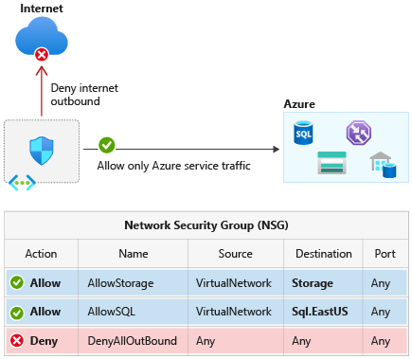
Service tags
Notes:
https://learn.microsoft.com/en-us/azure/virtual-network/service-tags-overview

Slide 16
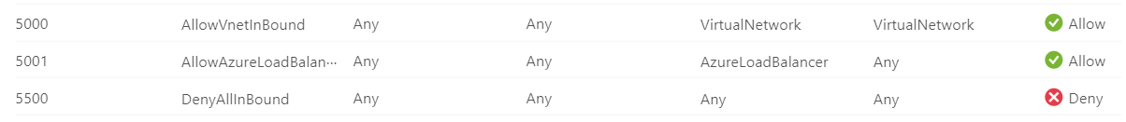
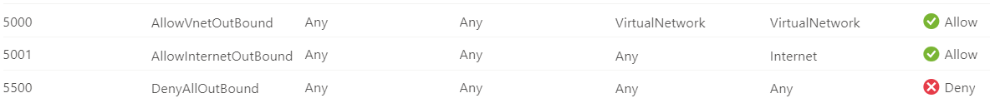
Network Security Group – default NSG rules
Inbound
Outbound

Slide 17
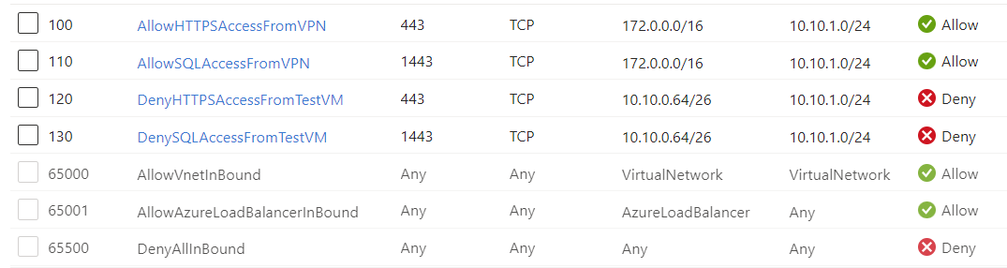
Network Security Group – examples
Inbound

Slide 18
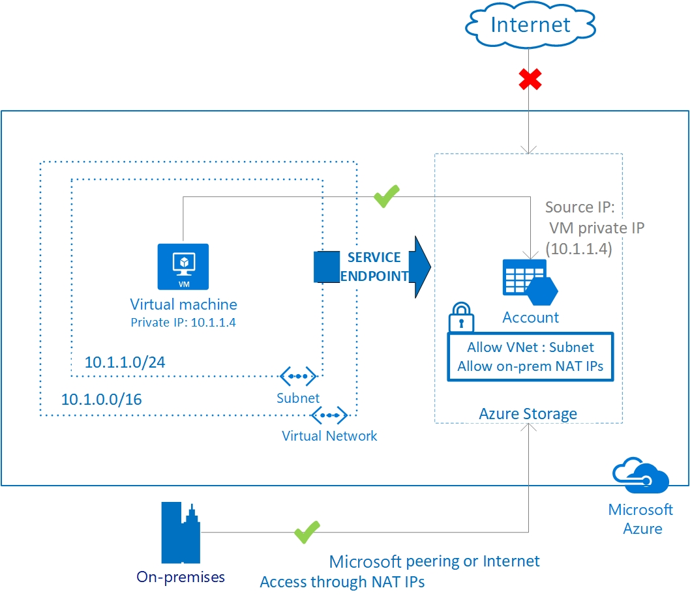
Service endpoints
Notes:
https://learn.microsoft.com/en-us/azure/virtual-network/virtual-network-service-endpoints-overview
Virtual Network (VNet) service endpoint provides secure and direct connectivity to Azure services over an optimized route over the Azure backbone network. Endpoints allow you to secure your critical Azure service resources to only your virtual networks. Service Endpoints enables private IP addresses in the VNet to reach the endpoint of an Azure service without needing a public IP address on the VNet.

Slide 19
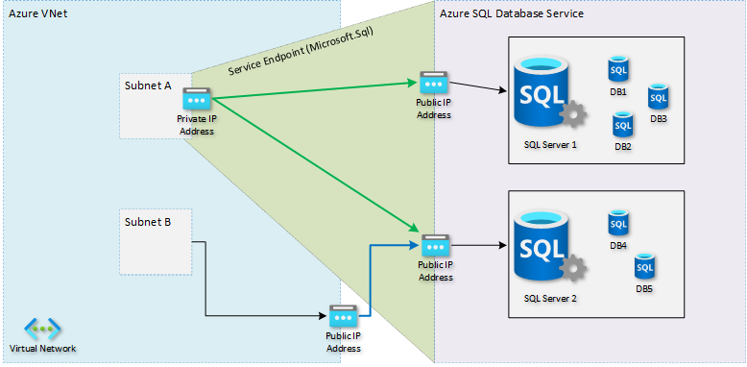
Service endpoints
Notes:
Virtual Network (VNet) service endpoint provides secure and direct connectivity to Azure services over an optimized route over the Azure backbone network. Endpoints allow you to secure your critical Azure service resources to only your virtual networks.
Service Endpoints enables private IP addresses in the VNet to reach the endpoint of an Azure service without needing a public IP address on the VNet.

Slide 20
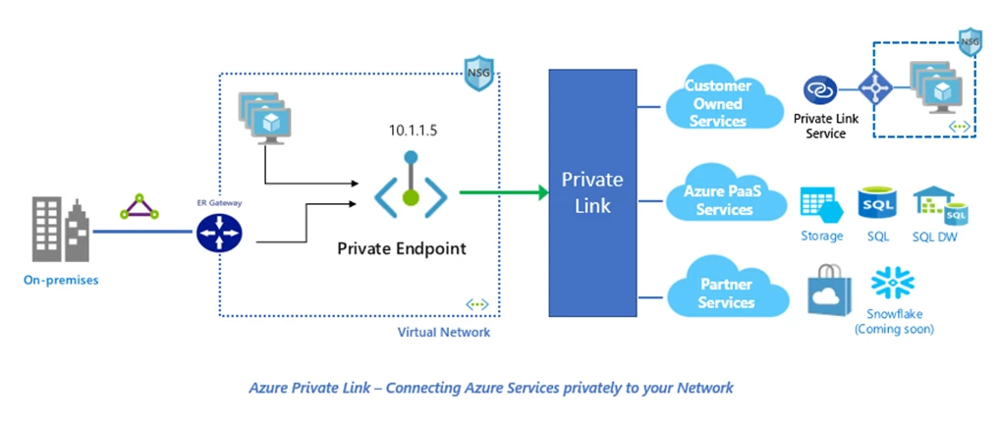
Private Endpoints and Private links
Privately access services on the Azure platform
On-premises and peered networks
Protection against data leakage
Extend to your own services
Notes:
Azure Private Link enables you to access Azure PaaS Services (for example, Azure KeyVault and SQL Database) and Azure hosted customer-owned/partner services over a private endpoint in your virtual network.
Traffic between your virtual network and the service travels the Microsoft backbone network.
Privately access services on the Azure platform
Connect your virtual network using private endpoints to all services that can be used as application components in Azure. Service providers can render their services in their own virtual network and consumers can access those services in their local virtual network. The Private Link platform will handle the connectivity between the consumer and services over the Azure backbone network.
On-premises and peered networks
Access services running in Azure from on-premises over ExpressRoute private peering, VPN tunnels, and peered virtual networks using private endpoints. There's no need to configure ExpressRoute Microsoft peering or traverse the internet to reach the service. Private Link provides a secure way to migrate workloads to Azure.
Protection against data leakage
A private endpoint is mapped to an instance of a PaaS resource instead of the entire service. Consumers can only connect to the specific resource. Access to any other resource in the service is blocked. This mechanism provides protection against data leakage risks.
Extend to your own services
Enable the same experience and functionality to render your service privately to consumers in Azure. By placing your service behind a standard Azure Load Balancer, you can enable it for Private Link. The consumer can then connect directly to your service using a private endpoint in their own virtual network. You can manage the connection requests using an approval call flow. Azure Private Link works for consumers and services belonging to different Azure Active Directory tenants.
You can use private endpoints for your Azure Storage accounts to allow clients on a virtual network (VNet) to securely access data over a Private Link. The private endpoint uses a separate IP address from the VNet address space for each storage account service. Network traffic between the clients on the VNet and the storage account traverses over the VNet and a private link on the Microsoft backbone network, eliminating exposure from the public internet.
Exposing your service to the public internet is no longer necessary. You can create your own private link service in your virtual network and deliver it to your customers.

Slide 21
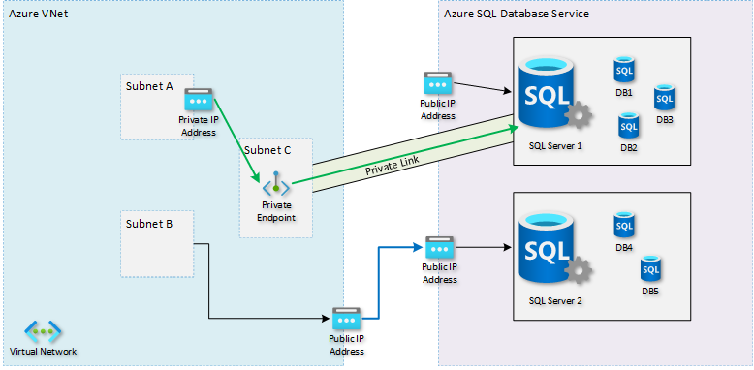
Private Endpoints and Private links

Slide 22
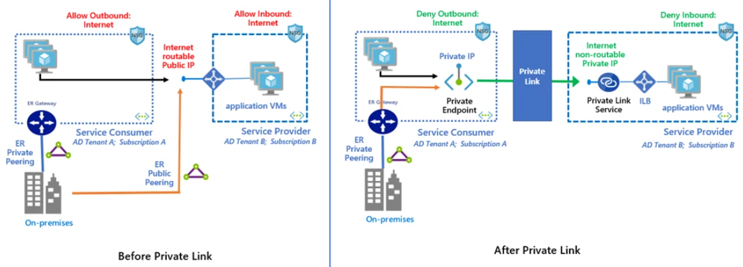
Private connectivity to your own service
https://learn.microsoft.com/en-us/azure/private-link/private-link-service-overview

Slide 23


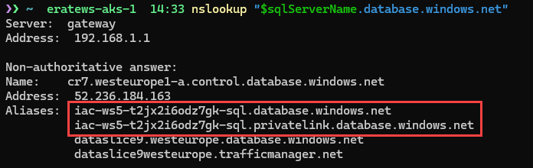
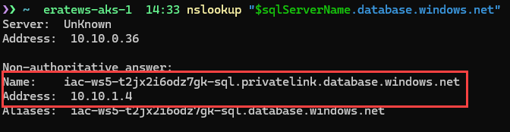
Private Endpoint Name Resolution
Host file
Use a private DNS zone
Use your DNS forwarder
privatelink.database.windows.net
foobar.privatelink.database.windows.net A 10.10.0.6
10.10.0.6
10.10.0.0/24
foobar.database.windows.net A 52.236.184.163
Notes:
It's important to correctly configure your DNS settings to resolve the private endpoint IP address to the fully qualified domain name (FQDN) of the connection string.
Existing Microsoft Azure services might already have a DNS configuration for a public endpoint. This configuration must be overridden to connect using your private endpoint.
The network interface associated with the private endpoint contains the information to configure your DNS. The network interface information includes FQDN and private IP addresses for your private link resource.

Slide 24
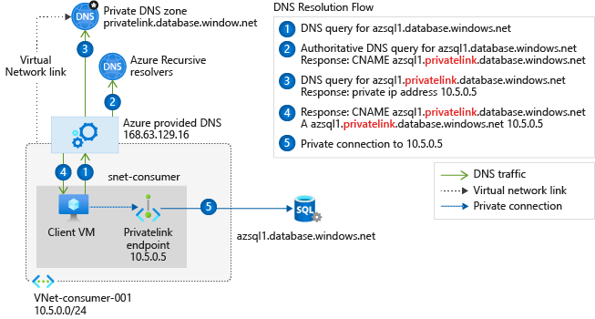
Virtual network workloads without custom DNS server

Slide 25
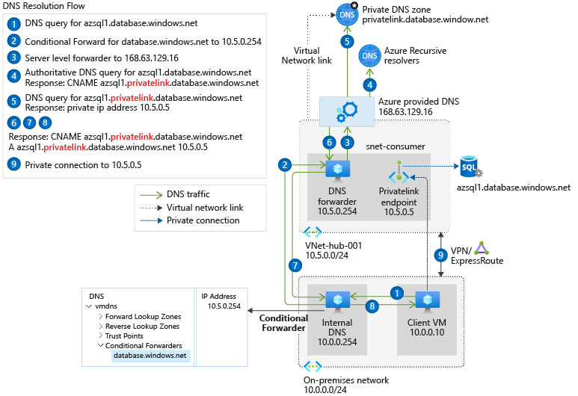
On-premises workloads using a DNS forwarder

Slide 26

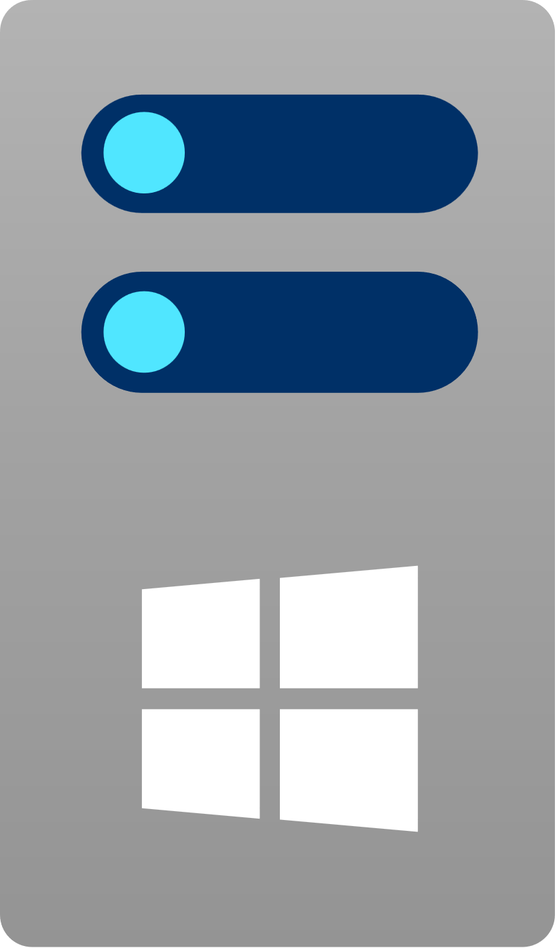
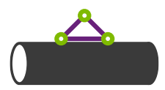

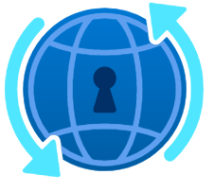
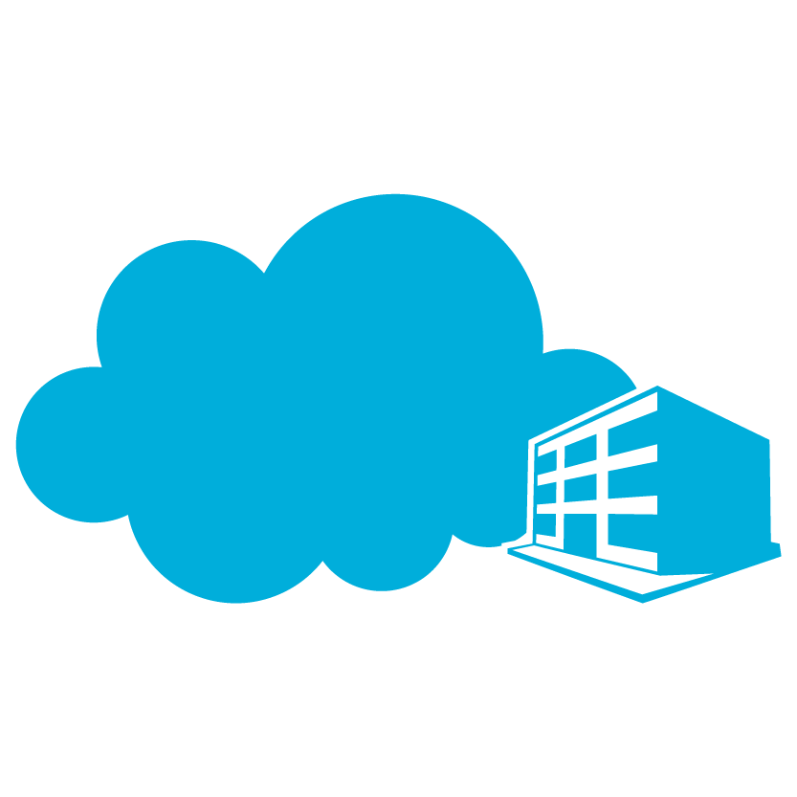
Azure Private DNS Resolver
Azure
abc.privatelink.blob.core.windows.net – 7.7.7.7
abc.privatelink.azure-api.net - 6.6.6.6
Azure Private DNS
B
Virtual network link
4
Azure DNS
Azure ExpressRoute
10.0.0.0/24
A
On-premises
3
10.1.0.0/24
APP 1
10.0.0.0/28
Spoke 1
On-premises server
A
VM 1
APP 2
1
APP 3
10.2.0.0/24
Windows desktops
DNS Query
Inbound endpoint 10.0.0.8
Spoke 2
2
Site-to-site or Azure ExpressRoute gateway
10.0.0.16/28
VM 2
Peering (optional)
192.168.0.1 / 2
Azure DNS Private Resolver
App1.onprem.company.com - 192.168.0.8
App2.onprem.company.com - 192.168.0.9
privatelink.blob.core.windows.net – 10.0.0.8 (forwarder)
privatelink.azure-api.net – 10.0.0.8 (forwarder)
Outbound endpoint 10.0.0.19
https://learn.microsoft.com/en-us/azure/dns/dns-private-resolver-overview
Notes:
Azure DNS Private Resolver is a service that enables you to query Azure DNS private zones from an on-premises environment and vice versa without deploying VM based DNS servers.
Azure DNS Private Resolver requires an Azure Virtual Network. When you create an Azure DNS Private Resolver inside a virtual network, one or more inbound endpoints are established that can be used as the destination for DNS queries.

Slide 27
NSG support for Private Endpoint
Enable PrivateEndpointNetworkPolicies at the subnet
Doesn’t support NSG flow logs ☹

Slide 28
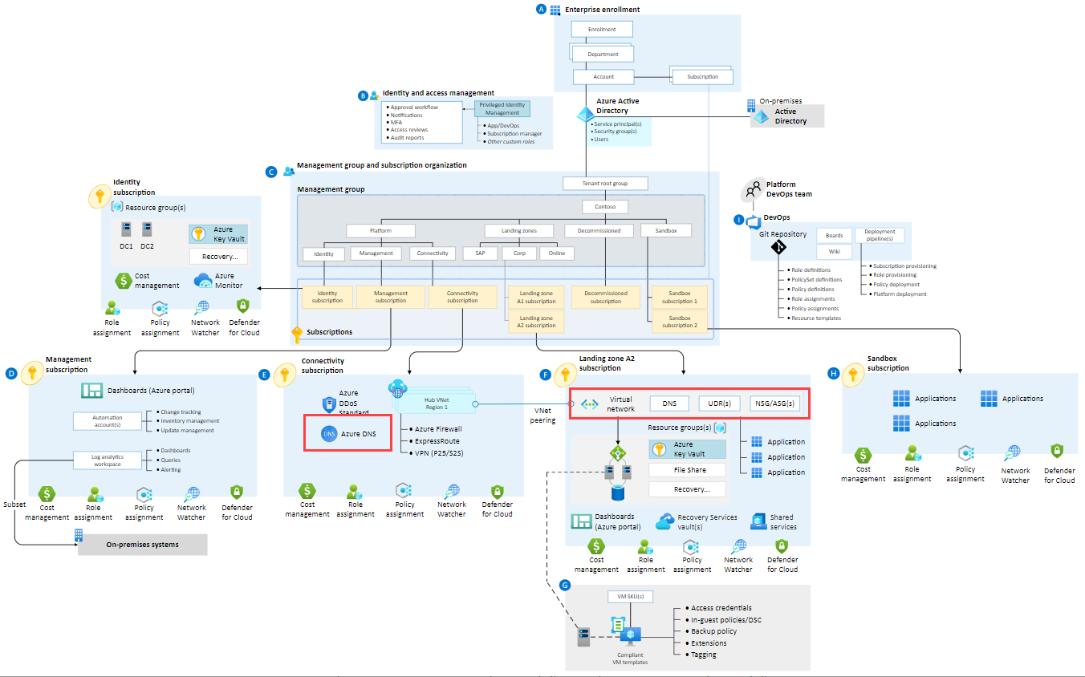
Private Endpoints in Azure Landing Zone
Private Zones at Connectivity LZ
Private Endpoint at Workload LZ
Workload SPN doesn’t have permissions at Connectivity LZ

Slide 29

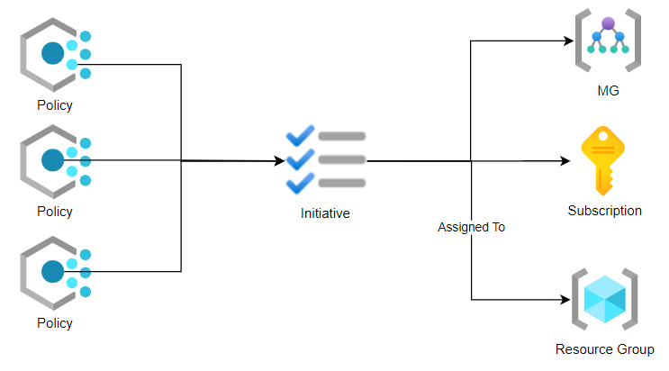
Governance : Azure Policy
Evaluates resources and actions
Compares properties of the resourse to rules
Rules are JSON
Policy effects (not completed):
Deny
Audit
DeployIfNotExists
Modify
Notes:
Azure Policy evaluates resources and actions in Azure by comparing the properties of those resources to business rules.

Slide 30
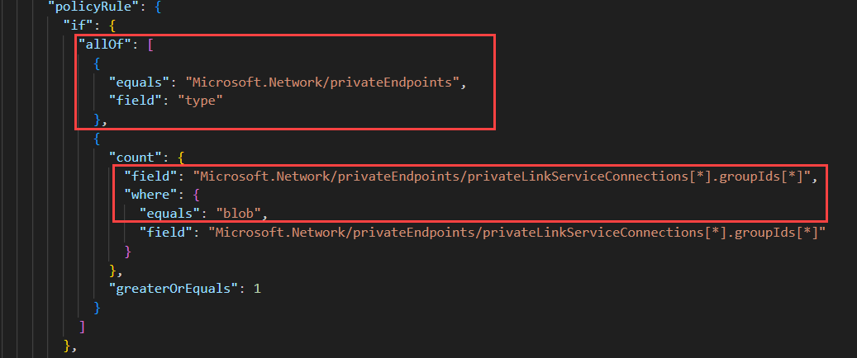
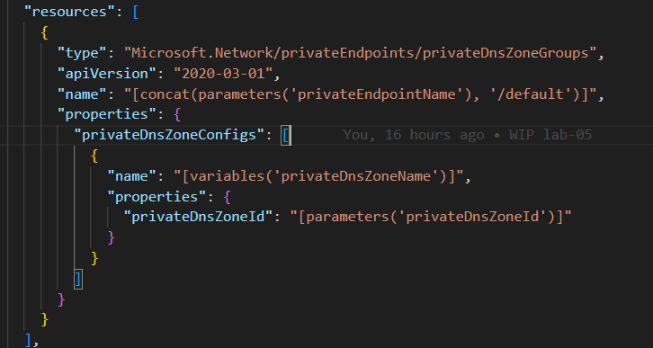
Deploy Storage Account Blob Private Endpoint DNS Record Policy

Slide 31
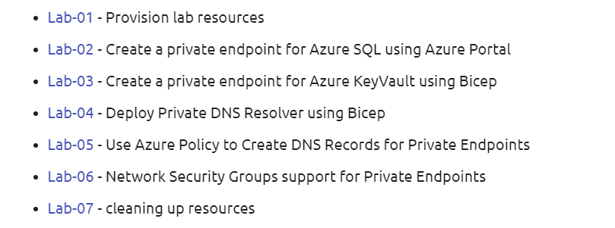
Labs

Slide 32


