Slide 1
MedSAM-U
Uncertainty-Guided Auto Multi-Prompt Adaptation for Reliable MedSAM
Research Paper Presentation
Sudhanshu Kumar
B.Tech, Artificial Intelligence & Machine Learning

Slide 2
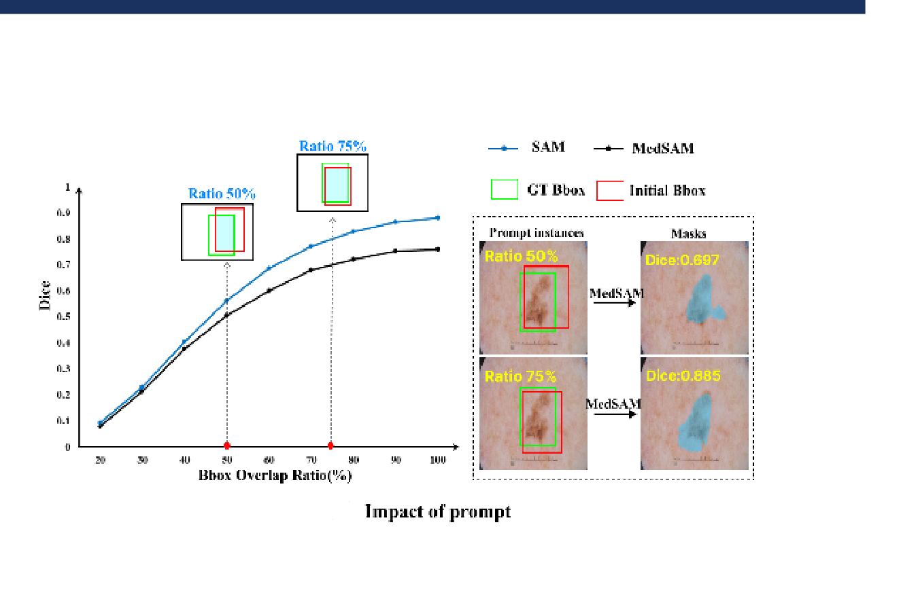
Introduction
• SAM is a prompt-based segmentation model. • MedSAM adapts SAM for medical image segmentation. • MedSAM depends on the quality of the initial bounding-box prompt. • An inaccurate prompt can lead to inaccurate segmentation. • MedSAM-U uses uncertainty to improve the prompt.

Slide 3
Literature Study
SAM → MedSAM → MedSAM-U
SAM • Prompt-based segmentation • Supports point and box prompts MedSAM • Medical adaptation of SAM • Uses bounding-box prompts Research Gap • Sensitive to prompt quality • Uncertainty can be used to guide prompt refinement
The paper combines: 1. MPA-MedSAM 2. UGMP 3. UGPA The aim is to make segmentation more reliable when the initial prompt is imperfect.

Slide 4
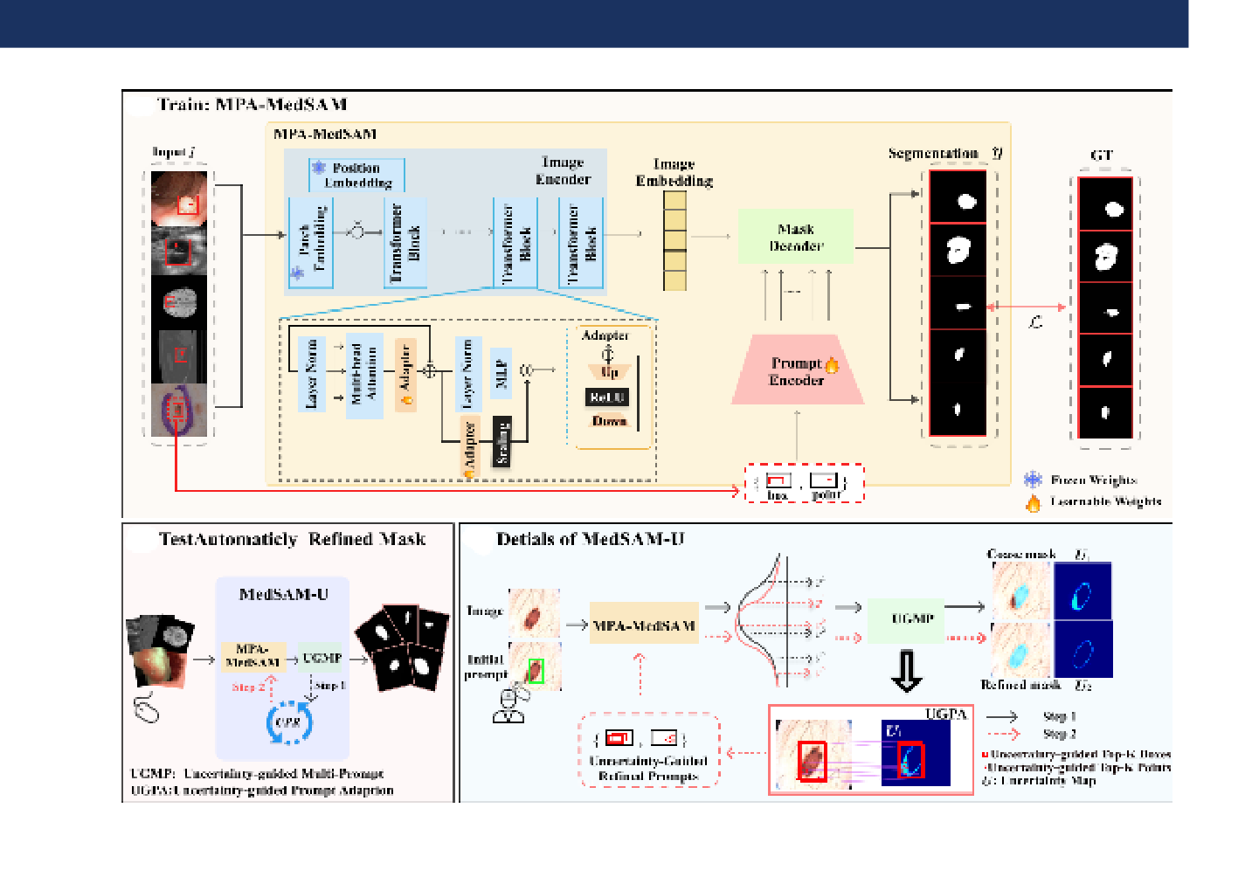
Contribution
MPA-MedSAM Adapts MedSAM to work with point and box prompts. UGMP Generates multiple perturbed prompts and estimates uncertainty from their predictions. UGPA Uses uncertain regions to refine the prompts and performs segmentation again.

Slide 5
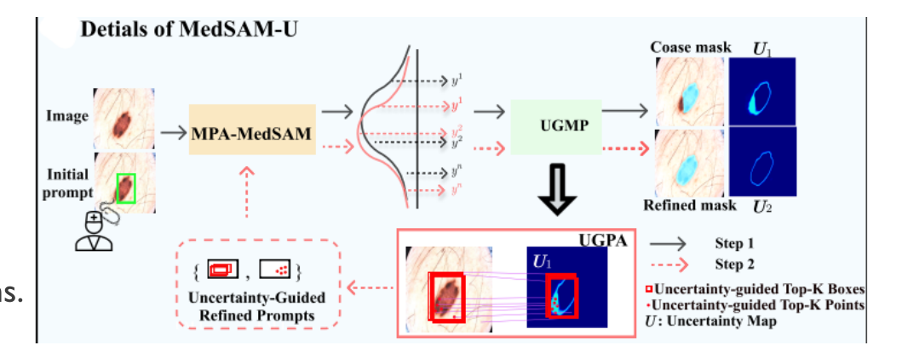
Methodology
UGMP: 1. Start with an initial bounding box. 2. Generate multiple perturbed boxes. 3. Run MedSAM for every box. 4. Obtain multiple masks and probability maps. 5. Calculate entropy to obtain the uncertainty map. UGPA: Uses the high-uncertainty regions to create refined prompts.
UGMP & UGPA

Slide 6
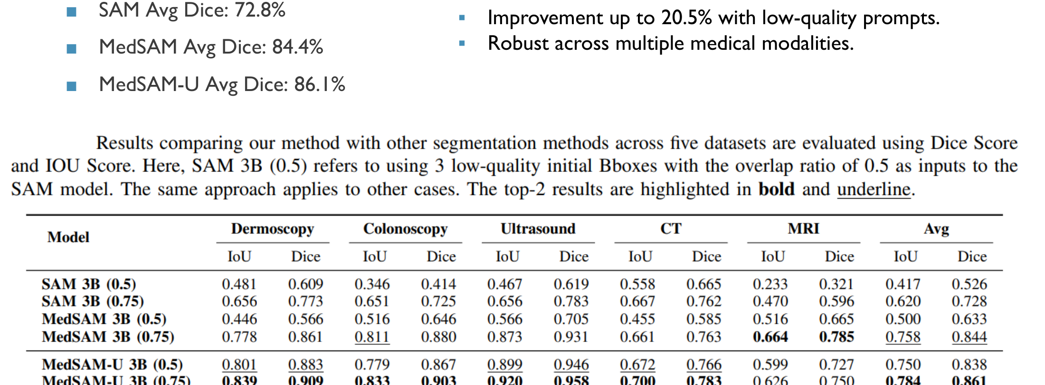
Results
Datasets: • ISIC-2017 • Kvasir-SEG • CT2US • KiTS23 • BraTS 2021 Average Dice: SAM: 72.8% MedSAM: 84.4% MedSAM-U: 86.1%

Slide 7
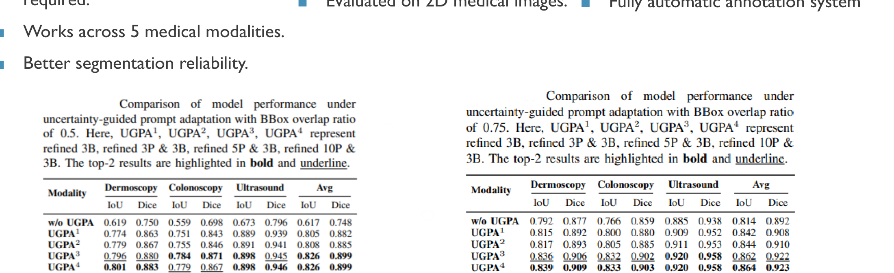
Comparison Study
SAM 72.8% average Dice MedSAM 84.4% average Dice MedSAM-U 86.1% average Dice The paper reports improvements of up to 20.5% when the initial prompts are of low quality.

Slide 8
Conclusion & Future Work
Conclusion • MedSAM-U uses uncertainty to refine segmentation prompts. • Multiple predictions help identify uncertain regions. • The paper reports better results than SAM and MedSAM. Limitations • Two-stage inference increases computation. • Evaluation focuses on 2D medical images.
Future Work • Integrate uncertainty estimation into the adapter. • Develop a more automatic annotation system. My Implementation • UGMP prototype implemented in Google Colab. • Generated perturbed boxes. • Generated multiple MedSAM masks. • Calculated probability maps and entropy.

