Slide 1
On Premises Power BI
Dan O’Dea
Sr. Consultant
Feb 22, 2017

Slide 2
Power BI - Quick Overview
Business analytics service provided by Microsoft
Allows for self-service business intelligence
Power BI Desktop
Consume data from cloud and third party services as well as on prem data sources.
Azure
Amazon Redshift data connector
Onsite via Power BI gateways
Publish Powerbi.com or Office 365 SharePoint online

Slide 3
Case for On Premises
Cloud Readiness
Corporate IT policy, no data in cloud
Cloud IT governance strategy, executive sponsorship
Corporate culture, apprehension to the cloud
Control, own and manage infrastructure
Ensure regulatory compliance, sensitive data where it should not belong
Ethical handling of information / HIPAA, etc.
Security

Slide 4
Organizations Desire an On Premises Option
High priority on Microsoft BI roadmap
SQL Server vNext
Publish and consume on-prem
Expected GA in mid-2017
Technical Preview
January 2017 Technical Preview – available as download
Power BI reports in SQL Server Reporting Services
Power BI desktop
Also, pre-configured Azure VM

Slide 5


Power BI Reports in SQL Server Reporting Services (SSRS)
Host Power BI reports within SSRS
Reporting Services web portal replaces Report Manager
Reports must be created with Power BI Desktop (no browser-based app)*
Only live connections to SSAS (tabular or multidimensional)*
No support for custom visuals*
No support for R visuals*
More information:
Tech preview download and what’s new
https://msdn.microsoft.com/en-us/library/ms170438.aspx
Pre-configured Azure VM
https://portal.azure.com/#create/reportingservices.technical-previewpreview
* as of January 2017 tech preview

Slide 6
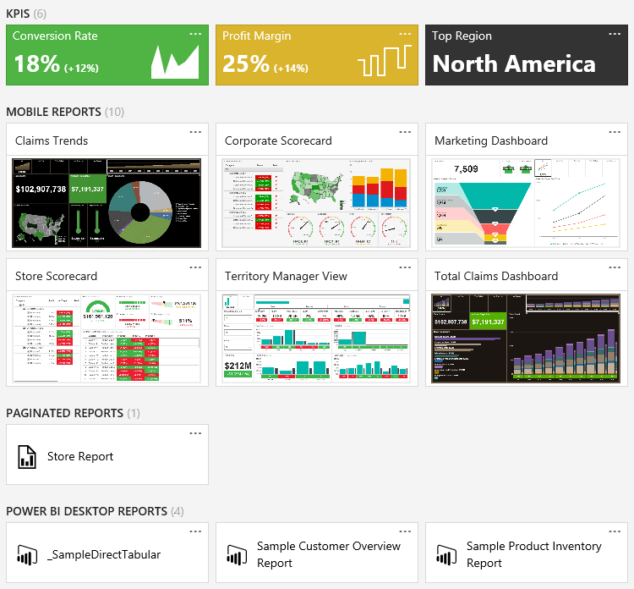
Demo
Power BI reports in SQL Server Reporting Services: Technical Preview

Slide 7
Questions?

Slide 8
Appendix

Slide 9
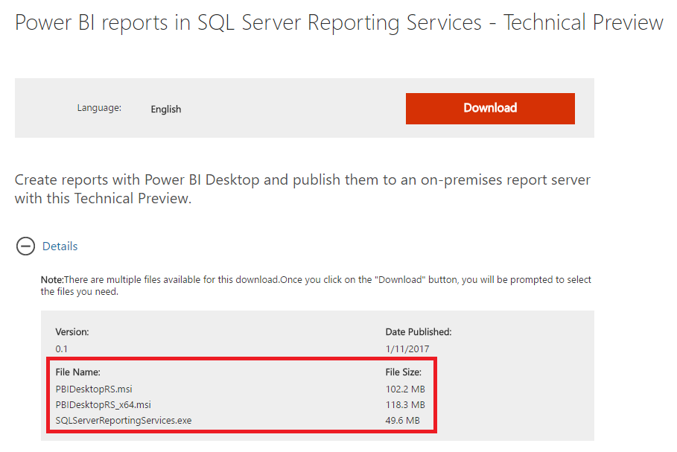
Download and Install Preview
https://go.microsoft.com/fwlink/?linkid=839351

Slide 10
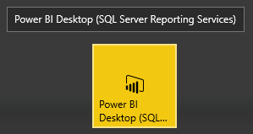
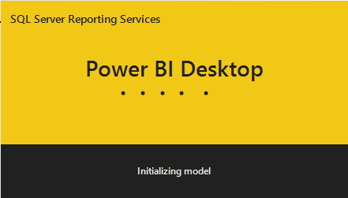
Launch Power BI Desktop
Installs alongside existing Power BI installation
SSRS appended to name

Slide 11
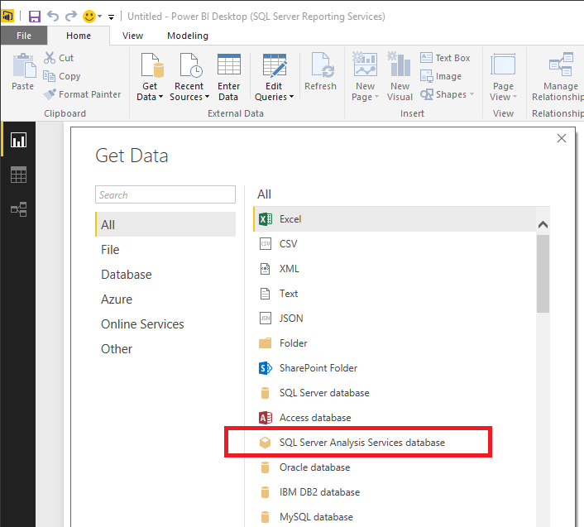
Select and configure a data source

Slide 12
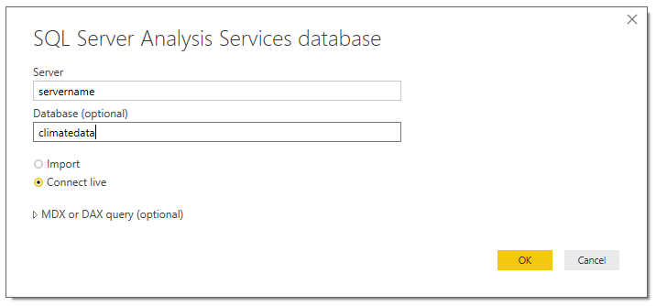
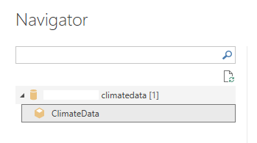
Enter server name and database
Select “Connect live”. “Import” will not work.
Select data model

Slide 13
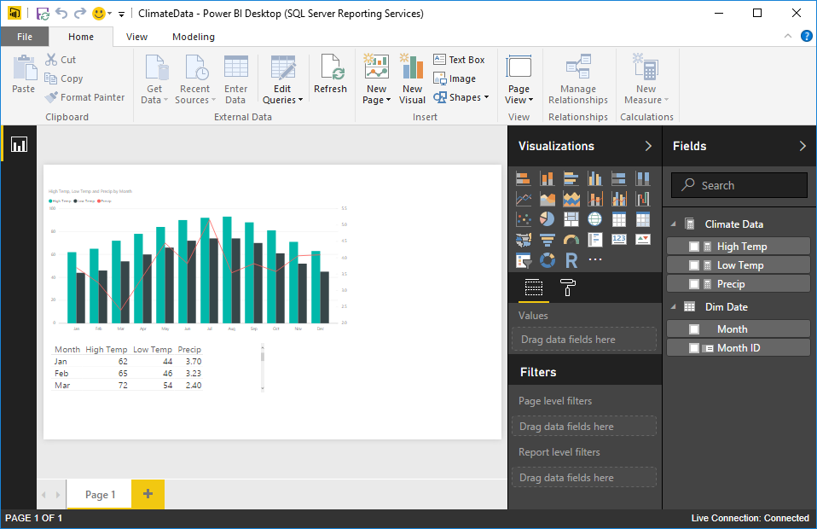
Create Report

Slide 14
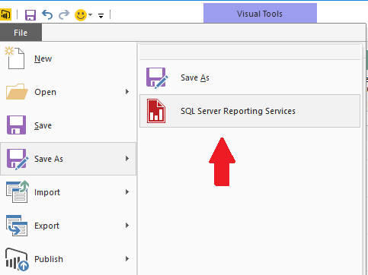
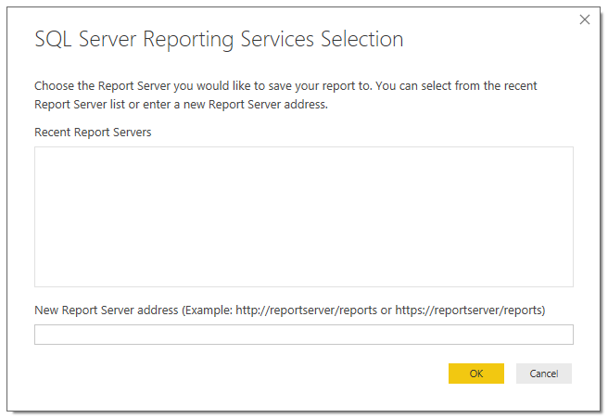
Save report to Reporting Services

Slide 15
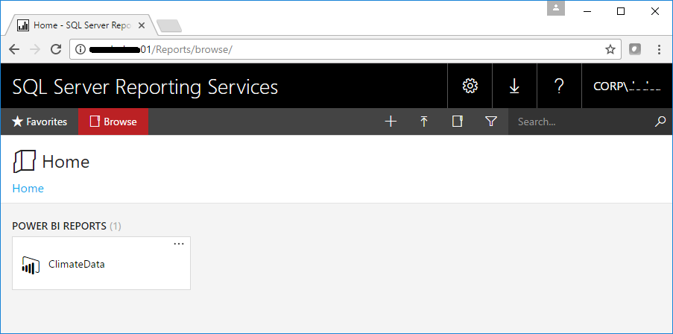
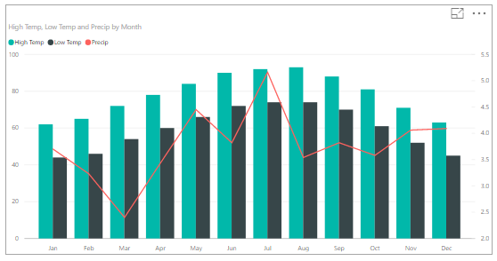
Browser report in Reporting Services web portal

Slide 16
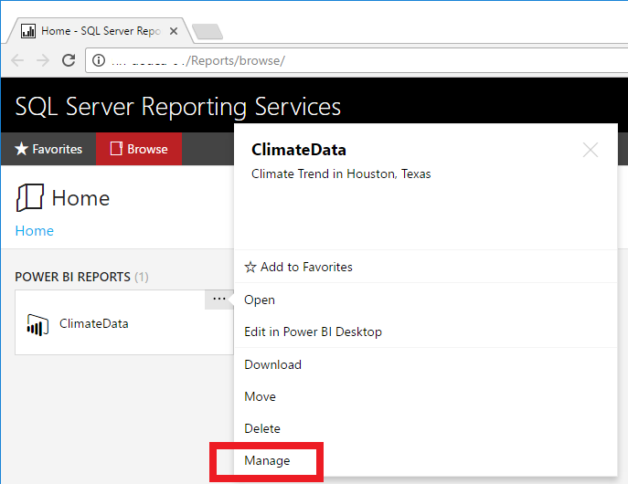
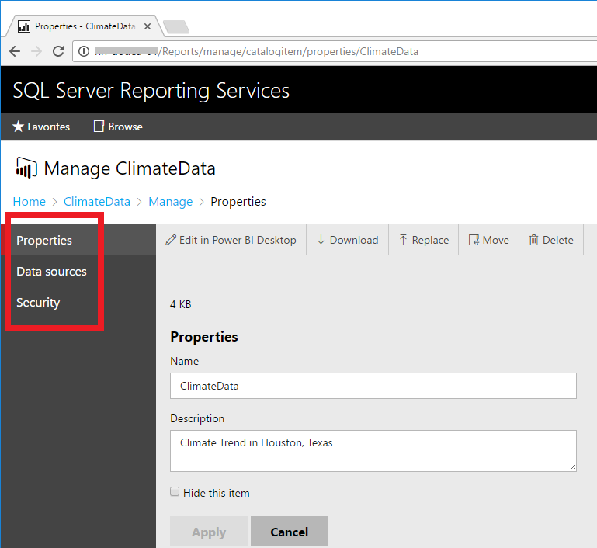
Explore options for managing reports

Slide 17
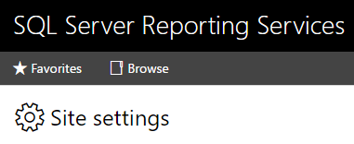
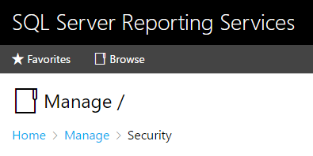
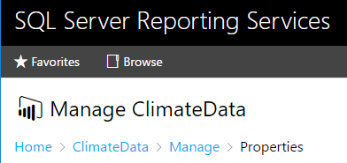
Security can be managed different levels
Site, Folder, Report

Slide 18
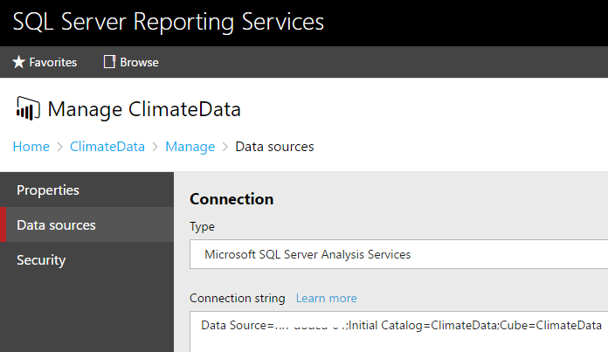
Data source can be changed

Slide 19
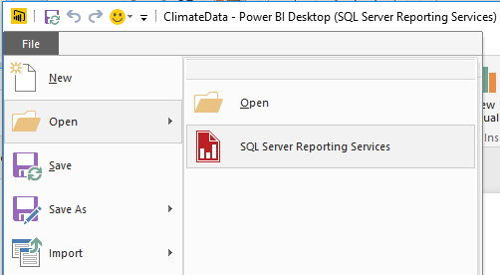
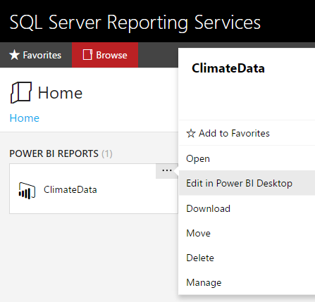
Edit existing report saved to Reporting Services web portal
Open report from Power BI Desktop or launch from web portal

Slide 20
Resources
What's new in Reporting Services
https://msdn.microsoft.com/en-us/library/ms170438.aspx
SSRS Team Blog announcing Tech Preview
https://blogs.msdn.microsoft.com/sqlrsteamblog/2017/01/17/power-bi-reports-in-sql-server-reporting-services-january-2017-technical-preview-now-available/
Pre-configured Azure VM
https://portal.azure.com/#create/reportingservices.technical-previewpreview
Download Technical Preview
https://go.microsoft.com/fwlink/?linkid=839351

