Slide 1
CONTACTLESS STAPLE FOOD VENDING MACHINE

Slide 2
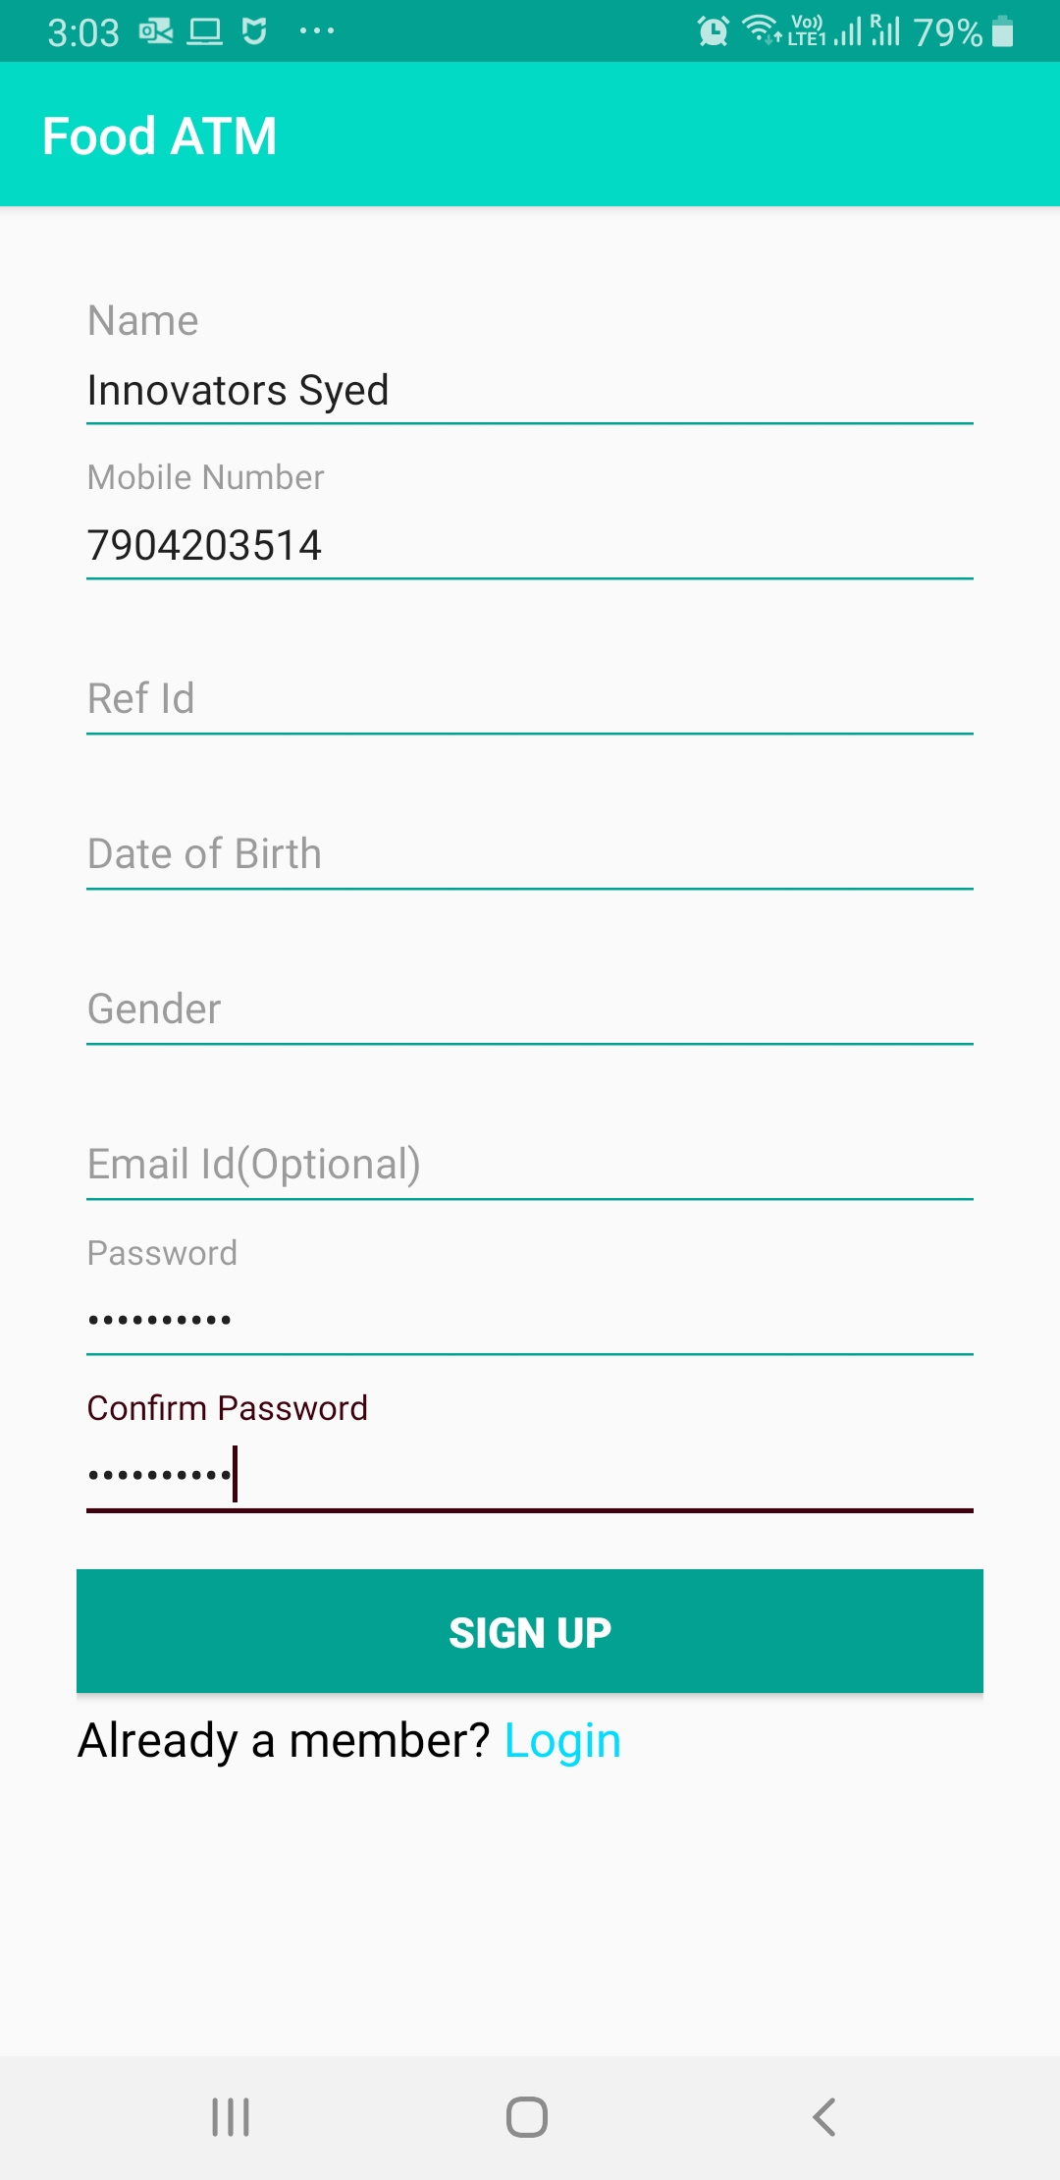
Sign Up

Slide 3
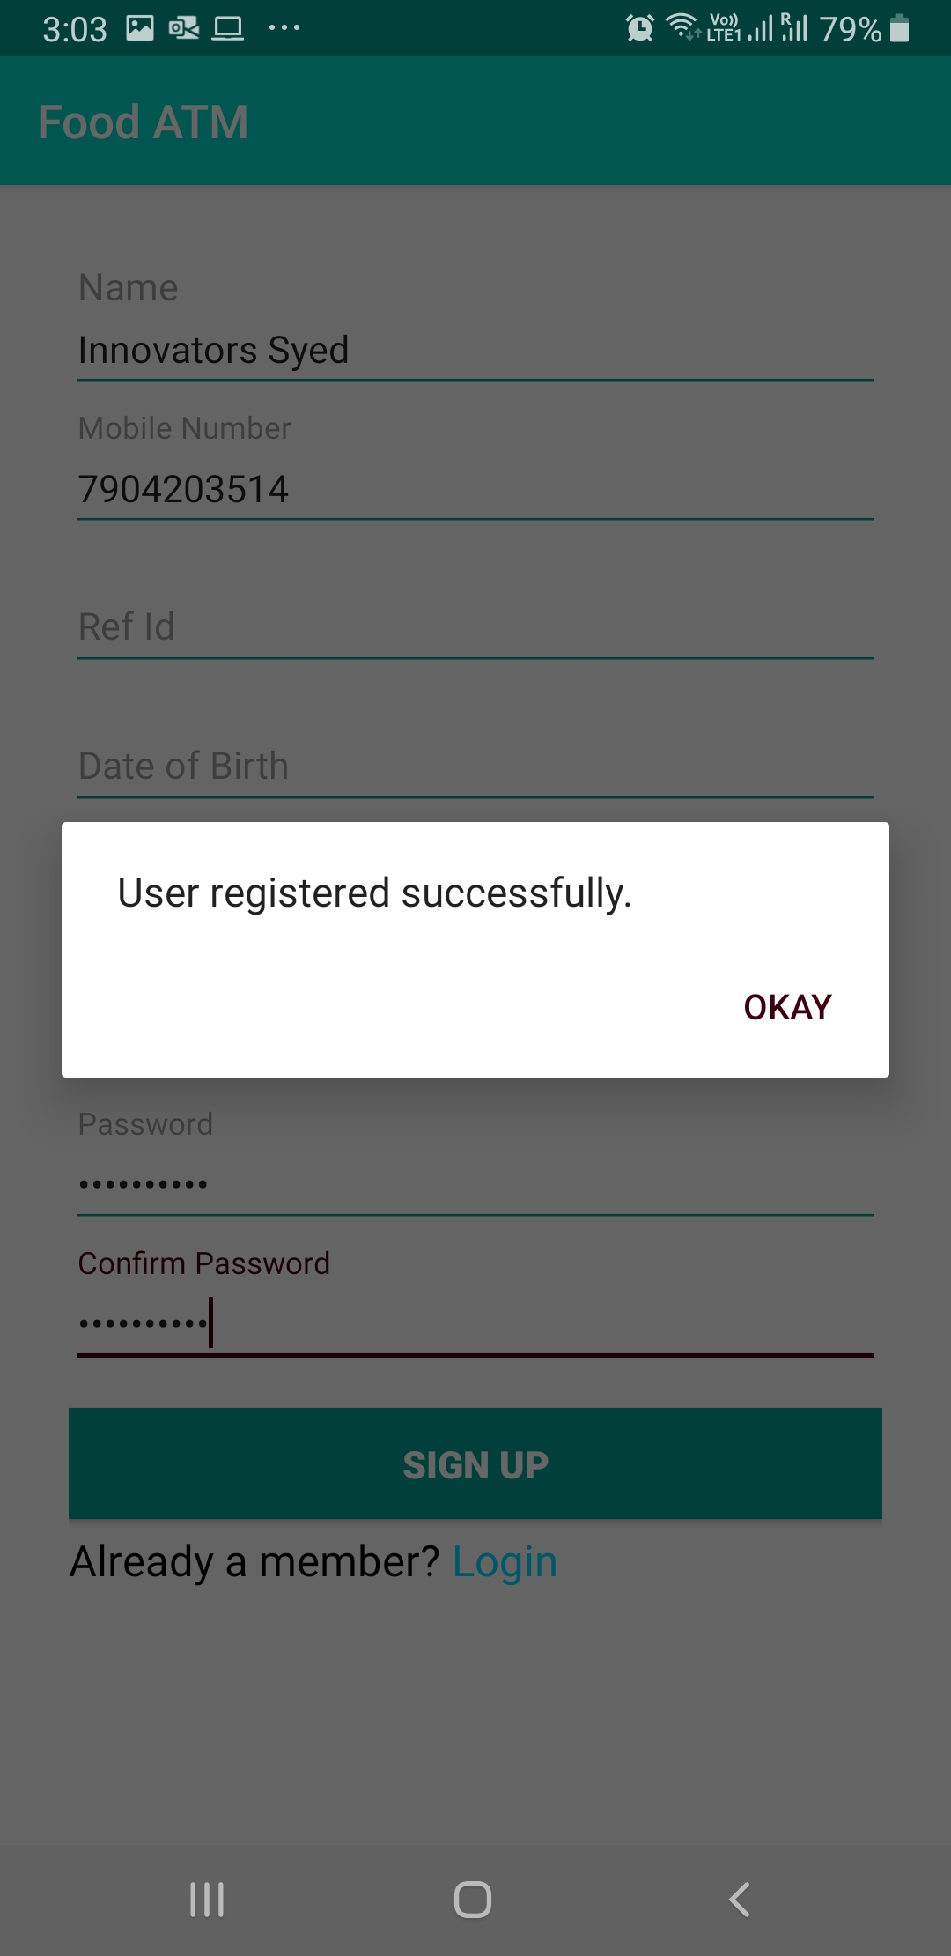

Slide 4
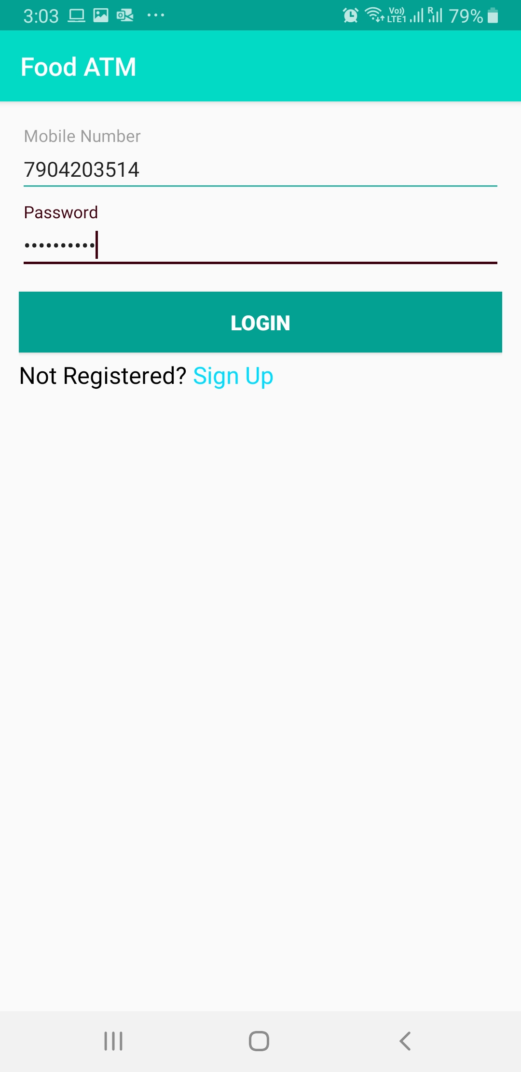
Login

Slide 5
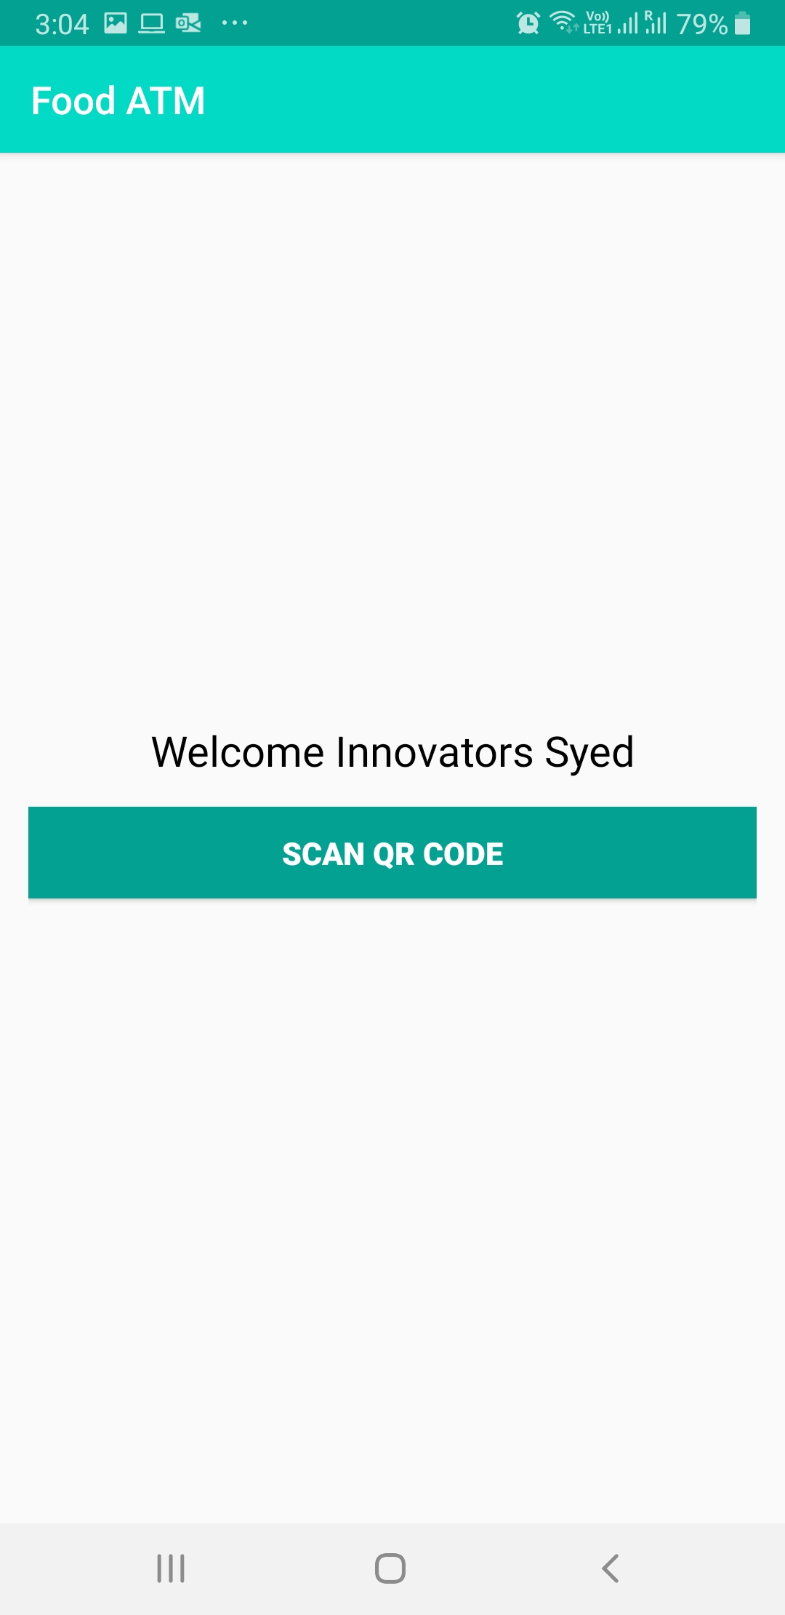
Home Page

Slide 6
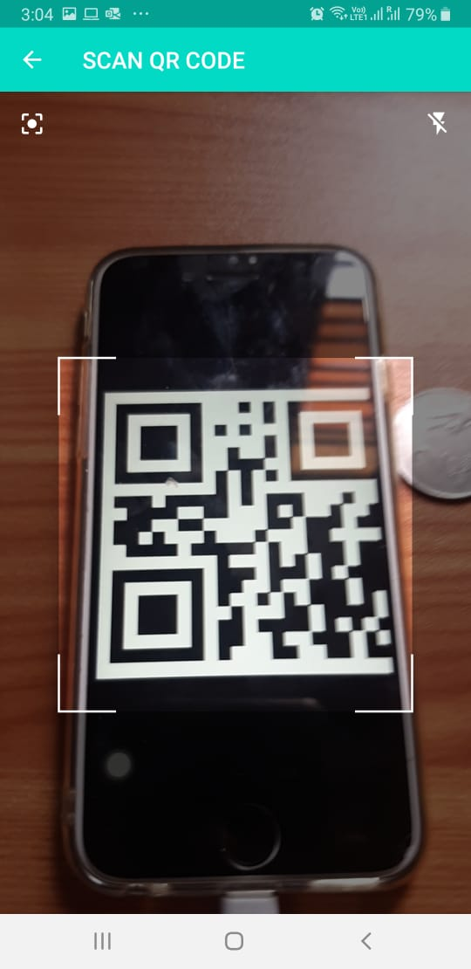
Scan QR Code

Slide 7
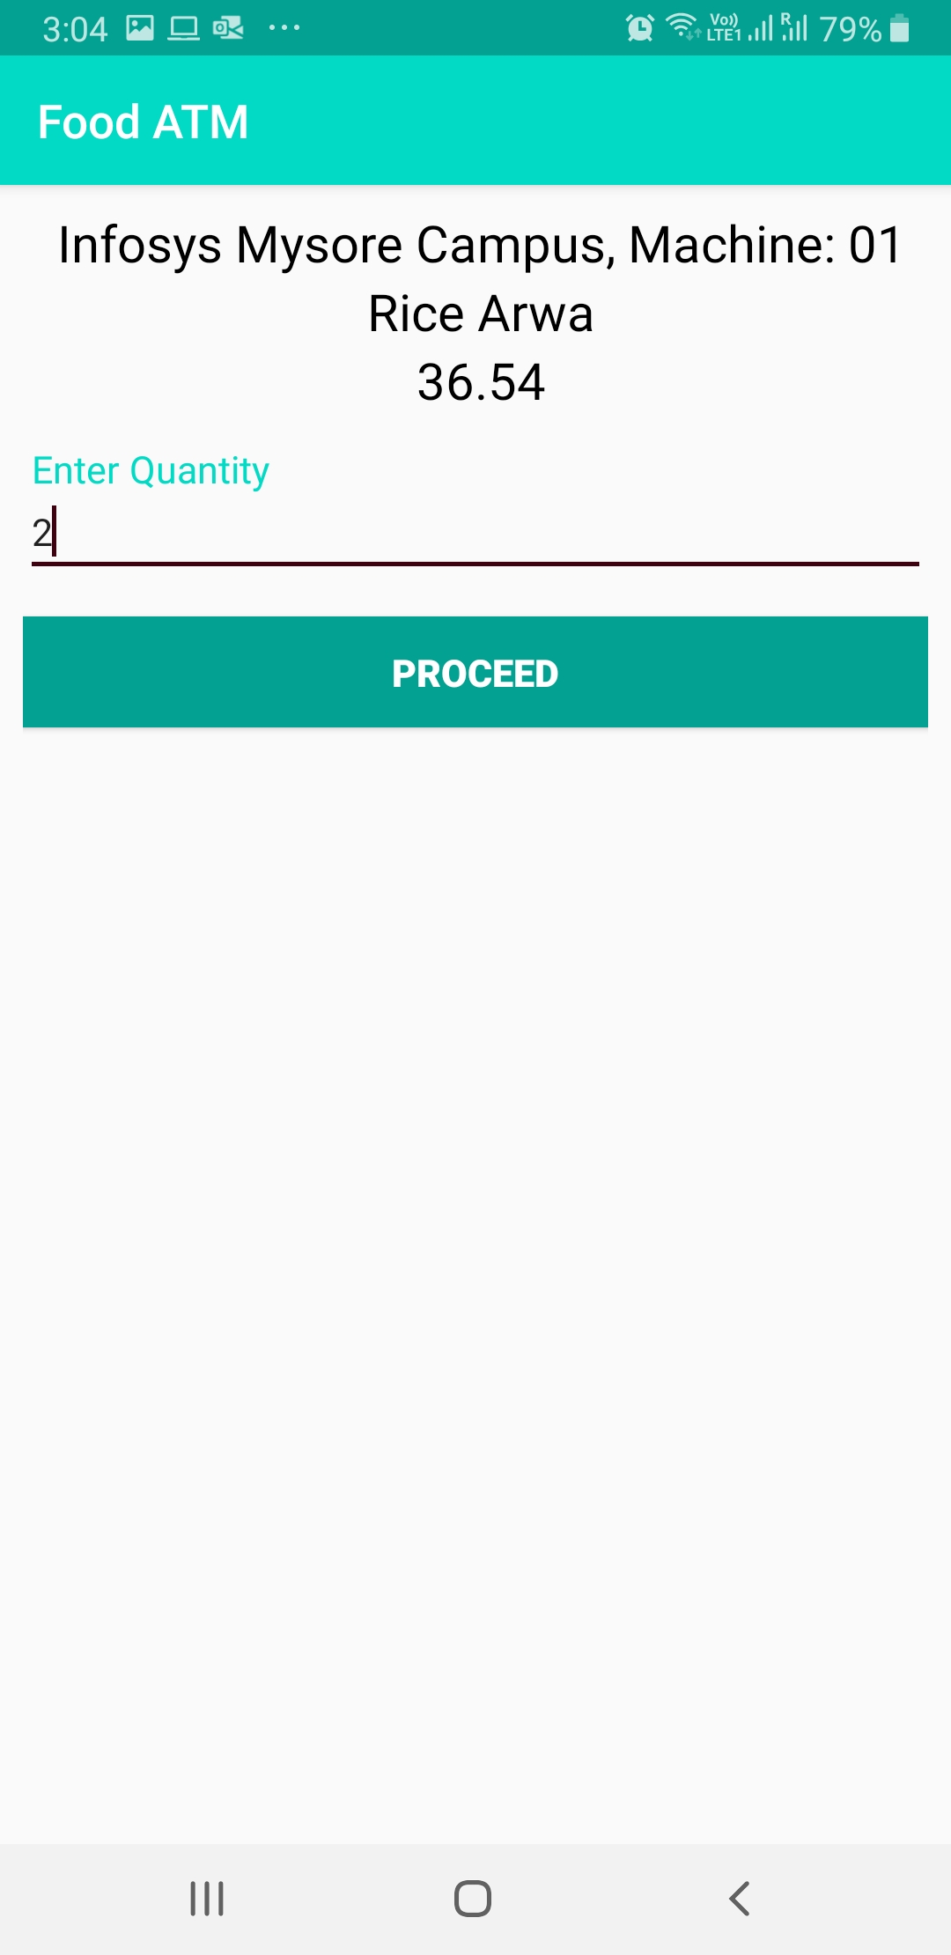
Input Quantity
Text

Slide 8
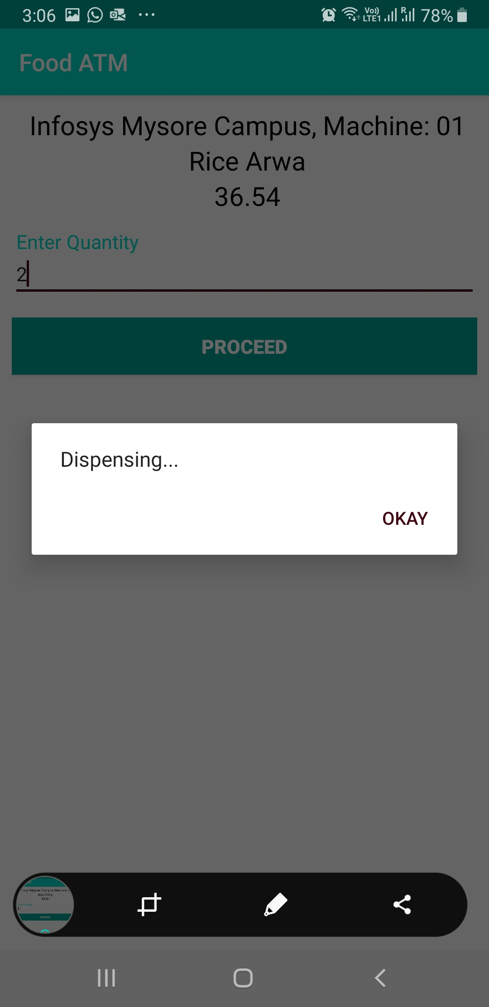
Dispensing: IoT Device Triggered - Valve Opened

Slide 9
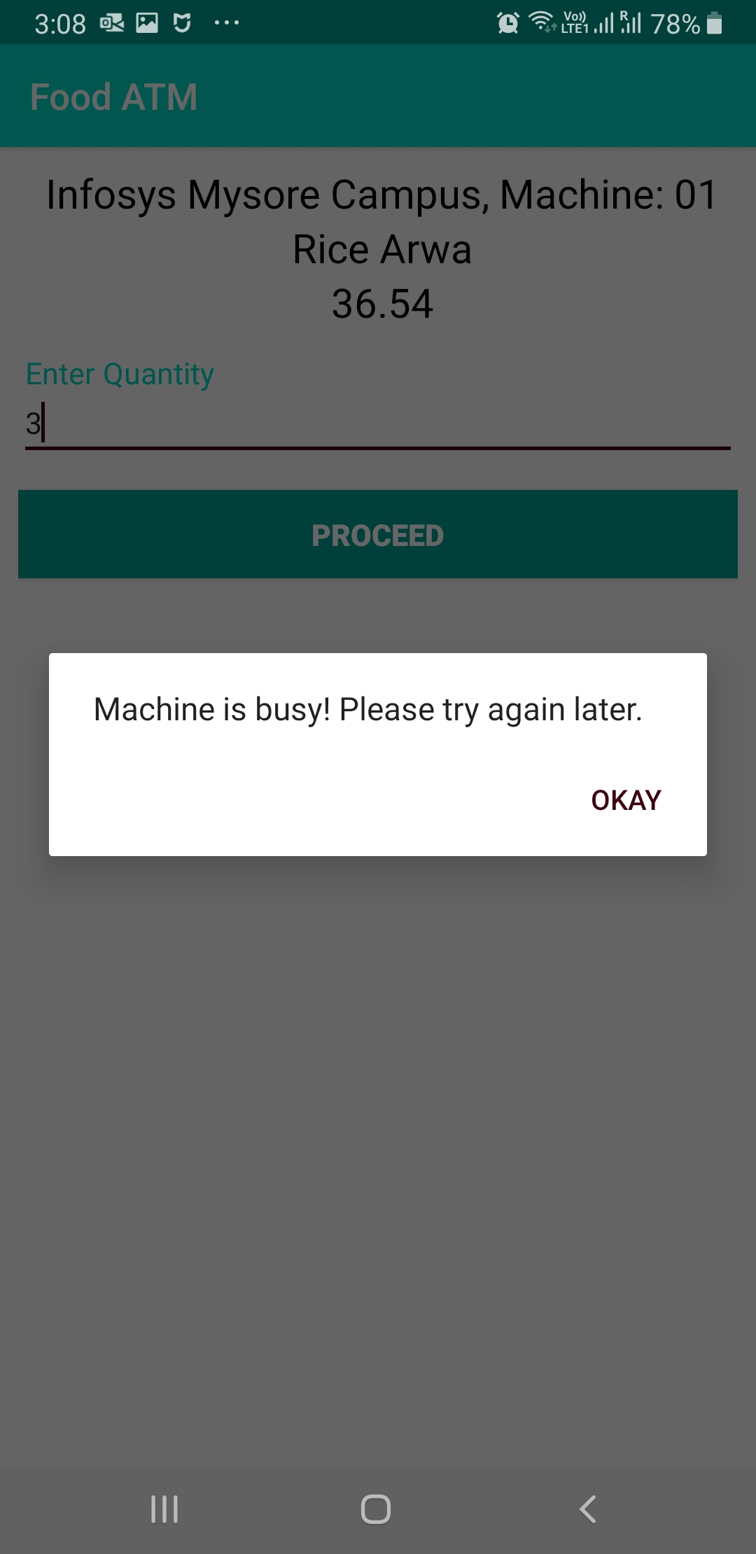
Machine Busy: IoT Device Dispensing Other Request

Slide 10
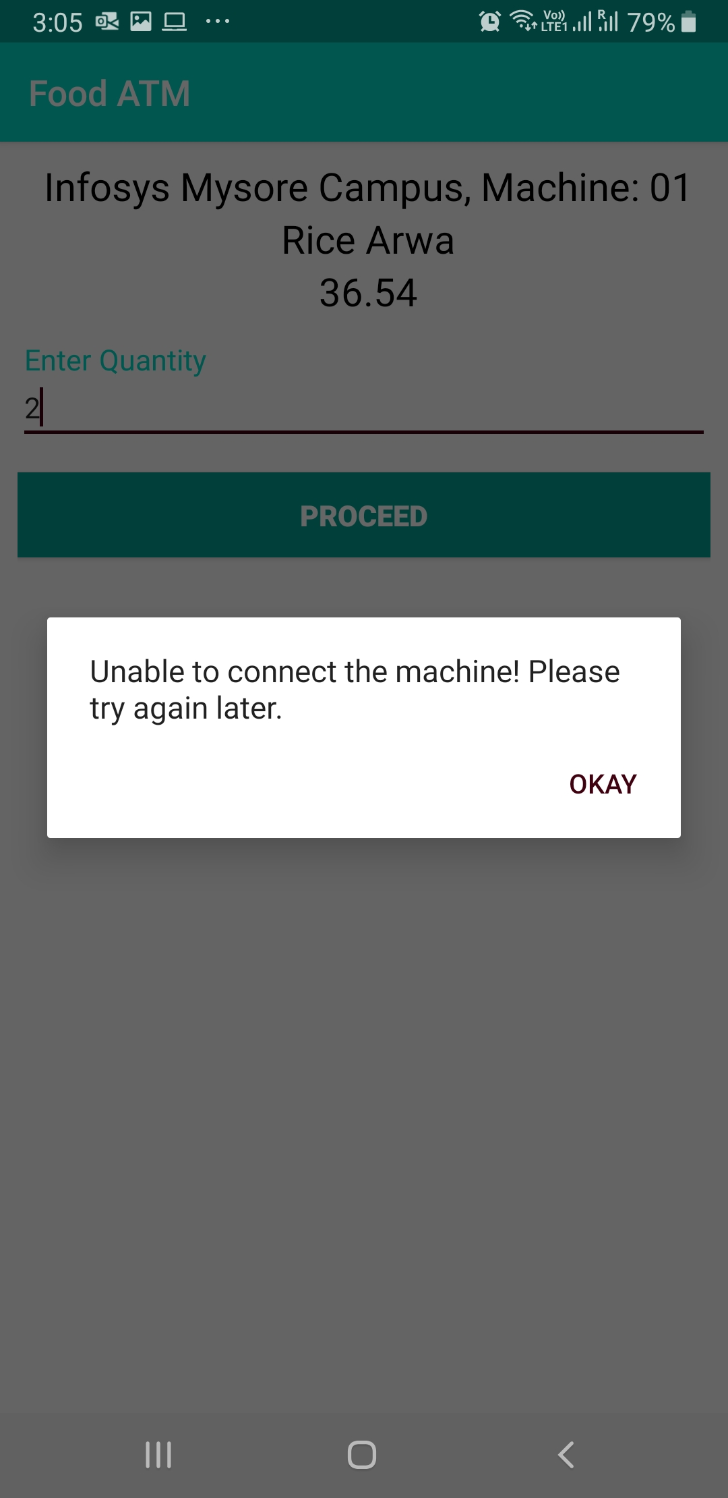
Machine Offline: Internet Unavailable or IoT Device Powered Off

