Slide 1
OpenHack with IBM
Call for Code 2020: COVID-19

Slide 2
Team and Use Case
Team Name | Team Member Name | Mail Id | PU
INNOVATORS | Sanaul Haque | Sanaul.haque@Infosys.com | DX
 | Pragya Vaghela | Pragya.Vaghela@Infosys.com | DX
 | Syed Abdul Rahman | Syedabdulrahman.a@infosys.com | IS
 | Mahaboob Ibrahim | Mahaboob_G@Infosys.com | DX
 | Nikhil Gupta | Nikhil.gupta44@Infosys.com | DX
Use Case description (Community cooperation) | The team is proposing a Contactless Staple Food Vending machine which would provide people the basic essential commodities like Rice, Dal, Sugar ,etc. in a contactless manner. This is an idea where we are extending the Indian Government scheme of providing the peoples with the basic commodities mentioned where they do not need to come in direct contact with any other person or the machine. The peoples who have a smartphone will be able to use a mobile application to scan the QR code on the machine will be sent to the server and from the server we would be able to identify the allotted quantities to the specified individuals which can be vended out of the machine. This application will also have a donation feature for people who wants to donate these food items across the country, they could simply do so by using this application. This application will ensure the donation to reach the right people who are in need.

Slide 3
CONTACTLESS STAPLE FOOD
VENDING MACHINE

Slide 4
Use Case
CONTEXT : The business problem that we are taking up is that in the current situation, when social distancing is a must and people are out of work and facing challenges related to procurement of essential commodities, the government has come up with variety of schemes to provide necessary food items to the needy people in the society. But currently there is no way to ensure that the benefits reach the people by avoiding direct contact and also migrant workers does not have facility to avail the government scheme in a different state.
BUSINESS RELEVANCE : The problem stated above is a genuine one where we have seen many reports in the news where the people are actually not able to get the benefits even though the government has announced the scheme and is working on that.
BUSINESS SOLUTION : The solution we suggest includes a vending machine and a mobile application that would help us identify the individual and the benefits he is eligible for and then we can send an instruction to the vending machine to vend that much quantity of food grains. This way we can have a digital database to track the individuals who had benefitted directly and also we can remove the middle man benefitting by hoarding of grains and providing wrong measurements of food grains.

Slide 5
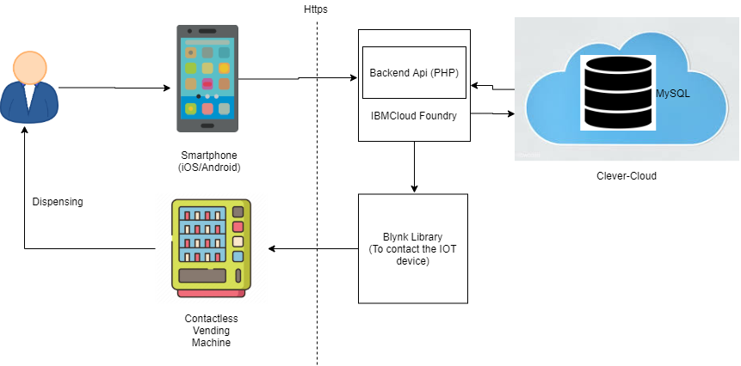
Architecture Diagram

Slide 6
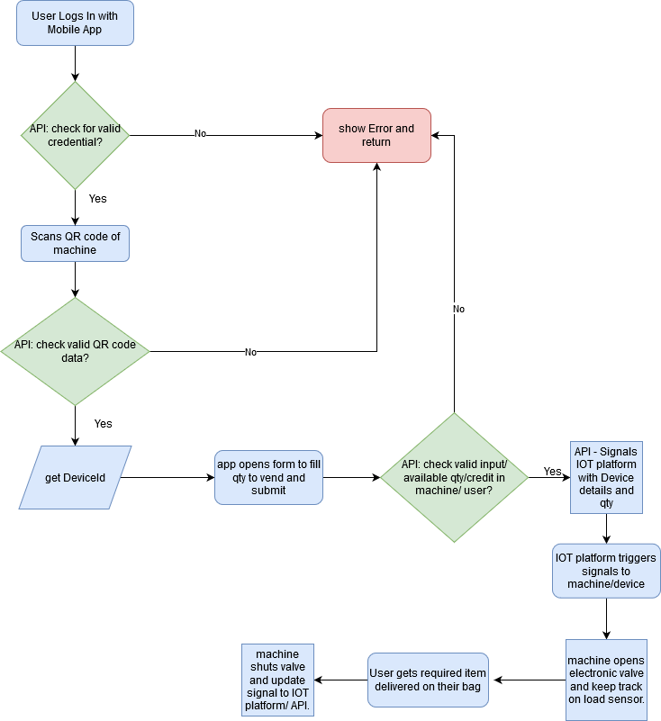
How vending machine will work?

Slide 7
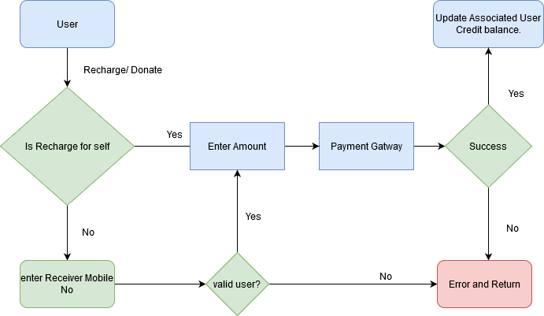
How someone will donate?
App would show needy contact details and also nearby details based on data. So that people can add up credit to their accounts.

Slide 8
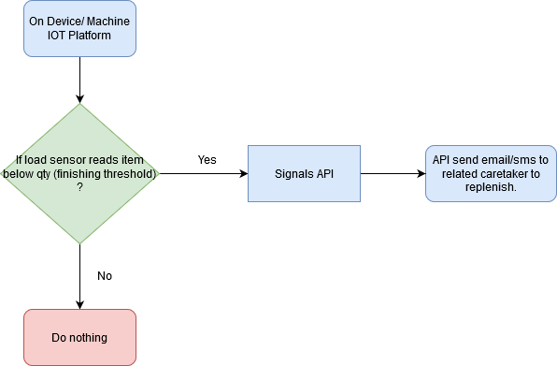
How caretaker will know about food is getting end in machine?

Slide 9
Deployment
Machine can be deployed anywhere, where people can use it effectively and efficiently for example near a railway station or empathy centre.
Code will be deployed in IBM cloud.
How did we arrive this solution?
We are constantly listening in the news that people are facing difficulty in arranging food for them, especially in India where people are walking miles to reach their hometown. So we identified this and IBM also have given us a chance to explore our skills and find a solution for this problem.
We just thought of making something to solve this issue and we started adding people, debating, brain storming then we came up with this solution.

Slide 10
Technology Stack
Arduino ESP8266
Node.js/PHP/IBM Cloud Foundry
Android
iOS
IBM Cloud
Future Scope
In future we will be enhancing this solution for people without a smartphone.

Slide 11
Thank You

