Slide 1
Star Wars KB
Diploma project
Vedeneev Victor
https://github.com/Ingafen/StarWarsKb

Slide 2
Annotation
Front-End, Back-End: ASP.NET Core MVC 3.1, EF, xUnit, PostgreSQL
SCM: Git
Tests: Unit tests
Quality gate: SonarQube Community
IaC: Terraform, Ansible, Yandex Cloud, Kubernetes by Kubespray
Logging: Prometheus
Monitoring: Prometheus, Grafana
Scalability/redundancy: Kubernetes Pod Scaling
Etc: YouTrack Cloud

Slide 3
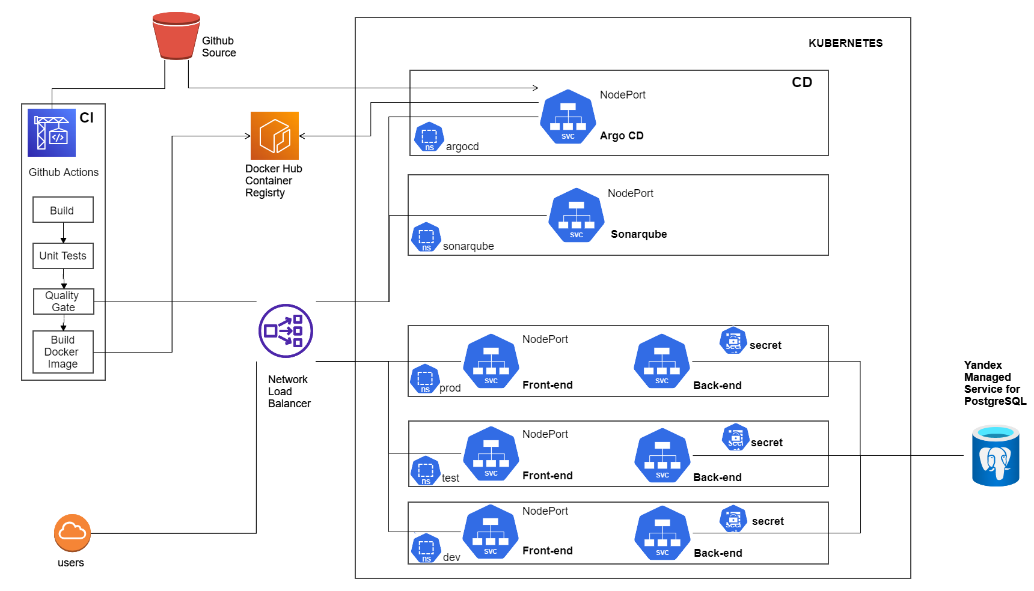
CI/CD

Slide 4
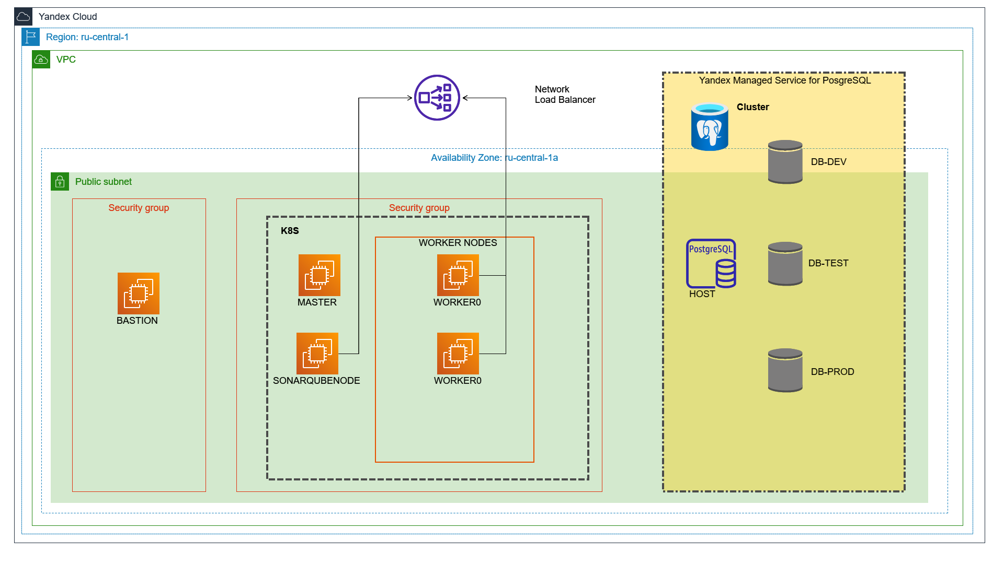
Infrastructure, cloud

