Slide 1
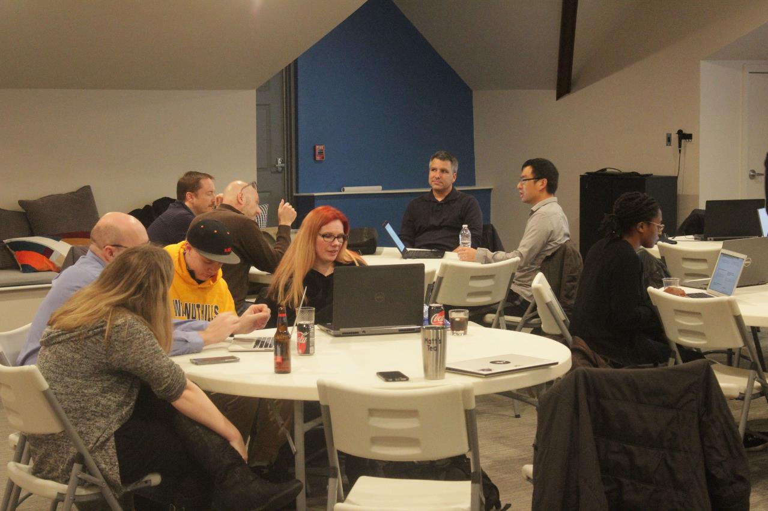
Code, Craft, Community
5/20/2026

Slide 2
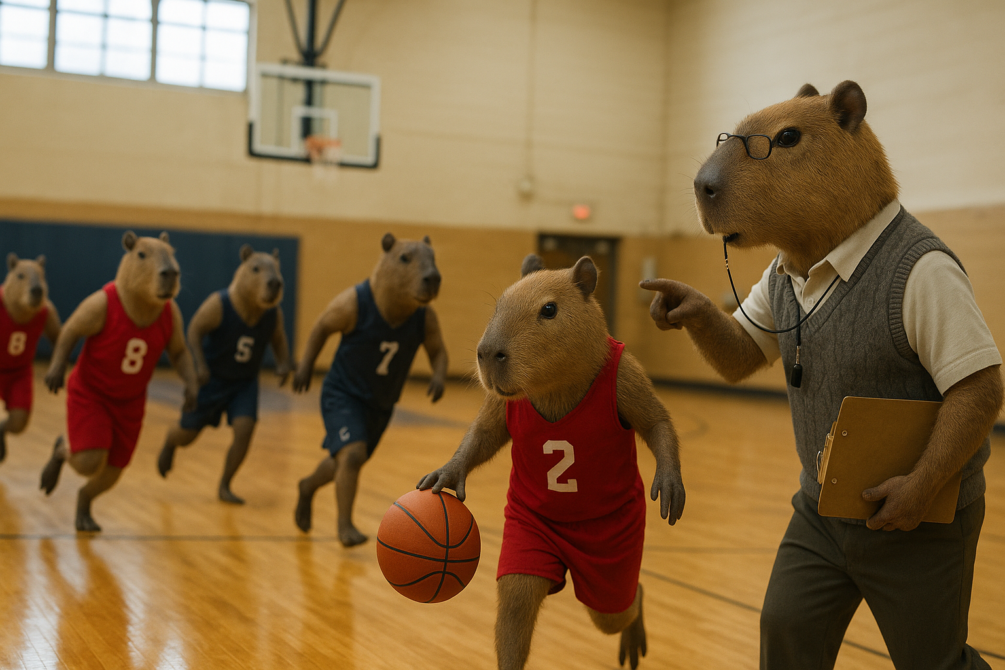
Notes:
Practice

Slide 3

Notes:
Technology Agnostic

Slide 4

Notes:
Better together

Slide 5

Notes:
Point at code

Slide 6
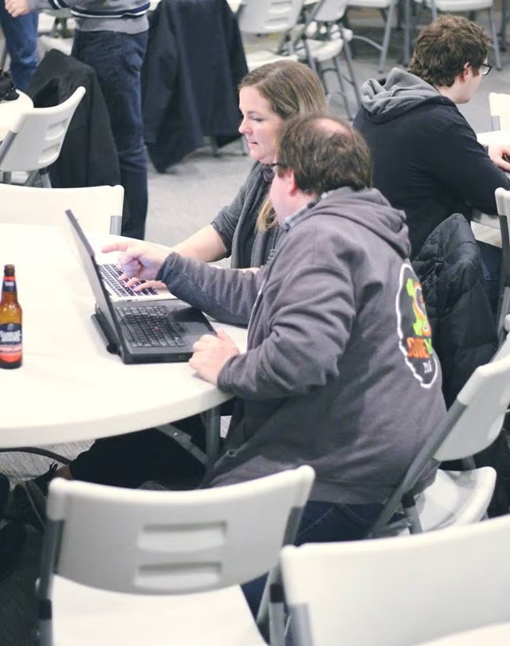

Slide 7
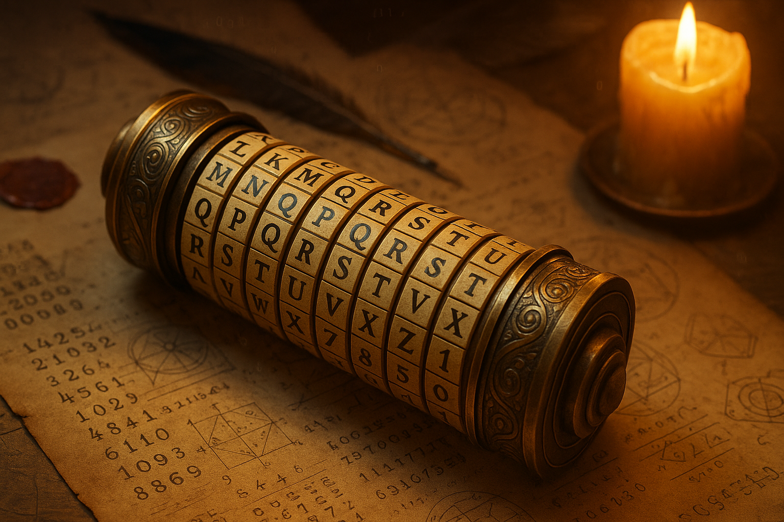
Notes:
write code

Slide 8
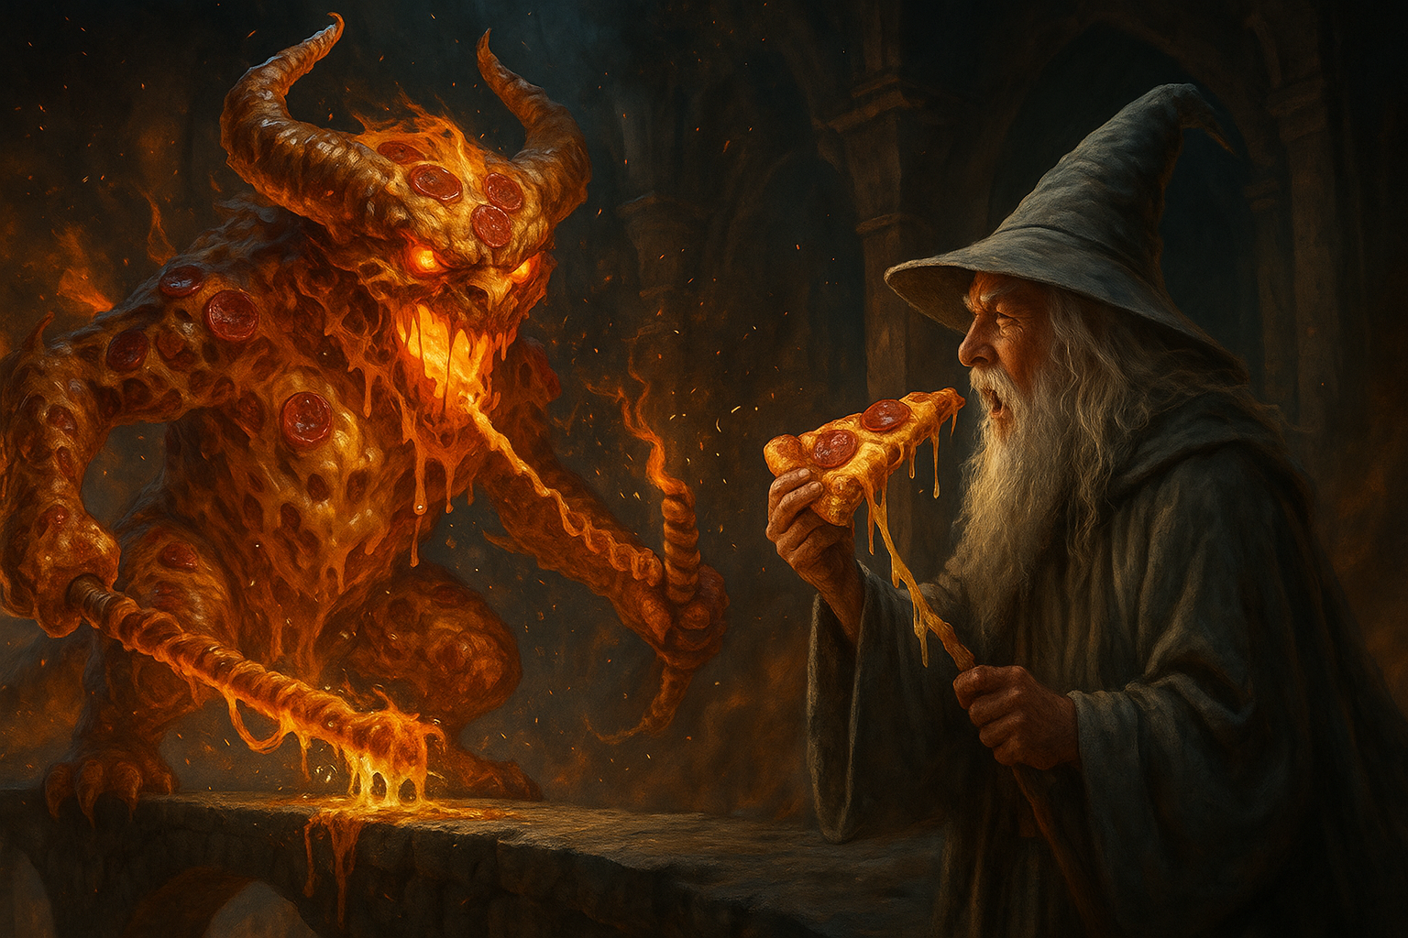

Slide 9
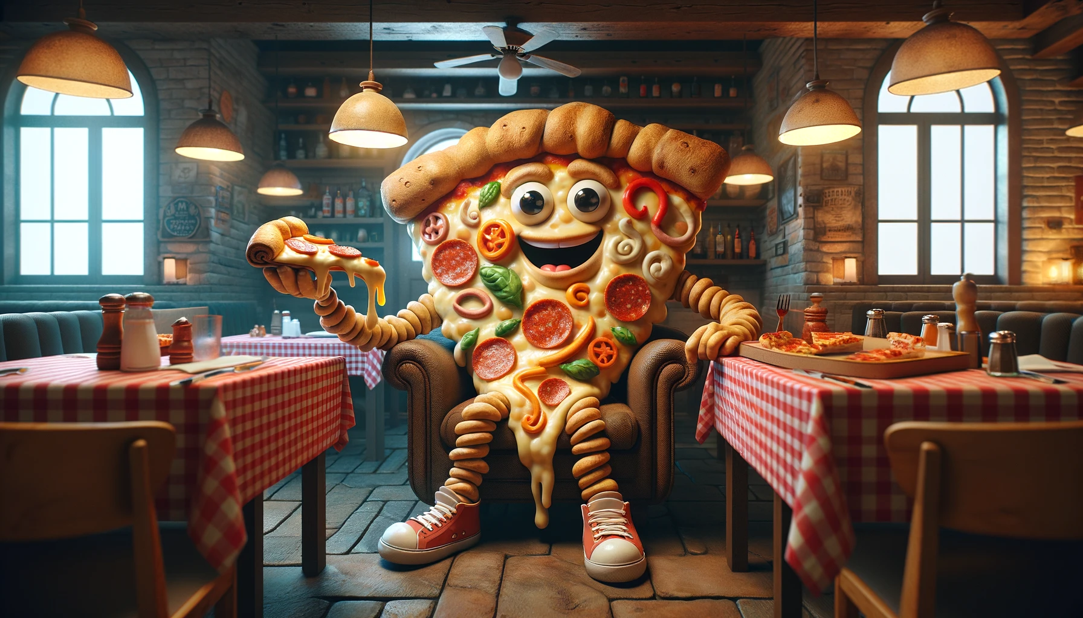
Notes:
pizza

Slide 10
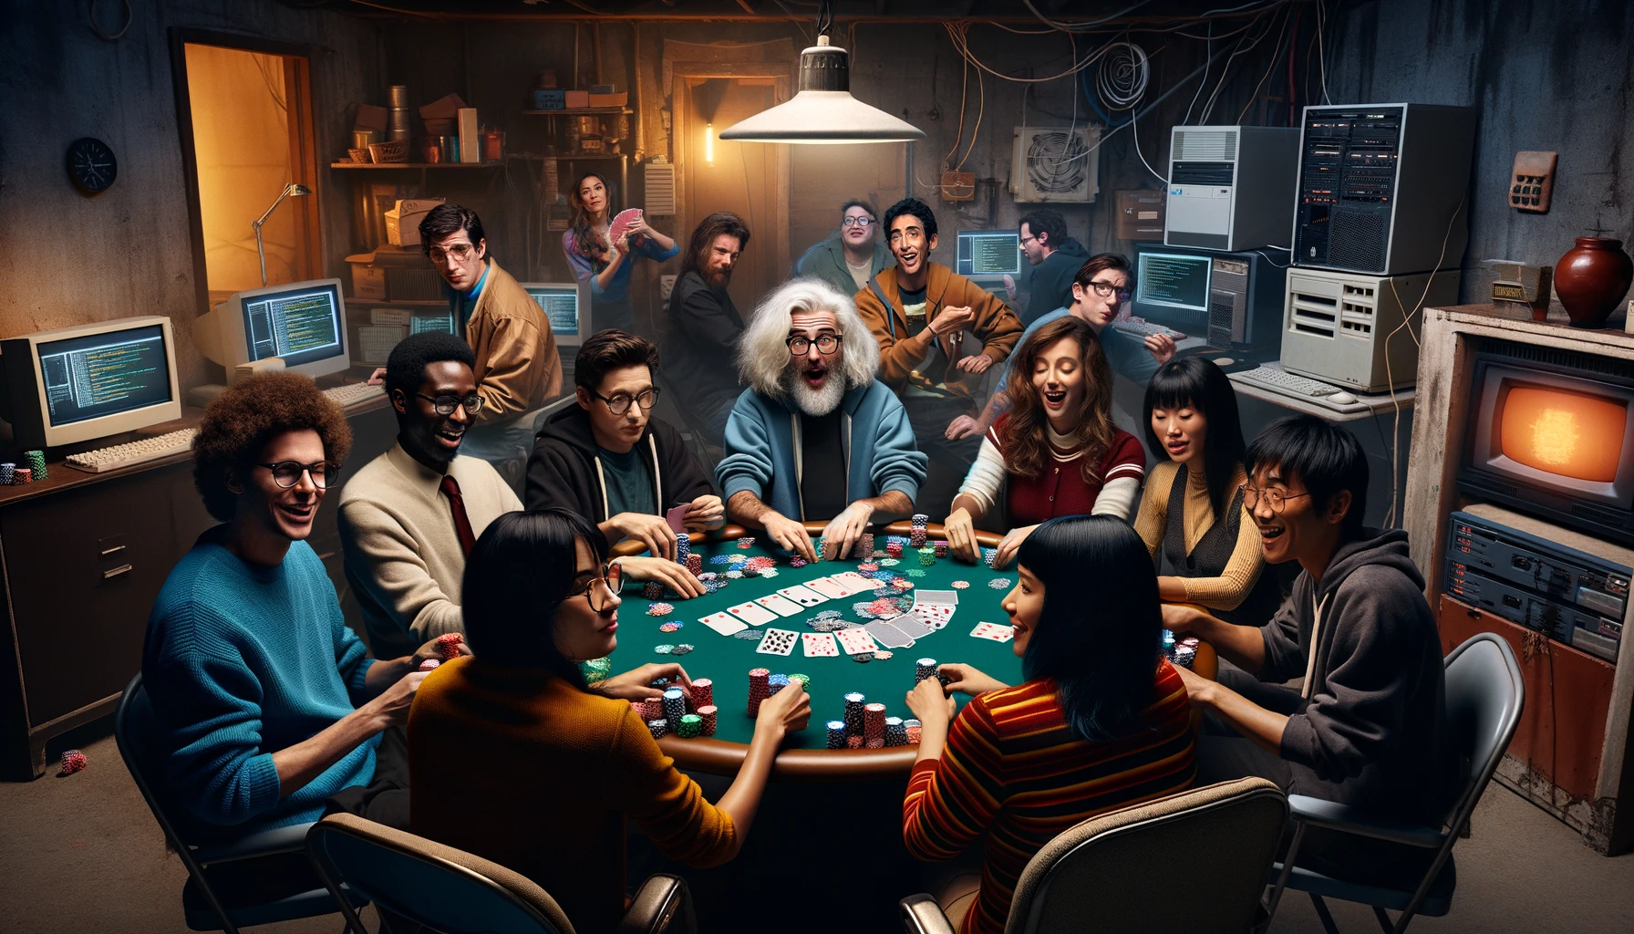
Notes:
raffle

Slide 11

Cincy AI Week
June 9-11, 2026
Over-the-Rhine
https://www.joinaiweek.com/cincy
Day Passes Available

Slide 12

Cincy Deliver 2026
Friday, July 24, 2026
Manor House in Mason, Ohio.
Early Bird - $70 through June 1st
https://www.cincydeliver.org/
36 Sessions including 1 from Ken

Slide 13

Momentum Developer Conference
Thursday, October 15, 2026
Hard Rock Casino Cincinnati
Join the mailing list to be notified when tickets are available
https://momentumdevcon.com/
Call for Speakers open until June 1st

Slide 14
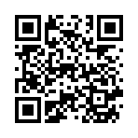
Discord Server
https://discord.gg/Bn7wVwH4m4

Slide 15
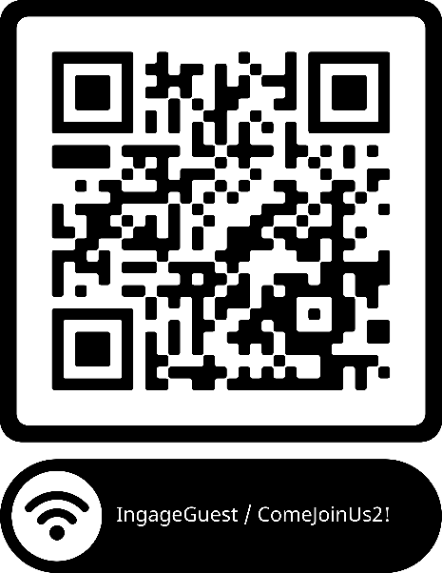
Handy QR Codes

Slide 16
Tennis Refactoring Kata
Practice finding code smells and discussing refactoring decisions collaboratively.
Use automated tests to safely refactor while supporting working behavior.
Focus on communication, code reviews, and shared problem-solving skills.
Explore how human judgment and clean design remain important in AI-assisted development.

Slide 17
Tennis Refactoring Kata
https://youtu.be/XifUs1FhWRc?si=QAmD09z2Q3Tq2C2p

Slide 18
Why is this important in the age of AI?
AI-generated code can still hold hidden code smells and poor design choices.
Passing tests does not guarantee maintainable or readable code.
Developers need strong refactoring and review skills to evaluate AI output.
Recognizing code smells helps reduce technical debt before it spreads.
Human judgment is still critical for clean architecture and long-term maintainability.

Slide 19
The Repo
https://github.com/Ingage-Meetup/20260520-tennis-refactoring

Slide 20
Raffle
A JetBrains license, good for any of their IDEs (IntelliJ, WebStorm, etc.) for one year. It is a “perpetual fallback license”, meaning you can continue to use the version of the IDE that was activated, even after the year has passed and the license is expired.
Winners, talk to Jim Kriz, who will send you a PDF with details to redeem your license.
Notes:
Suppose you're on a game show, and you're given the choice of three doors: Behind one door is a car; behind the others, goats. You pick a door, say No. 1, and the host, who knows what's behind the doors, opens another door, say No. 3, which has a goat. He then says to you, "Do you want to pick door No. 2?" Is it to your advantage to switch your choice?

Slide 21
As developers we are:
…deliberately trying to get better
…not focused on any particular stack, vendor, or language
…better as a group
…here to write code, think about code, discuss the craft
…dreaming of eating pizza together

