Slide 1
Code, Craft, Community
Wifi: !mpacts0urcing
10/16/2019

Slide 2
Southwest Ohio Givecamp 2019
Who: Developers, Designers, Testers, and anyone else willing to help.
What: Spend the weekend creating software projects for non-profits
When: October 18, 6:00PM – October 20, 4:00 PM
Where: Miami University Voice of America Learning Center, West Chester, Ohio.
Why: Weekend of learning, networking, and giving back
How: Sign up at southwestohiogivecamp.org

Slide 3
As developers we are:
…deliberately trying to get better
…not focused on any particular stack, vendor, or language
…better as a group
…here to write code, think about code, discuss the craft
…going to eat pizza

Slide 4
Agenda
Any side-projects, issues, or questions?
What are you going to learn next?
Eat Pizza
College Linked-list Exercise
Eat Pizza

Slide 5








Wifi: !mpacts0urcing

Slide 6



















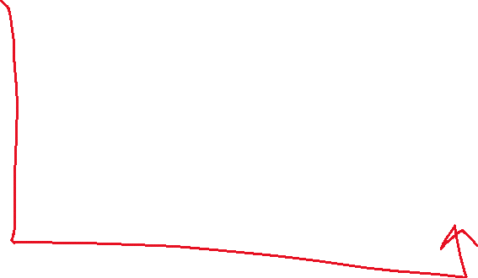
Wifi: !mpacts0urcing
AddHead(Node n)

Slide 7





Wifi: !mpacts0urcing
AddTail(Node n)

Slide 8
Wifi: !mpacts0urcing
Repo:
https://github.com/Ingage-Meetup/Meeting-20191016
Linked List:
https://www.geeksforgeeks.org/implementing-a-linked-list-in-java-using-class/
Iterable/Iterator Interface
https://www.geeksforgeeks.org/java-implementing-iterator-and-iterable-interface/

