Slide 1
Code, Craft, Community
Wifi: !mpacts0urcing
1/20/2021

Slide 2
As developers we are:
…deliberately trying to get better
…not focused on any particular stack, vendor, or language
…better as a group
…here to write code, think about code, discuss the craft
…dreaming of eating pizza together

Slide 3
Raffle
1 Jetbrains licenses, good for any of their IDEs (IntelliJ, WebStorm, etc.) or Resharper.
Winners, put email in chat and Jim Kriz will take care of contacting Jetbrains. When he submits your email address to Jetbrains, you will receive an email directly with a license.
Notes:
Suppose you're on a game show, and you're given the choice of three doors: Behind one door is a car; behind the others, goats. You pick a door, say No. 1, and the host, who knows what's behind the doors, opens another door, say No. 3, which has a goat. He then says to you, "Do you want to pick door No. 2?" Is it to your advantage to switch your choice?

Slide 4

Notes:
Suppose you're on a game show, and you're given the choice of three doors: Behind one door is a car; behind the others, goats. You pick a door, say No. 1, and the host, who knows what's behind the doors, opens another door, say No. 3, which has a goat. He then says to you, "Do you want to pick door No. 2?" Is it to your advantage to switch your choice?

Slide 5
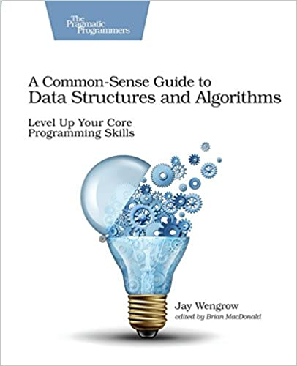
Notes:
Suppose you're on a game show, and you're given the choice of three doors: Behind one door is a car; behind the others, goats. You pick a door, say No. 1, and the host, who knows what's behind the doors, opens another door, say No. 3, which has a goat. He then says to you, "Do you want to pick door No. 2?" Is it to your advantage to switch your choice?

Slide 6
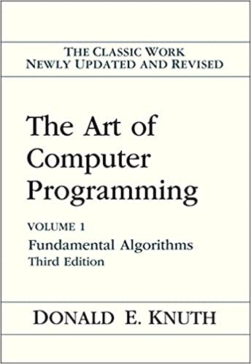
Notes:
Suppose you're on a game show, and you're given the choice of three doors: Behind one door is a car; behind the others, goats. You pick a door, say No. 1, and the host, who knows what's behind the doors, opens another door, say No. 3, which has a goat. He then says to you, "Do you want to pick door No. 2?" Is it to your advantage to switch your choice?

Slide 7
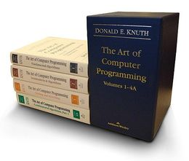
Published
Volume 1 – Fundamental Algorithms Volume 2 – Seminumerical Algorithms Volume 3 – Sorting and Searching Volume 4A – Combinatorial Algorithms, Part 1
Planned Volume 4B, 4C, etc. – Combinatorial Algorithms, Parts 2, 3, etc. Volume 5 – Syntactic Algorithms (Lexical Analysis, Parsing)
Maybe
Volume 6 – Theory of Context-free Languages
Volume 7 – Compiler Techniques

Slide 8
The 100 or so Books that shaped a Century of Science from "Scientists' Bookshelf" American Scientist, November-December 1999, Volume 87, No. 6
Monographs
The principles of quantum mechanics (1930) by Paul Dirac ; 4th ed. (1958) here
The collected papers of Albert Einstein, volume 2 : the Swiss years : writings, 1902-09 by Albert Einstein
Fractals : form, chance, & dimension (1977) by Benoit B. Mandelbrot
Nature of the chemical bond and the structure of molecules and crystals; an introduction to modern structural chemistry (1939) by Linus Pauling ; 3d ed. (1960) here
Principia mathematica (1910-13, 3 vols. Vol. 1; Vol. 2; Vol. 3) by Bertrand Russell and Alfred North Whitehead ; 2d ed. here
A search for structure : selected essays on science, art, and history (1981) by Cyril Smith
Theory of games and economic behavior (1944) by John von Neumann and Oskar Morgenstern ; 3d ed. (1953) here; 60th anniversary ed. (2004) here
Cybernetics : or, Control and communication in the animal and the machine (1948) by Norbert Wiener ; 2d ed. here
The conservation of orbital symmetry (1970) by R. B. Woodward and Roald Hoffmann
The meaning of relativity (1922) by Albert Einstein ; 5th ed. here
QED : the strange theory of light and matter (1985) by Richard Feynman ; 7th printing, with corrections, here
The art of computer programming (1968) by Donald Knuth ; 2d ed here ; 3d ed here

Slide 9

Learning Reference https://github.com/sindresorhus/awesome

Slide 10
https://github.com/Ingage-Meetup/XC-20210120

