Slide 1
Code, Cr0aft, Community
Wifi: !mpacts0urcing
1/20/2021

Slide 2
As developers we are:
…deliberately trying to get better
…not focused on any particular stack, vendor, or language
…better as a group
…here to write code, think about code, discuss the craft
…dreaming of eating pizza together

Slide 3
Raffle
2 Jetbrains licenses, good for any of their IDEs (IntelliJ, WebStorm, etc.)
Winners, put email in chat and Jim Kriz will take care of contacting Jetbrains. When he submits your email address to Jetbrains, you will receive an email directly with a license.
Notes:
Suppose you're on a game show, and you're given the choice of three doors: Behind one door is a car; behind the others, goats. You pick a door, say No. 1, and the host, who knows what's behind the doors, opens another door, say No. 3, which has a goat. He then says to you, "Do you want to pick door No. 2?" Is it to your advantage to switch your choice?

Slide 4

Notes:
Suppose you're on a game show, and you're given the choice of three doors: Behind one door is a car; behind the others, goats. You pick a door, say No. 1, and the host, who knows what's behind the doors, opens another door, say No. 3, which has a goat. He then says to you, "Do you want to pick door No. 2?" Is it to your advantage to switch your choice?

Slide 5
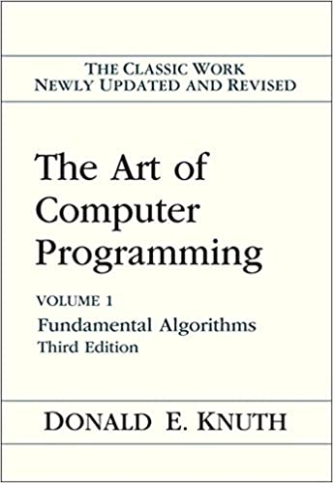
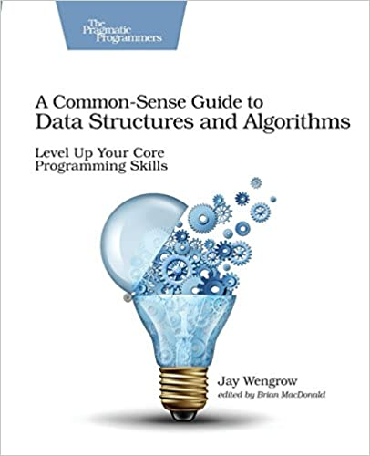
Notes:
Suppose you're on a game show, and you're given the choice of three doors: Behind one door is a car; behind the others, goats. You pick a door, say No. 1, and the host, who knows what's behind the doors, opens another door, say No. 3, which has a goat. He then says to you, "Do you want to pick door No. 2?" Is it to your advantage to switch your choice?

Slide 6
The 100 or so Books that shaped a Century of Science from "Scientists' Bookshelf" American Scientist, November-December 1999, Volume 87, No. 6
Monographs
The principles of quantum mechanics (1930) by Paul Dirac ; 4th ed. (1958) here
The collected papers of Albert Einstein, volume 2 : the Swiss years : writings, 1902-09 by Albert Einstein
Fractals : form, chance, & dimension (1977) by Benoit B. Mandelbrot
Nature of the chemical bond and the structure of molecules and crystals; an introduction to modern structural chemistry (1939) by Linus Pauling ; 3d ed. (1960) here
Principia mathematica (1910-13, 3 vols. Vol. 1; Vol. 2; Vol. 3) by Bertrand Russell and Alfred North Whitehead ; 2d ed. here
A search for structure : selected essays on science, art, and history (1981) by Cyril Smith
Theory of games and economic behavior (1944) by John von Neumann and Oskar Morgenstern ; 3d ed. (1953) here; 60th anniversary ed. (2004) here
Cybernetics : or, Control and communication in the animal and the machine (1948) by Norbert Wiener ; 2d ed. here
The conservation of orbital symmetry (1970) by R. B. Woodward and Roald Hoffmann
The meaning of relativity (1922) by Albert Einstein ; 5th ed. here
QED : the strange theory of light and matter (1985) by Richard Feynman ; 7th printing, with corrections, here
The art of computer programming (1968) by Donald Knuth ; 2d ed here ; 3d ed here

Slide 7
XC Team Scoring
Cross country running is both an individual and a team sport. Individuals are ranked based on the order that they cross the finish line. A team score is calculated by assigning points to individual team members, and then summing the points of the team’s top five runners. Teams are then ranked by the order of their team score from lowest to highest. The rules for awarding points to individual team members, and calculating a team score are as follows:

Slide 8
A team must have at least five runners to earn points and receive a team score. If a team has less than five runners, those runners cannot earn points and the team is excluded from the team results.
Only the top seven runners from each team earn points; if a team has more than seven runners, the additional runners do not earn points and are excluded from the team results.
Each team's score is calculated by adding up the points earned by the top five runners on that team.
In the event of a tie where multiple teams earn the same team score, the 6th-place runner from each of those teams is the tiebreaker (i.e., the team whose 6th-place runner earned a lower point value wins).

Slide 9
Here is an example that shows the finish place, along with points awarded and total team scores for a race with participants from four different teams:Shawn Berger from Hamilton Academy did not receive points because their team has les
Place | Athlete Name | Team Name | Elapsed Time | Points
1 | Noah Perry | Central High | 17:35 | 1
2 | Jake Sandefur | Hamilton Academy | 17:43
3 | Sam Gibbs | Springfield | 17:44 | 2
4 | David Sander | Springfield | 17:59 | 3
5 | Lucas Webster | Central High | 18:19 | 4
6 | Jack Hatton | Gray County | 18:24 | 5
7 | Logan Walters | Central High | 18:40 | 6
8 | Bradley Davis | Central High | 18:54 | 7
9 | Cameron Brockman | Springfield | 19:03 | 8
10 | James Springer | Gray County | 19:08 | 9
11 | Dylan Hasler | Central High | 19:10 | 10
12 | Shawn Berger | Hamilton Academy | 19:23
13 | Austin Schwartz | Springfield | 19:31 | 11
14 | Tyler Bergman | Springfield | 19:34 | 12
15 | Brandon Schultz | Central High | 19:35 | 13
16 | Evan Holtz | Gray County | 19:36 | 14
17 | Josh Obermeyer | Springfield | 19:44 | 15
18 | Alex Morris | Central High | 19:50 | 16
19 | William Cook | Gray County | 19:56 | 17
20 | Justin Holloway | Springfield | 19:57 | 18
21 | Hunter Kohlsmith | Gray County | 19:58 | 19
22 | Anthony Rone | Gray County | 20:05 | 20
23 | Ethan Conrad | Central High | 20:09
24 | Matthew McCain | Gray County | 20:26 | 21
Team Scores
Place | Team Name | Scorers | Total Points
1 | Central High | 1+4+6+7+10 (13+16) | 28
2 | Springfield | 2+3+8+11+12 (15+18) | 36
3 | Gray County | 5+9+14+17+19 (20+21) | 64
Jake Sandefur and Shawn Berger from Hamilton Academy did not receive points because their team has less than five runners. Also notice that Hamilton Academy is not listed in the team scores.
Ethan Conrad from Central High did not receive points because he was the 8th place finisher for his team. Only the top seven places per team can earn points.

Slide 10
Implement the GetTeamScores() function shown here.
The function accepts a list of race participants who finished the race, and returns a list of team scores.
You can assume that the list of race participants is already ordered by finish place.
Your function should return a list of team scores ordered by the team finish place (i.e., the winning team should be index 0).
Each TeamScore element in the returned list should include the Team Name, the Total Points earned by the team, and a list of point values for all participants on the team who earned points.
public class ScoreManager
{
public List<TeamScore> GetTeamScores(List<Participant> participants)
{
// implement this function
}
}

