Slide 1
TITRE
Sous-Titre

Slide 2
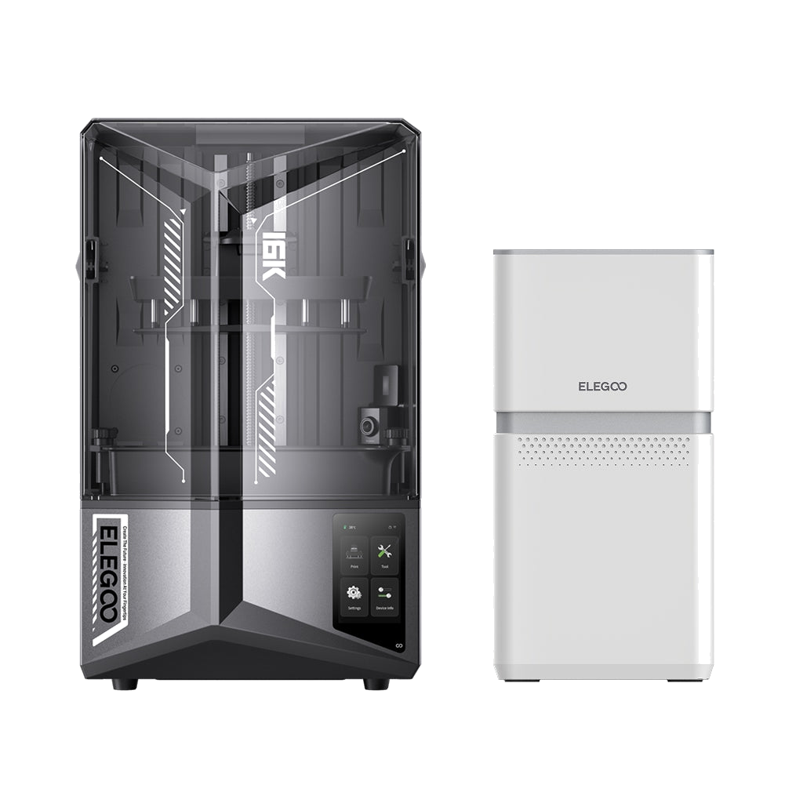
Sommaire
What is SLA 3D printing ?
When is it relevant to use ?
How to use the SLA printer ?
  Safety measures
  Software
  Processes
  Maintenance

Slide 3
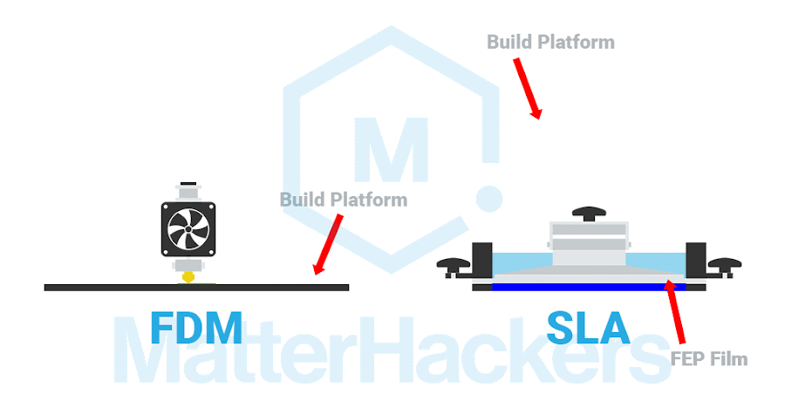
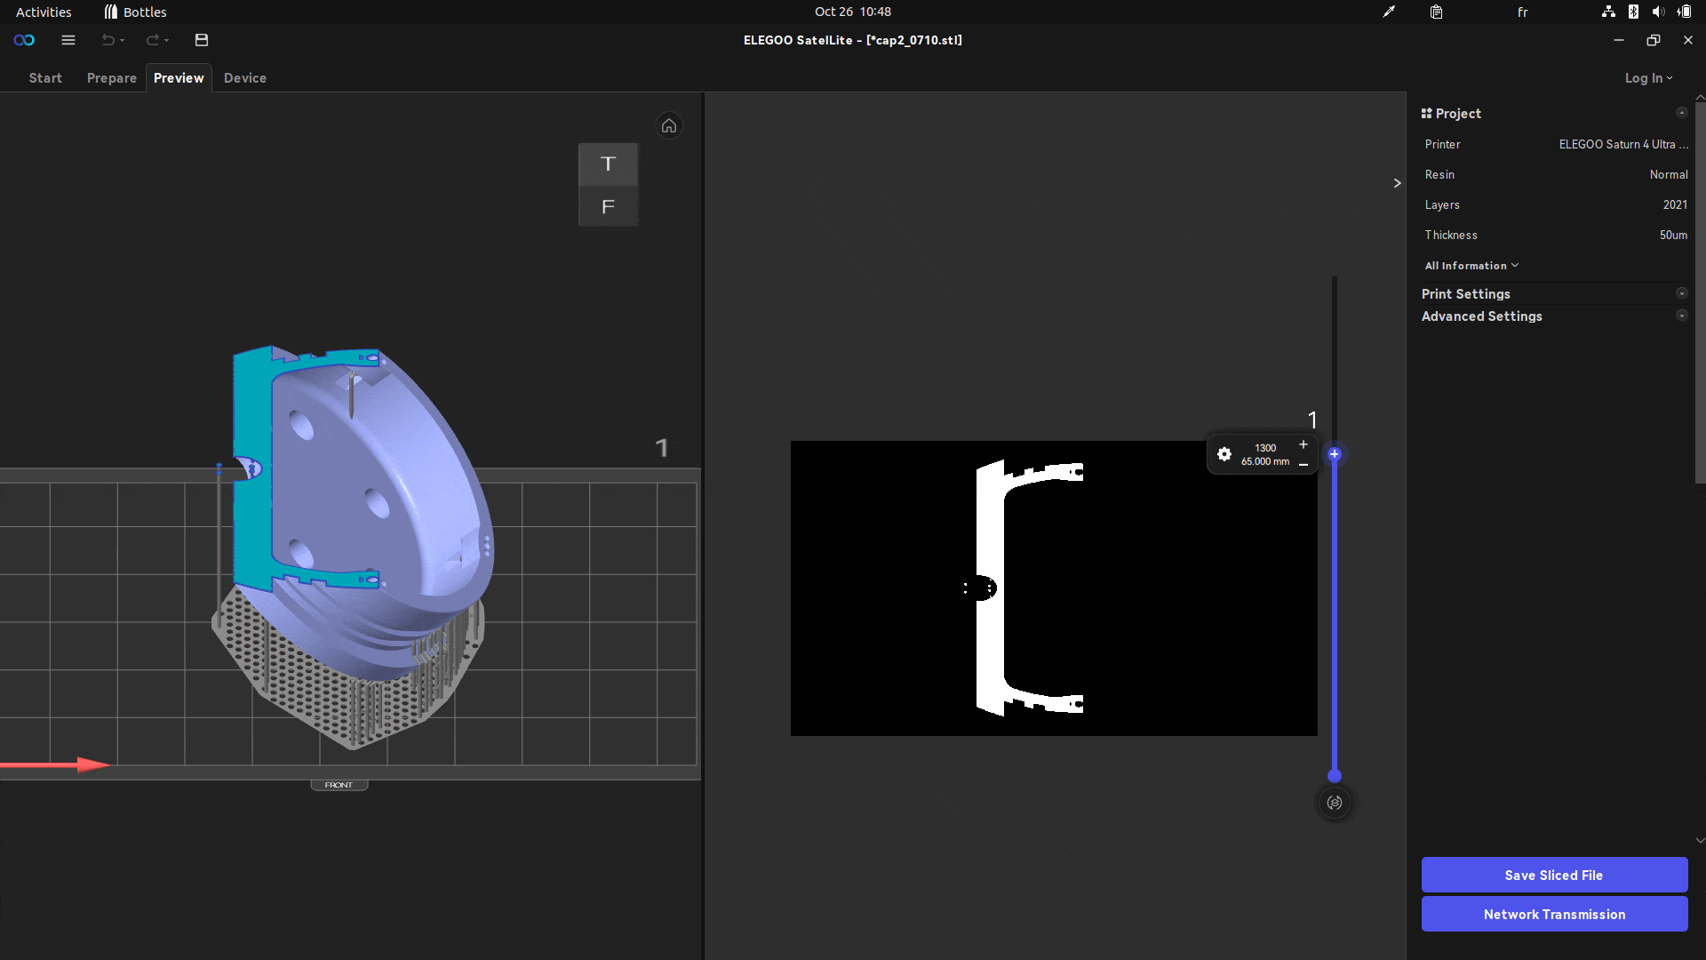
What is SLA 3D printing ?
SLA printers use liquid UV resin
The build platform is facing down on the screen
An UV LCD screen display a black and white image corresponding to the layer
Each layer is exposed a certain amount of time to let the resin cure
The build platform raises until the model is printed

Slide 4
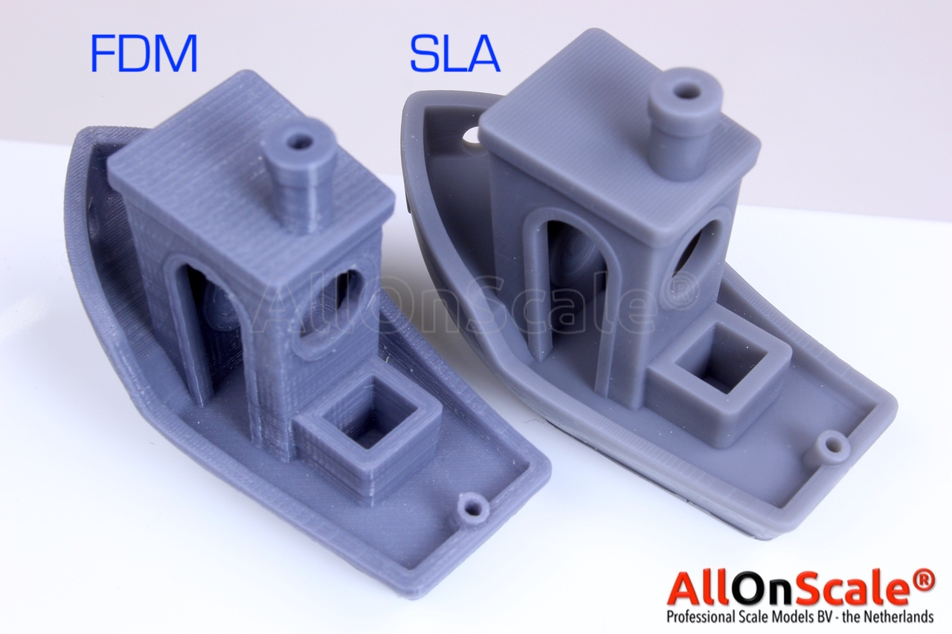
When is it relevant to use ?
Advantages :
  Great resolution
  Homogeneous solid (no layer weakness, watertight)
  Various materials to choose from
Drawbacks :
  Complex handling and post processing
  Safety issues
  Hard to get precise dimensions
When is it useful for robots ?
  For watertight or smooth parts
  If a specific material is needed

Slide 5



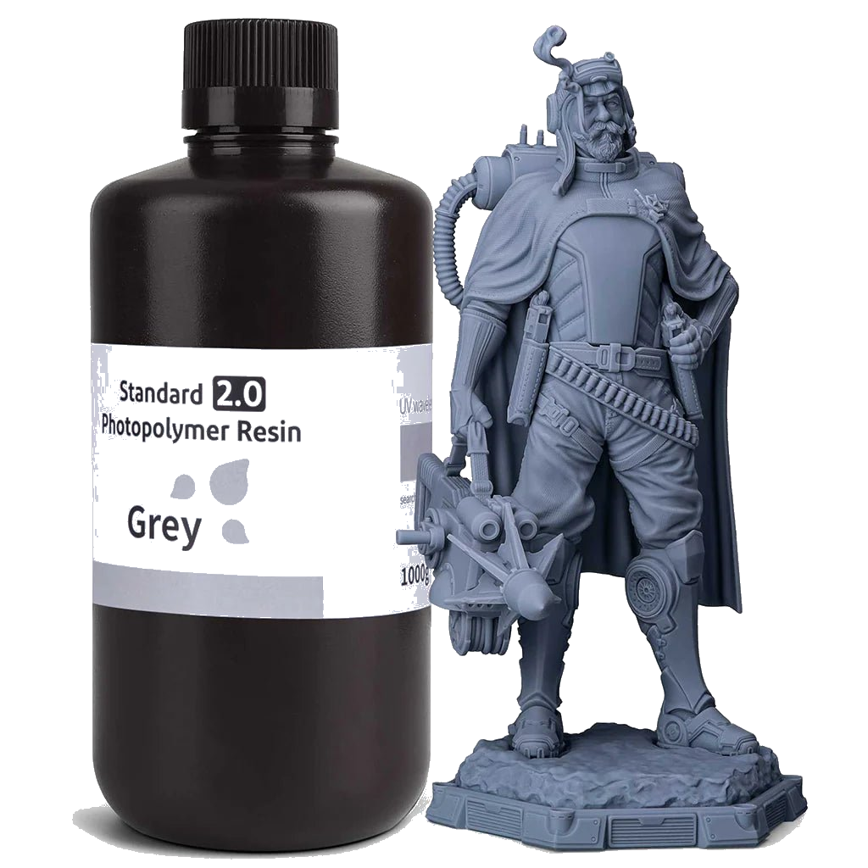
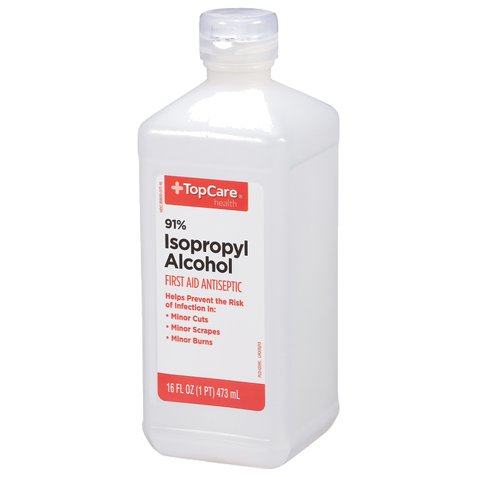
How to use the SLA printer ? - Safety measures
Health Hazard/Hazardous to the Atmospheric System
  Acute toxicity (oral, dermal, inhalation)
  Skin irritation
  Eye irritation
  Skin sensitization
  Respiratory tract irritation
  Narcotic effects
Hazardous to the Environment
  Acute hazards to the aquatic environment
  Chronic hazards to the aquatic environment
Flammable

Slide 6


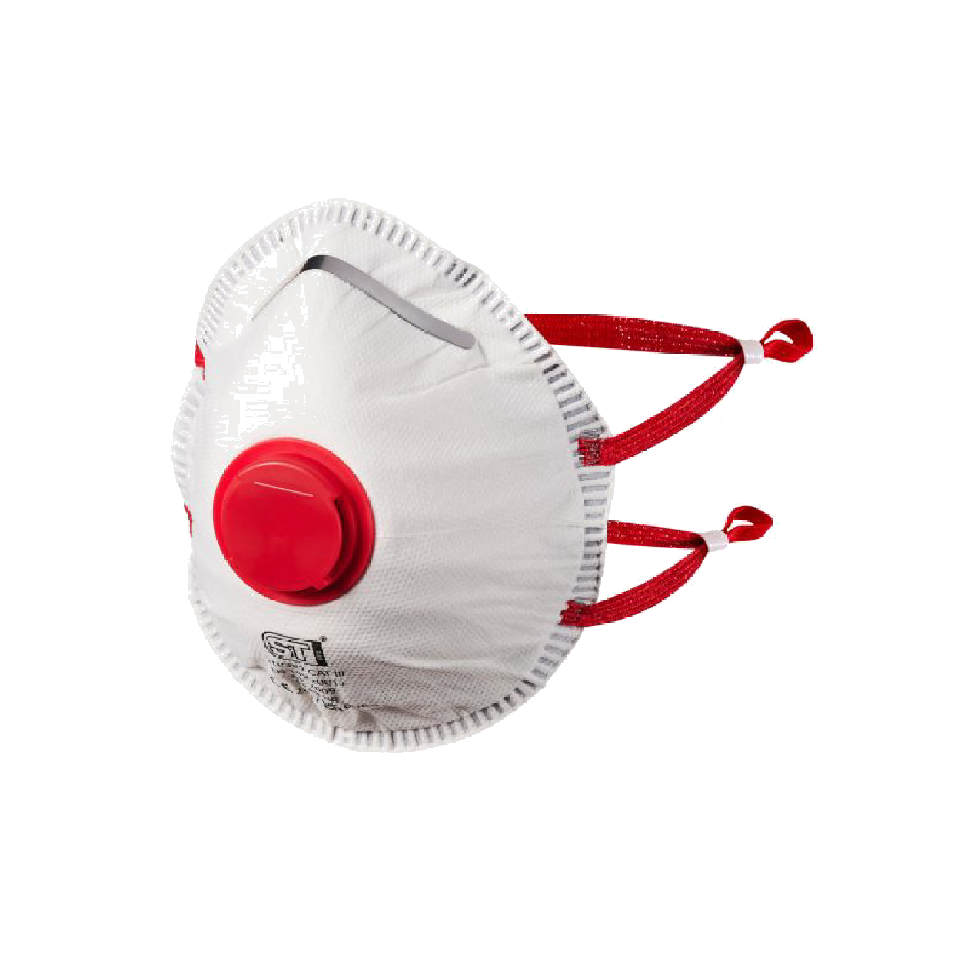
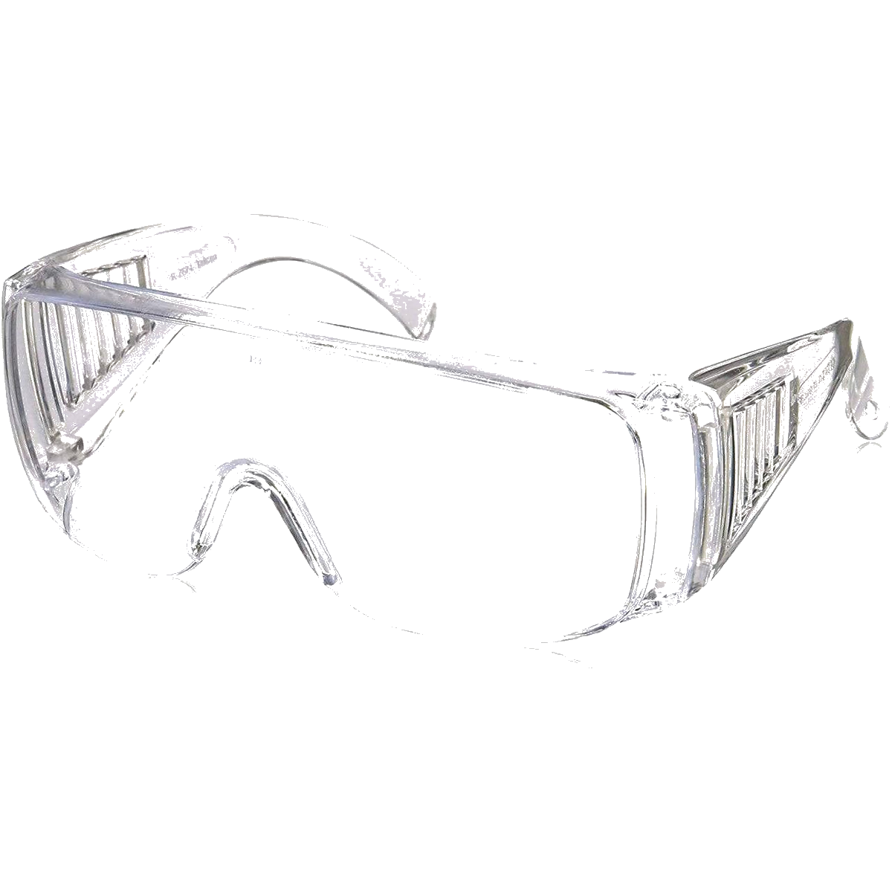
How to use the SLA printer ? - Safety measures
Mandatory safety measures :
  Butyle gloves
  Safety glasses
  Respiratory mask
  Lab coat
  Ventilation
Consider the workspace as contaminated
Every resin waste belong in the hazard bin
No liquid that has resin should be disposed of in the sink

Slide 7
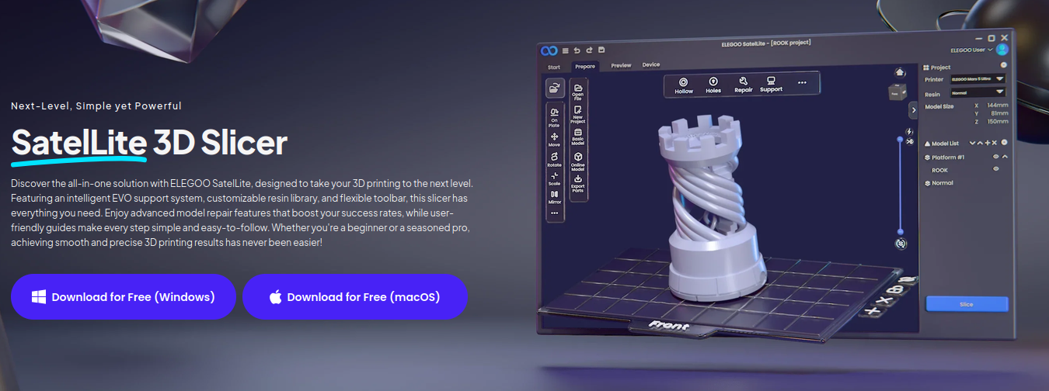

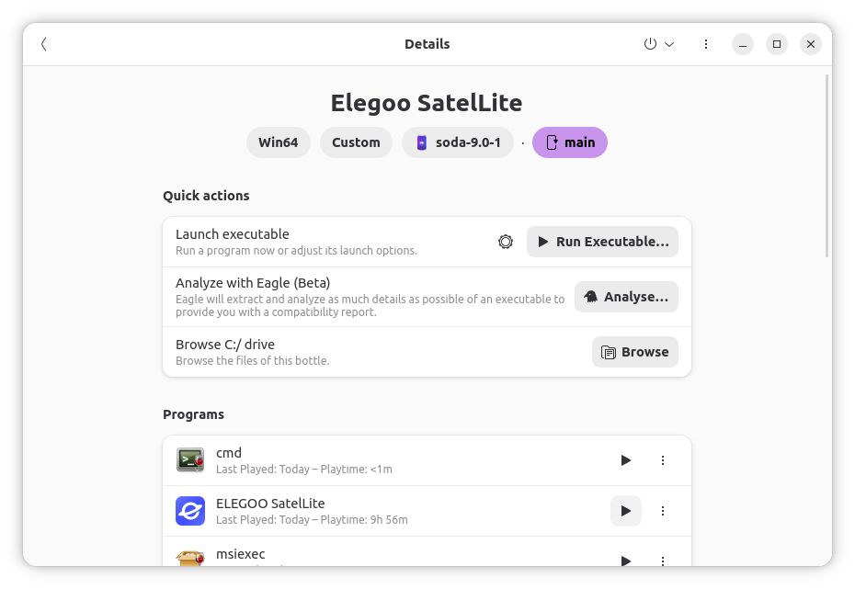
How to use the SLA printer ? - Software
Elegoo SatelLite 3D Slicer
  Native for Windows
  For Linux, use with Bottles (soda-9.0-1)

Slide 8
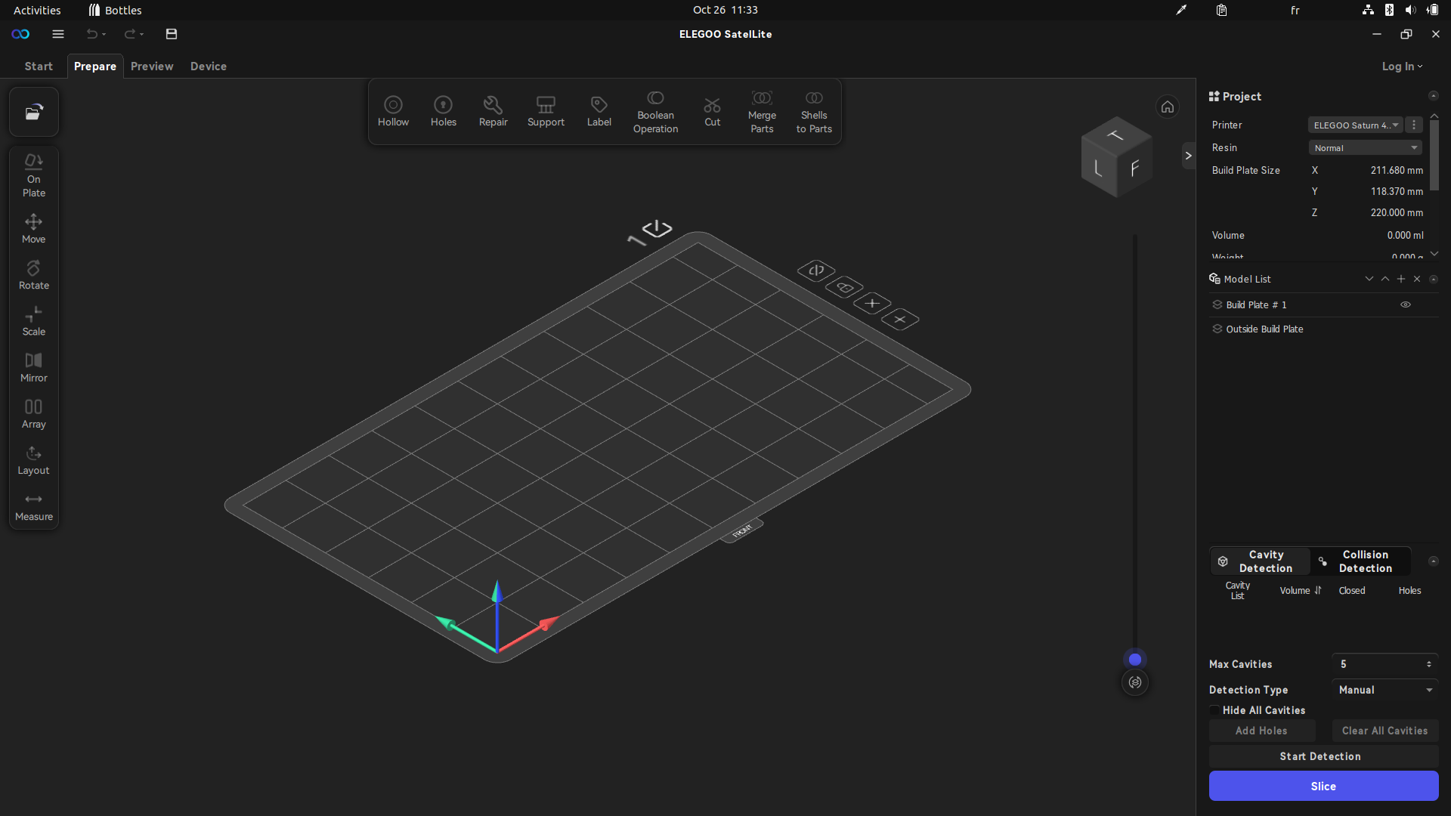
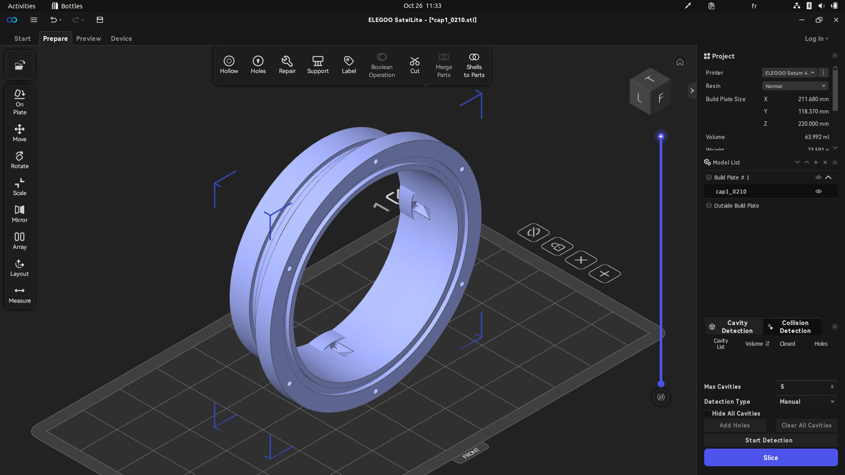
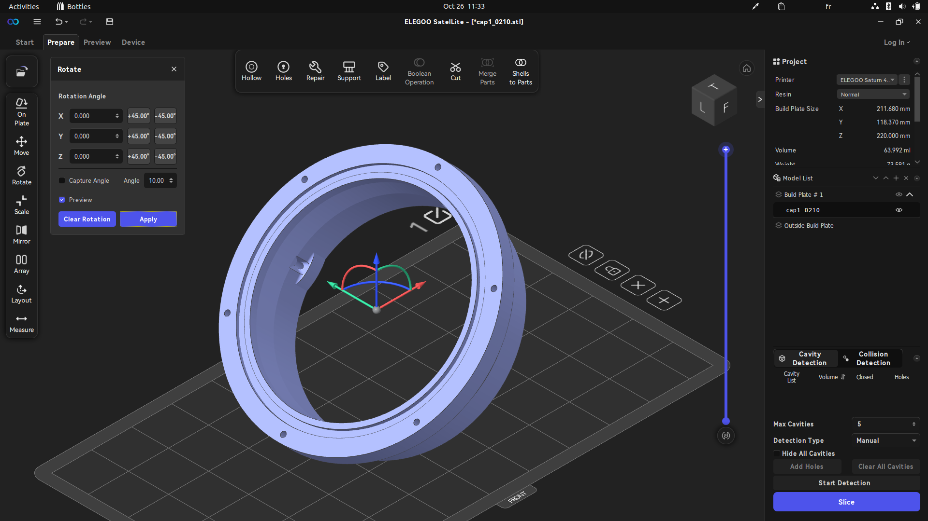
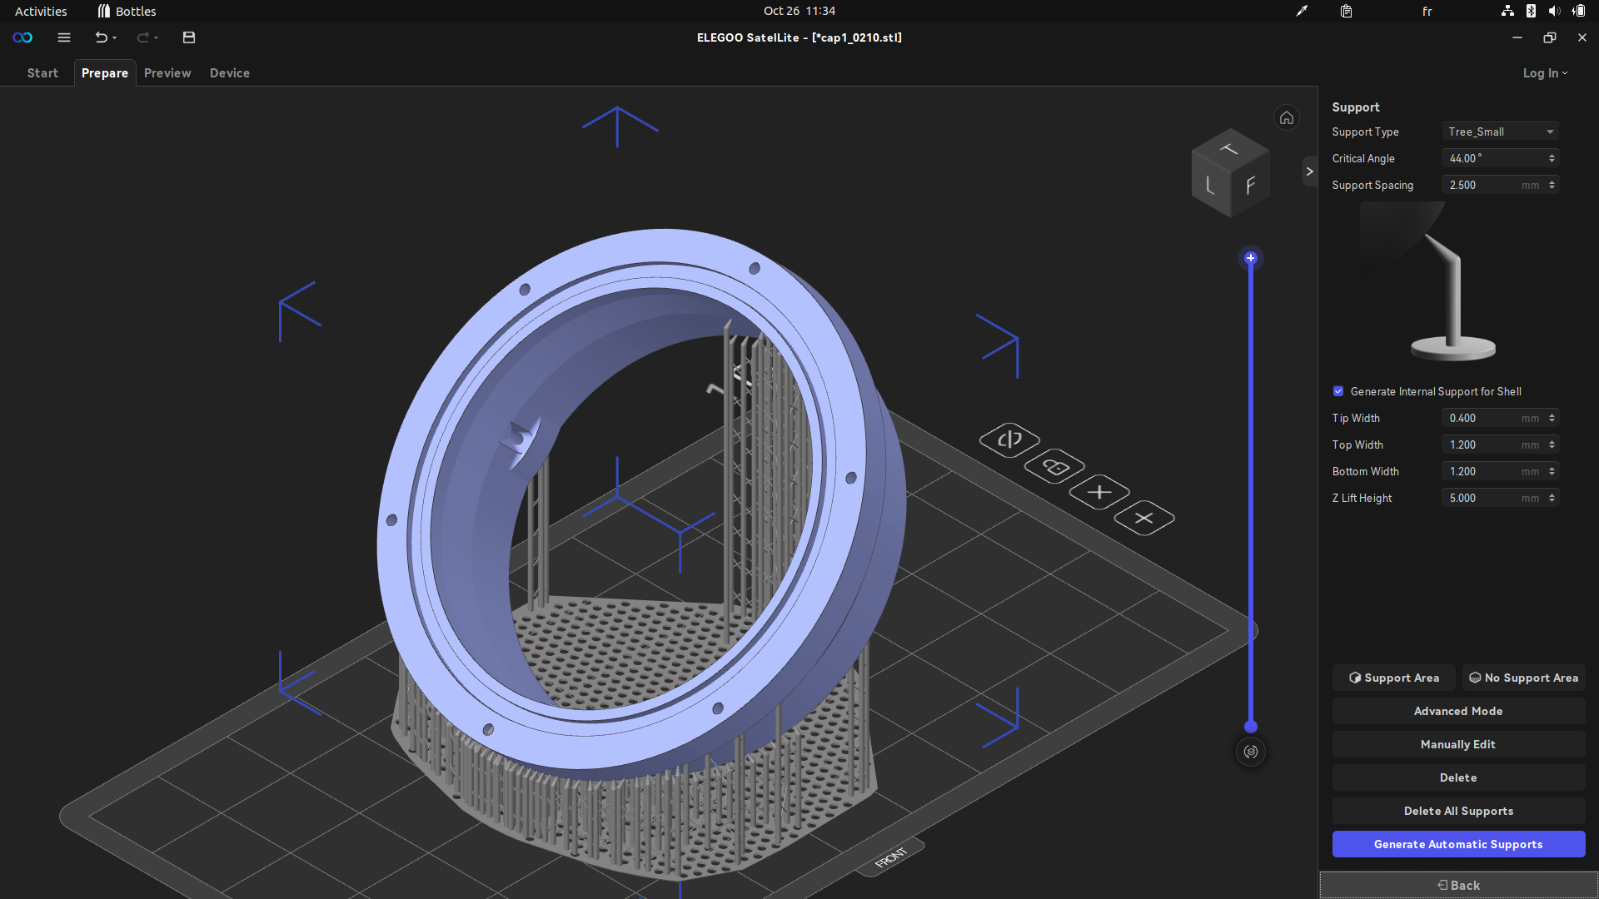
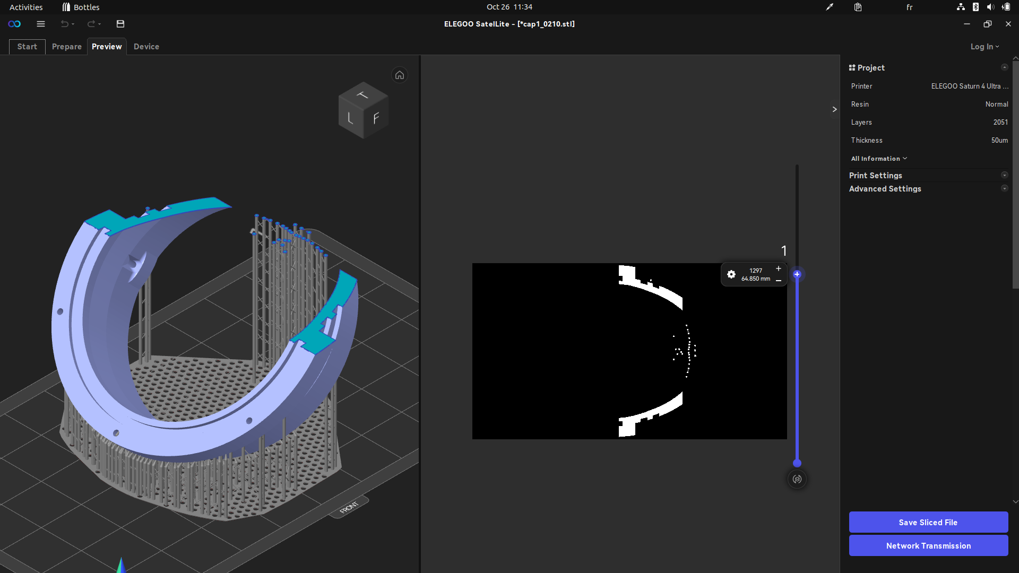
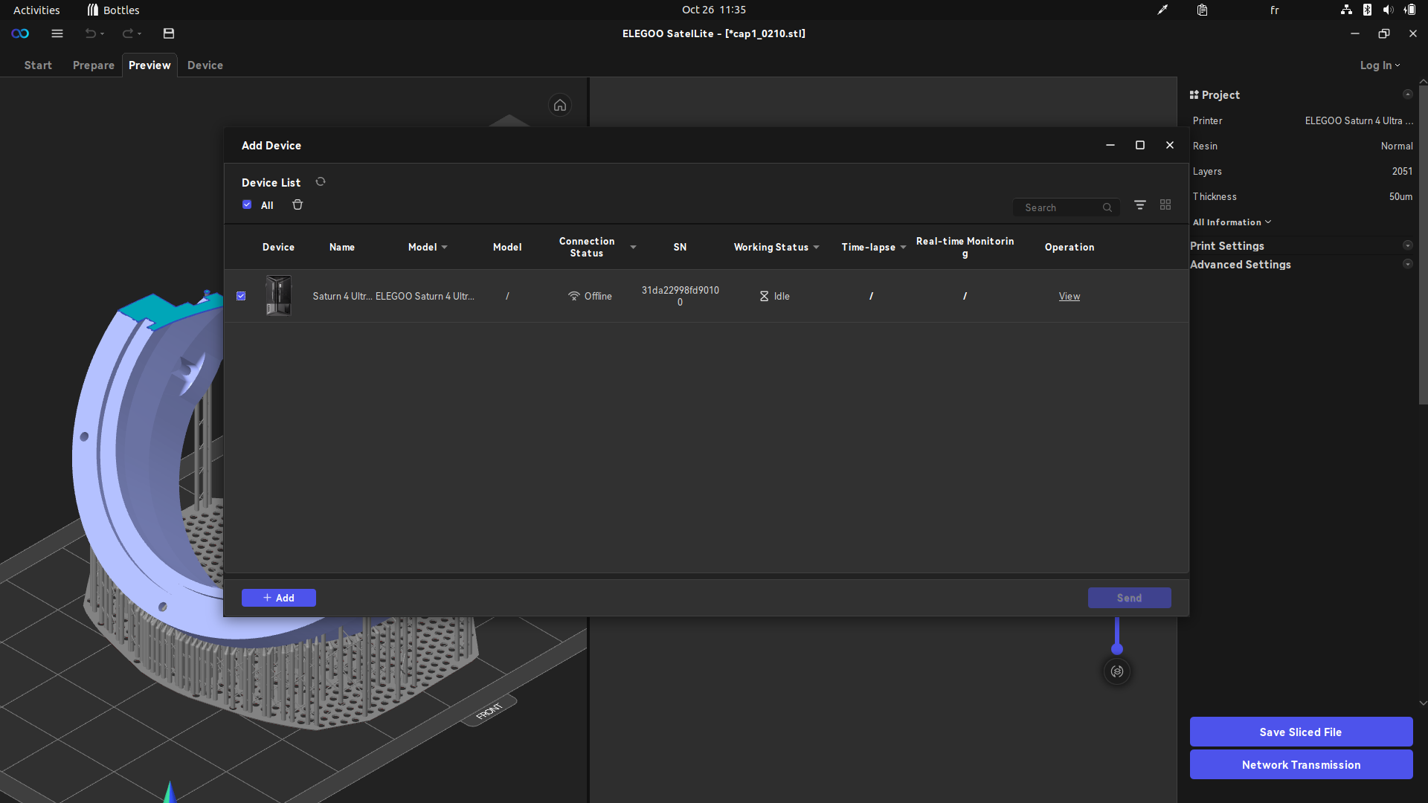
How to use the SLA printer ? - Software
Elegoo SatelLite 3D Slicer
  Native for Windows
  For Linux, use with Bottles (soda-9.0-1)
Software workflow :
  Export desired part in .STL
  Import in SatelLite
  Rotate to guarantee correct printing
  Generate support
  Slice
  Send via network to the printer

Slide 9
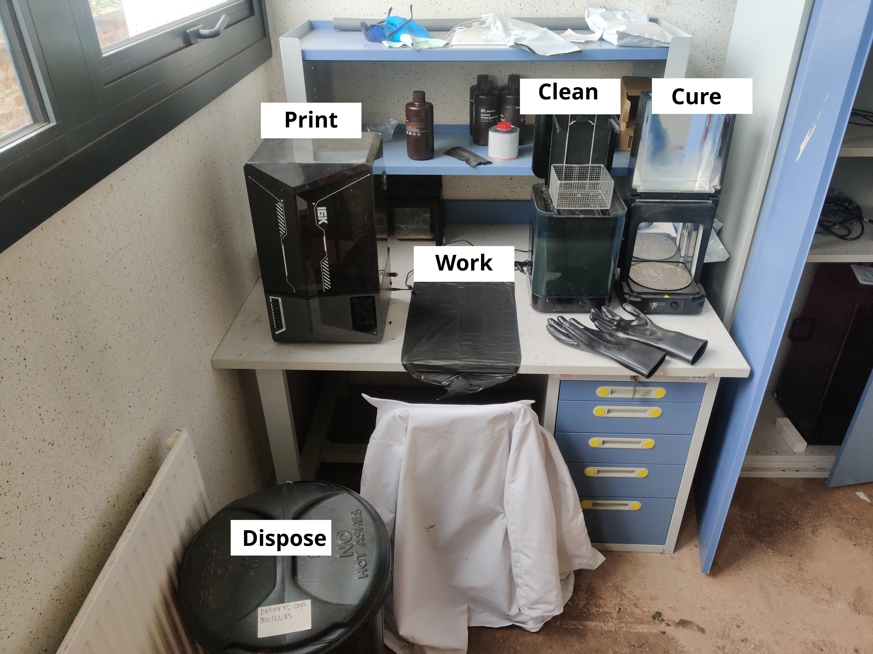
How to use the SLA printer ? - Processes
Print
  Wear all safety equipments
  Check that the resin level is between MIN and MAX
  Check that the film is clean
  Select sent file and print
Clean
  Wear all safety equipments
  Prepare the workplace with a disposable trash bag
  Prepare paper towel with isopropylic alcool
  Remove the build plate
  Remove the printed part on the trash bag
  Clean the build plate and put it back on the printer
  Remove supports
  Wash the parts in the washer
Cure
  Wear all safety equipments
  Once cleaned, wipe dry the parts
  Cure the parts in the curer

Slide 10
How to use the SLA printer ? - Maintenance
Maintenance
  The printer film is delicate, it should be replaced frequently (layer count on the printer)
  The clean tank should be replaced (WIP)
  The waste should be emptied (WIP)

Slide 11

Thank you for your attention
Do you have any question?

