Slide 1
Binary Search

Slide 2
Why Binary Search?
Where can we use binary search?
: In any monotonic sequence.

Slide 3
Use case of Binary Search
To determine the passing marks for a subject out of a total of 100, how many minimum steps are needed? (To be answered by 1st and 2nd years)
1
100
25
Something else

Slide 4
Overview of Binary Search
Binary search is a powerful algorithm for searching in sorted datasets.
Key Concept: Ignore half of the elements in each step, leading to logarithmic time complexity.

Slide 5
Why Binary Search?
Time complexity: O(log(n))

Slide 6
Topics to be covered
Searching for an element in a sorted array.
Finding lower bound and upper bound in a multivalued sorted array.
Solving binary search on answer problems.

Slide 7
Case 1: Basic Binary Search (Distinct Elements)
Example:
Searching for an element x in a sorted array.
n = length of the array
arr = the sorted array

Slide 8
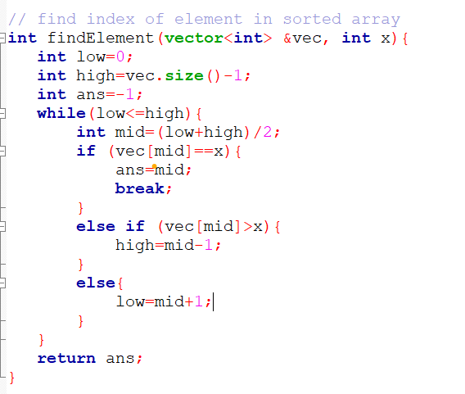

Slide 9
Case 2: Multivalued Sorted Array (Example 1)
Example: Find the first index of the element x in a sorted array.
n = length of the array
arr = the sorted array

Slide 10
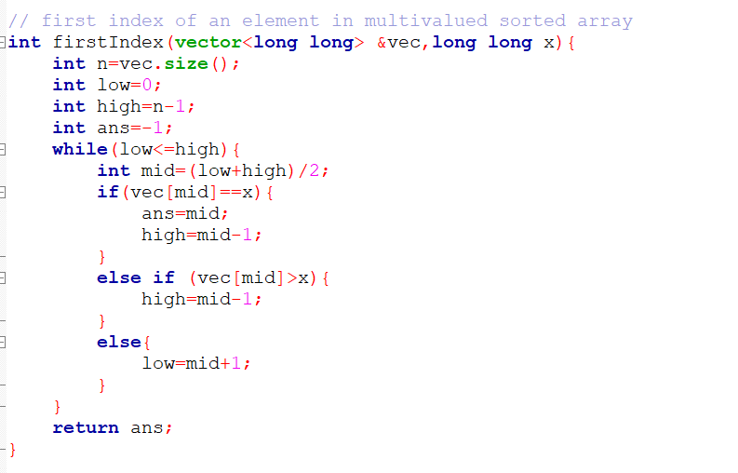

Slide 11
Case 2: Multivalued Sorted Array (Example 2)
Example: Find the last index of the element x in a sorted array.
n = length of the array
arr = the sorted array

Slide 12
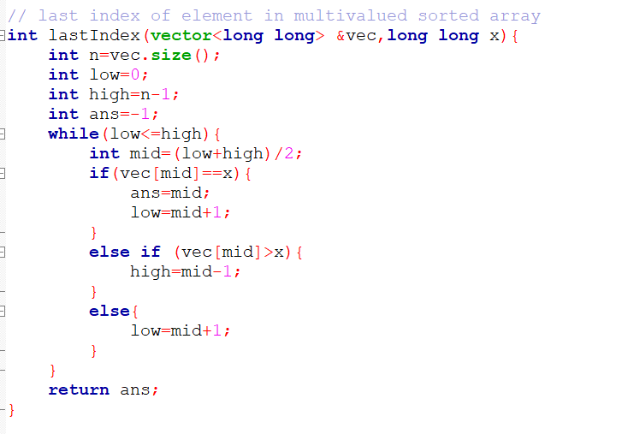

Slide 13
Exercise: Upper Bound in a Multivalued Sorted Array
Find the index of the upper bound of an element x in a multivalued sorted array.
Upper bound: First element which is greater than x.
n = length of the array
arr = the sorted array

Slide 14
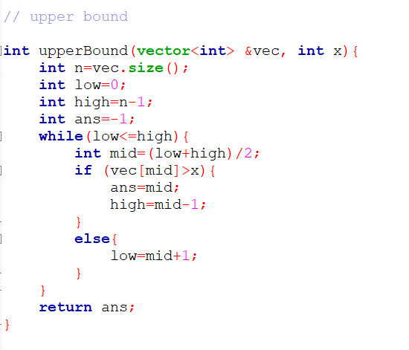

Slide 15
Problems on Binary Search on Answers
Problem 1:
https://www.geeksforgeeks.org/problems/index-of-first-1-in-a-sorted-array-of-0s-and-1s4048/1
Problem 2:
https://www.geeksforgeeks.org/problems/square-root/1
Problem 3 (1st year can skip):
https://www.geeksforgeeks.org/assign-stalls-to-k-cows-to-maximize-the-minimum-distance-between-them/

Slide 16
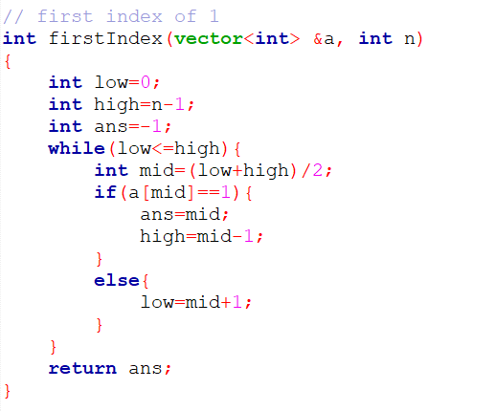

Slide 17
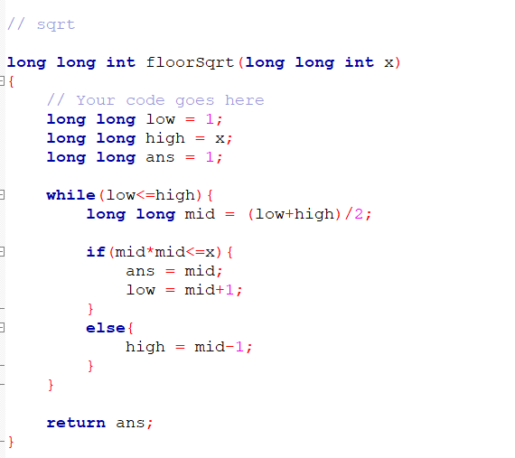

Slide 18
