Slide 1


//Developers_Institute_TLV Coding Bootcamp
Exploring the Book Market: Analyzing Genre Trends,
Author Demographics, and Pricing
Developers Institute ranked for Best Coding Bootcamp Worldwide for 2024
Azerbaijan 🇦🇿- México 🇲🇽 - Cameroon 🇨🇲 - Senegal 🇸🇳 - Burkina Faso 🇧🇫 - Mali 🇲🇱 - Ghana 🇬🇭 - Togo 🇹🇬 - Mauritius 🇲🇺 - Morocco 🇲🇦 - India 🇮🇳 - Georgia 🇬🇪 - Israël 🇮🇱

Slide 2
Project Overview
Original database "GoodReads Best Books" provides a comprehensive collection of books that have been listed in GoodReads Best Books Ever. The dataset features diverse information on each book, from ratings, page numbers and editions, genres and languages, to awards, prices, first publish dates and characters.
Purpose & Objectives:
To analyze trends in book genres and pricing.
Explore the demographic profile of authors.
Provide data-driven recommendations to support key stakeholders in the book industry.

Slide 3
Exploring the Book Market: Analyzing Genre Trends, Author Demographics, and Pricing
Analysis of the book market using data-driven insights
Explore trends in book genres, author demographics, and pricing patterns
Provide a comprehensive view of the literary world
Reveal hidden patterns and trends in data
Find valuable information for publishers, authors, and readers

Slide 4
Project Limitations.
Technical Constraints:
API Limitations: Due to time constraints, I wasn't able to fully utilize external APIs to enrich the dataset with additional information, such as detailed author backgrounds or more specific genre classifications.
Simplification of Methods:
Due to the time constraints, some methods were simplified.
Computational Resources:
The large size of the dataset required careful consideration and management, which limited the ability to perform more complex analyses or explore additional features.

Slide 5




Stack
Trello: Project management and task tracking.
PyCharm: Development environment for structured coding.
Data filtering.
Removing duplicates.
Date formatting.
Handling missing values.
Python (pandas and NumPy): Used for data cleaning, analysis, and preprocessing.
Gender Detection.
Main Genre Extraction
Rating distribution analysis.
Genre popularity.
Price analysis.
Page count analysis.
Open Library API: Used to validate and supplement the data.
Git & GitHub: Version and changes control.
Tableau: Created an interactive dashboard and visualizations.
Tableau dashboard.
Interactive filters.

Slide 6
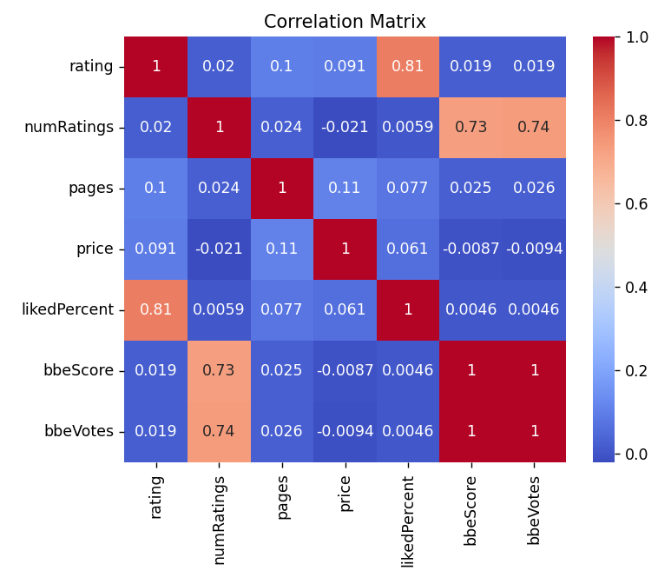
Python Visualizations
Strong positive correlation:
Rating & LikedPercent: higher ratings correlate with higher liked percentages.
Moderate correlation:
numRatings & Popularity Scores: more ratings often lead to higher popularity metrics.
Weak or no significant correlation:
Pages, price & other metrics: number of pages and price don't significantly impact ratings or popularity.
bbeScore - the score of the book on GoodReads' Best Books Ever (BBE) list.
bbeVotes - the number of votes cast for the book on BBE list.
likedPercent - the percentage of readers who liked the book.

Slide 7
My next step
Project Steps:
Deeper Data Analysis: Conduct more advanced data analysis to uncover hidden patterns and insights within the dataset.
API Integration: Integrate additional APIs to enrich the dataset, ensuring more accurate and comprehensive results.
Career Development Steps:
Learning New Skills: Focus on learning new tools and technologies relevant to data analysis and visualization.
Improving Existing Skills: Enhance proficiency in current technologies like Python, Tableau, and data processing libraries to handle more complex projects.
Networking and Job Search: Actively engage in networking and apply for data analysis roles, utilizing skills gained from this project.

Slide 8
Link
https://github.com/IngerMasha/Final-Project
https://github.com/IngerMasha/Final-Project/tree/master/video
https://www.datascienceportfol.io/dashboard
https://public.tableau.com/authoring/Analysisofthebookdataset/Dashboard2#1
https://github.com/IngerMasha/Final-Project/blob/master/video/Technical%20article

Slide 9
Career Prep
https://docs.google.com/document/d/1VMRe5BkJLca9PXw-c6iqau8GT8psgW-N/edit?usp=sharing&ouid=104459381762924220748&rtpof=true&sd=true
https://www.linkedin.com/in/mariainger/

