Slide 1
Clean Architecture

Slide 2
Clean architecture
A way to organize a project to achieve maintainability and scalability

Slide 3
Clean architecture
A way to organize a project to achieve maintainability and scalability
One concern per component

Slide 4
Clean architecture
A way to organize a project to achieve maintainability and scalability
One concern per component
Structured in layers of dependency

Slide 5
Clean architecture
A way to organize a project to achieve maintainability and scalability
One concern per component
Structured in layers of dependency
Implementation layers depend on abstract layers

Slide 6
Clean architecture
A way to organize a project to achieve maintainability and scalability
One concern per component
Structured in layers of dependency
Implementation layers depend on abstract layers
Is not specific to mobile development

Slide 7
Clean architecture
A way to organize a project to achieve maintainability and scalability
One concern per component
Structured in layers of dependency
Implementation layers depend on abstract layers
Is not specific to mobile development
Uncle Bob (Robert C. Martin) - Clean Architecture

Slide 8
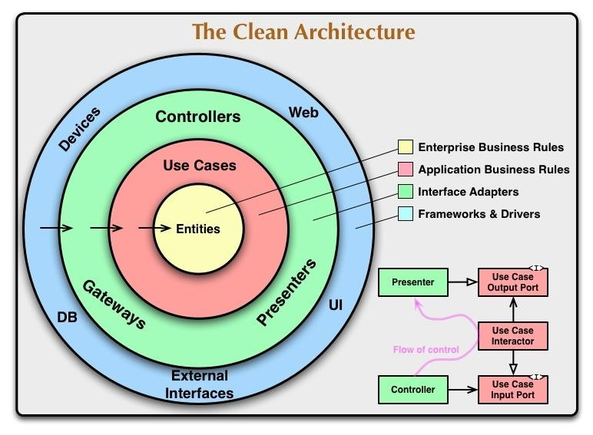
Clean architecture

Slide 9
Clean architecture
Strict architecture - hard to make mistakes

Slide 10
Clean architecture
Strict architecture - hard to make mistakes
Business logic is encapsulated, easy to use and test

Slide 11
Clean architecture
Strict architecture - hard to make mistakes
Business logic is encapsulated, easy to use and test
Enforcement of dependencies through encapsulation

Slide 12
Clean architecture
Strict architecture - hard to make mistakes
Business logic is encapsulated, easy to use and test
Enforcement of dependencies through encapsulation
Allows for parallel development

Slide 13
Clean architecture
Strict architecture - hard to make mistakes
Business logic is encapsulated, easy to use and test
Enforcement of dependencies through encapsulation
Allows for parallel development
Highly scalable

Slide 14
Clean architecture
Strict architecture - hard to make mistakes
Business logic is encapsulated, easy to use and test
Enforcement of dependencies through encapsulation
Allows for parallel development
Highly scalable
Easy to understand and maintain

Slide 15
Clean architecture
Strict architecture - hard to make mistakes
Business logic is encapsulated, easy to use and test
Enforcement of dependencies through encapsulation
Allows for parallel development
Highly scalable
Easy to understand and maintain
Testing is facilitated

