Slide 1
Clean Architecture
components

Slide 2
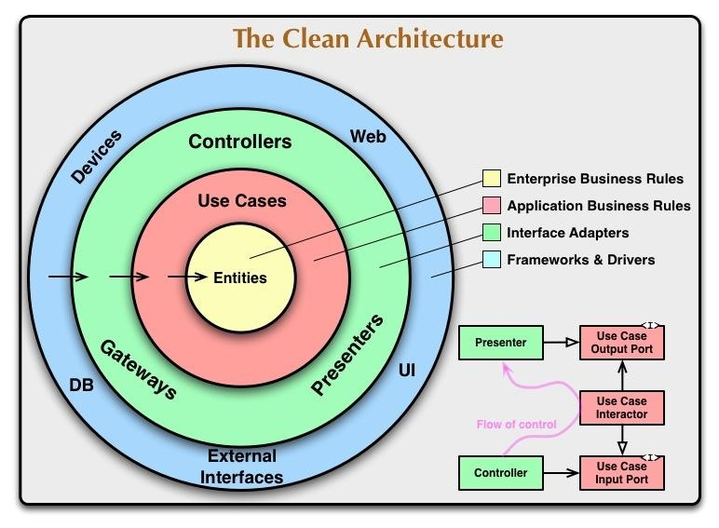
Clean architecture

Slide 3
Entities
Domain objects
Foundational business logic
POJOs

Slide 4
Use cases
Actions that can be taken on the entities
Depend on entities
Business logic, plain code
No other dependencies
A use case doesn’t know how the result is going to be used

Slide 5
Controllers, presenters, adapters
Interfaces
Retrieve data from various sources
Present data in a specific format (e.g XML, JSON)
Depend on lower level layers

Slide 6
Infrastructure
How the data is interpreted and presented
Most volatile layer, likely to change
Interacts with interfaces to retrieve data
UI, Frameworks, devices etc

