Slide 1
MVVM

Slide 2
MVVM
View
actions
ViewModel
Model
read and update data
async callbacks

Slide 3
ViewModel
A class that stores UI related data

Slide 4
ViewModel
A class that stores UI related data
A bridge between the model and the View

Slide 5
ViewModel
A class that stores UI related data
A bridge between the model and the View
Has a (very simplified) lifecycle

Slide 6
ViewModel
A class that stores UI related data
A bridge between the model and the View
Has a (very simplified) lifecycle
Should not depend on the activity context

Slide 7
ViewModel
A class that stores UI related data
A bridge between the model and the View
Has a (very simplified) lifecycle
Should not depend on the activity context Can depend on the application context if necessary

Slide 8
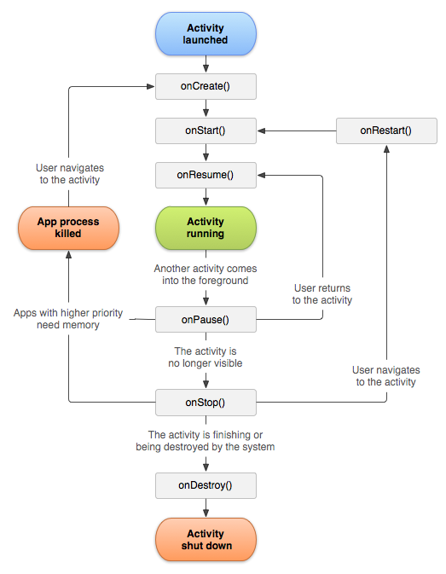
Activity lifecycle

Slide 9
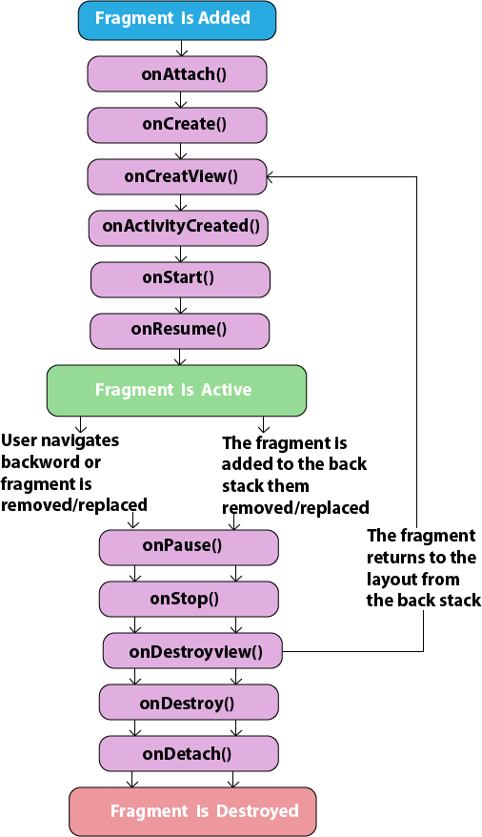
Fragment lifecycle

Slide 10
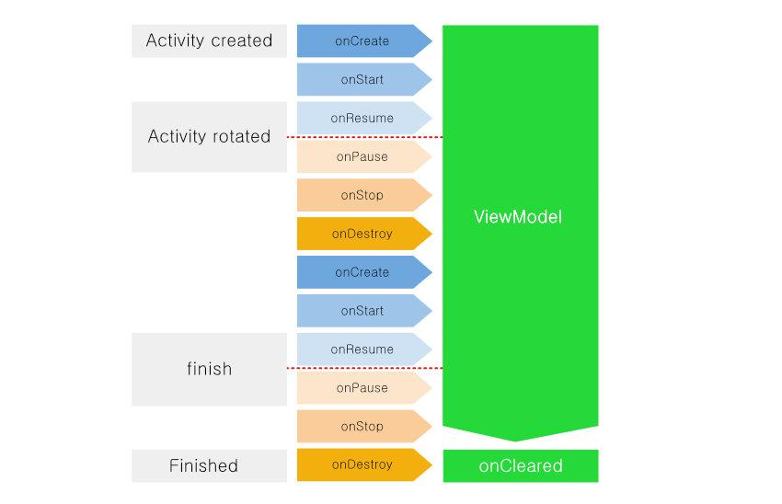
ViewModel lifecycle

Slide 11
LiveData
An observable

Slide 12
LiveData
An observable
Lifecycle aware

Slide 13
LiveData
An observable
Lifecycle aware
No memory leaks

Slide 14
LiveData
An observable
Lifecycle aware
No memory leaks
Always up to date data

Slide 15
LiveData
An observable
Lifecycle aware
No memory leaks
Always up to date data
Manages configuration changes

